Slide 1
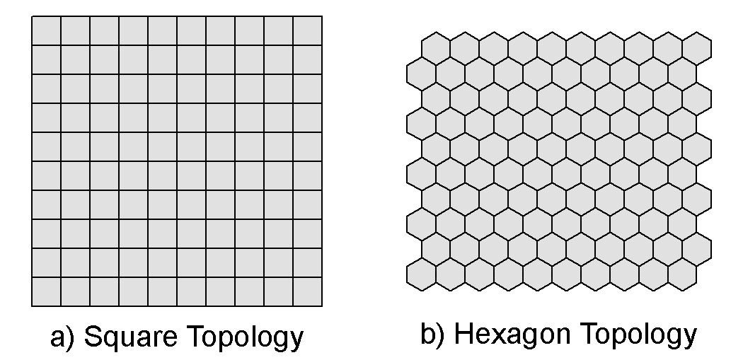
Self-Organizing Map (SOM) = Kohonen Map
artificial neural network
  topological order
  2D lattice of neurons

Slide 2
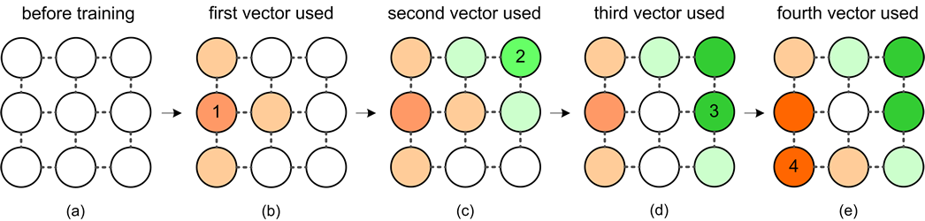
Self-Organizing Map (SOM) = Kohonen Map
artificial neural network
  topological order
  2D lattice of neurons
  training with n-dimensional data
    e.g., census statistics; financial data; text documents

Slide 3
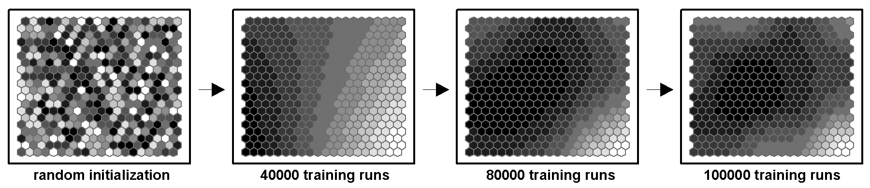
Self-Organizing Map (SOM) = Kohonen Map
artificial neural network
  topological order
  2D lattice of neurons
  training with n-dimensional data
    e.g., census statistics; financial data; text documents

Slide 4
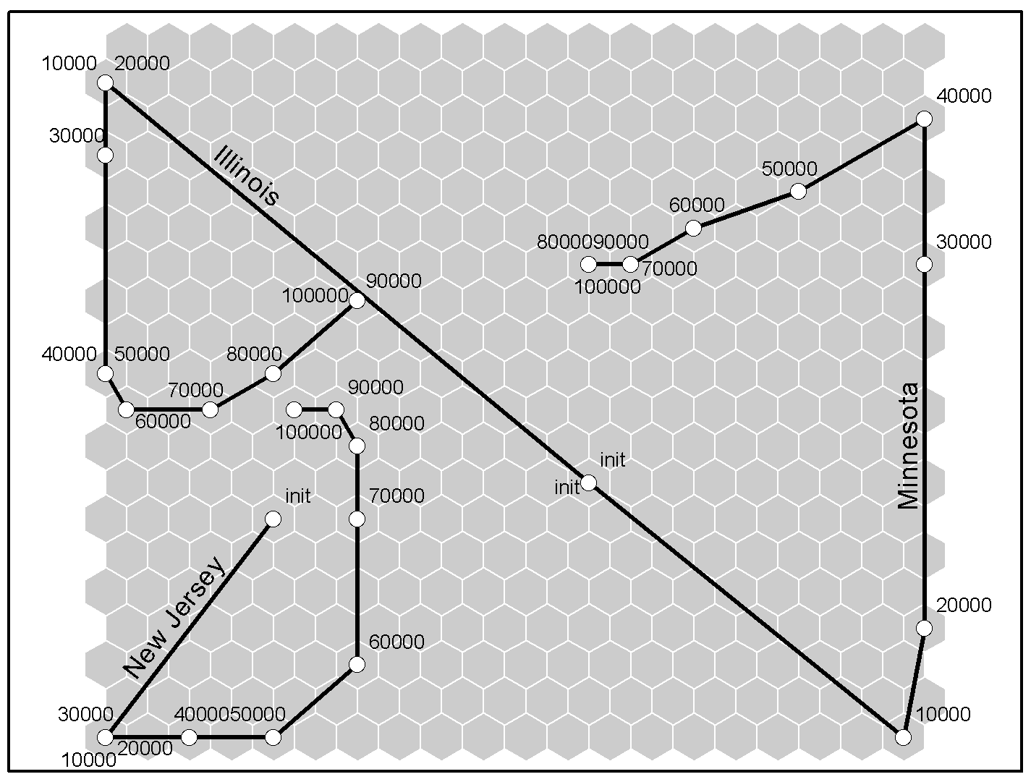
Self-Organizing Map (SOM) = Kohonen Map

Slide 5
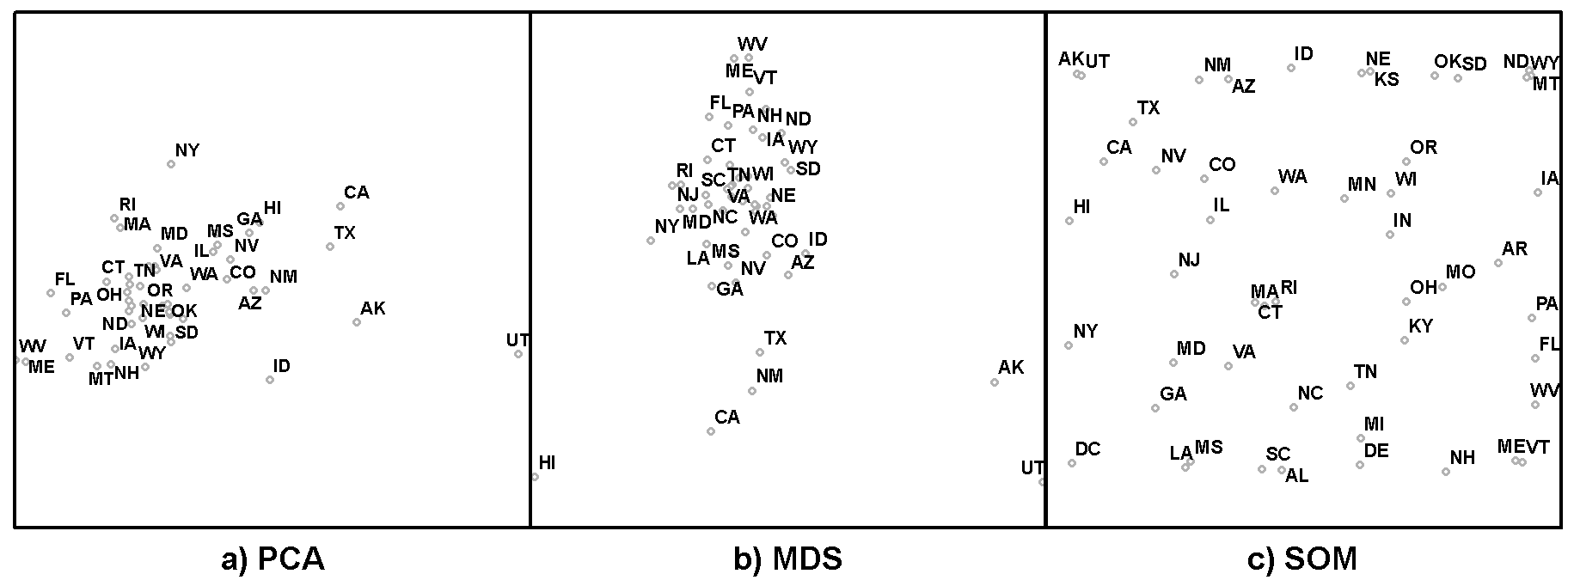
Self-Organizing Map (SOM) = Kohonen Map
SOM as dimensionality reduction method

Slide 6
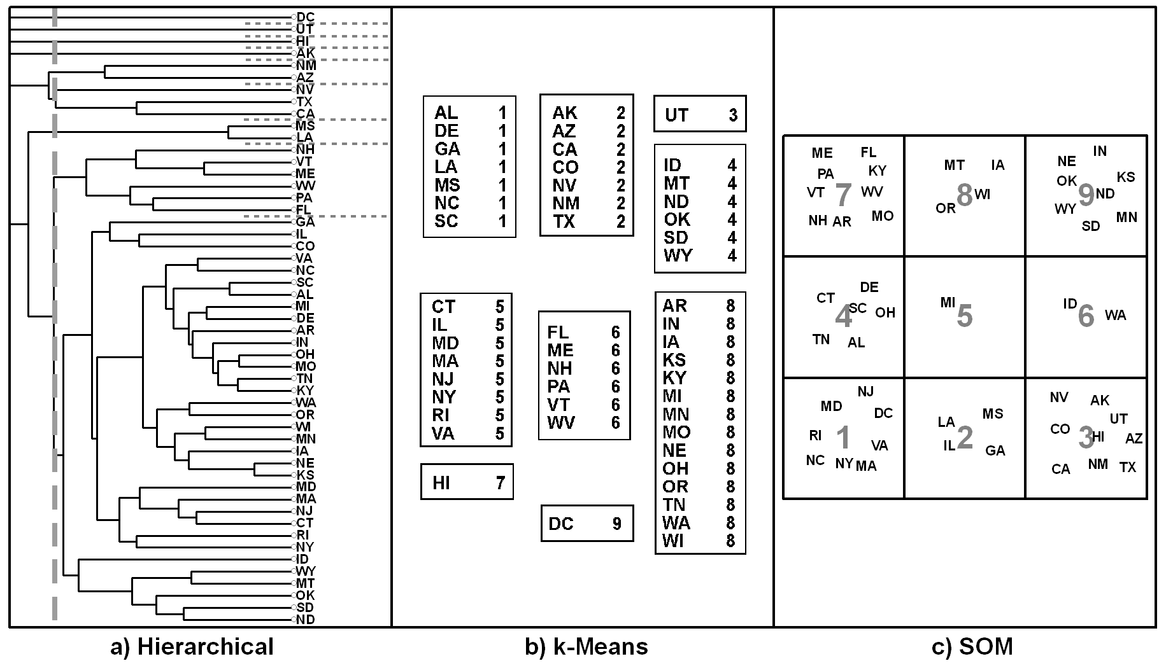
Self-Organizing Map (SOM) = Kohonen Map
SOM as clustering method

Slide 7
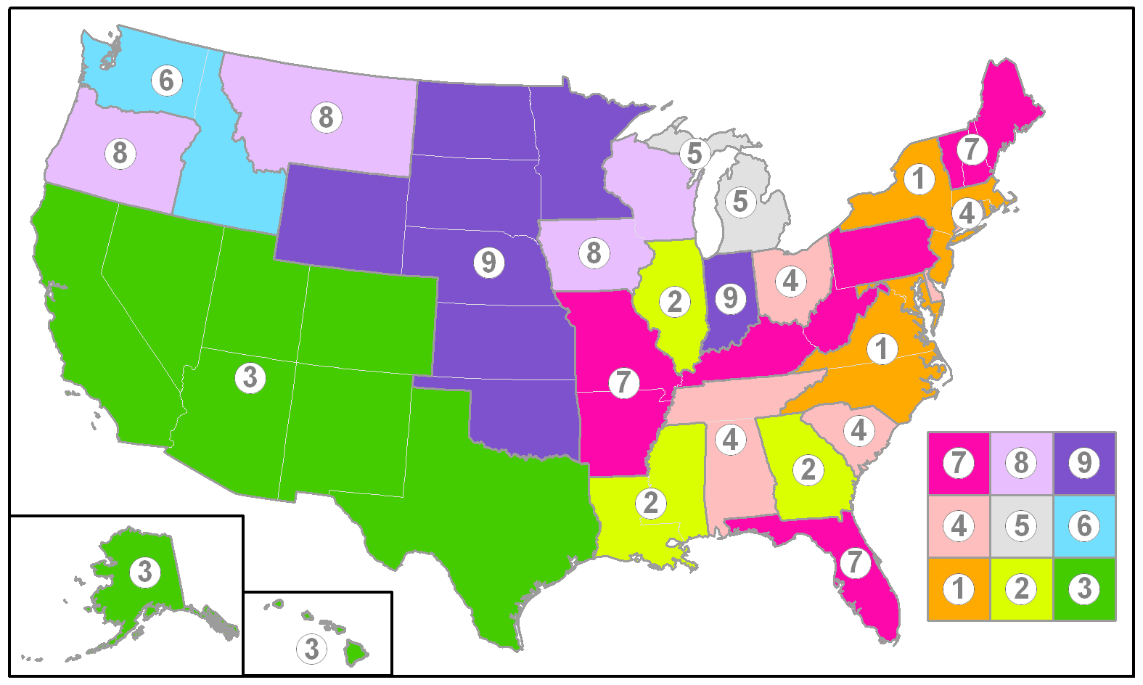
Self-Organizing Map (SOM) = Kohonen Map

Slide 8
SOM – Examples of Edge Effects
Higher density representation of n-dimensional space at edge neurons
  Indicated by:
    Higher density of input vectors mapped onto edge neurons
    Higher internal variance of input vector mapped onto edge neurons
Criss-crossing of trajectories from one edge to another
  what I call the Siberia-Alaska effect in world maps centered on prime meridian (they’re close in geographic space, yet widely separated in world map)
  Comparable to the practical difficulty in GIS of showing travel across the date line

Slide 9
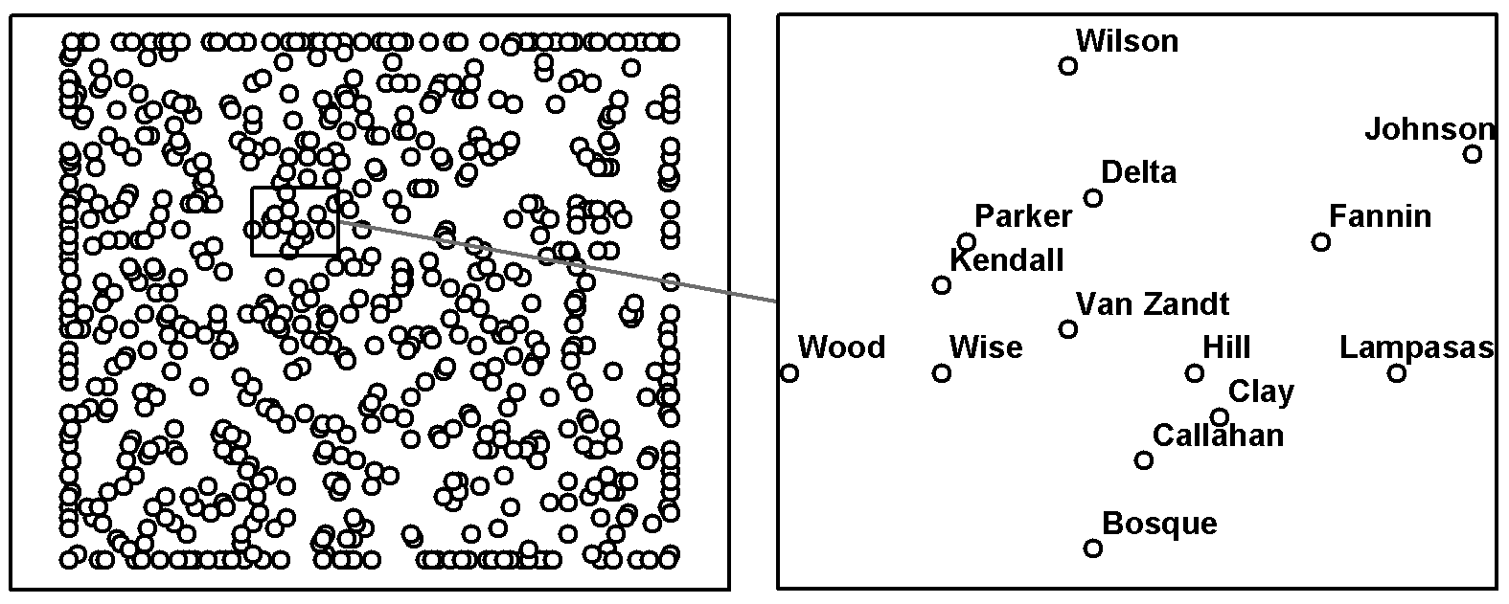
Example for higher density at edge neurons (figure from Skupin & Hagelman, 2005)
  Census data for TX counties x 3 (1980,1990, 2000)
  notice alignment and overplotting along edges

Slide 10
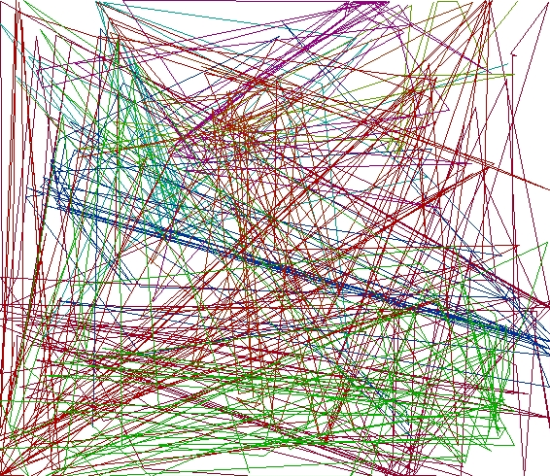
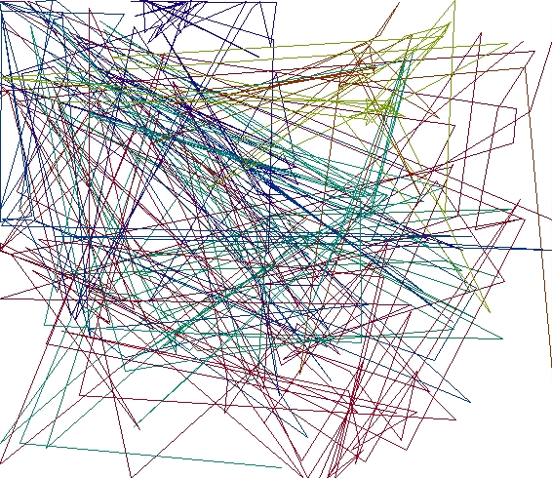
Example for trajectories criss-crossing (figure from Gregg Verutes’ current work)
  Movement through knowledge space based on transcribed lectures
  Notice long distance moves involving edge neurons (may be real, may be artifact of edges, which is why we need to understand edge effects and whether it helps to counteract them)
Graduate Courses
Introductory Courses

