Slide 1
DPX Light Response
5.6.2018

Slide 2
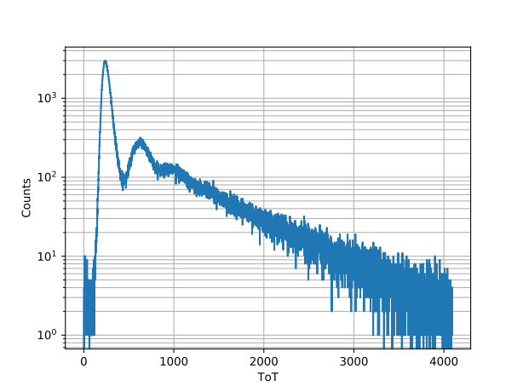
Daylight - Evening

Slide 3
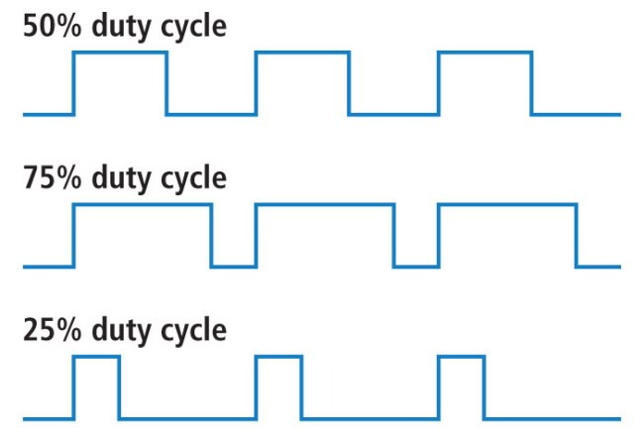
Duty Cycle
DPX is placed inside a box which is illuminated by an LED
The LED is pulsed: frequency as well as the duty cycle has influence on the detector’s response!

Slide 4
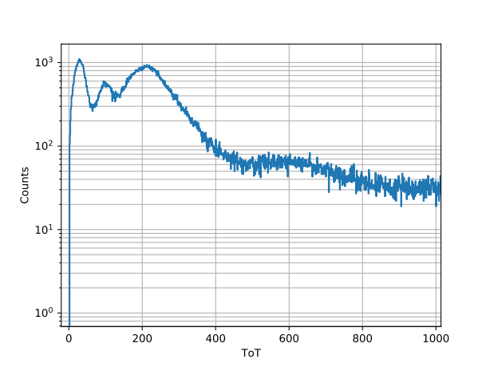
LED Red – 50% duty

Slide 5
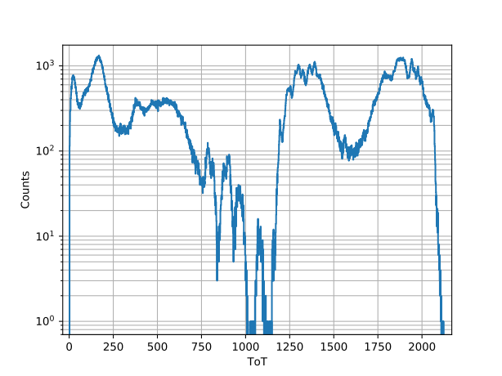
LED Red – 75% duty
Periodic structures?
Also position of LED has large influence on the resulting spectrum

Slide 6
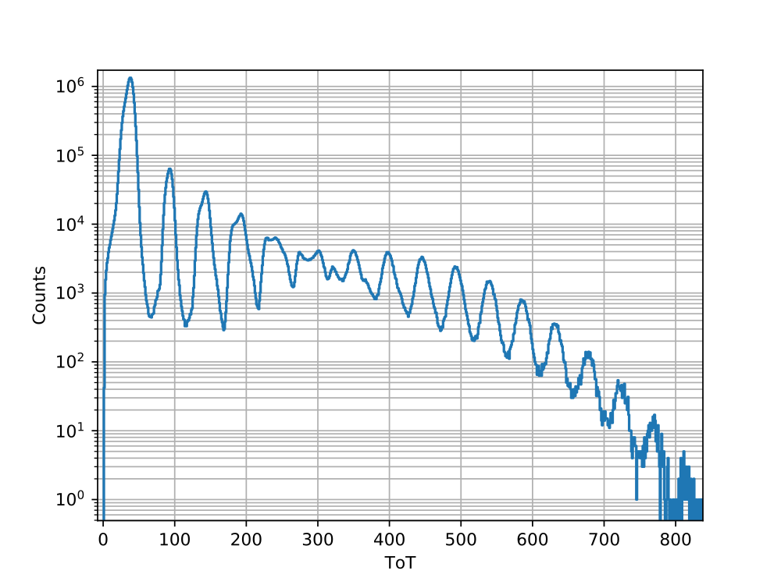
LED Blue – 40% duty
Move light source...
Change duty cycle…
Change frequency…
Until periodic structures manifest!

Slide 7

LED Blue – 40% duty
Count the peaks!

Slide 8
LED Blue – 40% duty
1
One! One peak!

Slide 9
LED Blue – 40% duty
1
2
Two! Two peaks!

Slide 10
LED Blue – 40% duty
1
2
3
Three! Three peaks!

Slide 11
LED Blue – 40% duty
Where do the peaks come from?
LED is incoherent and not thermal
It seems like LED triggers noise in electronics
1
2
3
17
Seventeen!
Seventeen peaks!
Ah ah ah ah...

Slide 12
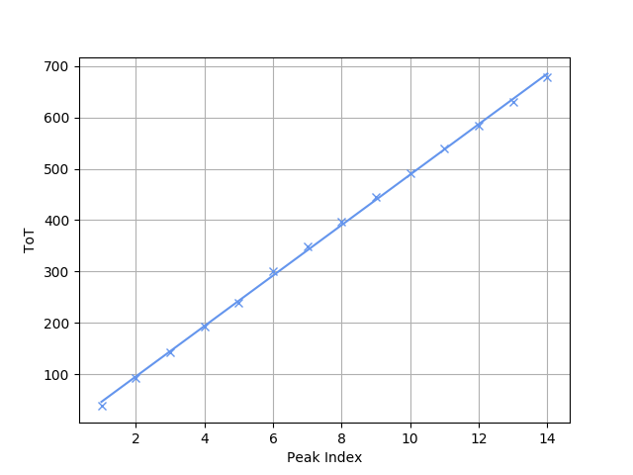
LED Blue - Linearity
Apply linear fit
Slight deviation at first and last points
Slope of 49.1 +/- 0.4

Slide 13
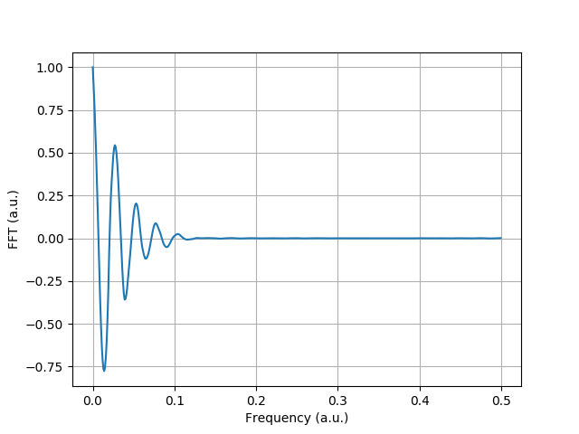
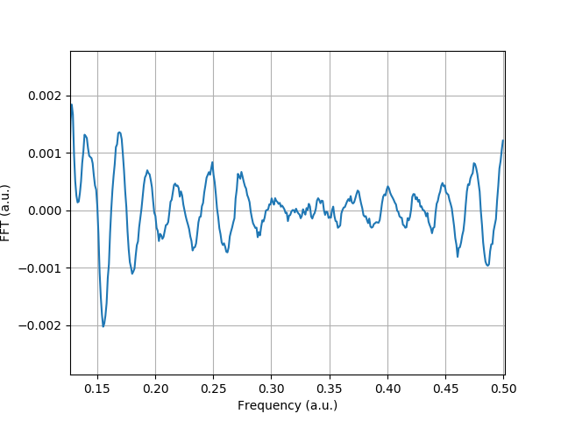
LED Blue - FFT

Slide 14
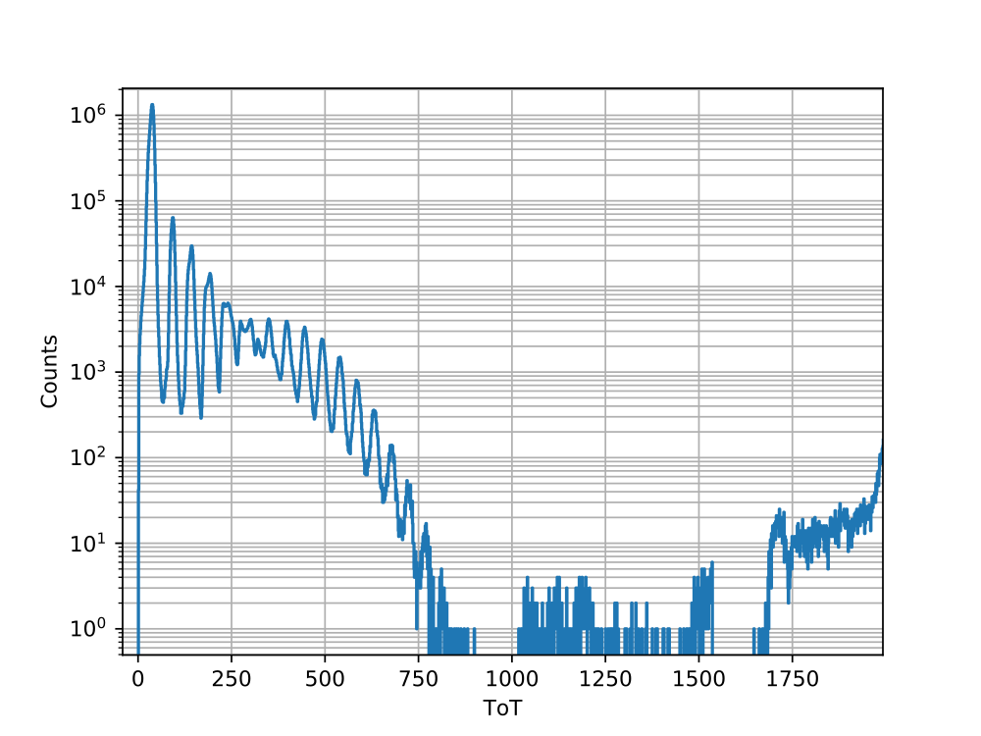
LED Blue – Low energies
Not much happening until 2000 ToT...
But...

Slide 15
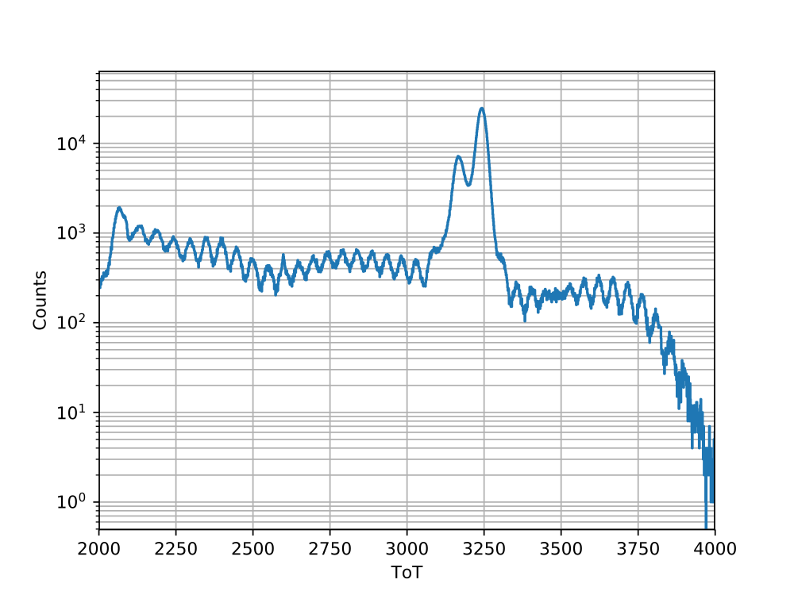
LED Blue – High energies

Slide 16
LED Blue – High energies
Let’s count again!

Slide 17
LED Blue – High energies
About 38! 38 peaks!

Slide 18
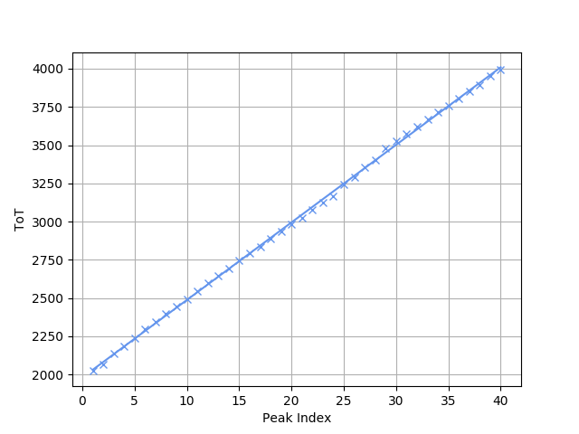
LED Blue - Linearity
Apply linear fit
Linearity of the pre-amplifier for high energies confirmed?
Slope of 50.7 +/- 0.2
→ Similar slopes for both ToT-ranges

Slide 19
TODO
Is the phenomenon the same for every pixel?
Optimize measurement setup
Per-pixel analysis
Potential:
  Proof of linearity of pre-amplifier for high energies
  ToT-Calibration: scale x-axis until peak positions are the same for each pixel

Slide 20
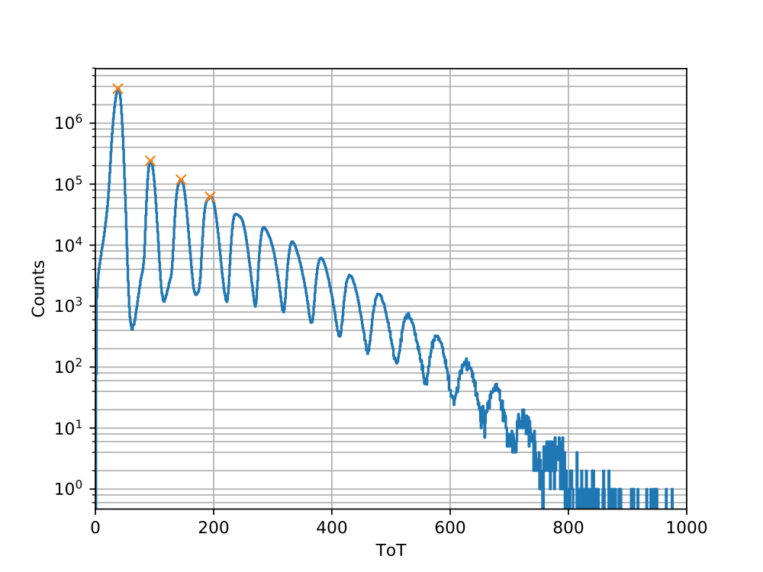
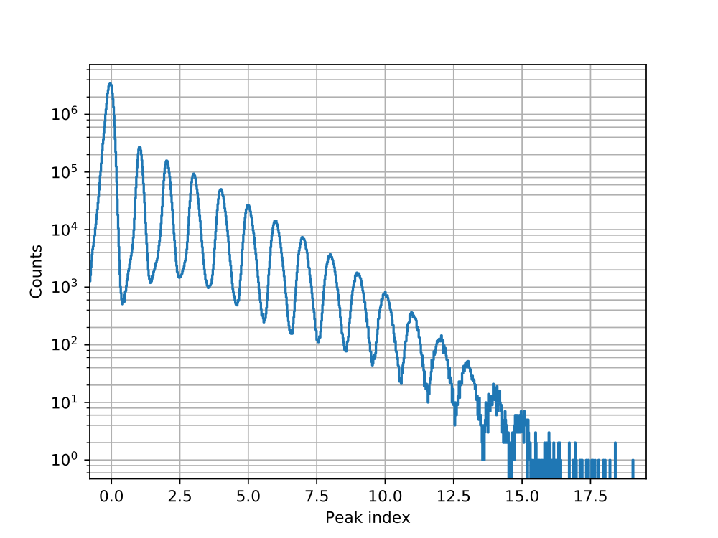
Energy Correction
Get the peak positions in the spectrum and assign a peak index to them
Perform linear correction
Uncorrected
Corrected

Slide 21
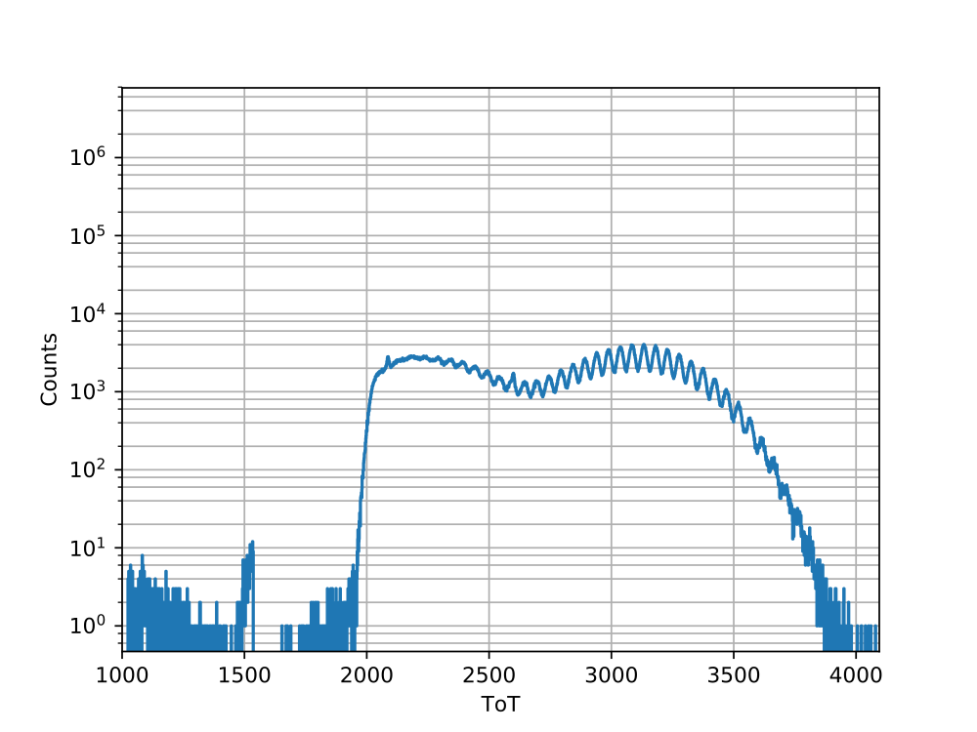
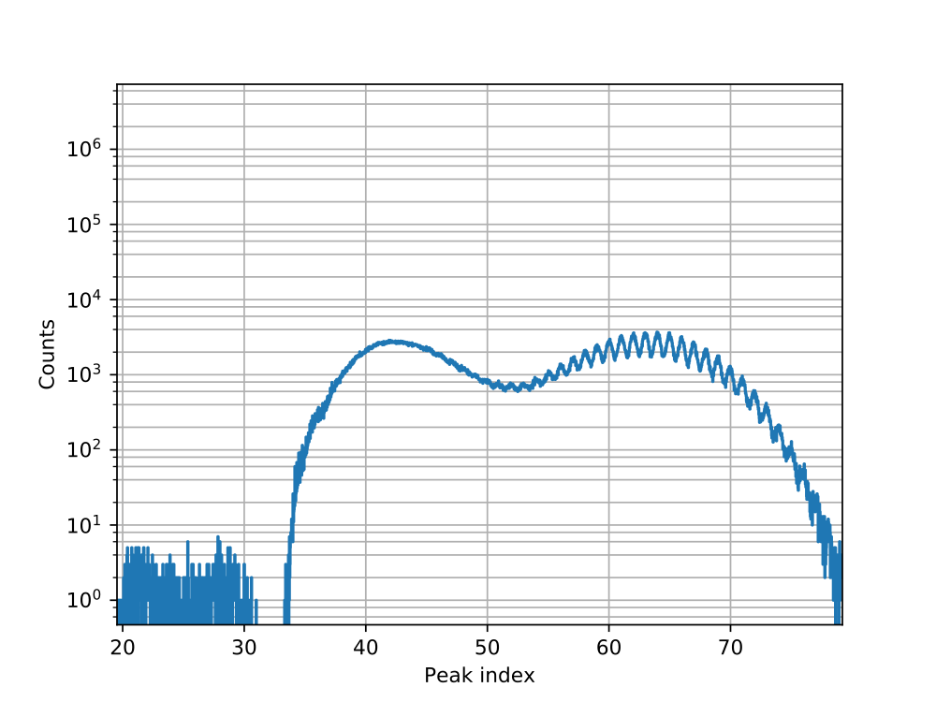
Energy Correction
For high energies
Different shape after correction
Seems like fluctuating region gets smaller
Uncorrected
Corrected

Slide 22
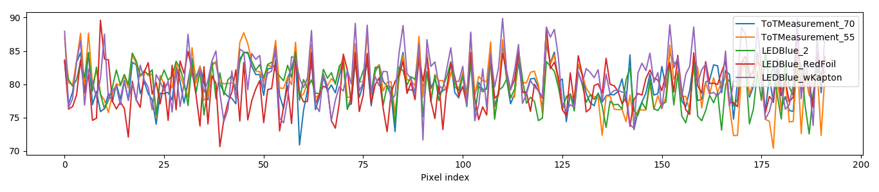
Reproducibility
Is the result the same for different measurements?
Performed a large quantity of measurements
Apply linear correction and store parameters
Compare maximum deviation, from 0 to 4095 ToT for some measurements

Slide 23
TODO
Measurement with high statistics for each pixel
Get standard deviation as a function of deposited energy → Useful for simulation
Evaluate method by performing measurement with radioactive source

