Slide 1





Active Buffer Management in Datacenters
Vamsi Addanki, Maria Apostolaki, Manya Ghobadi, Stefan Schmid, Laurent Vanbever
Notes:
Hi everyone. Thanks for attending the talk. I am Vamsi Addanki. Today I will be presenting ABM: Active Buffer Management in Datacenters.
This is a joint work with colleagues from Princeton, MIT, TU Berlin and ETH Zurich.

Slide 2
Active Queue Management (AQM)
Buffer Management (BM)
Notes:
I hope everyone in the audience are familiar with these two keywords in Networking; Active Queue Management and Buffer Management.
The answer to what is ABM lies within this slide. Let me put it into perspective.

Slide 3
AQM
Controlling queueing delay
Notes:
On one hand, we have active queue management that aims to control queueing delays.

Slide 4
ECN
eg., RED
AQM
Controlling queueing delay
Notes:
For instance, ecn-based approaches like RED,

Slide 5
ECN
eg., RED
Trimming
eg., Cut payload
AQM
Controlling queueing delay
Notes:
Trimming or drop based approaches

Slide 6
ECN
eg., RED
Trimming
eg., Cut payload
Delay
eg., CoDel
AQM
Controlling queueing delay
Notes:
Delay based approaches such as codel.

Slide 7
Stable drain time
ECN
Trimming
Delay
AQM
Controlling queueing delay
Notes:
Delay based approaches such as codel.

Slide 8
BM
Controlling total buffer
Stable drain time
ECN
Trimming
Delay
AQM
Controlling queueing delay
Notes:
On the other hand, we have buffer management schemes that control the total shared buffer occupancy.

Slide 9
BM
Dynamic Thresholds
Controlling total buffer
Stable drain time
ECN
Trimming
Delay
AQM
Controlling queueing delay
Notes:
On the other hand, we have buffer management schemes that control the total shared buffer occupancy.

Slide 10
BM
DT
Better isolation
Controlling total buffer
Stable drain time
ECN
Trimming
Delay
AQM
Controlling queueing delay
Notes:
On the other hand, we have buffer management schemes that control the total shared buffer occupancy.

Slide 11
BM
DT
Burst absorption
Better isolation
Controlling total buffer
Stable drain time
ECN
Trimming
Delay
AQM
Controlling queueing delay
Notes:
Within this space we propose ABM in this work.

Slide 12
BM
DT
Burst absorption
Better isolation
Controlling total buffer
Stable drain time
ECN
Trimming
Delay
AQM
Controlling queueing delay
Notes:
Within this space we propose ABM in this work.

Slide 13
What is ABM?
A novel Buffer Sharing algorithm for datacenter switches
Notes:
So, ABM is a novel buffer sharing algorithm for datacenter switches.

Slide 14
What is ABM?
A novel Buffer Sharing algorithm
Independent AQM and Buffer Management
Notes:
It is not an independent combination of AQM and Buffer management.

Slide 15
What is ABM?
A novel Buffer Sharing algorithm
Independent AQM and Buffer Management
AQM that depends on Buffer Management
Notes:
Rather intuitively, it can be visualized as AQM that depends on Buffer Management.

Slide 16
What is ABM?
A novel Buffer Sharing algorithm
Independent AQM and Buffer Management
Active Buffer Management
Notes:
We hence call it Active Buffer Management.

Slide 17
What is ABM?
A novel Buffer Sharing algorithm
Independent AQM and Buffer Management
Active Buffer Management
Isolation across traffic priorities (eg., different SLAs)
Notes:
ABM offers isolation across traffic priorities

Slide 18
What is ABM?
A novel Buffer Sharing algorithm
Independent AQM and Buffer Management
Active Buffer Management
Isolation across traffic priorities (eg., different SLAs)
Bounded queue drain time (Queueing delay)
Notes:
It bounds queue drain time

Slide 19
What is ABM?
A novel Buffer Sharing algorithm
Independent AQM and Buffer Management
Active Buffer Management
Isolation across traffic priorities (eg., different SLAs)
Bounded queue drain time (Queueing delay)
Better burst absorption
Notes:
And finally provides better burst absorption.

Slide 20
Background on Buffer Sharing
Both BM and AQM calculate drop thresholds
Notes:
Before going into further details, let me give you a brief background on Buffer sharing.
Both Buffer management and AQM calculate drop thresholds.

Slide 21
Background on Buffer Sharing
Both BM and AQM calculate drop thresholds
BM calculates a threshold for every queue in a device
function of the shared buffer space
Notes:
Buffer management calculates thresholds for each queue across the entire device. It is a function of the total shared buffer space.

Slide 22
Background on Buffer Sharing
Both BM and AQM calculate drop thresholds
BM calculates a threshold for every queue in a device
function of the shared buffer space
AQM calculates thresholds for a single queue
function of queue statistics
Notes:
AQM calaculates thresholds for a single queue. It is a function of the queue statistics.

Slide 23
Background on Buffer Sharing
Both BM and AQM calculate drop thresholds
BM calculates a threshold for every queue in a device
function of the shared buffer space
AQM calculates thresholds for a single queue
function of queue statistics
BM and AQM act independently
Notes:
Importantly, both buffer management and queue management act independently.

Slide 24
Hierarchical Admission Control Scheme
BM
AQM
True
True
Packet
Enqueue
False
False
Drop
Drop
Notes:
This results in a hierarchical admission control scheme where upon packet arrival, First buffer management takes a buffer decision and passes it on to the active queue management which then finally enqueues or drops a packet.

Slide 25
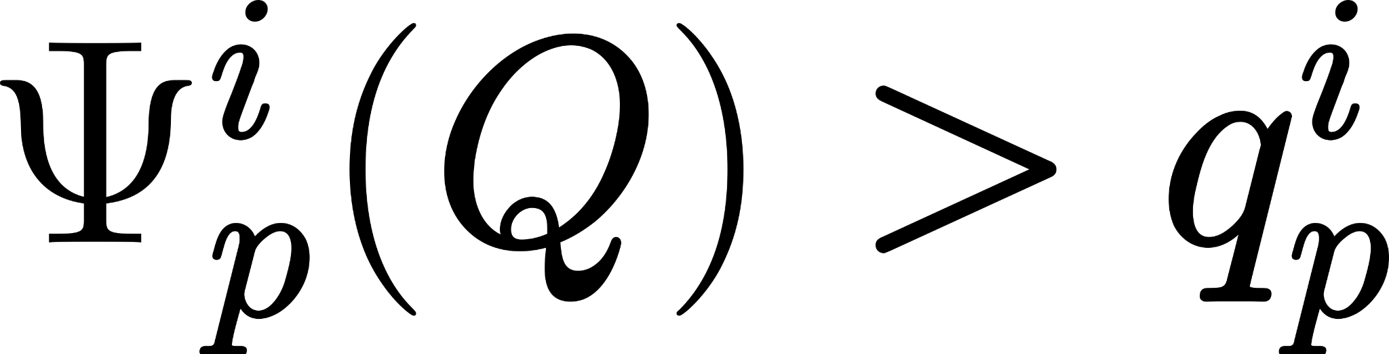
Hierarchical Admission Control Scheme
BM
AQM
True
True
Packet
Enqueue
False
False
Drop
Drop
Notes:
Concretely, Buffer management first calculates a threshold and compares it against the corresponding queue length; Upon acceptance, it then passes it on to AQM.

Slide 26
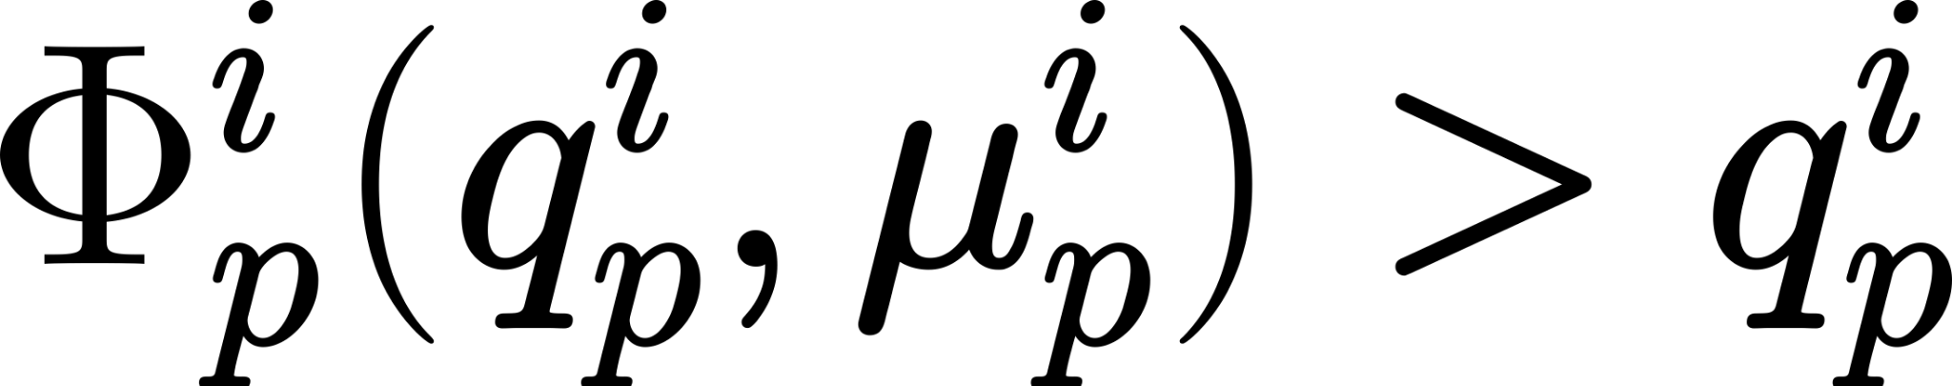
Hierarchical Admission Control Scheme
BM
AQM
True
True
Packet
Enqueue
False
False
Drop
Drop
Notes:
AQM then calculates another threshold and compares it against the corresponding queue length.

Slide 27

Hierarchical Admission Control Scheme
BM
AQM
True
True
Packet
Enqueue
False
False
Drop
Drop
Notes:
The resulting threshold of such a hierarchical scheme can be expressed as the minimum over the thresholds calculated by Buffer management and queue management.
It is important to observe that only one of the thresholds is active at any time instance but not both or any function of both.

Slide 28
Large Buffers
BM
AQM
True
True
True
Packet
Enqueue
False
False
Drop
Drop
Notes:
Suppose we have large buffers, buffer management simply buffers every packet since there is enough remaining buffer always.

Slide 29
Large Buffers
AQM becomes more important!
BM
AQM
True
True
True
Packet
Enqueue
False
False
Drop
Drop
Notes:
As a result, AQM becomes important here.

Slide 30
Shallow buffers
BM
AQM
True
True
True
Packet
Enqueue
False
False
Drop
Drop
Notes:
In contrast, if we have shallow buffers, like the top-of-the-rack switches in datacenters, then there is so little buffer that AQM is not triggered in the average case.

Slide 31
Shallow buffers
Buffer Management becomes more important!
BM
AQM
True
True
True
Packet
Enqueue
False
False
Drop
Drop
Notes:
Buffer Management becomes more important especially under shallow buffers.

Slide 32

Drawbacks of Dynamic Thresholds (State-of-the-art BM)
Threshold = alpha x (Remaining shared buffer)
Notes:
As a result, in our paper, we mainly focus on the drawbacks of the state-of-the-art buffer management scheme that is Dynamic Thresholds.
It calculates a threshold for each queue across the entire device as the product of an alpha parameter and the total remaining shared buffer space. The parameter alpha is set for each priority.

Slide 33
Drawbacks of Dynamic Thresholds (State-of-the-art BM)
Threshold = alpha x (Remaining shared buffer)
Priority inversion (No isolation)
Oblivious to buffer drain time
Notes:
Using analytical models, in our paper, we show that Dyanmic Thresholds has two important drawbacks. First priority inversion and second it is oblivious to buffer drain time.

Slide 34
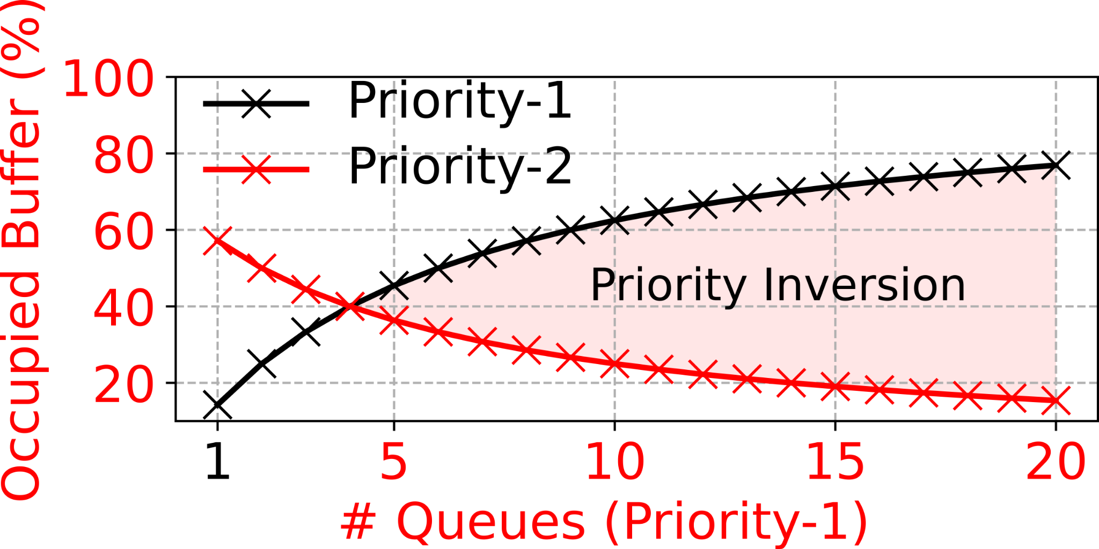
Drawbacks of Dynamic Thresholds (State-of-the-art BM)
No Isolation Properties
Notes:
I skip the analysis details in the interest of time. In this plot based on our analysis, we consider two priorities. Priority-1 shown in black is of low priority and Priority-2 shown in red is of high priority.
One high priority queue is using the buffer. On the x-axis we increase the number of low priority queues that are using the buffer and on the y-axis we show the occupied buffer.
As we see, as the number of low priority queues increase, they use more and more buffer leaving very little remaining buffer for the high priority. This leads to priority inversion problems.

Slide 35
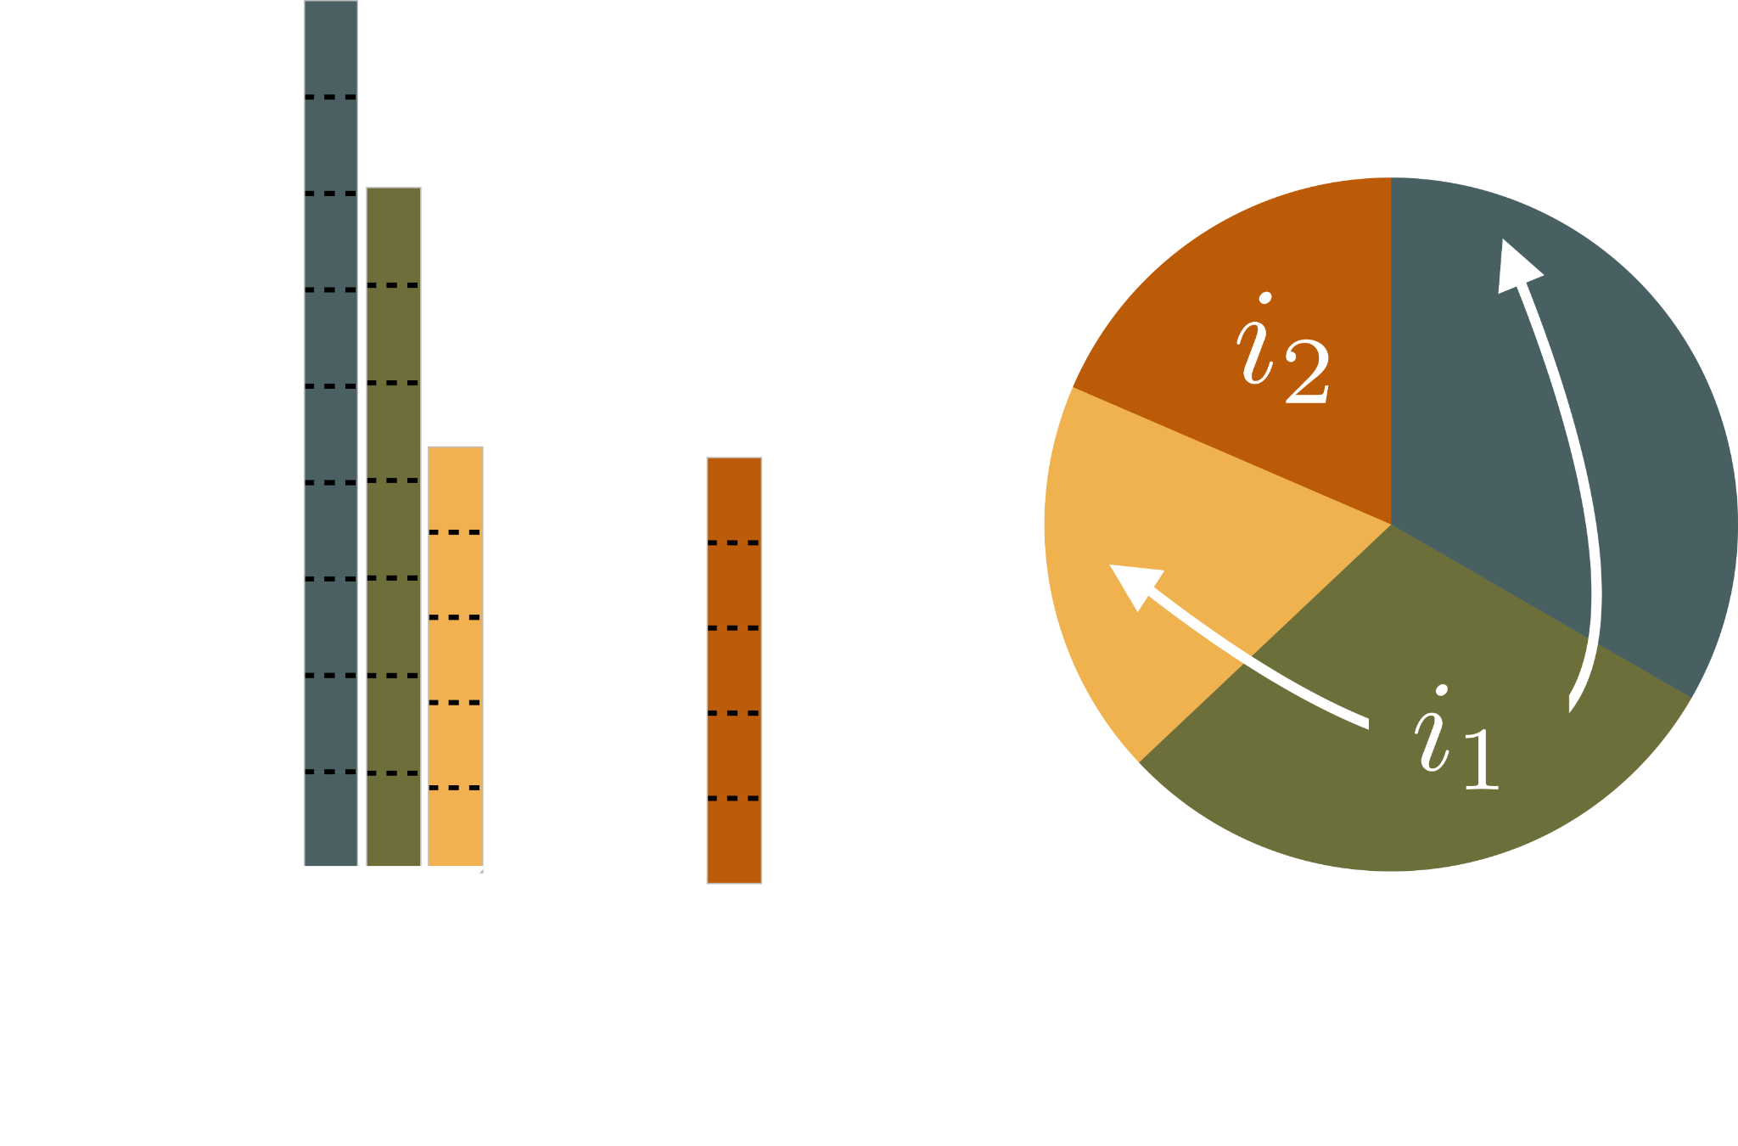
Drawbacks of Dynamic Thresholds (State-of-the-art BM)
Oblivious to drain rate
Notes:
Seconds, Dynamic Thresholds allocation scheme is oblivious to buffer drain time i.e it allocates buffer irrespective of what the queue drain rate is.
For instance, consider this example with Port i1 and i2. I1 has three queues using the buffer and i2 has a single queue using the buffer

Slide 36
Drawbacks of Dynamic Thresholds (State-of-the-art BM)
Oblivious to drain rate
Notes:
Dynamic thresholds allocates the same amount of buffer to these two highlighted queues irrespective of their drain rate. The resulting problem is that their queuing delays significantly differ.

Slide 37
Benefits and Drawbacks of Existing Approaches
BM can in-principle offer isolation across queues
oblivious to buffer drain time
AQM can in-principle offer bounded queue drain time
cannot fundamentally satisfy the isolation property
Notes:
More details about our analysis can be found in our paper. In summary, we find that, …..

Slide 38
Our Goals
Isolation across traffic priorities
Bounded drain time
Better burst absorption
requires both isolation and bounded drain time
Notes:
In this work we aim at three main goals. First, isolation across traffic priorities, second bounded buffer drain time and third burst absorption. Interestingly, burst absorption requires both isolation and bounded drain time.

Slide 39
BM
DT
Burst absorption
Better isolation
Controlling total buffer
Stable drain time
ECN
Trimming
Delay
AQM
Controlling queueing delay
Notes:
So, what we are looking for is not just a hierarchical scheme with BM and AQM but something that combines both.

Slide 40
BM
DT
Burst absorption
Better isolation
Controlling total buffer
Stable drain time
ECN
Trimming
Delay
AQM
Controlling queueing delay
Notes:
Within this space we propose ABM in this work.

Slide 41

ABM
Active Buffer Management
Threshold per queue
port i, priority p

Slide 42
ABM
Active Buffer Management
Parameter To be set for each priority

Slide 43
ABM
Active Buffer Management
# congested queues of priority p

Slide 44
ABM
Active Buffer Management
Remaining shared buffer

Slide 45
ABM
Active Buffer Management
Normalized dequeue rate

Slide 46

ABM
Active Buffer Management

Slide 47

Properties of ABM
Upper bounds the buffer allocated to a priority (Prevents monopoly)
Depends only on the parameter set for the corresponding priority

Slide 48

Properties of ABM
Lower bounds the buffer allocated to a priority (Minimum buffer guarantee)
Depends only on the parameter set for all priorities
Notes:
Only depends on the parameters.

Slide 49

Properties of ABM
Upper bounds the drain time for each priority (Bounded queuing delays)
Depends only on the parameter set for the corresponding priority
and the port bandwidth

Slide 50
Evaluation
NS3 simulations
Leaf-Spine topology (4:1 oversubscription)
9.6KB buffer-per-port-per-Gbps for all switches
Similar to Broadcom TridentII switch
Websearch + incast workload

Slide 51
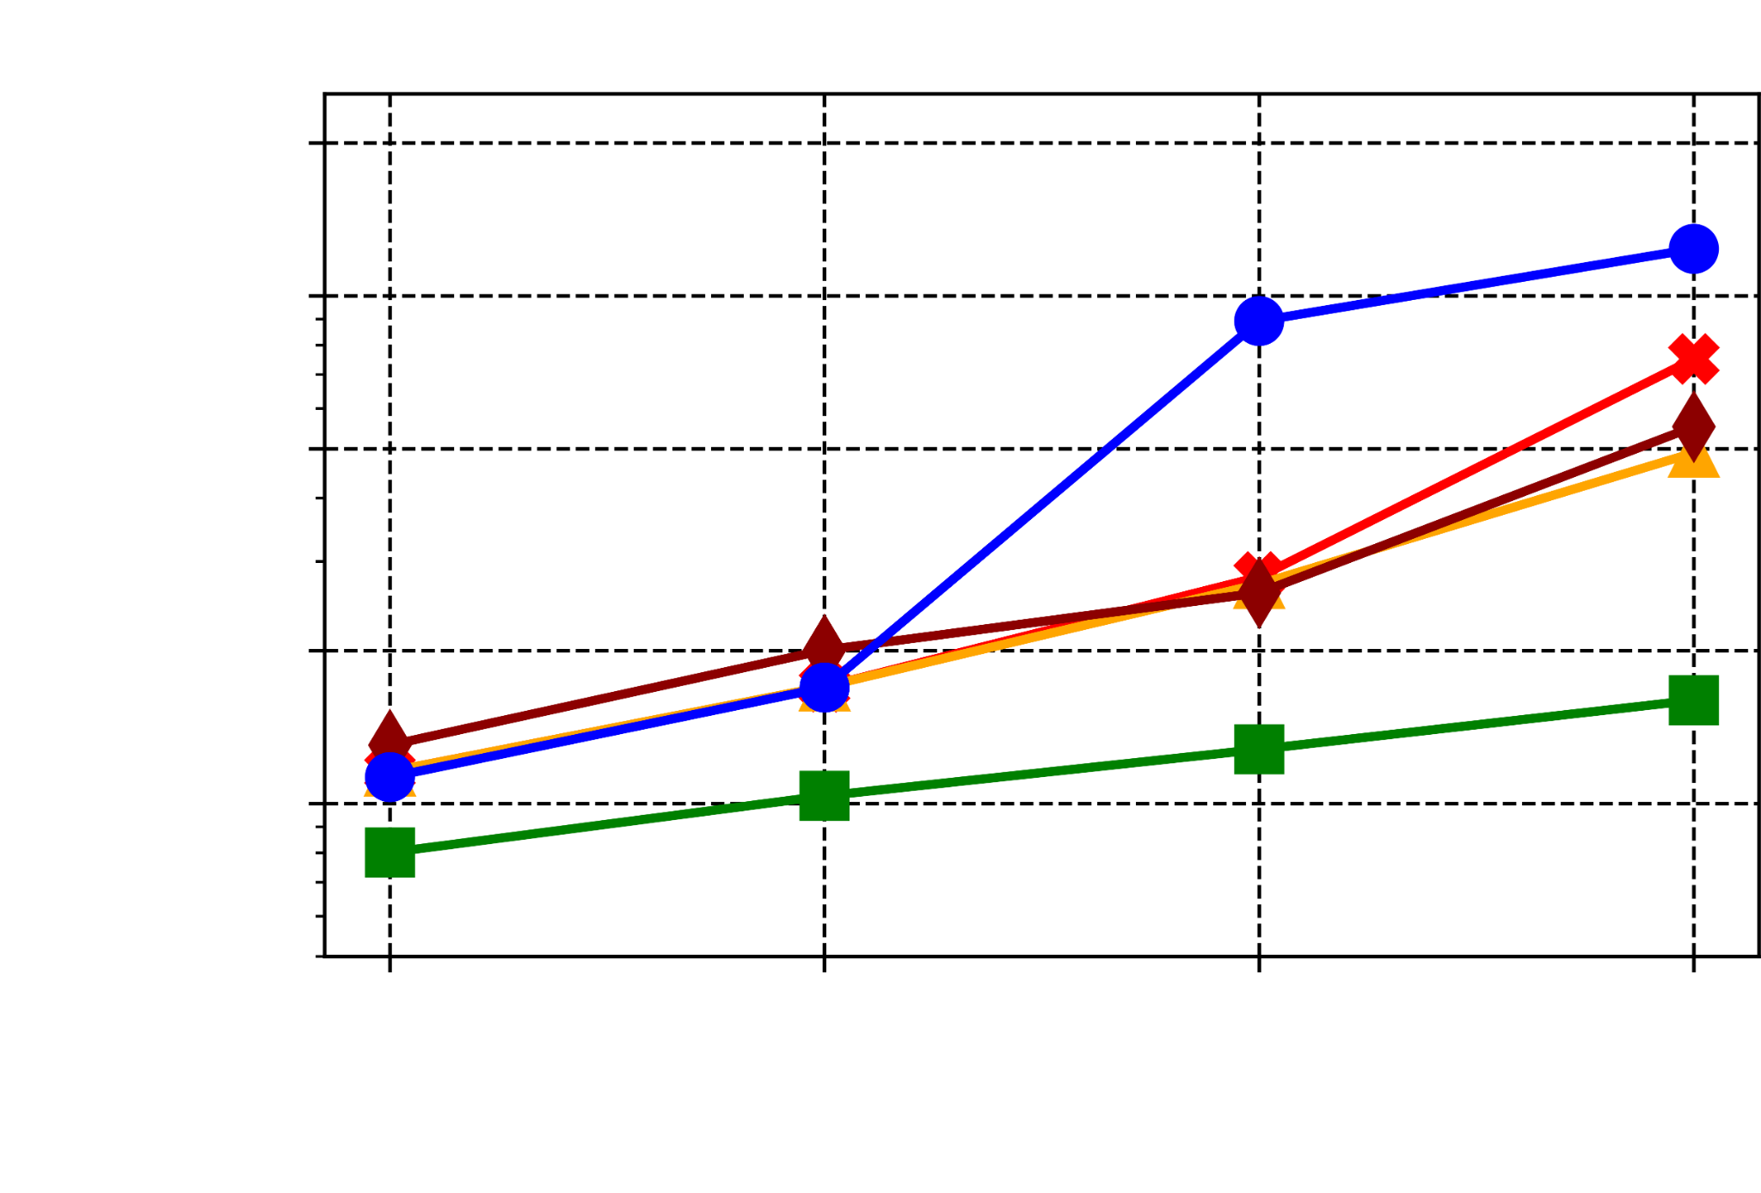
ABM Improves Short Flows FCTs
76%
Short flows
Notes:
Cubic as transport protocol. We compare against Short flows - At 20% load, 30% improvement. At 80% load, 76% improvement.

Slide 52
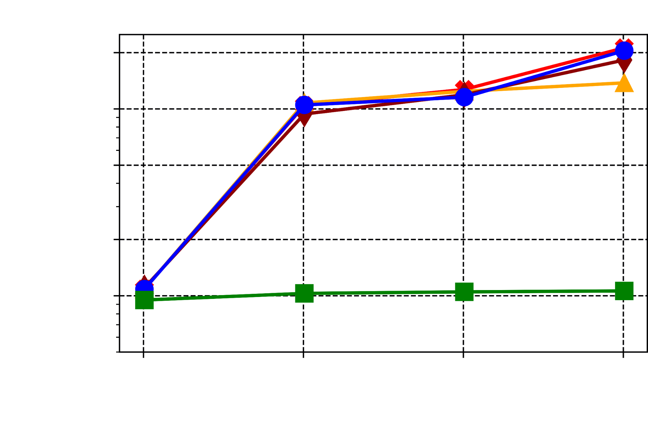
ABM Improves Incast Flows FCTs
80%
Incast flows

Slide 53
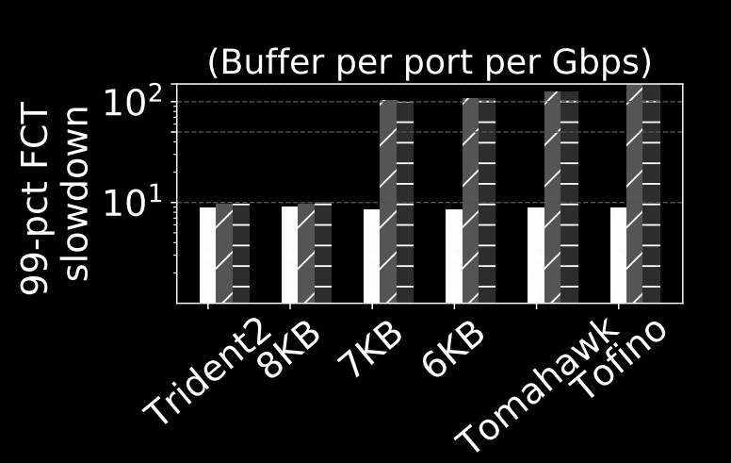
Evaluation under Shallow Buffers and Advanced CC
DCTCP

Slide 54
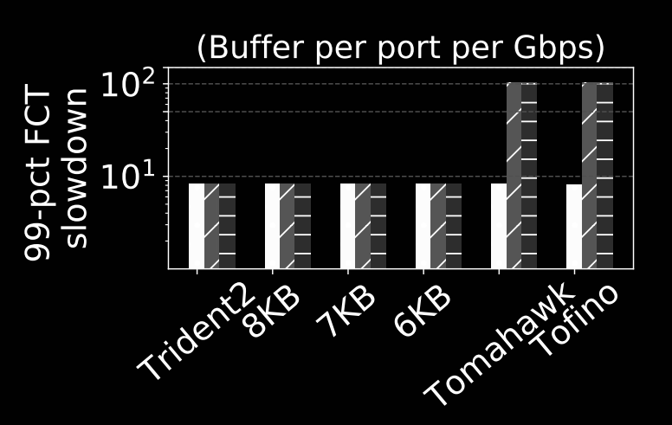
Evaluation under Shallow Buffers and Advanced CC
PowerTCP

Slide 55
Conclusion
Existing approach of hierarchical buffer sharing is fundamentally limited to a single dimension
ABM offers both isolation and stable drain time; and improves burst absorption
ABM significantly improves the performance of incast flows
ABM works well even under shallow buffers
https://github.com/inet-tub/ns3-datacenter

Slide 56
Thank you
https://github.com/inet-tub/ns3-datacenter

Slide 57
Background on Buffer Sharing
Top of the rack (ToR) switch
Shared Buffer
Queues

Slide 58

Background on Buffer Sharing
Top of the rack (ToR) switch
Queues

Slide 59
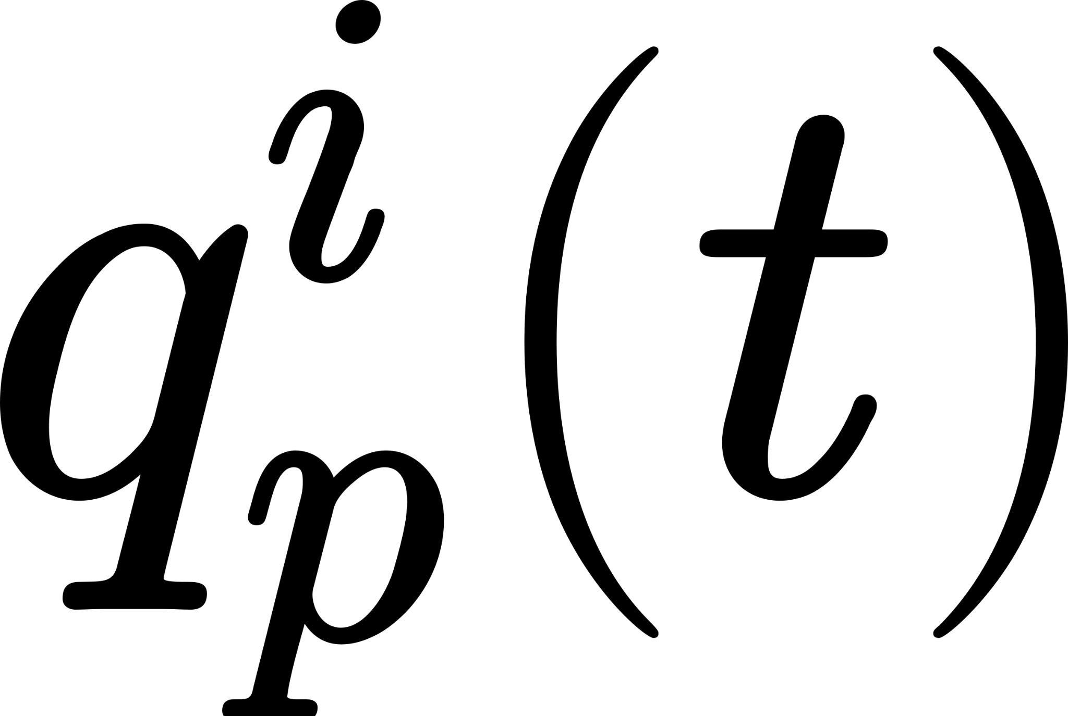
Background on Buffer Sharing
Top of the rack (ToR) switch
Queues

Slide 60
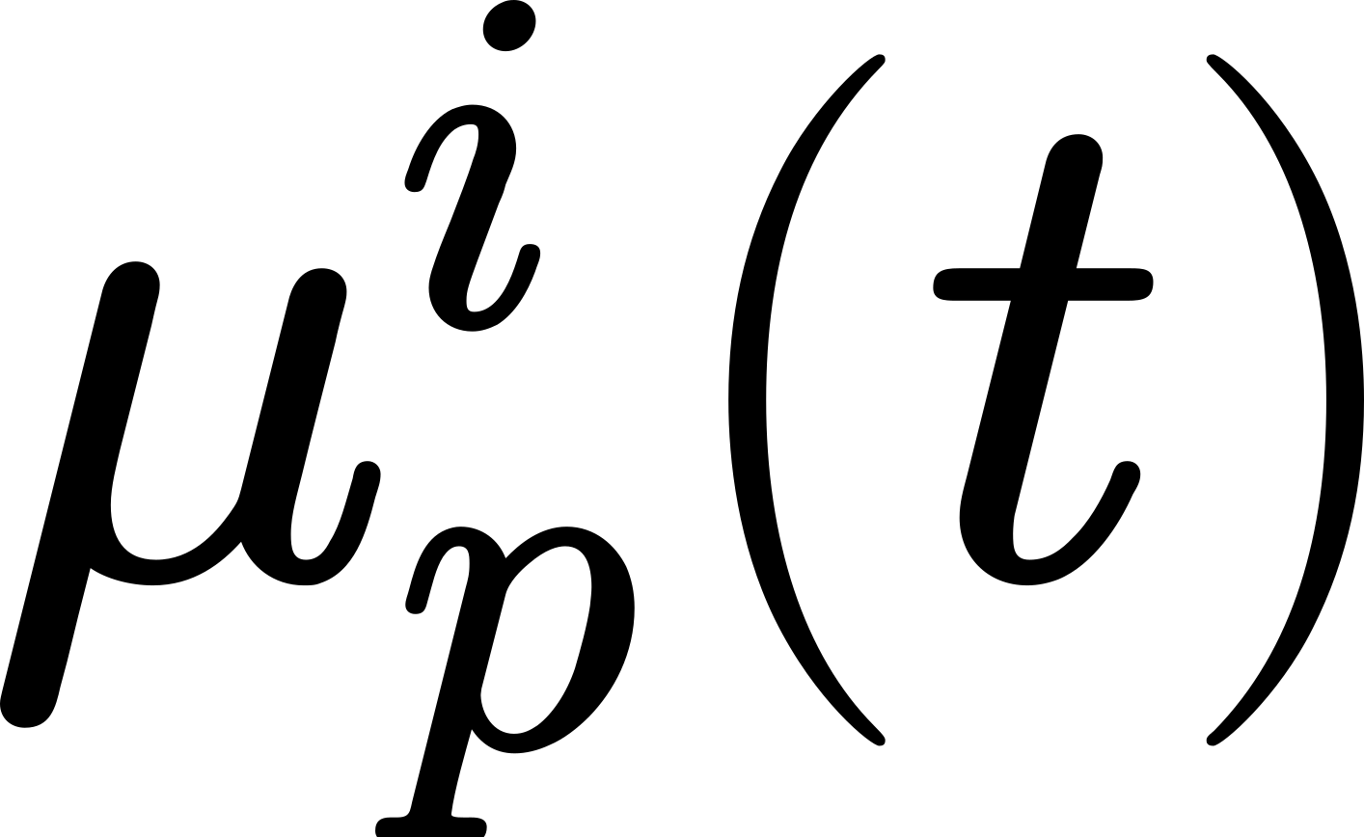
Background on Buffer Sharing
Top of the rack (ToR) switch
Queues

Slide 61

Background on Buffer Sharing
Top of the rack (ToR) switch
Queues

Slide 62
Background on Buffer Sharing
Buffer Management
Active Queue Management
Queues

Slide 63
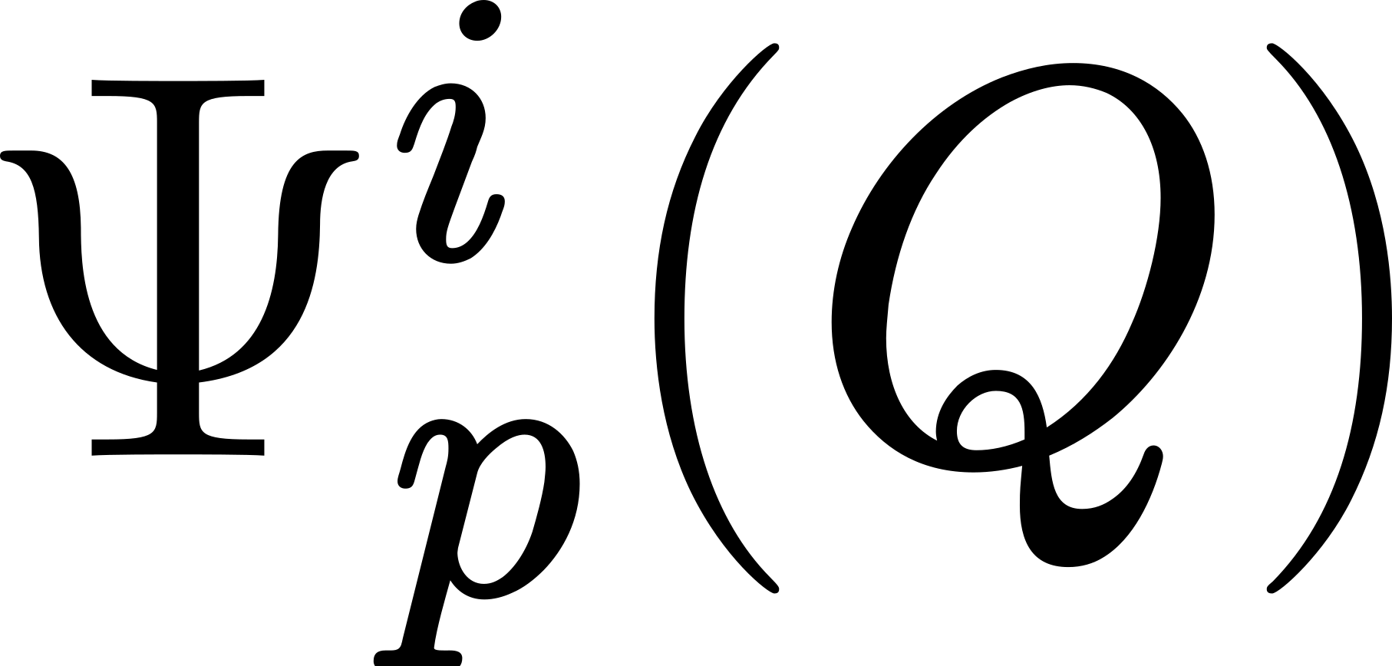

Background on Buffer Sharing
Buffer Management
Active Queue Management
= Total remaining shared buffer
Queues

Slide 64
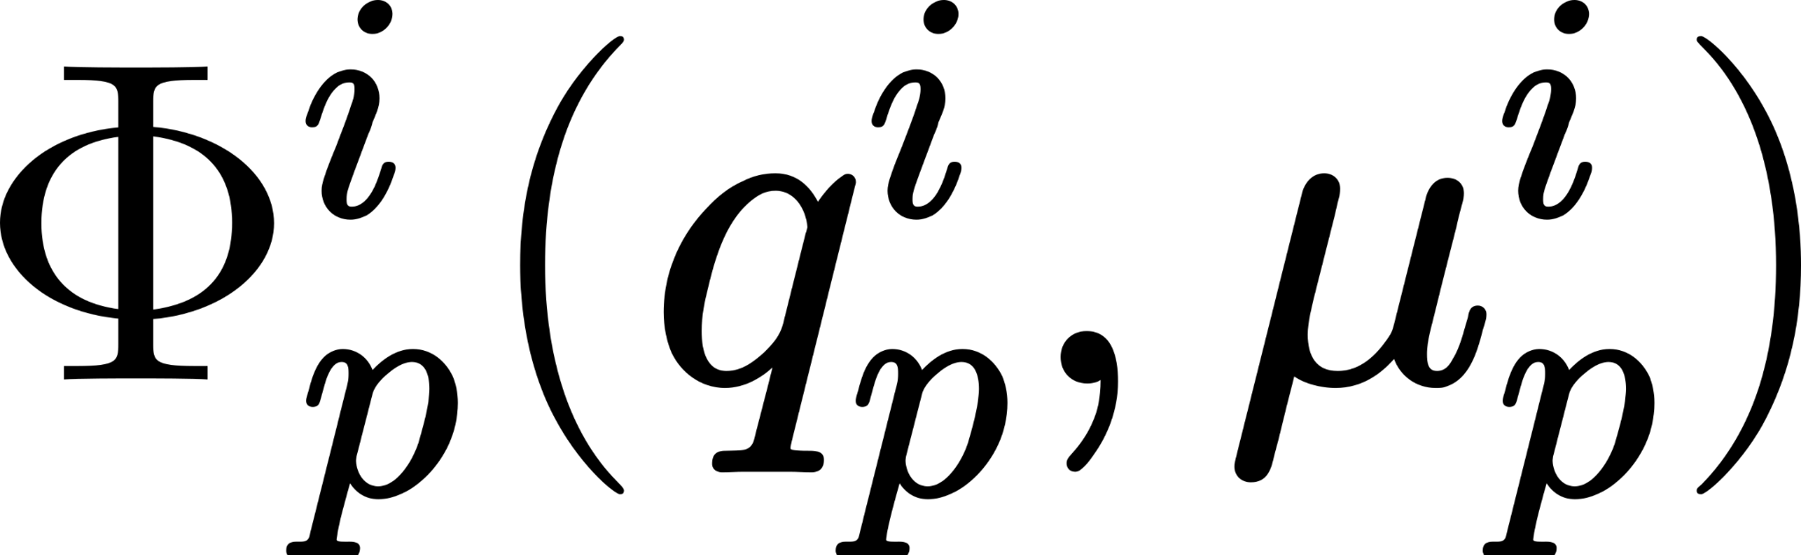


Background on Buffer Sharing
Buffer Management
Active Queue Management
= Total remaining shared buffer
= Queue length
Queues
= Queue dequeue rate

Slide 65
Background on Buffer Sharing
Buffer Management
Enqueue
Queues
Drop

Slide 66
Background on Buffer Sharing
Active Queue Management
Drop
Enqueue
Buffer Management
Queues
Drop

Slide 67
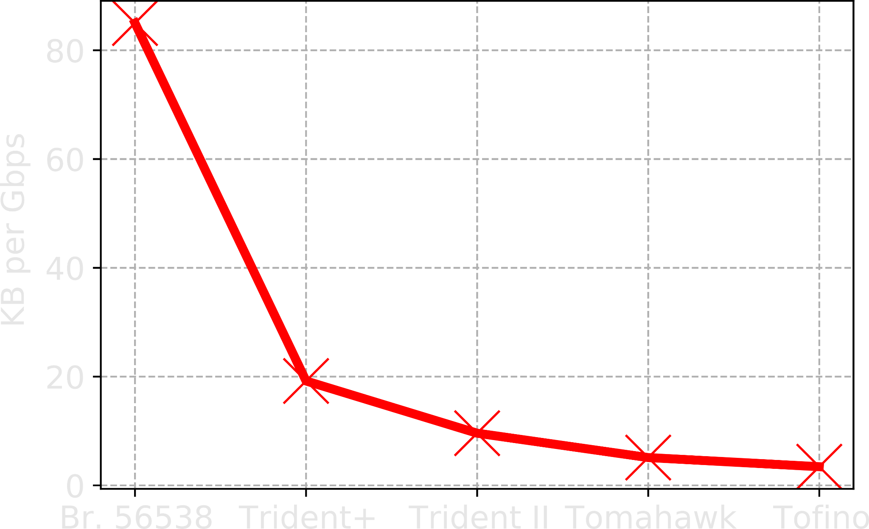
Shared buffer size in datacenter switches
Buffer per port per unit capacity (KB/port/Gbps)

Slide 68
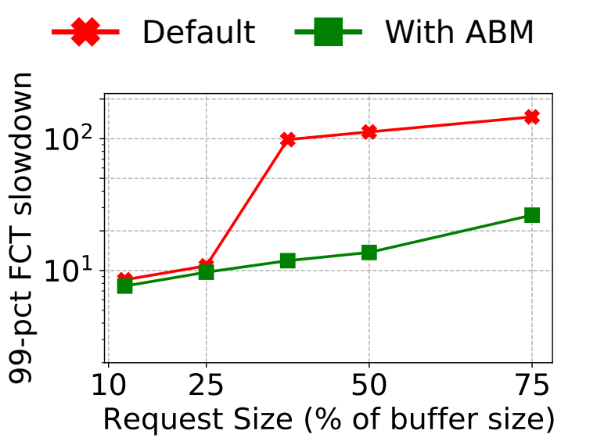
Evaluation - Advanced Congestion Control
DCTCP
Notes:
Incasts - 90.12% at 40% load; and by 94% at 80% load.

Slide 69
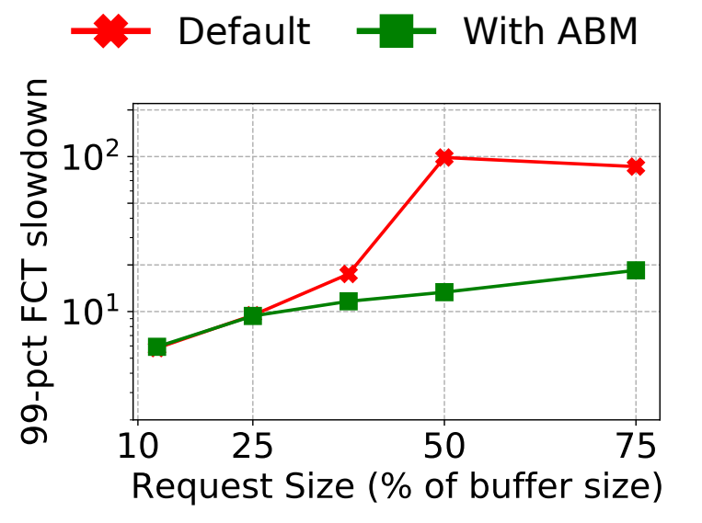
Evaluation - Advanced Congestion Control
TIMELY
Notes:
Incasts - 90.12% at 40% load; and by 94% at 80% load.

Slide 70
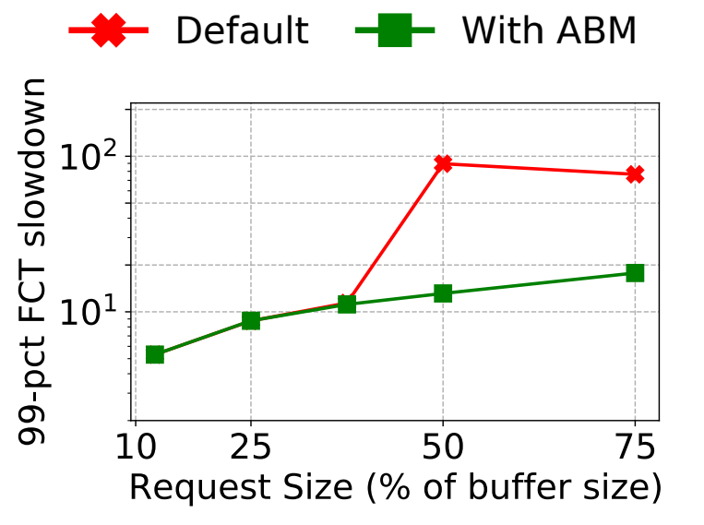
Evaluation - Advanced Congestion Control
PowerTCP
Notes:
Incasts - 90.12% at 40% load; and by 94% at 80% load.

Slide 71

Drawbacks of Dynamic Thresholds (State-of-the-art BM)
Threshold = alpha x (Remaining shared buffer)

Slide 72
Drawbacks of Dynamic Thresholds (State-of-the-art BM)
Threshold = alpha x (Remaining shared buffer)

Slide 73
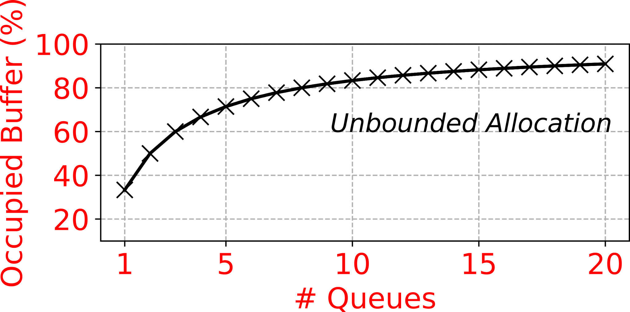
Drawbacks of Dynamic Thresholds (State-of-the-art BM)

Slide 74
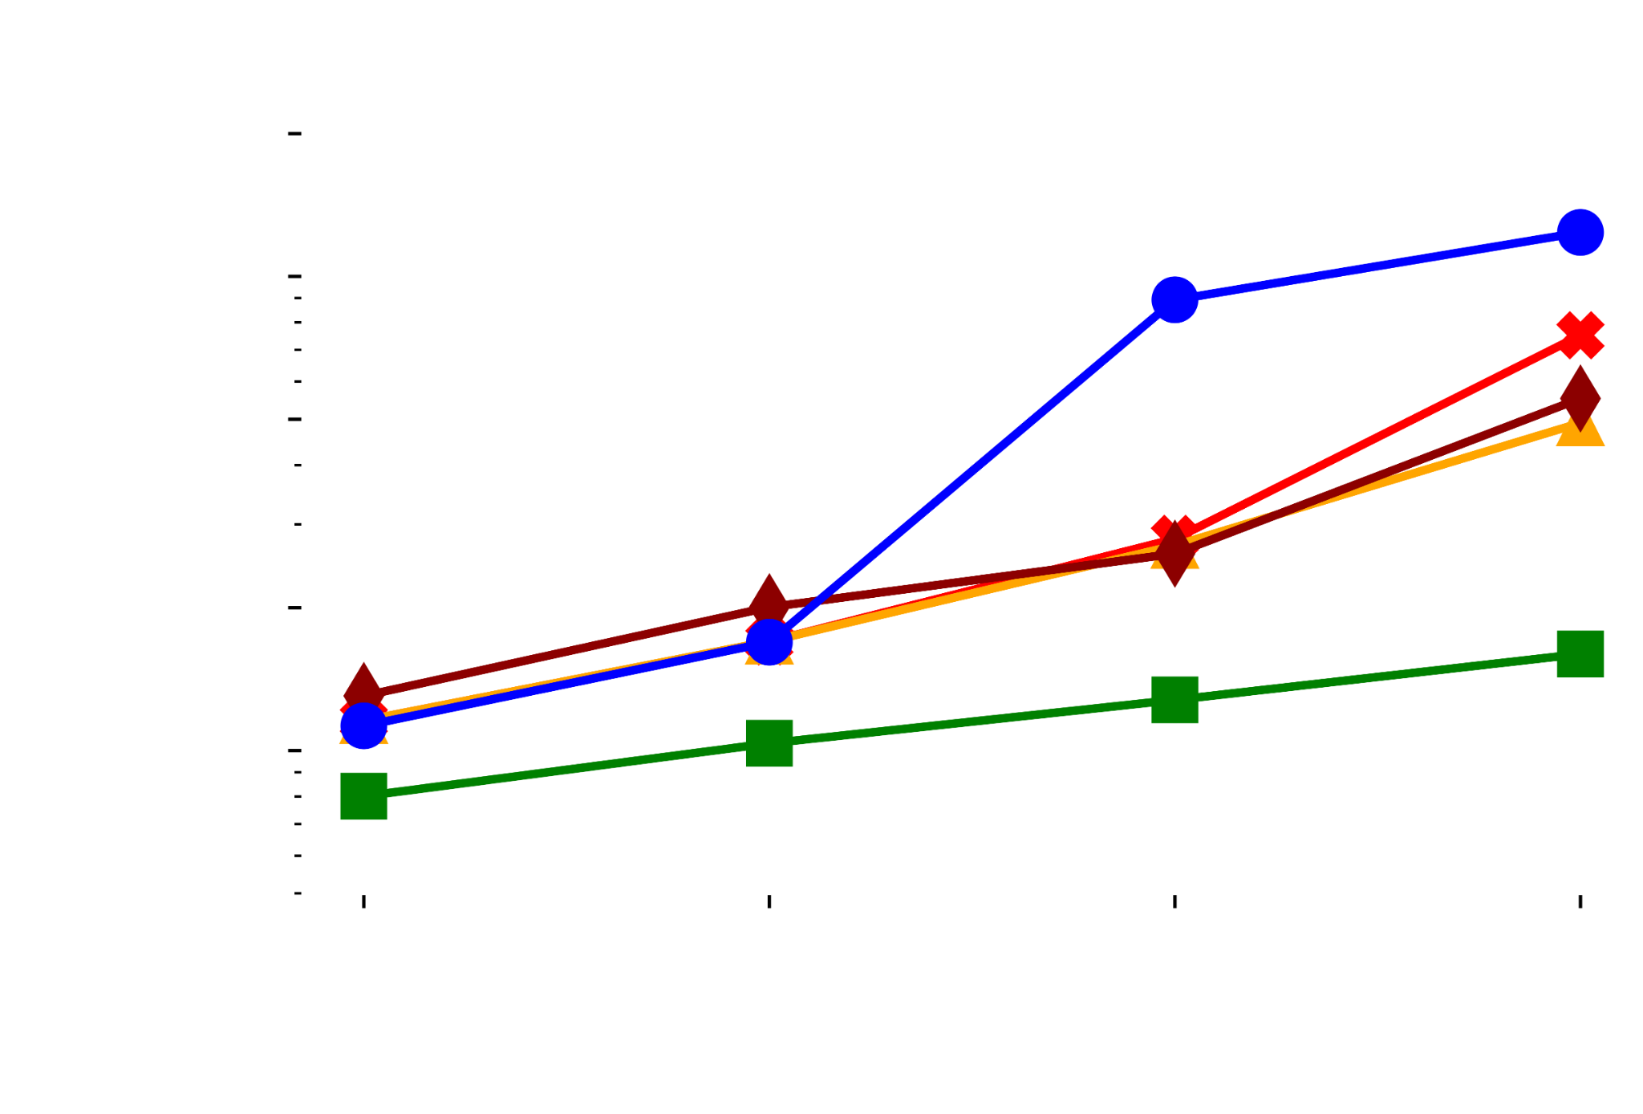
Evaluation - FCTs
76%
Short flows
Notes:
Cubic as transport protocol. We compare against Short flows - At 20% load, 30% improvement. At 80% load, 76% improvement.

Slide 75
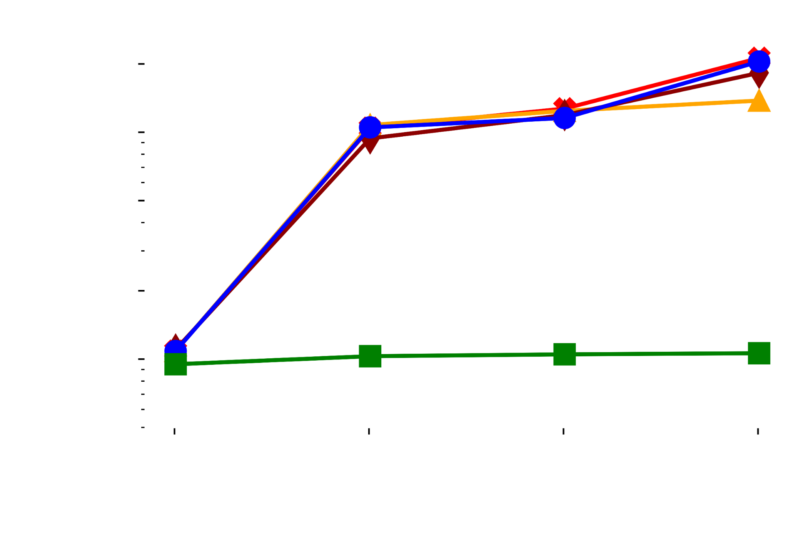
Evaluation - FCTs
76%
80%
Short flows
Incast flows

Slide 76
Building blocks of ABM
Dynamic Thresholds (BM)
Priority inversion
Oblivious to queue drain rate

Slide 77

Building blocks of ABM
Buffer Management
# congested queues of priority p
Priority inversion
Oblivious to queue drain rate

Slide 78
ABM
Active Buffer Management
Priority inversion
Oblivious to queue drain rate

Slide 79
ABM
Active Buffer Management

Slide 80

Building blocks of ABM
Buffer Management
Active Queue Management
# congested queues of priority p
Normalized dequeue rate

Slide 81
BM
DT
Controlling total buffer
Stable drain time
ECN
Trimming
Delay
AQM
Controlling queueing delay
Notes:
To better visualize, AQM provides stable drain time, and BM provides better isolation.

Slide 82
BM
DT
Better isolation
Controlling total buffer
Stable drain time
ECN
Trimming
Delay
AQM
Controlling queueing delay

