Slide 1
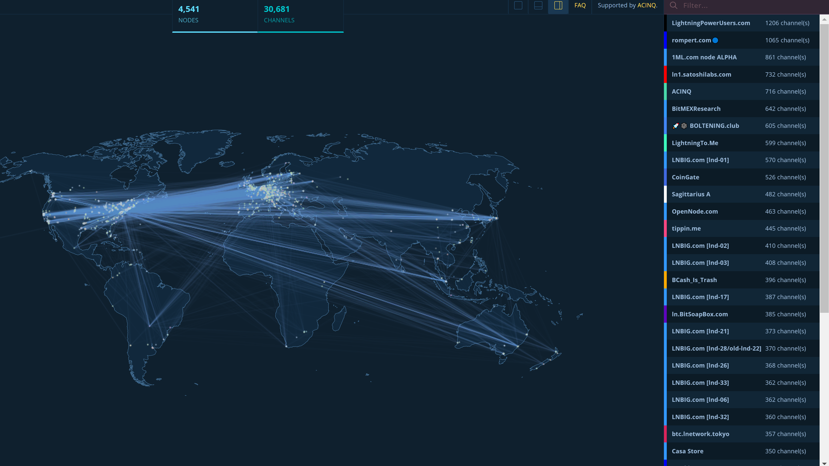
On Search Friction of Route Discovery in Off-chain Networks
Saar Tochner
The Hebrew University
saart@cs.huji.ac.il
Stefan Schmid
University of Vienna
stefan_schmid@univie.ac.at

Slide 2

Confidentiality
Route
Discovery
Effectiveness
Efficiency

Slide 3

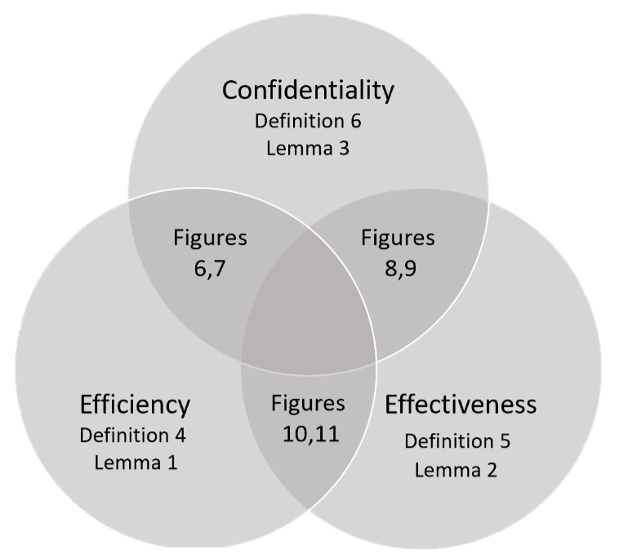
Agenda
The Lightning network
The problem of scale
Route Discovery Algorithm (RDA)
Confidentially-Efficiency-Effectiveness
Results

Slide 4

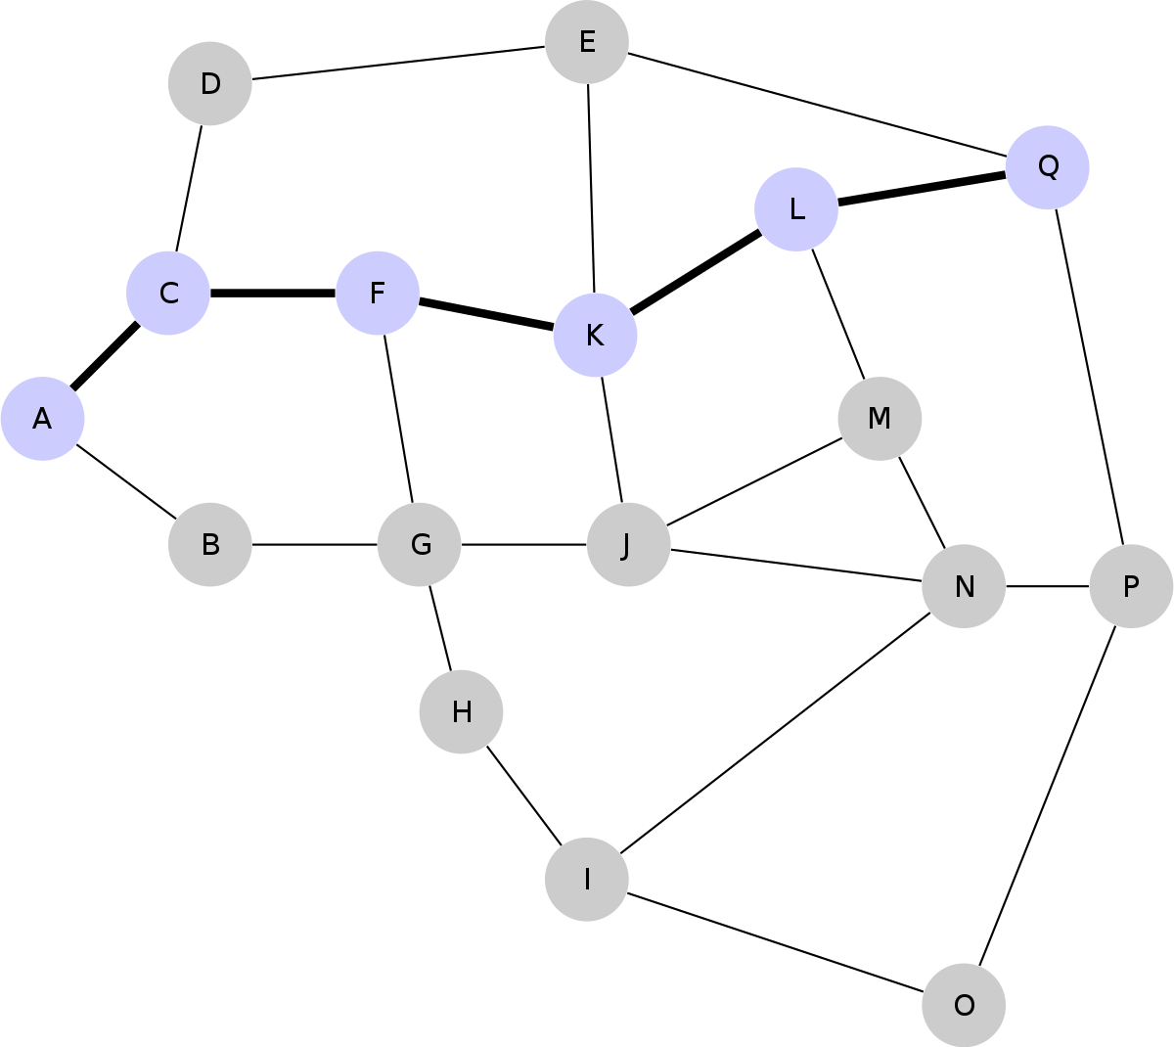
The Lightning Network
txid: 0adf2af3…
Liquidity: 1BTC
Fee: 0.01 base + 0.001 prop.
Solution to Bitcoin’s scalability issue
Channel – locked liquidity between two parties
Route – list of channels from source to target
Transaction – atomic swap of liquidities across route
Channel’s fee – the cost that the owner demands to use it in a transaction
Routing algorithm – choose the best route

Slide 5
The Problem of Scale
How to choose a route?
High number of channels
Frequent changes
Mobile users
Trampoline nodes
Selfishness

Slide 6
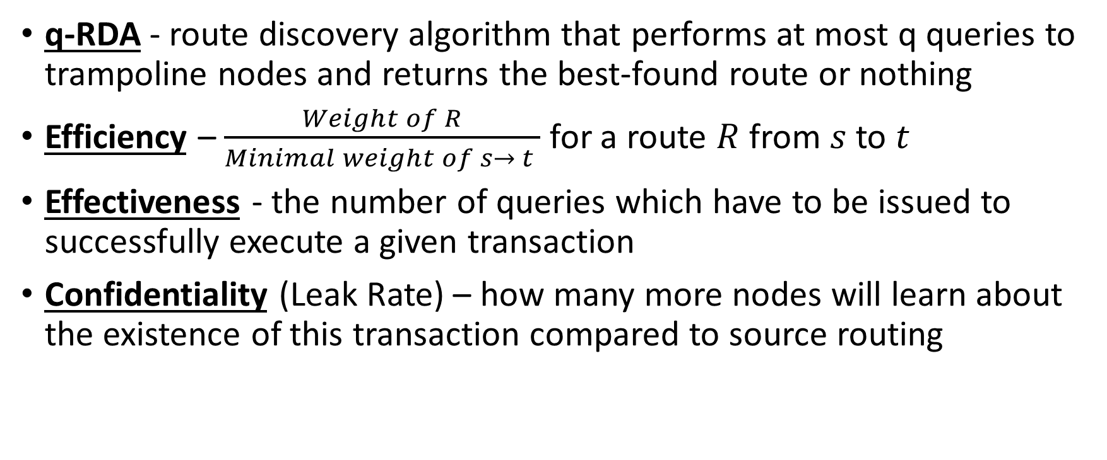
Definitions
q-RDA - route discovery algorithm that performs at most q queries to trampoline nodes and returns the best-found route or nothing
Efficiency – $\frac{Weight of R}{Minimal weight of s→ t }$ for a route $R$ from $s$ to $t$
Effectiveness - the number of queries which have to be issued to successfully execute a given transaction
Confidentiality (Leak Rate) – how many more nodes will learn about the existence of this transaction compared to source routing

Slide 7





Analytical Results
There is no perfect RDA: For every RDA there exists a topology in which the RDA is as bad as we want in Efficiency, Effectiveness and Confidentiality
Example with low efficiency: If there are q+1 direct neighbors, then any q-RDA struggles to find an efficient route
Examples with better measurements: Cliques, Scale-free networks
$$M$$
$$M$$
₁
₁
₁
₀
₀
₀
_{s}
....
$$M$$
₀
₀
₀
₁
₁
$$M$$
₁
$$M$$

Slide 8
Empirical Evaluations
Topologies:
The Lightning network (March. 24th 2020)
Sparse topology – nodes in a circle, with 2 outgoing links: to the next node and to a random node
Transactions Distributions:
Every pair performs a single transaction (uniform)
Power-law “activity level”

Slide 9
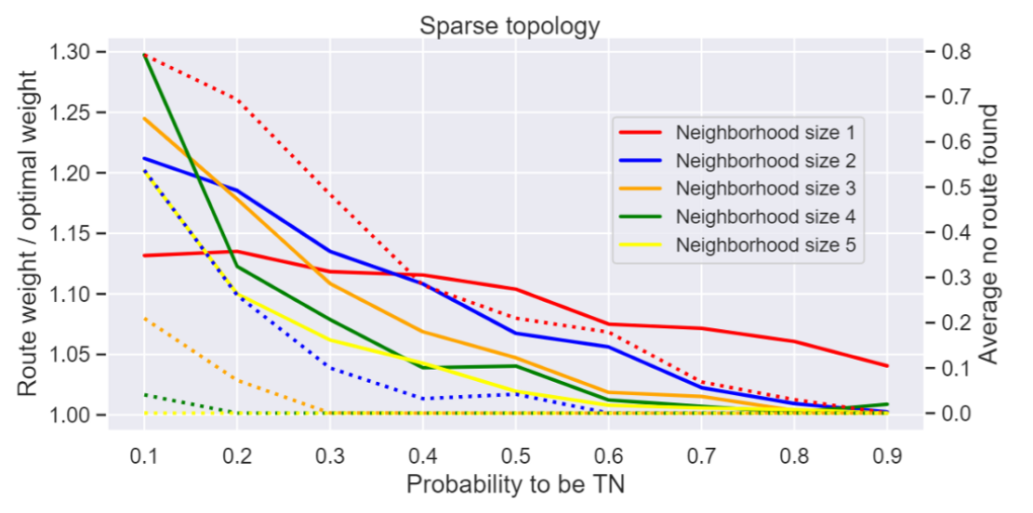
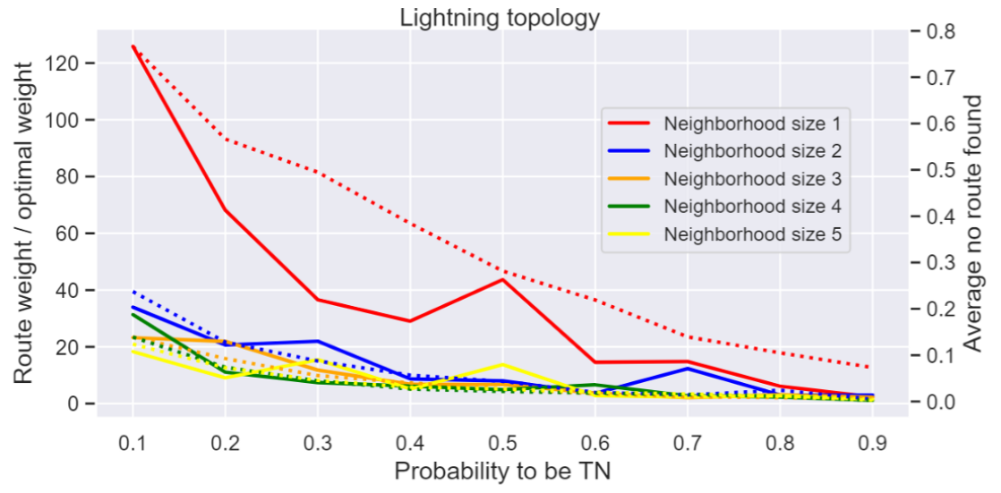
Efficiency-Confidentiality Tradeoff

Slide 10
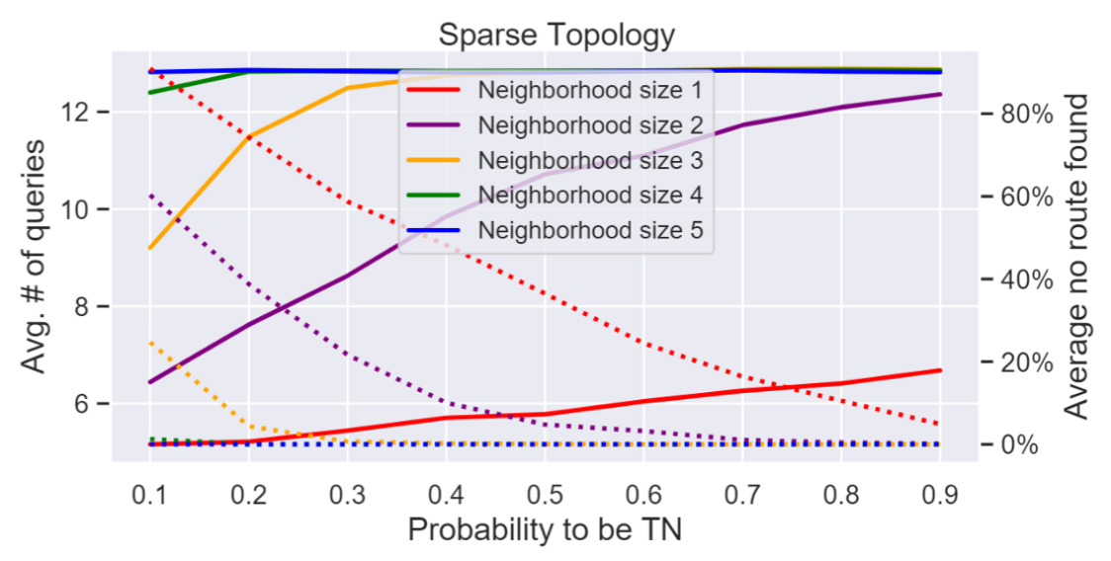
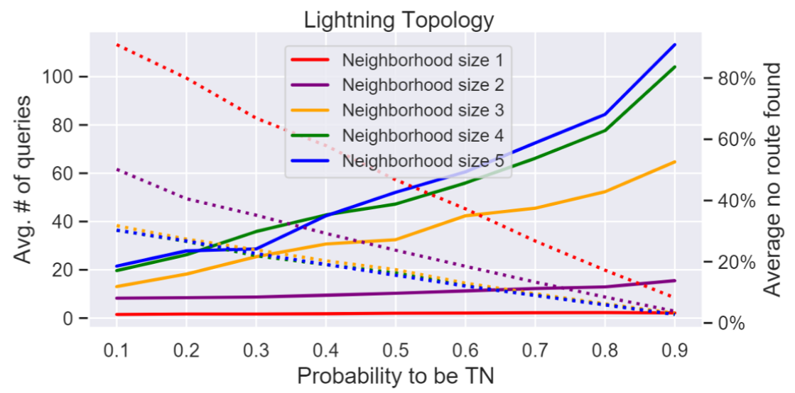
Effectiveness-Confidentiality Tradeoff

Slide 11
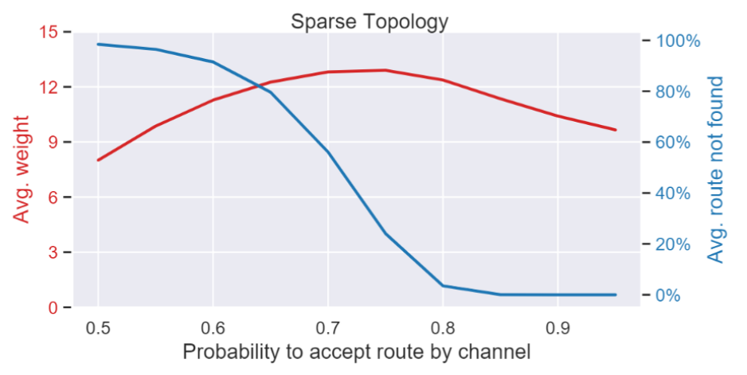
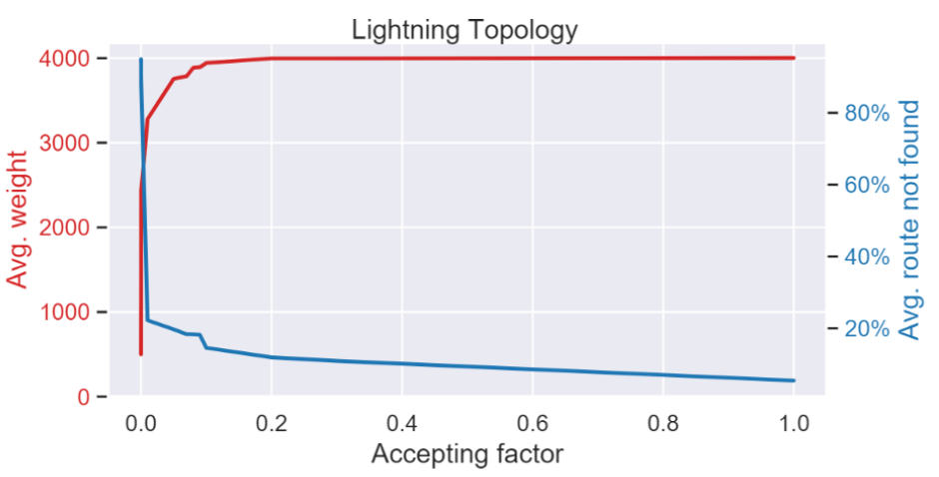
Effectiveness-Efficiency Tradeoff

Slide 12
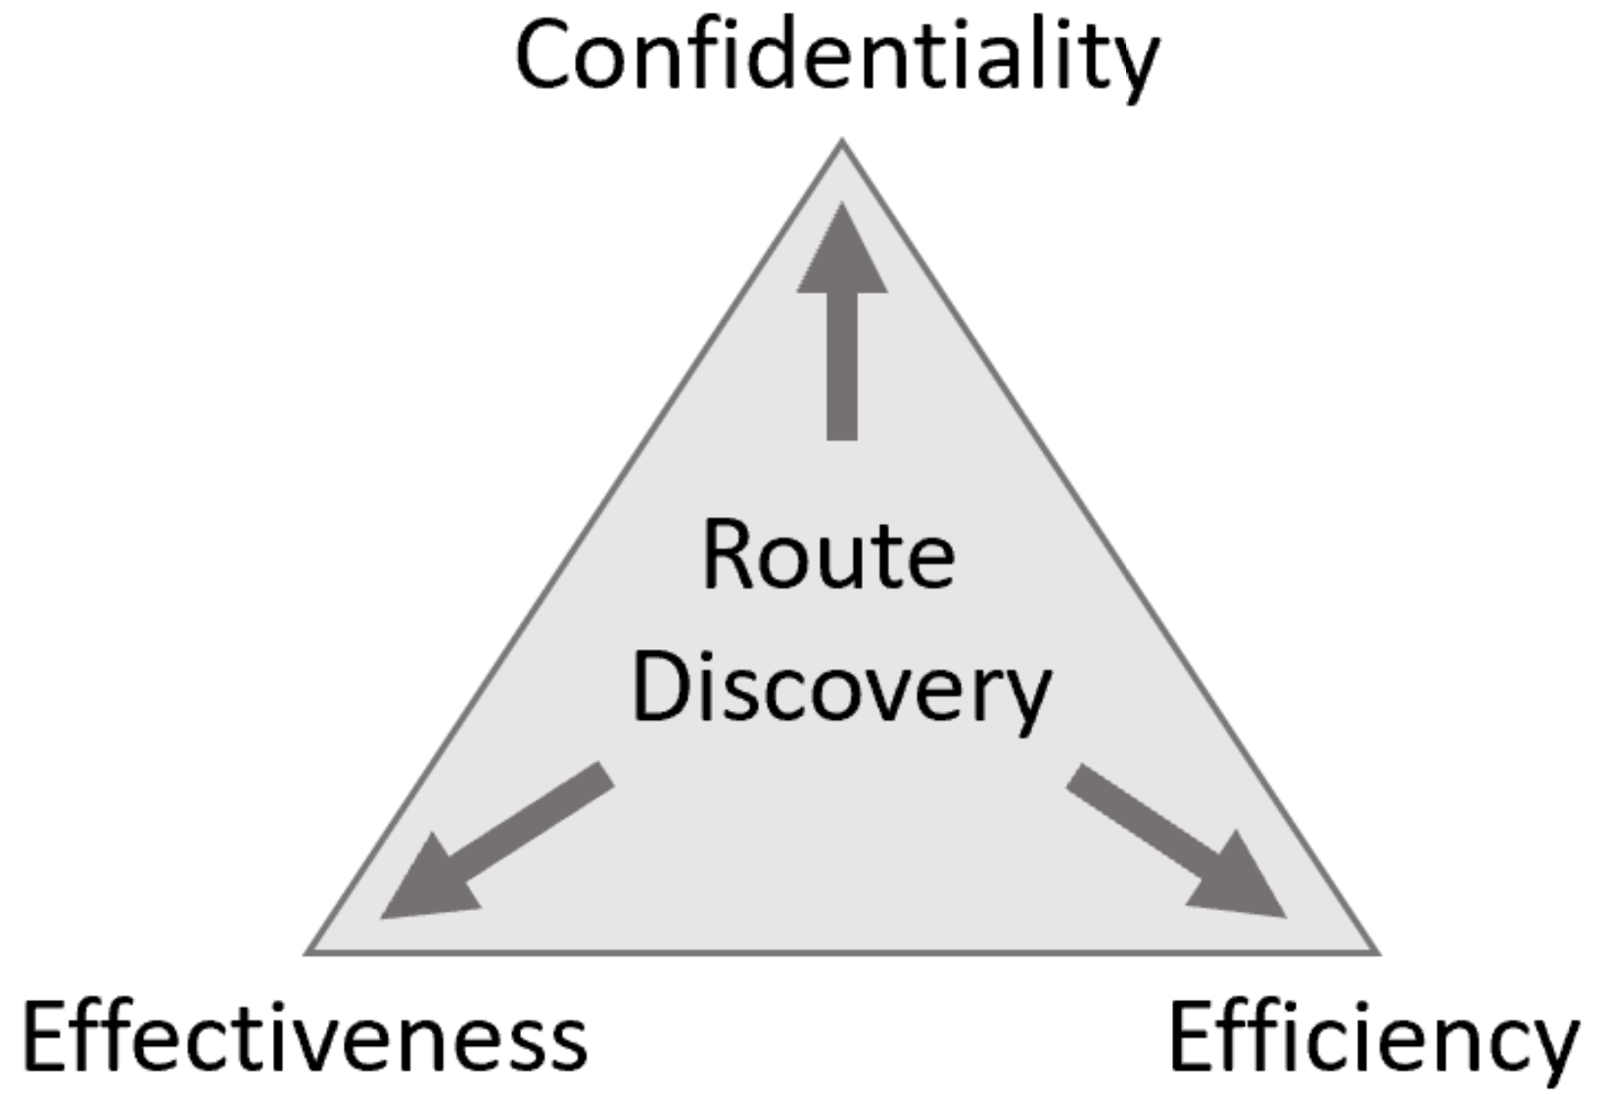
Take-aways
Trampoline nodes
Routing tradeoffs
Selfish Incentives

Slide 13


Questions?
Saar Tochner- saart@cs.huji.ac.il
Stefan Schmid - stefan_schmid@univie.ac.at
https://medium.com/blockchains-huji/routing-with-selfish-information-sharing-6ade69235531

