Slide 1


The Evolutionary Price of Anarchy
Laura Schmid
Joint work with S. Schmid and K. Chatterjee
OPODIS’19
Notes:
Hi and thank you for coming and for opportunity

Slide 2

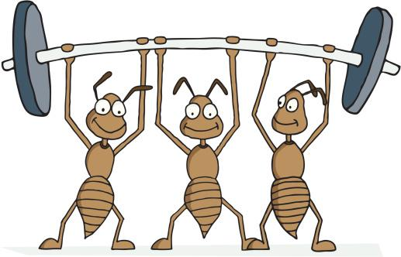
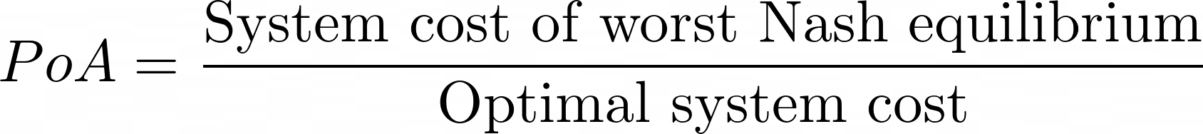
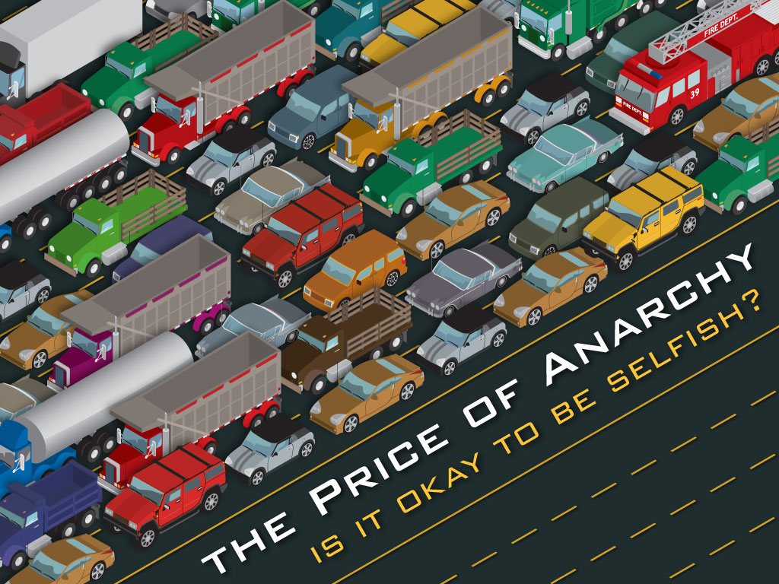
The price of anarchy
Large distributed systems often depend on cooperation, and can suffer if users behave selfishly
High costs and security issues
Price of anarchy: measure of how badly system can be affected by non-cooperative behavior
Nash: Given the other player‘s strategy, nobody can do better by changing their current action.

Slide 3
How realistic is this?
Are Nash equilibria/the PoA the right measure of efficiency?
A) The PoA typically considers one-shot interactions and fixed strategies
B) Players/nodes are rational and have global network information to play NE
C) Players enjoy unbounded resources, computation

Slide 4
How realistic is this?
Are Nash equilibria/the PoA the right measure of efficiency?
A) Distributed systems rely on dynamic interactions over time -> repeated games
B) Players/nodes are rational and have global network information to play NE
C) Players enjoy unbounded resources, computation

Slide 5
How realistic is this?
Are Nash equilibria/the PoA the right measure of efficiency?
A) Distributed systems rely on dynamic interactions over time -> repeated games
B) Nodes/players typically have local information about the network
C) Players enjoy unbounded resources, computation

Slide 6
How realistic is this?
Are Nash equilibria/the PoA the right measure of efficiency?
A) Distributed systems rely on dynamic interactions over time -> repeated games
B) Nodes/players typically have local information about the network
C) Players typically have limited resources and memory

Slide 7
How realistic is this?
Are Nash equilibria/the PoA the right measure of efficiency? No!
A) Distributed systems rely on dynamic interactions over time -> repeated games
B) Nodes/players typically have local information about the network
C) Players typically have limited resources and memory
The PoA does not account for this!

Slide 8
A new measure of efficiency
We would like to port the PoA to local information scenarios, where
- games are embedded in dynamical processes
- players are simple and even memoryless
- and strategies can evolve.
How?

Slide 9

Evolutionary games
“Classical” game theory framework: selfish individuals attempt to consciously reach best outcome for themselves
Central concept: (Nash-) equilibrium
Needs assumptions about rationality, beliefs, cognitive abilities
Evolutionary games do not!
Focus on dynamics -> equilibrium selection, off equilibrium behavior
Notes:
->Bounded rationality

Slide 10
Evolutionary games
Generic approach to evolutionary dynamics
Notes:
mathematical principles behind evolution
Do not have to be rational
Strategies can evolve (learning good strategies)
Looking at dynamics, not only stable states
depend on the actions of the co-players and therefore on
the abundance of different strategies

Slide 11
Evolution and evolutionary dynamics
Evolutionary dynamics: mathematical principles behind evolution
Main ingredients for evolutionary change: Replication + Mutation + Selection
Notes:
(Population of r
Mutations arise when replication is not perfectly accurate
Promote coexistence of different types
eproducing individuals)

Slide 12
Evolution and evolutionary dynamics
Evolutionary dynamics: mathematical principles behind evolution
Main ingredients for evolutionary change: Replication + Mutation + Selection
Notes:
(Population of reproducing individuals)
Fitness differs between types -> different reproduction rate
Population genetics: constant selection (=constant fitness)

Slide 13
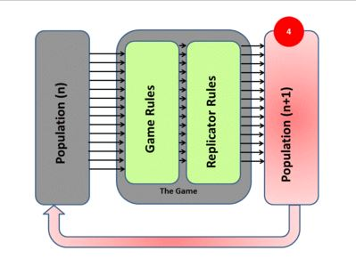
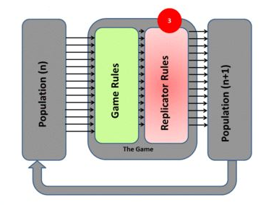
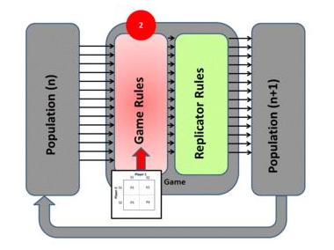
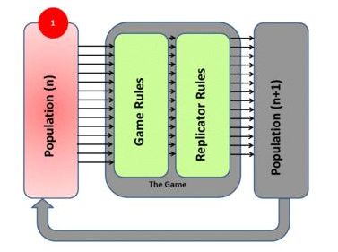
Evolutionary games
Generic approach to evolutionary dynamics
Frequency dependent fitness/selection
Population of players with individual strategies
Interactions with other players give payoffs ⬄ evolutionary fitness
Success in game -> reproductive success: good strategies reproduce faster & spread
Describe dynamics dependent on frequency of different types in population
Notes:
mathematical principles behind evolution
Do not have to be rational
Strategies can evolve (learning good strategies)
Looking at dynamics, not only stable states
depend on the actions of the co-players and therefore on
the abundance of different strategies

Slide 14
The evolutionary price of anarchy (ePoA)
The ePoA extends PoA to evolutionary games
More natural measure of efficiency than the static PoA
We consider simple memoryless agents without perfect information, interacting repeatedly and locally
Players do not even necessarily have to reach equilibrium in the game they are playing
We can study games under different evolutionary dynamics, different parameters
Exploration of equilibrium selection, long-term off-equilibrium behavior

Slide 15
Model game: Virus inoculation
Classic security game: N nodes in a network G must decide whether to install anti-virus software at cost V

Slide 16

Model game: Virus inoculation
Classic security game: N nodes in a network G must decide whether to install anti-virus software at cost V

Slide 17

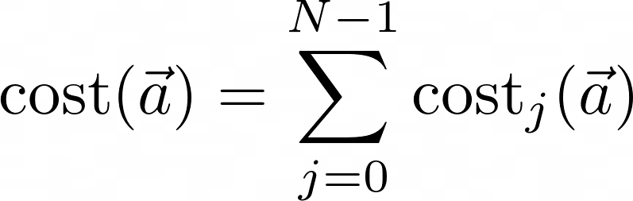
Model game: Virus inoculation
Classic security game: N nodes in a network G must decide whether to install anti-virus software at cost V
Unprotected nodes risk infection by virus spreading from a random location. Infection costs I > V.
Virus infects all unprotected nodes with direct path to an infected node. Inoculated nodes cannot be infected or transmit the virus.
Cost of strategy profile a for node i:
Resulting social cost:
Well known results on Nash equilibria, optimum approximation

Slide 18
Evolutionary virus inoculation games
Nodes probably do not know G and each others’ decision – they should only have local information!
Proposal: stochastic evolutionary process, iterated over many rounds
Three stages per round:

Slide 19
Evolutionary virus inoculation games
Nodes probably do not know the graph and each others’ decision – they should only have local information!
Proposal: stochastic evolutionary process, iterated over many rounds
Three stages per round:
- Decision making: Two possible choices (0 or 1)

Slide 20
Evolutionary virus inoculation games
Nodes probably do not know G and each others’ decision – they should only have local information!
Proposal: stochastic evolutionary process, iterated over many rounds
Three stages per round:
- Decision making
- Virus propagation

Slide 21
Evolutionary virus inoculation games
Nodes probably do not know G and each others’ decision – they should only have local information!
Proposal: stochastic evolutionary process, iterated over many rounds
Three stages per round:
- Decision making
- Virus propagation

Slide 22
Evolutionary virus inoculation games
Nodes probably do not know G and each others’ decision – they should only have local information!
Proposal: stochastic evolutionary process, iterated over many rounds
Three stages per round:
- Decision making
- Virus propagation
- Evolution of strategies
?
?
?
?
?

Slide 23
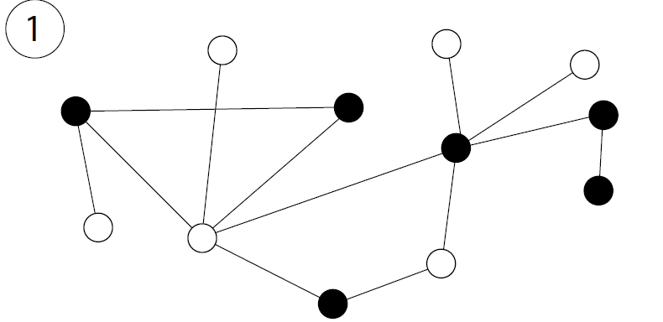
Evolution of strategies
We take selection and mutation into account
We can compare different memoryless evolutionary dynamics
Example: Genetic evolution - The Moran Death-Birth process

Slide 24
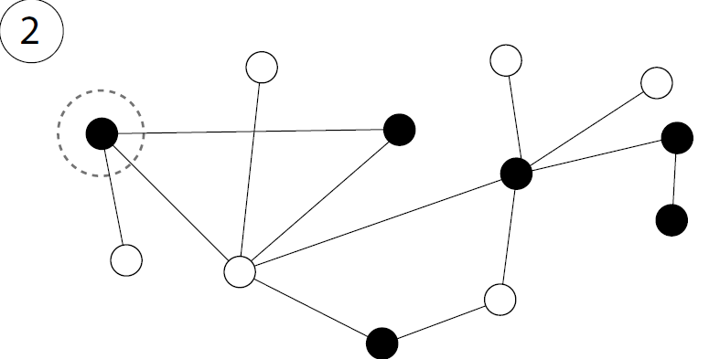
Evolution of strategies
We take selection and mutation into account
We can compare different memoryless evolutionary dynamics
Example: Genetic evolution - The Moran Death-Birth process
- Node is picked to die in each timestep

Slide 25
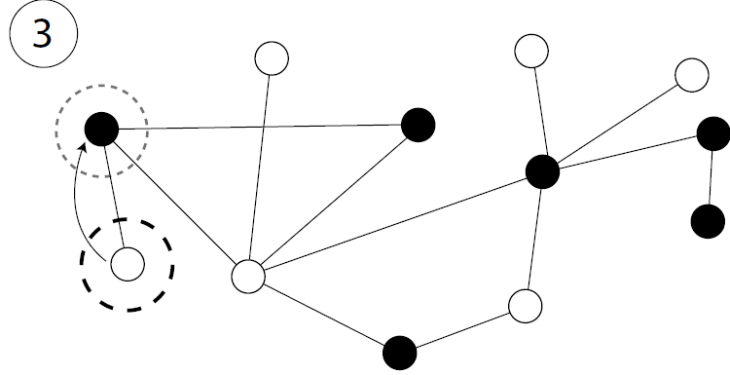
Evolution of strategies
We take selection and mutation into account
We can compare different memoryless evolutionary dynamics
Example: Genetic evolution - The Moran Death-Birth process
- Node is picked to die in each timestep
- Replaced by neighboring node proportional to the latter’s payoff π

Slide 26
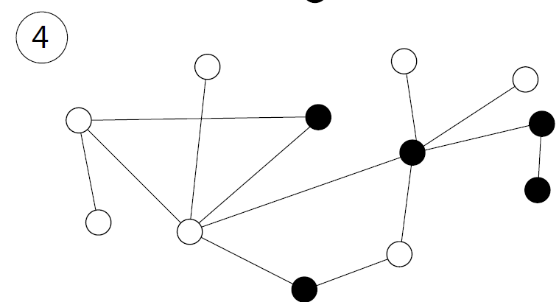
Evolution of strategies
We take selection and mutation into account
We can compare different memoryless evolutionary dynamics
Example: Genetic evolution - The Moran Death-Birth process
- Node is picked to die in each timestep
- Replaced by neighboring node proportional to the latter’s payoff
All considered dynamics can be described as ergodic Markov chains

Slide 27

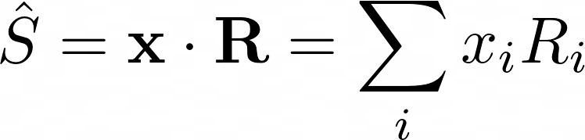

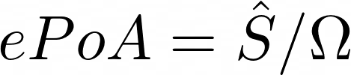
The evolutionary price of anarchy (ePoA), pt. 2
What is the stationary (limit) distribution of the underlying Markov chain = the probabilities of finding the system in different states?
Selection-mutation equilibrium x of a given evolutionary process
This allows us to find average social cost
where R contains the social costs of all possible system configurations
Definition: the evolutionary price of anarchy is the ratio of the average social cost of a process against the social optimum .

Slide 28
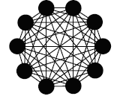





The virus game on a clique
Markov chain: (N+1) states, i=0,…N (# of inoculated nodes)
We can exactly calculate mutation-selection equilibrium x, for mutation rate and pure strategies ( )
Calculate payoffs for all nodes, for all configurations i
Then calculate transition matrix P containing the probabilities of moving between states
Mutation-selection equilibrium is the solution to
Average social cost
Measure efficiency of different dynamics by comparing

Slide 29
The virus game on a clique
Markov chain: (N+1) states, t=0,…N (# of inoculated nodes)

Slide 30
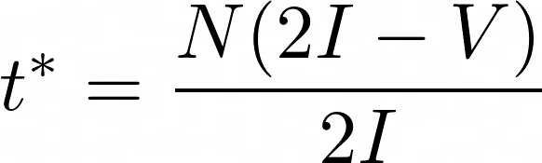

The virus game on a clique
t=3
Markov chain: (N+1) states, t=0,…N (# of inoculated nodes)
Optimum at
Nash equilibria: nodes inoculated => PoA
We can exactly calculate mutation-selection equilibrium x, for mutation rate and pure strategies ( )
Calculate average social cost => ePoA
Can do this for different dynamics and compare their efficiency
Do we recover Nash equilibria in dynamics? How does ePoA compare to PoA?

Slide 31
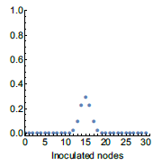
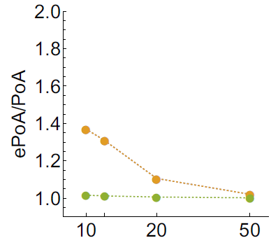
Clique results
N=30
V/I=1/2
=0.001
For “reasonable” parameters we recover the predicted Nash equilibria as the most abundant states of the evolutionary process
Most time is spent in states where nodes are inoculated
Process is stochastic -> neighboring states also frequent, but symmetric distribution
Corollary:
Efficiency of evolutionary processes approaches static game
Network size N

Slide 32
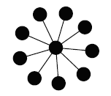
Virus game on star graphs
2N states, (c,l), c…inoculation state of center, l…number of inoculated leaf nodes

Slide 33



Virus game on star graphs
(c,l)=(1,2)
2N states, (c,l), c…inoculation state of center, l…number of inoculated leaf nodes
2 classes of Nash equilibria: and
is also the optimum!
We can again do exact calculations and get both ePoA and PoA
Now: Both classes of Nash equilibria are rare! The system exhibits strong off equilibrium behavior due to its topology
This implies that as long as mutation rate is small

Slide 34
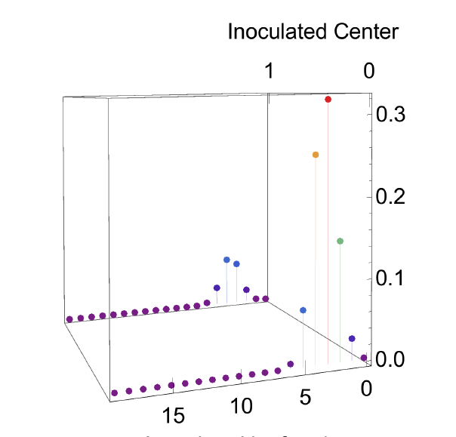
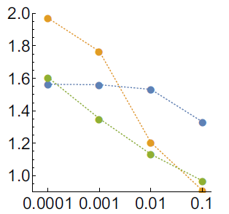
Virus game on star graphs
Now: Both classes of Nash equilibria are rare! The system exhibits off equilibrium behavior due to highly structured network
This implies that as long as mutation rate is small
Average costs are significantly higher
than in traditional static model!
ePoA/PoA
N=20
V/I=1/2
=0.001
Mutation rate

Slide 35
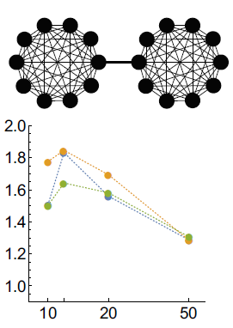
Simulations of more complex topologies
For most topologies, simulations are necessary – we cannot explicitly calculate x
Simulate the process, find average social welfare (or even stationary distribution approximation)
Example: 2-clique
ePoA/PoA
Network size N

Slide 36
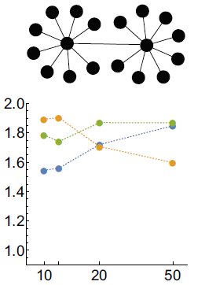
Simulations of more complex topologies
For most topologies, simulations are necessary – we cannot explicitly calculate x
Simulate the process, find average social welfare (or even stationary distribution approximation)
Example: 2-star
ePoA/PoA
Network size N
Notes:
Compare colors

Slide 37
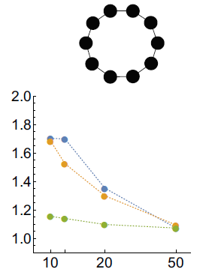
Simulations of more complex topologies
For most topologies, simulations are necessary – we cannot explicitly calculate x
Simulate the process, find average social welfare (or even stationary distribution approximation)
Example: cycle
Usually no recovery of Nash equilibria for any of the considered dynamics => ePoA higher than PoA as long as is not too high
=> The PoA usually underestimates actual system costs for more complex topologies!
ePoA/PoA
Network size N

Slide 38
Takeaways
Static analysis of distributed systems based on the price of anarchy is falling short
We have introduced the evolutionary price of anarchy (ePoA) to study behavior of simple agents repeatedly interacting in a distributed system based on local information
Resulting stationary state can be significantly different from static equivalent/equilibria
System costs are therefore often higher than predicted by static price of anarchy
Shows impact of limited information on games in networks
Many avenues for future research
Notes:
Strategies that have been shown to excel when info is publicare not that good anymore

Slide 39
Thank you!

