Slide 1

BA: Does Preprocessing Help under Congestion?
Klaus-Tycho Foerster, Janne H. Korhonen (IST Austria), Joel Rybicki (IST Austria), Stefan Schmid

Slide 2
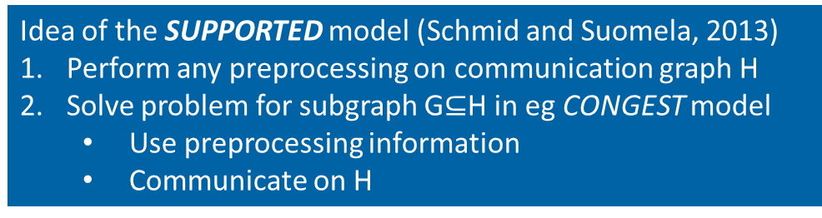
Motivation
Standard distributed computing models (eg CONGEST with O(log n) message sizes & IDs):
Network topology is unknown
Compute from scratch
But in many networking applications:
Communication topology remains unchanged
Only the problem input changes
Can we leverage preprocessing?
Idea of the SUPPORTED model (Schmid and Suomela, 2013)
Perform any preprocessing on communication graph H
Solve problem for subgraph G$⊆$H in eg CONGEST model
Use preprocessing information
Communicate on H

Slide 3
Brief Background
Congested Clique
Introduced at SPAA 2003: Lotker, Pavlov, Patt-Shamir, Peleg
Analogy: SUPPORTED CONGEST model if communication graph H is a clique
SUPPORTED model
Introduced for LOCAL and CONGEST at HotSDN 2013: Schmid and Suomela
CONGEST: Applications to subgraph detection at OPODIS 2017: Korhonen and Rybicki
LOCAL: Approximation bounds and connections to SLOCAL at INFOCOM 2019: Foerster, Hirvonen, Suomela, Schmid
This BA: How do CONGEST lower bounds transfer to the SUPPORTED CONGEST model?

Slide 4
Many Communication-Complexity Bounds Transfer
Common observation:
Many CONGEST lower bounds rely on small cuts
Topology information needs to be transferred over congested cut
High-level idea:
If small cut is also present on communication graph, then preprocessing does not help
Topology information of input/problem graph still needs to get across congested cut
Adapt proof from Abboud, Censor-Hillel, Khoury, Paz (arXiv 2019)
Family of lower bound graphs construction
Notes:
Note on Das Sarma et al

Slide 5
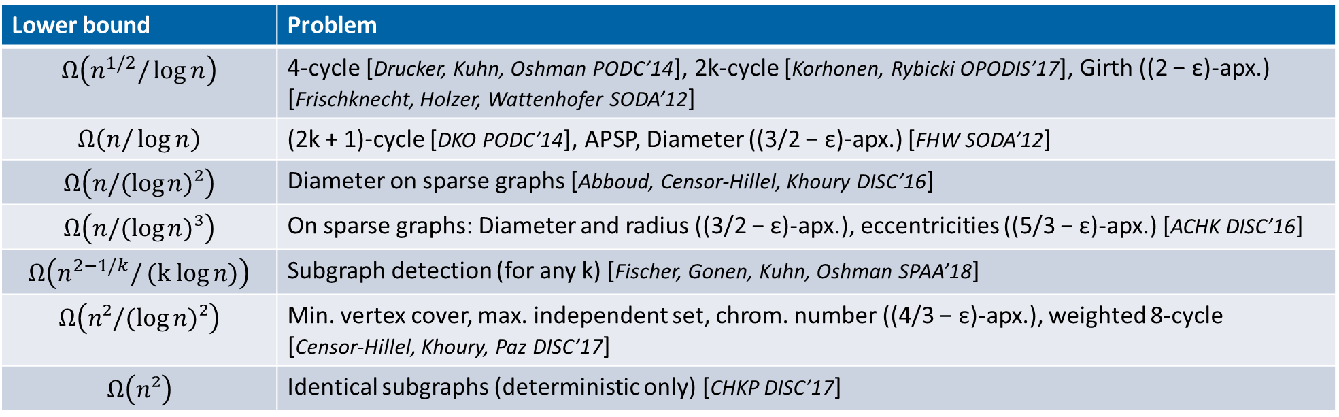
Transfer of Lower Bounds from CONGEST to SUPPORTED CONGEST
Lower bound | Problem
$$Ω\left(n^{1/2}/\log{n}\right)$$ | 4-cycle [Drucker, Kuhn, Oshman PODC’14], 2k-cycle [Korhonen, Rybicki OPODIS’17], Girth ((2 − ε)-apx.) [Frischknecht, Holzer, Wattenhofer SODA’12]
$$Ω\left(n/\log{n}\right)$$ | (2k + 1)-cycle [DKO PODC’14], APSP, Diameter ((3/2 − ε)-apx.) [FHW SODA’12]
$$Ω\left(n/(\log{n)²}\right)$$ | Diameter on sparse graphs [Abboud, Censor-Hillel, Khoury DISC’16]
$$Ω\left(n/(\log{n)³}\right)$$ | On sparse graphs: Diameter and radius ((3/2 − ε)-apx.), eccentricities ((5/3 − ε)-apx.) [ACHK DISC’16]
$$Ω\left(n^{2−1/k}/(k log{n)}\right)$$ | Subgraph detection (for any k) [Fischer, Gonen, Kuhn, Oshman SPAA’18]
$$Ω\left(n²/(\log{n)²}\right)$$ | Min. vertex cover, max. independent set, chrom. number ((4/3 − ε)-apx.), weighted 8-cycle [Censor-Hillel, Khoury, Paz DISC’17]
$$Ω\left(n²\right)$$ | Identical subgraphs (deterministic only) [CHKP DISC’17]

Slide 6
Summary and Outlook
We investigated the power of preprocessing in the CONGEST model
Many CONGEST lower bounds hold even under arbitrary preprocessing
Is SUPPORTED CONGEST maybe the proper way to look at lower bounds?
Is there a “proper” separation between CONGEST and SUPPORTED CONGEST for general graphs?
“Proper”: Without relying on identifiers and graph size?
Note: Easy on restricted graph classes, e.g., if H has small chromatic number

Slide 7
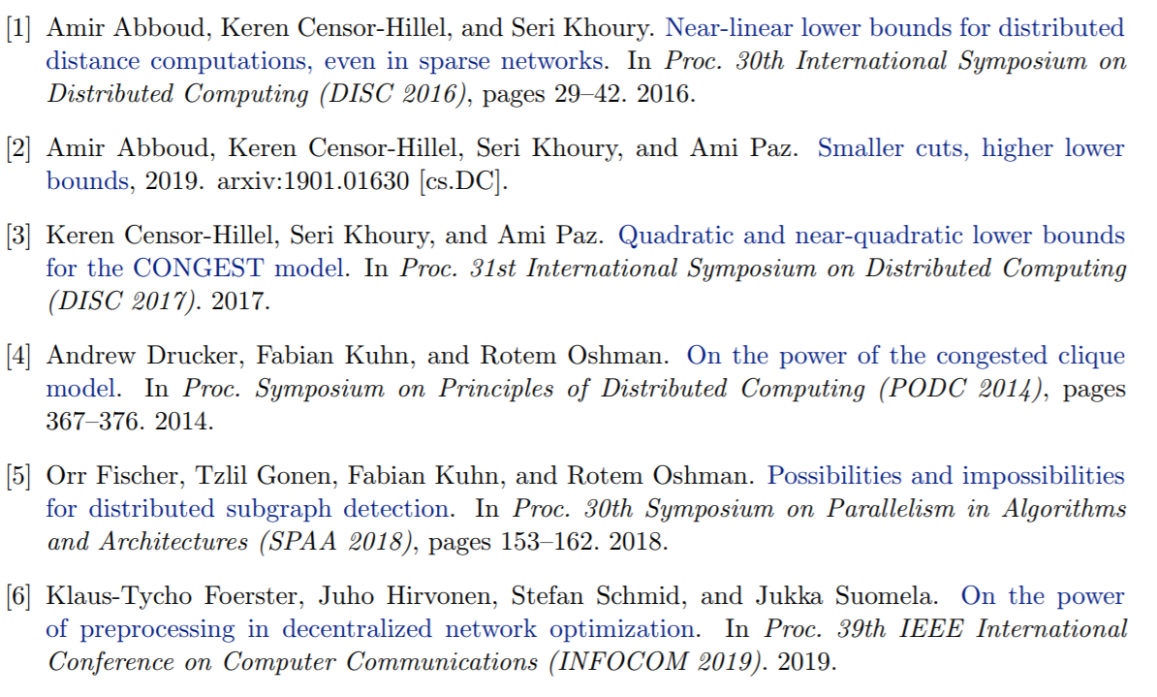
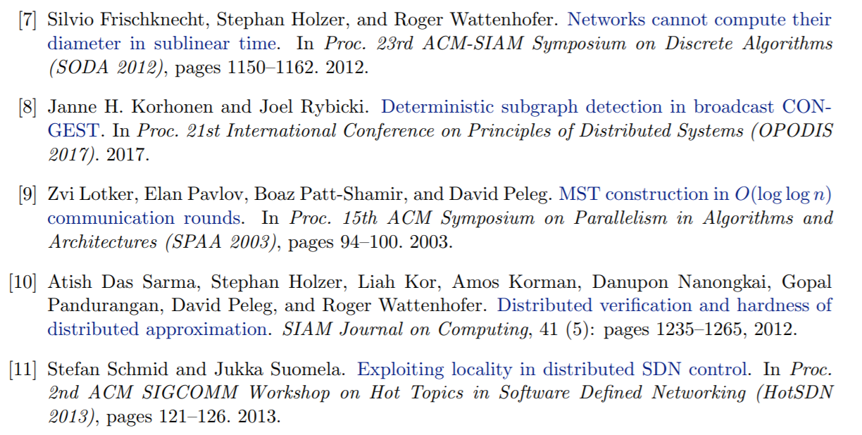
References

Slide 8
BA: Does Preprocessing Help under Congestion?
Klaus-Tycho Foerster, Janne H. Korhonen (IST Austria), Joel Rybicki (IST Austria), Stefan Schmid

