Slide 1



From Topology-Aware to Fabric-Adaptive: Rethinking Datacenter Networks for AI
Stefan Schmid (TU Berlin)
  “We cannot direct the wind,
  but we can adjust the sails.”
  (Folklore)
Acknowledgements:

Slide 2
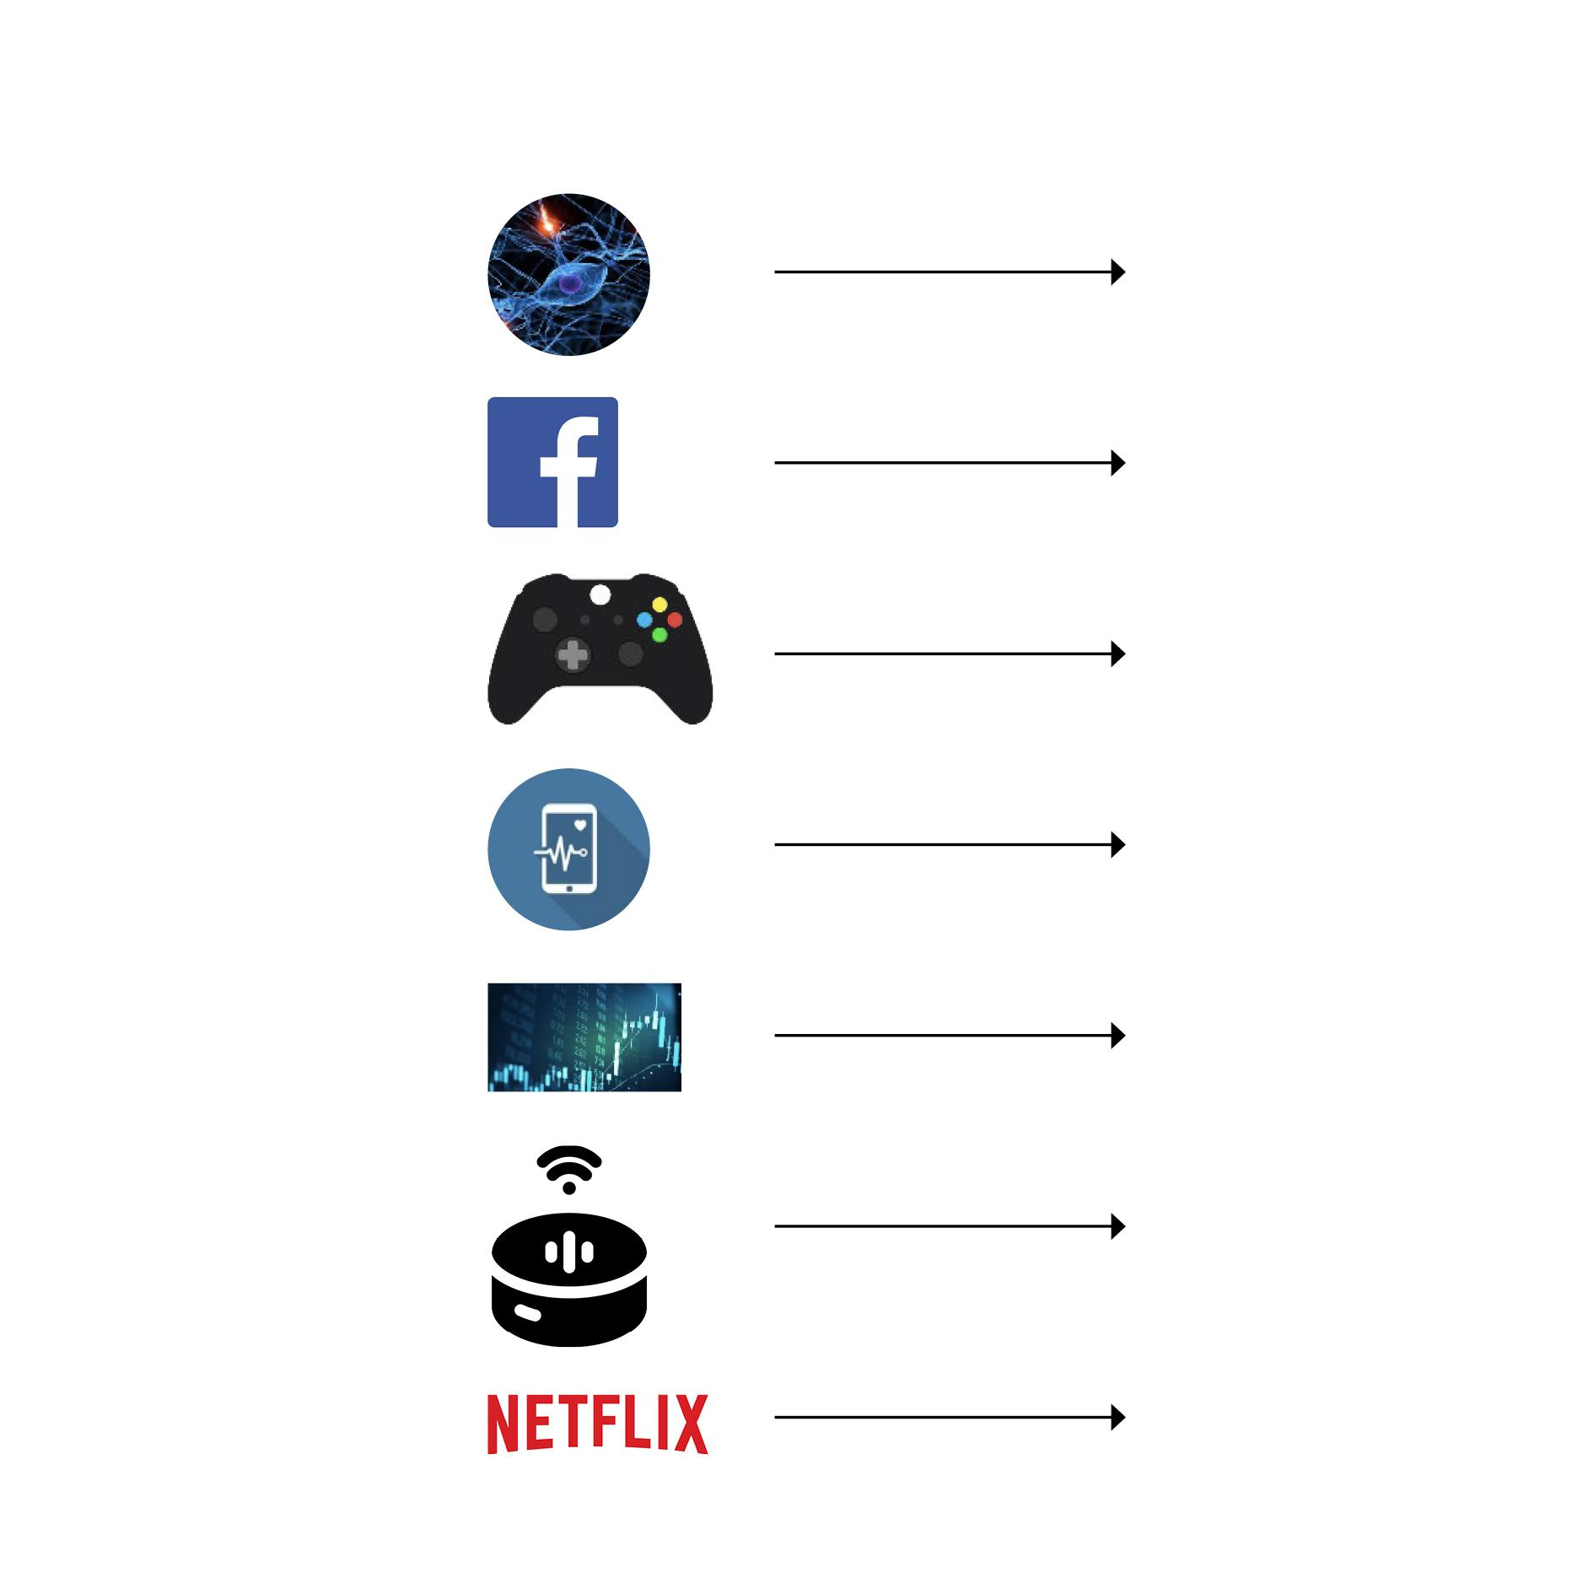

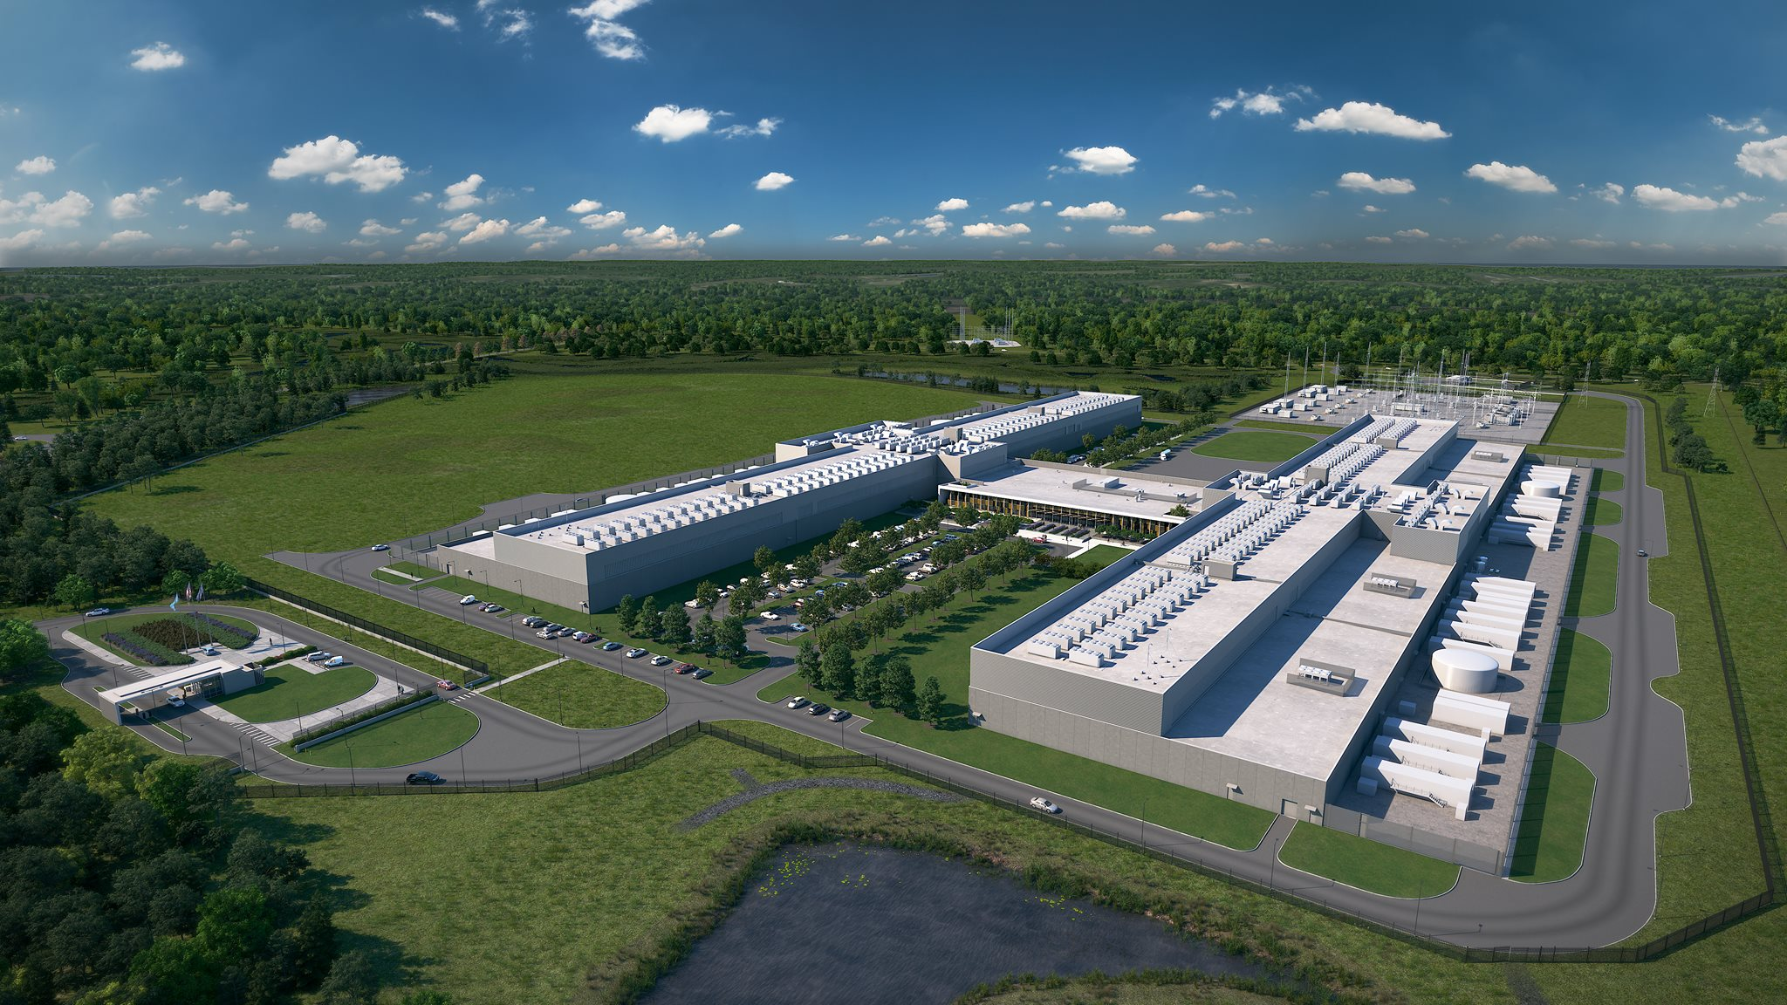
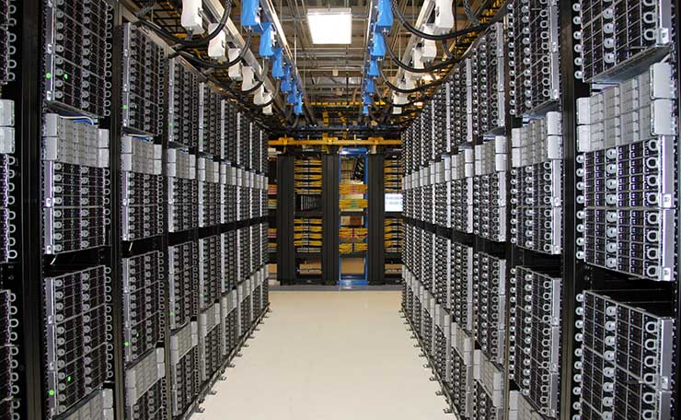
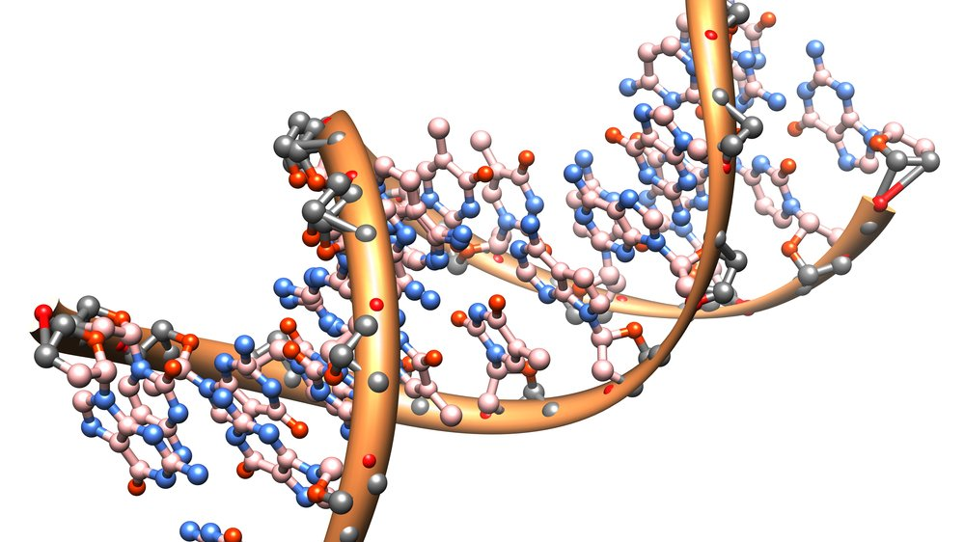

We live in the age of
Distributed Computation
Datacenters (“hyper-scale”)
+network
Source: Facebook
Traffic
Growth
Interconnecting networks:
a critical infrastructure
of our digital society.
1
Notes:
The interconnecting networks have become a critical infrastructure of our digital society.

Slide 3
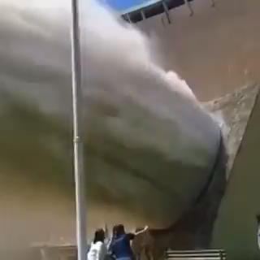
We live in the age of
Distributed Computation
Datacenters (“hyper-scale”)
+network
Source: Facebook
Traffic
Growth
Interconnecting networks:
a critical infrastructure
of our digital society.
Credits: Marco Chiesa
1
Notes:
The interconnecting networks have become a critical infrastructure of our digital society.

Slide 4
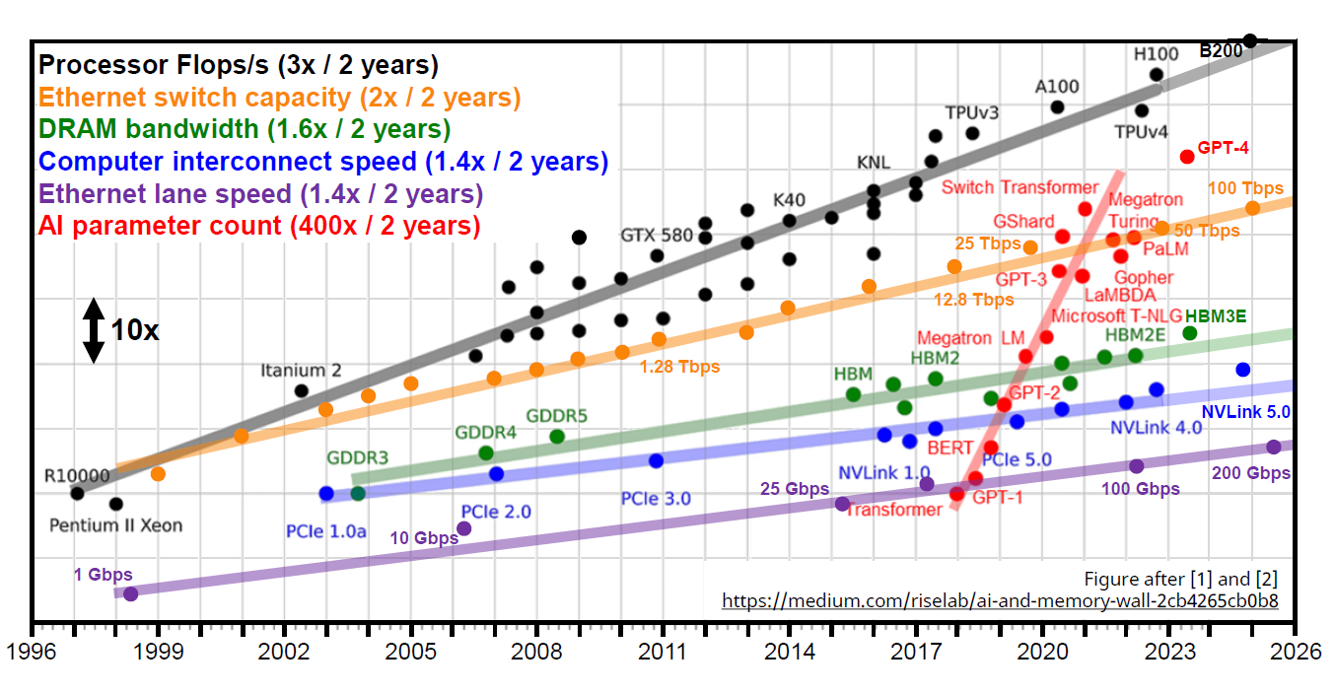
Technological Trends
Increasing Gap Between Compute and Network
Credits: Nicola Calabretta
2
Notes:
The interconnecting networks have become a critical infrastructure of our digital society.

Slide 5
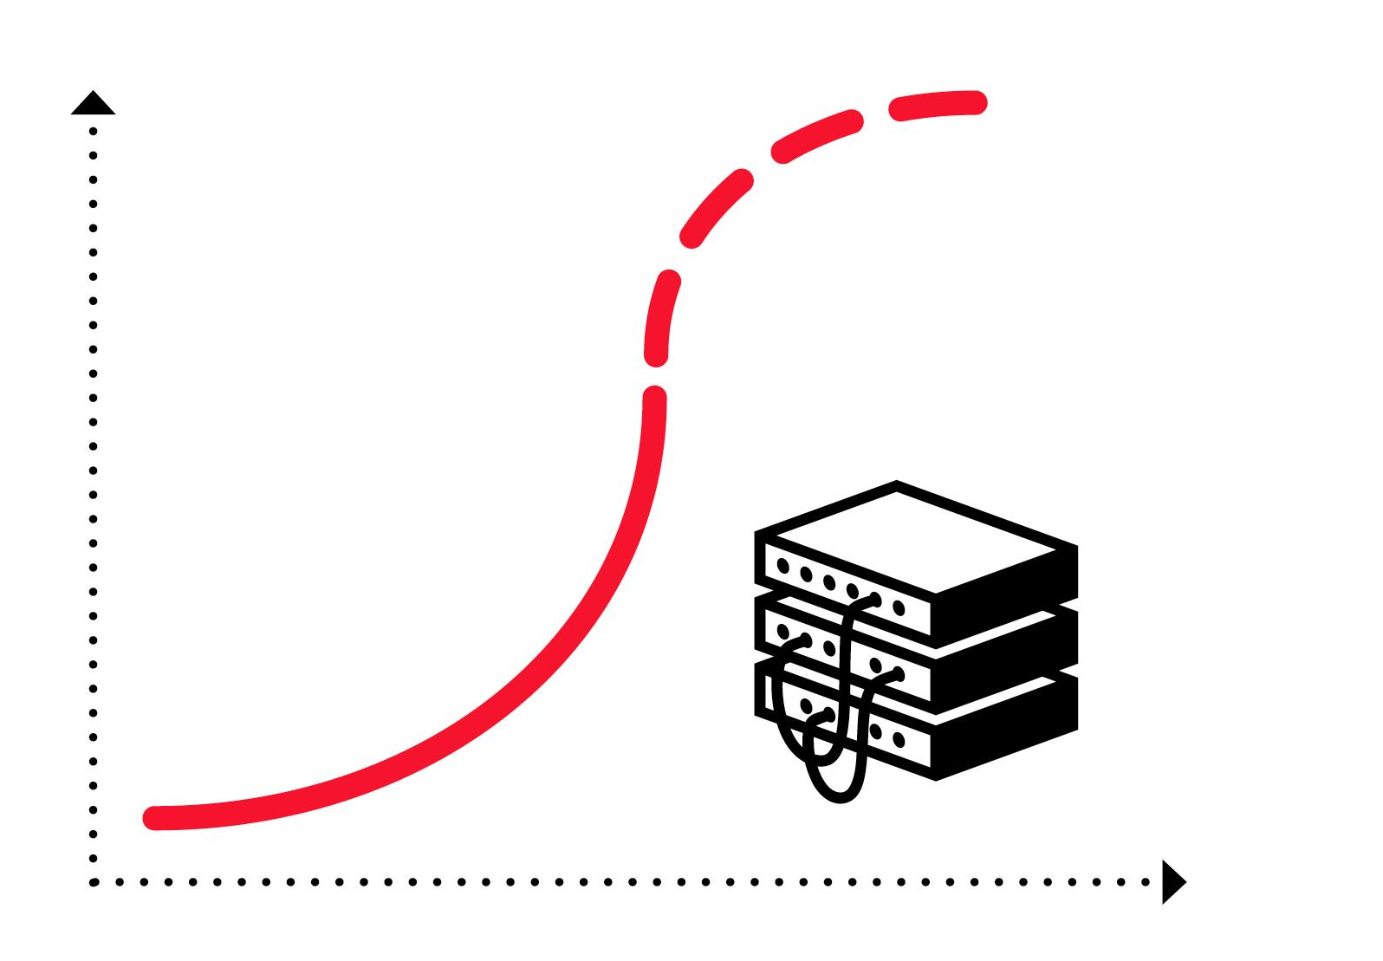
The Problem
Huge Infrastructure, Inefficient Use
⇢ Hence: more equipment,
larger networks
⇢ Resource intensive and:
inefficient
Credits: Paolo Costa, 2019
Gbps/€
Time
Annoying for companies,
opportunity for researchers!
Notes:
This may be annoying for companies, it introduces a great opportunity for researchers.

Slide 6
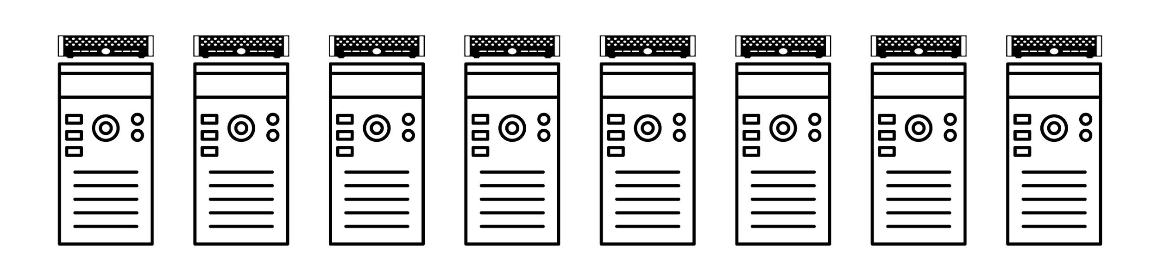
An Inefficiency
Fixed and Demand-Oblivious Topology
How to interconnect? Focus on this talk: scale-out network.
4
Notes:
A route cause for this inefficiency is related to how we interconnect these distributed systems.

Slide 7
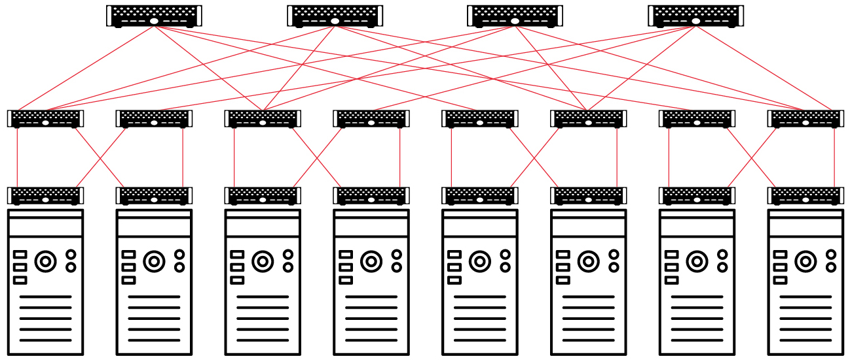
An Inefficiency
Fixed and Demand-Oblivious Topology
⇢ Example: fat-tree topology (bi-regular)
⇀ 2 types of switches: top-of-rack (ToR) connect to hosts,
additional switches connecting switches to increase throughput
4
Notes:
Today, many different network toplogies are used in datacenters, such as this one.
However, they all have in common that they are fixed and oblivious to the actual demand.

Slide 8
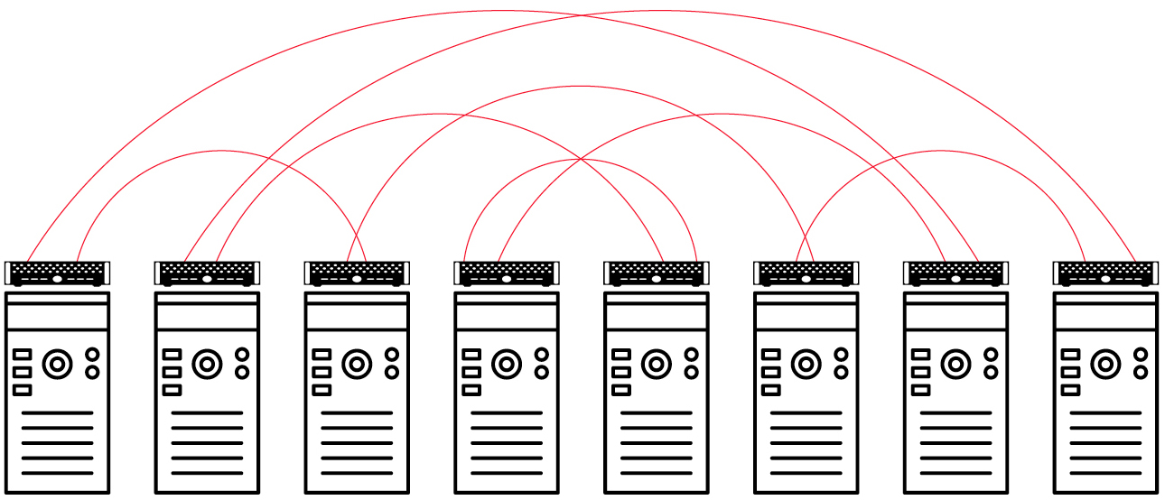
An Inefficiency
Fixed and Demand-Oblivious Topology
⇢ Example: expander topology (uni-regular)
⇀ Only 1 type of switches:
lower installation and management overheads
4
Notes:
Today, many different network toplogies are used in datacenters, such as this one.
However, they all have in common that they are fixed and oblivious to the actual demand.

Slide 9
An Inefficiency
Fixed and Demand-Oblivious Topology
⇢ Example: expander topology (uni-regular)
⇀ Only 1 type of switches:
lower installation and management overheads
Many flavors, but in
common: fixed and oblivious (“ignorant”) to actual demand.
4
Notes:
Today, many different network toplogies are used in datacenters, such as this one.
However, they all have in common that they are fixed and oblivious to the actual demand.

Slide 10
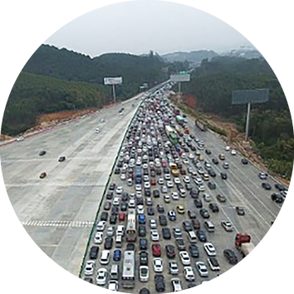
An Inefficiency
Fixed and Demand-Oblivious Topology
⇢ Example: expander topology (uni-regular)
⇀ Only 1 type of switches:
lower installation and management overheads
Highway which ignores
actual traffic: frustrating!
Many flavors, but in
common: fixed and oblivious (“ignorant”) to actual demand.
4
Notes:
Today, many different network toplogies are used in datacenters, such as this one.
However, they all have in common that they are fixed and oblivious to the actual demand.

Slide 11
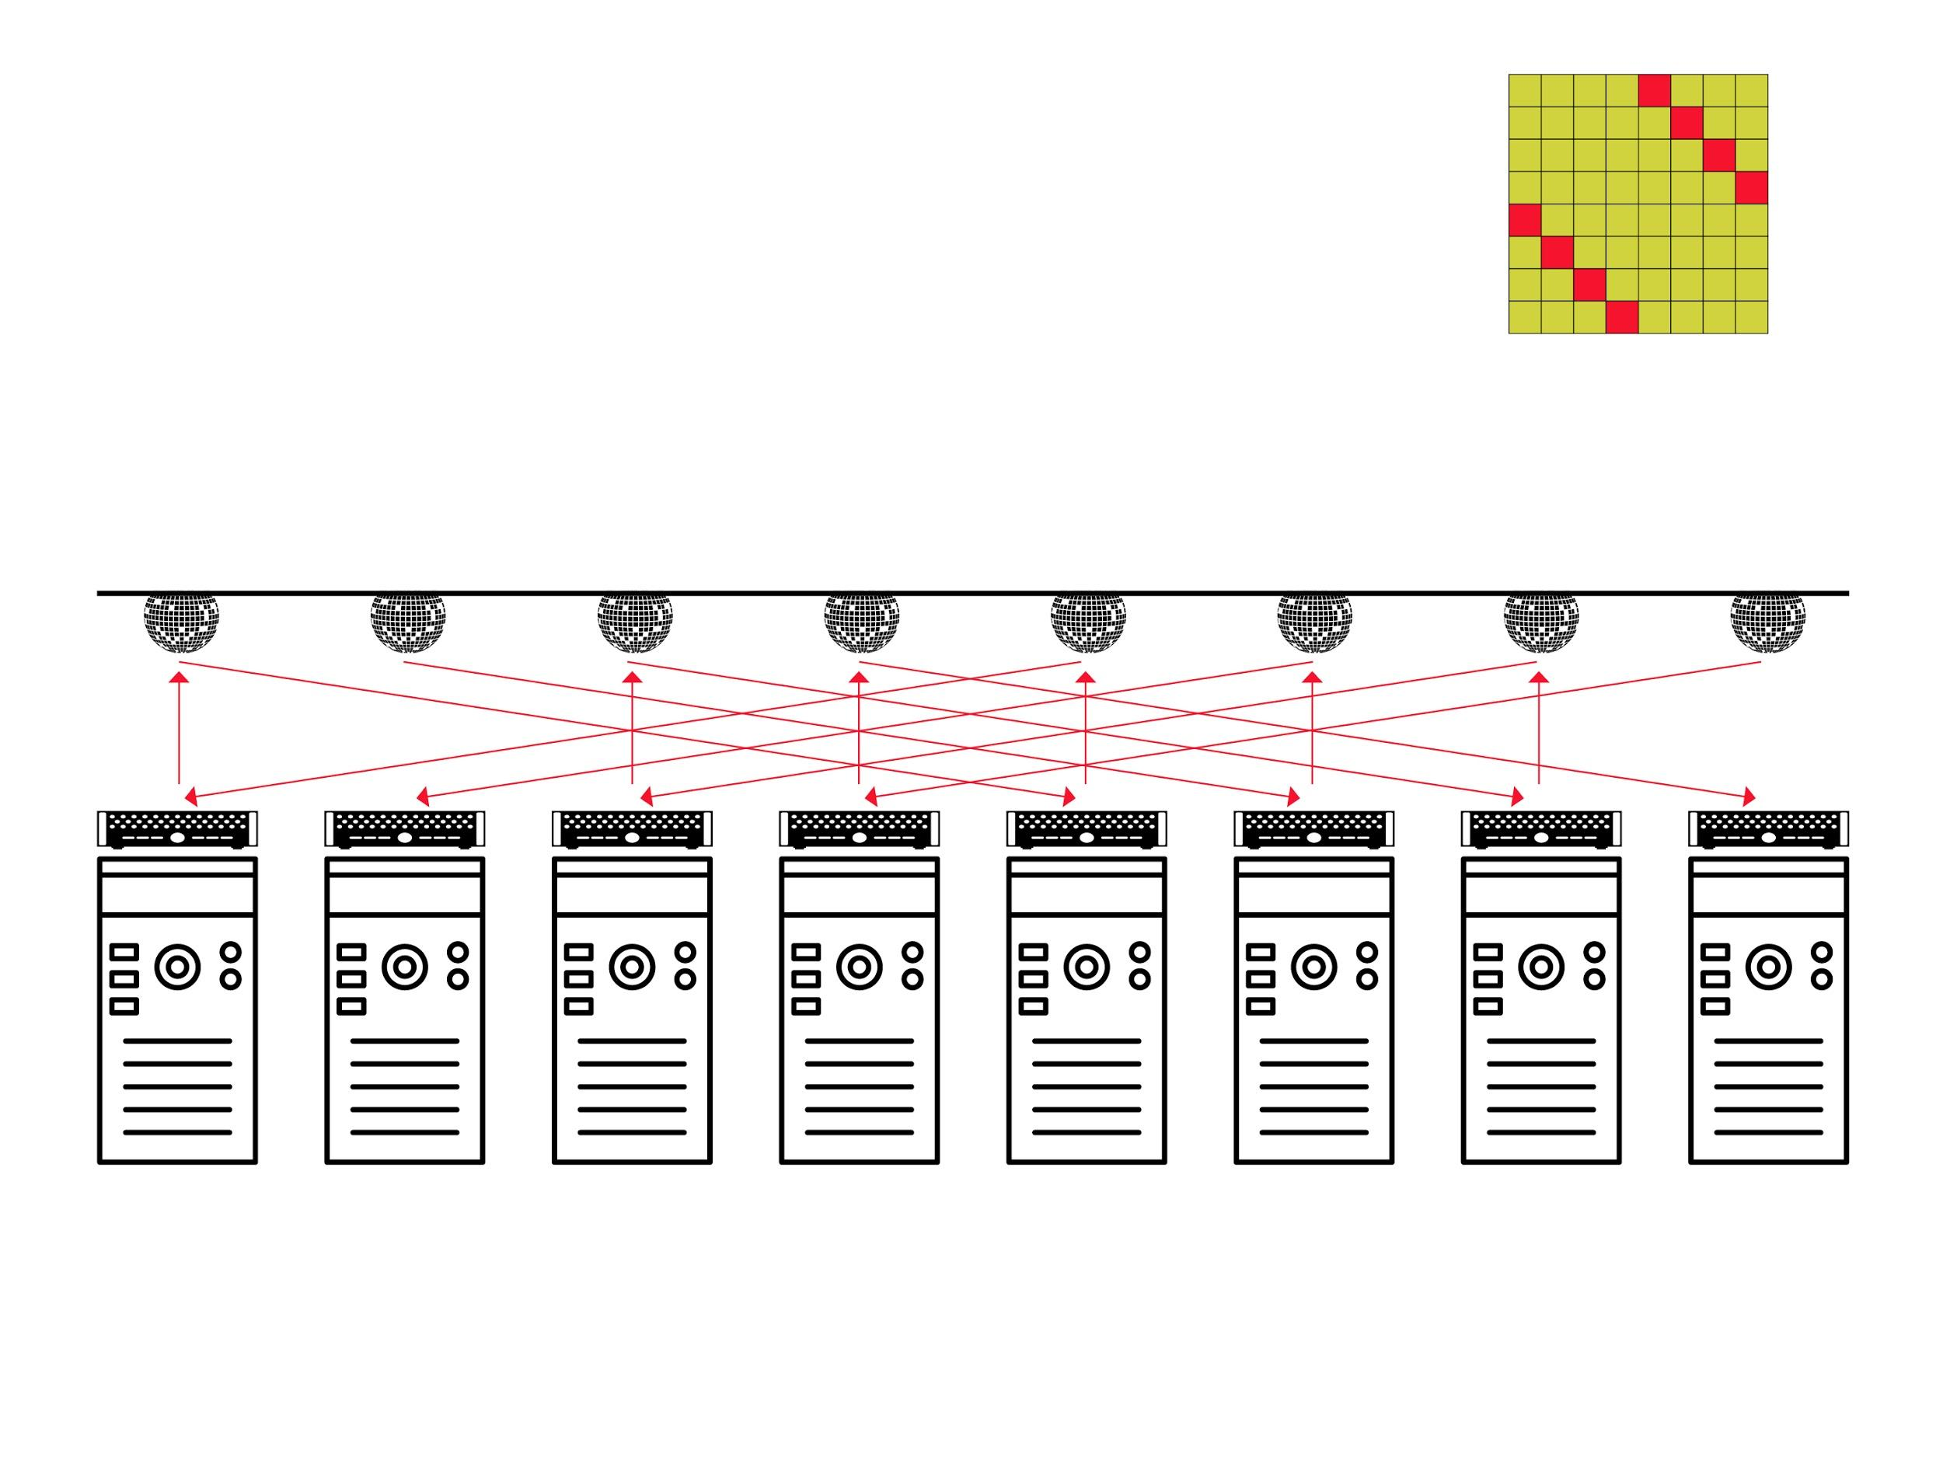
A Vision
Flexible and Demand-Aware Topologies
5
Notes:
My vision is that networks should become flexible and demand-aware.

Slide 12
A Vision
Flexible and Demand-Aware Topologies
e.g.,
mirrors
new flexible
interconnect
1
2
3
4
5
6
7
8
5
Notes:
e.g., based on mirrors.

Slide 13
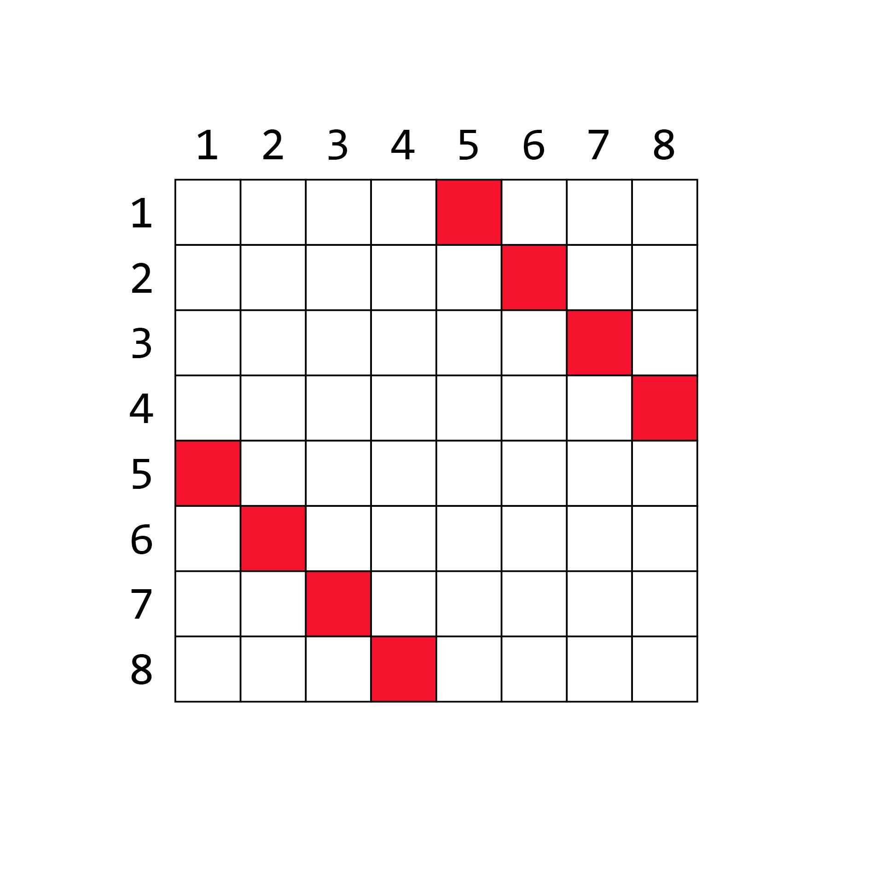
A Vision
Flexible and Demand-Aware Topologies
demand
matrix:
e.g.,
mirrors
new flexible
interconnect
1
2
3
4
5
6
7
8
5
Notes:
For example, if the demand matrix looks like this: 1 communicates to 5, 2 to 6, etc…

Slide 14
A Vision
Flexible and Demand-Aware Topologies
demand
matrix:
Matches demand
e.g.,
mirrors
new flexible
interconnect
1
2
3
4
5
6
7
8
5
Notes:
… it makes sense to interconnect the servers like this.
This perfectly matches the demand.

Slide 15
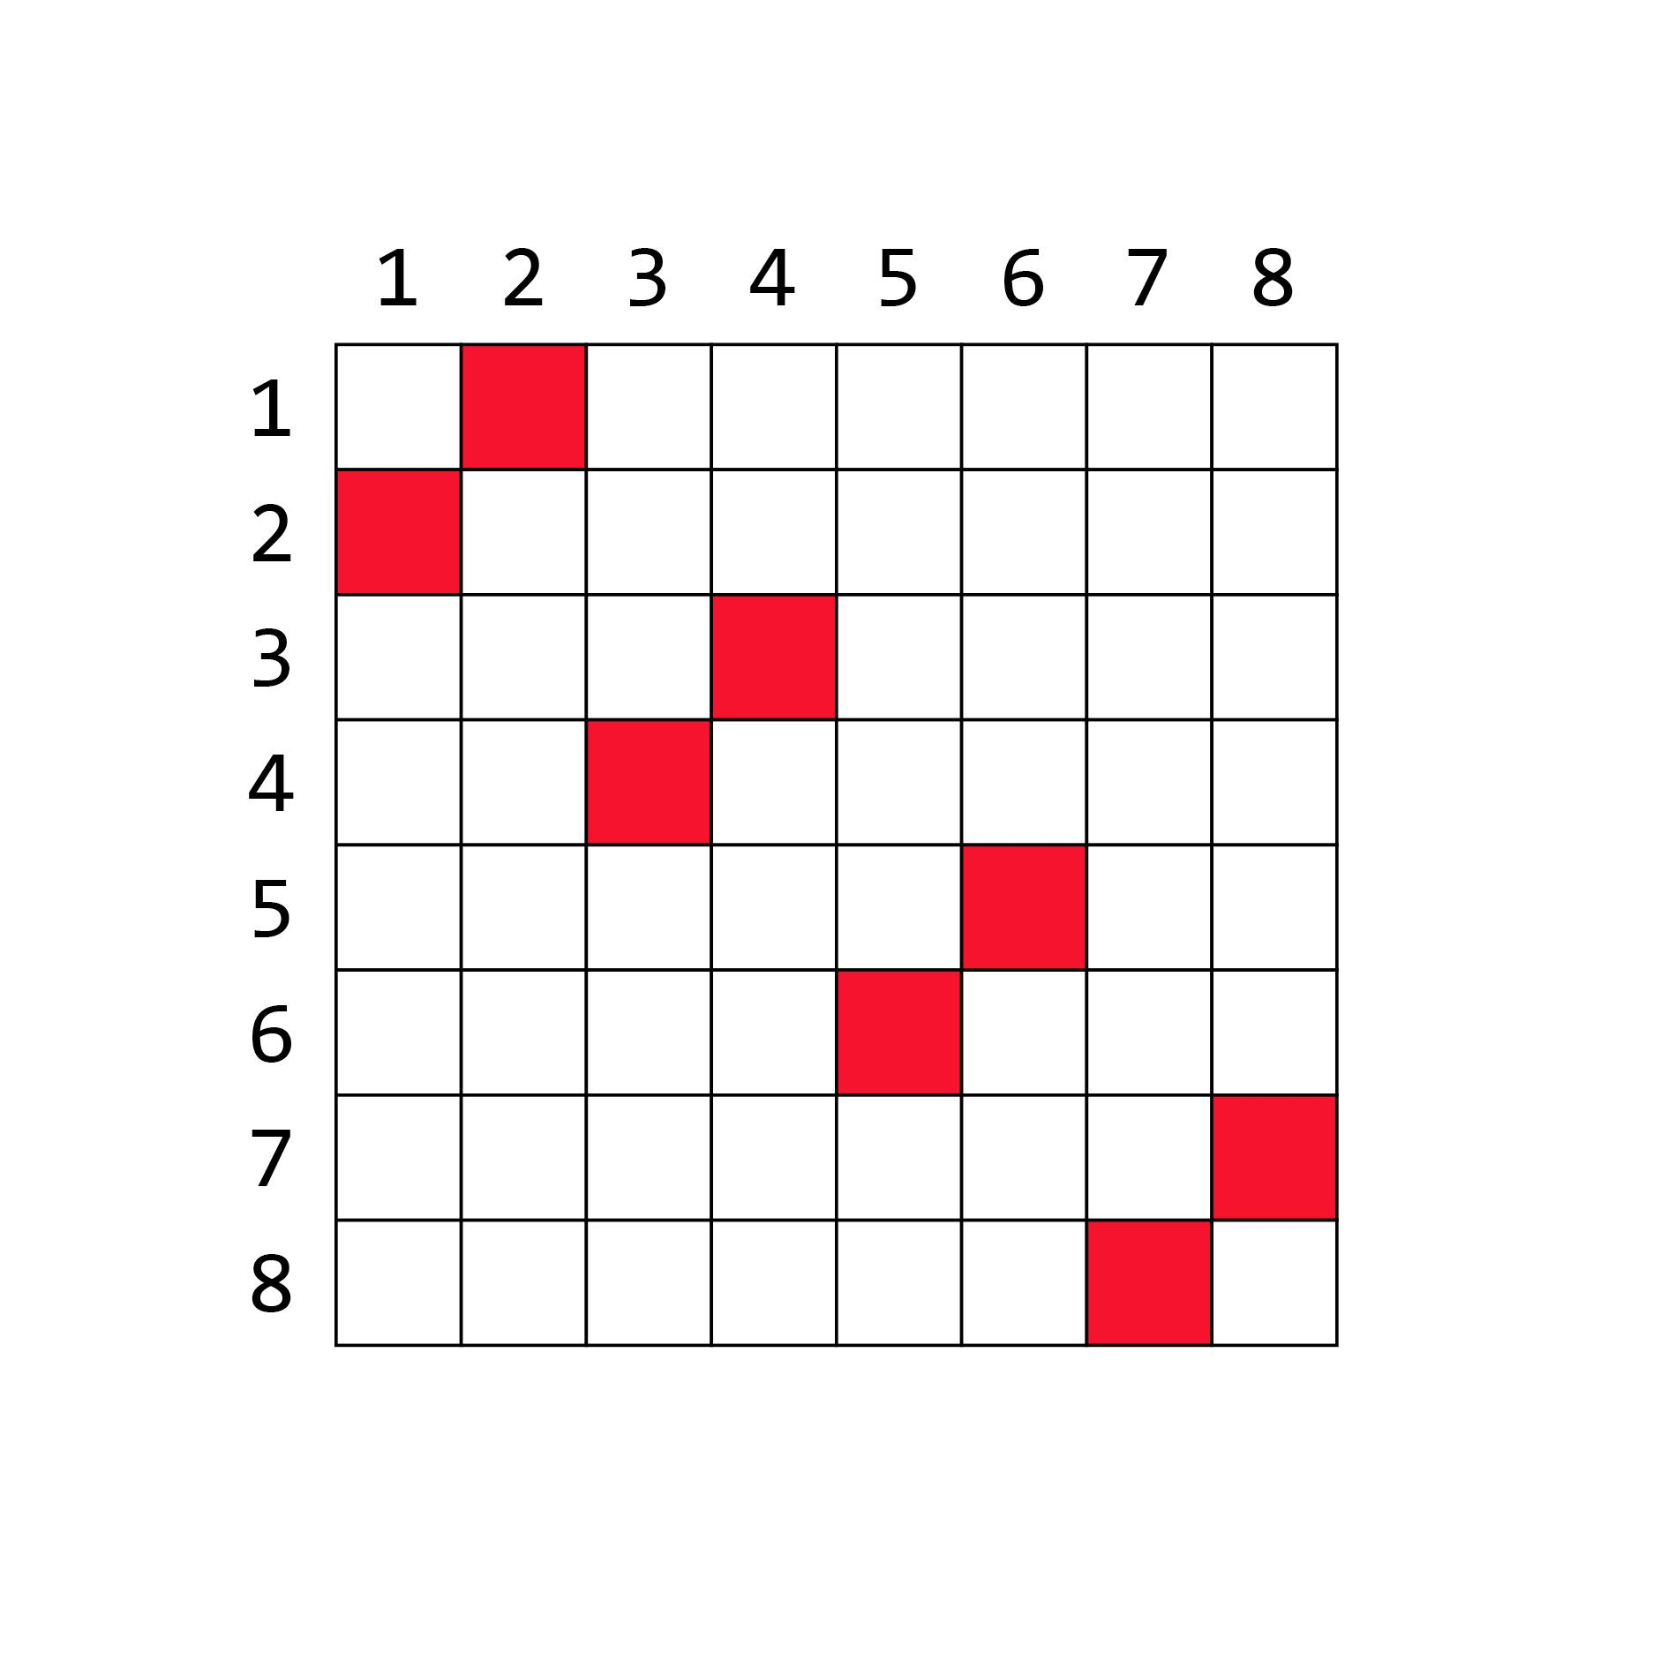
A Vision
Flexible and Demand-Aware Topologies
new
demand:
e.g.,
mirrors
new flexible
interconnect
1
2
3
4
5
6
7
8
5
Notes:
If the demand changes to this…

Slide 16
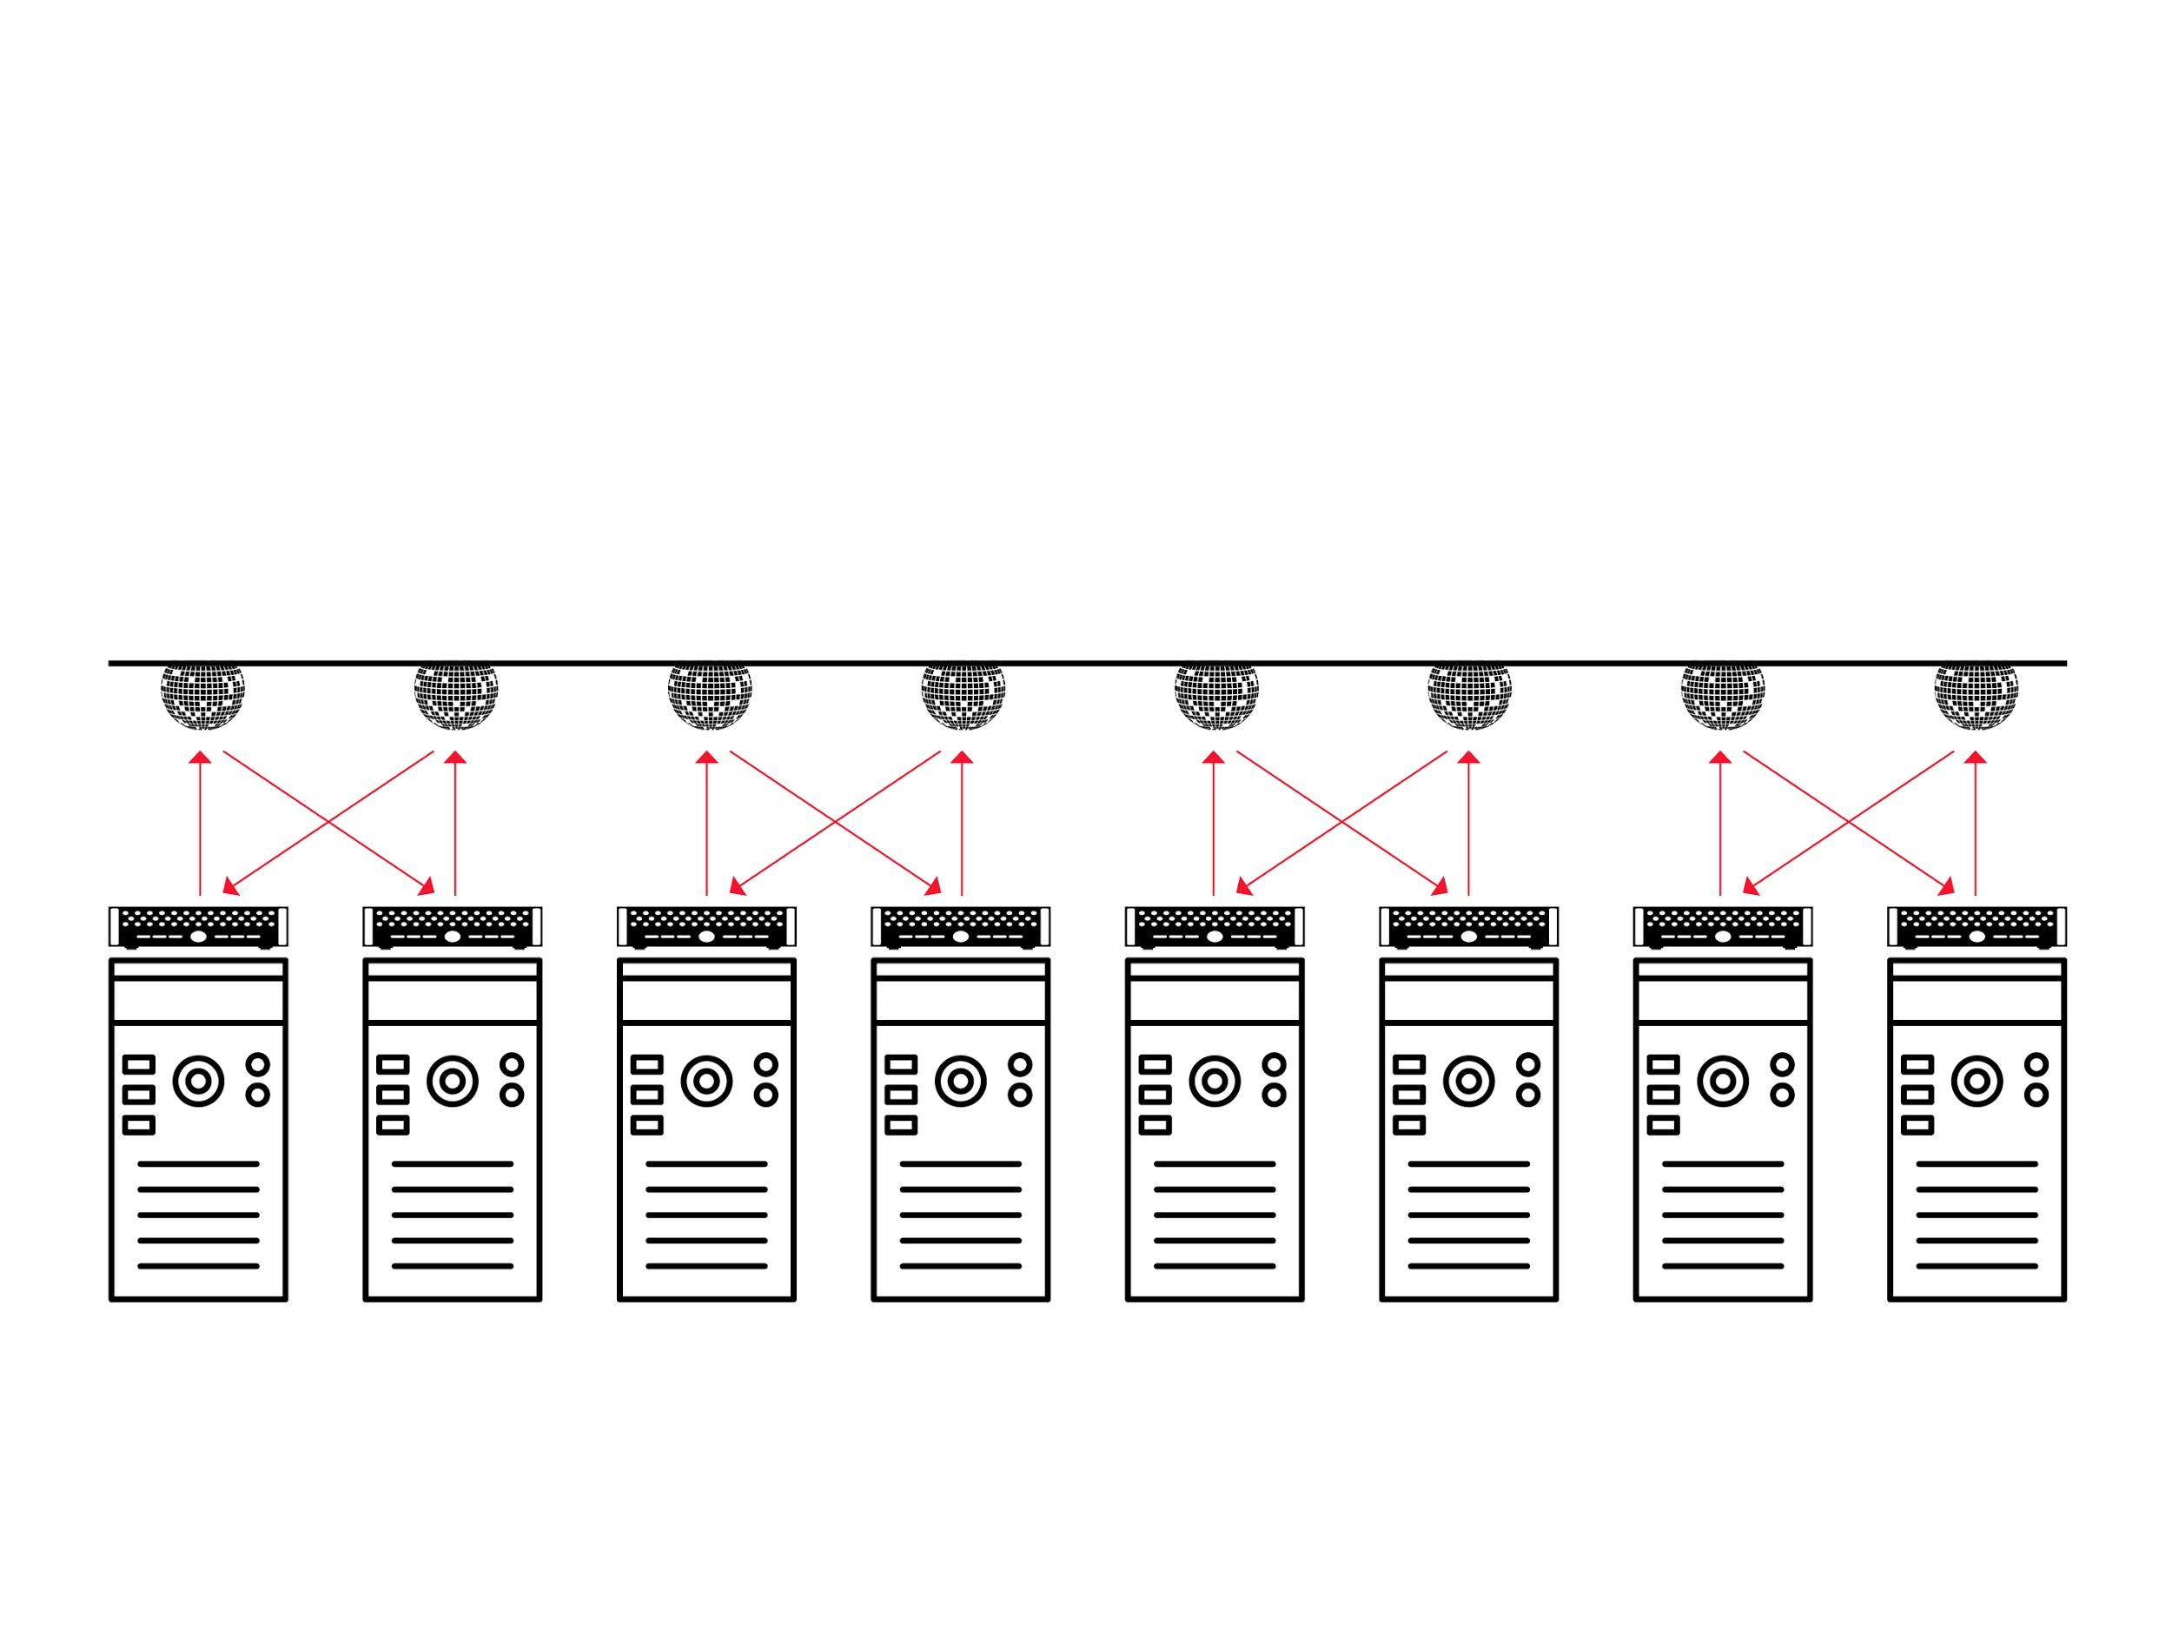
A Vision
Flexible and Demand-Aware Topologies
new
demand:
Matches demand
e.g.,
mirrors
new flexible
interconnect
1
2
3
4
5
6
7
8
5
Notes:
… the topology should be changed as well, to match the demand again.

Slide 17

A Vision
Flexible and Demand-Aware Topologies
new
demand:
Self-Adjusting
Networks
e.g.,
mirrors
new flexible
interconnect
1
2
3
4
5
6
7
8
5
Notes:
This is the idea of self-adjusting networks: they dynamically reconfigure over time, in a demand-aware manner.

Slide 18
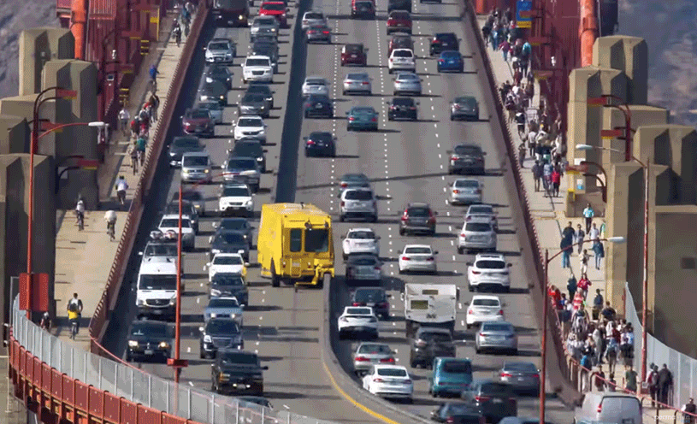
Analogy
Golden Gate Zipper
6
Notes:
Over the last years, we have worked on flexible routing (enabled by SDN) and flexible resource allocation and service embedding (enabled by virtualization).
With this project, we want to tackle the physical layer, enabled by emerging optical technologies.

Slide 19
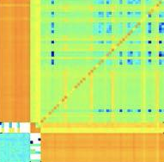
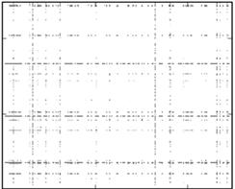
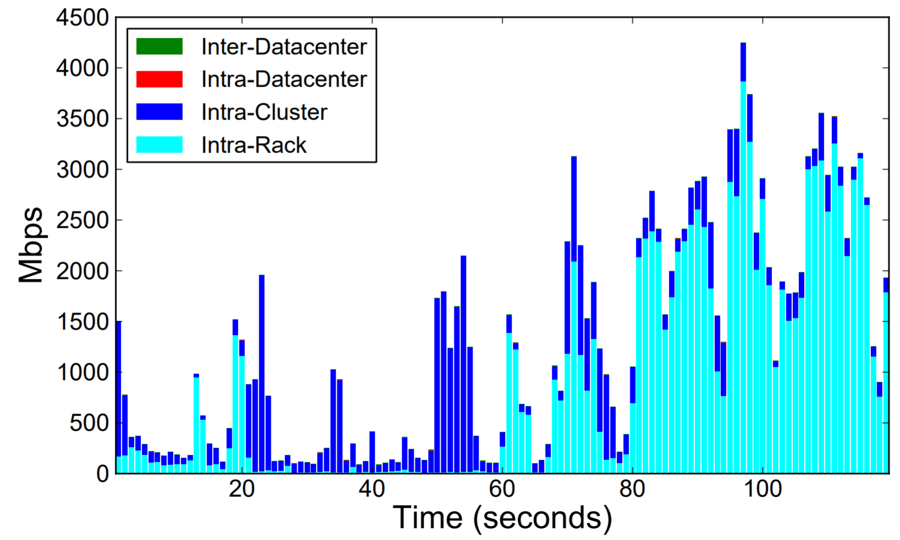
Empirical Motivation
Much Structure in the Demand
Empirical studies:
traffic matrices sparse and skewed
traffic bursty over time
Facebook
Microsoft
Facebook
sources
sources
Mbps
destinations
destinations
Time (seconds)
The hypothesis: can be exploited.
7
Notes:
My motivation for this project is that there is much structure in the demand indeed.
Empirical studies show that traffic matrices are sparse and skewed, and traffic bursty over time.
My hypothesis is that this can be exploited.

Slide 20
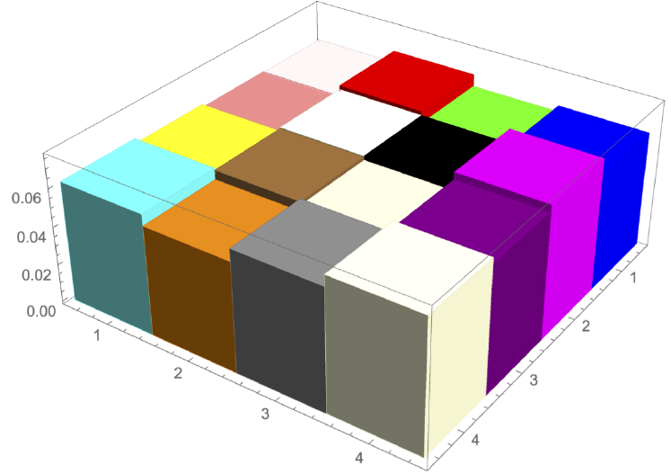
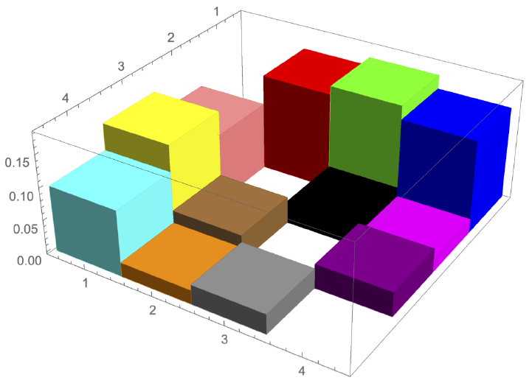
Example: ML Workloads
⇢ Traffic matrices of two different distributed ML apps
⇀ 4 GPUs, GPU-to-GPU traffic
Color = communication pair
vs
vs
ML App 1
ML App 2
Can have significant spatial structure!
8
Notes:
We believe that an information-theoretic approach can provide interesting insights here.
As a first approach, we have used iterative randomization and compression to identify the different dimensions of structure.
The resulting complexity map looks like this: On the x-axis, there is the temporal complexity, on the y-axis the non-temporal. Workloads without any structure end up on the upper right.

Slide 21
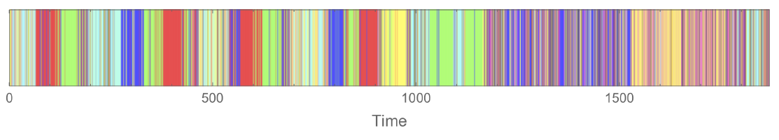
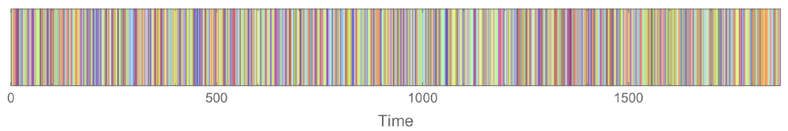
Example: ML Workloads
⇢ Traffic matrices of two different distributed ML apps
⇀ 4 GPUs, GPU-to-GPU traffic
ML App
vs
vs
Uniform
Can have significant temporal structure!
8
Notes:
We believe that an information-theoretic approach can provide interesting insights here.
As a first approach, we have used iterative randomization and compression to identify the different dimensions of structure.
The resulting complexity map looks like this: On the x-axis, there is the temporal complexity, on the y-axis the non-temporal. Workloads without any structure end up on the upper right.

Slide 22
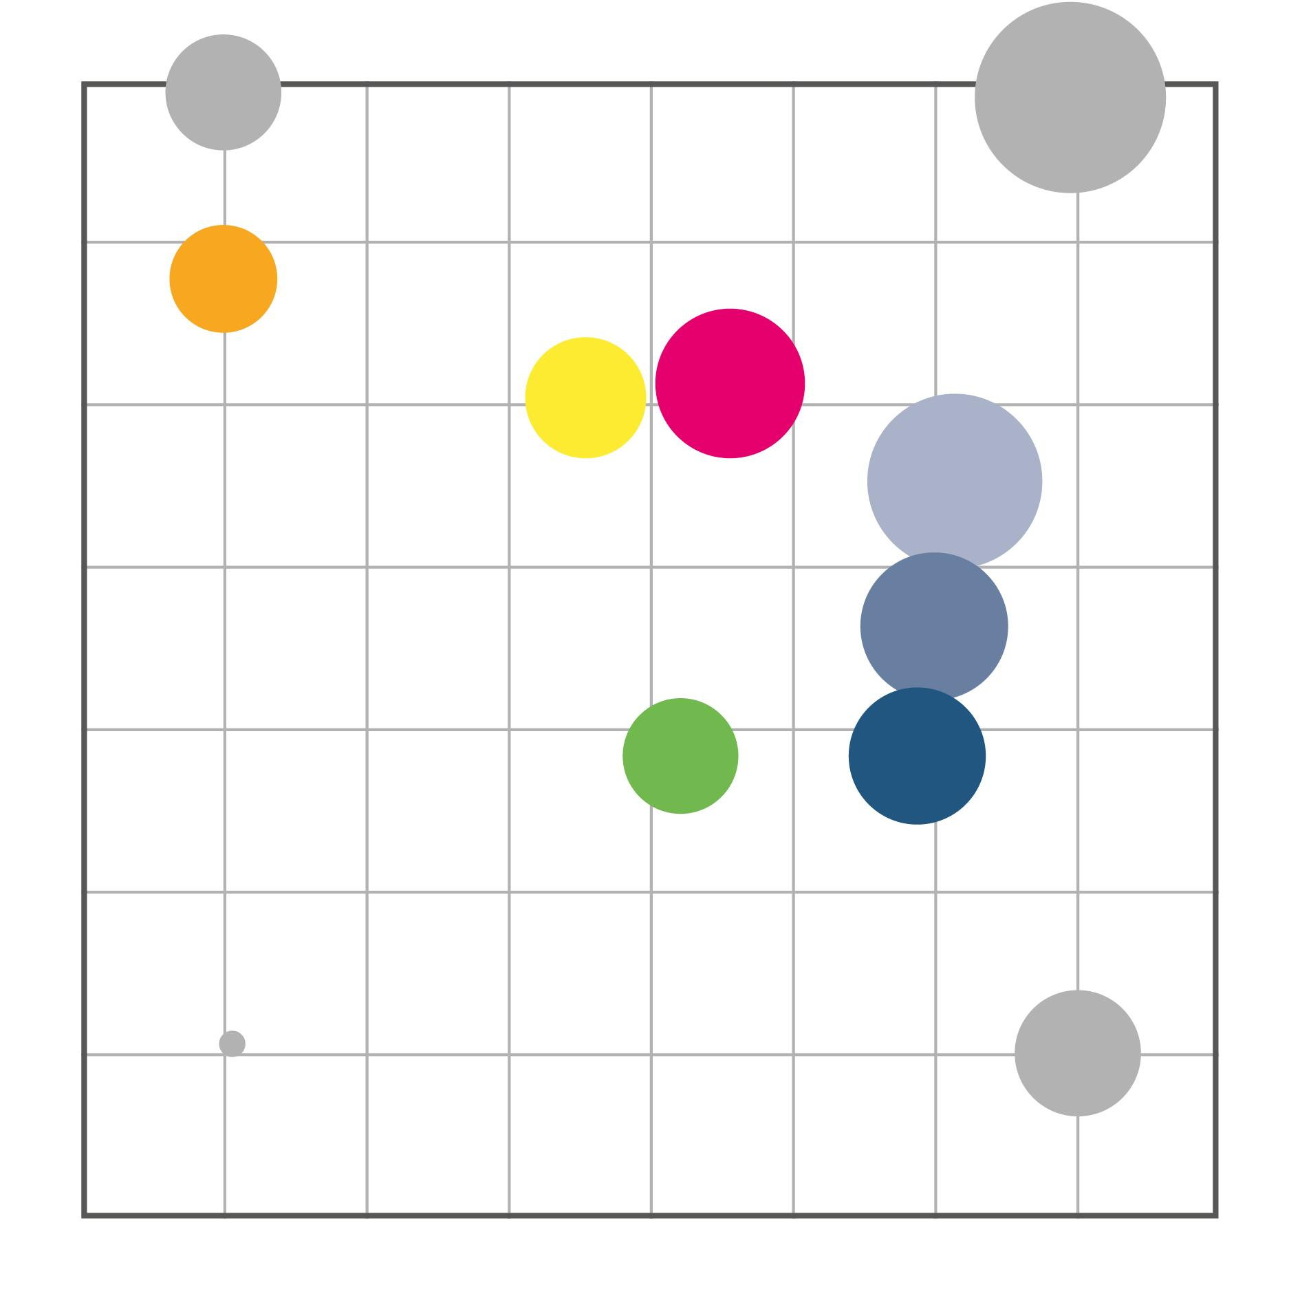
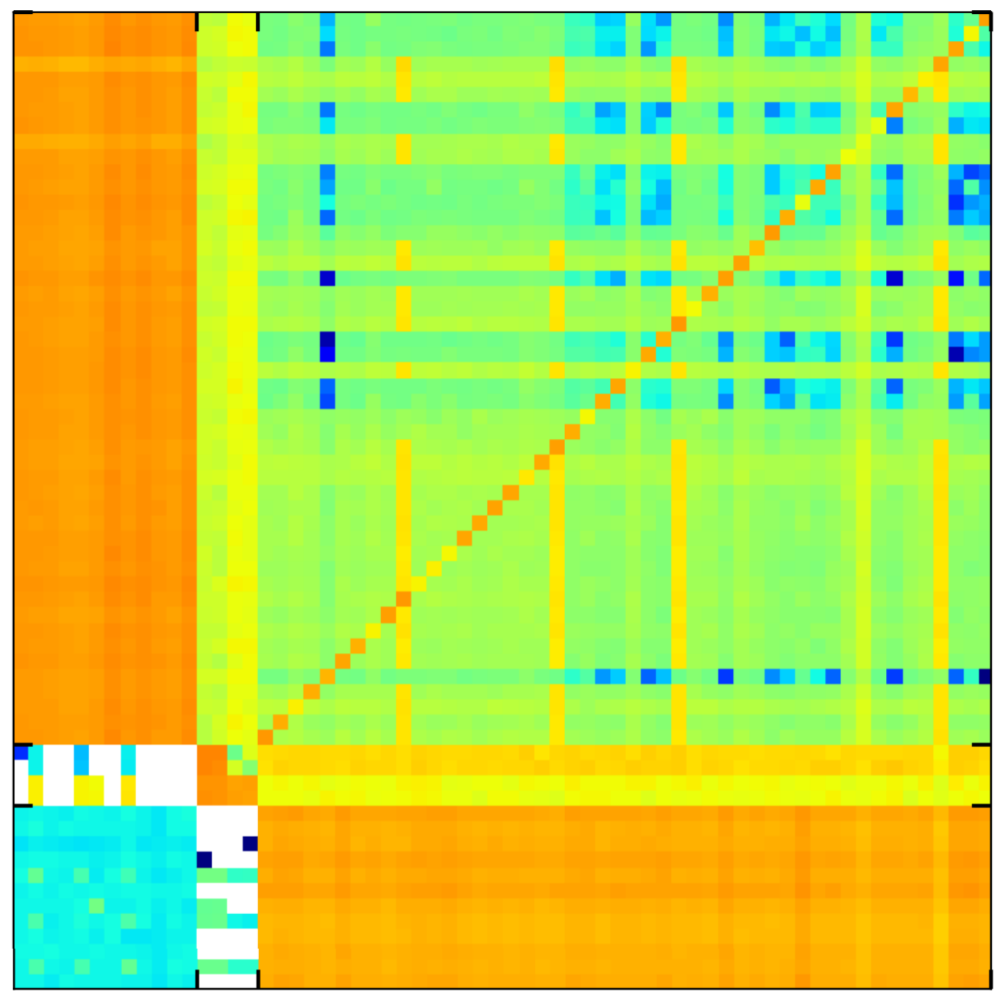
Visualizing Workload Structure
Complexity Map
bursty
uniform
No structure
pF
CNS
ML
DB
Web
non-temporal complexity
Multi
Grid
Had
NN
bursty & skewed
skewed
temporal complexity
9
Notes:
When mapping different applications, we can see that they end up at different locations: they have different amounts of temporal and non-temporal structures.

Slide 23
Visualizing Workload Structure
Complexity Map
bursty
uniform
No structure
pF
CNS
ML
DB
Web
Different structures!
non-temporal complexity
Multi
Grid
Had
NN
bursty & skewed
skewed
temporal complexity
9
Notes:
When mapping different applications, we can see that they end up at different locations: they have different amounts of temporal and non-temporal structures.

Slide 24
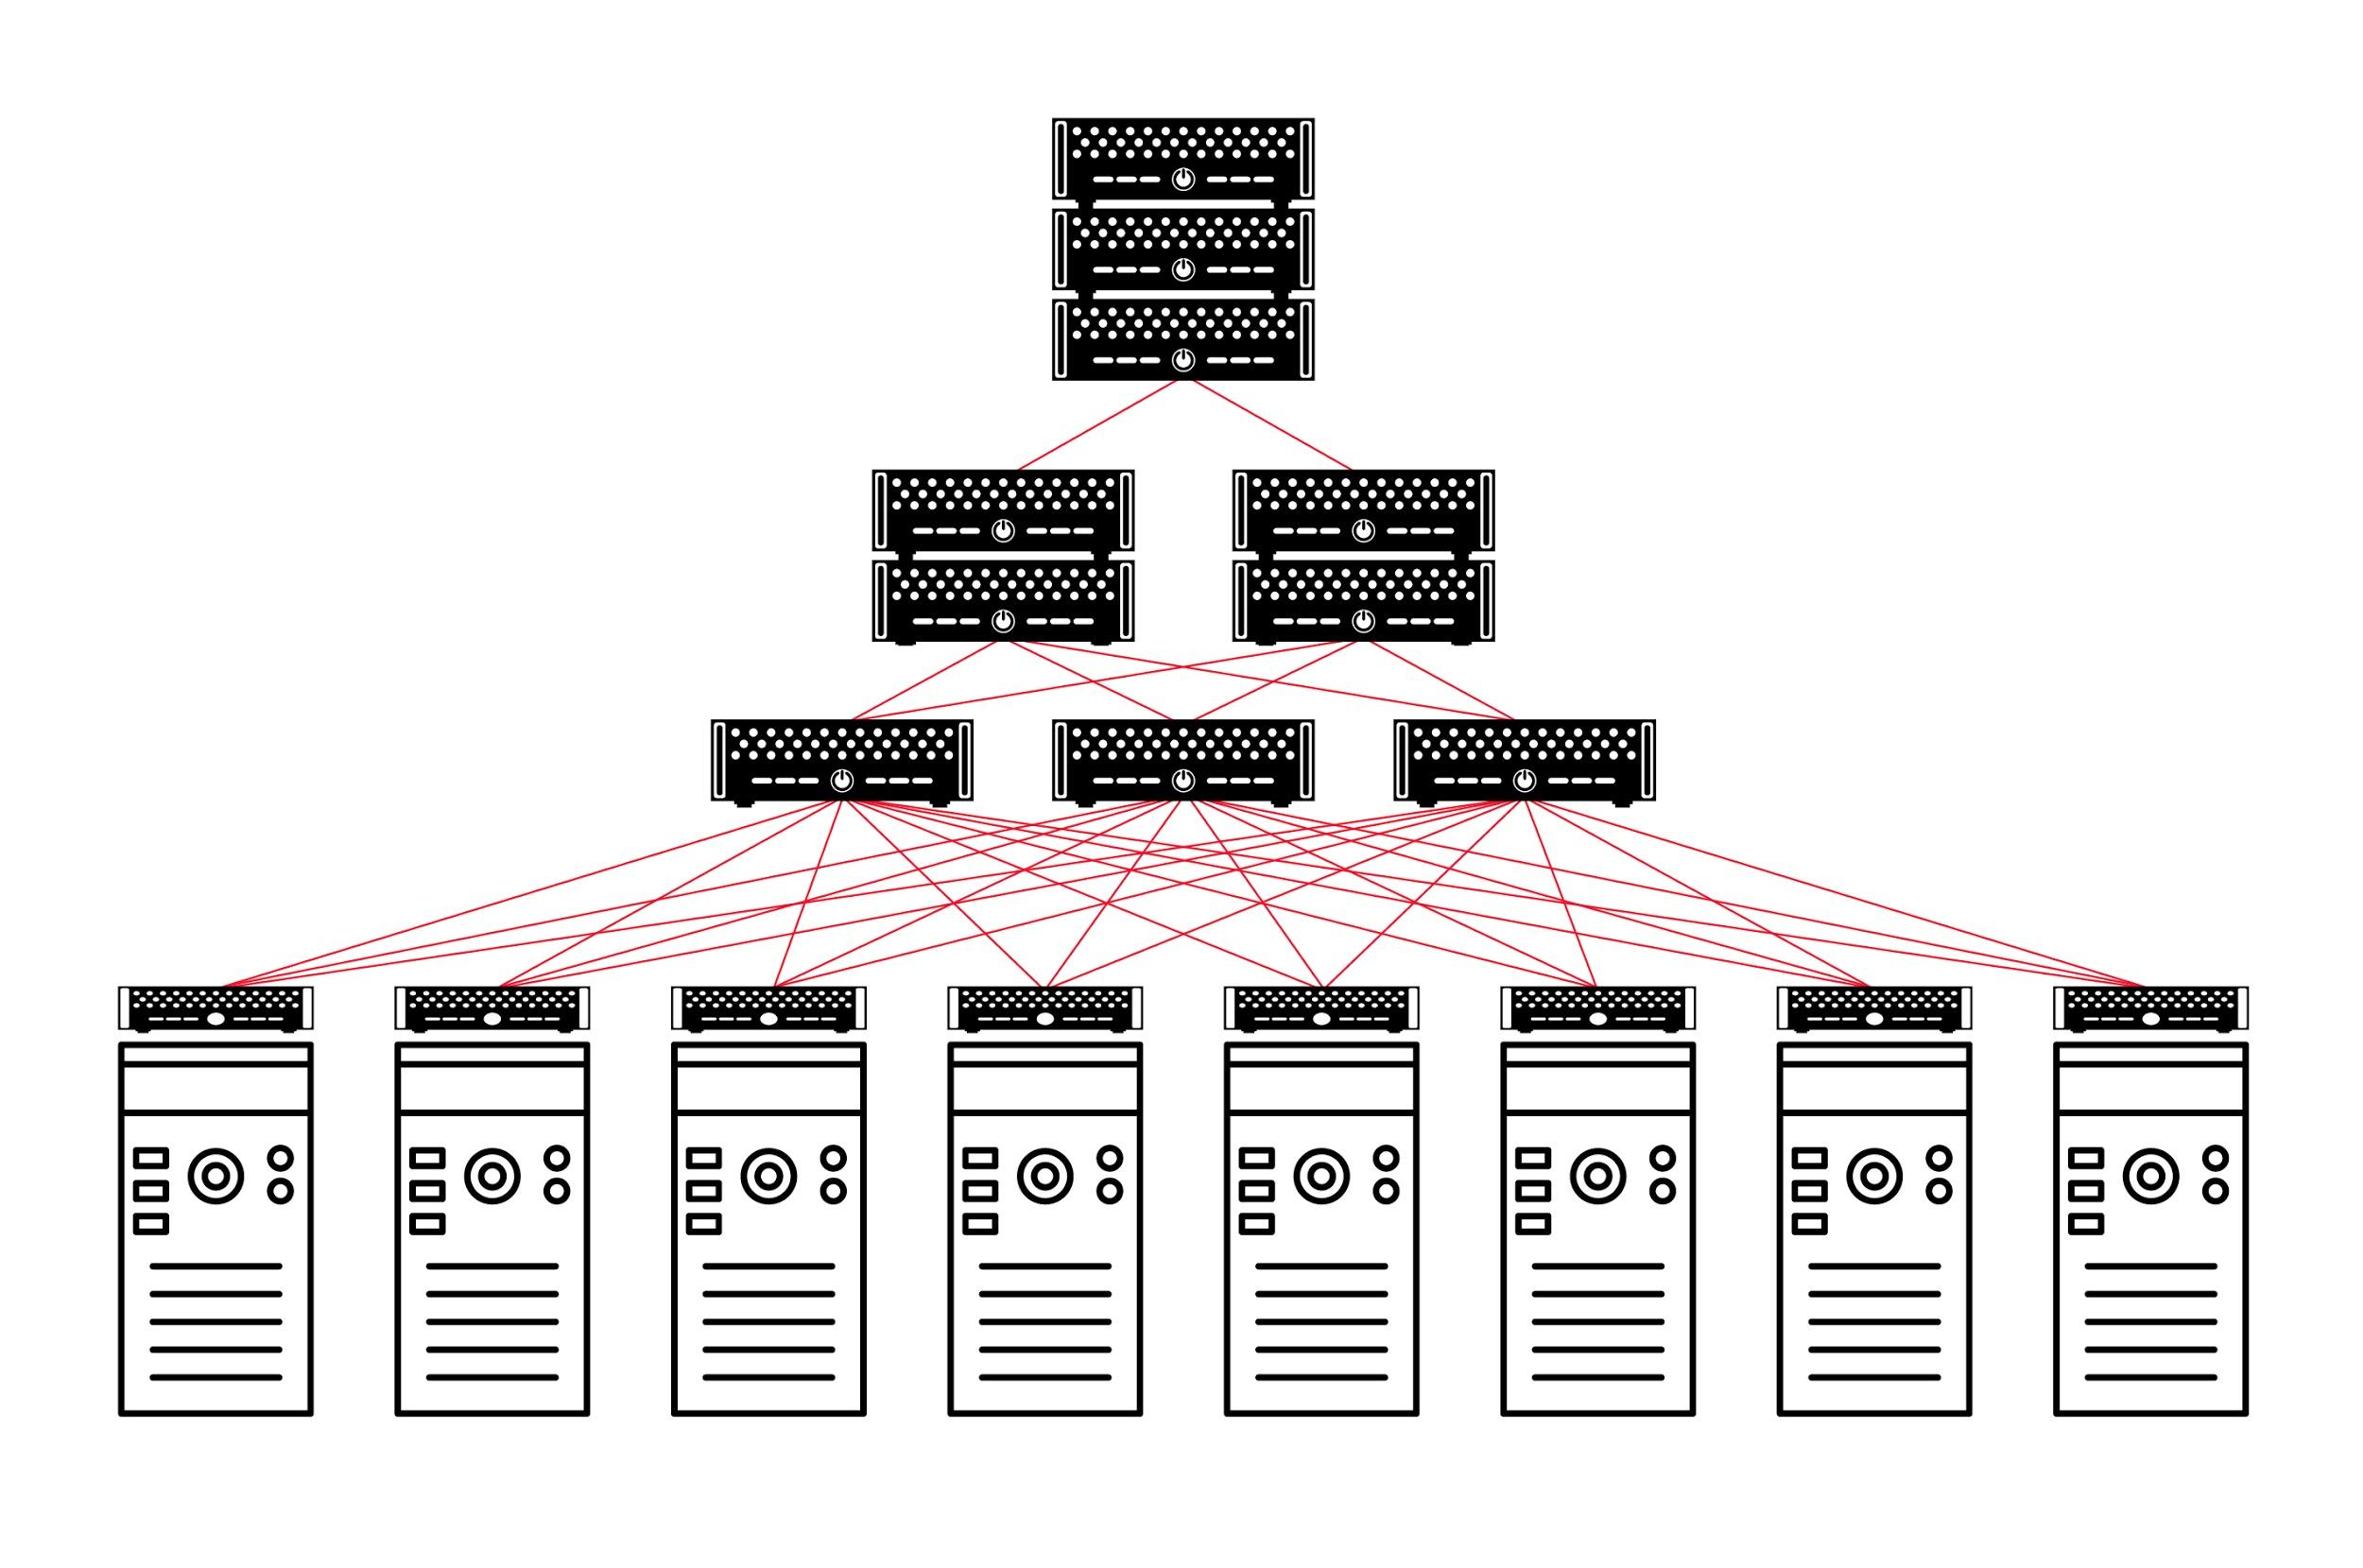
Visualizing Workload Structure
Complexity Map
bursty
uniform
pF
CNS
ML
DB
Potential gain!
Web
non-temporal complexity
Multi
Grid
Had
NN
bursty & skewed
skewed
temporal complexity
9
Notes:
The potential gain can be significant.

Slide 25
Visualizing Workload Structure
Complexity Map
bursty
uniform
pF
CNS
ML
DB
Potential gain!
Web
Systematic approach: iterative randomization and compression of trace to identify dimensions of structure.
non-temporal complexity
Multi
Grid
Had
NN
bursty & skewed
skewed
temporal complexity
9
Notes:
The potential gain can be significant.

Slide 26
Visualizing Workload Structure
Complexity Map
bursty
uniform
pF
CNS
ML
DB
Potential gain!
Web
Systematic approach: iterative randomization and compression of trace to identify dimensions of structure.
non-temporal complexity
Multi
Grid
Had
NN
bursty & skewed
skewed
temporal complexity
Further reading:
On the Complexity of Traffic Traces and Implications
Chen Avin et al. ACM Sigmetrics 2020.
Notes:
The potential gain can be significant.

Slide 27
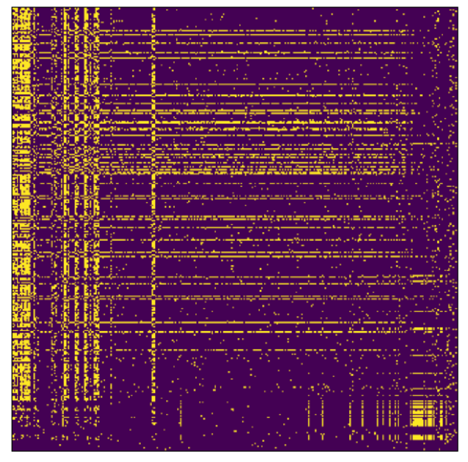
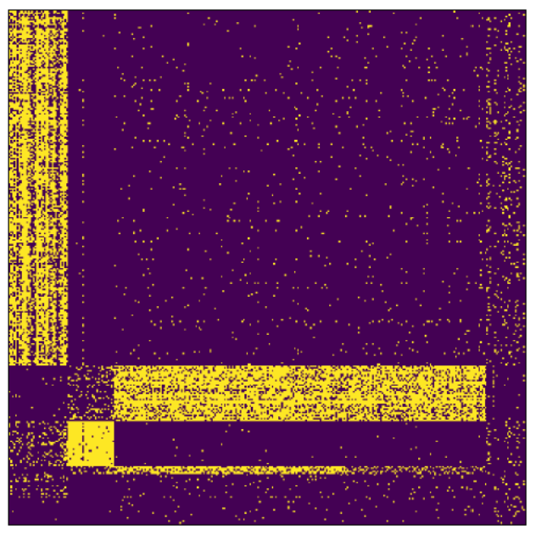
Traffic is also clustered: bi-clustering results
Small Stable Clusters
reordering based on
bicluster structure
Opportunity: exploit with little reconfigurations!
10

Slide 28
Traffic is also clustered: bi-clustering results
Small Stable Clusters
reordering based on
bicluster structure
Opportunity: exploit with little reconfigurations!
Further reading:
Analyzing the Communication Clusters in Datacenters. Förster et al., WWW 2023.

Slide 29
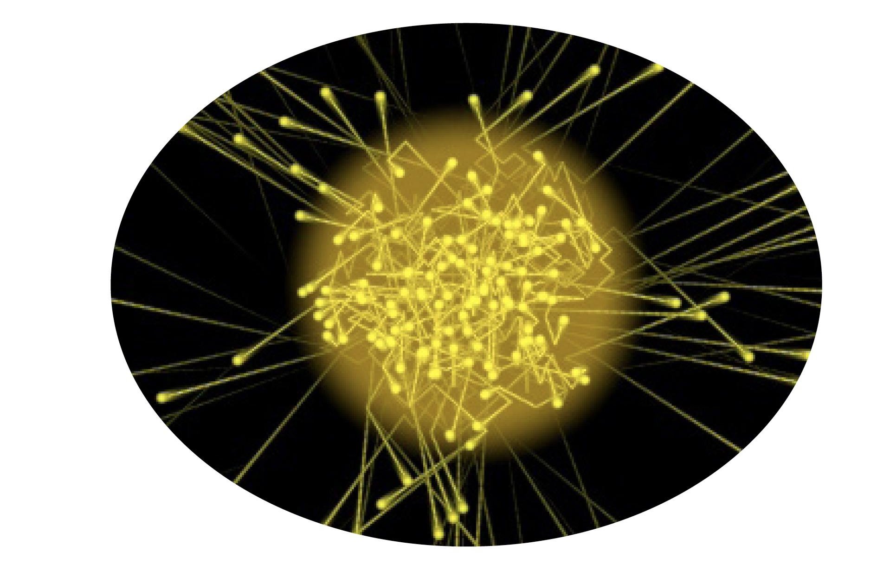
Sounds Crazy?
Emerging Enabling Technology.
H2020:
“Photonics one of only five
key enabling technologies
for future prosperity.”
US National Research Council:
“Photons are the new
Electrons.”
Photonics
11
Notes:
Generally, photonics is seen as one of the key enabling technologies of our future prosperity, both in the EU and in the US.

Slide 30
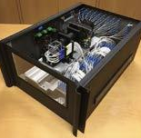
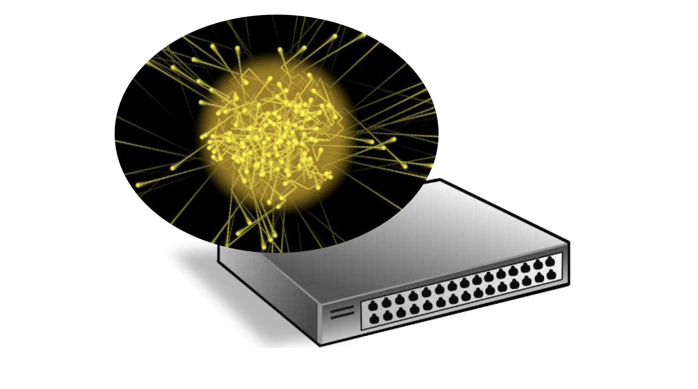
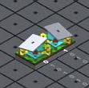
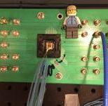
Enabler
Novel Reconfigurable Optical Switches
⇢ Spectrum of prototypes
⇀ Different sizes, different reconfiguration times
⇀ From ACM SIGCOMM workshop OptSys resp. HotOptics
Prototype 1
Moving antenna (ms)
Prototype 2
Moving mirrors (mus)
Prototype 3
Changing lambdas (ns)
11
Notes:
More specifically, the enabler for our project are reconfigurable optical switches.
There is currently a spectrum of prototypes emerging: these prototypes have different sizes, different reconfiguration times, etc.
Here are some examples from the SIGCOMM workshop we organized last month.

Slide 31
Example
Optical Circuit Switch
⇢ Optical Circuit Switch (OCS) rapid adaption of physical layer
⇀ Based on rotating mirrors
Lenses
Fixed
Mirror
Rotate Mirror
Mirrors on Motors
Optical Circuit Switch (OCS)
By Nathan Farrington, SIGCOMM 2010
12
Notes:
More specifically, the enabler for our project are reconfigurable optical switches.
There is currently a spectrum of prototypes emerging: these prototypes have different sizes, different reconfiguration times, etc.
Here are some examples from the SIGCOMM workshop we organized last month.

Slide 32
Example
Optical Circuit Switch
⇢ Optical Circuit Switch (OCS) rapid adaption of physical layer
⇀ Based on rotating mirrors
Lenses
Fixed
Mirror
vs
A Matching!
Rotate Mirror
Mirrors on Motors
Optical Circuit Switch (OCS)
By Nathan Farrington, SIGCOMM 2010
12
Notes:
More specifically, the enabler for our project are reconfigurable optical switches.
There is currently a spectrum of prototypes emerging: these prototypes have different sizes, different reconfiguration times, etc.
Here are some examples from the SIGCOMM workshop we organized last month.

Slide 33

Another Example
Tunable Lasers
⇢ Depending on wavelength, forwarded differently
⇢ Optical switch is passive
Multi-wavelength
source
Wavelength
selector
Electrical switch
with tunable laser
Optical switch
Passive
13
Ballani et al., Sirius, ACM SIGCOMM 2020.
Notes:
More specifically, the enabler for our project are reconfigurable optical switches.
There is currently a spectrum of prototypes emerging: these prototypes have different sizes, different reconfiguration times, etc.
Here are some examples from the SIGCOMM workshop we organized last month.

Slide 34
Another Example
Tunable Lasers
⇢ Depending on wavelength, forwarded differently
⇢ Optical switch is passive
Multi-wavelength
source
Wavelength
selector
Electrical switch
with tunable laser
Optical switch
Passive
13
Ballani et al., Sirius, ACM SIGCOMM 2020.
Notes:
More specifically, the enabler for our project are reconfigurable optical switches.
There is currently a spectrum of prototypes emerging: these prototypes have different sizes, different reconfiguration times, etc.
Here are some examples from the SIGCOMM workshop we organized last month.

Slide 35
Another Example
Tunable Lasers
⇢ Depending on wavelength, forwarded differently
⇢ Optical switch is passive
Multi-wavelength
source
Wavelength
selector
Electrical switch
with tunable laser
Optical switch
Passive
13
Ballani et al., Sirius, ACM SIGCOMM 2020.
Notes:
More specifically, the enabler for our project are reconfigurable optical switches.
There is currently a spectrum of prototypes emerging: these prototypes have different sizes, different reconfiguration times, etc.
Here are some examples from the SIGCOMM workshop we organized last month.

Slide 36
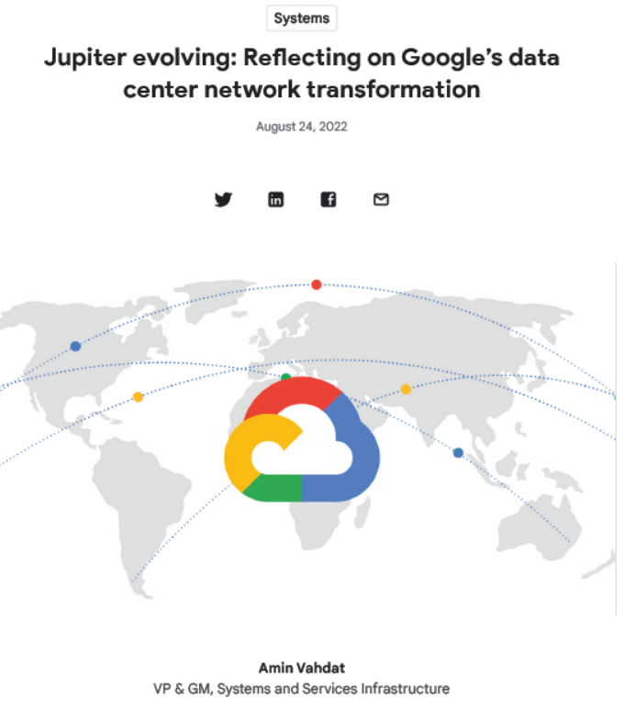
First Deployments
E.g., Google’s Datacenter Jupiter
14
Notes:
More specifically, the enabler for our project are reconfigurable optical switches.
There is currently a spectrum of prototypes emerging: these prototypes have different sizes, different reconfiguration times, etc.
Here are some examples from the SIGCOMM workshop we organized last month.

Slide 37
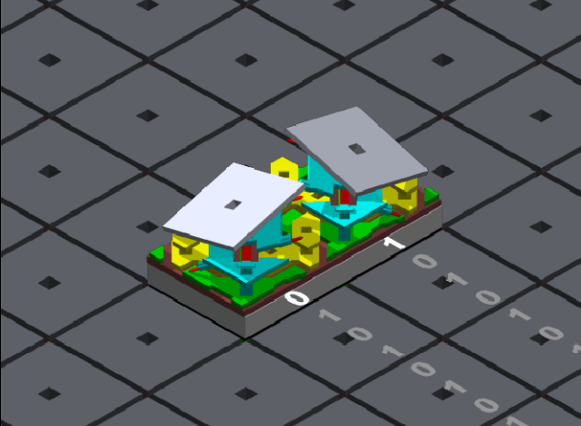
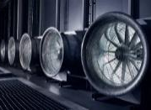
The Big Picture
Flexibility
Self-Adjusting
Networks
New!
Efficiency
Efficiency
Structure
More!
Now is the time!
15
Notes:
In a nutshell, the idea of this project is to exploit these new technological flexibilities, as well as the structure in the demand, to design self-adjusting networks, and improve efficiency. Now is the right time for this project:
it is possible to have impact as the community is currently re-achritecting networks anyways.

Slide 38
The Big Picture
Flexibility
Self-Adjusting
Networks
New!
Efficiency
Structure
More!
Now is the time!
Missing: Foundations of demand-aware, self-adjusting networks.
15
Notes:
Our goal is to develop the theoretical foundations of such demand-aware networks, and a framework which comes with provable guarantees.

Slide 39
Self-Adjusting Networks:
Mental Model and Taxonomy
16
Notes:
Of course, we are particularly interested in what can be achieved in self-adjusting networks.
To this end, we want to develop metrics for self-adjusting networks which depend on the demand, as well as algorithms.
Here we have some first insights that the entropy of the demand can serve as a useful metric for self-adjusting networks.

Slide 40
Reconfigurable Datacenters Based on OCSs:
It’s about Dynamic Matchings
Optical Switches
1
2
3
4
5
6
7
8
⇢ Racks connected to optical fabric
(often in addition to an electrical fabric: hybrid)
17

Slide 41
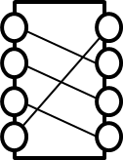
Reconfigurable Datacenters Based on OCSs:
It’s about Dynamic Matchings
S1
S2
Sk
…
1
2
3
4
5
6
7
8
⇢ Specifically: ToR switches connected to set of k OCSs
(often in addition to an electrical switches if hybrid)
17

Slide 42
Reconfigurable Datacenters Based on OCSs:
It’s about Dynamic Matchings
S1
S2
Sk
…
1
2
3
4
5
6
7
8
⇢ Recall: each OCS provides a matching
⇢ aka. ToR-Matching-ToR (TMT) model
17

Slide 43
Reconfigurable Datacenters Based on OCSs:
It’s about Dynamic Matchings
S1
S2
Sk
…
1
2
3
4
5
6
7
8
⇢ It’s dynamic: Each OCS Si can reconfigure over time
⇢ Two flavors: demand-aware vs demand-oblivious (periodic)
17

Slide 44
Two Types of Reconfigurable Optical Switches
Demand-Aware Demand-Oblivious
Demand-oblivious: OCS provides periodic matchings
Period 1
Period 2
M1
M2
M3
M1
M2
M3
Si:
time
Demand-aware switch: arbitrary/optimized matchings
M1
M1
M3
M2
M2
M1
Si:
time
18

Slide 45
Taxonomy and Opportunity
Orthogonal topology choices:
⇀ demand-oblivious and
demand-aware
⇀ static vs dynamic
Demand-
oblivious
Demand-
aware
19

Slide 46
Taxonomy and Opportunity
Dynamic
Orthogonal topology choices:
⇀ demand-oblivious and
demand-aware
⇀ static vs dynamic
Demand-
oblivious
Demand-
aware
Static
19

Slide 47
Taxonomy and Opportunity
Dynamic
Orthogonal topology choices:
⇀ demand-oblivious and
demand-aware
⇀ static vs dynamic
e.g., RotorNet (SIGCOMM‘17), Sirius(SIGCOMM‘20), Mars (SIGMETRICS‘23), Shale (SIGMETRICS‘24)
e.g., Helios (SIGCOMM‘10), ProjecToR (SIGCOMM‘16), SplayNet (ToN‘16), Duo (SIGMETRICS‘23)
Demand-
oblivious
Demand-
aware
e.g., Clos (SIGCOMM‘08), Slim Fly (SC‘14), Xpander (SIGCOMM‘17)
Static
19

Slide 48
Taxonomy and Opportunity
Dynamic
Orthogonal topology choices:
⇀ demand-oblivious and
demand-aware
⇀ static vs dynamic
Rotor
Demand-Aware
Demand-
oblivious
Demand-
aware
Static
Static
19

Slide 49
Taxonomy and Opportunity
Dynamic
Orthogonal topology choices:
⇀ demand-oblivious and
demand-aware
⇀ static vs dynamic
Rotor
Demand-Aware
Demand-
oblivious
Demand-
aware
Static
Which approach is best?
Static
19

Slide 50
A Tradeoff?
Dynamic
Rotor
Demand-Aware
Demand-
oblivious
Demand-
aware
⇀ Slower: optimized
⇀ Optimized
⇀ Need info about demand (?)
⇀ Faster to reconfigure
⇀ Not optimized
vs
Static
20

Slide 51
An Opportunity! Hybrid.
Dynamic
Hybrid designs:
Cerberus (Sigmetrics’22), Vermillion (NSDI‘27), etc.
Demand-
oblivious
Demand-
aware
⇀ Cerberus: serve large flows using demand-optimized links
and shuffle traffic using periodic links
⇀ Vermillion: less frequent demand-aware reconfigurations and
reconfigure periodically but fast meanwhile
Static
20

Slide 52
An Opportunity! Hybrid.
Dynamic
Hybrid designs:
Cerberus (Sigmetrics’22), Vermillion (NSDI‘27), etc.
Demand-
oblivious
Demand-
aware
⇀ Cerberus: serve large flows using demand-optimized links
and shuffle traffic using periodic links
⇀ Vermillion: less frequent demand-aware reconfigurations and
reconfigure periodically but fast meanwhile
Static
Further reading:
Vermilion: A Traffic-Aware Reconfigurable Optical Interconnect with Formal Throughput Guarantees
Addanki et al. USENIX NSDI 2027.
Vermilion: A Traffic-Aware Reconfigurable Optical Interconnect with Formal Throughput Guarantees
Addanki et al. USENIX NSDI 2027.

Slide 53
Why am I telling all this? I believe that
Self-Adjusting Networks Are Especially Useful for AI Workloads
21
Notes:
Of course, we are particularly interested in what can be achieved in self-adjusting networks.
To this end, we want to develop metrics for self-adjusting networks which depend on the demand, as well as algorithms.
Here we have some first insights that the entropy of the demand can serve as a useful metric for self-adjusting networks.

Slide 54
Example Workload
Collective Communications
⇀ Distributed HPC and ML applications frequently perform very
specific and predictable communication operations:
AllReduce, Broadcast, All-to-All, ...
⇀ Known as Collective Communications
⇀ Examples: Nvidia’s NCCL, AMD’s RCCL,....
⇀ Basically reincarnations of MPI
⇀ “CCL” stands for Collective Communication Library
22

Slide 55
Example Workload
Collective Communications
⇀ Distributed HPC and ML applications frequently perform very
specific and predictable communication operations:
AllReduce, Broadcast, All-to-All, ...
⇀ Known as Collective Communications
⇀ Examples: Nvidia’s NCCL, AMD’s RCCL,....
⇀ Basically reincarnations of MPI
⇀ “CCL” stands for Collective Communication Library
Importantly:
⇀ Collective algorithms realize primitives in communication phases
⇀ And communication is pair-wise (“matching”)
22

Slide 56
Example Workload
Collective Communications
especially relevant for MoE parallelism, for training and inference
⇀ Distributed HPC and ML applications frequently perform very
specific and predictable communication operations:
AllReduce, Broadcast, All-to-All, ...
⇀ Known as Collective Communications
⇀ Examples: Nvidia’s NCCL, AMD’s RCCL,....
⇀ Basically reincarnations of MPI
⇀ “CCL” stands for Collective Communication Library
Importantly:
⇀ Collective algorithms realize primitives in communication phases
⇀ And communication is pair-wise (“matching”)
More for data parallelism and tensor parallelism
22

Slide 57
Self-Adjusting Networks and AI:
It’s a Match!
Demand-aware self-adjusting networks are good when:
⇀ Demand is structured (sparse, skewed, large flows, …)
⇀ Demand is repetitive or predictable (can optimize for it offline)
This is often the case of AI/ML workloads:
⇀ Collective communication patterns form matchings!
Fits OCSs which provide such matchings.
⇀ Mixture-of-Expert workloads: skewed
23

Slide 58

Example of a Collective Communication
Broadcast
0
1
2
3
0
1
2
3
A
A
Vector of size $m$
0
1
2
3
B
B
Broadcast
0
1
2
3
C
C
0
1
2
3
D
D
A single node transmits its entire data to all other nodes.
24

Slide 59
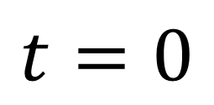
Example of a Collective Communication
Broadcast Algorithm
Initially has the message
$$t=0$$
Realization in collectives algorithm: pair-wise matchings!
25

Slide 60
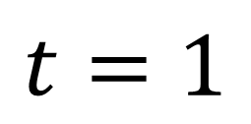
Example of a Collective Communication
Broadcast Algorithm
$$t=1$$
Realization in collectives algorithm: pair-wise matchings!
25

Slide 61
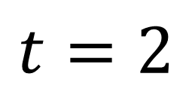
Example of a Collective Communication
Broadcast Algorithm
$$t=2$$
Realization in collectives algorithm: pair-wise matchings!
25

Slide 62
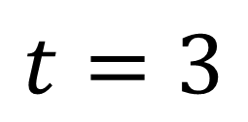
Example of a Collective Communication
Broadcast Algorithm
$$t=3$$
Realization in collectives algorithm: pair-wise matchings!
25

Slide 63
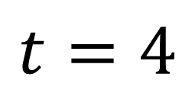
Example of a Collective Communication
Broadcast Algorithm
$$t=4$$
Realization in collectives algorithm: pair-wise matchings!
25

Slide 64
Example of a Collective Communication
Broadcast Algorithm
It’s about matchings! Fits OCS nicely.
$$t=4$$
Realization in collectives algorithm: pair-wise matchings!
25

Slide 65
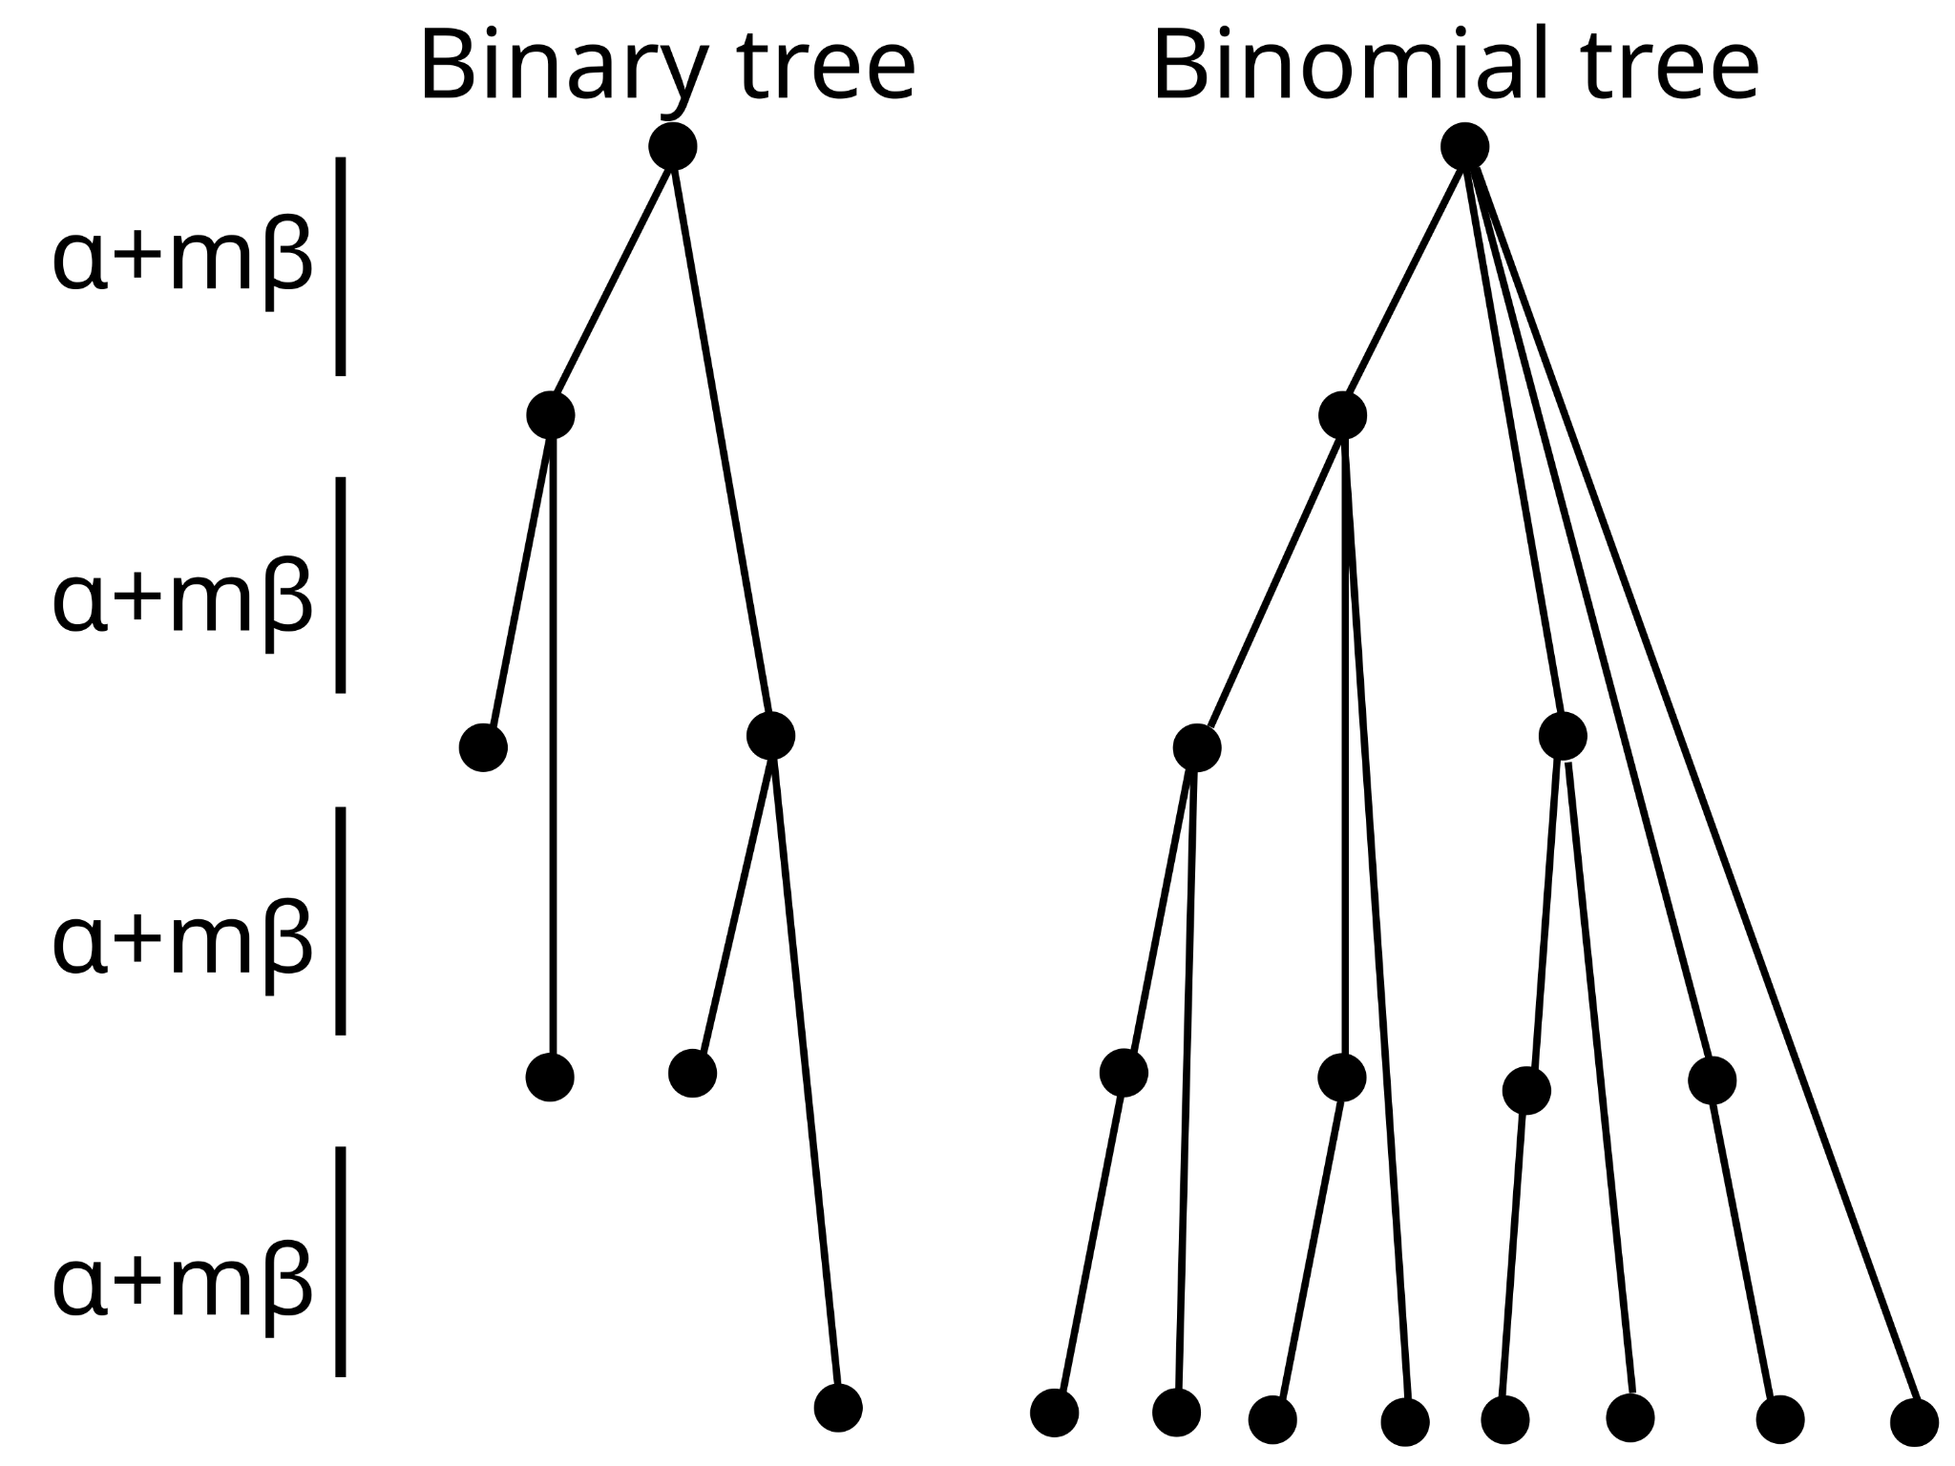
Example of a Collective Communication
Broadcast Algorithm
Keep helping in future too!
⇀ There are optimizations…
⇀ E.g., nodes continue helping,
aka binomial tree
⇀ But always a matching!
26

Slide 66
Example of a Collective Communication
AllReduce
0
1
2
3
0
1
2
3
A
A
0
1
2
3
0
1
2
3
B
B
Reduce
0
1
2
3
0
1
2
3
C
C
0
1
2
3
0
1
2
3
D
D
Every node transmits its vector to every other node, and aggregation (“reduction”) is performed (e.g, sum, min, max).
27

Slide 67
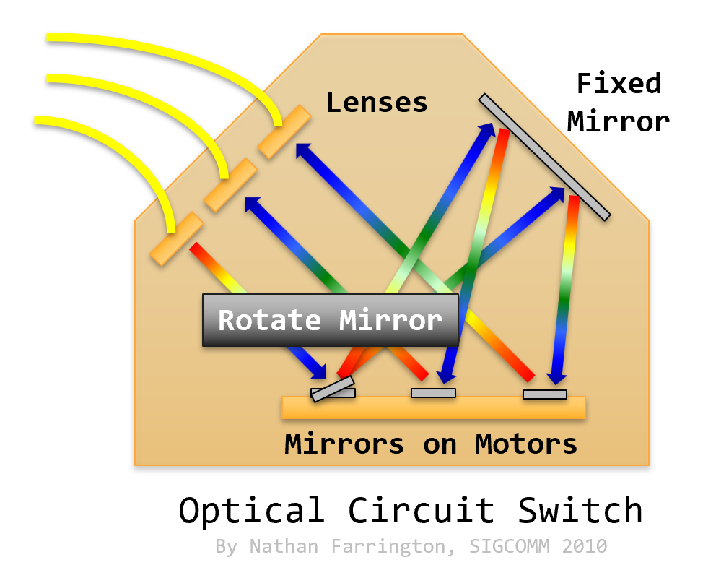
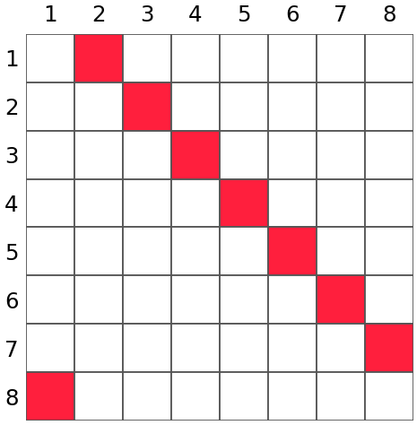
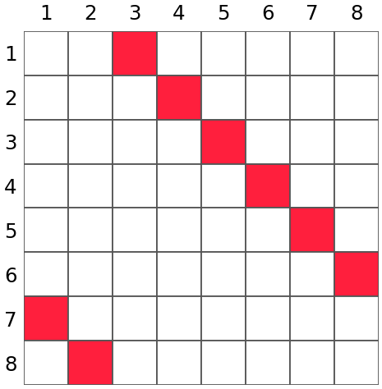
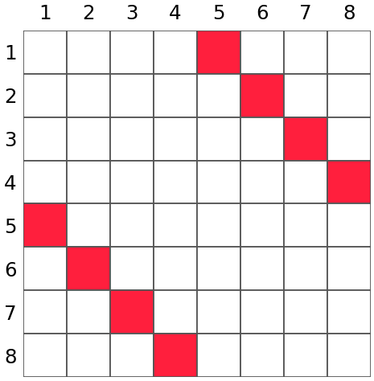
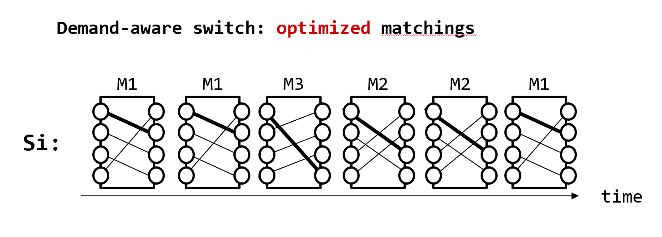
Example of a Collective Communication
All-to-All
⇀ Each node sends a unique vector to every other node
⇀ Algorithmic realization in phases=matchings: Bruck’s algorithm
K=0
K=1
K=2
⇀ Related algorithms: e.g., Birckhoff von Neumann decompositions:
how to serve a demand (matrix) with a sequence of matching?
28

Slide 68
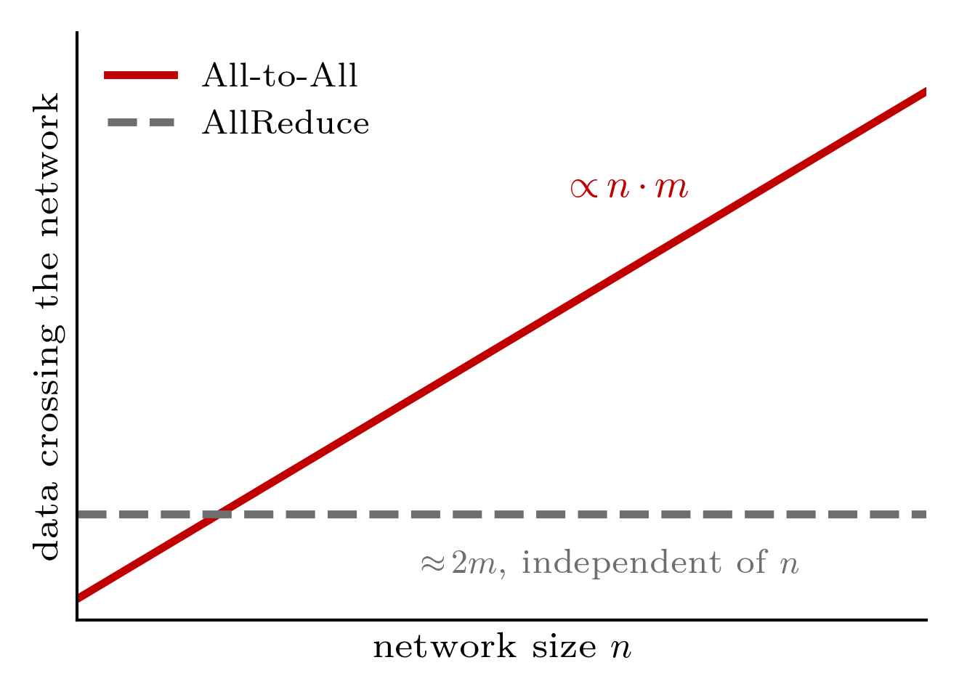
Bruck and OCS: A Match!
⇀ On ring topologies All-to-All
communication cost grows linearly in
network size while constant for,
e.g., AllReduce
⇀ So optical shortcuts beneficial
29

Slide 69
Bruck and OCS: A Match!
⇀ On ring topologies All-to-All
communication cost grows linearly in
network size while constant for,
e.g., AllReduce
⇀ So optical shortcuts beneficial
Note: Optimally scheduling collective communications over a network is still an open question even for many fixed topologies as well!
Classic HPC work on scheduling under assumption of complete network.
29

Slide 70
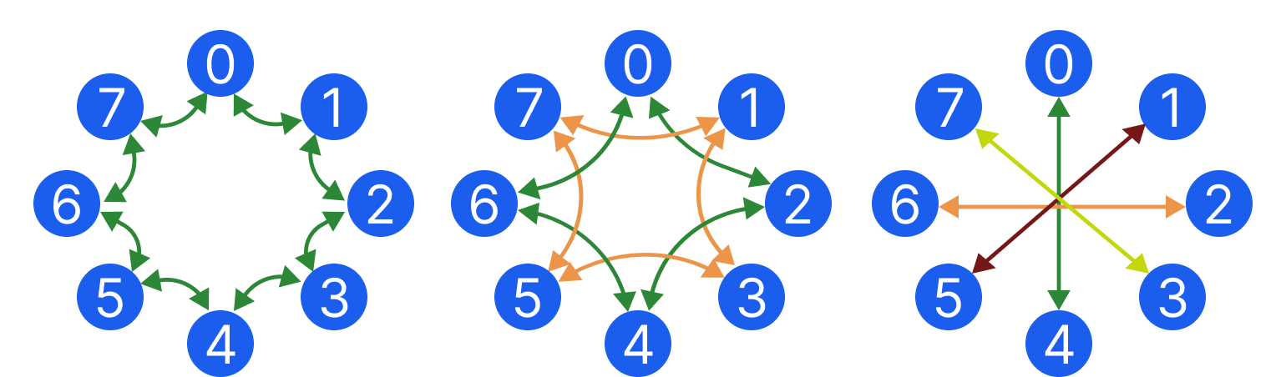



Especially Powerful: Combining the Two Techniques
Reconfigurable+Multiport
⇀ ReTri: Reconfigurable Trivance
(coming next)
⇀ Multi-port extension of Bruck
proceeds in subring phases
⇀ In reconfigurable networks, can build direct connections for these demands:
+
30
Communication pattern
Topology reconfiguration

Slide 71

Especially Powerful: Combining the Two Techniques
Reconfigurable+Multiport
⇀ ReTri: Reconfigurable Trivance
(coming next)
⇀ Multi-port extension of Bruck
proceeds in subring phases
⇀ In reconfigurable networks, can build direct connections for these demands:
Communication pattern
= Topology

Slide 72
Especially Powerful: Combining the Two Techniques
Reconfigurable+Multiport
⇀ ReTri: Reconfigurable Trivance
(coming next)
⇀ Multi-port extension of Bruck
proceeds in subring phases
⇀ In reconfigurable networks, can build direct connections for these demands:
It’s a Match!
Communication pattern
= Topology

Slide 73

Further Reading
HotOptics@Sigcomm 2026
The ReTri paper!
30

Slide 74

Particularly Powerful in Hybrid Networks
ACM Sigmetrics 2027
30

Slide 75

Reconfigurations Also Help Other Collectives
ACM MobiHoc 2026
30

Slide 76
Another attractive fabric capability:
Leveraging simultaneous communication ports for AI
31
Notes:
Of course, we are particularly interested in what can be achieved in self-adjusting networks.
To this end, we want to develop metrics for self-adjusting networks which depend on the demand, as well as algorithms.
Here we have some first insights that the entropy of the demand can serve as a useful metric for self-adjusting networks.

Slide 77
Motivation: Consider
Recursive Doubling (RD)
⇀ Recursive doubling: a fundamental algorithmic technique for
several collective communication operations
⇀ Idea: processes exchange their current data with partners
at exponentially increasing distances
⇀ Known for low latency: for n processes, takes log n rounds
⇀ Can be used for: AllReduce, AllGather, etc.
32

Slide 78

However, RD inefficient on high-diameter networks:
RD on the Ring
Recursive doubling on ring:
Communicate at distances
1, 2, 4, 8, etc.
⇀ Inefficiency 1: Multiple pairs share physical links
in same step: congestion
⇀ Inefficiency 2: While some other physical links
not used for propagation
33

Slide 79

De Sensi et al. at NSDI 2024 presented an
Improvement: Swing*
shorter distances
use both directions
less collisions
⇀ Idea to reduce collisions: Communication in both
directions at shorter distance (focus: AllReduce)
⇀ But still same latency: identical number of steps and
transferred data
*Swing: Short-cutting Rings for Higher Bandwidth Allreduce

Slide 80

Can we reduce number of steps further?
Latency-Optimal: Trivance
⇀ Idea: avoid idle ports/links, use ports simultaneously and
communicate bidirectionally in each step
⇀ Each node reduces data from both incoming communications
⇀ Data can be tripled per step, latency reduces
from log2 (n) to log3 (n) (58% less)
use both ports
RD
Trivance
reach further: better latency
balanced congestion
35

Slide 81
Can we reduce number of steps further?
Latency-Optimal: Trivance
⇀ Idea: avoid idle ports/links, use ports simultaneously and
communicate bidirectionally in each step
⇀ Each node reduces data from both incoming communications
⇀ Data can be tripled per step, latency reduces
from log2 (n) to log3 (n) (58% less)
use both ports
RD
Trivance
Completes one round faster!
And less congestion
reach further: better latency
balanced congestion
35

Slide 82

Further Reading
ACM SIGCOMM 2026
36

Slide 83
Many Exciting Open Problems
37
Notes:
Of course, we are particularly interested in what can be achieved in self-adjusting networks.
To this end, we want to develop metrics for self-adjusting networks which depend on the demand, as well as algorithms.
Here we have some first insights that the entropy of the demand can serve as a useful metric for self-adjusting networks.

Slide 84



Challenge: Computing
Heavy Matchings?
⇢ How to schedule a maximum amount of traffic/matchings on optical network?
⇢ Online algorithms, offline algorithms, dynamic algorithms
⇢ Several first results known
38

Slide 85

Demand-Aware Throughput?
Demand Matrix
$$T$$
Metric: throughput of a demand matrix…
39

Slide 86



Demand-Aware Throughput?
Demand Matrix
$$T$$
$$×$$
$$θ(T)$$
… is the maximal scale down factor by which traffic is feasible
$0≤θ\left(T\right)≤1$.
Metric: throughput of a demand matrix…
39

Slide 87



Demand-Aware Throughput?
Demand Matrix
$$T$$
$$×$$
$$θ(T)$$
$$⇒$$
… is the maximal scale down factor by which traffic is feasible
$0≤θ\left(T\right)≤1$.
Metric: throughput of a demand matrix…
$${\text{Throughput of network} θ}^{∗}:$$
$$\text{worst }\text{cas}\text{e} T$$
39

Slide 88
Demand-Aware Throughput?
Demand Matrix
$$T$$
$$×$$
$$θ(T)$$
$$⇒$$
… is the maximal scale down factor by which traffic is feasible
$0≤θ\left(T\right)≤1$.
Metric: throughput of a demand matrix…
$${\text{Throughput of network} θ}^{∗}:$$
$$\text{worst }\text{cas}\text{e} T$$
Definition extends to dynamic networks!
Abdu et al., SC 2016
Namyar et al., SIGCOMM 2021
39

Slide 89
Demand-Aware Throughput?
Demand Matrix
$$T$$
$$×$$
$$θ(T)$$
$$⇒$$
… is the maximal scale down factor by which traffic is feasible
$0≤θ\left(T\right)≤1$.
Metric: throughput of a demand matrix…
$${\text{Throughput of network} θ}^{∗}:$$
$$\text{worst }\text{cas}\text{e} T$$
Definition extends to dynamic networks!
T typically assumed to be doubly stochastic (entries sum to 1).
Worst T for different networks?
39

Slide 90
Demand-Aware Throughput?
Demand Matrix
$$T$$
$$×$$
$$θ(T)$$
$$⇒$$
… is the maximal scale down factor by which traffic is feasible
$0≤θ\left(T\right)≤1$.
Metric: throughput of a demand matrix…
$${\text{Throughput of network} θ}^{∗}:$$
$$\text{worst }\text{cas}\text{e} T$$
Definition extends to dynamic networks!
T typically assumed to be doubly stochastic (entries sum to 1).
Worst T for different networks?
39

Slide 91
Worst T for Oblivious
⇀ E.g., worst T for (oblivious) expander?
40

Slide 92


Worst T for Oblivious
⇀ E.g., worst T for (oblivious) expander?
Demand Matrix
$$T$$
Permutation matrix is the worst demand
40

Slide 93
Worst T for Oblivious
⇀ E.g., worst T for (oblivious) expander?
Demand Matrix
$$T$$
Permutation matrix is the worst demand
⇀ Actually the best T for demand-aware!
40

Slide 94


Challenge: Demand-Aware Throughput
Constructive Separation?
⇀ Known: worst case throughput $θ∗$ of
demand-oblivious networks at most ½ (tight)
⇀ Due to Keslassy, Chang, McKeown, Lee.
⇀ They consider (2n-1)-regular networks
⇀ Best oblivious network:
two links to every other node
* Same bound also holds for dynamic oblivious networks
Notes:
matrix is saturated
permutation matrix: is worst case for expander (pay much bandwidth tax), also worst for RotorNet
for demandaware it is the best
this is the worst case but what about real traffic?
depends on specific parameter of datamining
note

Slide 95


Challenge: Demand-Aware Throughput
Constructive Separation?
⇀ Known: worst case throughput $θ∗$ of
demand-oblivious networks at most ½ (tight)
⇀ Due to Keslassy, Chang, McKeown, Lee.
⇀ They consider (2n-1)-regular networks
⇀ Best oblivious network:
two links to every other node
⇀ For this graph, worst T is permutation
⇀ Best demand-aware network:
Knowing the demand, each node pointing
all (2n-1) links at its successor
gives perfect throughput 1
So demand-aware network much better in this bad case for oblivious.
Question: But is it better also under worst-case demand?
Notes:
matrix is saturated
permutation matrix: is worst case for expander (pay much bandwidth tax), also worst for RotorNet
for demandaware it is the best
this is the worst case but what about real traffic?
depends on specific parameter of datamining
note

Slide 96
Challenge: Demand-Aware Throughput
Constructive Separation?
⇀ Known: worst case throughput $θ∗$ of
demand-oblivious networks at most ½ (tight)
⇀ Due to Keslassy, Chang, McKeown, Lee.
⇀ They consider (2n-1)-regular networks
⇀ Best oblivious network:
two links to every other node
⇀ For this graph, worst T is permutation
⇀ Best demand-aware network:
Knowing the demand, each node pointing
all (2n-1) links at its successor
gives perfect throughput 1
So demand-aware network much better in this bad case for oblivious.
Question: But is it better also under worst-case demand? Subtle!
Notes:
matrix is saturated
permutation matrix: is worst case for expander (pay much bandwidth tax), also worst for RotorNet
for demandaware it is the best
this is the worst case but what about real traffic?
depends on specific parameter of datamining
note

Slide 97


Challenge: Demand-Aware Throughput
Constructive Separation?
⇀ Unknown: Demand-aware throughput can never be worse than demand-
oblivious, but is it always strictly better in the worst case?
ACM PODC 2026: The demand-aware throughput $θ∗$ asymptotically approaches at least 5/8. But: A probabilistic method proof.
Input: A doubly stochastic demand matrix M and a number 0 ≤ $θ$ ≤ 1.
Question: Is there a graph G such that the throughput of G with respect to M is at least $θ$?
42
Notes:
throughput = theta factor we multiply demand => scale it down so we can send it over topology: throughput of a matrix on a given topology. for each demand we have a factor.
matrix is saturated
permutation matrix: is worst case for expander (pay much bandwidth tax), also worst for RotorNet
for demandaware it is the best
this is the worst case but what about real traffic?
depends on specific parameter of datamining
note

Slide 98

Many More Open Questions, f. ex.
Hybrid Throughput?
⇀ More open questions, for dynamic hybrid datacenter networks
Addanki et al., arXiv 2025: https://arxiv.org/pdf/2405.20869
Addanki et al., Vermillion:
USENIX NSDI 2026
43
Notes:
throughput = theta factor we multiply demand => scale it down so we can send it over topology: throughput of a matrix on a given topology. for each demand we have a factor.
matrix is saturated
permutation matrix: is worst case for expander (pay much bandwidth tax), also worst for RotorNet
for demandaware it is the best
this is the worst case but what about real traffic?
depends on specific parameter of datamining
note

Slide 99

Further Reading
ACM PODC 2026
44
Notes:
The potential gain can be significant.

Slide 100

Challenge: Impact of Reconfigurations on
Network Layer?
⇢ ECMP reconvergence?! Benefits of Valiant routing?
⇢ How to avoid packet reorderings? RDMA network cards don’t like them!
⇢ Routing in hybrid networks: segregated vs non-segregated?
⇢ First ideas: local routing! Techniques from dynamic P2P systems?
45

Slide 101


Challenge: Impact of Reconfigurations on
Buffer Management?
46

Slide 102


Challenge: Impact of Reconfigurations on
Congestion Control?
⇢ First ideas for quickly reacting TCP: ReTCP, PowerTCP, …
⇢ Or better completely different approach? Even centralized?!
47

Slide 103
Case Study:
PowerTCP
Existing congestion control algorithms based on either
⇢ State (“voltage”) like BDP, queue length,
loss, e.g.:
⇢ DCTCP: uses ECN/loss
⇢ Swift: RTT
⇢ HPCC: inflight packets
⇢ Gradient (“current”) like reaction to queue
length change
⇢ Timely: RTT-gradient based
Design
48
Notes:
The interconnecting networks have become a critical infrastructure of our digital society.

Slide 104
Case Study:
PowerTCP
Existing congestion control algorithms based on either
⇢ State (“voltage”) like BDP, queue length,
loss, e.g.:
⇢ DCTCP: uses ECN/loss
⇢ Swift: RTT
⇢ HPCC: inflight packets
⇢ Gradient (“current”) like reaction to queue
length change
⇢ Timely: RTT-gradient based
☺ Can achieve near-zero queue equilibrium
☹ Slow reaction
49
Notes:
The interconnecting networks have become a critical infrastructure of our digital society.

Slide 105
Case Study:
PowerTCP
Existing congestion control algorithms based on either
⇢ State (“voltage”) like BDP, queue length,
loss, e.g.:
⇢ DCTCP: uses ECN/loss
⇢ Swift: RTT
⇢ HPCC: inflight packets
⇢ Gradient (“current”) like reaction to queue
length change
⇢ Timely: RTT-gradient based
☺ Fast reaction
☹ No equilibrium
49
Notes:
The interconnecting networks have become a critical infrastructure of our digital society.

Slide 106
Case Study:
PowerTCP
Existing congestion control algorithms based on either
⇢ State (“voltage”) like BDP, queue length,
loss, e.g.:
⇢ DCTCP: uses ECN/loss
⇢ Swift: RTT
⇢ HPCC: inflight packets
⇢ Gradient (“current”) like reaction to queue
length change
⇢ Timely: RTT-gradient based
Limitation: using only one of the two
may miss useful information for fine-grained adaptions!
Design
49
Notes:
The interconnecting networks have become a critical infrastructure of our digital society.

Slide 107
Limitation of SOTA
⇢ Consider a queue which may be in three different states:
1
growing
2
shrinking
Design
3
growing
50
Notes:
The interconnecting networks have become a critical infrastructure of our digital society.

Slide 108
Limitation of SOTA
⇢ Consider a queue which may be in three different states:
1
growing
2
shrinking
3
growing
2 and 3: impossible to distinguish for voltage-based CCA
50
Notes:
The interconnecting networks have become a critical infrastructure of our digital society.

Slide 109
Limitation of SOTA
⇢ Consider a queue which may be in three different states:
1
growing
2
shrinking
3
growing
1 and 3: impossible to distinguish for current-based CC
50
Notes:
The interconnecting networks have become a critical infrastructure of our digital society.

Slide 110
Limitation of SOTA
⇢ Consider a queue which may be in three different states:
1
growing
2
shrinking
3
growing
We need both: Power (Voltage x Current)
50
Notes:
The interconnecting networks have become a critical infrastructure of our digital society.

Slide 111


Limitation of SOTA
⇢ Consider a queue which may be in three different states:
1
growing
2
shrinking
3
growing
We need both: Power (Voltage x Current)
Inspired:
A control-theoretic approach
50
Notes:
The interconnecting networks have become a critical infrastructure of our digital society.

Slide 112
More benefits of optical & reconfigurable switching
So far: focus on throughput performance.
51
Notes:
Of course, we are particularly interested in what can be achieved in self-adjusting networks.
To this end, we want to develop metrics for self-adjusting networks which depend on the demand, as well as algorithms.
Here we have some first insights that the entropy of the demand can serve as a useful metric for self-adjusting networks.

Slide 113

Benefit 1:
Evolving Datacenters
⇢ Reconfigurable datacenter networks naturally support
heterogeneous network elements
⇢ And therefore also incremental hardware upgrades
See interview with Amin Vahdat, Google in CACM:
https://www.youtube.com/watch?v=IxcV1gu8ETA
52
Notes:
More specifically, the enabler for our project are reconfigurable optical switches.
There is currently a spectrum of prototypes emerging: these prototypes have different sizes, different reconfiguration times, etc.
Here are some examples from the SIGCOMM workshop we organized last month.

Slide 114



Benefit 2:
Energy and Latency
⇢ No need to convert photons in fiber to electrons in
switch (and back)
⇢ Can safe energy and reduce latency (in addition to
enabling almost unlimited throughput)
Optical fiber
Electric switch
Optical fiber
53
Notes:
More specifically, the enabler for our project are reconfigurable optical switches.
There is currently a spectrum of prototypes emerging: these prototypes have different sizes, different reconfiguration times, etc.
Here are some examples from the SIGCOMM workshop we organized last month.

Slide 115
Benefit 2:
Energy and Latency
⇢ No need to convert photons in fiber to electrons in
switch (and back)
⇢ Can safe energy and reduce latency (in addition to
enabling almost unlimited throughput)
Optical fiber
Optical switch
Optical fiber
53
Notes:
More specifically, the enabler for our project are reconfigurable optical switches.
There is currently a spectrum of prototypes emerging: these prototypes have different sizes, different reconfiguration times, etc.
Here are some examples from the SIGCOMM workshop we organized last month.

Slide 116
Benefit 2:
Energy and Latency
⇢ No need to convert photons in fiber to electrons in
switch (and back)
⇢ Can safe energy and reduce latency (in addition to
enabling almost unlimited throughput)
⇢ Interesting for emerging distributed datacenters!
Optical fiber
Optical switch
Optical fiber
53
Notes:
More specifically, the enabler for our project are reconfigurable optical switches.
There is currently a spectrum of prototypes emerging: these prototypes have different sizes, different reconfiguration times, etc.
Here are some examples from the SIGCOMM workshop we organized last month.

Slide 117


Benefit 3:
Resilience
Floodings in South Germany destroyed
much electrical network infrastructure
Solution: deploy optical infrastructure (in valleys) and electrical on hills where safe?
54
Notes:
More specifically, the enabler for our project are reconfigurable optical switches.
There is currently a spectrum of prototypes emerging: these prototypes have different sizes, different reconfiguration times, etc.
Here are some examples from the SIGCOMM workshop we organized last month.

Slide 118

Conclusion: Tip of Iceberg!
⇢ Opportunity: structure in demand and
reconfigurable networks
⇀ It‘s about matchings: finding
heavy matchings that can be offloaded
to optical network, statically
and dynamically
⇢ Many research opportunities
⇀ Optimal static networks for dense demands
⇀ Throughput: tight bounds and NP-hardness
⇀ Scheduling dynamic networks
(offline and online!) and beyond BvN
⇀ Routing and congestion control
⇀ Hybrid datacenters
⇀ Scalable control plane
⇀ Application-specific self-adjusting networks?
⇢ Many more opportunities for optical networks
55

Slide 119


Thank you! Questions?
Slides available here:
Notes:
Over the last years, we have worked on flexible routing (enabled by SDN) and flexible resource allocation and service embedding (enabled by virtualization).
With this project, we want to tackle the physical layer, enabled by emerging optical technologies.

Slide 120


Online Video Course
38

Slide 121

YouTube Interview & CACM
Revolutionizing Datacenter Networks via Reconfigurable Topologies
Chen Avin and Stefan Schmid.
Communications of the ACM (CACM), 2025.
Watch here: https://www.youtube.com/@self-adjusting-networks-course
Notes:
More specifically, the enabler for our project are reconfigurable optical switches.
There is currently a spectrum of prototypes emerging: these prototypes have different sizes, different reconfiguration times, etc.
Here are some examples from the SIGCOMM workshop we organized last month.

Slide 122




Websites
https://trace-collection.net/
Trace collection website
http://self-adjusting.net/
Project website
Notes:
Over the last years, we have worked on flexible routing (enabled by SDN) and flexible resource allocation and service embedding (enabled by virtualization).
With this project, we want to tackle the physical layer, enabled by emerging optical technologies.

Slide 123

June’25 CACM Article

Slide 124
References (1)
Revolutionizing Datacenter Networks via Reconfigurable Topologies
Chen Avin and Stefan Schmid.
Communications of the ACM (CACM), 2025.
Cerberus: The Power of Choices in Datacenter Topology Design (A Throughput Perspective)
Chen Griner, Johannes Zerwas, Andreas Blenk, Manya Ghobadi, Stefan Schmid, and Chen Avin.
ACM SIGMETRICS and ACM Performance Evaluation Review (PER), Mumbai, India, June 2022.
Mars: Near-Optimal Throughput with Shallow Buffers in Reconfigurable Datacenter Networks
Vamsi Addanki, Chen Avin, and Stefan Schmid.
ACM SIGMETRICS and ACM Performance Evaluation Review (PER), Orlando, Florida, USA, June 2023.
Vermilion: A Traffic-Aware Reconfigurable Optical Interconnect with Formal Throughput Guarantees
Vamsi Addanki, Deeksha Panduranga Rao, Goran Dario Knabe, Chen Avin, and Stefan Schmid.
24th USENIX Symposium on Networked Systems Design and Implementation (NSDI), Providence, Rhode Island, USA, May 2027.
Bridge: Optimizing Collective Communication Schedules in Reconfigurable Networks with Reusable Subrings
Anton Jürß and Stefan Schmid.
ACM International Symposium on Theory, Algorithmic Foundations, and Protocol Design for Mobile Networks and Mobile Computing (MobiHoc), Tokyo, Japan, November 2026.
Revisiting Bruck: Phase-Efficient All-to-All Collective Communication in Reconfigurable Networks
Anton Jürß and Stefan Schmid.
ACM SIGCOMM Workshop on Hot Topics in Optical Technologies and Applications in Networking (HotOptics), Denver, Colorado, USA, August 2026.
Duo: A High-Throughput Reconfigurable Datacenter Network Using Local Routing and Control
Johannes Zerwas, Csaba Györgyi, Andreas Blenk, Stefan Schmid, and Chen Avin.
ACM SIGMETRICS and ACM Performance Evaluation Review (PER), Orlando, Florida, USA, June 2023.
On the Complexity of Traffic Traces and Implications
Chen Avin, Manya Ghobadi, Chen Griner, and Stefan Schmid.
ACM SIGMETRICS and ACM Performance Evaluation Review (PER), Boston, Massachusetts, USA, June 2020.
Trivance: Latency-Optimal AllReduce by Shortcutting Multiport Networks
Anton Jürß, Vamsi Addanki, and Stefan Schmid.
ACM SIGCOMM, Denver, Colorado, USA, August 2026.
Notes:
Over the last years, we have worked on flexible routing (enabled by SDN) and flexible resource allocation and service embedding (enabled by virtualization).
With this project, we want to tackle the physical layer, enabled by emerging optical technologies.

Slide 125
References (2)
TCP's Third Eye: Leveraging eBPF for Telemetry-Powered Congestion Control
Jörn-Thorben Hinz, Vamsi Addanki, Csaba Györgyi, Theo Jepsen, and Stefan Schmid.
SIGCOMM Workshop on eBPF and Kernel Extensions (eBPF), Columbia University, New York City, New York, USA, September 2023.
ABM: Active Buffer Management in Datacenters
Vamsi Addanki, Maria Apostolaki, Manya Ghobadi, Stefan Schmid, and Laurent Vanbever.
ACM SIGCOMM, Amsterdam, Netherlands, August 2022.
ExRec: Experimental Framework for Reconfigurable Networks Based on Off-the-Shelf Hardware
Johannes Zerwas, Chen Avin, Stefan Schmid, and Andreas Blenk.
16th ACM/IEEE Symposium on Architectures for Networking and Communications Systems (ANCS), Virtual Conference, December 2021.
Demand-Aware Network Design with Minimal Congestion and Route Lengths
Chen Avin, Kaushik Mondal, and Stefan Schmid.
IEEE/ACM Transactions on Networking (TON), 2022.
A Survey of Reconfigurable Optical Networks
Matthew Nance Hall, Klaus-Tycho Foerster, Stefan Schmid, and Ramakrishnan Durairajan.
Optical Switching and Networking (OSN), Elsevier, 2021.
SplayNet: Towards Locally Self-Adjusting Networks
Stefan Schmid, Chen Avin, Christian Scheideler, Michael Borokhovich, Bernhard Haeupler, and Zvi Lotker.
IEEE/ACM Transactions on Networking (TON), Volume 24, Issue 3, 2016.
PowerTCP: Pushing the Performance Limits of Datacenter Networks
Vamsi Addanki, Oliver Michel, and Stefan Schmid.
19th USENIX Symposium on Networked Systems Design and Implementation (NSDI), Renton, Washington, USA, April 2022.
Credence: Augmenting Datacenter Switch Buffer Sharing with ML Predictions
Vamsi Addanki, Maciej Pacut, and Stefan Schmid.
21st USENIX Symposium on Networked Systems Design and Implementation (NSDI), Santa Clara, California, USA, April 2024.
.
Notes:
Over the last years, we have worked on flexible routing (enabled by SDN) and flexible resource allocation and service embedding (enabled by virtualization).
With this project, we want to tackle the physical layer, enabled by emerging optical technologies.

Slide 126
References (3)
DistroMatch: Distributed Disjoint Weighted Matchings in Demand-Aware Reconfigurable Optical Datacenters
Sophia Heck, Kathrin Hanauer, and Stefan Schmid.
ACM International Conference on Supercomputing (ICS), Belfast, Northern Ireland, United Kingdom, July 2026.
Dynamic Demand-Aware Link Scheduling for Reconfigurable Datacenters
Kathrin Hanauer, Monika Henzinger, Lara Ost, and Stefan Schmid.
IEEE Conference on Computer Communications (INFOCOM), New York, USA, May 2023.
Fast and Heavy Disjoint Weighted Matchings for Demand-Aware Datacenter Topologies
Kathrin Hanauer, Monika Henzinger, Stefan Schmid, and Jonathan Trummer.
IEEE Conference on Computer Communications (INFOCOM), Virtual Conference, May 2022.
Toward Demand-Aware Networking: A Theory for Self-Adjusting Networks (Editorial)
Chen Avin and Stefan Schmid.
ACM SIGCOMM Computer Communication Review (CCR), October 2018.
Notes:
Over the last years, we have worked on flexible routing (enabled by SDN) and flexible resource allocation and service embedding (enabled by virtualization).
With this project, we want to tackle the physical layer, enabled by emerging optical technologies.

Slide 127

Bonus Material
Hogwarts Stair
E
Notes:
Over the last years, we have worked on flexible routing (enabled by SDN) and flexible resource allocation and service embedding (enabled by virtualization).
With this project, we want to tackle the physical layer, enabled by emerging optical technologies.

Slide 128
Optimal Hybrid RDCNs
E

Slide 129
Flow Size Matters
On what should topology type depend? We argue: flow size.
⇢ Observation 2: The transmission time of a flow depends on its size.
⇢ Observation 3: For small flows, flow completion time suffers if
network needs to be reconfigured first.
⇢ Observation 4: For large flows, reconfiguration time may amortize.
E

Slide 130

Flow Size Matters
On what should topology type depend? We argue: flow size.
⇢ Observation 2: The transmission time of a flow depends on its size.
⇢ Observation 3: For small flows, flow completion time suffers if
network needs to be reconfigured first.
⇢ Observation 4: For large flows, reconfiguration time may amortize.
⇢ Observation 1: Different apps have different flow size distributions.
⇢ Observation 2: The transmission time of a flow depends on its size.
⇢ Observation 3: For small flows, flow completion time suffers if
network needs to be reconfigured first.
⇢ Observation 4: For large flows, reconfiguration time may amortize.
E

Slide 131
Flow Size Matters
Similar tradeoff for 800Gbps or 1.6 Tpbs
⇢ Observation 1: Different apps have different flow size distributions.
⇢ Observation 2: The transmission time of a flow depends on its size.
⇢ Observation 3: For small flows, flow completion time suffers if
network needs to be reconfigured first.
⇢ Observation 4: For large flows, reconfiguration time may amortize.
E

Slide 132
Flow Size Matters
⇢ Observation 1: Different apps have different flow size distributions.
⇢ Observation 2: The transmission time of a flow depends on its size.
⇢ Observation 3: For small flows, flow completion time suffers if
network needs to be reconfigured first.
⇢ Observation 4: For large flows, reconfiguration time may amortize.
E

Slide 133

Optimal: Cerberus
Optical Switches
1
2
3
4
5
6
7
8
E

Slide 134
Optimal: Cerberus
K_{s}
static
switches
K_{r}
rotor
switches
K_{d}
demand-aware
switches
1
2
3
4
5
6
7
8
E

Slide 135

Optimal: Cerberus
K_{s}
static
switches
K_{r}
rotor
switches
K_{d}
demand-aware
switches
1
2
3
4
5
6
7
8
Scheduling: Small flows go via static switches…
E

Slide 136

Optimal: Cerberus
K_{s}
static
switches
K_{r}
rotor
switches
K_{d}
demand-aware
switches
1
2
3
4
5
6
7
8
Scheduling: … medium flows via rotor switches…
E

Slide 137
Optimal: Cerberus
K_{s}
static
switches
K_{r}
rotor
switches
K_{d}
demand-aware
switches
1
2
3
4
5
6
7
8
Scheduling: … and large flows via demand-aware switches
(if one available, otherwise via rotor).
E

Slide 138
Optimal: Cerberus
K_{s}
static
switches
K_{r}
rotor
switches
K_{d}
demand-aware
switches
1
2
3
4
5
6
7
8
How good is it? Open problem. But there are bounds.
E

Slide 139
Optimal: Cerberus
K_{s}
static
switches
K_{r}
rotor
switches
K_{d}
demand-aware
switches
1
2
3
4
5
6
7
8
How good is it? Open problem. But there are bounds.
How to realize such an architecture?! Scalable control plane?
E

Slide 140
Question:
How to Quantify such “Structure” in the Demand?
E
Notes:
Let me give you an idea of the questions and approach used in our project.
A first most basic question regards how we can quantify the structure in the demand.

Slide 141
Intuition
Which demand has more structure?
⇢ Traffic matrices of two different distributed ML applications
⇀ GPU-to-GPU
Color = communication pair
vs
vs
E
Notes:
We believe that an information-theoretic approach can provide interesting insights here.
As a first approach, we have used iterative randomization and compression to identify the different dimensions of structure.
The resulting complexity map looks like this: On the x-axis, there is the temporal complexity, on the y-axis the non-temporal. Workloads without any structure end up on the upper right.

Slide 142
Intuition
Which demand has more structure?
⇢ Traffic matrices of two different distributed ML applications
⇀ GPU-to-GPU
Color = communication pair
vs
vs
More uniform
More structure
E
Notes:
We believe that an information-theoretic approach can provide interesting insights here.
As a first approach, we have used iterative randomization and compression to identify the different dimensions of structure.
The resulting complexity map looks like this: On the x-axis, there is the temporal complexity, on the y-axis the non-temporal. Workloads without any structure end up on the upper right.

Slide 143
Intuition
Spatial vs temporal structure
⇢ Two different ways to generate same traffic matrix:
⇀ Same non-temporal structure
⇢ Which one has more structure?
vs
vs
E
Notes:
We believe that an information-theoretic approach can provide interesting insights here.
As a first approach, we have used iterative randomization and compression to identify the different dimensions of structure.
The resulting complexity map looks like this: On the x-axis, there is the temporal complexity, on the y-axis the non-temporal. Workloads without any structure end up on the upper right.

Slide 144
Intuition
Spatial vs temporal structure
⇢ Two different ways to generate same traffic matrix:
⇀ Same non-temporal structure
⇢ Which one has more structure?
vs
vs
Systematically?
E
Notes:
We believe that an information-theoretic approach can provide interesting insights here.
As a first approach, we have used iterative randomization and compression to identify the different dimensions of structure.
The resulting complexity map looks like this: On the x-axis, there is the temporal complexity, on the y-axis the non-temporal. Workloads without any structure end up on the upper right.

Slide 145

Trace Complexity
Information-Theoretic Approach
“Shuffle&Compress”
Original
Time
E
Notes:
We believe that an information-theoretic approach can provide interesting insights here.
As a first approach, we have used iterative randomization and compression to identify the different dimensions of structure.
The resulting complexity map looks like this: On the x-axis, there is the temporal complexity, on the y-axis the non-temporal. Workloads without any structure end up on the upper right.

Slide 146



Trace Complexity
Information-Theoretic Approach
“Shuffle&Compress”
Original
Randomize rows
Uniform
Increasing complexity (systematically randomized)
More structure (compresses better)
E
Notes:
We believe that an information-theoretic approach can provide interesting insights here.
As a first approach, we have used iterative randomization and compression to identify the different dimensions of structure.
The resulting complexity map looks like this: On the x-axis, there is the temporal complexity, on the y-axis the non-temporal. Workloads without any structure end up on the upper right.

Slide 147
Trace Complexity
Information-Theoretic Approach
“Shuffle&Compress”
Original
Randomize rows
Uniform
Remove temporal
Remove non-temp.
E
Notes:
We believe that an information-theoretic approach can provide interesting insights here.
As a first approach, we have used iterative randomization and compression to identify the different dimensions of structure.
The resulting complexity map looks like this: On the x-axis, there is the temporal complexity, on the y-axis the non-temporal. Workloads without any structure end up on the upper right.

Slide 148
Trace Complexity
Information-Theoretic Approach
“Shuffle&Compress”
Original
Randomize rows
Uniform
Shuffle
Remove temporal
Remove non-temp.
Compress
Difference in size (entropy)?
Difference in size (entropy)?
E
Notes:
We believe that an information-theoretic approach can provide interesting insights here.
As a first approach, we have used iterative randomization and compression to identify the different dimensions of structure.
The resulting complexity map looks like this: On the x-axis, there is the temporal complexity, on the y-axis the non-temporal. Workloads without any structure end up on the upper right.

Slide 149
Trace Complexity
Information-Theoretic Approach
“Shuffle&Compress”
Original
Randomize rows
Uniform
Shuffle
Remove temporal
Remove non-temp.
Can be used to define 2-dimensional complexity map!
Compress
Difference in size (entropy)?
Difference in size (entropy)?
E
Notes:
We believe that an information-theoretic approach can provide interesting insights here.
As a first approach, we have used iterative randomization and compression to identify the different dimensions of structure.
The resulting complexity map looks like this: On the x-axis, there is the temporal complexity, on the y-axis the non-temporal. Workloads without any structure end up on the upper right.

Slide 150

Our Methodology
Complexity Map
bursty
uniform
No structure
Our approach: iterative randomization and compression of trace to identify dimensions of structure.
non-temporal complexity
bursty & skewed
skewed
temporal complexity
E
Notes:
We believe that an information-theoretic approach can provide interesting insights here.
As a first approach, we have used iterative randomization and compression to identify the different dimensions of structure.
The resulting complexity map looks like this: On the x-axis, there is the temporal complexity, on the y-axis the non-temporal. Workloads without any structure end up on the upper right.

Slide 151
Our Methodology
Complexity Map
bursty
uniform
No structure
pF
CNS
ML
DB
Our approach: iterative randomization and compression of trace to identify dimensions of structure.
Web
non-temporal complexity
Multi
Grid
Had
NN
bursty & skewed
Different structures!
skewed
temporal complexity
E
Notes:
When mapping different applications, we can see that they end up at different locations: they have different amounts of temporal and non-temporal structures.

Slide 152
Our Methodology
Complexity Map
bursty
uniform
pF
CNS
ML
DB
Our approach: iterative randomization and compression of trace to identify dimensions of structure.
Potential gain!
Web
non-temporal complexity
Multi
Grid
Had
NN
bursty & skewed
Different structures!
skewed
temporal complexity
E
Notes:
The potential gain can be significant.

Slide 153

Further Reading
ACM SIGMETRICS 2020
E
Notes:
The potential gain can be significant.

Slide 154
The Natural Question:
Given This Structure,
What Can Be Achieved?
Metrics and Algorithms?
A first insight: entropy of the demand.
E
Notes:
Of course, we are particularly interested in what can be achieved in self-adjusting networks.
To this end, we want to develop metrics for self-adjusting networks which depend on the demand, as well as algorithms.
Here we have some first insights that the entropy of the demand can serve as a useful metric for self-adjusting networks.

Slide 155



Insight:
Connection to
Datastructures
Traditional BST
Demand-aware BST
Self-adjusting BST
More structure: improved access cost
E
Notes:
One approach in this project is to exploit a connection to self-adjusting datastructures.
We know today that the more structure there is in an access pattern to a datastructure, the more we can improve the access cost if we make the datastructure more demand-aware and self-adjusting.

Slide 156
Insight:
Connection to
Datastructures & Coding
Traditional BST
(Worst-case coding)
Demand-aware BST
(Huffman coding)
Self-adjusting BST
(Dynamic Huffman coding)
More structure: improved access cost / shorter codes
E
Notes:
Similar benefits exist also for coding, by the way.

Slide 157



Insight:
Connection to
Datastructures & Coding
Traditional BST
(Worst-case coding)
Demand-aware BST
(Huffman coding)
Self-adjusting BST
(Dynamic Huffman coding)
More structure: improved access cost / shorter codes
Similar benefits?
E
Notes:
With our research we want to investigate whether similar benefits can be obtained in self-adjusting networks as well.

Slide 158
Insight:
Connection to
Datastructures & Coding
Traditional BST
(Worst-case coding)
Demand-aware BST
(Huffman coding)
Self-adjusting BST
(Dynamic Huffman coding)
More than
an analogy!
More structure: improved access cost / shorter codes
Similar benefits?
E
Notes:
However, this is more than an analogy.

Slide 159
Insight:
Connection to
Datastructures & Coding
Traditional BST
(Worst-case coding)
Demand-aware BST
(Huffman coding)
Self-adjusting BST
(Dynamic Huffman coding)
More than
an analogy!
log n
entropy
entropy
rate?
Generalize methodology:
... and transfer entropy bounds and algorithms of data-structures to networks.
log n
entropy
entropy
rate?
First result:
Demand-aware networks of asymptotically optimal route lengths.
Reduced expected route lengths!
E
Notes:
Actually, we also have first results on how we can exploit algorithms from coding and datastructures to design self-adjusting networks which match these lower bounds and are hence asymptotically optimal.

Slide 160



Case Study “Route Lengths”
Constant-Degree Demand-Aware Network
Destinations
1
2
3
4
5
6
7
7
1
0 | $$\frac{2}{65}$$ | $$\frac{1}{13}$$ | $$\frac{1}{65}$$ | $$\frac{1}{65}$$ | $$\frac{2}{65}$$ | $$\frac{3}{65}$$
$$\frac{2}{65}$$ | 0 | $$\frac{1}{65}$$ | 0 | 0 | 0 | $$\frac{2}{65}$$
$$\frac{1}{13}$$ | $$\frac{1}{65}$$ | 0 | $$\frac{2}{65}$$ | 0 | 0 | $$\frac{1}{13}$$
$$\frac{1}{65}$$ | 0 | $$\frac{2}{65}$$ | 0 | $$\frac{4}{65}$$ | 0 | 0
$$\frac{1}{65}$$ | 0 | $$\frac{3}{65}$$ | $$\frac{4}{65}$$ | 0 | 0 | 0
$$\frac{2}{65}$$ | 0 | 0 | 0 | 0 | 0 | $$\frac{3}{65}$$
$$\frac{3}{65}$$ | $$\frac{2}{65}$$ | $$\frac{1}{13}$$ | 0 | 0 | $$\frac{3}{65}$$ | 0
2
1
6
3
Sources
4
5
2
5
6
7
3
4
$$=\sum_{(u,v)∈\text{D}}{p\left(u,v\right)∙dN(u,v)}$$
$$ERL\left(\text{D}\text{,N}\right)$$
E
Notes:
So far, we have just scratched the surface, and with this ERC project, we want to explore the rest of the iceberg.
Indeed, the notion of self-adjusting networks opens are large uncharted field, with many questions.
We structure our project around models and metrics, algorithms, fault-tolerance, integration into higher layers, and case studies.
In particular, we will explore metrics and algorithms for by how much load can be lowered, energy reduced and quality-of-service improved in selfadjusting networks.
We also need to develop models for the tradeoff between the benefits and costs of reconfigurations over time.
We also study how self-adjusting networks can be used to improve fault-tolerance, what is the impact on other layers, and how to apply our solutions in a specific case study, e.g., how to develop a scalable control plane.
This project hence requires expertises from different fields, from networking, over distributed systems, algorithms, to performance evaluation.
I have the necessary background in all these areas.

Slide 161
Case Study “Route Lengths”
Constant-Degree Demand-Aware Network
Destinations
1
2
3
4
5
6
7
7
1
0 | $$\frac{2}{65}$$ | $$\frac{1}{13}$$ | $$\frac{1}{65}$$ | $$\frac{1}{65}$$ | $$\frac{2}{65}$$ | $$\frac{3}{65}$$
$$\frac{2}{65}$$ | 0 | $$\frac{1}{65}$$ | 0 | 0 | 0 | $$\frac{2}{65}$$
$$\frac{1}{13}$$ | $$\frac{1}{65}$$ | 0 | $$\frac{2}{65}$$ | 0 | 0 | $$\frac{1}{13}$$
$$\frac{1}{65}$$ | 0 | $$\frac{2}{65}$$ | 0 | $$\frac{4}{65}$$ | 0 | 0
$$\frac{1}{65}$$ | 0 | $$\frac{3}{65}$$ | $$\frac{4}{65}$$ | 0 | 0 | 0
$$\frac{2}{65}$$ | 0 | 0 | 0 | 0 | 0 | $$\frac{3}{65}$$
$$\frac{3}{65}$$ | $$\frac{2}{65}$$ | $$\frac{1}{13}$$ | 0 | 0 | $$\frac{3}{65}$$ | 0
2
1
6
3
Sources
4
5
2
5
6
7
3
4
$$=\sum_{(u,v)∈\text{D}}{p\left(u,v\right)∙dN(u,v)}$$
$$ERL\left(\text{D}\text{,N}\right)$$
Expected Route
Length
Demand
DAN
E
Notes:
So far, we have just scratched the surface, and with this ERC project, we want to explore the rest of the iceberg.
Indeed, the notion of self-adjusting networks opens are large uncharted field, with many questions.
We structure our project around models and metrics, algorithms, fault-tolerance, integration into higher layers, and case studies.
In particular, we will explore metrics and algorithms for by how much load can be lowered, energy reduced and quality-of-service improved in selfadjusting networks.
We also need to develop models for the tradeoff between the benefits and costs of reconfigurations over time.
We also study how self-adjusting networks can be used to improve fault-tolerance, what is the impact on other layers, and how to apply our solutions in a specific case study, e.g., how to develop a scalable control plane.
This project hence requires expertises from different fields, from networking, over distributed systems, algorithms, to performance evaluation.
I have the necessary background in all these areas.

Slide 162
Case Study “Route Lengths”
Constant-Degree Demand-Aware Network
Destinations
1
2
3
4
5
6
7
7
1
0 | $$\frac{2}{65}$$ | $$\frac{1}{13}$$ | $$\frac{1}{65}$$ | $$\frac{1}{65}$$ | $$\frac{2}{65}$$ | $$\frac{3}{65}$$
$$\frac{2}{65}$$ | 0 | $$\frac{1}{65}$$ | 0 | 0 | 0 | $$\frac{2}{65}$$
$$\frac{1}{13}$$ | $$\frac{1}{65}$$ | 0 | $$\frac{2}{65}$$ | 0 | 0 | $$\frac{1}{13}$$
$$\frac{1}{65}$$ | 0 | $$\frac{2}{65}$$ | 0 | $$\frac{4}{65}$$ | 0 | 0
$$\frac{1}{65}$$ | 0 | $$\frac{3}{65}$$ | $$\frac{4}{65}$$ | 0 | 0 | 0
$$\frac{2}{65}$$ | 0 | 0 | 0 | 0 | 0 | $$\frac{3}{65}$$
$$\frac{3}{65}$$ | $$\frac{2}{65}$$ | $$\frac{1}{13}$$ | 0 | 0 | $$\frac{3}{65}$$ | 0
2
1
6
3
Sources
4
5
2
5
6
Much from 4 to 5
7
Add link
3
4
$$=\sum_{(u,v)∈\text{D}}{p\left(u,v\right)∙dN(u,v)}$$
$$ERL\left(\text{D}\text{,N}\right)$$
E
Notes:
So far, we have just scratched the surface, and with this ERC project, we want to explore the rest of the iceberg.
Indeed, the notion of self-adjusting networks opens are large uncharted field, with many questions.
We structure our project around models and metrics, algorithms, fault-tolerance, integration into higher layers, and case studies.
In particular, we will explore metrics and algorithms for by how much load can be lowered, energy reduced and quality-of-service improved in selfadjusting networks.
We also need to develop models for the tradeoff between the benefits and costs of reconfigurations over time.
We also study how self-adjusting networks can be used to improve fault-tolerance, what is the impact on other layers, and how to apply our solutions in a specific case study, e.g., how to develop a scalable control plane.
This project hence requires expertises from different fields, from networking, over distributed systems, algorithms, to performance evaluation.
I have the necessary background in all these areas.

Slide 163
Case Study “Route Lengths”
Constant-Degree Demand-Aware Network
Communicated with many
Destinations
1
2
3
4
5
6
7
7
1
0 | $$\frac{2}{65}$$ | $$\frac{1}{13}$$ | $$\frac{1}{65}$$ | $$\frac{1}{65}$$ | $$\frac{2}{65}$$ | $$\frac{3}{65}$$
$$\frac{2}{65}$$ | 0 | $$\frac{1}{65}$$ | 0 | 0 | 0 | $$\frac{2}{65}$$
$$\frac{1}{13}$$ | $$\frac{1}{65}$$ | 0 | $$\frac{2}{65}$$ | 0 | 0 | $$\frac{1}{13}$$
$$\frac{1}{65}$$ | 0 | $$\frac{2}{65}$$ | 0 | $$\frac{4}{65}$$ | 0 | 0
$$\frac{1}{65}$$ | 0 | $$\frac{3}{65}$$ | $$\frac{4}{65}$$ | 0 | 0 | 0
$$\frac{2}{65}$$ | 0 | 0 | 0 | 0 | 0 | $$\frac{3}{65}$$
$$\frac{3}{65}$$ | $$\frac{2}{65}$$ | $$\frac{1}{13}$$ | 0 | 0 | $$\frac{3}{65}$$ | 0
2
1
6
3
indirect
Sources
4
5
2
5
6
7
3
4
$$=\sum_{(u,v)∈\text{D}}{p\left(u,v\right)∙dN(u,v)}$$
$$ERL\left(\text{D}\text{,N}\right)$$
E
Notes:
So far, we have just scratched the surface, and with this ERC project, we want to explore the rest of the iceberg.
Indeed, the notion of self-adjusting networks opens are large uncharted field, with many questions.
We structure our project around models and metrics, algorithms, fault-tolerance, integration into higher layers, and case studies.
In particular, we will explore metrics and algorithms for by how much load can be lowered, energy reduced and quality-of-service improved in selfadjusting networks.
We also need to develop models for the tradeoff between the benefits and costs of reconfigurations over time.
We also study how self-adjusting networks can be used to improve fault-tolerance, what is the impact on other layers, and how to apply our solutions in a specific case study, e.g., how to develop a scalable control plane.
This project hence requires expertises from different fields, from networking, over distributed systems, algorithms, to performance evaluation.
I have the necessary background in all these areas.

Slide 164
Case Study “Route Lengths”
Constant-Degree Demand-Aware Network
Destinations
1
2
3
4
5
6
7
7
1
0 | $$\frac{2}{65}$$ | $$\frac{1}{13}$$ | $$\frac{1}{65}$$ | $$\frac{1}{65}$$ | $$\frac{2}{65}$$ | $$\frac{3}{65}$$
$$\frac{2}{65}$$ | 0 | $$\frac{1}{65}$$ | 0 | 0 | 0 | $$\frac{2}{65}$$
$$\frac{1}{13}$$ | $$\frac{1}{65}$$ | 0 | $$\frac{2}{65}$$ | 0 | 0 | $$\frac{1}{13}$$
$$\frac{1}{65}$$ | 0 | $$\frac{2}{65}$$ | 0 | $$\frac{4}{65}$$ | 0 | 0
$$\frac{1}{65}$$ | 0 | $$\frac{3}{65}$$ | $$\frac{4}{65}$$ | 0 | 0 | 0
$$\frac{2}{65}$$ | 0 | 0 | 0 | 0 | 0 | $$\frac{3}{65}$$
$$\frac{3}{65}$$ | $$\frac{2}{65}$$ | $$\frac{1}{13}$$ | 0 | 0 | $$\frac{3}{65}$$ | 0
2
1
6
Don’t
communicate
3
Makes sense
Sources
4
5
2
5
6
7
3
4
$$=\sum_{(u,v)∈\text{D}}{p\left(u,v\right)∙dN(u,v)}$$
$$ERL\left(\text{D}\text{,N}\right)$$
E
Notes:
So far, we have just scratched the surface, and with this ERC project, we want to explore the rest of the iceberg.
Indeed, the notion of self-adjusting networks opens are large uncharted field, with many questions.
We structure our project around models and metrics, algorithms, fault-tolerance, integration into higher layers, and case studies.
In particular, we will explore metrics and algorithms for by how much load can be lowered, energy reduced and quality-of-service improved in selfadjusting networks.
We also need to develop models for the tradeoff between the benefits and costs of reconfigurations over time.
We also study how self-adjusting networks can be used to improve fault-tolerance, what is the impact on other layers, and how to apply our solutions in a specific case study, e.g., how to develop a scalable control plane.
This project hence requires expertises from different fields, from networking, over distributed systems, algorithms, to performance evaluation.
I have the necessary background in all these areas.

Slide 165
Algorithm: Idea
Destinations
1
2
3
4
5
6
7
1
0 | $$\frac{2}{65}$$ | $$\frac{1}{13}$$ | $$\frac{1}{65}$$ | $$\frac{1}{65}$$ | $$\frac{2}{65}$$ | $$\frac{3}{65}$$
$$\frac{2}{65}$$ | 0 | $$\frac{1}{65}$$ | 0 | 0 | 0 | $$\frac{2}{65}$$
$$\frac{1}{13}$$ | $$\frac{1}{65}$$ | 0 | $$\frac{2}{65}$$ | 0 | 0 | $$\frac{1}{13}$$
$$\frac{1}{65}$$ | 0 | $$\frac{2}{65}$$ | 0 | $$\frac{4}{65}$$ | 0 | 0
$$\frac{1}{65}$$ | 0 | $$\frac{3}{65}$$ | $$\frac{4}{65}$$ | 0 | 0 | 0
$$\frac{2}{65}$$ | 0 | 0 | 0 | 0 | 0 | $$\frac{3}{65}$$
$$\frac{3}{65}$$ | $$\frac{2}{65}$$ | $$\frac{1}{13}$$ | 0 | 0 | $$\frac{3}{65}$$ | 0
2
3
Sources
Huffman tree:
“ego-tree”
4
5
6
E
Notes:
So far, we have just scratched the surface, and with this ERC project, we want to explore the rest of the iceberg.
Indeed, the notion of self-adjusting networks opens are large uncharted field, with many questions.
We structure our project around models and metrics, algorithms, fault-tolerance, integration into higher layers, and case studies.
In particular, we will explore metrics and algorithms for by how much load can be lowered, energy reduced and quality-of-service improved in selfadjusting networks.
We also need to develop models for the tradeoff between the benefits and costs of reconfigurations over time.
We also study how self-adjusting networks can be used to improve fault-tolerance, what is the impact on other layers, and how to apply our solutions in a specific case study, e.g., how to develop a scalable control plane.
This project hence requires expertises from different fields, from networking, over distributed systems, algorithms, to performance evaluation.
I have the necessary background in all these areas.

Slide 166
Algorithm: Idea
Destinations
1
2
3
4
5
6
7
1
0 | $$\frac{2}{65}$$ | $$\frac{1}{13}$$ | $$\frac{1}{65}$$ | $$\frac{1}{65}$$ | $$\frac{2}{65}$$ | $$\frac{3}{65}$$
$$\frac{2}{65}$$ | 0 | $$\frac{1}{65}$$ | 0 | 0 | 0 | $$\frac{2}{65}$$
$$\frac{1}{13}$$ | $$\frac{1}{65}$$ | 0 | $$\frac{2}{65}$$ | 0 | 0 | $$\frac{1}{13}$$
$$\frac{1}{65}$$ | 0 | $$\frac{2}{65}$$ | 0 | $$\frac{4}{65}$$ | 0 | 0
$$\frac{1}{65}$$ | 0 | $$\frac{3}{65}$$ | $$\frac{4}{65}$$ | 0 | 0 | 0
$$\frac{2}{65}$$ | 0 | 0 | 0 | 0 | 0 | $$\frac{3}{65}$$
$$\frac{3}{65}$$ | $$\frac{2}{65}$$ | $$\frac{1}{13}$$ | 0 | 0 | $$\frac{3}{65}$$ | 0
2
3
Sources
Huffman tree:
“ego-tree”
4
5
6
Cost: Entropy!
E
Notes:
So far, we have just scratched the surface, and with this ERC project, we want to explore the rest of the iceberg.
Indeed, the notion of self-adjusting networks opens are large uncharted field, with many questions.
We structure our project around models and metrics, algorithms, fault-tolerance, integration into higher layers, and case studies.
In particular, we will explore metrics and algorithms for by how much load can be lowered, energy reduced and quality-of-service improved in selfadjusting networks.
We also need to develop models for the tradeoff between the benefits and costs of reconfigurations over time.
We also study how self-adjusting networks can be used to improve fault-tolerance, what is the impact on other layers, and how to apply our solutions in a specific case study, e.g., how to develop a scalable control plane.
This project hence requires expertises from different fields, from networking, over distributed systems, algorithms, to performance evaluation.
I have the necessary background in all these areas.

Slide 167

Entropy Upper Bound
⇢ Idea for algorithm:
⇀ Union of trees
⇀ Reduce degree
⇀ But keep distances
⇢ Ok for sparse demands
⇀ not everyone gets tree
⇀ helper nodes
E
Notes:
So far, we have just scratched the surface, and with this ERC project, we want to explore the rest of the iceberg.
Indeed, the notion of self-adjusting networks opens are large uncharted field, with many questions.
We structure our project around models and metrics, algorithms, fault-tolerance, integration into higher layers, and case studies.
In particular, we will explore metrics and algorithms for by how much load can be lowered, energy reduced and quality-of-service improved in selfadjusting networks.
We also need to develop models for the tradeoff between the benefits and costs of reconfigurations over time.
We also study how self-adjusting networks can be used to improve fault-tolerance, what is the impact on other layers, and how to apply our solutions in a specific case study, e.g., how to develop a scalable control plane.
This project hence requires expertises from different fields, from networking, over distributed systems, algorithms, to performance evaluation.
I have the necessary background in all these areas.

Slide 168
Entropy Upper Bound
⇢ Idea for algorithm:
⇀ Union of trees
⇀ Reduce degree
⇀ But keep distances
⇢ Ok for sparse demands
⇀ Not everyone gets tree
⇀ Helper nodes
E
Notes:
So far, we have just scratched the surface, and with this ERC project, we want to explore the rest of the iceberg.
Indeed, the notion of self-adjusting networks opens are large uncharted field, with many questions.
We structure our project around models and metrics, algorithms, fault-tolerance, integration into higher layers, and case studies.
In particular, we will explore metrics and algorithms for by how much load can be lowered, energy reduced and quality-of-service improved in selfadjusting networks.
We also need to develop models for the tradeoff between the benefits and costs of reconfigurations over time.
We also study how self-adjusting networks can be used to improve fault-tolerance, what is the impact on other layers, and how to apply our solutions in a specific case study, e.g., how to develop a scalable control plane.
This project hence requires expertises from different fields, from networking, over distributed systems, algorithms, to performance evaluation.
I have the necessary background in all these areas.

Slide 169
Entropy Upper Bound
Gives upper bound of conditional entropy*
*O(H(X|Y)+H(Y|X)
Notes:
So far, we have just scratched the surface, and with this ERC project, we want to explore the rest of the iceberg.
Indeed, the notion of self-adjusting networks opens are large uncharted field, with many questions.
We structure our project around models and metrics, algorithms, fault-tolerance, integration into higher layers, and case studies.
In particular, we will explore metrics and algorithms for by how much load can be lowered, energy reduced and quality-of-service improved in selfadjusting networks.
We also need to develop models for the tradeoff between the benefits and costs of reconfigurations over time.
We also study how self-adjusting networks can be used to improve fault-tolerance, what is the impact on other layers, and how to apply our solutions in a specific case study, e.g., how to develop a scalable control plane.
This project hence requires expertises from different fields, from networking, over distributed systems, algorithms, to performance evaluation.
I have the necessary background in all these areas.

Slide 170
Entropy Upper Bound
Gives upper bound of conditional entropy*
Matching lower bound for sparse demands!
*O(H(X|Y)+H(Y|X)
Notes:
So far, we have just scratched the surface, and with this ERC project, we want to explore the rest of the iceberg.
Indeed, the notion of self-adjusting networks opens are large uncharted field, with many questions.
We structure our project around models and metrics, algorithms, fault-tolerance, integration into higher layers, and case studies.
In particular, we will explore metrics and algorithms for by how much load can be lowered, energy reduced and quality-of-service improved in selfadjusting networks.
We also need to develop models for the tradeoff between the benefits and costs of reconfigurations over time.
We also study how self-adjusting networks can be used to improve fault-tolerance, what is the impact on other layers, and how to apply our solutions in a specific case study, e.g., how to develop a scalable control plane.
This project hence requires expertises from different fields, from networking, over distributed systems, algorithms, to performance evaluation.
I have the necessary background in all these areas.

Slide 171
Entropy Upper Bound
Gives upper bound of conditional entropy*
Matching lower bound for sparse demands!
Tight for sparse demands!
*O(H(X|Y)+H(Y|X)
Notes:
So far, we have just scratched the surface, and with this ERC project, we want to explore the rest of the iceberg.
Indeed, the notion of self-adjusting networks opens are large uncharted field, with many questions.
We structure our project around models and metrics, algorithms, fault-tolerance, integration into higher layers, and case studies.
In particular, we will explore metrics and algorithms for by how much load can be lowered, energy reduced and quality-of-service improved in selfadjusting networks.
We also need to develop models for the tradeoff between the benefits and costs of reconfigurations over time.
We also study how self-adjusting networks can be used to improve fault-tolerance, what is the impact on other layers, and how to apply our solutions in a specific case study, e.g., how to develop a scalable control plane.
This project hence requires expertises from different fields, from networking, over distributed systems, algorithms, to performance evaluation.
I have the necessary background in all these areas.

Slide 172
Related Problem:
Virtual Network Embedding Problem (VNEP)
Example △=2: A Minium Linear Arrangement (MLA) Problem
⇀ Minimizes sum of virtual
edges
Embedding?
E
Notes:
So far, we have just scratched the surface, and with this ERC project, we want to explore the rest of the iceberg.
Indeed, the notion of self-adjusting networks opens are large uncharted field, with many questions.
We structure our project around models and metrics, algorithms, fault-tolerance, integration into higher layers, and case studies.
In particular, we will explore metrics and algorithms for by how much load can be lowered, energy reduced and quality-of-service improved in selfadjusting networks.
We also need to develop models for the tradeoff between the benefits and costs of reconfigurations over time.
We also study how self-adjusting networks can be used to improve fault-tolerance, what is the impact on other layers, and how to apply our solutions in a specific case study, e.g., how to develop a scalable control plane.
This project hence requires expertises from different fields, from networking, over distributed systems, algorithms, to performance evaluation.
I have the necessary background in all these areas.

Slide 173
Related Problem:
Virtual Network Embedding Problem (VNEP)
Example △=2: A Minium Linear Arrangement (MLA) Problem
⇀ Minimizes sum of virtual
edges
cost 5
Bad!
E
Notes:
So far, we have just scratched the surface, and with this ERC project, we want to explore the rest of the iceberg.
Indeed, the notion of self-adjusting networks opens are large uncharted field, with many questions.
We structure our project around models and metrics, algorithms, fault-tolerance, integration into higher layers, and case studies.
In particular, we will explore metrics and algorithms for by how much load can be lowered, energy reduced and quality-of-service improved in selfadjusting networks.
We also need to develop models for the tradeoff between the benefits and costs of reconfigurations over time.
We also study how self-adjusting networks can be used to improve fault-tolerance, what is the impact on other layers, and how to apply our solutions in a specific case study, e.g., how to develop a scalable control plane.
This project hence requires expertises from different fields, from networking, over distributed systems, algorithms, to performance evaluation.
I have the necessary background in all these areas.

Slide 174
Related Problem:
Virtual Network Embedding Problem (VNEP)
Example △=2: A Minium Linear Arrangement (MLA) Problem
⇀ Minimizes sum of virtual
edges
cost 1
Good!
E
Notes:
So far, we have just scratched the surface, and with this ERC project, we want to explore the rest of the iceberg.
Indeed, the notion of self-adjusting networks opens are large uncharted field, with many questions.
We structure our project around models and metrics, algorithms, fault-tolerance, integration into higher layers, and case studies.
In particular, we will explore metrics and algorithms for by how much load can be lowered, energy reduced and quality-of-service improved in selfadjusting networks.
We also need to develop models for the tradeoff between the benefits and costs of reconfigurations over time.
We also study how self-adjusting networks can be used to improve fault-tolerance, what is the impact on other layers, and how to apply our solutions in a specific case study, e.g., how to develop a scalable control plane.
This project hence requires expertises from different fields, from networking, over distributed systems, algorithms, to performance evaluation.
I have the necessary background in all these areas.

Slide 175
Related Problem:
Virtual Network Embedding Problem (VNEP)
Example △=2: A Minium Linear Arrangement (MLA) Problem
⇀ Minimizes sum of virtual
edges
MLA is NP-hard
⇀ … and so is our problem!
E
Notes:
So far, we have just scratched the surface, and with this ERC project, we want to explore the rest of the iceberg.
Indeed, the notion of self-adjusting networks opens are large uncharted field, with many questions.
We structure our project around models and metrics, algorithms, fault-tolerance, integration into higher layers, and case studies.
In particular, we will explore metrics and algorithms for by how much load can be lowered, energy reduced and quality-of-service improved in selfadjusting networks.
We also need to develop models for the tradeoff between the benefits and costs of reconfigurations over time.
We also study how self-adjusting networks can be used to improve fault-tolerance, what is the impact on other layers, and how to apply our solutions in a specific case study, e.g., how to develop a scalable control plane.
This project hence requires expertises from different fields, from networking, over distributed systems, algorithms, to performance evaluation.
I have the necessary background in all these areas.

Slide 176

Related Problem:
Virtual Network Embedding Problem (VNEP)
Example △=2: A Minium Linear Arrangement (MLA) Problem
⇀ Minimizes sum of virtual
edges
MLA is NP-hard
⇀ … and so is our problem!
But what about △>2?
⇀ Embedding problem still hard
⇀ But we have a new degree of
freedom!
E
Notes:
So far, we have just scratched the surface, and with this ERC project, we want to explore the rest of the iceberg.
Indeed, the notion of self-adjusting networks opens are large uncharted field, with many questions.
We structure our project around models and metrics, algorithms, fault-tolerance, integration into higher layers, and case studies.
In particular, we will explore metrics and algorithms for by how much load can be lowered, energy reduced and quality-of-service improved in selfadjusting networks.
We also need to develop models for the tradeoff between the benefits and costs of reconfigurations over time.
We also study how self-adjusting networks can be used to improve fault-tolerance, what is the impact on other layers, and how to apply our solutions in a specific case study, e.g., how to develop a scalable control plane.
This project hence requires expertises from different fields, from networking, over distributed systems, algorithms, to performance evaluation.
I have the necessary background in all these areas.

Slide 177
Related Problem:
Virtual Network Embedding Problem (VNEP)
Example △=2: A Minium Linear Arrangement (MLA) Problem
⇀ Minimizes sum of virtual
edges
MLA is NP-hard
⇀ … and so is our problem!
But what about △>2?
⇀ Embedding problem still hard
⇀ But we have a new degree of
freedom!
Simplifies problem?!
E
Notes:
So far, we have just scratched the surface, and with this ERC project, we want to explore the rest of the iceberg.
Indeed, the notion of self-adjusting networks opens are large uncharted field, with many questions.
We structure our project around models and metrics, algorithms, fault-tolerance, integration into higher layers, and case studies.
In particular, we will explore metrics and algorithms for by how much load can be lowered, energy reduced and quality-of-service improved in selfadjusting networks.
We also need to develop models for the tradeoff between the benefits and costs of reconfigurations over time.
We also study how self-adjusting networks can be used to improve fault-tolerance, what is the impact on other layers, and how to apply our solutions in a specific case study, e.g., how to develop a scalable control plane.
This project hence requires expertises from different fields, from networking, over distributed systems, algorithms, to performance evaluation.
I have the necessary background in all these areas.

Slide 178
Remark
VNEP vs DAN Design?
⇢ Idea to design demand-aware network:
⇢ Choose a “universally good” host graph, e.g., an
expander, in oblivious manner
⇢ Optimally embed the demand matrix (guest graph)
E
Notes:
So far, we have just scratched the surface, and with this ERC project, we want to explore the rest of the iceberg.
Indeed, the notion of self-adjusting networks opens are large uncharted field, with many questions.
We structure our project around models and metrics, algorithms, fault-tolerance, integration into higher layers, and case studies.
In particular, we will explore metrics and algorithms for by how much load can be lowered, energy reduced and quality-of-service improved in selfadjusting networks.
We also need to develop models for the tradeoff between the benefits and costs of reconfigurations over time.
We also study how self-adjusting networks can be used to improve fault-tolerance, what is the impact on other layers, and how to apply our solutions in a specific case study, e.g., how to develop a scalable control plane.
This project hence requires expertises from different fields, from networking, over distributed systems, algorithms, to performance evaluation.
I have the necessary background in all these areas.

Slide 179
Remark
VNEP vs DAN Design?
⇢ Idea to design demand-aware network:
⇢ Choose a “universally good” host graph, e.g., an
expander, in oblivious manner
⇢ Optimally embed the demand matrix (guest graph)
⇢ Expected path length can be Ω(log log n) factor more
than on the optimal host graph, for networks of size n.
E
Notes:
So far, we have just scratched the surface, and with this ERC project, we want to explore the rest of the iceberg.
Indeed, the notion of self-adjusting networks opens are large uncharted field, with many questions.
We structure our project around models and metrics, algorithms, fault-tolerance, integration into higher layers, and case studies.
In particular, we will explore metrics and algorithms for by how much load can be lowered, energy reduced and quality-of-service improved in selfadjusting networks.
We also need to develop models for the tradeoff between the benefits and costs of reconfigurations over time.
We also study how self-adjusting networks can be used to improve fault-tolerance, what is the impact on other layers, and how to apply our solutions in a specific case study, e.g., how to develop a scalable control plane.
This project hence requires expertises from different fields, from networking, over distributed systems, algorithms, to performance evaluation.
I have the necessary background in all these areas.

Slide 180
Another Related Problem
Low Distortion Spanners
⇢ Classic problem: find sparse, distance-preserving
(low-distortion) spanner of a graph
⇢ But:
⇢ Spanners aim at low distortion among all pairs;
in our case, we are only interested in the
distortion between communication neighbors (in demand matrix)
⇢ We allow auxiliary edges (not a subgraph): similar to
geometric spanners
⇢ We require constant degree
E
Notes:
So far, we have just scratched the surface, and with this ERC project, we want to explore the rest of the iceberg.
Indeed, the notion of self-adjusting networks opens are large uncharted field, with many questions.
We structure our project around models and metrics, algorithms, fault-tolerance, integration into higher layers, and case studies.
In particular, we will explore metrics and algorithms for by how much load can be lowered, energy reduced and quality-of-service improved in selfadjusting networks.
We also need to develop models for the tradeoff between the benefits and costs of reconfigurations over time.
We also study how self-adjusting networks can be used to improve fault-tolerance, what is the impact on other layers, and how to apply our solutions in a specific case study, e.g., how to develop a scalable control plane.
This project hence requires expertises from different fields, from networking, over distributed systems, algorithms, to performance evaluation.
I have the necessary background in all these areas.

Slide 181
From Spanners to DANs
An Algorithm
⇢ Yet, can leverage the connection to spanners sometimes!
Theorem: If demand matrix is regular and uniform, and if we can find a constant distortion, linear sized (i.e., constant, sparse) spanner for this request graph: then we can design a constant degree DAN providing an optimal expected route length (i.e., O(H(X|Y)+H(Y|X)).
  r-regular and uniform demand:
  Sparse, irregular (constant) spanner:
  Constant degree optimal DAN (ERL at most log r):
subgraph!
auxiliiary edges
E
Notes:
So far, we have just scratched the surface, and with this ERC project, we want to explore the rest of the iceberg.
Indeed, the notion of self-adjusting networks opens are large uncharted field, with many questions.
We structure our project around models and metrics, algorithms, fault-tolerance, integration into higher layers, and case studies.
In particular, we will explore metrics and algorithms for by how much load can be lowered, energy reduced and quality-of-service improved in selfadjusting networks.
We also need to develop models for the tradeoff between the benefits and costs of reconfigurations over time.
We also study how self-adjusting networks can be used to improve fault-tolerance, what is the impact on other layers, and how to apply our solutions in a specific case study, e.g., how to develop a scalable control plane.
This project hence requires expertises from different fields, from networking, over distributed systems, algorithms, to performance evaluation.
I have the necessary background in all these areas.

Slide 182
From Spanners to DANs
An Algorithm
⇢ Yet, can leverage the connection to spanners sometimes!
Theorem: If demand matrix is regular and uniform, and if we can find a constant distortion, linear sized (i.e., constant, sparse) spanner for this request graph: then we can design a constant degree DAN providing an optimal expected route length (i.e., O(H(X|Y)+H(Y|X)).
Our degree reduction
trick again!
  r-regular and uniform demand:
  Sparse, irregular (constant) spanner:
  Constant degree optimal DAN (ERL at most log r):
Why optimal:
in r-regular graphs,
conditional entropy
is log r.
subgraph!
subgraph!
auxiliiary edges
auxiliiary edges
E
Notes:
So far, we have just scratched the surface, and with this ERC project, we want to explore the rest of the iceberg.
Indeed, the notion of self-adjusting networks opens are large uncharted field, with many questions.
We structure our project around models and metrics, algorithms, fault-tolerance, integration into higher layers, and case studies.
In particular, we will explore metrics and algorithms for by how much load can be lowered, energy reduced and quality-of-service improved in selfadjusting networks.
We also need to develop models for the tradeoff between the benefits and costs of reconfigurations over time.
We also study how self-adjusting networks can be used to improve fault-tolerance, what is the impact on other layers, and how to apply our solutions in a specific case study, e.g., how to develop a scalable control plane.
This project hence requires expertises from different fields, from networking, over distributed systems, algorithms, to performance evaluation.
I have the necessary background in all these areas.

Slide 183

Further Reading
Dist.Comp. 2020
E
Notes:
The potential gain can be significant.

Slide 184
Further Reading
Dist.Comp. 2020
Also includes spanner result and other special graphs (e.g., bounded doubling dimension). Open problem: dense demands.
E
Notes:
The potential gain can be significant.

Slide 185

Further Reading
OPODIS 2024
VNEP vs DAN
E
Notes:
The potential gain can be significant.

Slide 186
Example Design
Semiconductor optical amplifier (SOA)
Multi-wavelength
source
Wavelength
Selector
Wavelength
Selector
Laser
SOA
Laser
SOA
MUX
…
…
Laser
SOA
Switching Control Signal
Sirius also implemented other designs
(details in the paper)
E
Ballani et al., Sirius, ACM SIGCOMM 2020.

Slide 187
Idea: Disaggregated Laser
Idea
Disaggregated Laser
Tuning
Gain
Tuning
Multi-wavelength
source
Wavelength
Selector
Steady State
Switching Control Signal
E
Ballani et al., Sirius, ACM SIGCOMM 2020.

