Slide 1
Anton Juerss and Stefan Schmid

Slide 2
All-to-All: everyone sends to everyone
Training and inference require synchronizations across accelerators
Example: All-to-All — each node sends a unique message to every other node
Notes:
Training and inference require synchronizations across accelerators
Collective primitives define initial/final synchronization state
Collective algorithms realize primitives in communication phases
Example: All-to-All Primitive
each node sends a unique
message to every other node
Pairwise algorithm:
each message is routed
via shortest path

Slide 3
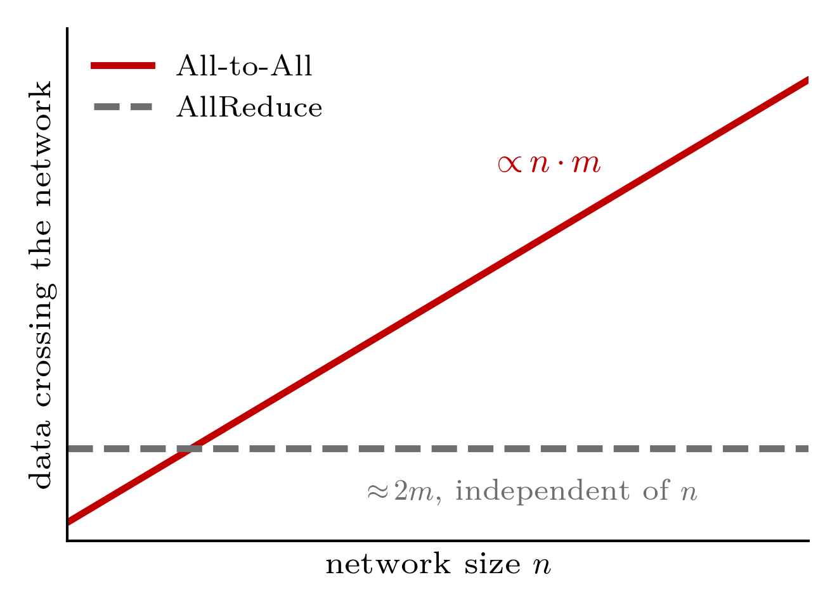
All-to-All: everyone sends to everyone
Training and inference require synchronizations across accelerators
Example: All-to-All — each node sends a unique message to every other node
All-to-All cost grow linearly with n in rings topologies with network size
Notes:
Training and inference require synchronizations across accelerators
Collective primitives define initial/final synchronization state
Collective algorithms realize primitives in communication phases
Example: All-to-All Primitive
each node sends a unique
message to every other node
Pairwise algorithm:
each message is routed
via shortest path

Slide 4
All-to-All: everyone sends to everyone
Training and inference require synchronizations across accelerators
Example: All-to-All — each node sends a unique message to every other node
All-to-All cost grow linearly with n in rings topologies with network size
All-to-All cost grow linearly with n in rings topologies with network size
Can we use reconfigurable networks to fix this problem?
Notes:
Training and inference require synchronizations across accelerators
Collective primitives define initial/final synchronization state
Collective algorithms realize primitives in communication phases
Example: All-to-All Primitive
each node sends a unique
message to every other node
Pairwise algorithm:
each message is routed
via shortest path

Slide 5
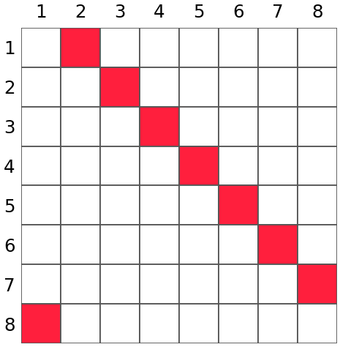
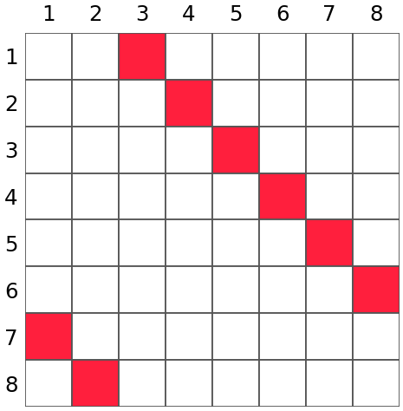
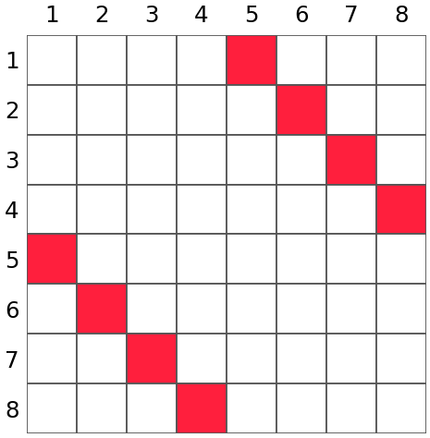
Collectives match reconfigurable networks
Collectives naturally offer:
Known demand matrices
Node synchronization between phases
Concurrent transmissions have equal cost
Natural opportunities to reconfigure

Slide 6

Collectives match reconfigurable networks
Collectives naturally offer:
Known demand matrices
Node synchronization between phases
Concurrent transmissions have equal cost
Natural opportunities to reconfigure
Common reconfiguration approaches:
One-shot: before collective operations
Dynamic: between each collective phases
K=0
K=1
K=2
K=0,1,2,...

Slide 7
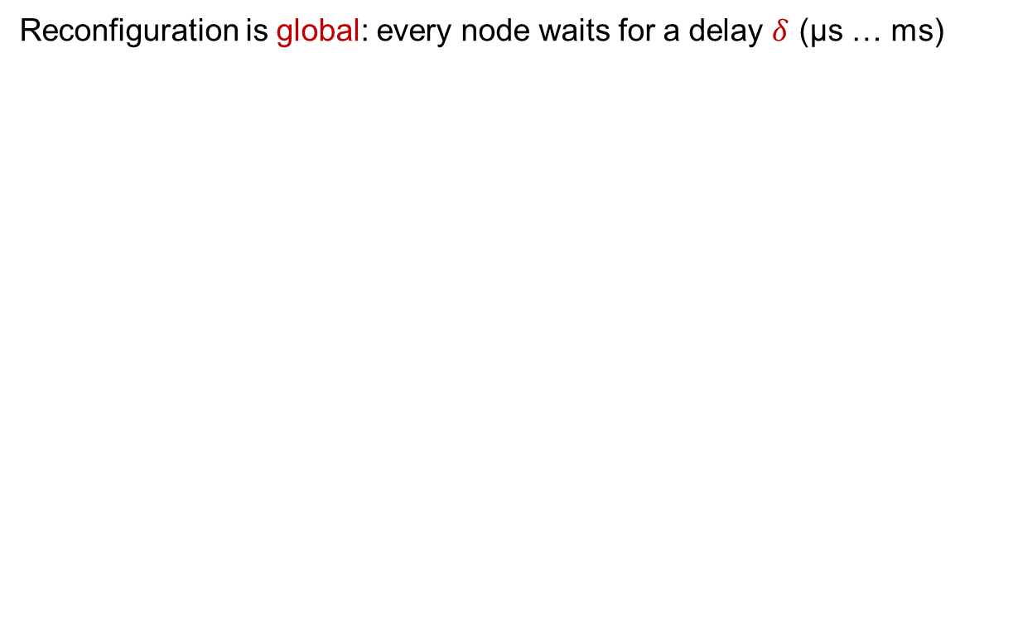
Optimization problem
Reconfiguration is global: every node waits for a delay $δ$ (µs … ms)

Slide 8
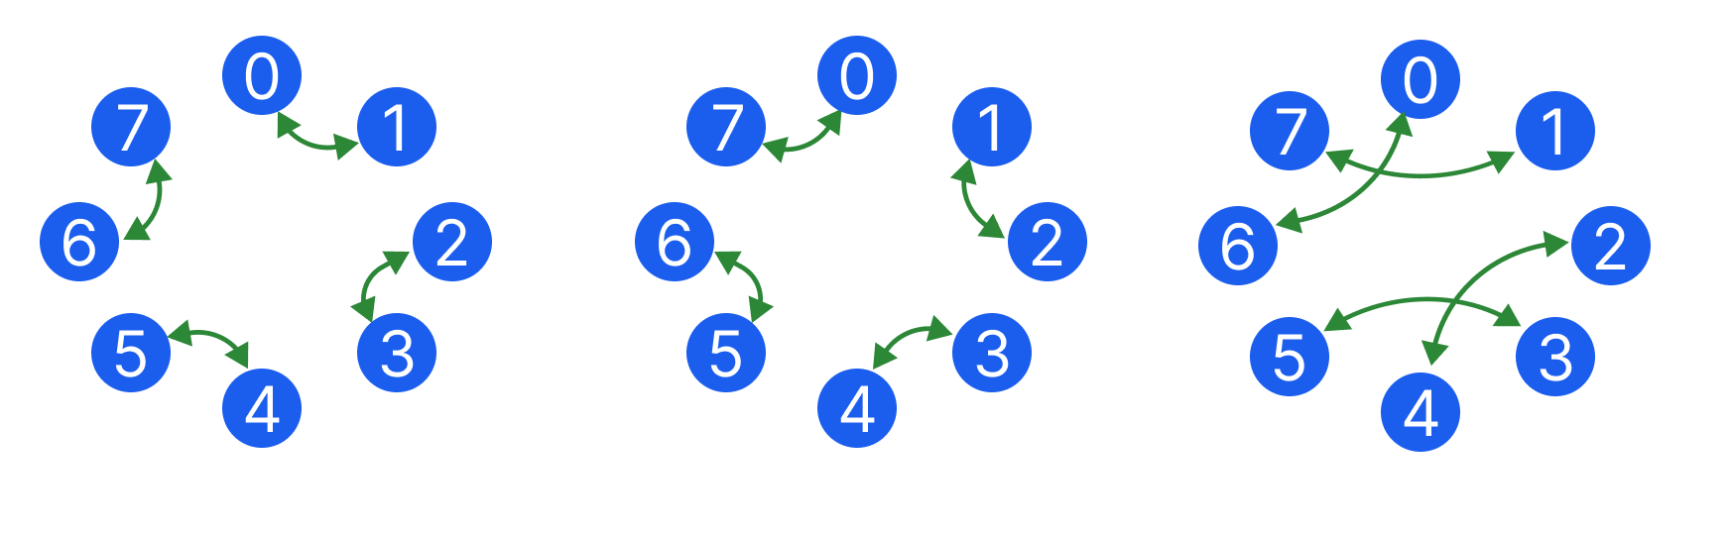
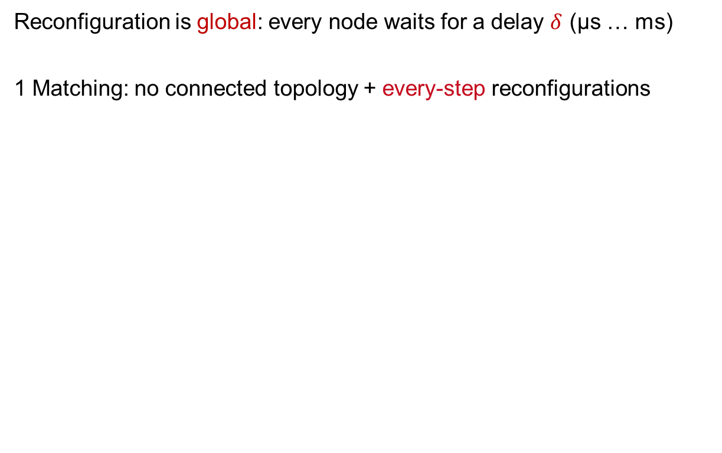
Optimization problem
Reconfiguration is global: every node waits for a delay $δ$ (µs … ms)
1 Matching: no connected topology + every-step reconfigurations
Phase 0
Phase 1
Phase 2

Slide 9
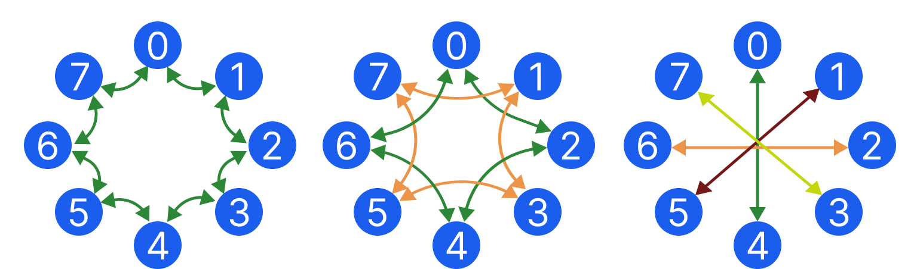
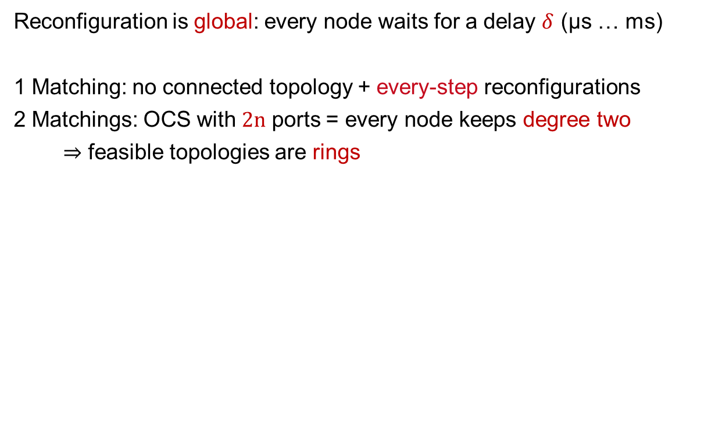
Optimization problem
Reconfiguration is global: every node waits for a delay $δ$ (µs … ms)
1 Matching: no connected topology + every-step reconfigurations
2 Matchings: OCS with 2n ports = every node keeps degree two
⇒ feasible topologies are rings
Ring topology
Small subrings

Slide 10
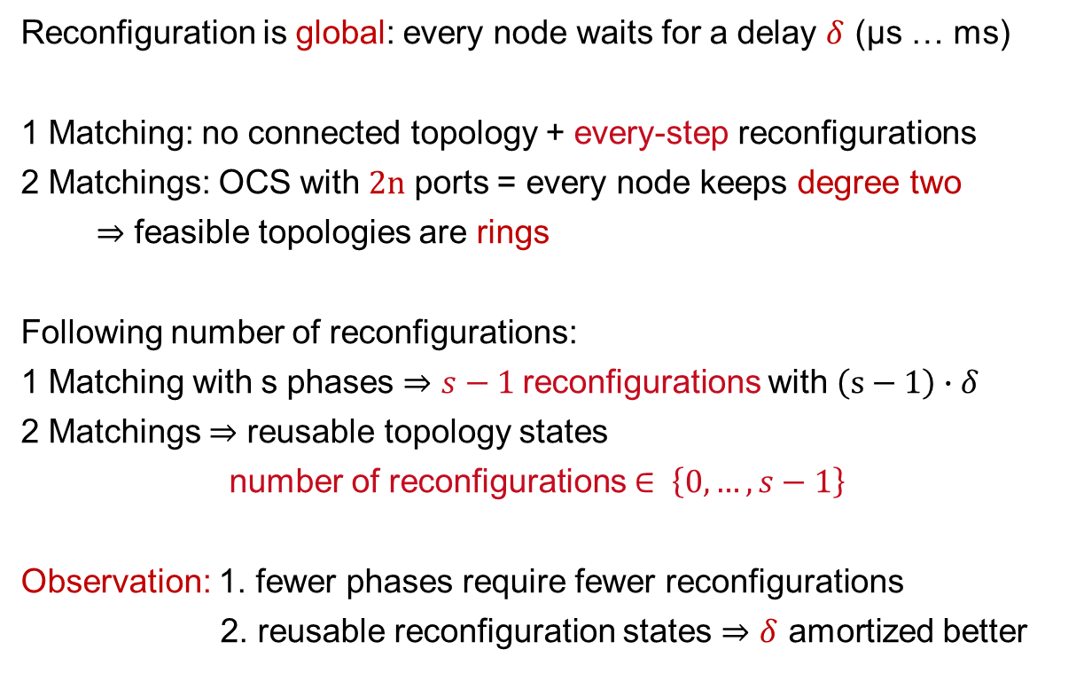
Optimization problem
Reconfiguration is global: every node waits for a delay $δ$ (µs … ms)
1 Matching: no connected topology + every-step reconfigurations
2 Matchings: OCS with 2n ports = every node keeps degree two
⇒ feasible topologies are rings
Following number of reconfigurations:
1 Matching with s phases ⇒ $s−1$reconfigurations with $\left(s−1\right)∙δ$
2 Matchings ⇒ reusable topology states
number of reconfigurations $∈ \left\{0,…,s−1\right\}$
Observation: 1. fewer phases require fewer reconfigurations
2. reusable reconfiguration states ⇒ $δ$ amortized better

Slide 11
Challenges in reconfigurable All-to-All
Pairwise A2A: each node sends block directly to its destination

Slide 12
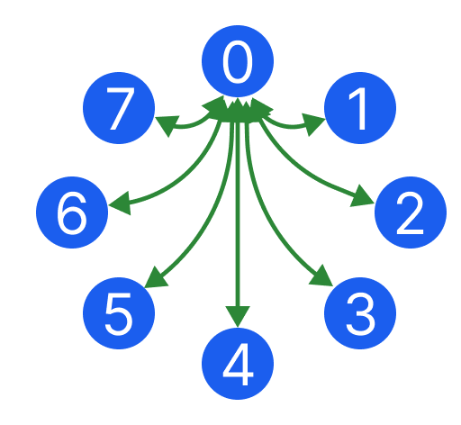
Challenges in reconfigurable All-to-All
Pairwise A2A: each node sends block directly to its destination
Option 1: one step with all simultaneous communication
Transmissions from node 0

Slide 13
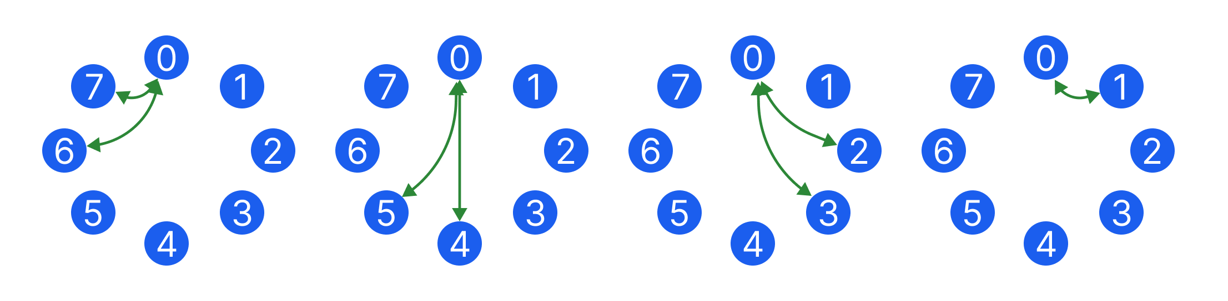
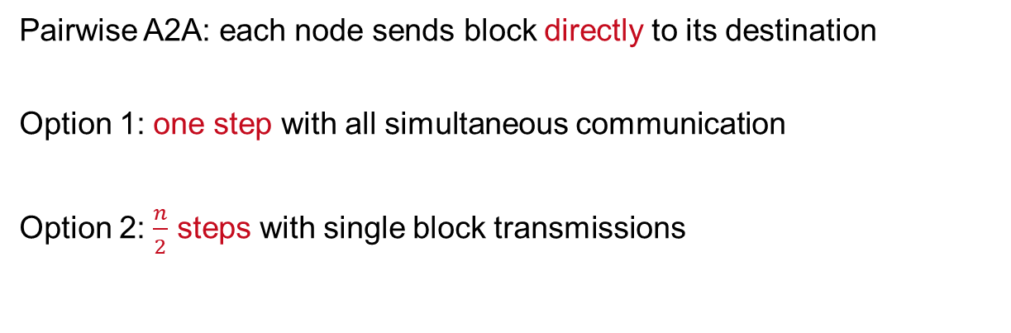
Challenges in reconfigurable All-to-All
Pairwise A2A: each node sends block directly to its destination
Option 1: one step with all simultaneous communication
Option 2: $\frac{n}{2}$ steps with single block transmissions
Step 0
Step 1
Step 2
Step 3

Slide 14
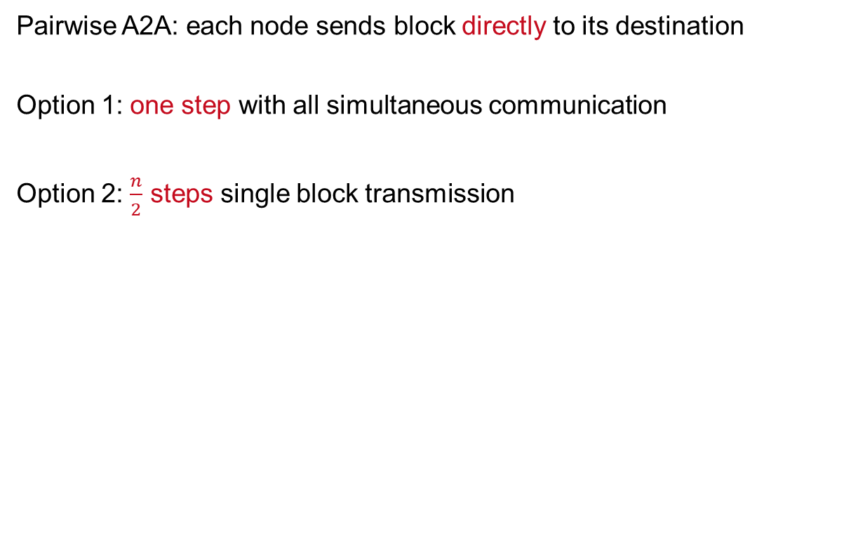
Challenges in reconfigurable All-to-All
Pairwise A2A: each node sends block directly to its destination
Option 1: one step with all simultaneous communication
Option 2: $\frac{n}{2}$ steps single block transmission
Observation: Both implementations are not feasible for reconfigurable networks
Step 0
Step 1
Step 2
Step 3

Slide 15
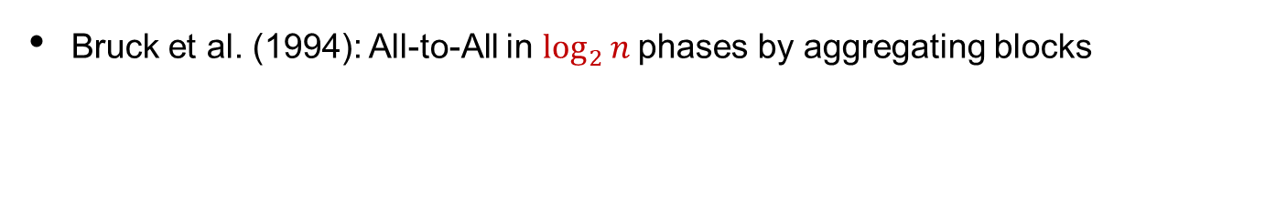
Bruck‘s algorithm for reconfigurable networks
Bruck et al. (1994): All-to-All in $\log_{2}{n }$phases by aggregating blocks

Slide 16
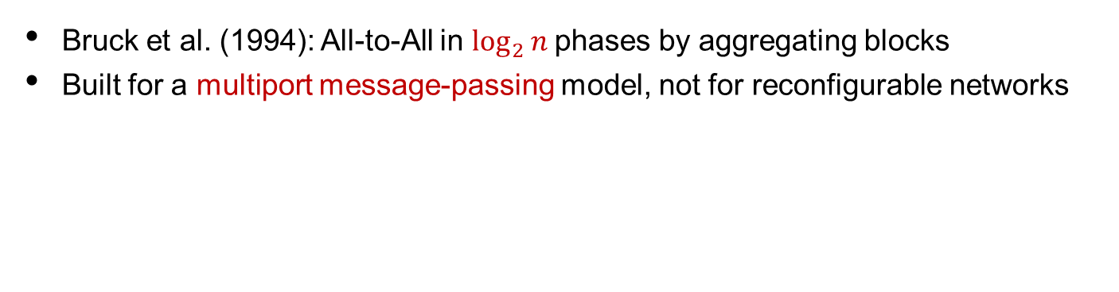
Bruck‘s algorithm for reconfigurable networks
Bruck et al. (1994): All-to-All in $\log_{2}{n }$phases by aggregating blocks
Built for a multiport message-passing model, not for reconfigurable networks

Slide 17
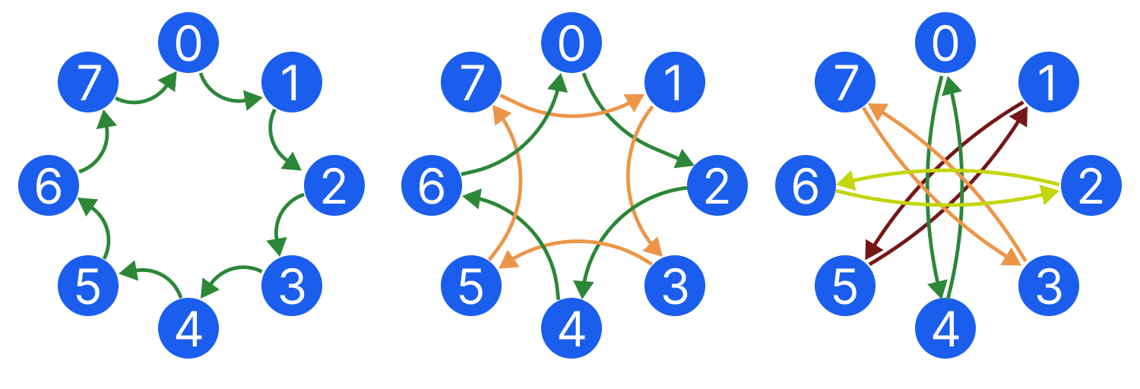
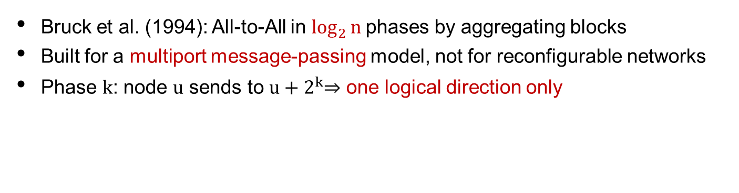
Bruck‘s algorithm for reconfigurable networks
Bruck et al. (1994): All-to-All in $\log_{2}{n }$phases by aggregating blocks
Built for a multiport message-passing model, not for reconfigurable networks
Phase k: node u sends to $u+2^{k}$⇒ one logical direction only
Phase 0
Phase 1
Phase 2

Slide 18


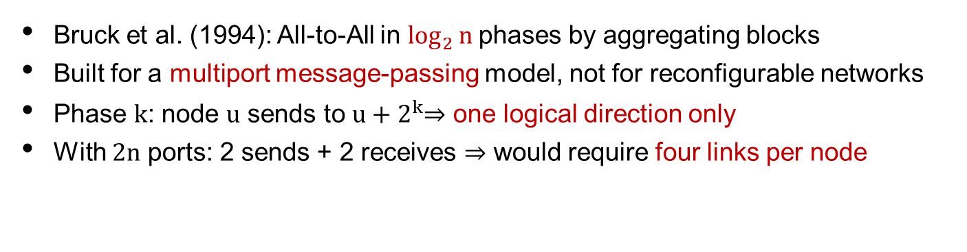



Bruck‘s algorithm for reconfigurable networks
Bruck et al. (1994): All-to-All in $\log_{2}{n }$phases by aggregating blocks
Built for a multiport message-passing model, not for reconfigurable networks
Phase k: node u sends to $u+2^{k}$⇒ one logical direction only
With 2n ports: 2 sends + 2 receives ⇒ would require four links per node
$$u−{2∙3}^{k}$$
$$u+3^{k}$$
$$u$$
$$u−3^{k}$$
$$u+{2∙3}^{k}$$

Slide 19
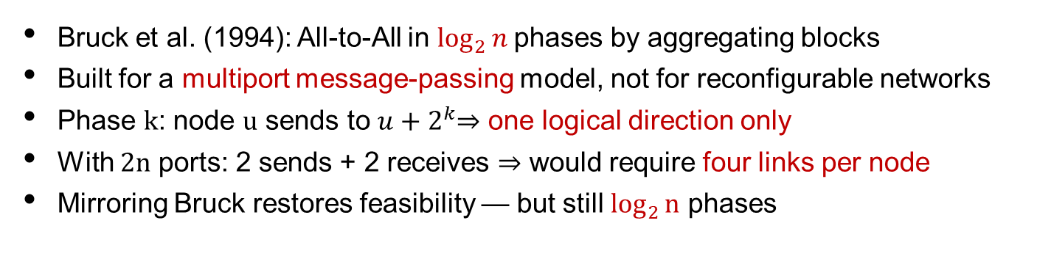
Bruck‘s algorithm for reconfigurable networks
Bruck et al. (1994): All-to-All in $\log_{2}{n }$phases by aggregating blocks
Built for a multiport message-passing model, not for reconfigurable networks
Phase k: node u sends to $u+2^{k}$⇒ one logical direction only
With 2n ports: 2 sends + 2 receives ⇒ would require four links per node
Mirroring Bruck restores feasibility — but still $\log_{2}{n}$ phases

Slide 20
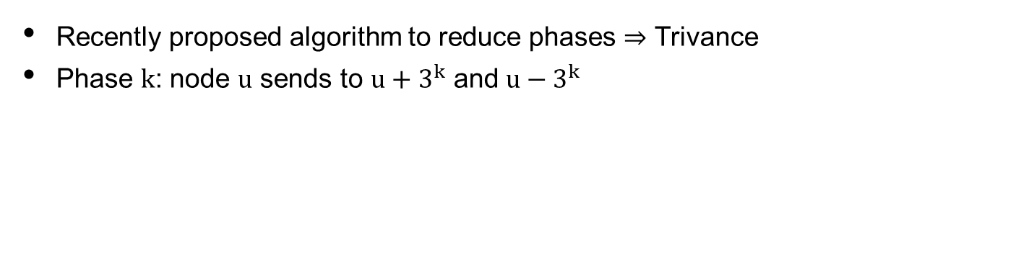
ReTri: Reconfigurable Trivance
18th August SIGCOMM
1:50 PM Research Session 3
Recently proposed algorithm to reduce phases ⇒ Trivance
Phase k: node $u$ sends to $u+3^{k}$ and $u−3^{k}$

Slide 21
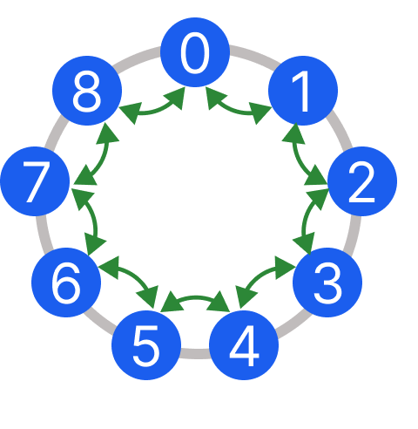
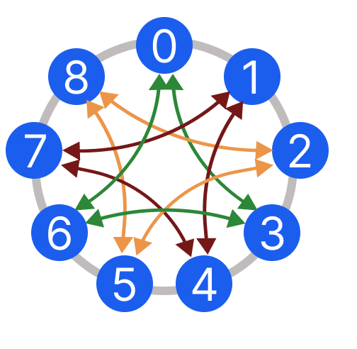
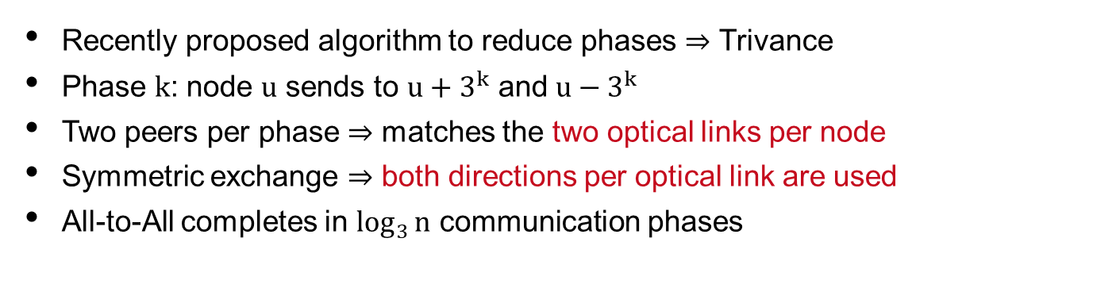
ReTri: Reconfigurable Trivance
Recently proposed algorithm to reduce phases ⇒ Trivance
Phase k: node $u$ sends to $u+3^{k}$ and $u−3^{k}$
Two peers per phase ⇒ matches the two optical links per node
Symmetric exchange ⇒ both directions per optical link are used
All-to-All completes in $\log_{3}{n}$ communication phases
Case: Topology remains static
Phase 0
Phase 1

Slide 22
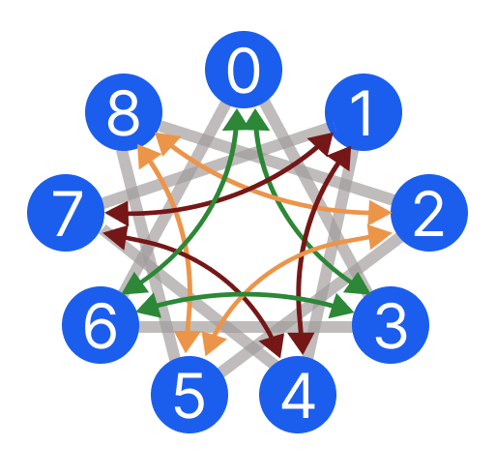
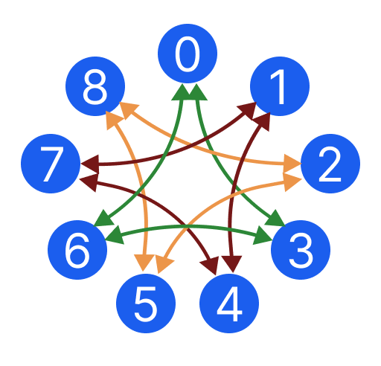
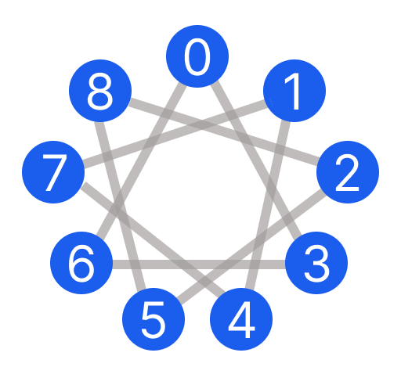
ReTri: Reconfigurable Trivance
Recently proposed algorithm to reduce phases ⇒ Trivance
Phase k: node $u$ sends to $u+3^{k}$ and $u−3^{k}$
Two peers per phase ⇒ matches the two optical links per node
Symmetric exchange ⇒ both directions per optical link are used
All-to-All completes in $\log_{3}{n}$ communication phases
Case: Reconfiguration
+
Phase 0
Communication pattern
Topology reconfiguration

Slide 23
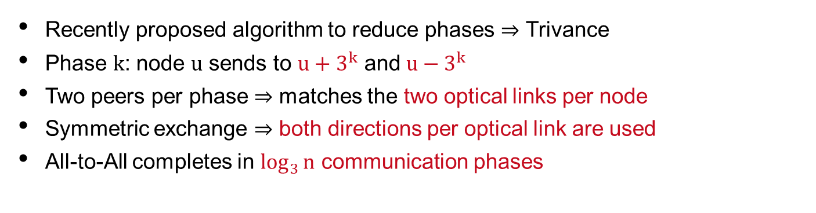
ReTri: Reconfigurable Trivance
Recently proposed algorithm to reduce phases ⇒ Trivance
Phase k: node $u$ sends to $u+3^{k}$ and $u−3^{k}$
Two peers per phase ⇒ matches the two optical links per node
Symmetric exchange ⇒ both directions per optical link are used
All-to-All completes in $\log_{3}{n}$ communication phases
Case: Reconfiguration
Minimal communication cost
Phase 0
Phase 1

Slide 24
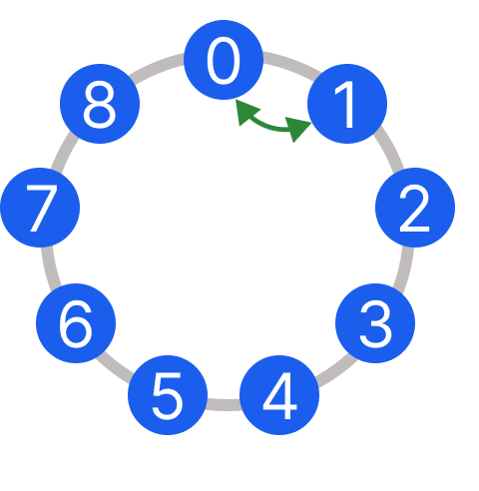
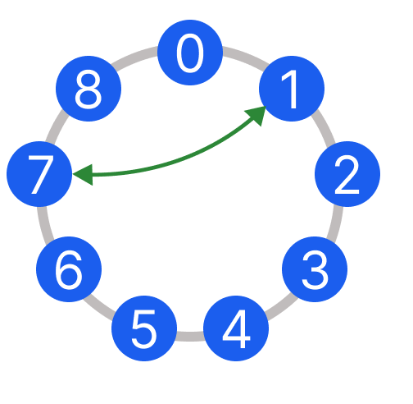
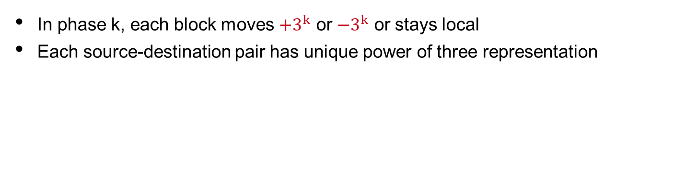
ReTri: block propagation
In phase k, each block moves $+3^{k}$ or $−3^{k}$ or stays local
Each source-destination pair has unique power of three representation
Block propagation from node 0 to node 7:
Phase 0
Phase 1

Slide 25
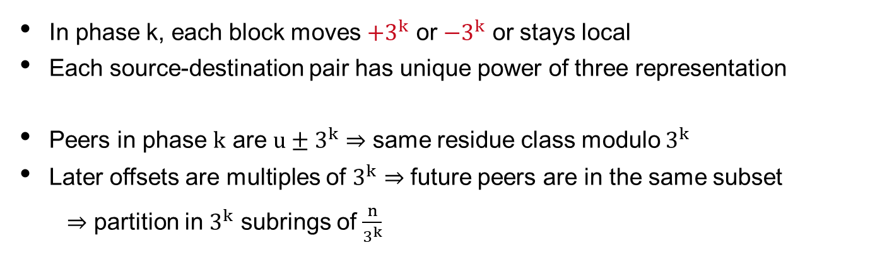
ReTri: ternary subrings
In phase k, each block moves $+3^{k}$ or $−3^{k}$ or stays local
Each source-destination pair has unique power of three representation
Peers in phase k are $u±3^{k}$ ⇒ same residue class modulo $3^{k}$
Later offsets are multiples of $3^{k}$ ⇒ future peers are in the same subset
  ⇒ partition in $3^{k}$ subrings of $\frac{n}{3^{k}}$
Phase 0
Phase 1

Slide 26
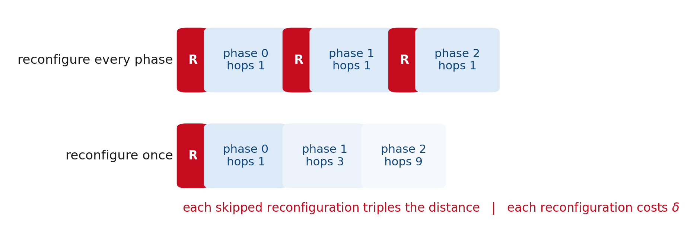
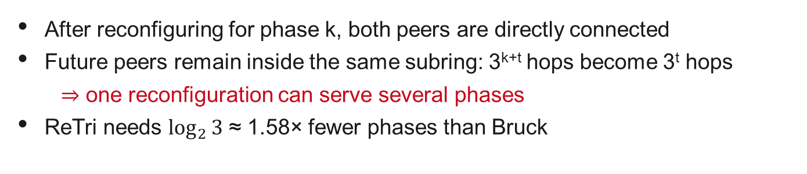
Reconfiguration: reuse instead of repeat
After reconfiguring for phase k, both peers are directly connected
Future peers remain inside the same subring: 3^{k+t} hops become 3^{t} hops
⇒ one reconfiguration can serve several phases
ReTri needs $\log_{2}{3}$ ≈ 1.58× fewer phases than Bruck

Slide 27
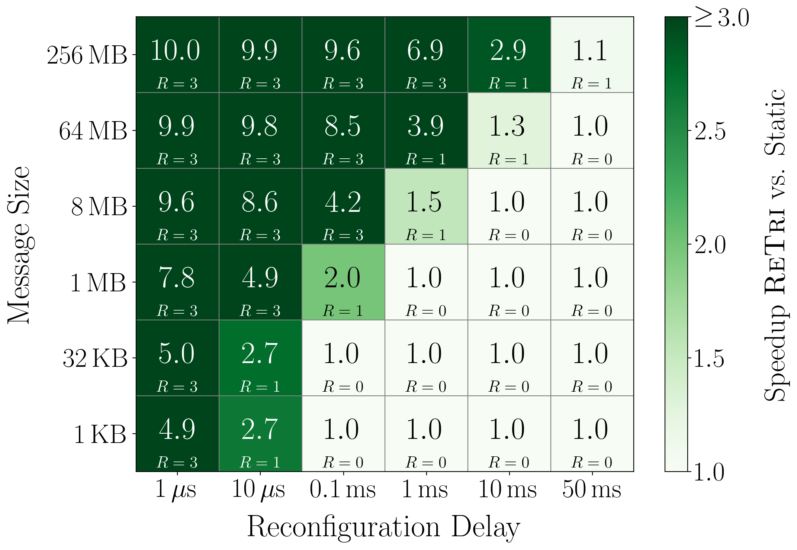
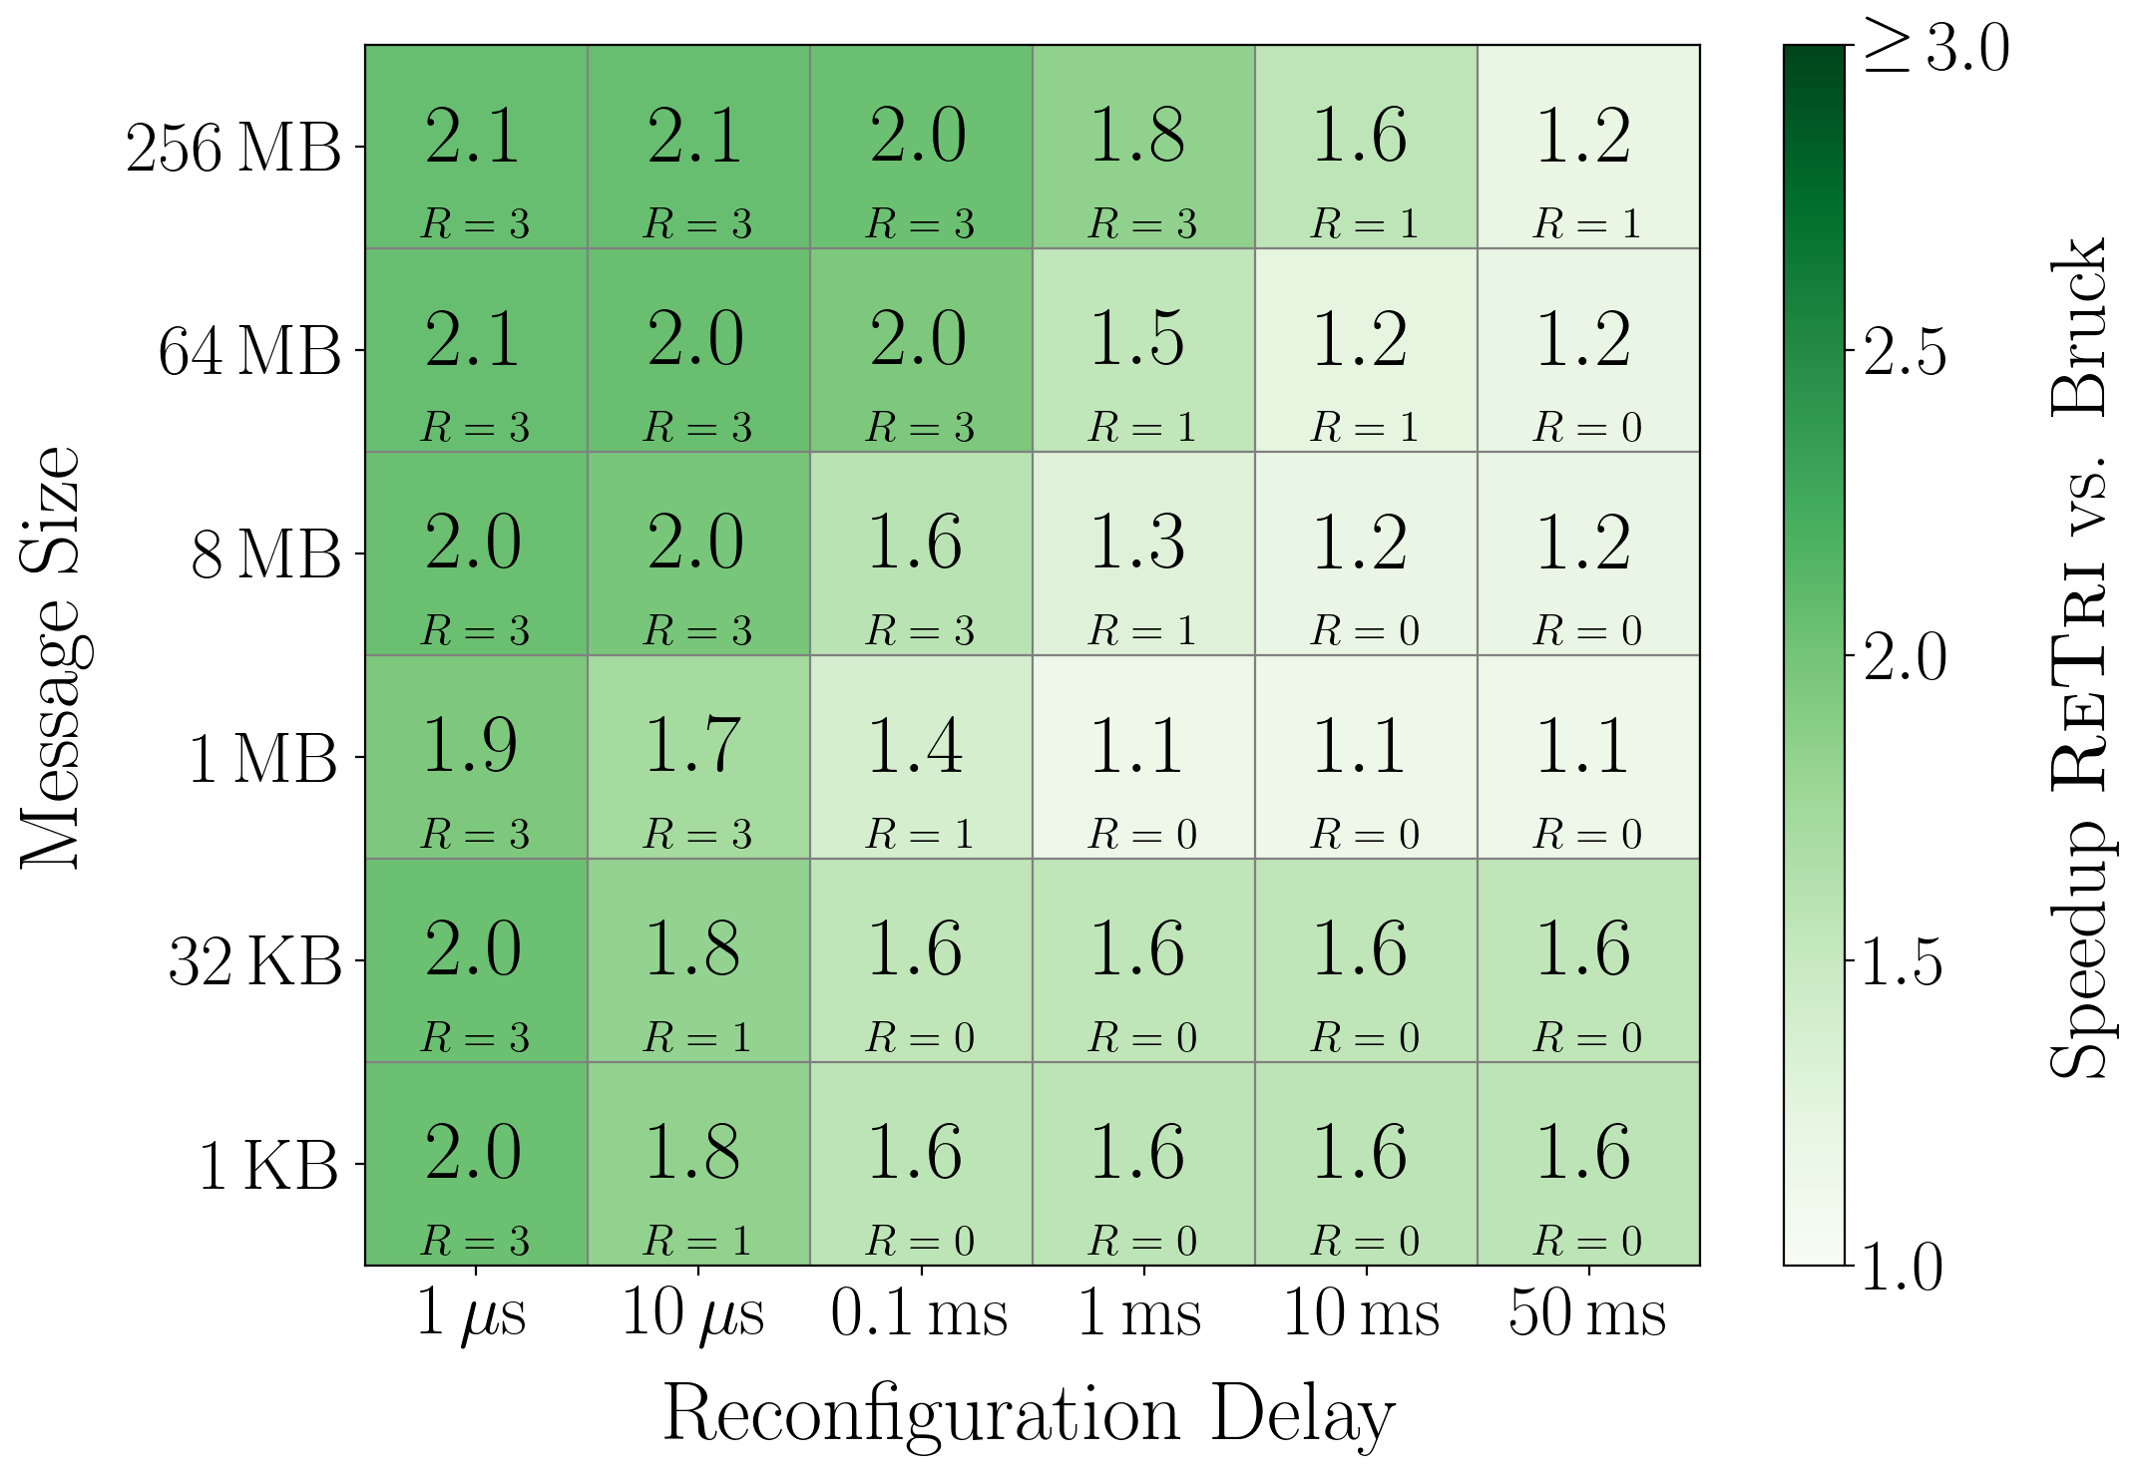
Simulation with Astra-Sim/ns-3
Astra-Sim + ns-3 · 400 Gb/s links · 1 µs link latency · 1.7 µs per phase latency · Messages 1 KB – 256 MB · $δ$ = 100ns – 50 ms · ReTri n = 81 vs. Bruck n = 64
Trivance vs. Static
Trivance vs. Reconf. Bruck

Slide 28
Simulation with Astra-Sim/ns-3
Astra-Sim + ns-3 · 400 Gb/s links · 1 µs link latency · 1.7 µs per phase latency · Messages 1 KB – 256 MB · $δ$ = 100ns – 50 ms · ReTri n = 81 vs. Bruck n = 64
Trivance vs. Static
Trivance vs. Reconf. Bruck
Speedup increases vs. Static with message size

Slide 29
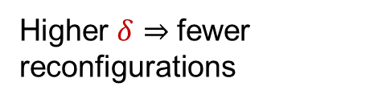
Simulation with Astra-Sim/ns-3
Astra-Sim + ns-3 · 400 Gb/s links · 1 µs link latency · 1.7 µs per phase latency · Messages 1 KB – 256 MB · $δ$ = 100ns – 50 ms · ReTri n = 81 vs. Bruck n = 64
Trivance vs. Static
Trivance vs. Reconf. Bruck
Speedup increases vs. Static with message size
Higher $δ$ ⇒ fewer reconfigurations

Slide 30
Simulation with Astra-Sim/ns-3
Astra-Sim + ns-3 · 400 Gb/s links · 1 µs link latency · 1.7 µs per phase latency · Messages 1 KB – 256 MB · $δ$ = 100ns – 50 ms · ReTri n = 81 vs. Bruck n = 64
Trivance vs. Static
Trivance vs. Reconf. Bruck
Speedup increases vs. Static with message size
Higher $δ$ ⇒ fewer reconfigurations
Improvement is
constant

Slide 31
Simulation with Astra-Sim/ns-3
Astra-Sim + ns-3 · 400 Gb/s links · 1 µs link latency · 1.7 µs per phase latency · Messages 1 KB – 256 MB · $δ$ = 100ns – 50 ms · ReTri n = 81 vs. Bruck n = 64
Trivance vs. Static
Trivance vs. Reconf. Bruck
Speedup increases vs. Static with message size
Without reconfigs.
ReTri still improves Bruck
Higher $δ$ ⇒ fewer reconfigurations
Improvement is
constant

Slide 32
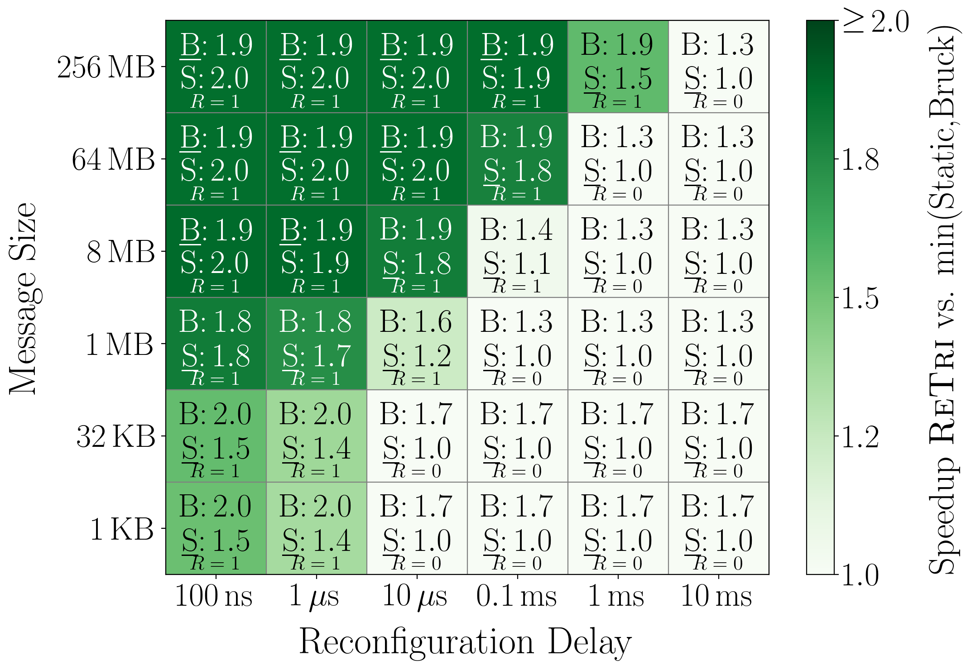
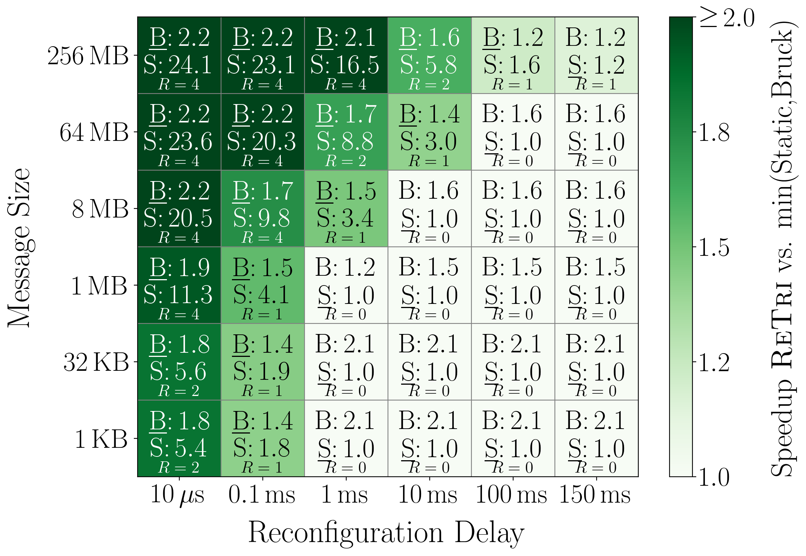
Simulation with Astra-Sim/ns-3
Astra-Sim + ns-3 · 400 Gb/s links · 1 µs link latency · 1.7 µs per phase latency · Messages 1 KB – 256 MB · $δ$ = 100ns – 50 ms · ReTri n = 81 vs. Bruck n = 64
Network size = 8/9
Network size = 256/243
Continuous improvement over Bruck by 1.3-2.2

Slide 33
Simulation with Astra-Sim/ns-3
Astra-Sim + ns-3 · 400 Gb/s links · 1 µs link latency · 1.7 µs per phase latency · Messages 1 KB – 256 MB · $δ$ = 100ns – 50 ms · ReTri n = 81 vs. Bruck n = 64
Network size = 8/9
Network size = 256/243
Continuous improvement over Bruck by 1.7-2.2
Larger networks = larger speedups

Slide 34
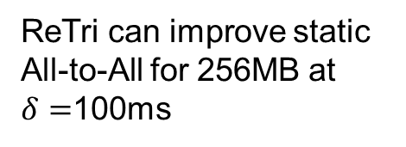
Simulation with Astra-Sim/ns-3
Astra-Sim + ns-3 · 400 Gb/s links · 1 µs link latency · 1.7 µs per phase latency · Messages 1 KB – 256 MB · $δ$ = 100ns – 50 ms · ReTri n = 81 vs. Bruck n = 64
Network size = 8/9
Network size = 256/243
Continuous improvement over Bruck by 1.7-2.2
Larger networks = larger speedups
ReTri can improve static All-to-All for 256MB at
$δ=$100ms

Slide 35
Summary
Objectives for collectives in reconfigurable networks:
⇒ algorithms need to follow constrains of reconfigurable networks
⇒ reduction of required communication phases
⇒ reusable reconfigurable links

Slide 36
Summary
Objectives for collectives in reconfigurable networks:
⇒ algorithms need to follow constrains of reconfigurable networks
⇒ reduction of required communication phases
⇒ reusable reconfigurable links
Reconfigurations during collective
operations become desirable when:
⇒ Networks increase in size
⇒ Message size increases
⇒ Reconfiguration delay decreases

Slide 37
Summary
Objectives for collectives in reconfigurable networks:
⇒ algorithms need to follow constrains of reconfigurable networks
⇒ reduction of required communication phases
⇒ reusable reconfigurable links
Reconfigurations during collective
operations become desirable when:
⇒ Networks increase in size
⇒ Message size increases
⇒ Reconfiguration delay decreases
Thank you!
Email: juerss@campus.tu-berlin.de

