Slide 1

Democracy for DAOs
An Empirical Study of Decentralized Governance and Dynamics
Burak Arda Okutan¹, Stefan Schmid¹, Yvonne-Anne Pignolet²
¹TU Berlin, ²DFINITY Foundation

Slide 2

Introduction to DAOs
Decentralized Autonomous Organizations
Shift power from centralized authorities to distributed communities.
Enable collective decision-making through smart contracts and token voting.

Slide 3

Challenges in DAO Governance
Voter fatigue and disengagement.
High operational costs (gas fees)
Slow decision-making and proposal delays.
=> Little scalability and effectiveness.

Slide 4


SNS DAO Framework on ICP
Liquid democracy: Hybrid of direct and delegated voting.
Reverse gas model removes tx fees for voters.
Voting rewards incentivize participation

Slide 5
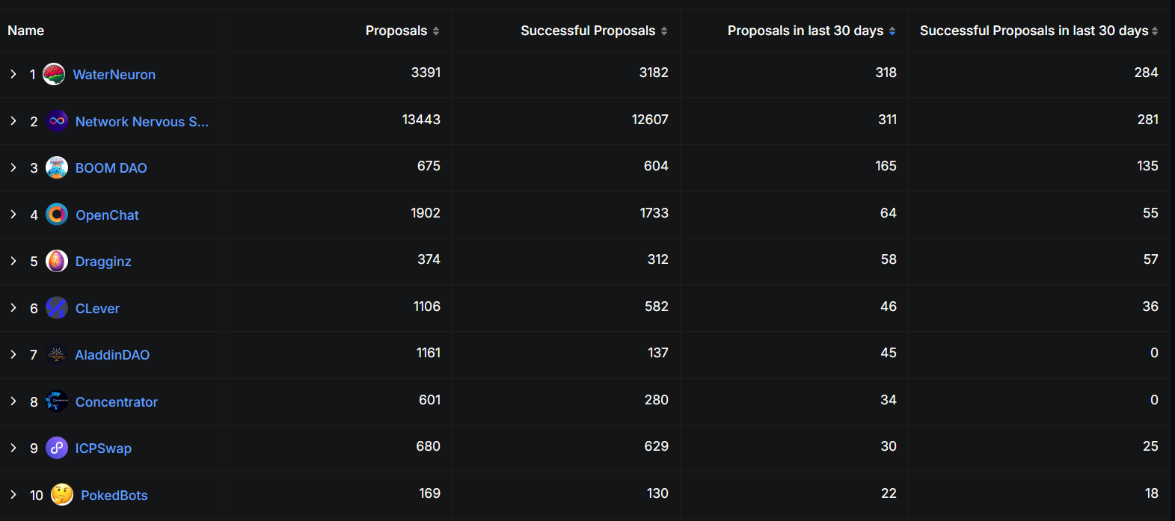


Most Active DAOs in the last 30 Days

Slide 6
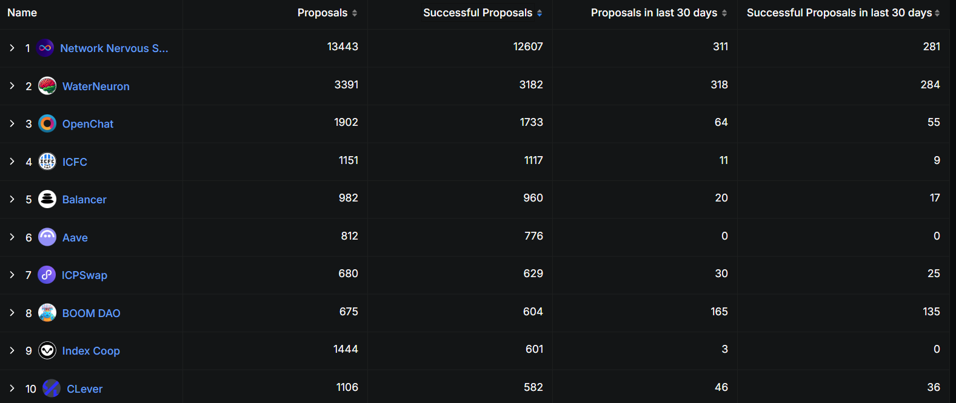
DAOs with the Most Proposals

Slide 7


Internet Computer Protocol (ICP)
Decentralized compute platform
Fast, scalable smart contracts called canisters
Reverse gas model: paid by developers, not user

Slide 8
Service Nervous System (SNS)
Application-specific DAOs running on ICP
Customizable per DAO.
Voting power based on locked tokens and lock duration.
Topic-based delegation and token rewards.

Slide 9
Research Questions
How do SNS DAOs perform on participation, approval, and decision speed?
What are the temporal trends in SNS governance activity?
Which design features influence these governance dynamics?
How do SNS DAOs compare with Ethereum DAOs on governance efficiency?

Slide 10
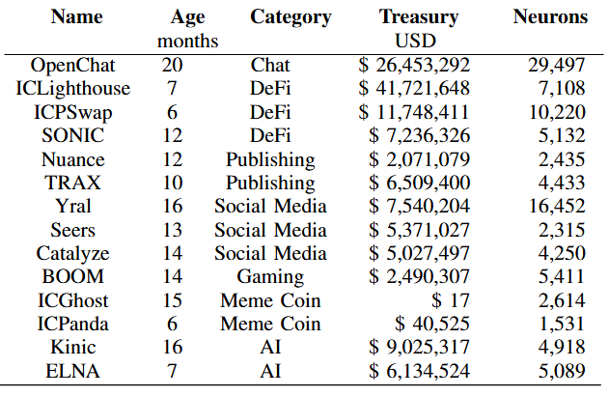
Data Set

Slide 11
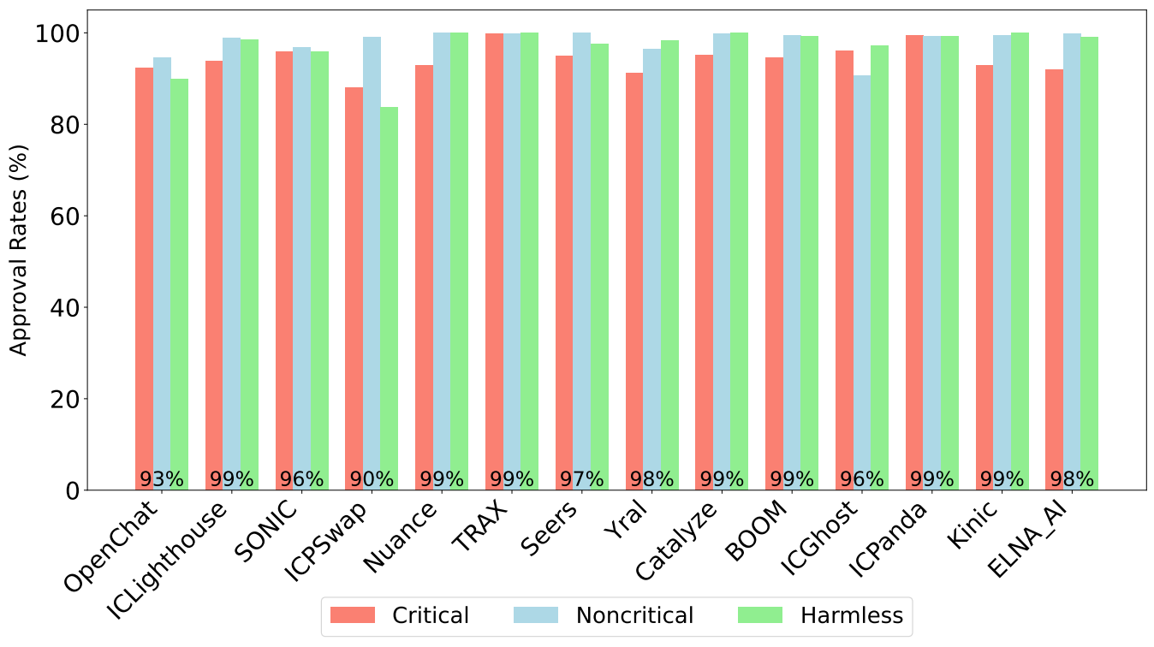
Voting power in favour/total power exercised
Mean
SNS 97%
Compound 89%, Aragon 94%, DAOstack 86%, DAOhaus 91%
motions and SNS canister upgrades

Slide 12
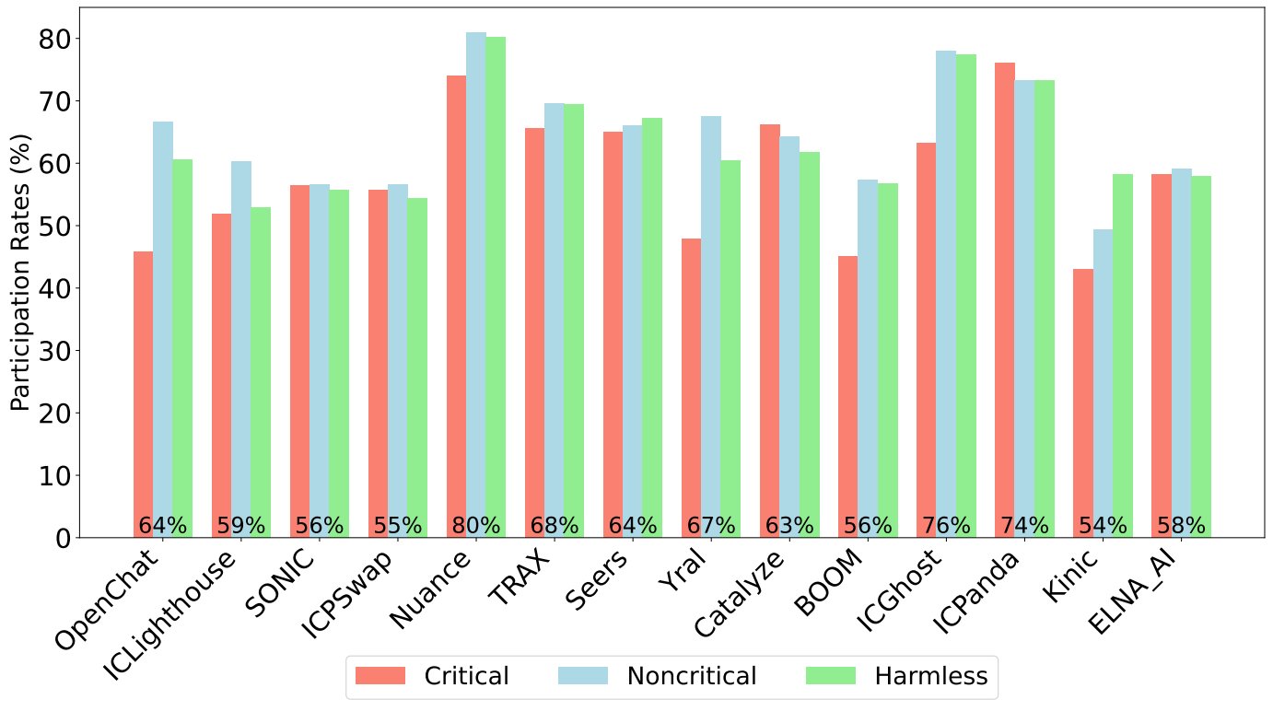
Mean
SNS 64%
Compound, UniSwap 31-34%, ENS 39.2%, Gitcoin, 28.6%,
Aragon / DAOstack 10%, DAOhaus 40%
Participating voting power (%)

Slide 13
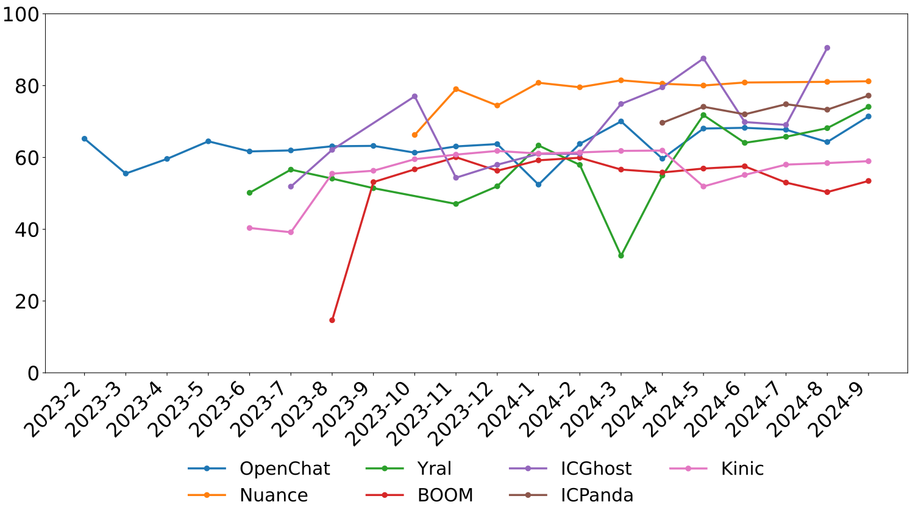
Participating voting power (%)
Related work reports drastically decreasing participation over time

Slide 14
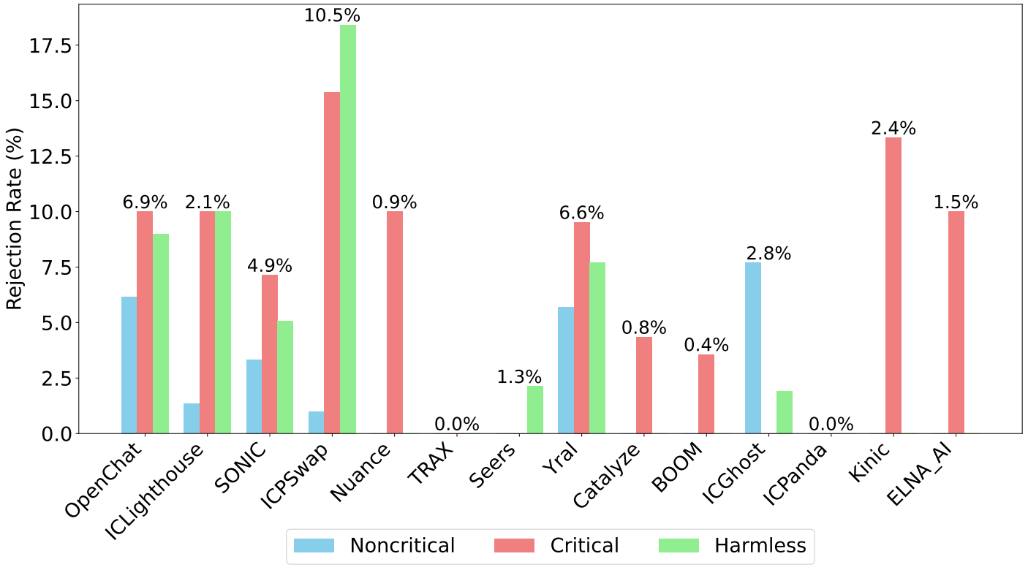
Number of rejected proposals (%)
Not considered in related work
Only treasury and motion proposals were ever rejected in critical and harmless topics

Slide 15
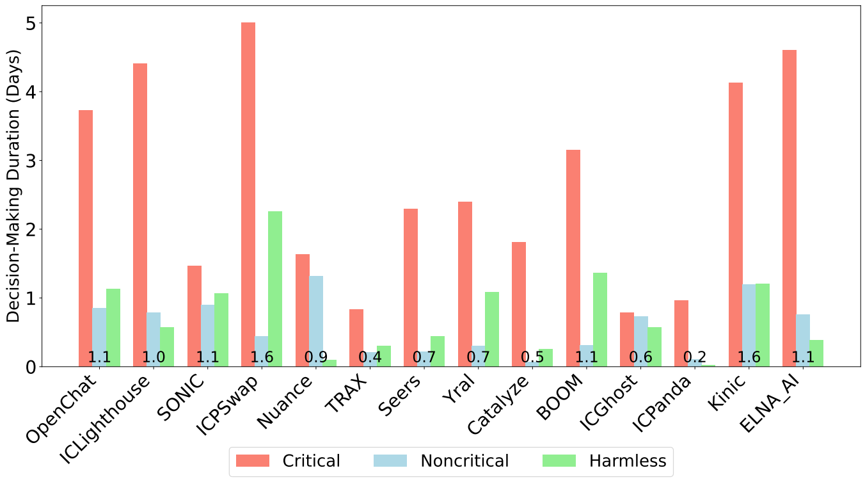
Proposal Durations for SNS DAOs
Mean
SNS 27h,
Compound and Uniswap similar, snapshot >2 days

Slide 16
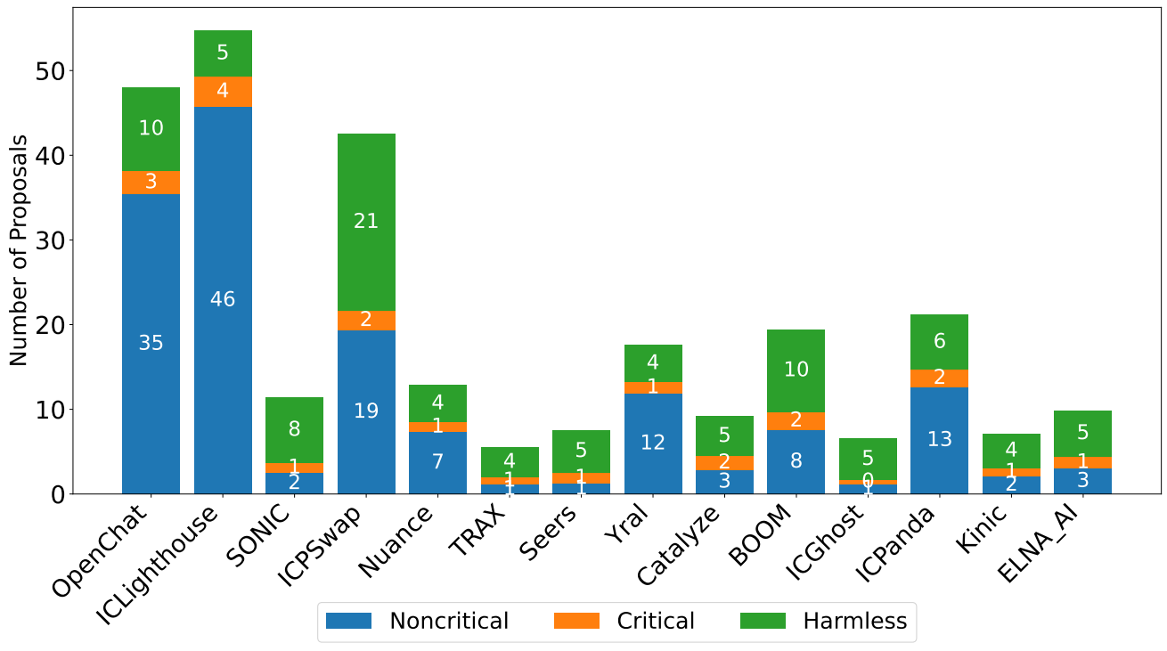
Monthly Frequency of Proposals
Mean
SNS 8, no decline over time
Compound 4.3 and Uniswap 1.7, decline over time

Slide 17
Summary
14 SNS DAOs
3000 proposals
Metrics
  participation rates
  voting power in favour/against
  frequency of proposals
  decision duration
Mean cost per proposal
-SNS <11 USD ,
-Gitcoin, Uniswap, Compound 2500-20,000 USD
In comparison to DAOs on other chains:
higher activity, faster decisions, lower costs,
sustained or increasing participation

Slide 18

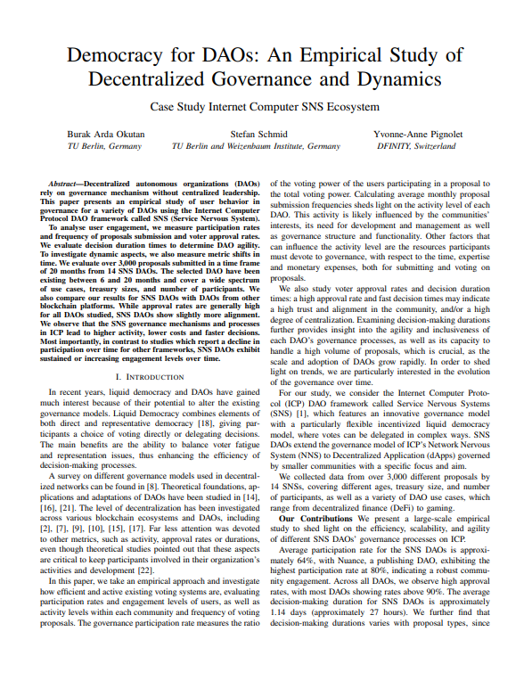
Questions & Answers
Thank you for your attention!
I welcome your questions and discussions.

