Slide 1
Anton Juerss¹³, Vamsi Addanki², Stefan Schmid¹³
1
2
3
Notes:
Result of joint collaboration

Slide 2
AllReduce and torus networks
AllReduce = Aggregation across all nodes — distribute result to all
Small AllReduce operations are increasingly latency-sensitive
SIGCOMM'26: DynamiQ: Accelerating Gradient Synchronization using Compressed Multi-hop All-reduce
Wenchen Han, Shay Vargaftik, Michael Mitzenmacher, Ran Ben Basat
SIGCOMM'26: OptCCL: Scalable Synthesis of Optimal Collective Communication Algorithms
Richard Shapley, Rachit Agarwal, David Shmoys
SIGCOMM'26: Harvest: Adaptive Photonic Switching Schedules for Collective Communication in Scale-up Domains
Mahir Rahman, Samuel Joseph, Nihar Kodkani, Vamsi Addanki et al.
SIGCOMM'26: Theseus: Runtime-Adaptive GPU Collective Communication with Hot-Swappable Schedules
Rui Ding, Xiandong Lu, Jiajun Wang, Xunpeng Liu et al.
SIGCOMM'25: SyCCL: Exploiting Symmetry for Efficient Collective Communication Scheduling
Jiamin Cao, Shangfeng Shi, Jiaqi Gao, Weisen Liu et al.
NSDI'25: OptiReduce: Resilient and Tail-Optimal AllReduce for Distributed Deep Learning in the Cloud
Ertza Warraich, Omer Shabtai, Khalid Manaa, Shay Vargaftik et al.
SIGCOMM'25: ResCCL: Resource-Efficient Scheduling for Collective Communication
Tongrui Liu, Chenyang Hei, Fuliang Li, Chengxi Gao et al.
NSDI'24: Swing: Short-cutting Rings for Higher Bandwidth Allreduce
Daniele De Sensi, Tommaso Bonato, David Saam, Torsten Hoefler
SC'21: Flare: Flexible In-Network Allreduce
Daniele De Sensi, Salvatore Di Girolamo, Saleh Ashkboos, Torsten Hoefler et al.
Notes:
Communication accounts for an increasing fraction of the overall execution.
Particularly for small vector sizes, latency rather than bandwidth becomes determining factor

Slide 3


AllReduce and torus networks
AllReduce = Aggregation across all nodes — distribute result to all
Small AllReduce operations are increasingly latency-sensitive
Torus = mesh/grid with wrap-around links
— every dimension is a ring
Neighbor links
Wrap-around links
Notes:
Communication accounts for an increasing fraction of the overall execution.
Particularly for small vector sizes, latency rather than bandwidth becomes determining factor

Slide 4
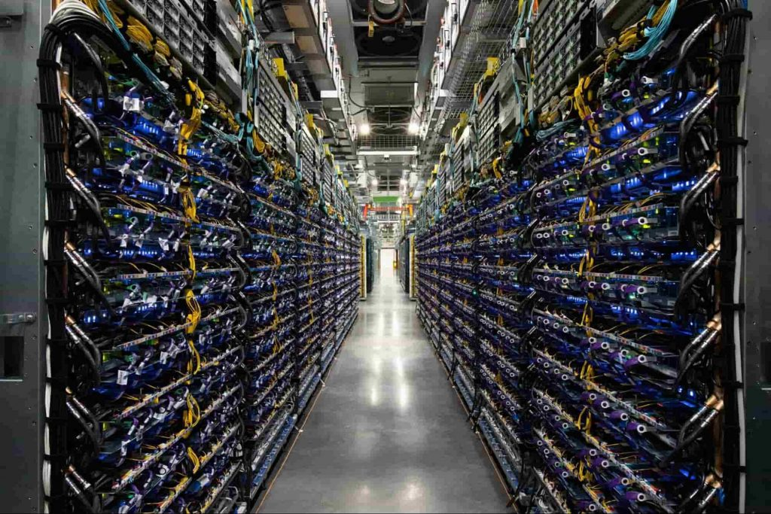
AllReduce and torus networks
AllReduce = Aggregation across all nodes — distribute result to all
Small AllReduce operations are increasingly latency-sensitive
Torus = mesh/grid with wrap-around links
— every dimension is a ring
Google TPU Pods
up to 4,096 chips on a 3D torus (TPUv4);
TPU 8t scales a superpod to 9,600
Neighbor links
Wrap-around links
AWS Trainium2 UltraServer
64 chips on a 4×4×4 3D torus
Notes:
Communication accounts for an increasing fraction of the overall execution.
Particularly for small vector sizes, latency rather than bandwidth becomes determining factor

Slide 5
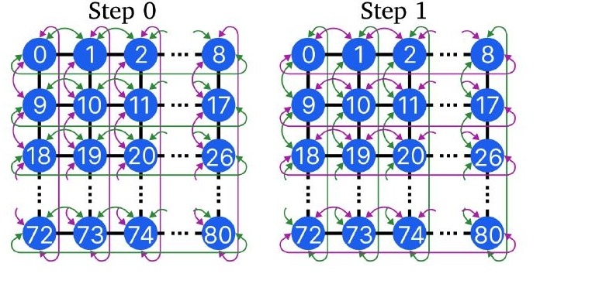
AllReduce and torus networks
AllReduce = Aggregation across all nodes — distribute result to all
Small AllReduce operations are increasingly latency-sensitive
Torus = mesh/grid with wrap-around links
— every dimension is a ring
Google TPU Pods
up to 4,096 chips on a 3D torus (TPUv4);
TPU 8t scales a superpod to 9,600
AWS Trainium2 UltraServer
64 chips on a 4×4×4 3D torus
Notes:
Mention congestion

Slide 6
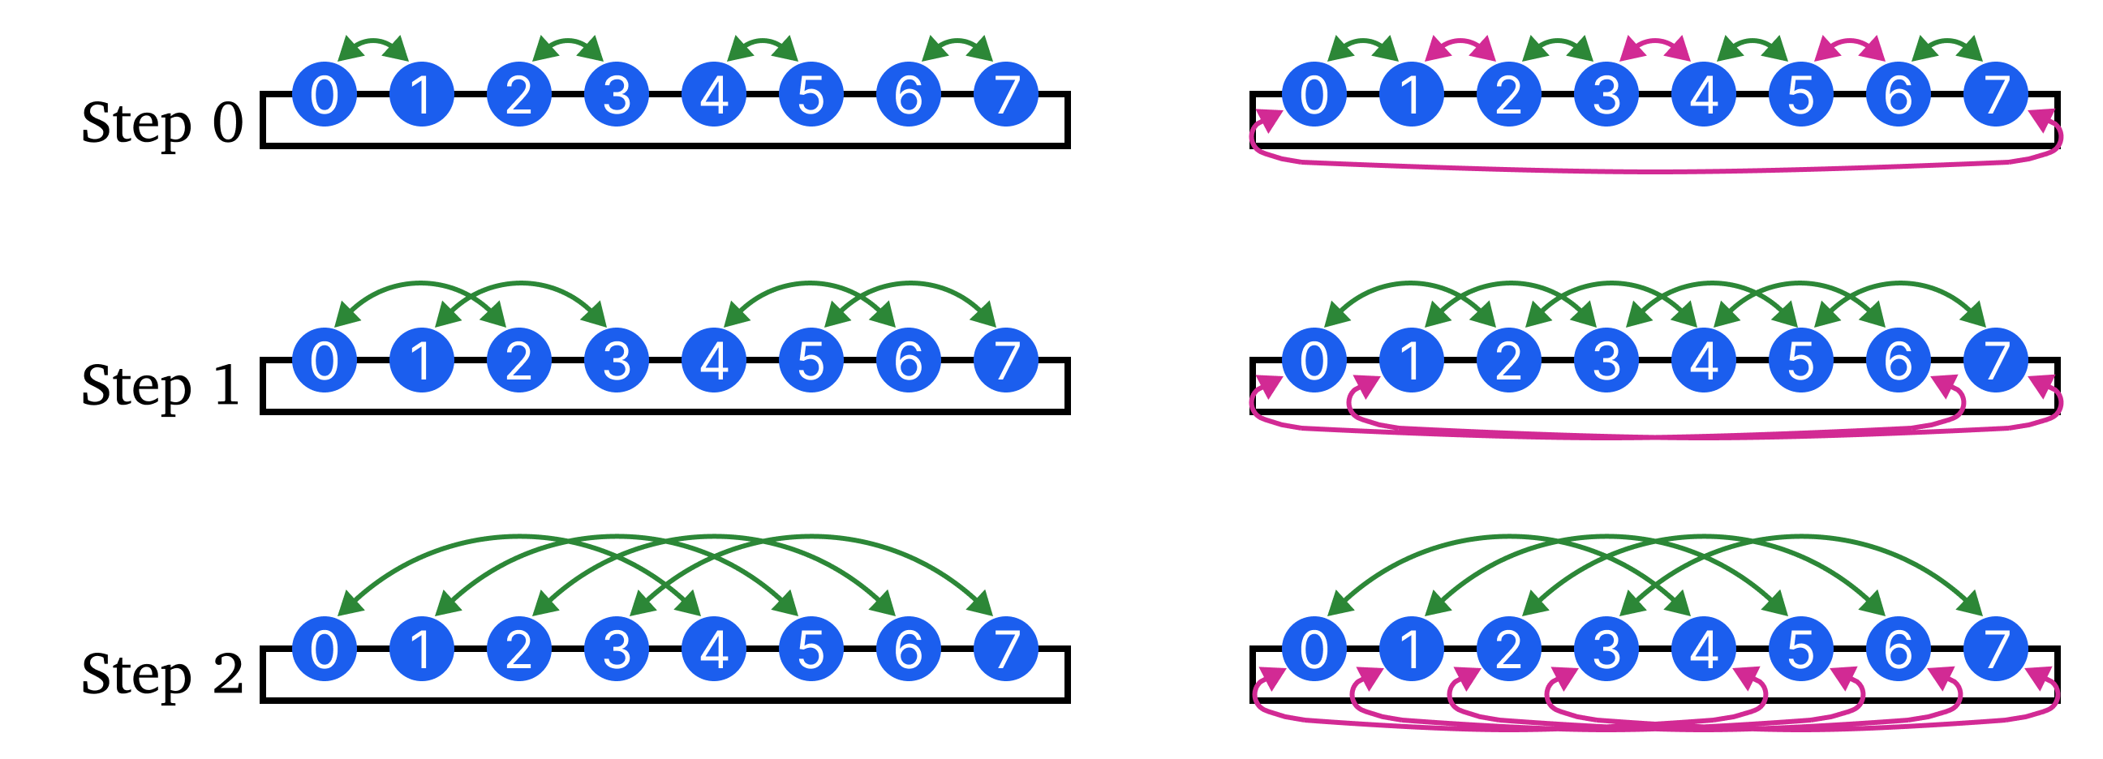
Existing multi-port extension: collective mirroring
Single-port
Multi-port with mirroring
Original AllReduce
Mirrored AllReduce

Slide 7
Existing multi-port extension: collective mirroring
Single-port
Multi-port with mirroring
Result: available bandwidth doubles — latency remains identical

Slide 8
Existing multi-port extension: collective mirroring
Single-port
Multi-port with mirroring
Result: available bandwidth doubles — latency remains identical
Research Questions: Can both ports serve the same collective?
Reduce the number of communication steps?
Minimize the communication distance?

Slide 9
Trivance
↔
Use BOTH ports simultaneously
⊕
Joint reduction
Communicate left and right with the same distance offset
Both incoming messages are reduced together

Slide 10
Trivance
↔
Use BOTH ports simultaneously
⊕
Joint reduction
Communicate left and right with the same distance offset
Both incoming messages are reduced together
×3
Triple communication distance
∧
Latency-optimal
Distance equals 3ᵏ per step k
Trivance reaches all nodes in log₃ n steps

Slide 11
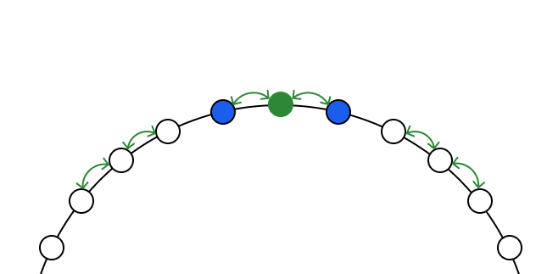
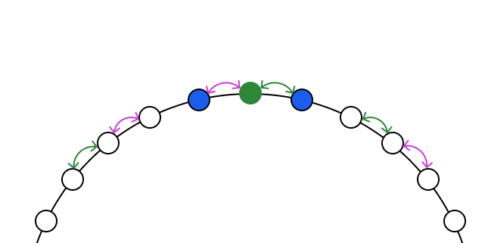
Trivance
↔
Use BOTH ports simultaneously
⊕
Joint reduction
Communicate left and right with the same distance offset
Both incoming messages are reduced together
×3
Triple communication distance
∧
Latency-optimal
Distance equals 3ᵏ per step k
Trivance reaches all nodes in log₃ n steps
Step k = 0
Trivance
Recursive Doubling
F
F
4
5
6
4
5
6
3
7
3
7
2
8
2
8
1
9
1
9
1
2
3
4
5
6
7
8
9
1
2
3
4
5
6
7
8
9

Slide 12


Trivance
↔
Use BOTH ports simultaneously
⊕
Joint reduction
Communicate left and right with the same distance offset
Both incoming messages are reduced together
×3
Triple communication distance
∧
Latency-optimal
Distance equals 3ᵏ per step k
Trivance reaches all nodes in log₃ n steps
Step k = 0
Trivance
Recursive Doubling
Root node
$$r$$
$$r$$
F
F
4
5
6
4
5
6
3
7
3
7
2
8
2
8
Split vector in two separate AllReduces
1
9
1
9
1
2
3
4
5
6
7
8
9
1
2
3
4
5
6
7
8
9
Notes:
We fix a node r from which we follow the communication pattern of both algorithms

Slide 13
Trivance
↔
Use BOTH ports simultaneously
⊕
Joint reduction
Communicate left and right with the same distance offset
Both incoming messages are reduced together
×3
Triple communication distance
∧
Latency-optimal
Distance equals 3ᵏ per step k
Trivance reaches all nodes in log₃ n
steps
Step k = 0
Trivance
Recursive Doubling
Root node
$$r$$
$$r$$
F
F
4
5
6
4
5
6
3
7
3
7
2
8
2
8
1
9
1
9
Left/right peer of r
1
2
3
4
5
6
7
8
9
1
2
3
4
5
6
7
8
9

Slide 14
Trivance
↔
Use BOTH ports simultaneously
⊕
Joint reduction
Communicate left and right with the same distance offset
Both incoming messages are reduced together
×3
Triple communication distance
∧
Latency-optimal
Distance equals 3ᵏ per step k
Trivance reaches all nodes in log₃ n steps
Step k = 0
Trivance
Recursive Doubling
Root node
$$r$$
$$r$$
F
F
4
5
6
4
5
6
3
7
3
7
2
8
2
8
1
9
1
9
Left/right peer of r
Mirrored peer
Original peer
1
2
3
4
5
6
7
8
9
1
2
3
4
5
6
7
8
9

Slide 15
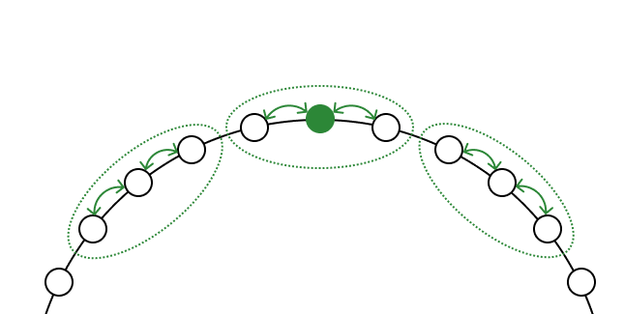
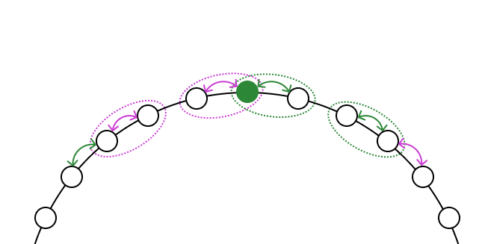

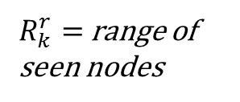


Trivance
↔
Use BOTH ports simultaneously
⊕
Joint reduction
Communicate left and right with the same distance offset
Both incoming messages are reduced together
×3
Triple communication distance
∧
Latency-optimal
Distance equals 3ᵏ per step k
Trivance reaches all nodes in log₃ n steps
After Step k = 0
Trivance
Recursive Doubling
$R_{k}^{r}=$range of seen nodes
$$R_{0}^{r}$$
$$r$$
$$r$$
F
F
4
5
6
4
5
6
3
7
3
7
2
8
2
8
1
9
1
9
1
2
3
4
5
6
7
8
9
1
2
3
4
5
6
7
8
9

Slide 16



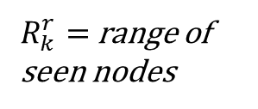
Trivance
↔
Use BOTH ports simultaneously
⊕
Joint reduction
Communicate left and right with the same distance offset
Both incoming messages are reduced together
×3
Triple communication distance
∧
Latency-optimal
Distance equals 3ᵏ per step k
Trivance reaches all nodes in log₃ n steps
After Step k = 0
Trivance
Recursive Doubling
$R_{k}^{r}=$range of seen nodes
$$R_{0}^{r}$$
$$R_{0}^{r}$$
$$r$$
$$r$$
$$R_{0}^{r}$$
F
F
4
5
6
4
5
6
3
7
3
7
2
8
2
8
1
9
1
9
1
2
3
4
5
6
7
8
9
1
2
3
4
5
6
7
8
9

Slide 17
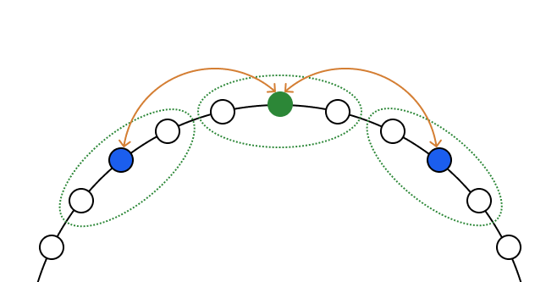
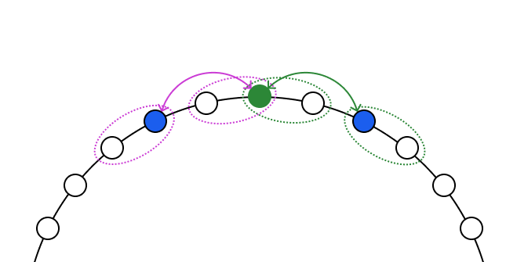


Trivance
↔
Use BOTH ports simultaneously
⊕
Joint reduction
Communicate left and right with the same distance offset
Both incoming messages are reduced together
×3
Triple communication distance
∧
Latency-optimal
Distance equals 3ᵏ per step k
Trivance reaches all nodes in log₃ n steps
Step k = 1
Trivance
Recursive Doubling
$$r$$
$$r$$
F
F
4
5
6
4
5
6
3
7
3
7
2
8
2
8
1
9
1
9
1
2
3
4
5
6
7
8
9
1
2
3
4
5
6
7
8
9

Slide 18
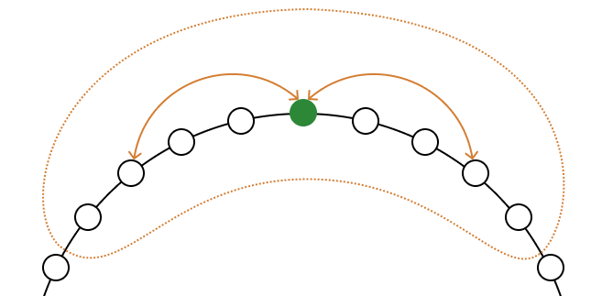
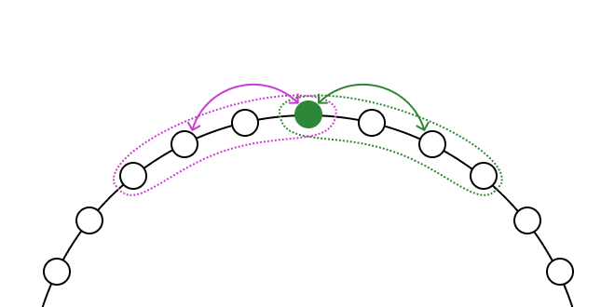





Trivance
↔
Use BOTH ports simultaneously
⊕
Joint reduction
Communicate left and right with the same distance offset
Both incoming messages are reduced together
×3
Triple communication distance
∧
Latency-optimal
Distance equals 3ᵏ per step k
Trivance reaches all nodes in log₃ n steps
After Step k = 1
Trivance
Recursive Doubling
$$R_{0}^{r}$$
$$r$$
$$r$$
F
F
4
5
6
$$R_{0}^{r}$$
4
5
6
3
7
3
$$R_{0}^{r}$$
7
2
8
2
8
1
9
1
4 nodes seen
per collective
9
9 nodes seen
1
2
3
4
5
6
7
8
9
1
2
3
4
5
6
7
8
9

Slide 19
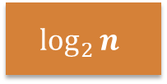
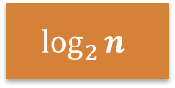
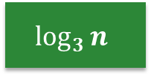
Tradeoffs and optimality factors
Ring
Rec.Doub.
Swing
Trivance
Communication steps
2n
$$\log_{2}{n}$$
$$\log_{2}{n}$$
$$\log_{3}{n}$$
Optimal
Near-Optimal
Average
Worst

Slide 20

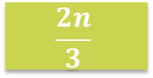
Tradeoffs and optimality factors
Ring
Rec.Doub.
Swing
Trivance
Communication steps
2n
$$\log_{2}{n}$$
$$\log_{2}{n}$$
$$\log_{3}{n}$$
Number of hops
2n
n
$$\frac{2n}{3}$$
$$\frac{n}{2}$$
Optimal
Near-Optimal
Average
Worst

Slide 21
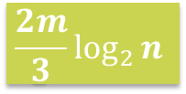
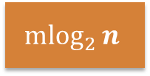
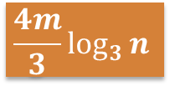
Tradeoffs and optimality factors
Ring
Rec.Doub.
Swing
Trivance
Communication steps
2n
$$\log_{2}{n}$$
$$\log_{2}{n}$$
$$\log_{3}{n}$$
Number of hops
2n
n
$$\frac{2n}{3}$$
$$\frac{n}{2}$$
Transmission delay
2m
$${mlog}_{2}{n}$$
$$\frac{2m}{3}\log_{2}{n}$$
$$\frac{4m}{3}\log_{3}{n}$$
Transmitted data size times number of overlapping links
Optimal
Near-Optimal
Average
Worst

Slide 22

Tradeoffs and optimality factors
Ring
Rec.Doub.
Swing
Trivance
Communication steps
2n
$$\log_{2}{n}$$
$$\log_{2}{n}$$
$$\log_{3}{n}$$
Number of hops
2n
n
$$\frac{2n}{3}$$
$$\frac{n}{2}$$
Transmission delay
2m
$${mlog}_{2}{n}$$
$$\frac{2m}{3}\log_{2}{n}$$
$$\frac{4m}{3}\log_{3}{n}$$
Transmitted data size times number of overlapping links
Transmission delay
in a 3D torus
2m
2.34m
2.08m
2.16m
Optimal
Near-Optimal
Average
Worst

Slide 23
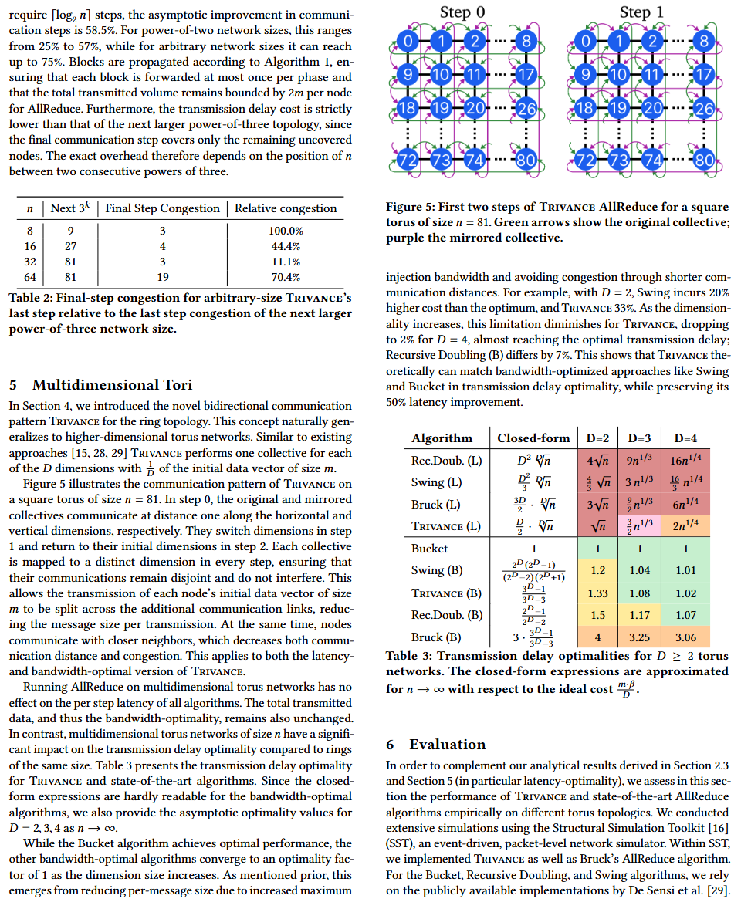
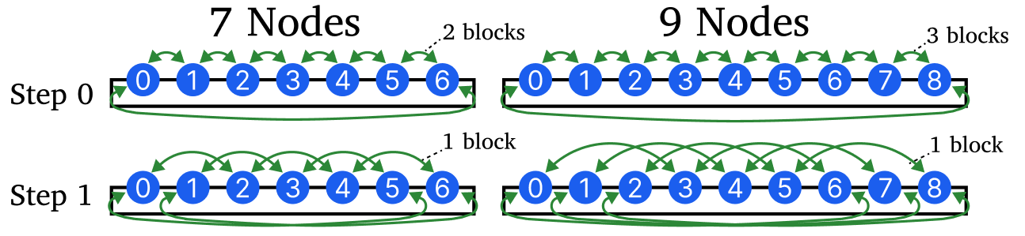
Generalization to multidimensional tori
Extension to arbitrary network sizes
Extension to arbitrary network sizes
Full analysis and details in the paper
Generalization to D-dimensional tori

Slide 24
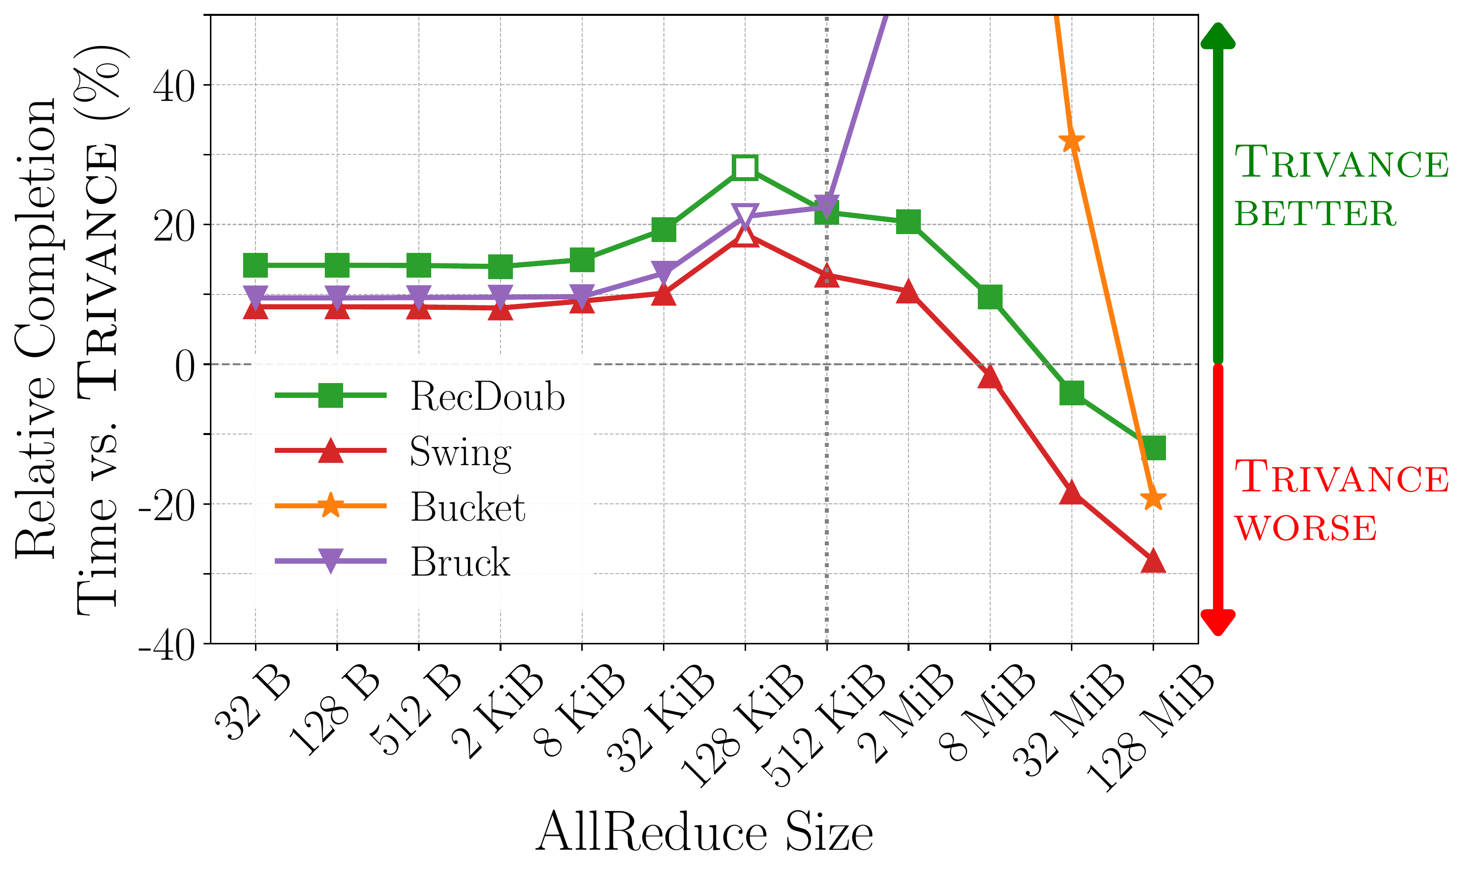
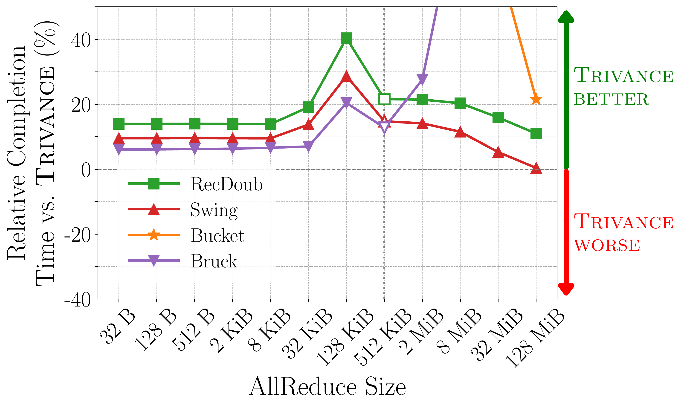
Simulation in SST
Simulator: SST (event-driven, packet-level) · 200 - 3200 Gb/s links · 200 ns per-hop latency · α = 1.5 µs/step · Message sizes: 32B – 128MiB
2D torus, 32 × 32
3D torus, 16 × 16 × 16
Notes:
To compare and evaluation trivance to existing state-of-the-art allreduce approaches, we implement them in SST and simulated them for varying network parameters and topology shapes and sizes.

Slide 25
Simulation in SST
Simulator: SST (event-driven, packet-level) · 200 - 3200 Gb/s links · 200 ns per-hop latency · α = 1.5 µs/step · Message sizes: 32B – 128MiB
2D torus, 32 × 32
3D torus, 16 × 16 × 16
Switch from latency-optimal to bandwidth-optimal variants

Slide 26
Simulation in SST
Simulator: SST (event-driven, packet-level) · 200 - 3200 Gb/s links · 200 ns per-hop latency · α = 1.5 µs/step · Message sizes: 32B – 128MiB
2D torus, 32 × 32
3D torus, 16 × 16 × 16
Switch from latency-optimal to bandwidth-optimal variants
Tradeoff point, where existing baselines are better due to fewer overlapping communications

Slide 27
When is Trivance beneficial?
Trivance (joint-reductions) vs.
baselines with mirroring
32 B
128 B
512 B
2 KiB
8 KiB
32 KiB
128 KiB
512 KiB
2 MiB
8 MiB
32 MiB
128 MiB
n = 8
n = 16
1D torus
n = 32
n = 64
n = 128
8 × 8
8 × 16
8 × 32
8 × 64
2D torus
8 × 128
16 × 16
16 × 32
16 × 64
32 × 32
200 Gb/s
2D 32×32
varying BW
800 Gb/s
1.6 Tb/s
3.2 Tb/s
Power of three
27 × 27
3D torus
8×8×8
16×16×16
Trivance is the fastest >10%
Trivance speedup
by 0%-10%
A mirrored baseline is faster
Notes:
Tradeoff point shifts to the right

Slide 28
When is Trivance beneficial?
Trivance (joint-reductions) vs.
baselines with mirroring
32 B
128 B
512 B
2 KiB
8 KiB
32 KiB
128 KiB
512 KiB
2 MiB
8 MiB
32 MiB
128 MiB
Small AllReduce sizes
n = 8
n = 16
1D torus
n = 32
n = 64
n = 128
8 × 8
8 × 16
8 × 32
8 × 64
2D torus
8 × 128
16 × 16
16 × 32
16 × 64
32 × 32
200 Gb/s
2D 32×32
varying BW
800 Gb/s
1.6 Tb/s
3.2 Tb/s
Power of three
27 × 27
3D torus
8×8×8
16×16×16
Trivance is the fastest >10%
Trivance speedup
by 0%-10%
A mirrored baseline is faster

Slide 29
When is Trivance beneficial?
Trivance (joint-reductions) vs.
baselines with mirroring
32 B
128 B
512 B
2 KiB
8 KiB
32 KiB
128 KiB
512 KiB
2 MiB
8 MiB
32 MiB
128 MiB
Small AllReduce sizes
Increasing dimensionality (3D
or 4D tori)
n = 8
n = 16
1D torus
n = 32
n = 64
n = 128
8 × 8
8 × 16
8 × 32
8 × 64
2D torus
8 × 128
16 × 16
16 × 32
16 × 64
32 × 32
200 Gb/s
2D 32×32
varying BW
800 Gb/s
1.6 Tb/s
3.2 Tb/s
Power of three
27 × 27
3D torus
8×8×8
16×16×16
Trivance is the fastest >10%
Trivance speedup
by 0%-10%
A mirrored baseline is faster

Slide 30
When is Trivance beneficial?
Trivance (joint-reductions) vs.
baselines with mirroring
32 B
128 B
512 B
2 KiB
8 KiB
32 KiB
128 KiB
512 KiB
2 MiB
8 MiB
32 MiB
128 MiB
Small AllReduce sizes
Increasing dimensionality (3D
or 4D tori)
Large networks/dimension sizes
n = 8
n = 16
1D torus
n = 32
n = 64
n = 128
8 × 8
8 × 16
8 × 32
8 × 64
2D torus
8 × 128
16 × 16
16 × 32
16 × 64
32 × 32
200 Gb/s
2D 32×32
varying BW
800 Gb/s
1.6 Tb/s
3.2 Tb/s
Power of three
27 × 27
3D torus
8×8×8
16×16×16
Trivance is the fastest >10%
Trivance speedup
by 0%-10%
A mirrored baseline is faster

Slide 31
When is Trivance beneficial?
Trivance (joint-reductions) vs.
baselines with mirroring
32 B
128 B
512 B
2 KiB
8 KiB
32 KiB
128 KiB
512 KiB
2 MiB
8 MiB
32 MiB
128 MiB
Small AllReduce sizes
Increasing dimensionality (3D
or 4D tori)
Large networks/dimension sizes
High bandwidth
High per-step or per-hop latency
n = 8
n = 16
1D torus
n = 32
n = 64
n = 128
8 × 8
8 × 16
8 × 32
8 × 64
2D torus
8 × 128
16 × 16
16 × 32
16 × 64
32 × 32
200 Gb/s
2D 32×32
varying BW
800 Gb/s
1.6 Tb/s
3.2 Tb/s
Power of three
27 × 27
3D torus
8×8×8
16×16×16
Trivance is the fastest >10%
Trivance speedup
by 0%-10%
A mirrored baseline is faster

Slide 32
When is Trivance beneficial?
Trivance (joint-reductions) vs.
baselines with mirroring
32 B
128 B
512 B
2 KiB
8 KiB
32 KiB
128 KiB
512 KiB
2 MiB
8 MiB
32 MiB
128 MiB
Small AllReduce sizes
Increasing dimensionality (3D
or 4D tori)
Large networks/dimension sizes
High bandwidth
High per-step or per-hop latency
Power-of-three networks
n = 8
n = 16
1D torus
n = 32
n = 64
n = 128
8 × 8
8 × 16
8 × 32
8 × 64
2D torus
8 × 128
16 × 16
16 × 32
16 × 64
32 × 32
200 Gb/s
2D 32×32
varying BW
800 Gb/s
1.6 Tb/s
3.2 Tb/s
Power of three
27 × 27
3D torus
8×8×8
16×16×16
Trivance is the fastest >10%
Trivance speedup
by 0%-10%
A mirrored baseline is faster

Slide 33
When is Trivance beneficial?
Trivance (joint-reductions) vs.
baselines with mirroring
32 B
128 B
512 B
2 KiB
8 KiB
32 KiB
128 KiB
512 KiB
2 MiB
8 MiB
32 MiB
128 MiB
Small AllReduce sizes
Increasing dimensionality (3D
or 4D tori)
Large networks/dimension sizes
High bandwidth
High per-step or per-hop latency
Power-of-three networks
In latency-sensitive scenarios
n = 8
n = 16
1D torus
n = 32
n = 64
n = 128
8 × 8
8 × 16
8 × 32
8 × 64
2D torus
8 × 128
16 × 16
16 × 32
16 × 64
32 × 32
200 Gb/s
2D 32×32
varying BW
800 Gb/s
1.6 Tb/s
3.2 Tb/s
Power of three
27 × 27
3D torus
8×8×8
16×16×16
Trivance is the fastest >10%
Trivance speedup
by 0%-10%
A mirrored baseline is faster

Slide 34
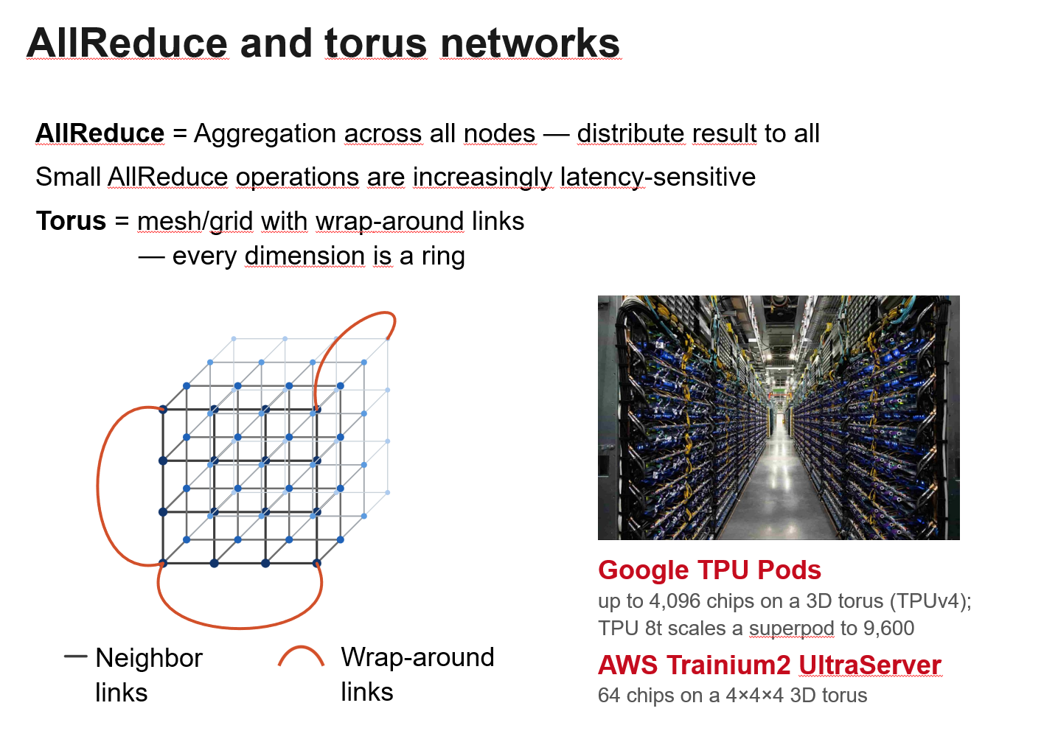
Conclusion
Notes:
To conclude:
- showed that latency is becoming increasingly important for AllReduce in multiport torus networks
- We proposed trivance, a new latency optimal algorithm for bidirectional rings which completes in log_3 n communication steps
We showed in our simulation how joint reductions improve completion compared to state-of-the-art algorithms
For latency sensitive scenarios and consistently for 3D torus networks.

Slide 35
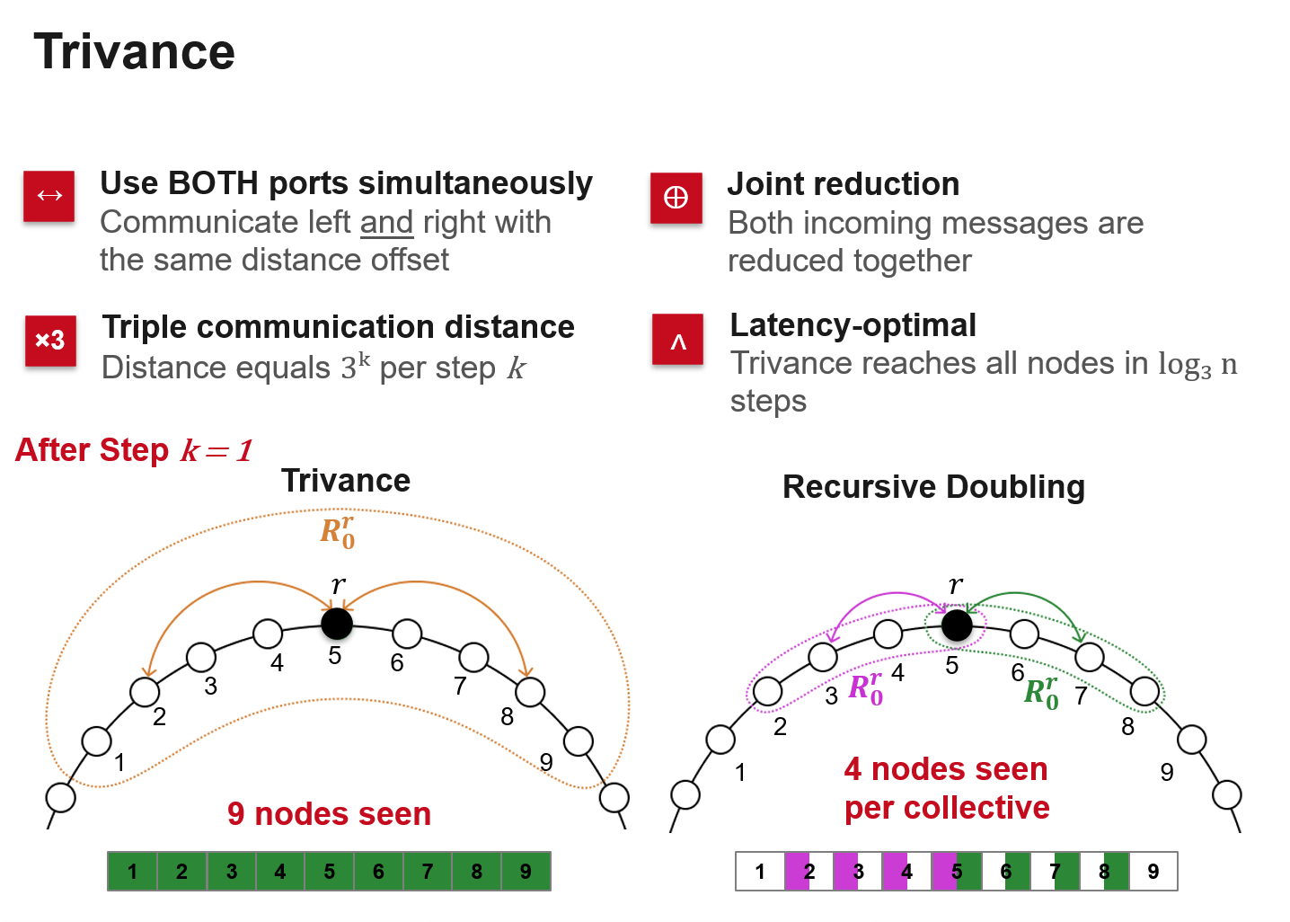
Conclusion

Slide 36
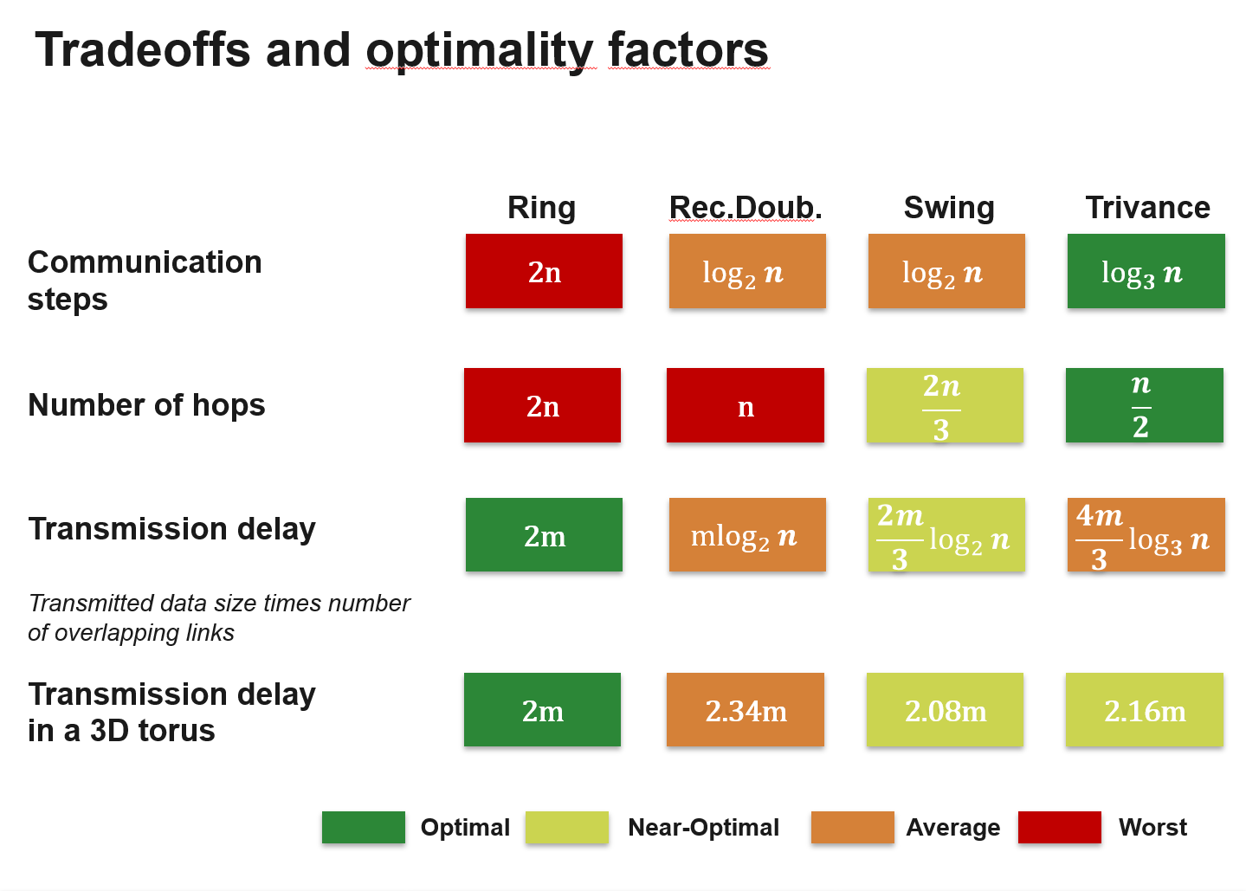
Conclusion

Slide 37
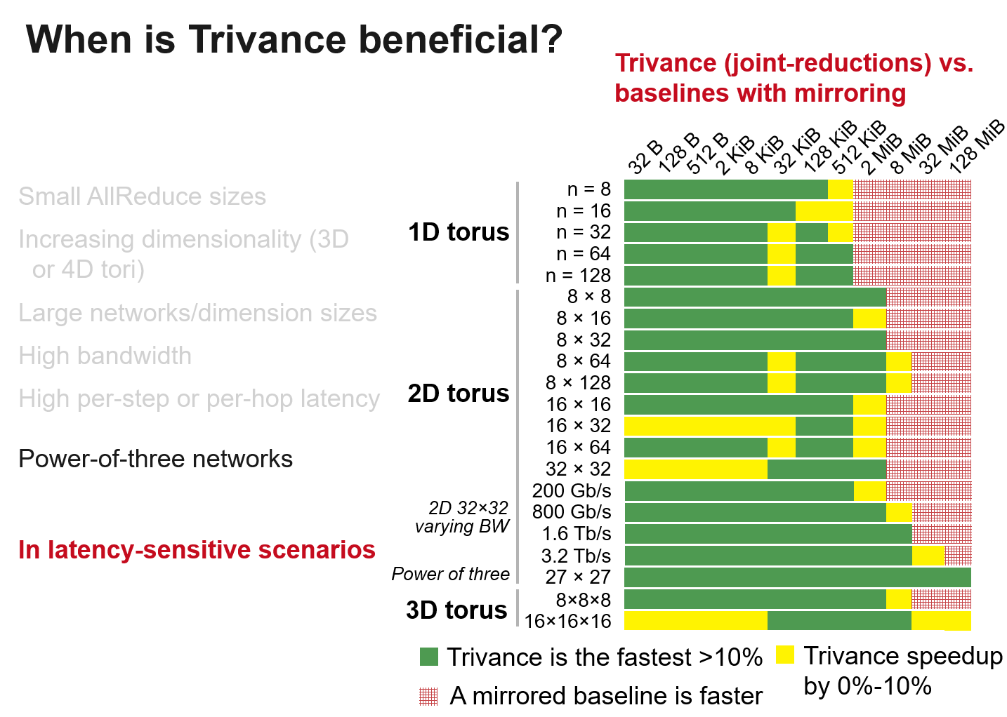
Conclusion

Slide 38
Conclusion
Thank you!
Email: juerss@campus.tu-berlin.de

Slide 39
Thank you!
Email: juerss@campus.tu-berlin.de

Slide 40
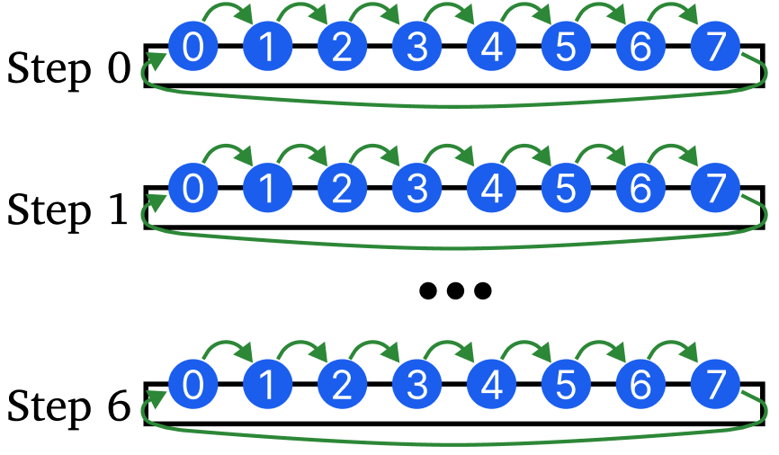

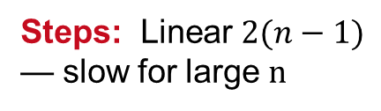




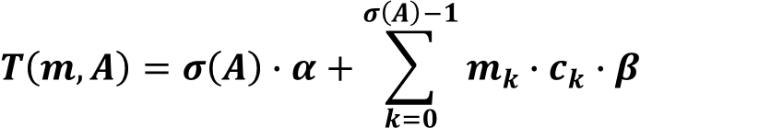
AllReduce on rings
$$σ\left(A\right)=number of communication steps$$
Cost function:
Transmission Delay
$$α=latency cost$$
Latency
$$β=bandwidth cost$$
$$T\left(m,A\right)=σ\left(A\right)∙α+\sum_{k=0}^{σ\left(A\right)−1}{m_{k}∙c_{k}∙β}$$
$$m_{k}=message size$$
$$c_{k}=network congestion$$
Hamiltonian Ring AllReduce
Steps: Linear $2(n−1)$ — slow for large n
Congestion: None, no overlap
Path length: Linear$n−1$

Slide 41
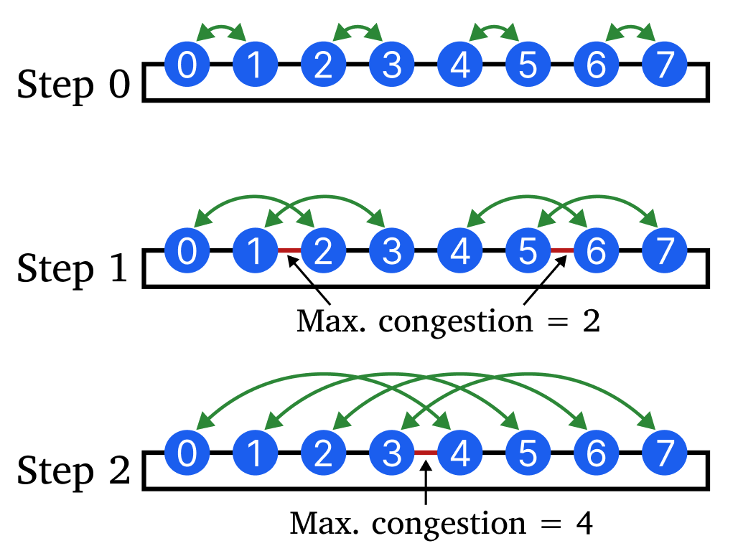


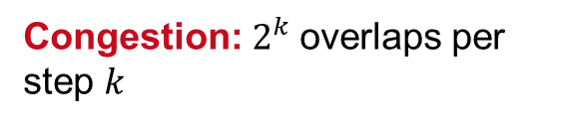
AllReduce on rings
$$σ\left(A\right)=number of communication steps$$
Cost function:
Transmission Delay
$$α=latency cost$$
Latency
$$β=bandwidth cost$$
$$T\left(m,A\right)=σ\left(A\right)∙α+\sum_{k=0}^{σ\left(A\right)−1}{m_{k}∙c_{k}∙β}$$
$$m_{k}=message size$$
$$c_{k}=network congestion$$
Recursive Doubling AllReduce
Steps:$\log_{2}{n}$steps
Congestion: $2^{k}$overlaps per step $k$
Path length: Linear$n−1$

Slide 42
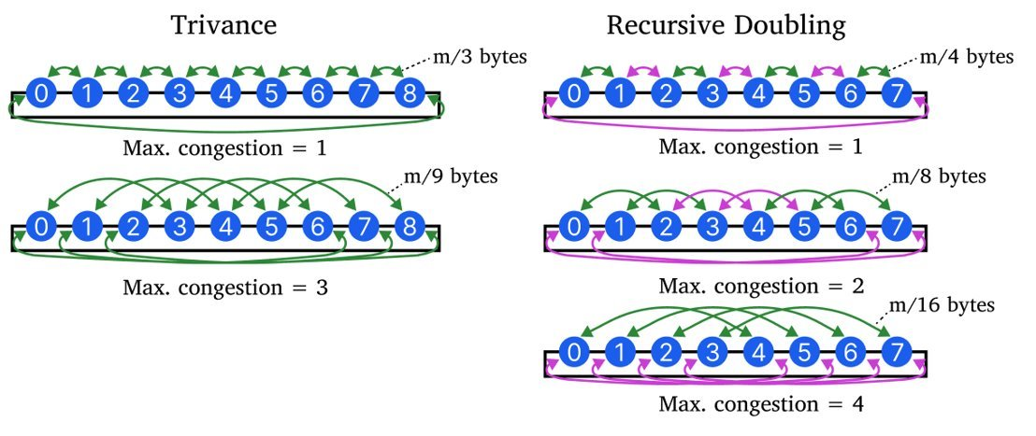
Trivance
↔
Use BOTH ports simultaneously
×3
Triple communication distance
Communicate left and right with the same distance offset
Distance grows as 3ᵏ per step
⊕
Joint reduction
∧
Latency-optimal
Both incoming messages are reduced together before forwarding
Trivance reaches all nodes in log₃ n steps

Slide 43
Generalization to multidimensional tori

Slide 44
Extention to arbitrary network sizes

Slide 45
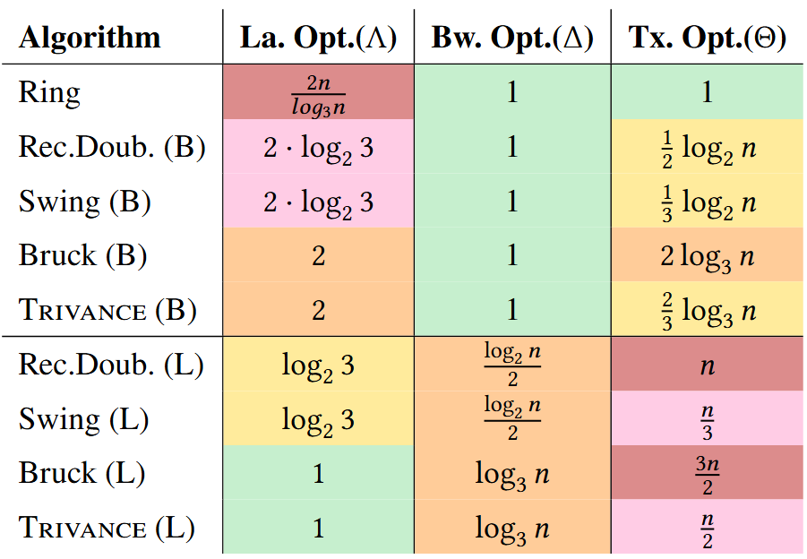
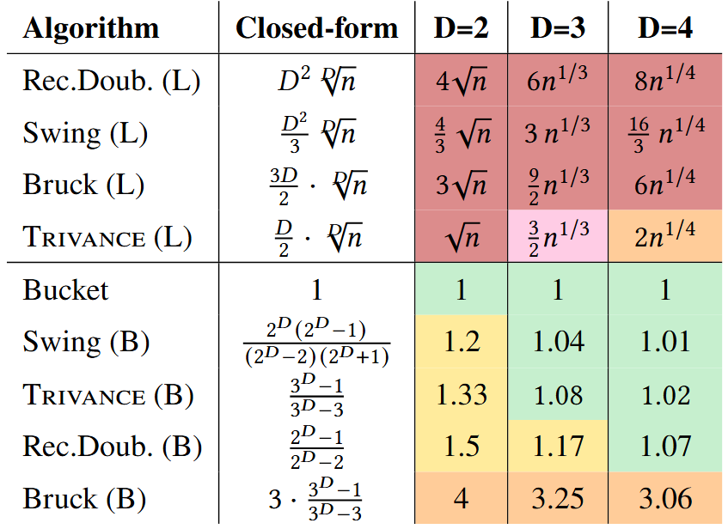
Trivance
Ring Optimalities for Latency, Bandwidth and Tx
Torus Optimalities for Transmission Delay

