Slide 1
Identifying Emotion in Lyrics
Project for the course DD2380
At KTH

Slide 2
Outline
Motivation
Difficulties
Bag-of-Words Model
Implementation
Results
Conclusion

Slide 3
Coldplay – Fix You
And the tears come streaming down your face
When you lose something you can't replace
When you love someone but it goes to waste
Could it be worse?
Lights will guide you home
And ignite your bones
And I will try to fix you
...

Slide 4
Survey of Labeling Emotions

Slide 5
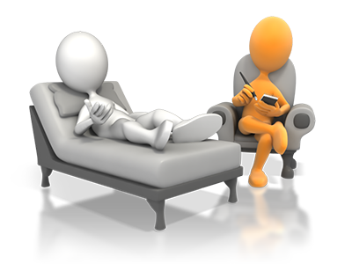


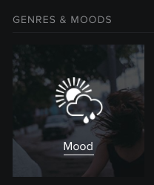
Areas of Application
[1]
Psychological therapy
Edutainment
[2]
Music player

Slide 6
Bag-of-Words Model
Dataset
Pre-Processing
Feature Extraction
Dictionary
n-gram collection
Trainingsset
Testset
test classifier
Classifier
train classifier
Labels

Slide 7
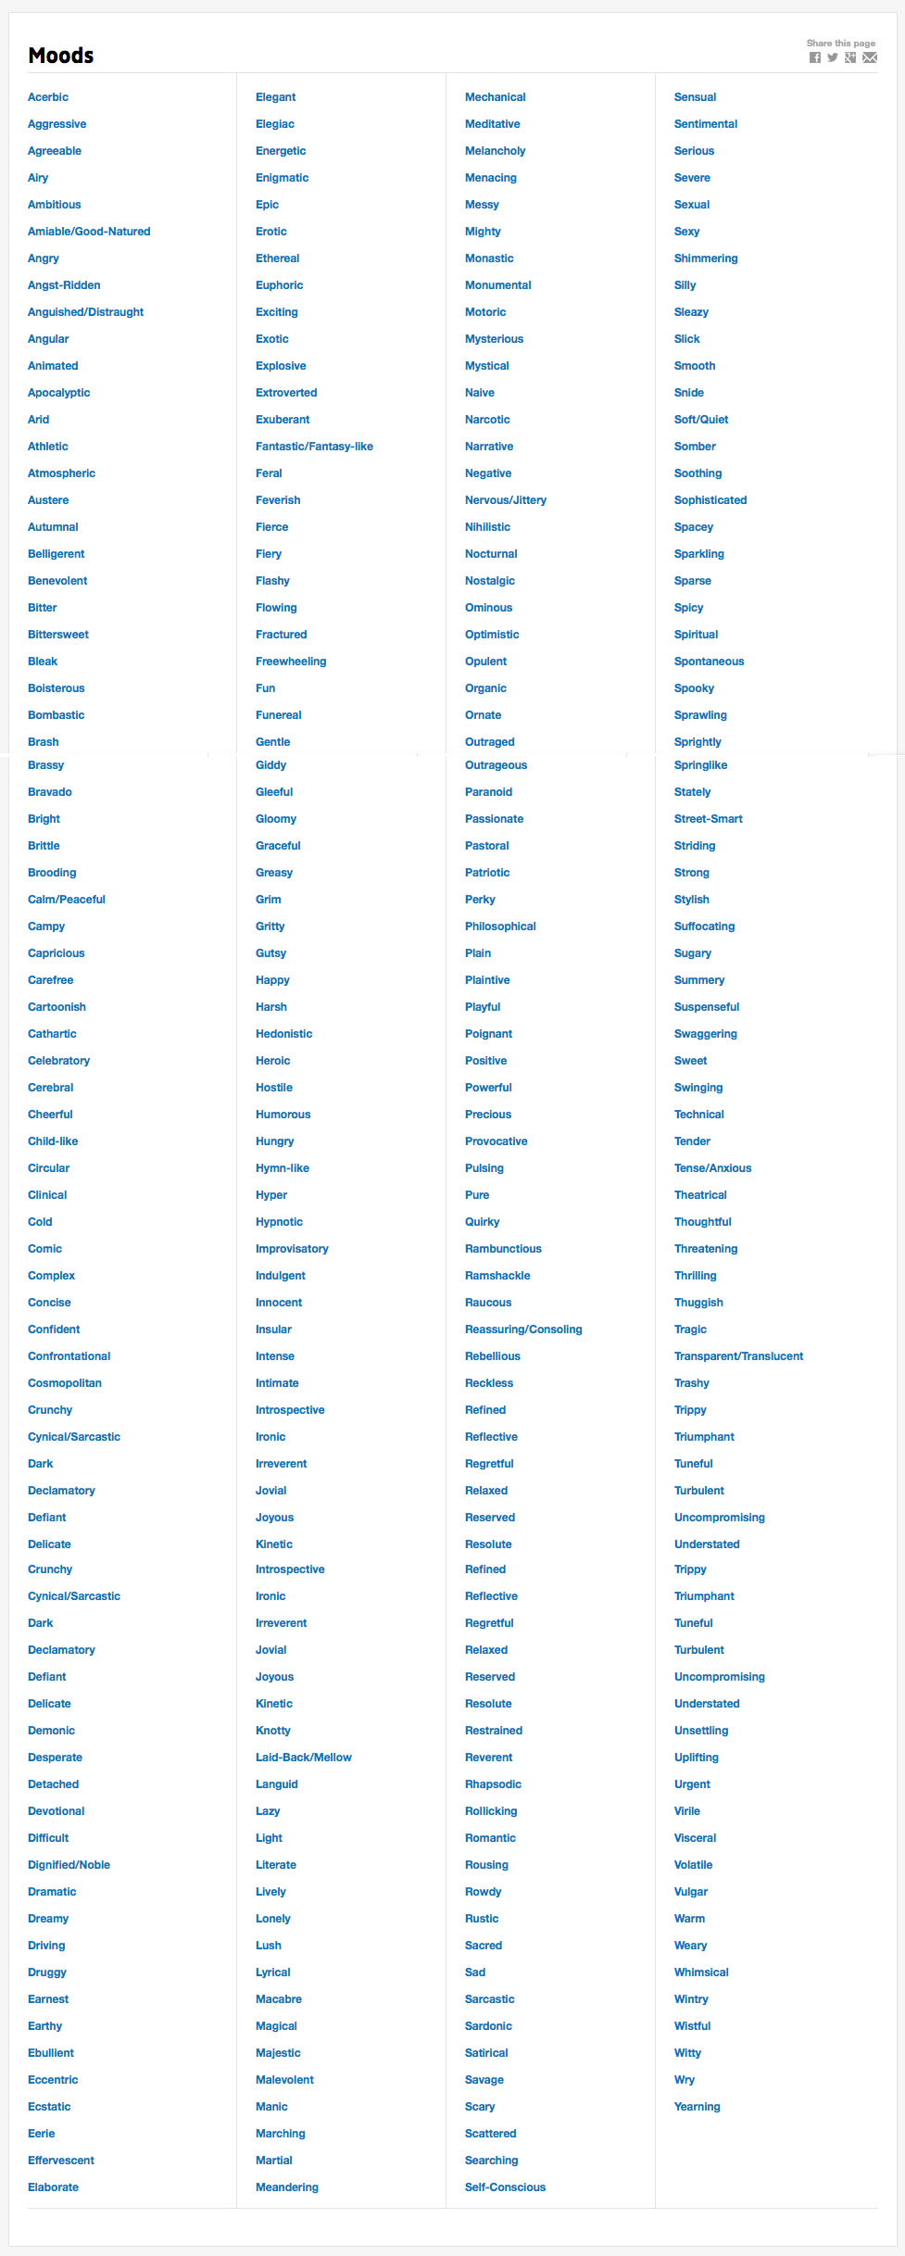
Difficulties
Finding a labelled database
Allmusic.com
Labelled with about 290 moods
→ overspecified
[2]

Slide 8
Emotional Categories Model
Binary Model
Positive | Negative
amiable-good-natured, boisterous, bright, campy, cheerful, effervescent, euphoric, exuberant, fun, giddy, gleeful, happy, joyous, laid-back-mallow, lazy, light, pastoral, precious, reverent, romantic, sensual, silly, smooth, sparkling, spicy, springlike, stylish, sugary, summery, sweet, thrilling, warm | aggressive, angry, anguished-distraught, autumnal, bleak, brittle, brooding, circular, cold, complex, dark, detached, difficult, druggy, eccentric, eerie, enigmatic, epic, fierce, fractured, gloomy, harsh, hostile, hungry, insular, knotty, manic, meandering, naive, outraged, outrageous, paranoid, rustic, self-conscious, spacey, sparse, spooky, suspenseful, thuggish, uncompromising, volatile, wintry

Slide 9
Emotional Categories Model
5 Cluster Model
Cluster 1 | Cluster 2 | Cluster 3 | Cluster 4 | Cluster 5
passionate, rousing, confident, boisterous, rowdy | rollicking, cheerful, fun, sweet, amiable-good-natured | literate, poignant, wistful, bittersweet, autumnal, brooding | humorous, silly, campy, quirky, whimsical, witty, wry | aggressive, fiery, tense-anxious, intense, volatile, visceral

Slide 10
Bag-of-Words Model
Dataset
Pre-Processing
Pre-Processing
Feature Extraction
Feature Extraction
Dictionary
n-gram collection
Dictionary
n-gram collection
Trainingsset
Trainingsset
Testset
Testset
test classifier
test classifier
Classifier
Classifier
train classifier
train classifier
Labels
Labels

Slide 11
Bag-of-Words Model
Dataset
Pre-Processing
Feature Extraction
Dictionary
n-gram collection
Trainingsset
Testset
test classifier
Classifier
train classifier
Labels
Labels

Slide 12
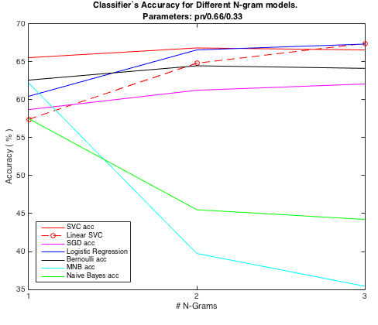
Results – pos/neg Model

Slide 13
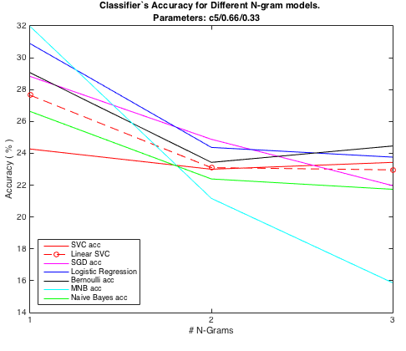
Results – 5 Cluster Model

Slide 14
Interpretation Difficulties
The Beatles – Maxwell‘s Silver Hammer
Bang, bang, Maxwell's silver hammer
Came down upon her head
Bang, bang, Maxwell's silver hammer
Made sure that she was dead

Slide 15
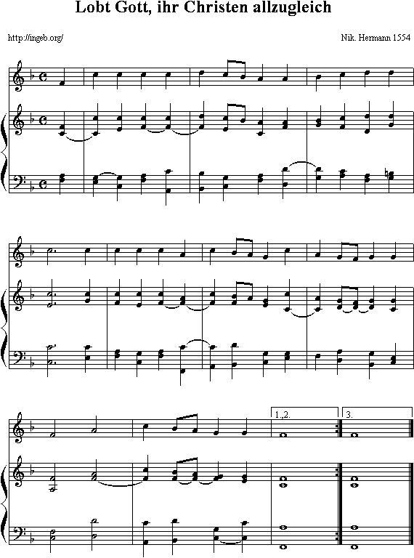
Further Research
Incooperate more features
Larger Database
→ do survey to get more reliable labels
Bang, bang, Maxwell's silver hammer
Came down upon her head
Bang, bang, Maxwell's silver hammer
Made sure that she was dead

Slide 16
Questions?

Slide 17
References
XHJS Downie, Cyril Laurier, and MBAF Ehmann. The 2007 mirex au- dio mood classification task: Lessons learned. In ISMIR 2008: Proceed- ings of the 9th International Conference of Music Information Retrieval, page 462. Lulu. com, 2008.
Youngmoo E Kim, Erik M Schmidt, Raymond Migneco, Brandon G Morton, Patrick Richardson, Jeffrey Scott, Jacquelin A Speck, and Dou- glas Turnbull. Music emotion recognition: A state of the art review. In Proc. ISMIR, pages 255–266. Citeseer, 2010.
Yong H Li and Anil K. Jain. Classification of text documents. The Computer Journal, 41(8):537–546, 1998.
Thomas M. Mitchell. Machine Learning. McGraw-Hill, Inc., New York, NY, USA, 1 edition, 1997.
Jason D Rennie, Lawrence Shih, Jaime Teevan, David R Karger, et al. Tackling the poor assumptions of naive bayes text classifiers. In ICML, volume 3, pages 616–623. Washington DC), 2003.
Theresa Wilson, Janyce Wiebe, and Paul Hoffmann. Recognizing con- textual polarity in phrase-level sentiment analysis. In Proceedings of the conference on human language technology and empirical methods in nat- ural language processing, pages 347–354. Association for Computational Linguistics, 2005.
Dan Yang and Won-Sook Lee. Music emotion identification from lyrics. In Multimedia, 2009. ISM’09. 11th IEEE International Symposium on, pages 624–629. IEEE, 2009.
Yi-Hsuan Yang, Yu-Ching Lin, Ya-Fan Su, and Homer H Chen. A regression approach to music emotion recognition. Audio, Speech, and Language Processing, IEEE Transactions on, 16(2):448–457, 2008.

Slide 18
Resources
[1] http://respiratio-coaching.de/wp-content/uploads/2013/08/therapie_small.png
[2] https://player.spotify.com/browse
[3] http://www.allmusic.com/moods

Slide 19
Bag-of-Words Model
Dataset
Pre-Processing
Feature Extraction
Dictionary
n-gram collection
Trainingsset
Testset
test classifier
Classifier
train classifier
Labels

