Slide 1
Identifying Emotion in Lyrics
Project for the course DD2380
At KTH

Slide 2
Outline
Motivation
Difficulties
Bag-of-Words Model
Implementation
Results
Conclusion

Slide 3
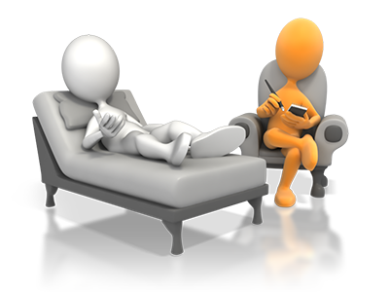


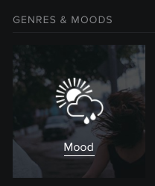
Motivation
[1]
Psychological therapy
Edutainment
[2]
Music player

Slide 4
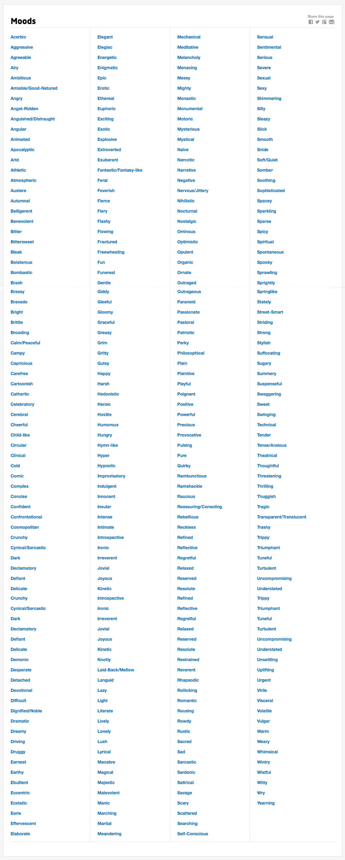
Difficulties
Finding a labelled database
Allmusic.com
Labelled with about 290 moods
→ overspecified
[2]

Slide 5
Bag-of-Words Model
Dataset
Pre-Processing
Feature Extraction
Dictionary
n-gram collection
Trainingsset
Testset
test classifier
Classifier
train classifier
Labels

Slide 6
Emotional Categories Model
Binary Model
Positive | Negative
amiable-good-natured, boisterous, bright, campy, cheerful, effervescent, euphoric, exuberant, fun, giddy, gleeful, happy, joyous, laid-back-mallow, lazy, light, pastoral, precious, reverent, romantic, sensual, silly, smooth, sparkling, spicy, springlike, stylish, sugary, summery, sweet, thrilling, warm | aggressive, angry, anguished-distraught, autumnal, bleak, brittle, brooding, circular, cold, complex, dark, detached, difficult, druggy, eccentric, eerie, enigmatic, epic, fierce, fractured, gloomy, harsh, hostile, hungry, insular, knotty, manic, meandering, naive, outraged, outrageous, paranoid, rustic, self-conscious, spacey, sparse, spooky, suspenseful, thuggish, uncompromising, volatile, wintry

Slide 7
Emotional Categories Model
5 Cluster Model
Cluster 1 | Cluster 2 | Cluster 3 | Cluster 4 | Cluster 5
passionate, rousing, confident, boisterous, rowdy | rollicking, cheerful, fun, sweet, amiable-good-natured | literate, poignant, wistful, bittersweet, autumnal, brooding | humorous, silly, campy, quirky, whimsical, witty, wry | aggressive, fiery, tense-anxious, intense, volatile, visceral

Slide 8
Bag-of-Words Model
Dataset
Pre-Processing
Pre-Processing
Feature Extraction
Feature Extraction
Dictionary
n-gram collection
Dictionary
n-gram collection
Trainingsset
Trainingsset
Testset
Testset
test classifier
test classifier
Classifier
Classifier
train classifier
train classifier
Labels

Slide 9
Classifier
Naive Bayes
Multinomial Naive Bayes
Bernoulli Naive Bayes
Logistic Regression
SGD
SVC
Linear SVC

Slide 10
Bag-of-Words Model
Dataset
Pre-Processing
Feature Extraction
Dictionary
n-gram collection
Trainingsset
Testset
test classifier
Classifier
train classifier
Labels
Labels

Slide 11
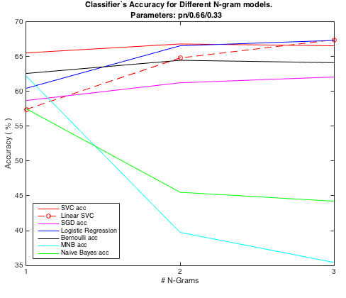
Results – pos/neg Model

Slide 12
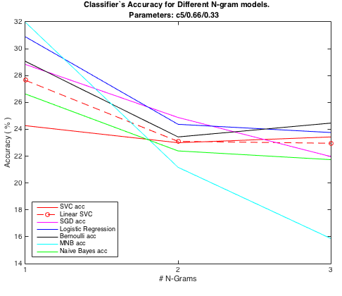
Results – 5 Cluster Model

Slide 13
Difficulties
Pharell Williams - Happy
Classification
It might seem crazy what I'm about to say
Sunshine she's here, you can take a break
I'm a hot air balloon that could go to space
With the air, like I don't care baby by the way
Because I'm happy
Clap along if you feel like a room without a roof
Because I'm happy
Clap along if you feel like happiness is the truth
Because I'm happy
Clap along if you know what happiness is to you
Because I'm happy
Clap along if you feel like that's what you wanna do
Positive
Cluster 5
aggressive, fiery, tense-anxious, intense, volatile, visceral

Slide 14
Difficulties
Pharell Williams - Happy
Classification
It might seem crazy what I'm about to say
Sunshine she's here, you can take a break
I'm a hot air balloon that could go to space
With the air, like I don't care baby by the way
Because I'm happy
Clap along if you feel like a room without a roof
Because I'm happy
Clap along if you feel like happiness is the truth
Because I'm happy
Clap along if you know what happiness is to you
Because I'm happy
Clap along if you feel like that's what you wanna do
Negative
Cluster 4
humorous, silly, campy, quirky, whimsical, witty, wry

Slide 15
Difficulties
Bastille - Pompeii
Classification
But if you close your eyes,
Does it almost feel like
Nothing changed at all?
And if you close your eyes,
Does it almost feel like
You've been here before?
How am I gonna be an optimist about this?
How am I gonna be an optimist about this?
Negative
Cluster 1
passionate, rousing, confident, boisterous, rowdy

Slide 16
References
XHJS Downie, Cyril Laurier, and MBAF Ehmann. The 2007 mirex au- dio mood classification task: Lessons learned. In ISMIR 2008: Proceed- ings of the 9th International Conference of Music Information Retrieval, page 462. Lulu. com, 2008.
Youngmoo E Kim, Erik M Schmidt, Raymond Migneco, Brandon G Morton, Patrick Richardson, Jeffrey Scott, Jacquelin A Speck, and Dou- glas Turnbull. Music emotion recognition: A state of the art review. In Proc. ISMIR, pages 255–266. Citeseer, 2010.
Yong H Li and Anil K. Jain. Classification of text documents. The Computer Journal, 41(8):537–546, 1998.
Thomas M. Mitchell. Machine Learning. McGraw-Hill, Inc., New York, NY, USA, 1 edition, 1997.
Jason D Rennie, Lawrence Shih, Jaime Teevan, David R Karger, et al. Tackling the poor assumptions of naive bayes text classifiers. In ICML, volume 3, pages 616–623. Washington DC), 2003.
Theresa Wilson, Janyce Wiebe, and Paul Hoffmann. Recognizing con- textual polarity in phrase-level sentiment analysis. In Proceedings of the conference on human language technology and empirical methods in nat- ural language processing, pages 347–354. Association for Computational Linguistics, 2005.
Dan Yang and Won-Sook Lee. Music emotion identification from lyrics. In Multimedia, 2009. ISM’09. 11th IEEE International Symposium on, pages 624–629. IEEE, 2009.
Yi-Hsuan Yang, Yu-Ching Lin, Ya-Fan Su, and Homer H Chen. A regression approach to music emotion recognition. Audio, Speech, and Language Processing, IEEE Transactions on, 16(2):448–457, 2008.

Slide 17
Resources
[1] http://respiratio-coaching.de/wp-content/uploads/2013/08/therapie_small.png
[2] https://player.spotify.com/browse
[3] http://www.allmusic.com/moods

Slide 18
Bag-of-Words Model
Dataset
Pre-Processing
Feature Extraction
Dictionary
n-gram collection
Trainingsset
Testset
test classifier
Classifier
train classifier
Labels

