Slide 1
SDI: Integrated Warning
System
Mary Muthee, Louis Schmalisch, Asad Ullah
SDI Service Implementation
23.06.2026

Slide 2
Project Idea
Core Problem
Solution
• Alpine Region highly prone to natural disasters
• Cross-border management between Bavaria and Salzburg hindered by differences in...
• National coordinate reference systems (CRS)
• Data formats
• Semantic definitions
• Transboundary Spatial Data Infrastructure (SDI) acting as an integrated early warning system
• Combining static historic cadasters with real-time meteorological data

Slide 3
Proto Persona
Demographic: female/male/diverse volunteers
Age-range: 25-60 years
Occupation: Alpine Rescue Coordinator
Location: Berchtesgaden Alps
Hypothetic Background
Alpine Rescue personal are mostly volunteers and do not have a background in GIS. They can read maps, but don’t work with direct data.
Rescue situations are stressful and therefore complicated data/map access is not helpful.
Frustration
Needs
Goals
How the SDI helps him:
Fragmented Systems
different national legislation and authorities
Information Overload
emergency expert, not GIS specialist, no raw data or manual calculations
Proactive Warning
Anticipate natural disasters to warn public and prepare
Unified Visualization
Up-to-date, easy-to-read map including topographic data, land-use cadastres, mobility and biodiversity
Real-Time Threat assessment
Using real-time climate and weather data (temperature, wind, soil moisture, rain/snow) intersected with historic data of prior events to predict possible hazards
• Overcoming Cross-Border Data Fragmentation
• Reduces Information Overload
• Real-Time Threat Assessment

Slide 4
Project Management – WP’s
SDI_IWS
Workpackage 1:
Project Management
Louis Schmalisch
1.1 Topic & Abstract
1.2 Define Objectives
1.3 GitLab setup for Project Management
Workpackage 2:
Data Acquisition
Asad Ullah
2.2 Gather needed data
2.3 Evaluate data quality
2.4 Store data in Database
Workpackage 3:
Data Processing
3.1 static data
Mary Muthee
3.1.1 Harmonize cross-boarder data
3.1.2 Identify hazard zones
3.1.3 In cooperate historic data
3.2 dynamic data
Louis Schmalisch
3.2.1 API integration
3.2.2 Compatibility check
Workpackage 4:
SDI development
Louis Schmalisch
4.2 Database setup
4.3 User Interface design
4.4 First Prototype
Workpackage 5:
Feedback
Louis Schmalisch
5.1 Evaluate User feedback
5.2 Apply Feedback
Workpackage 6:
Final Presentation and Documentation
Submission
Louis Schmalisch
6.1 SDI publication
6.2 Documentation
6.3 GitLab
2.1 Literature Review
4.1 Define Targetgroup/Personas

Slide 5
Milestones
Abstract
PIP
Finished
WP 2 & 3
First
prototype
4/4/26
31/4/26
23/6/26
18/3/26
12/4/26
15/5/26
14/6/26
Extended
Abstract
List all
Datasets
Final
Presentation
& GitLab

Slide 6
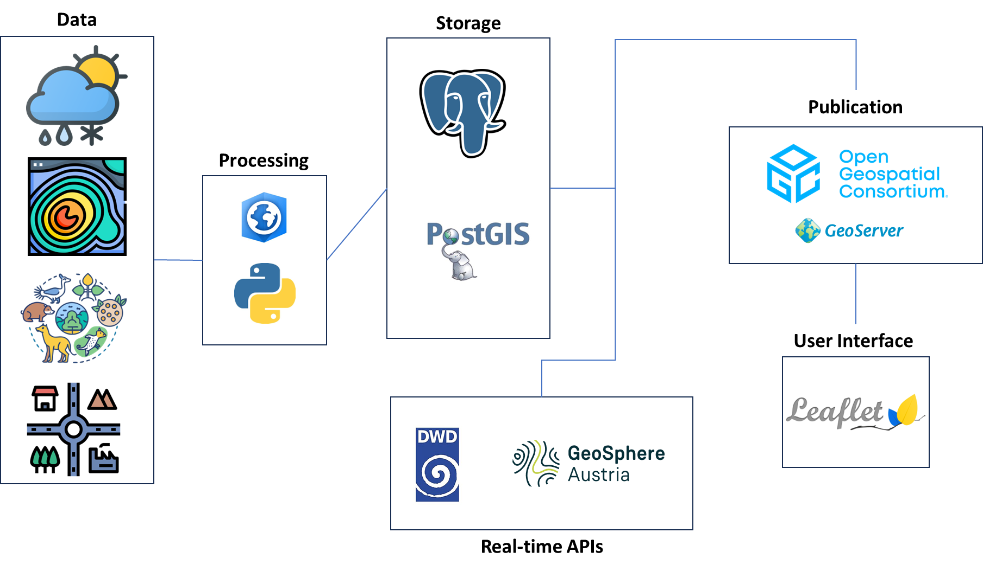
SDI Architecture

Slide 7
Data Acquisition
 | Dataset Category​ | Concrete Dataset Name (Your Data)​ | Source / Provider​ | Area Covered​ | Format / Service​
 | Weather / Meteorological data (real‑time + historic)​ ​ ​ | INCA hourly weather data (precipitation, temperature, wind, humidity)​ | GeoSphere Austria​ | Salzburg region​ | API / WMS​
 |  | Short‑term weather forecast (rain & snow)​ | GeoSphere Austria (INCA forecast)​ | Salzburg region​ | API​
 |  | DWD weather layers (precipitation, temperature, pressure)​ | Deutscher Wetterdienst (DWD) GeoServer​ | Berchtesgaden region​ | WMS​
 | Topographic data (DEM, slope, aspect, hillshade)​ | Digital Elevation Model (DEM)​ | Open Government Data portals​ | Austria & Germany​ | GeoTIFF​
 |  | Derived slope & hillshade layers | Derived from DEM​ | Austria & Germany​ | Raster​
 | Land use / buildings / roads​ ​ | Roads and hiking paths​ | OpenStreetMap (Geofabrik)​ | Austria & Germany​ | SHP​
 |  | Building footprints​ | OpenStreetMap​ | Austria & Germany​ | SHP​
 | Biodiversity & protected areas​ | Species occurrence records​ | GBIF (Global Biodiversity Information Facility)​ | Austria & Germany​ | CSV / SHP​
 |  | Protected Areas (Natura 2000) | European Environmental Agency | Austria & Germany | SHP

Slide 8
Data Processing
What to process?
Harmonization Steps
Hazard Zone Calculations
All acquired datasets must be cleaned, reprojected, and standardised before SDI integration. This includes static layers (DEM, land-use, buildings, biodiversity, historic disasters) and dynamic feeds (live weather APIs from DWD and GeoSphere).
1. Reproject all layers to common CRS (EPSG:25832 UTM)
2. Create semantic crosswalk table (DE ↔ AT definitions)
3. Standardise attribute names & data types
4. Validate geometry (fix overlaps, gaps at border)
5. Export to OGC-compliant formats (GeoPackage / PostGIS)
Using the DEM:
• Slope analysis (danger: >30°)
• Aspect analysis (sun/shade exposure)
• Hillshade for terrain visualisation
Overlay with historic disaster locations to validate terrain-risk correlation. Output: risk classification raster layer.
Static Data Tasks
Dynamic Data Tasks
Harmonize CRS → Reproject German & Austrian datasets to EPSG:25832
Identify Hazard Zones → Slope/aspect from DEM, overlay historic events
Historic Data → Integrate past disaster records into unified schema
API Integration → Python scripts to pull DWD & GeoSphere weather feeds into PostGIS
Compatibility Check → Align units, timestamps & spatial coverage; handle update frequency mismatch between APIs
8

Slide 9




Implementation
APIs
Node-red
GeoSphere - klima-v2-1h
DWD - Alpenwetter
Alpenwetter → sdi_dwd_alpenwetter
klima-v2-1h → sdi_weather_history_7d & sdi_weather_live
Database
External WMS
sdi_dwd_alpenwetter
sdi_weather_history_7d
sdi_weather_live
Satellite: https://maps.eox.at/
  CC BY-NC-SA 4.0
OSM: https://terrestris.de/
  copyright notice
Icon source: flaticon.com
Notes:
APIs:
DWD Alpenwetter – daily forecast for German alpine region
GeoSphere Austria “klima-v2-1h” – hourly climate data from weather stations
6300 Salzburg Flughafen, 6305 Salzburg Freisaal, 9211 Lofer Ort, 9215 Loferer Alm, 9406 Golling, 12302 Saalbach, 12504 Bischofshofen
Node-Red:
DWD Alpenwetter -> sdi_dwd_alpenwetter
GeoSphere Austria -> sdi_weather_history_7d & sdi_weather_live
PostGIS/Postgre Database
3 DBs
sdi_weather_history_7d
sdi_weather_live
sdi_dwd_alpenwetter

Slide 10

OGC Services & Metadata
Metadata Standardization
  ISO 19115 / ISO 19139 metadata records
  Published through GeoNetwork

Slide 11
Dashboard
  https://schmlou.github.io/sdi_biwa/

