Slide 1
SDI: Integrated Warning
System
Interim Project Presentation
Mary Muthee, Louis Schmalisch, Asad Ullah
1

Slide 2
Project Idea
Core Problem
Solution
• Alpine Region highly prone to natural disasters
• Cross-border management between Bavaria and Salzburg hindered by differences in...
• national coordinate reference systems (CRS)
• Data formats
• Semantic definitions
• Transboundary Spatial Data Infrastructure (SDI) acting as an integrated early warning system
• Combining static historic cadasters with real-time meteorological data
2

Slide 3
Persona/Target group
Name: Markus Weber
Age: 45 Years
Occupation: Operations Commander “Bergrettung”
Location: Berchtesgaden
Background
Markus is a 45-year-old emergency responder, who coordinates rescue missions, evacuations and disaster mitigation across the Berchtesgaden Alps. He works with the local authorities and emergency services to ensure safety in his region.
Frustration
Needs
Goals
How the SDI helps him:
Fragmented Systems
different national legislation and authorities
Information Overload
emergency expert, not GIS specialist, no raw data or manual calculations
Proactive Warning
Anticipate natural disasters to warn public and prepare
Unified Visualization
Up-to-date, easy-to-read map including topographic data, land-use cadastres, mobility and biodiversity
Real-Time Threat assessment
Using real-time climate and weather data (temperature, wind, soil moisture, rain/snow) intersected with historic data of prior events to predict possible hazards
• Overcoming Cross-Border Data Fragmentation
• Reduces Information Overload
• Real-Time Threat Assessment
3

Slide 4
Project Management
SDI_IWS
Workpackage 1:
Project Management
1.1 Topic & Abstract
1.2 Define Objectives
1.3 Define Targetgroup/Personas
1.4 GitLab setup for Project Management
Workpackage 2:
Data Acquisition
2.2 Gather needed data
2.3 Evaluate data quality
2.4 Store data in Database
Workpackage 3:
Data Processing
3.1 static data
3.1.1 Harmonize cross-boarder data
3.1.2 Identify hazard zones
3.1.3 Incooperate historic data
3.2 dynamic data
3.2.1 API integration
3.2.2 Compatability check
Workpackage 4:
SDI development
4.1 Database setup
4.2 User Interface design
4.3 First Prototype
Workpackage 5:
Feedback
5.1 Evaluate User feedback
5.2 Apply Feedback
Workpackage 6:
Final Presentation and Documentation
Submission
6.1 SDI publication
6.2 Documentation
6.3 GitLab
2.1 Literature Review
SDI_IWS
WP 3
Data Processing
4

Slide 5
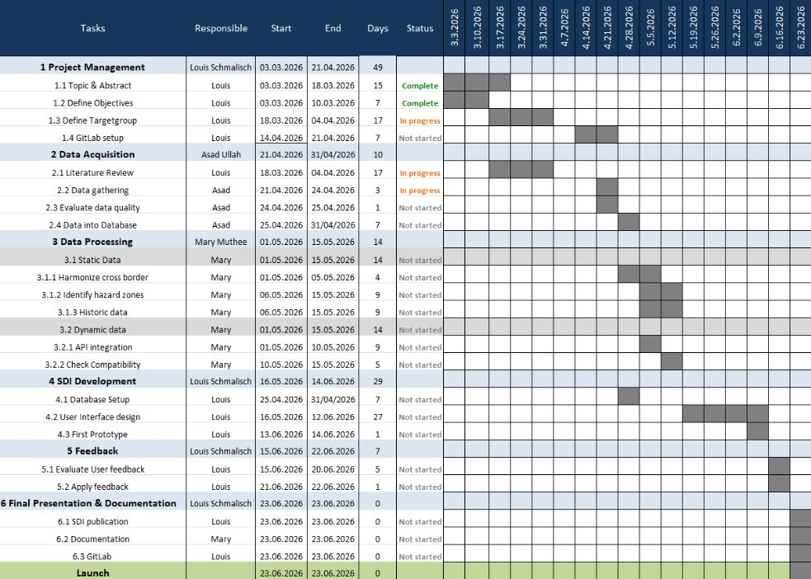
Gantt Chart
5
4.3 First Prototype
Louis
13.06.2026
14.06.2026
1
Not started
5 Feedback
Louis Schmalisch
15.06.2026
22.06.2026
7
5.1 Evaluate User feedback
Louis
15.06.2026
20.06.2026
5
Not started
5.2 Apply feedback
Louis
21.06.2026
22.06.2026
1
Not started
6 Final Presentation & Documentation
Louis Schmalisch
23.06.2026
23.06.2026
0
6.1 SDI publication
Louis
23.06.2026
23.06.2026
0
Not started
6.2 Documentation
Mary
23.06.2026
23.06.2026
0
Not started
6.3 GitLab
Louis
23.06.2026
23.06.2026
0
Not started
Launch
23.06.2026
23.06.2026
0

Slide 6
Milestones
Abstract
PIP
Finished
WP 2 & 3
First
prototype
Project
End
3/3/26
4/4/26
31/4/26
23/3/26
18/3/26
12/4/26
15/5/26
14/6/26
30/6/26
Project
Start
Extended
Abstract
List all
Datasets
Final
Presentation
& GitLab
6

Slide 7
Data Acquisition
Asad Ullah
Type of data we need?​
Weather / Meteorological data (real‑time + historic)​
Topographic data (DEM, slope, aspect, Hillshade)​
Land use / buildings / roads​
Biodiversity & protected areas
7

Slide 8
Data Acquisition
Asad Ullah
Dataset Category​ | Concrete Dataset Name (Your Data)​ | Source / Provider​ | Area Covered​ | Format / Service​
Weather / Meteorological data (real‑time + historic)​ | INCA hourly weather data (precipitation, temperature, wind, humidity)​ | GeoSphere Austria​ | Salzburg region​ | API / WMS​
​ | Short‑term weather forecast (rain & snow)​ | GeoSphere Austria (INCA forecast)​ | Salzburg region​ | API​
​ | DWD weather layers (precipitation, temperature, pressure)​ | Deutscher Wetterdienst (DWD) GeoServer​ | Berchtesgaden region​ | WMS​
Topographic data (DEM, slope, aspect, hillshade)​ | Digital Elevation Model (DEM)​ | Open Government Data portals​ | Austria & Germany​ | GeoTIFF​
​ | Derived slope & hillshade layers​ | Derived from DEM​ | Austria & Germany​ | Raster​
Land use / buildings / roads​ | Roads and hiking paths​ | OpenStreetMap (Geofabrik)​ | Austria & Germany​ | SHP​
​ | Building footprints​ | OpenStreetMap​ | Austria & Germany​ | SHP​
Biodiversity & protected areas​ | Species occurrence records​ | GBIF (Global Biodiversity Information Facility)​ | Austria & Germany​ | CSV / SHP​
 | Protected Areas (Natura 2000) | European Environmental Agency | Austria & Germany | SHP
7

Slide 9
Data processing
Mary Muthee
What to process?
Harmonization Steps
Hazard Zone Calculations
All acquired datasets must be cleaned, reprojected, and standardised before SDI integration. This includes static layers (DEM, land-use, buildings, biodiversity, historic disasters) and dynamic feeds (live weather APIs from DWD and GeoSphere).
1. Reproject all layers to common CRS (EPSG:25832 UTM)
2. Create semantic crosswalk table (DE ↔ AT definitions)
3. Standardise attribute names & data types
4. Validate geometry (fix overlaps, gaps at border)
5. Export to OGC-compliant formats (GeoPackage / PostGIS)
Using the DEM:
• Slope analysis (danger: >30°)
• Aspect analysis (sun/shade exposure)
• Hillshade for terrain visualisation
Overlay with historic disaster locations to validate terrain-risk correlation. Output: risk classification raster layer.
Static Data Tasks
Dynamic Data Tasks
Harmonize CRS → Reproject German & Austrian datasets to EPSG:25832
Identify Hazard Zones → Slope/aspect from DEM, overlay historic events
Historic Data → Integrate past disaster records into unified schema
API Integration → Python scripts to pull DWD & GeoSphere weather feeds into PostGIS
Compatibility Check → Align units, timestamps & spatial coverage; handle update frequency mismatch between APIs
8
6

Slide 10
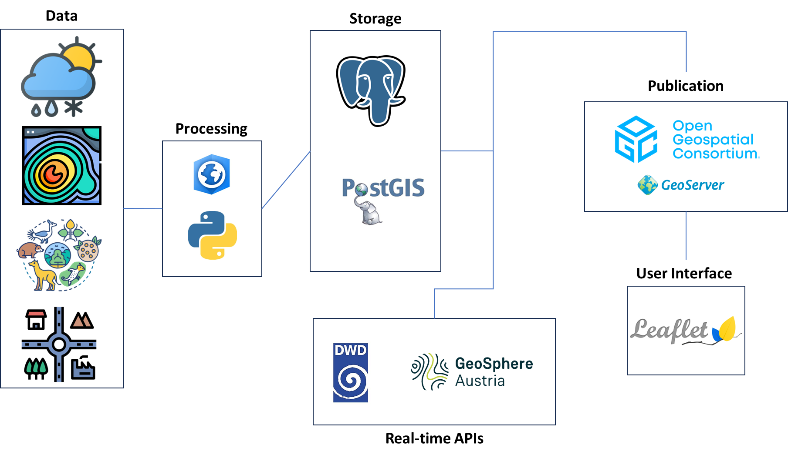
Planned SDI Architecture
10
Notes:
Data
Protocol
Engine
Static Data (topographic basemap, authoritative risk zones, Land-use, buildings, biodiversity)
WMS/WMTS
GeoServer
Dynamic Data (weather data)
OGC APIs
pygeoapi

Slide 11
Implementation Status
• Data Acquisition till 31.04
• PM mostly done
• WP 1 finished
• Entering Data processing phase (WP 3)
• 01.05-15.05
• Standardising & harmonising data
• Calculation of hazard zones
11

