Slide 1
getPairs {RecordLinkage}
Omar Besic, Thierry Schmidt, Chantal Zbinden
Vertiefung in R, 05.06.2019

Slide 2
Agenda
Das Paket: "RecordLinkage"
Vorgehen
Generating record pairs
Weight calculation
Classification --> getPairs()
Problem
Lösungsansätze

Slide 3
Das Paket: "RecordLinkage"
Record Linkage = Duplikaterkennung
"Provides functions for linking and de-duplicating data sets. Methods based on a stochastic approach are implemented as well as classification algorithms from the machine learning domain."

Slide 4
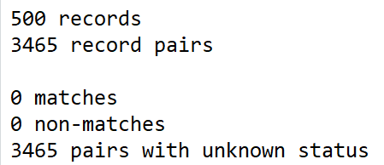
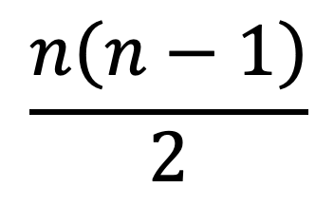
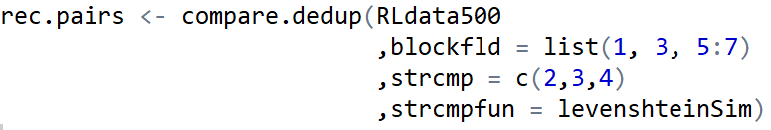
Vorgehen: 1. Generating record pairs
Data preprocessing --> Data Set laden (RLdata500)
Building comparison patterns --> "Bildet Paare"
compare.dedup vs. compare.linkage
compare.dedup vs. RLBigdataDedup
Notes:
Unterschied: RLBigDataDedup vs. Compare.dedup
These functions act as constructors for the S4 classes "RLBigDataDedup" and "RLBigDataLinkage". They make up the initial stage in a Record Linkage process using large data sets (>= 1.000.000 record pairs) after possibly normalizing the data. Two general scenarios are reflected by the two functions: RLBigDataDedup works on a single data set which is to be deduplicated, RLBigDataLinkage is intended for linking two data sets together. Their usage follows the functionscompare.dedup and compare.linkage, which are recommended for smaller amounts of data, e.g. training sets.

Slide 5
Codebeispiele: compare.dedup

Slide 6
Vorgehen: 2. Add weight calculation
epiWeight
emWeight
Calculates weights for record pairs based on the EpiLink approach
{0,…,1}
Calculates weights for Record Linkage based on an EM algorithm.
{-10,…,35}

Slide 7
Vorgehen 3: getPairs()
Show pairs with the weights of them
Use filter on weights
→Classify
Notes:
Nur, wenn man epiClassify ausführt, kann man mit show selektieren

Slide 8
One Threshold → Threshold.upper
Threshold upper
Non links
links
Frequency
Weights

Slide 9
Two Thresholds → Threshold upper & Threshold.under
Two Thresholds → Threshold upper & Threshold.under
Threshold under
Threshold upper
Non links
possible
links
Frequency
Weights

Slide 10
Vorgehen 4: Classification
To select with „show“ in getPairs() function, you need first to Classify your dataset with epiClassify() or emClassify() depending your approach (epiWeight or emWeigth)
emClassify
EM Algorithm
epiClassify
EpiLink
Threshold.upper → Schwellenwert ab wann, pairs zu links werden
Threshold.under → Schwellenwert ab wann, non-links zu possible links werden

Slide 11
Codebeispiele: getpairs

Slide 12
False matches and false non-matches
Synonym: Bsp. Martin und Mädde
Homonym: Bsp. Bank (Institution vs. Sitzbank)

Slide 13
Codebeispiele: homonym synonym

Slide 14
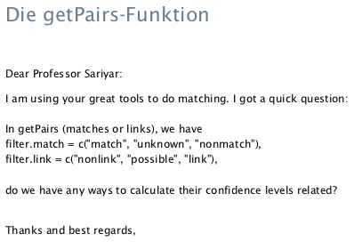
Problem

Slide 15
Lösungsansätze

Slide 16
Threshold Determination
Clerical Review
getParetoThreshold: calculates a classification threshold based on a generalized Pareto distribution fitted to the weights distribution of the given data pairs
optimalThreshold: Calculates the optimal threshold for weight-based RecordLinkage my = error bound for false positives ny = error bound for false negatives

