Slide 1
Versioning

Slide 2
Change Management

Slide 3
Deprecation

Slide 4
URL Route
POST /api/v1/jobs

Slide 5
URL Query
/api/foo?api-version=1.0
/api/foo?api-version=2.0-Alpha

Slide 6
Header
Header: X-Api-Version: 2.0

Slide 7
URL
POST /api/jobs
Accept: application/json;v=1.0

Slide 8
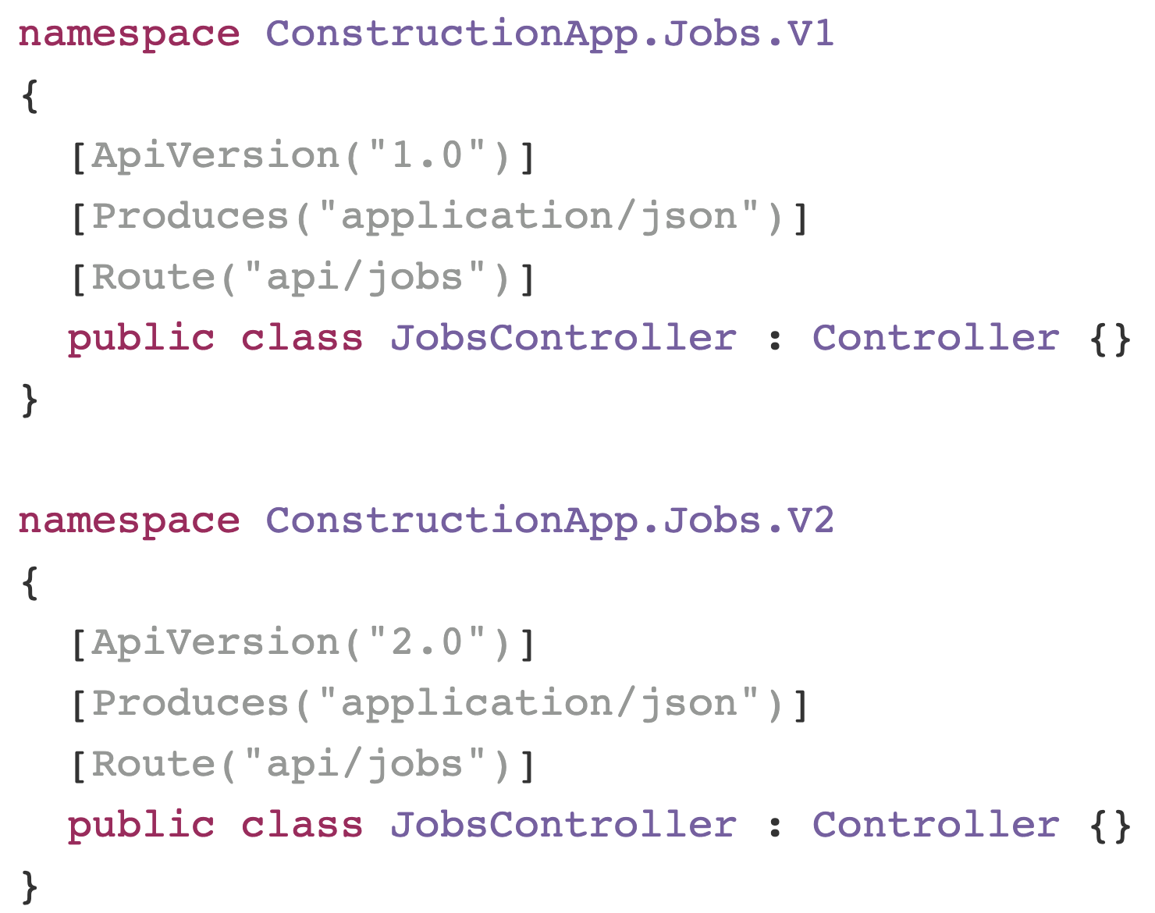
URL
POST /api/v1/jobs

Slide 9
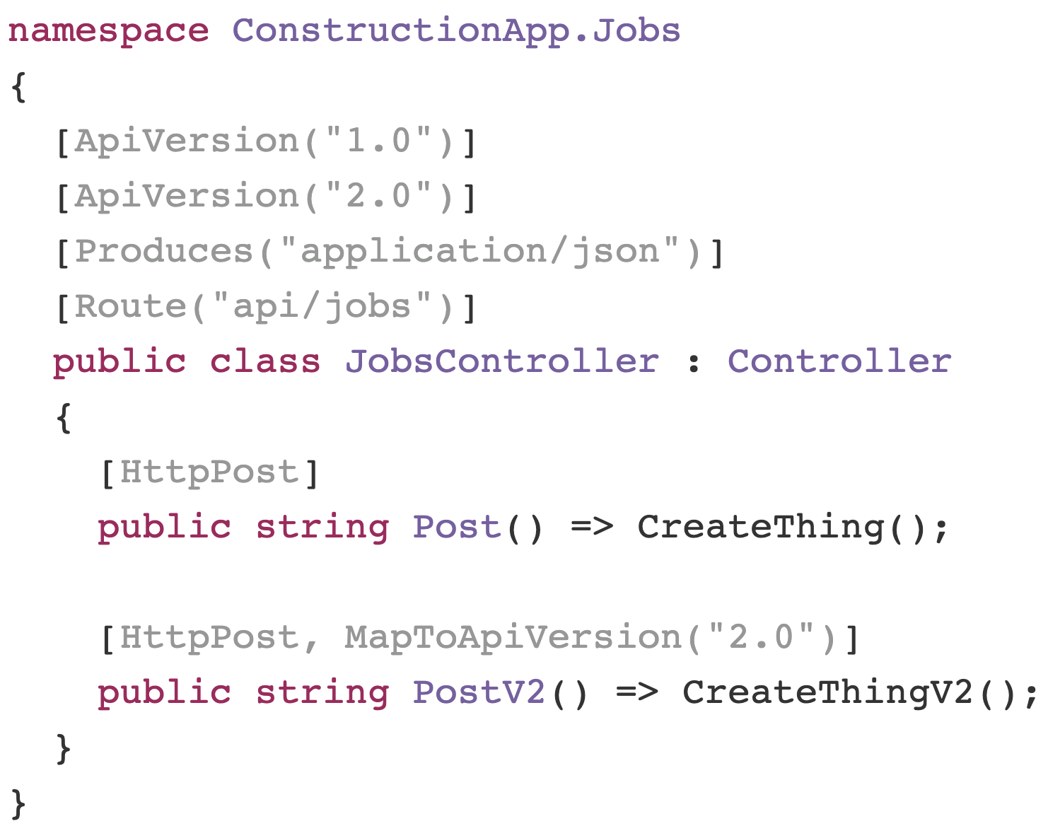
URL
POST /api/v1/jobs

Slide 10
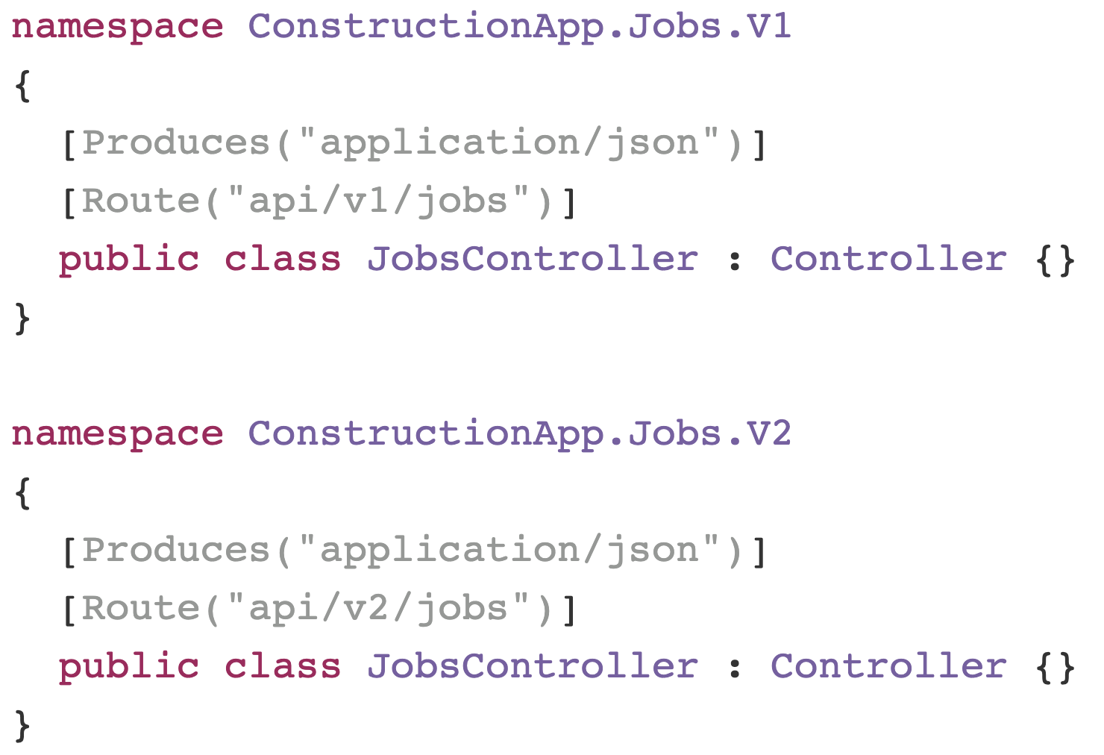

Slide 11
Contracts

Slide 12
Versioning > Breaking Changes

Slide 13
Always a balancing act

Slide 14
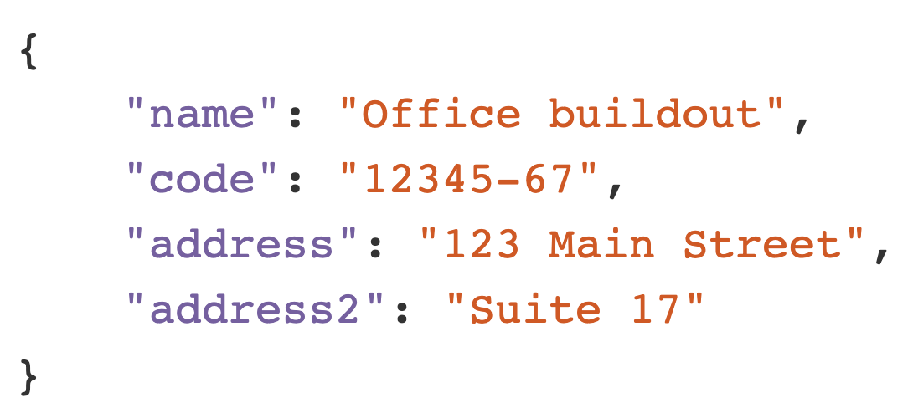
v2

Slide 15
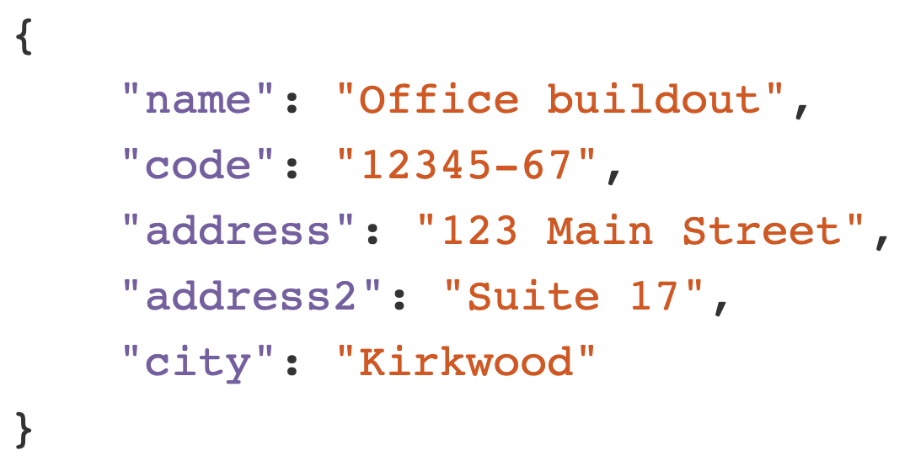
v3

Slide 16
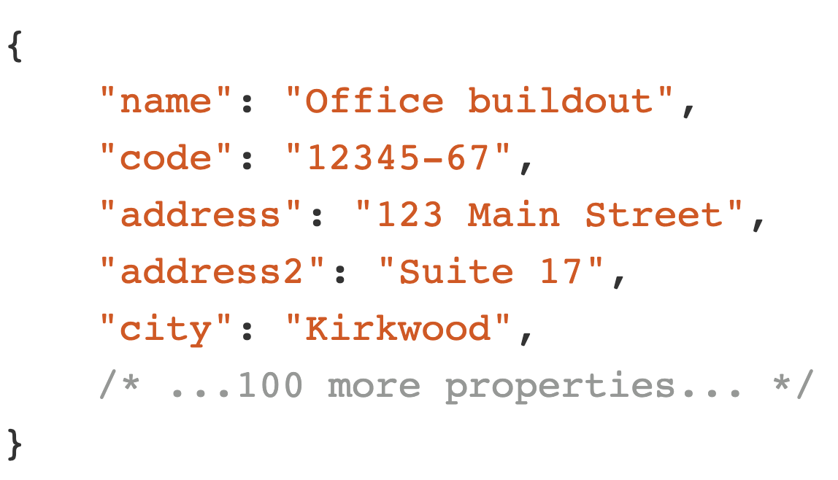
v56

Slide 17
Change management is hard

Slide 18
Questions?

