Slide 1
COP 3402 Systems Software
Lecture 4: Implementing Subprograms

Slide 2
Different Conventions !!!
Note that the convention used in Chapter 10 of the book “Programming Languages” by Sebesta is different from ours!!!
Sebesta uses a different ordering of Functional Value, Static Link, Dynamic Link, Return Address, Parameters, and Locals in an Activation Record.
The goal of the lecture is to explain the purpose of the dynamic and static links in more detail.

Slide 3
Chapter 10
Implementing Subprograms

Slide 4
Chapter 10 Topics
The General Semantics of Calls and Returns
Implementing “Simple” Subprograms
Implementing Subprograms with Stack-Dynamic Local Variables
Nested Subprograms
Blocks
Implementing Dynamic Scoping

Slide 5
The General Semantics of Calls and Returns
The subprogram call and return operations of a language are together called its subprogram linkage
A subprogram call has numerous actions associated with it
Parameter passing methods
Static local variables
Execution status of calling program
Transfer of control
Subprogram nesting

Slide 6
Implementing “Simple” Subprograms: Call Semantics
Save the execution status of the caller
Carry out the parameter-passing process
Pass the return address to the callee
Transfer control to the callee

Slide 7
Implementing “Simple” Subprograms: Return Semantics
If pass-by-value-result parameters are used, move the current values of those parameters to their corresponding actual parameters
If it is a function, move the functional value to a place the caller can get it
Restore the execution status of the caller
Transfer control back to the caller

Slide 8
Implementing “Simple” Subprograms: Parts
Two separate parts: the actual code and the noncode part (local variables and data that can change)
The format, or layout, of the noncode part of an executing subprogram is called an activation record
An activation record instance is a concrete example of an activation record (the collection of data for a particular subprogram activation)

Slide 9
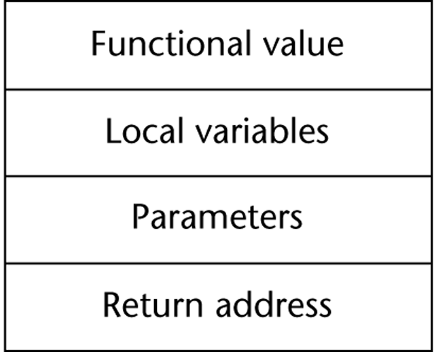
An Activation Record for “Simple” Subprograms

Slide 10
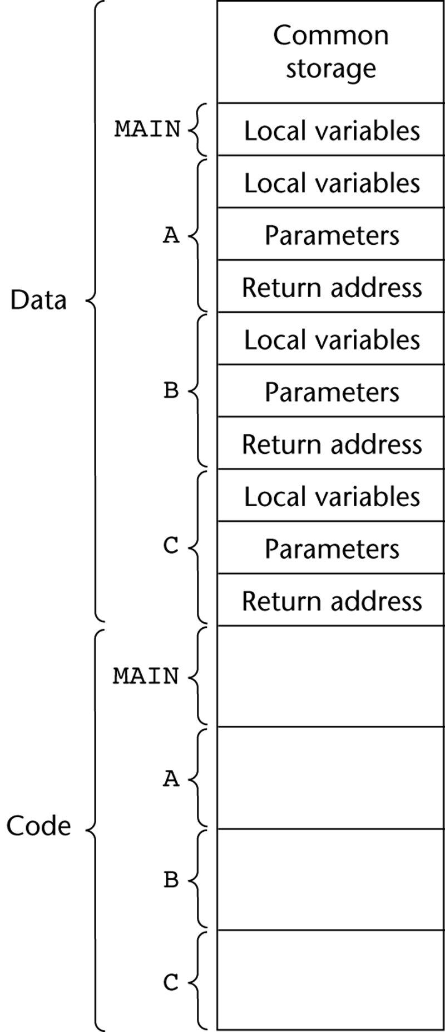
Code and Activation Records of a Program with “Simple” Subprograms

Slide 11
Implementing Subprograms with Stack-Dynamic Local Variables
More complex activation record
The compiler must generate code to cause implicit allocation and de-allocation of local variables
Recursion must be supported (adds the possibility of multiple simultaneous activations of a subprogram)

Slide 12
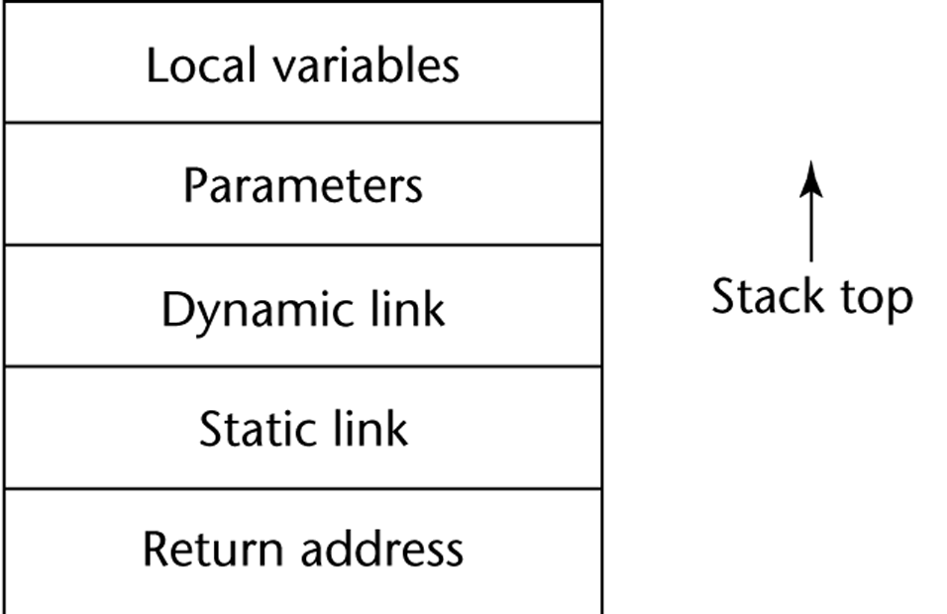
Typical Activation Record for a Language with Stack-Dynamic Local Variables

Slide 13
Implementing Subprograms with Stack-Dynamic Local Variables: Activation Record
The activation record format is static, but its size may be dynamic
The dynamic link points to the top of an instance of the activation record of the caller
An activation record instance is dynamically created when a subprogram is called
Run-time stack

Slide 14
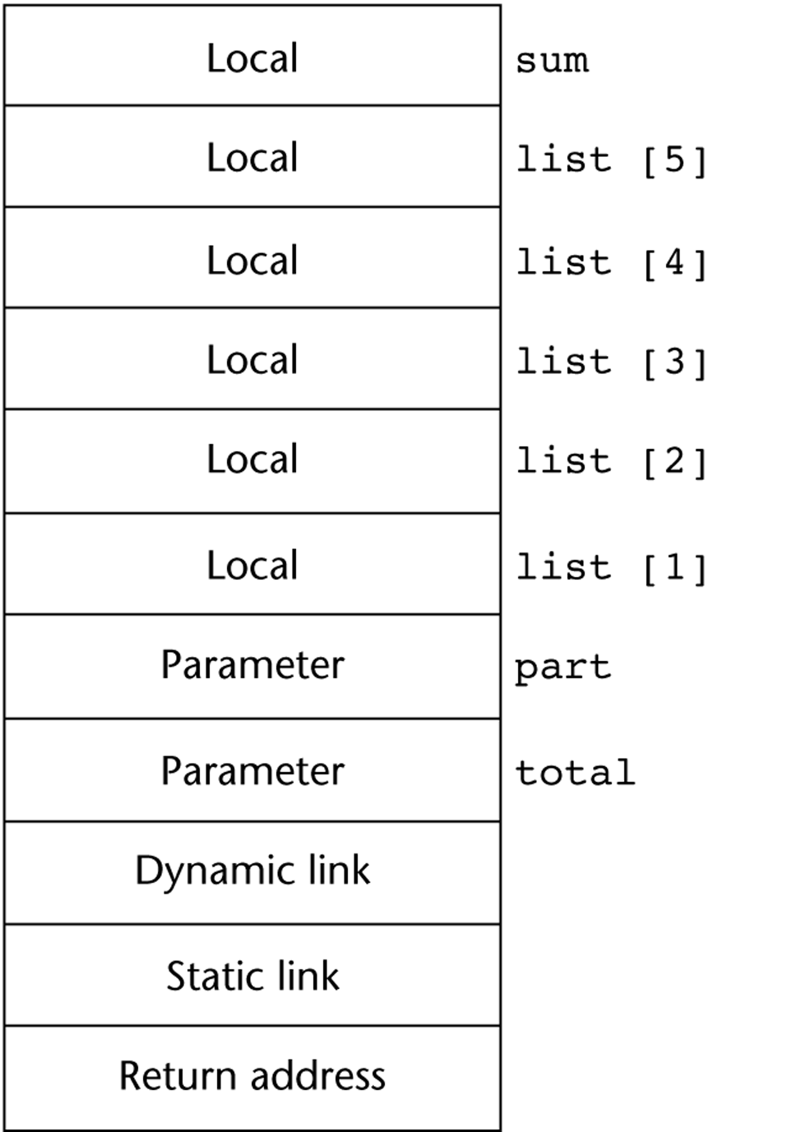
An Example: C Function
void sub(float total, int part)
{
int list[4];
float sum;
…
}
[4]
[3]
[2]
[1]
[0]

Slide 15
An Example Without Recursion
void A(int x) {
int y;
...
C(y);
...
}
void B(float r) {
int s, t;
...
A(s);
...
}
void C(int q) {
...
}
void main() {
float p;
...
B(p);
...
}
main calls B
B calls A
A calls C

Slide 16
An Example Without Recursion

Slide 17
Dynamic Chain and Local Offset
The collection of dynamic links in the stack at a given time is called the dynamic chain, or call chain
Local variables can be accessed by their offset from the beginning of the activation record. This offset is called the local_offset
The local_offset of a local variable can be determined by the compiler at compile time

Slide 18
An Example With Recursion
The activation record used in the previous example supports recursion, e.g.
int factorial (int n) {
<-----------------------------1
if (n <= 1) return 1;
else return (n * factorial(n - 1));
<-----------------------------2
}
void main() {
int value;
value = factorial(3);
<-----------------------------3
}

Slide 19
Example with recursion (cont.)
Activation record format
Parameter
Top of Stack
Dynamic Link
Return Address
Functional Value

Slide 20
Example with recursion (cont.)
factorial() called from Main with a parameter of 3
Top
Parameter
3
First AR for factorial
Dynamic Link
Return (to main)
Functional Value
?
AR for Main
?
Value

Slide 21
Example with recursion (cont.)
factorial(2) called from factorial(3)
Notice how the dynamic link points back to the bottom of the activation record of the calling party? This series of links (or dynamic chain) allows you to trace back the history of execution.
Top
Parameter
2
Second AR for factorial
Dynamic Link
Return (to fact)
Functional Value
?
Parameter
3
First AR for factorial
Dynamic Link
Return (to main)
Functional Value
?
AR for Main
?
Value

Slide 22
Example with recursion (cont.)
Top
Parameter
1
Third AR for factorial
Dynamic Link
factorial(1) called from factorial(2)
Return (to factorial)
Functional Value
?
Parameter
2
Second AR for factorial
Dynamic Link
Return (to factorial)
Functional Value
?
Parameter
3
First AR for factorial
Dynamic Link
Return (to main)
Functional Value
?
AR for Main
?
Value

Slide 23
Example with recursion (cont.)
Top
Parameter
1
Third AR for factorial
Dynamic Link
factorial(1) finished, and returns a value of 1 via functional value
Return (to factorial)
Functional Value
1
Parameter
2
Second AR for factorial
Dynamic Link
Return (to factorial)
Functional Value
?
Parameter
3
First AR for factorial
Dynamic Link
Return (to main)
Functional Value
?
AR for Main
?
Value

Slide 24
Example with recursion (cont.)
factorial(2) finished, and returns a value of 2 via functional value
Functional Value
1
Top
Parameter
2
Second AR for factorial
Dynamic Link
Return (to factorial)
Functional Value
2
Parameter
3
First AR for factorial
Dynamic Link
Return (to main)
Functional Value
?
AR for Main
?
Value

Slide 25
Example with recursion (cont.)
factorial(3) finishes and calculates a value of 6 to be returned to main via functional value
Functional Value
2
Top
Parameter
3
First AR for factorial
Dynamic Link
Return (to main)
Functional Value
6
AR for Main
?
Value

Slide 26
Example with recursion (cont.)
Main now sets value of local variable ‘value’ to calculated value of factorial.
Functional Value
6
Top
AR for Main
6
Value

Slide 27
Example with recursion (cont.)
Main now sets ‘value = 6’
AR for Main
6
Top
Value

Slide 28
Nested Subprograms
Some non-C-based static-scoped languages (e.g., Fortran 95, Ada, JavaScript) use stack-dynamic local variables and allow subprograms to be nested
All variables that can be non-locally accessed reside in some activation record instance in the stack
The process of locating a non-local reference:
Find the correct activation record instance
Determine the correct offset within that activation record instance

Slide 29
Locating a Non-local Reference
Finding the offset is easy
Finding the correct activation record instance
Static semantic rules guarantee that all non-local variables that can be referenced have been allocated in some activation record instance that is on the stack when the reference is made

Slide 30
Static Scoping
A static chain is a chain of static links that connects certain activation record instances
The static link in an activation record instance for subprogram A points to one of the activation record instances of A's static parent
The static chain from an activation record instance connects it to all of its static ancestors

Slide 31
Example Pascal Program
program MAIN_2;
var X : integer;
procedure BIGSUB;
var A, B, C : integer;
procedure SUB1;
var A, D : integer;
begin { SUB1 }
A := B + C; <-----------------------1
end; { SUB1 }
procedure SUB2(X : integer);
var B, E : integer;
procedure SUB3;
var C, E : integer;
begin { SUB3 }
SUB1;
E := B + A: <--------------------2
end; { SUB3 }
begin { SUB2 }
SUB3;
A := D + E; <-----------------------3
end; { SUB2 }
begin { BIGSUB }
SUB2(7);
end; { BIGSUB }
begin
BIGSUB;
end; { MAIN_2 }

Slide 32
Example Pascal Program (continued)
Call sequence for MAIN_2
MAIN_2 calls BIGSUB
BIGSUB calls SUB2
SUB2 calls SUB3
SUB3 calls SUB1

Slide 33
Stack Contents at Position 1

Slide 34
Displays
An alternative to static chains
Static links are stored in a single array called a display
The contents of the display at any given time is a list of addresses of the accessible activation record instances

Slide 35
Blocks
Blocks are user-specified local scopes for variables
An example in C
{int temp;
temp = list [upper];
list [upper] = list [lower];
list [lower] = temp
}
The lifetime of temp in the above example begins when control enters the block
An advantage of using a local variable like temp is that it cannot interfere with any other variable with the same name

Slide 36
Implementing Blocks
Two Methods:
Treat blocks as parameter-less subprograms that are always called from the same location
Every block has an activation record; an instance is created every time the block is executed
2. Since the maximum storage required for a block can be statically determined, this amount of space can be allocated after the local variables in the activation record

Slide 37
Implementing Dynamic Scoping
Deep Access: non-local references are found by searching the activation record instances on the dynamic chain
Shallow Access: put locals in a central place
One stack for each variable name
Central table with an entry for each variable name

Slide 38
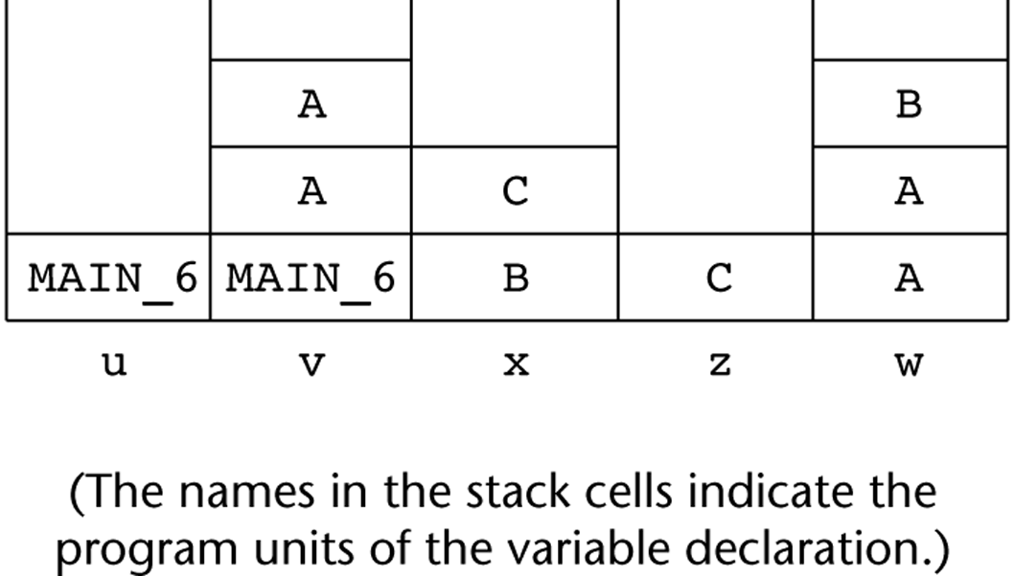
Using Shallow Access to Implement Dynamic Scoping

Slide 39
Summary
Subprogram linkage semantics requires many action by the implementation
Simple subprograms have relatively basic actions
Stack-dynamic languages are more complex
Subprograms with stack-dynamic local variables and nested subprograms have two components
actual code
activation record

Slide 40
Summary (continued)
Activation record instances contain formal parameters and local variables among other things
Static chains are the primary method of implementing accesses to non-local variables in static-scoped languages with nested subprograms
Access to non-local variables in dynamic-scoped languages can be implemented by use of the dynamic chain or thru some central variable table method

