Slide 1
COP 3402 Systems Software
Lexical Analysis

Slide 2
Outline
Lexical analyzer/Lexer
Regular expressions
Deterministic and non-deterministic finite automata
Transition tables
Lex: lexical-analyzer generator

Slide 3
Lexical Analyzer
The following slides are based on Chapter 2 Lexical Analysis of the book Modern Compiler Implementation in C by Andrew Appel.
The lexical analyzer takes a stream of characters and produces a stream of lexical tokens; it discards white space and comments between the tokens.
Lexical tokens
A lexical token is a sequence of characters that can be treated as a unit in the grammar of a programming language.
A programming language classifies lexical tokens into a finite set of token types.

Slide 4
Lexical Analyzer
For example, some of the token types of a programming language such as C are:
Token type Examples
ID foo n14 last
NUM 73 0 00 515 082
REAL 66.1 .5 10. 1e67 5.5e-10
IF if
COMMA ,
NOTEQ !=
LPAREN (
RPAREN )
Punctuation tokens such as IF, VOID, RETURN constructed from alphabetic characters are called reserved words, and in most languages, cannot be used as identifiers.

Slide 5
Lexical Analyzer
Examples of non-tokens are
comment /* try again */
preprocessor directive #include <stdio.h>
preprocessor directive #define NUMS 5 , 6
macro NUMS
blanks, tabs, and newlines
In languages weak enough to require a macro processor, the preprocessor operates on the source character stream, producing another character stream that is then fed to the lexical analyzer.

Slide 6
Lexical Analyzer
Given a program such as
float match0(char *s) /* find a zero */
{if (!strncmp(s, “0.0”, 3))
return 0.;
}
the lexical analyzer will return the stream
FLOAT ID(match0) LPAREN CHAR STAR ID(s) RPAREN
LBRACE IF BANG ID(strncmp) LPAREN ID(s) COMMA STRING(0.0) COMMA
NUM(3) RPAREN RPAREN RETURN REAL(0.0) SEMI RBRACE EOF
where the token-type of each token is reported.
Some of the tokens, such as identifiers and literals, have semantic values attached to them, giving auxiliary information in addition to the token type.

Slide 7
PL/0 Symbols
Example program written in PL/0:
const m = 7, n = 85;
var i, x, y, z, q, r;
procedure mult;
var a, b;
begin
a := x; b := y; z := 0;
while b > 0 do
begin
if odd x then z := z+a;
a := 2*a;
b := b/2;
end
end;
begin
x := m;
y := n;
call mult;
end.

Slide 8
PL/0 Symbols
Example program written in PL/0:
const m = 7, n = 85;
var i, x, y, z, q, r;
procedure mult;
var a, b;
begin
a := x; b := y; z := 0;
while b > 0 do
begin
if odd x then z := z+a;
a := 2*a;
b := b/2;
end
end;
begin
x := m;
y := n;
call mult;
end.
Reserved Words (Keywords)

Slide 9
PL/0 Symbols
Example program written in PL/0:
const m = 7, n = 85;
var i, x, y, z, q, r;
procedure mult;
var a, b;
begin
a := x; b := y; z := 0;
while b > 0 do
begin
if odd x then z := z + a;
a := 2 * a;
b := b / 2;
end
end;
begin
x := m;
y := n;
call mult;
end.
Operators
+, -, *, /, <, =, >, <=, <>, >=, :=

Slide 10
PL/0 Symbols
Example program written in PL/0:
const m = 7, n = 85;
var i, x, y, z, q, r;
procedure mult;
var a, b;
begin
a := x; b := y; z := 0;
while b > 0 do
begin
if odd x then z := z + a;
a := 2 * a;
b := b / 2;
end
end;
begin
x := m;
y := n;
call mult;
end.
Operators
+, -, *, /, <, =, >, <=, <>, >=, :=
Special Symbols
(, ), ,, ., ;

Slide 11
PL/0 Symbols
Example program written in PL/0:
const m = 7, n = 85;
var i, x, y, z, q, r;
procedure mult;
var a, b;
begin
a := x; b := y; z := 0;
while b > 0 do
begin
if odd x then z := z + a;
a := 2 * a;
b := b / 2;
end
end;
begin
x := m;
y := n;
call mult;
end.
Numbers such as
7, 85, 0, 2, ...

Slide 12
PL/0 Symbols
Example program written in PL/0:
const m = 7, n = 85;
var i, x, y, z, q, r;
procedure mult;
var a, b;
begin
a := x; b := y; z := 0;
while b > 0 do
begin
if odd x then z := z + a;
a := 2 * a;
b := b / 2;
end
end;
begin
x := m;
y := n;
call mult;
end.
Identifiers:
- a letter or
- a letter followed by more letters or
- a letter followed by more letters or digits.
Examples:
x, m, celsius, mult, intel486

Slide 13
Designing a Lexer
Define identifiers and numbers (tokens with semantic values), reserved words, and remaining lexical tokens in PL/0
Identifiers: a lower case letter, followed by sequence consisting of digits or letters (total length 16 or less), not equal to a reserved word
Numbers: integer numbers; max value 2^16-1
Reserved words:
begin call const do end if odd procedure then var while
Operators and special symbols:
+ - * /
( )
:=
=
<>
, ; .
<= >= < >

Slide 14
Designing a Lexer
/* PL0 token types */
typedef enum token {
nulsym = 1, identsym, numbersym, plussym, minussym,
multsym, slashsym, oddsym, eqsym, neqsym, lessym, leqsym,
gtrsym, geqsym, lparentsym, rparentsym, commasym, semicolonsym,
periodsym, becomessym, beginsym, endsym, ifsym, thensym,
whilesym, dosym, callsym, constsym, varsym, procsym, writesym,
readsym , elsesym
} token_type;

Slide 15
Designing a Lexer
I found it helpful to define the following arrays in my implementation of the lexer.
For instance, to check if a keyword occurs, I go through the keyword array and check if the corresponding substring starts at the current position in the source code file. (But be careful an identifier could be called variable, so you have to do an additional check.)
/* names of reserved words */
char *keyword[] = {
“null”, “begin”, “call”, “const”, “do”, “else”, “end”, “if”,
“odd”, “procedure”, “read”, “then”, “var”, “while”, “write”
};
/* types of reserved words */
int keyword_type[] = {
nul, beginsym, callsym, constsym, dosym, elsesym, endsym,
ifsym, oddsym, procsym, readsym, thensym, varsym, whilesym, writesym
};

Slide 16
Regular Expressions
The mathematical notion of regular expression is very useful to describe lexical token of a programming language.
A language is a set of strings.
A string is a finite sequence of symbols.
The symbols are themselves taken from a finite alphabet.
To specify languages (some of which may be infinite) with finite descriptions, we use the notation of regular expressions.
Each regular expression stands for a set of string.

Slide 17
Regular Expressions
Symbol
For each symbol a in the alphabet of the language, the regular expression a denotes the language containing just the string a.
Alternation
A string is in the language of M | N if it is in the language of M or in the language of N.
Concatenation
A string is in the language M ∙ N if it is the concatenation of any two strings α and β such that α is in M and β is in N. Often, we just write M N.
Epsilon
The regular expression ε represents a language whose only string is the empty string.
Repetition
A string is in M* if it is the concatenation of zero or more strings, all of which are in M.
M* is called the Kleene closure of M.

Slide 18
Regular Expressions
Using symbols, alternation, concatenation, epsilon, and Kleene closure we can specify the set of ASCII strings corresponding to the lexical tokens of a programming language.
For example:
(0 | 1)* ∙ 0 binary numbers that are multiple of two
b*(abb*)*(a | ) strings of a’s and b’s with no consecutive a’s
(a | b)* aa (a | b) strings of a’s and b’s containing consecutive a’s
In writing regular expressions, the concatenation operator or the epsilon are often omitted, and it is assumed that the Kleene closure binds tighter than concatenation, and concatenation binds tighter than alternation.

Slide 19
Regular Expressions
Some more abbreviations:
[abcd] means (a | b | c | d)
[b-g] means [bcdefg]
[b-gM-Qkr] means [bcdefgMNOPQkr]
M? means (M | )
M+ means M M*
M{n,m} means the language of strings that are concatenations of at least n and at most m strings in the language of M
These extensions are convenient, but none extend the descriptive power of regular expressions.

Slide 20
Finite Automata
Regular expressions are convenient for specifying lexical tokens.
But we need a formalism that can be implemented as a computer program.
For this we can use finite automata.
A finite automaton has a finite set of states; edges lead from one state to another, and each edge is labeled with a symbol.
One state is the start state, and certain of the states are distinguished as final states.

Slide 21
Example of Finite Automaton
Finite automaton for recognizing C comments.
other
*
/
*
*
/
1
2
3
4
5
symbol
other
state
/
*
other
final state
1
2
no
2
3
no
3
3
4
3
no
4
5
4
3
no
5
yes
Transition table

Slide 22
Generation of a Lexer
The regular expressions that describe the lexical tokens of a programming language are combined and give rise to a non-deterministic finite automaton.
The non-deterministic automaton is converted into a deterministic finite automaton.
The deterministic finite automaton is translated into a computer program.
All these steps are handled automatically by the tool lex.

Slide 23
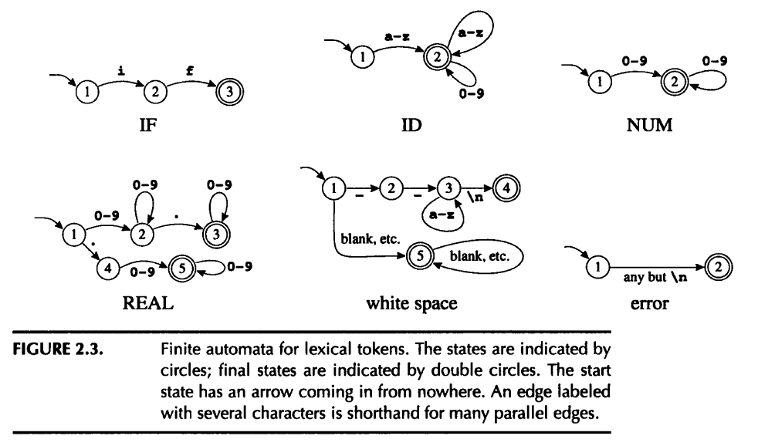
Regular expressions

Slide 24
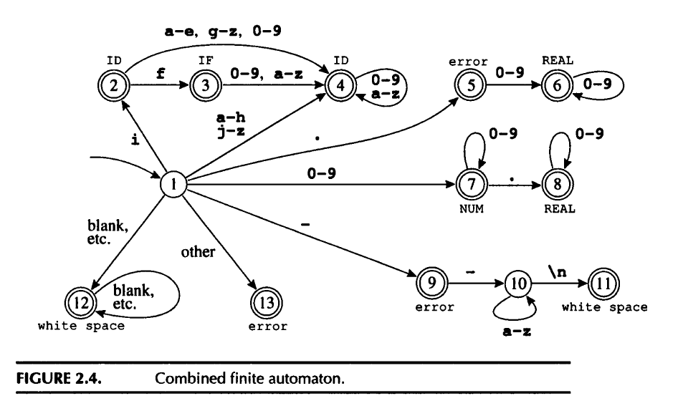
DFA

Slide 25
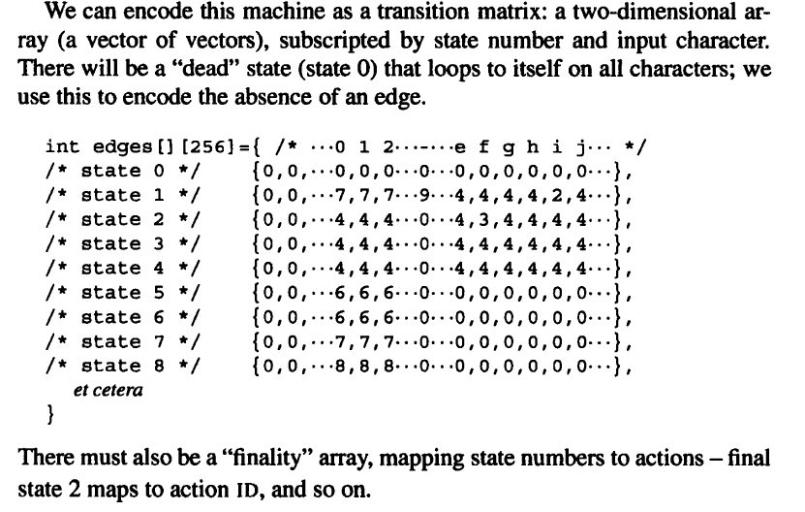
Transition matrix

Slide 26
Recognizing the Longest Match
There are two important disambiguation rules used by Lex and other similar lexical-analyzer generators:
Longest match
The longest initial substring of the input that can match any regular expression is taken as the next token.
For instance, if8 is recognized as ID and not IF followed by NUM.
Rule priority
For a particular longest initial substring, the first regular expression that can match determines the next token.
This means that the order of writing down the regular-expression rules has significance.

Slide 27
Recognizing the Longest Match
It is easy to see how to use the transition table to recognize whether to accept or reject a string.
But the job of a lexical analyzer is to find the longest match, the longest initial substring of the input that is a valid token.
While interpreting transitions, the lexer must keep track of the longest match seen so far, and the position of that match.

Slide 28
Lex
%{
/* C declarations */
%}
/* Lex definitions */
%%
/* Regular expressions and actions */

Slide 29
Lex
Regular expressions are static and declarative.
Automata are dynamic and imperative.
Lex has a mechanism to mix states with regular expressions.
One can declare a set of start states; each regular expression can be prefixed by the set of state in which it is valid.
The action fragments can explicitly change the start state.
In effect we have a finite automaton whose edges are labeled by regular expressions.

Slide 30
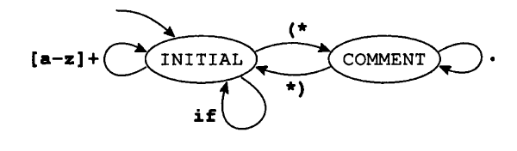
Lex
This example shows a language with simple identifiers, if tokens, and comments delimited by (* and *) brackets.

Slide 31
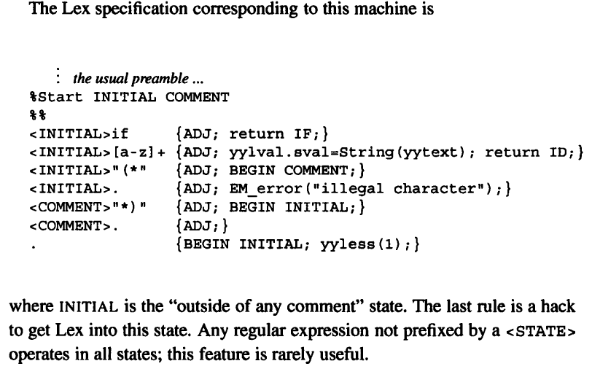
Lex

