Slide 1
Regular Expressions and DFAs
COP 3402

Slide 2
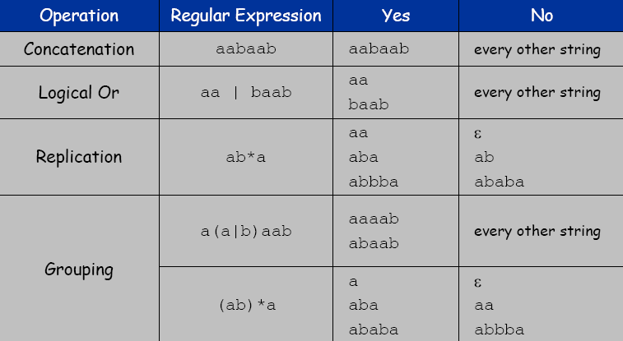
Regular Expression
Notation to specify a set of strings

Slide 3
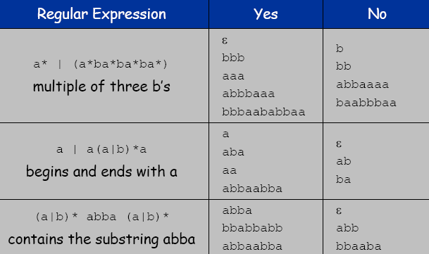
Examples

Slide 4
Exercise 1
Let ∑ be a finite set of symbols
∑ = {10, 11}, ∑* = ?

Slide 5
Answer
Answer: ∑* = {є, 10, 11, 1010, 1011, 1110,
1111, …}

Slide 6
Exercises 2
Let ∑={0,1} be a finite set of symbols and let L1 and L2 be sets of strings from ∑*. L1L2 is the set {xy | x is in L1, and y is in L2}
L1 = {10, 1}, L2 = {011, 11}, L1L2 = ?

Slide 7
Answer
L1L2 = {10011, 1011, 111}

Slide 8
Exercises 3
Write RE for
All strings of 0’s and 1’s
All strings of 0’s and 1’s with at least 2
consecutive 0’s
All strings of 0’s and 1’s beginning with
1 and not having two consecutive 0’s

Slide 9
Answer
(0|1)*
All strings of 0’s and 1’s
(0|1)*00(0|1)*
All strings of 0’s and 1’s with at least 2
consecutive 0’s
(1|10)+
All strings of 0’s and 1’s beginning with 1
and not having two consecutive 0’s

Slide 10
More Exercises
1) (0|1)*011
2) 0*1*2*
3) 00*11*22*

Slide 11
More Exercises (Answers)
1) (0|1)*011
Answer: all strings of 0’s and 1’s ending in 011
2) 0*1*2*
Answer: any number of 0’s followed by
any number of 1’s followed by any number
of 2’s
3) 00*11*22*
Answer: strings in 0*1*2 with at least one of
each symbol

Slide 12
Using Regular Expressions
Regular expressions are a standard programmer's tool.
Built in to Java, Perl, Unix, Python, . . . .

Slide 13
Deterministic Finite Automata (DFA)
Simple machine with N states.
Begin in start state.
Read first input symbol.
Move to new state, depending on current state and input symbol.
Repeat until last input symbol read.
Accept or reject string depending on label of last state.

Slide 14
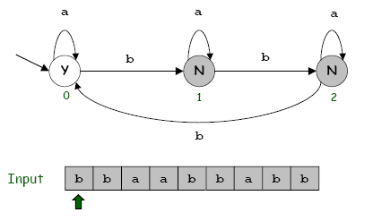
DFA

Slide 15
Theory of DFAs and REs
RE. Concise way to describe a set of strings.
DFA. Machine to recognize whether a given string is in a given set.
Duality: for any DFA, there exists a regular expression to describe the same set of strings; for any regular expression, there exists a DFA that recognizes the same set.

Slide 16

Duality Example
DFA for multiple of 3 b’s:
RE for multiple of 3 b’s:

Slide 17
Duality…
Practical consequence of duality proof: to match regular expression patterns, (i) build DFA and (ii) simulate DFA on input string.

Slide 18
Fundamental Questions
Which languages CANNOT be described by any RE?
Set of all bit strings with equal number of 0s and 1s.
Set of all decimal strings that represent prime numbers.
Many more. . . .

Slide 19
Problem 1
Make a DFA that accepts the strings in the language denoted by regular expression ab*a

Slide 20
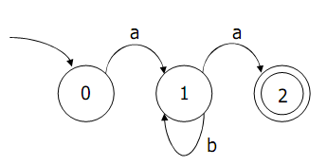
Solution
ab*a:

Slide 21
Problem 2
Write the RE for the following automata:

Slide 22
Solution
a(a|b)*aa*

Slide 23
DFA to RE: State Elimination
Eliminates states of the automaton and replaces the edges with regular expressions that includes the behavior of the eliminated states.
Eventually we get down to the situation with just a start and final node, and this is easy to express as a RE

Slide 24
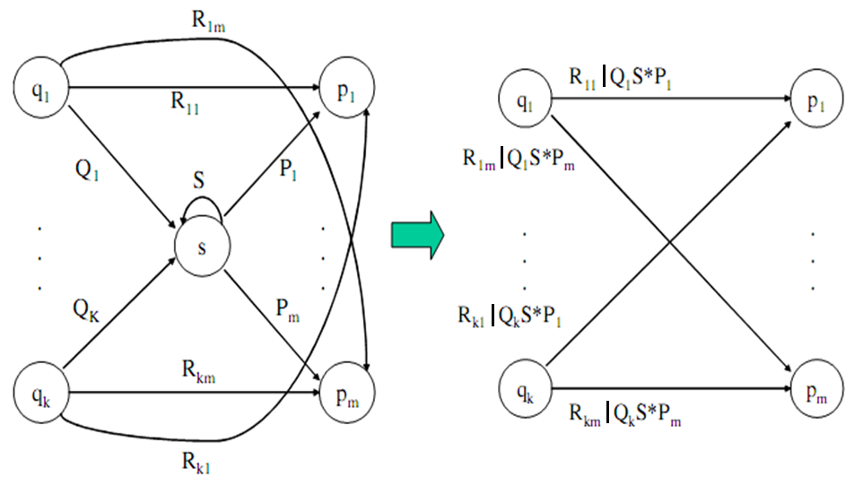
State Elimination
Consider the figure below, which shows a generic state s about to be eliminated.
The labels on all edges are regular expressions.
To remove s, we must make labels from each qi to p1 up to pm that include the paths we could have made through s.

Slide 26
DFA to RE via State Elimination (1)
Starting with intermediate states and then moving to accepting states, apply the state elimination process to produce an equivalent automaton with regular expression labels on the edges.
The result will be a one or two state automaton with a start state and accepting state.

Slide 27
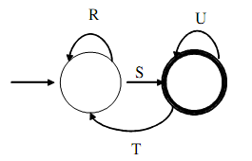
DFA to RE State Elimination (2)
If the start state is not an accepting state, we will have an automaton that looks like the following:
We can describe this automaton as: (R | SU*T)*SU*

Slide 28
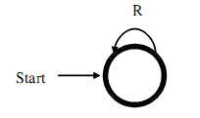
DFA to RE State Elimination (3)
If the start state is also an accepting state, then we must also perform a state elimination from the original automaton that gets rid of every state but the start state. This leaves the following:
We can describe this automaton as simply R*

Slide 29
DFA to RE State Elimination (4)
If there are n accepting states, we must repeat the above steps for each accepting states to get n different regular expressions, R1, R2, … Rn.
For each repeat we turn any other accepting state to non-accepting.
The desired regular expression for the automaton is then the union of each of the n regular expressions: R1 U R2… U RN

Slide 30
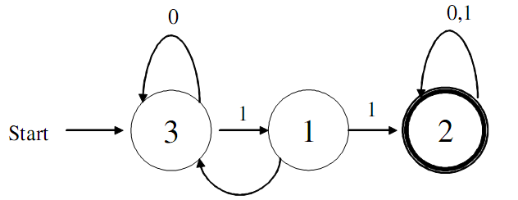
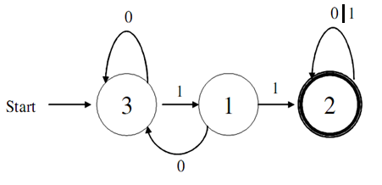
DFA->RE Example
Convert the following to a RE:
First convert the edges to RE’s:

Slide 31
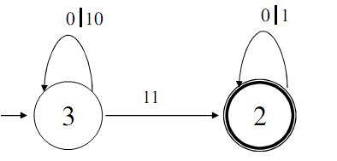
DFA -> RE Example (2)
Eliminate State 1:
Note edge from 3->3
Answer: (0|10)*11(0|1)*

Slide 32
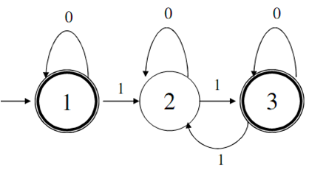
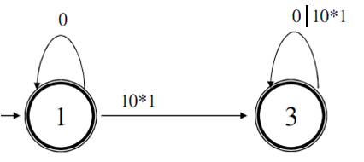
Second Example
Automata that accepts even number of 1’s
Eliminate state 2:

Slide 33
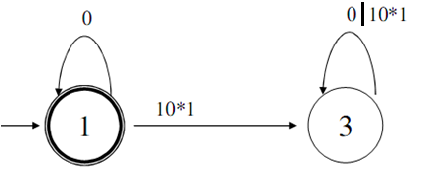
Second Example (2)
Two accepting states, turn off state 3 first
This is just 0*; we can ignore going to state 3 since we would “die” (can’t come back to an accepting state).

Slide 34
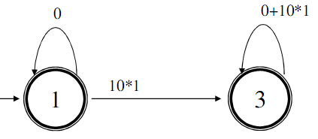
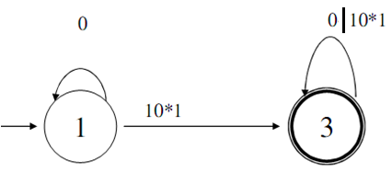
Second Example (3)
Turn off state 1 second:
This is just 0*10*1(0|10*1)*
Combine from previous slide to get 0* | 0*10*1(0|10*1)*

Slide 35
RE -> Automata
We can do this easiest by converting a RE to an NFA (Non-deterministic Finite Automata).
Beyond the scope of this course…

Slide 36
Questions

