Slide 1
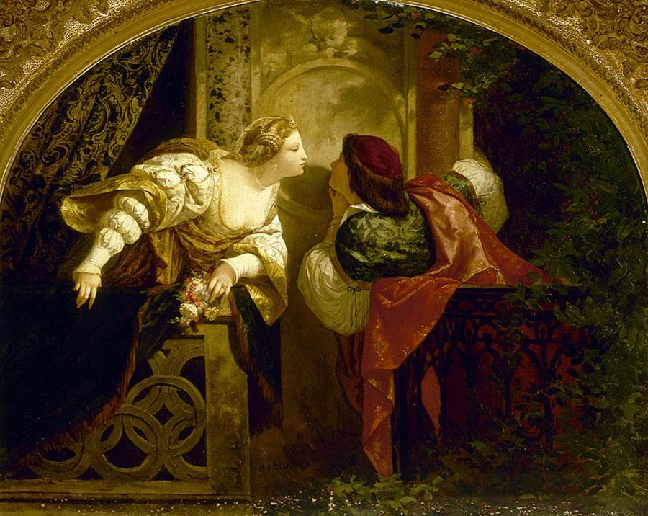
Why Symbol Tables?
What’s in a name? That which we call a rose, by any other name would smell as sweet…
Romeo and Juliet by Henri-Pierre Picou

Slide 2

Why Symbol Tables?
роза
rose
玫瑰
rosa
róża
ros
Some programming languages allow us to use multiple names for the same object.
(For instance: references in C++).
Notes:
English, Spanish, Swedish, Rusian, Chinese (Méiguī), Polish

Slide 3

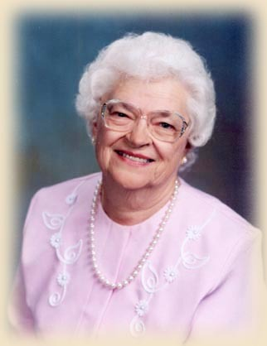
Why Symbol Tables?
rose
rose
rose
The same word could mean different objects in different contexts.
(For example: a local variable and a global variable).
rose?

Slide 4
Symbol Table
It records information about symbol names in a program.
Don’t confuse symbol and identifier:
A symbol (or name) is the object (variable, function, procedure, program, etc).
An identifier is a way to reference some symbol.
rose

Slide 5
When is the Symbol Table used?
Lexical Analysis
Lexical Analyzer scans program
Finds Symbols
Adds Symbols to symbol table
Syntactic Analysis
Information about each symbol is filled in
Used for type checking during semantic analysis

Slide 6
Info provided by Symbol Table
Given an identifier which symbol is it?
What information is to be associated with a name?
How do we access this information?
How do we associate this information with a name?

Slide 7
Symbol Attributes
Each piece of info associated with a name is called an attribute.
Attributes are language dependent:
Actual characters of the name (“rose”).
Type (variable, function, program, etc).
Storage allocation info (number of bytes).
Line number where declared.
Lines where referenced.
Scope.
“rose”
flower
12’’ tall

Slide 8
Symbol Classes
Different Classes of Symbols have different Attributes.
Variable, Type, Constant, Parameter, Record field.
Type is one of attributes (int, float, char).
Procedure or function.
Number of Parameters, Parameters, Result Type.
Array
Number of Dimensions, Array bounds.
File
Record Size, Record Type.

Slide 9
Other Attributes
A scope of a variable can be represented by
A number (scope is just one of attributes).
A different symbol table is constructed for different scope.
Object Oriented languages have classes like
Method names, class names, object names.
Scoping is VERY important. (Inheritance).
Functional Languages Lisp
Binding Issues.

Slide 10
Symbol Table Operations
Two operations required:
Insert: adds a symbol to the table.
Lookup: finds a symbol in the table (and get its attributes).
Insertion is only done once per symbol.
Lookup is done many times per symbol.
We need fast lookups.

Slide 11
Example program
01 PROGRAM Main
02 GLOBAL a,b
03 PROCEDURE P (PARAMETER x)
04 LOCAL a
05 BEGIN {P}
06 …a…
07 …b…
08 …x…
09 END {P}
10 BEGIN{Main}
11 Call P(a)
12 END {Main}

Slide 12
Symbol Table: External Structure
It refers to the way in which we handle the symbols. Could be implemented as:
Unordered List
Ordered List
Binary Tree
Hash Table

Slide 13

Symbol Table: Unordered List
Fast inserts: O(1)
Slow lookups: O(n)
Only useful if there is a small number of symbols
Identifier Class Scope
Main Program 0
a Variable 0
b Variable 0
P Procedure 0
x Parameter 1
a Variable 1

Slide 14
Symbol Table: Ordered List
Ordered by identifier
Ordered Array:
Slow inserts: O(n)
Fast lookups: O(log n)
Linked List:
Slow inserts: O(n)
Slow lookups: O(n)
Identifier Class Scope
a Variable 0
a Variable 1
b Variable 0
Main Program 0
P Procedure 0
x Parameter 1

Slide 15
Symbol Table: Binary Tree
Main | Program | 0 | Line1
P | Procedure | 1 | Line3 | Line11
x | Parameter | 1 | Line3 | Line8
a | Variable | 0 | Line2 | Line11
b | Variable | 0 | Line2 | Line7
a | Variable | 1 | Line4 | Line6

Slide 16
Symbol Table: Binary Tree
Fast inserts: O(log n)
Fast lookups: O(log n)
Space efficient.
Easy to print alphabetized list of names.
Scoping is difficult, unless a different tree is used for each scope.

Slide 17
Symbol Table: Hash Table
Most efficient. Used by production compilers.
Fast insertion: O(1).
Fast lookup: O(1) best case, O(n) worst case (very rare).
A good hashing function is needed.
As an example, let’s use the following hashing function:
H(id) = (First letter + last letter) mod 11

Slide 18
Symbol Table: Hash Table
0
1
2
3
4
5
6
7
8
9
10
Main | Program | 0 | Line1
M | n | a | b | P | x
77 | 110 | 97 | 98 | 80 | 120
PROGRAM Main
GLOBAL a,b
PROCEDURE P(PARAMETER x)
LOCAL a
BEGIN (P)
…a…
…b…
…x…
END (P)
BEGIN (Main)
Call P(a)
End (Main)
P | Procedure | 1 | Line 3
a | Variable | 0 | Line2
a | Variable | 1 | Line4
b | Variable | 0 | Line2
x | Parameter | 0 | Line2

Slide 19
Symbol Table: Hash Table
Scoping is easy to implement. No need to use extra tables.
Drawbacks?
It is not as space efficient as a binary tree.

Slide 20
Symbol Table: Internal Structure
The internal structure is how we organize each symbol and its attributes.
Logical view: a symbol table is a list of names, and each name has a list of attributes.
Implementation: a symbol table might have multiple tables:
String table.
Class table.
Name table.

Slide 21
Example of Internal Structure
rose: Array [1…100] of Integer;
Class Table
…
Array
…
…
…
Attribute Table
…
1
1
100
…
Name Table
…
…
…
…
…
Hash(rose)
 | String Table
… | rose | …

