Slide 1
Hyperspectral Unmixing
EO 2021 – Earth Observation Symposium – 14.07.2021
Philip Liehr, Clemens Lang, Shawn Schneidereit, Janis Klug

Slide 2
Overview
Research goal
Methods
Study Area
Vegetation classes
Workflow
3. Results
Non-vegetation vs. vegetation fraction
Non-woody vegetation fraction
Woody vegetation class fraction
4. Discussion
Literature
Hyperspectral Unmixing – Liehr, Lang, Schneidereit, Klug - 14.07.2021

Slide 3
1. Research goal
Comparison of vegetation class fraction maps based on hyperspectral and multi-temporal multi-spectral imagery
Hyperspectral Unmixing – Liehr, Lang, Schneidereit, Klug - 14.07.2021

Slide 4
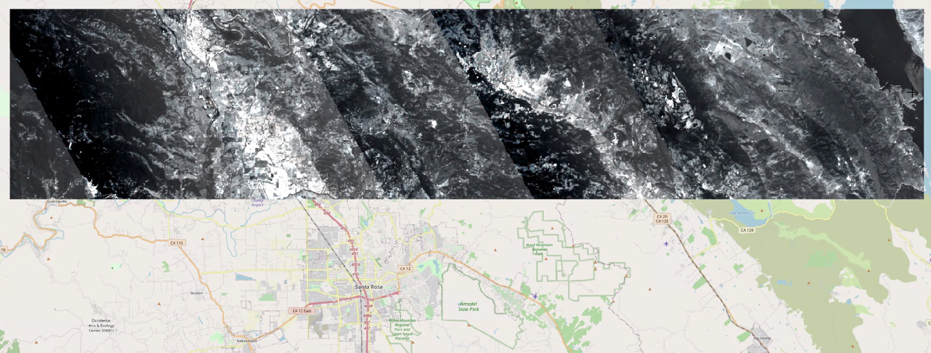
2. Methods Study Area
North of Santa Rosa, California (USA)
Extend: approx. 72 km x 15 km
Time frame hyperspectral (EnMAP): 07.06.2013
Time frame Landsat: 02.01.2013 – 28.12.2013
Fig. 1: Overview of the study area
(Data provided by HU Berlin Earth Observation department, 2021 and Open Street Map, 2021)
Hyperspectral Unmixing – Liehr, Lang, Schneidereit, Klug - 14.07.2021

Slide 5
2. Methods Vegetation classes
Land cover characterised by e. g. urban, water, forest, shrub- and grassland
Agriculture dominated by viticulture (wine falls under class shrub)
Vegetation classes based on hierarchical approach with four levels
Tab. 1: Hierarchical vegetation classes ref. to Cooper et al. (2020)
Hyperspectral Unmixing – Liehr, Lang, Schneidereit, Klug - 14.07.2021

Slide 6
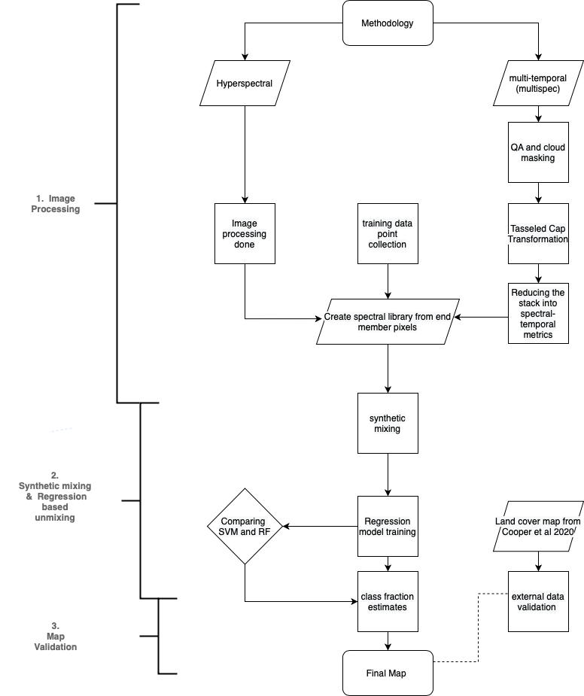
2. Methods Workflow
Calculation (RAM?) issue for STMs
with Python script by Leon Nill
(otherwise R and QGIS were applied)
Current step (first results on next slide)
Fig. 2: Workflow V.5

Slide 7
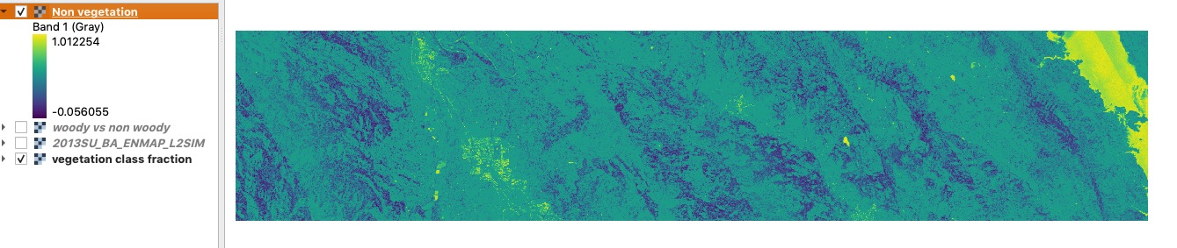
3. Results Non-Vegetation vs. Vegetation fraction
Fig. 3: Map 1 (Non-Vegetation vs. Vegetation)
Hyperspectral Unmixing – Liehr, Lang, Schneidereit, Klug - 14.07.2021

Slide 8
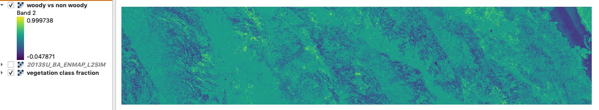
3. Results Non-Woody vegetation fraction
Fig. 4: Map 2 (Non-Woody)
Hyperspectral Unmixing – Liehr, Lang, Schneidereit, Klug - 14.07.2021

Slide 9
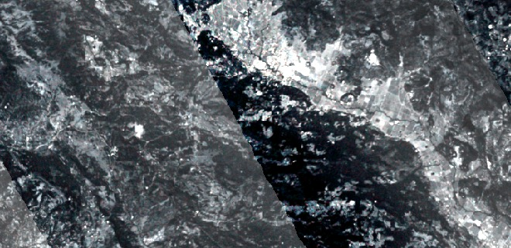
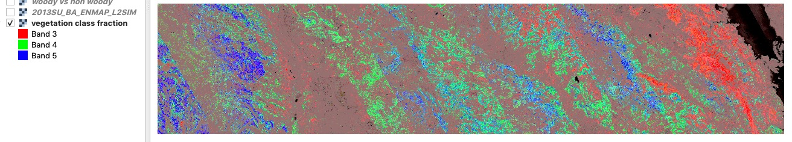
3. Results Woody vegetation class fraction
Shrub
Broadleaf
Coniferous
Fig. 5 top: Hyperspectral image
bottom: Map 1 (Woody vegetation class fraction)
Hyperspectral Unmixing – Liehr, Lang, Schneidereit, Klug - 14.07.2021

Slide 10
4. Discussion
Use of hyperspectral imagery led to seemingly adequate fractional cover estimations across the study area
2. Endmembers affected by data artefacts from flight paths
3. Hyperspectral and multi-temporal multi-spectral imagery requires
extensive computational resources…
Hyperspectral Unmixing – Liehr, Lang, Schneidereit, Klug - 14.07.2021

Slide 11
Thank you for you_R attention!

Slide 12
Literature
Cooper et al. (2020): Disentangling fractional vegetation cover: Regression-based unmixing of simulated spaceborne imaging spectroscopy data. Remote Sensing of Environment, 246. DOI: 10.1016/j.rse.2020.111856
Jänicke, C., Okujeni, A., Cooper, S., Clark, M., Hostert, P. and van der Linden, S., 2020. Brightness gradient-corrected hyperspectral image mosaics for fractional vegetation cover mapping in northern California. Remote Sensing Letters, 11(1), pp.1-10.
Okujeni, A., van der Linden, S., Suess, S., Hostert, P., 2017. Ensemble learning from synthetically mixed training data for quantifying urban land cover with support vector regression. IEEE J. Sel. Top. Appl. Earth Observ. Remote Sens. 10, 1640–1650.
QGIS (2021): QGIS Geographic Information System. QGIS Association. URL: http://www.qgis.org [2021-07-11]
R Core Team (2021): R: A language and environment for statistical computing. R Foundation for Statistical Computing, Vienna, Austria. URL: https://www.r-project.org [2021-07-11]
Roberts et al. (2018): Hyperspectral vegetation indices. In: Hyperspectral indices and image classifications for agriculture and vegetation.
Referring as well to California natural resources agency (2021) for Cropping (e.g. vineyards, apple plantations, wheat etc.). URL: https://data.cnra.ca.gov/dataset/crop-mapping-2014 [2021-06-19]

