Slide 1
Hyperspectral Unmixing
Phy_Liehr, Clemens Lang, Shawn Schneidereit, Janis Klug
EO 2021 – Earth Observation Symposium – 14.07.2021

Slide 2
Research goal
Comparison of vegetation class fraction maps based on hyperspectral and multi-temporal multi-spectral imagery
Hyperspectral Unmixing – 14.07.2021

Slide 3
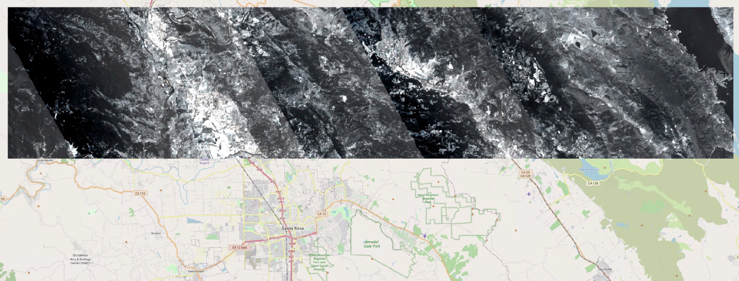
Study Area
North of Santa Rosa, California (USA)
Extend: approx. 72 km x 15 km
Time frame hyperspectral (EnMAP): 07.06.2013
Time frame Landsat: 02.01.2013 – 28.12.2013
Fig. 1: Overview of the study area
(Data provided by HU Berlin Earth Observation department, 2021 and Open Street Map, 2021)
Hyperspectral Unmixing – 14.07.2021

Slide 4
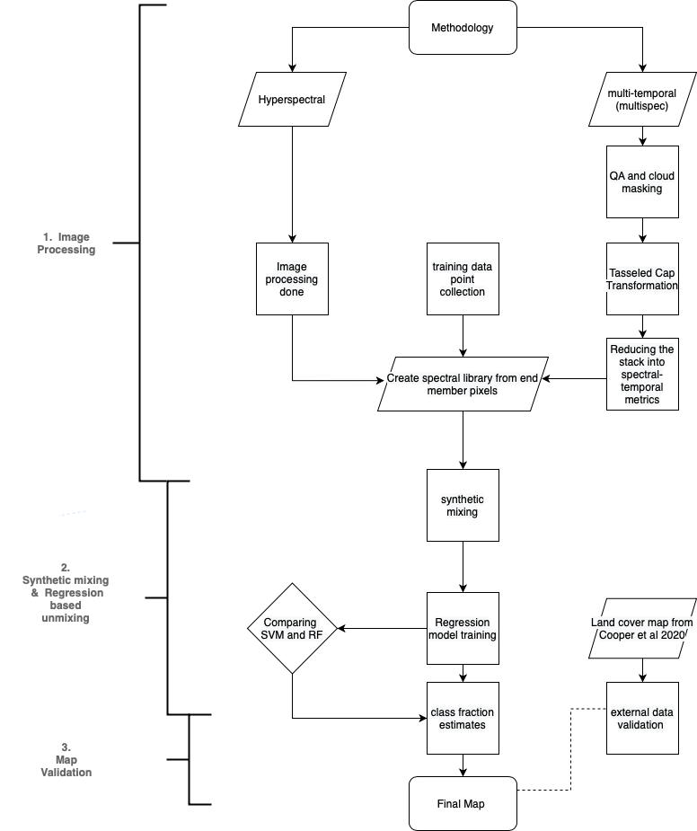
Workflow
Calculation (RAM?) issue for STMs
Current step, first results on next slide
Hyperspectral Unmixing – 14.07.2021
Fig. 2: Workflow V.5

Slide 5
Map
Fig. 3: Map 1 (Non-Vegetation vs. Vegetation)
Hyperspectral Unmixing – 14.07.2021

Slide 6
Main Results
three main results
Hyperspectral Unmixing – 14.07.2021

Slide 7
discussion items
as three discussion items

