Slide 1
DATA STRUCTURES
Palindrome
A PRESENTATION BY
Noel Joe –
ROLL NO.38
Kunal Chaudhary – ROLL NO.28
Shawn Louis
– ROLL NO.31
Student Attendance management system

Slide 2

ATTENDANCE MANAGEMENT SYSTEM

Slide 3
We have developed this system to prevent the hassle and the wastage which is caused due to the use of paper.
This system is fully developed in C++.
This system is fully computerised and is very easy to store.
This system uses files to store,retrive and delete data.

Slide 4
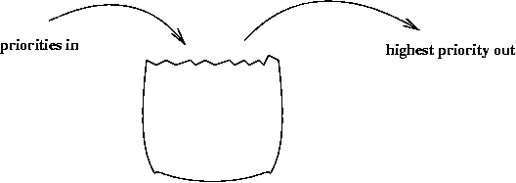
OUR PROJECT MAKES USE OF HEAPS,PRIORITQUEUE AND ARRAY'S DATA STRUCTURE
THIS INFORMATION IS STORED IN ARRAYS AND HEAPS AND SORTED USING QUICK SORT
Student information is entered
Student data is stored in arrays
Priority is given to students based on priority

Slide 5
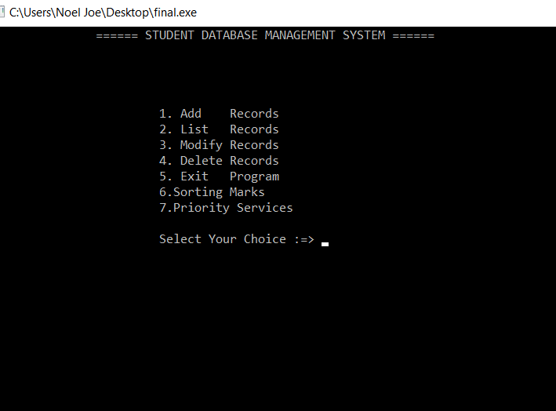
THE USER CAN PERFORM THE FOLLOWING TASK
1.Enter Data in the file
2.List the Data in the file
3.Modify the data in the file
4.Delete data in the file
5.Sort marks in the array
6.Move to any student using Djikstra algorithm.

Slide 6
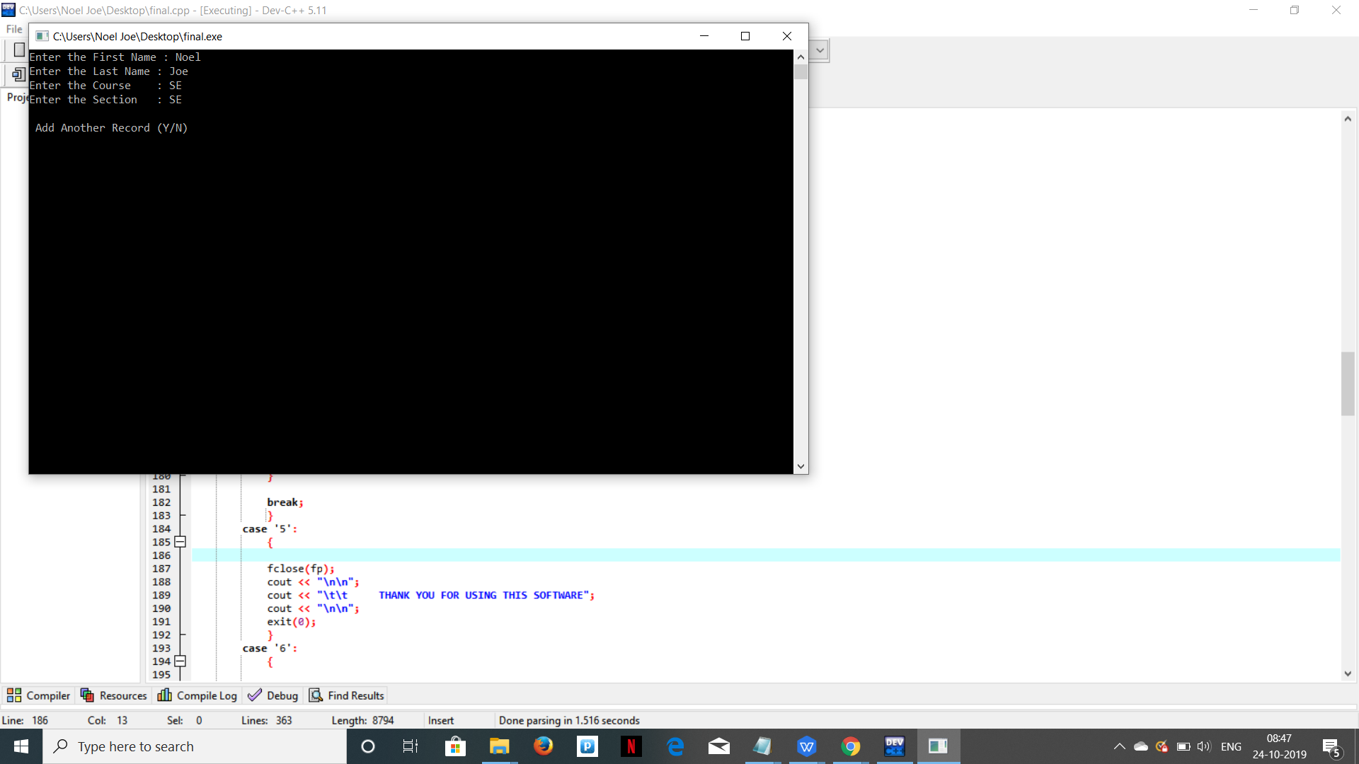
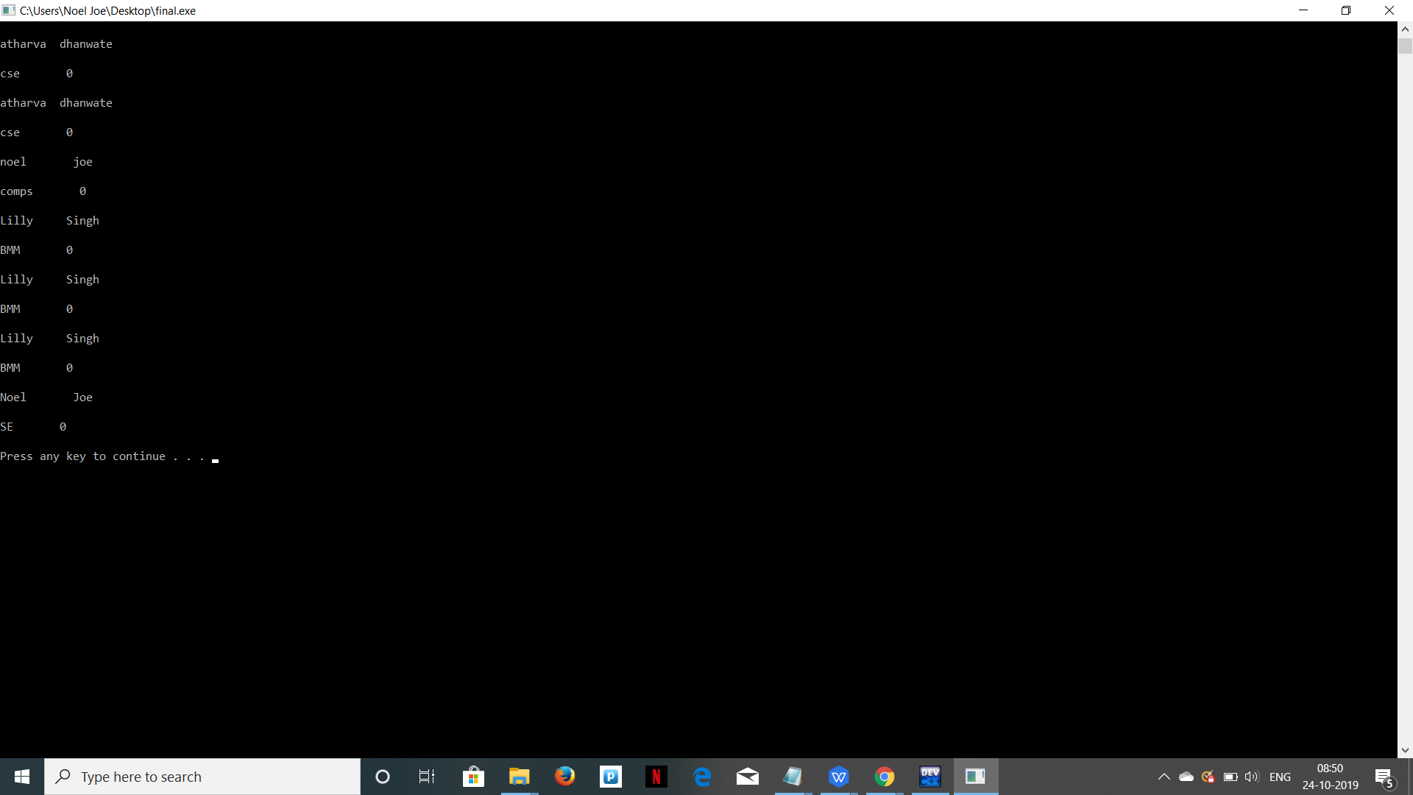
This project uses file system for reading, writing and storing data in the file.
Algorithm:-
Algorithm for Opening and Reading the text file
For opening a text file
Start
Declare variable and file pointer
Assign file pointer to fopen() function with write format
If file is not opened, print error message
Else give the content using loop
Close the file
Stop
For Reading a Text File
Start
Declare variables and file pointer
Open the file
If the file is not opened print error massage
Print the content of the text file using loop
Close the file
Stop

Slide 7

We use Quick sort for sorting the marks in the array.
Decide any value to be the pivot from the list (generally the last value). Suppose for two values “Low” and “High” corresponding to the first index, and last index.
In our case low is 0 and high is 5.
Values at low and high are 50 and 32 and Value of pivot is 32.
Hence, call for partitioning, rearranging the array in such a way that pivot (32) comes to its actual position. And to the left of the pivot, the array has all the elements less than it, and to the right greater than it.
In the partition function, we start from the first element and compare it with the pivot. Since 50 is greater than 32, we don’t make any change and move on to the next element 23.

Slide 8
Compare again with the pivot. Since 23 is less than 32, we swap 50 and 23. The array becomes 23, 50, 9, 18, 61, 32.
We move on to the next element 9 which is again less than pivot (32) thus swapping it with 50 makes our array as
23, 9, 50, 18, 61, 32.
Similarly, for next element 18 which is less than 32, the array becomes
23, 9, 18, 50, 61, 32 Now 61 is greater than pivot (32), hence no changes.
Lastly, we swap our pivot with 50 so that it comes to the correct position.
Thus the pivot (32) comes at its actual position and all elements to its left are lesser, and all elements to the right are greater than itself

Slide 9
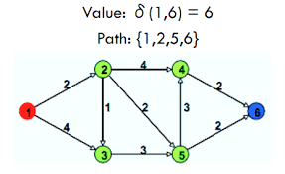
We use the Dijkstra's shortest path algorithm for finding the shortest path

Slide 10
Algorithm. Let the node at which we are starting be called the initial node. Let the distance of node Y be the distance from the initial node to Y. Dijkstra's algorithm will assign some initial distance values and will try to improve them step by step. 1. Mark all nodes unvisited. Create a set of all the unvisited nodes called the unvisited set. 2. Assign to every node a tentative distance value: set it to zero for our initial node and to infinity for all other nodes. Set the initial node as current.[13] 3. For the current node, consider all of its unvisited neighbours and calculate their tentative distances through the current node. Compare the newly calculated tentative distance to the current assigned value and assign the smaller one. For example, if the current node A is marked with a distance of 6, and the edge connecting it with a neighbour B has length 2, then the distance to B through A will be 6 + 2 = 8. If B was previously marked with a distance greater than 8 then change it to 8. Otherwise, the current value will be kept.

Slide 11
4. When we are done considering all of the unvisited neighbours of the current node, mark the current node as visited and remove it from the unvisited set. A visited node will never be checked again. 5. If the destination node has been marked visited (when planning a route between two specific nodes) or if the smallest tentative distance among the nodes in the unvisited set is infinity (when planning a complete traversal; occurs when there is no connection between the initial node and remaining unvisited nodes), then stop. The algorithm has finished. 6. Otherwise, select the unvisited node that is marked with the smallest tentative distance, set it as the new "current node", and go back to step 3. When planning a route, it is actually not necessary to wait until the destination node is "visited" as above: the algorithm can stop once the destination node has the smallest tentative distance among all "unvisited" nodes (and thus could be selected as the next "current

Slide 12

OUTPUT

Slide 13
Case Study 2: Checking whether the given string is a palindrome using link list

Slide 14
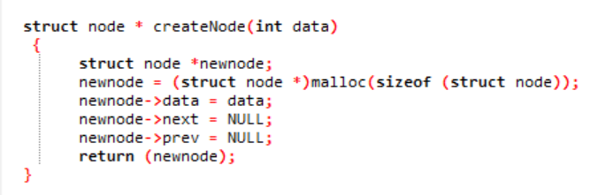
AlGORITHM TO CREATE NODE
First create node and store the address in temp.
Temp=(struct node *)malloc(sizeof(struct node))
Then update the pointers
Temp->data=data;
Temp->next=NULL;
Temp->prev=NULL
Return temp;

Slide 15
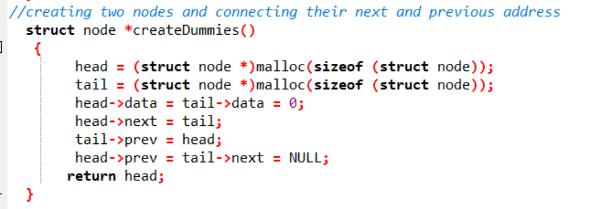
ALGORITHM TO CREATE THE LINKS i.e LINKING THE NEXT AND THE PREVIOUS
Create two node and store their address in head and tail
Set the data of both the nodes as zero
Link the next and previous of both the nodes
head->next=tail
tail->prev=head
head->prev=tail->next=NULL
Return the head as it would be required for displaying the linked list

Slide 16
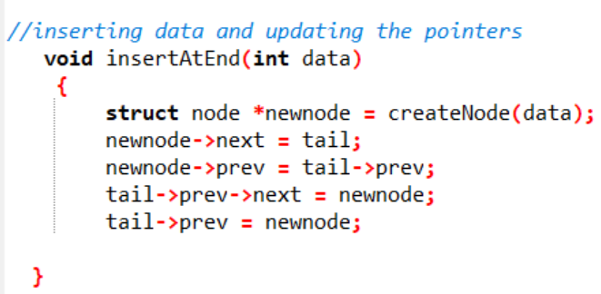
ALGORITHM TO INSERT
AT THE END
Struct node *t=createnode(data);
Update the pointers
t->next=tail
tail->prev=tail->prev
tail->prev->next=t
tail->prev=t

Slide 17
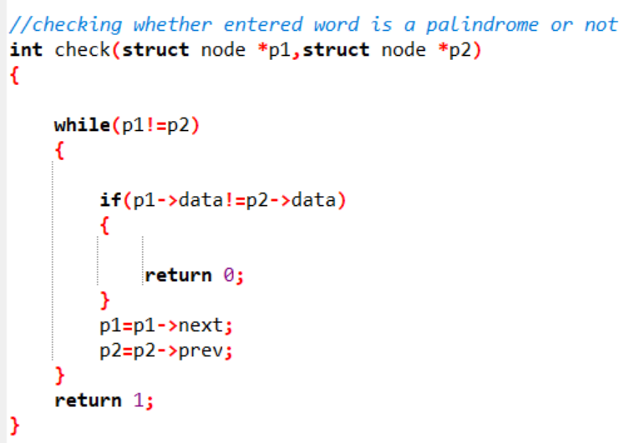
ALGORITHM TO CHECK WHETHER THE STRING IS A PALINDROME OR NOT
Take the start and the end node in p1 & p2
While(p1!=p2)
i.If the data in both the strings is not equal the return 0;
ii. else update the pointers
p1=p1->next
p2=p2->prev
Return 1;

Slide 18
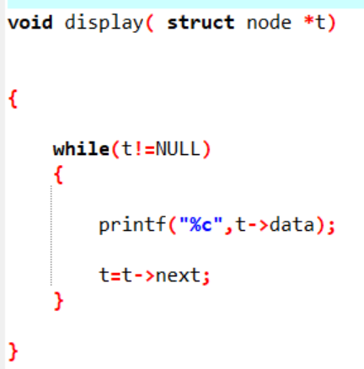
ALGORITHM TO DISPLAY THE LINKED LIST FROM THE START
take the start into a node variable t
while(t!=NULL)
Print the data into that node
T=t->next

Slide 19
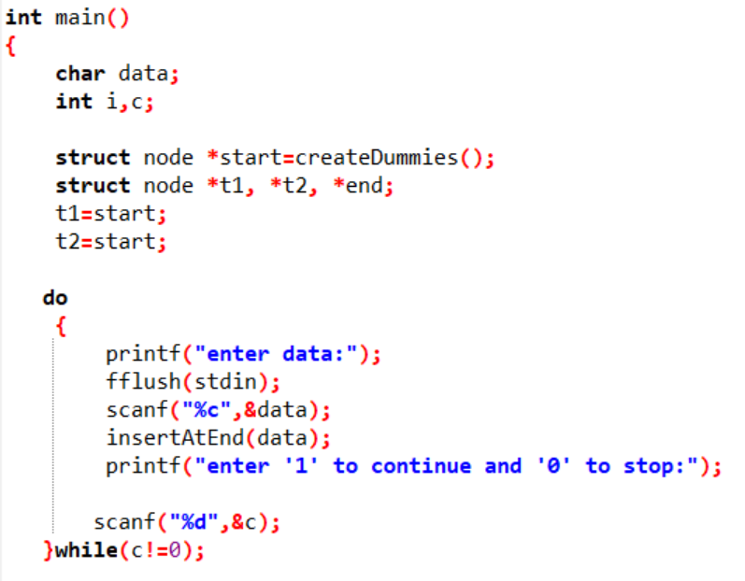
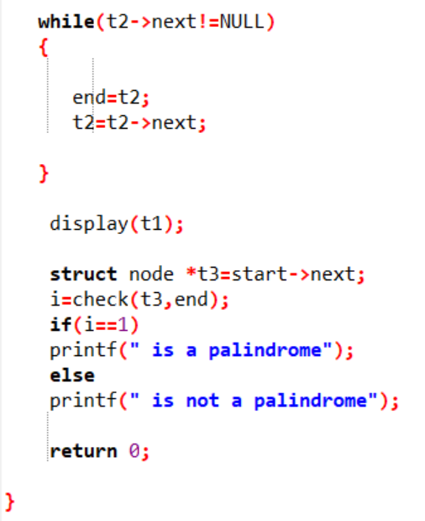
ALGORITHM FOR THE MAIN FUNCTION
take the input from the user using insertatend(data) function
traverse through the linked list and take the end end in node type variable end
display(start)
call the function to check the entered string
i=check(start->next,end)
if i==1
print that the string is a palindrome
else
print that the string is not a palindrome

Slide 20
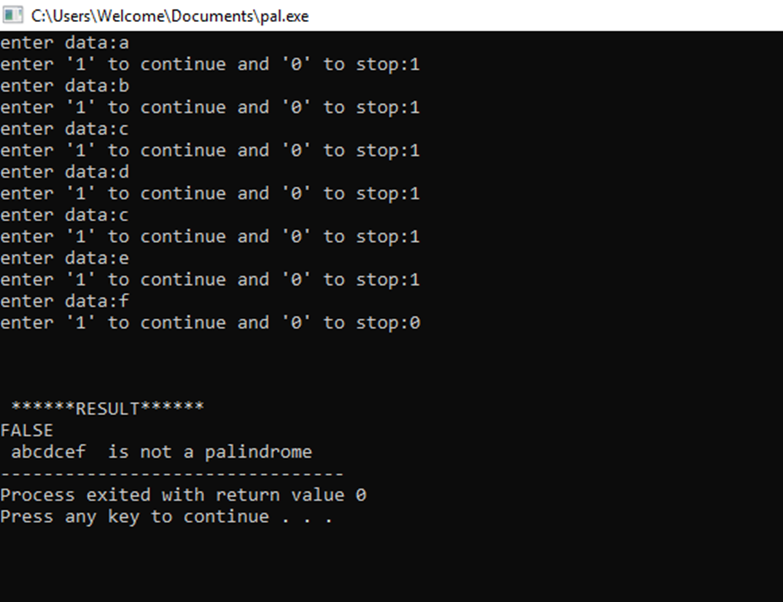
Output

