Slide 1
IPv4 unicast extensions
“IPv4 and IPv6 are going to will exist for the indefinate future”
“Merely
Dave Taht
John Gilmore
Paul Wouters

Slide 2
Motivation

Slide 3
DEMO
Connect to SSID “class-e”
Try to access:
milliways.taht.net (255.255.255.254)
If you have these patches installed:
bigbangburgerbar.taht.net (0.0.0.1)
blacksun.taht.net (127.1.0.0)
mcast.taht.net (225.0.0.1)

Slide 4
Overview
0.0.0.0/8
127.0.0.0/8
225.0.0.0/8-231.0.0.0/8
240.0.0.0/4

Slide 5
About the ipv4 cleanup project
START: IPv4 could use some janitorial work
Methods:
  Search engines
  Whole OS and toolchain builds
  Testbeds both virtual and physical

Slide 6
Motivations
Even with a linear projection of the “Best” IPv6 deployment in the world, it’s 7 years to 90%
Linear growth of ipv6 is unlikely
And I’d got a new “high speed internet link” - with a lousy CGN’d IP address.
Notes:
There’s vast swaths of the internet totally unreachable – halliburton, the DoD -
Can’t get static Ipv6 from my ISP
Dynamic DNS for IPv6 is brittle
And I still couldn’t get an IPv6 delegation for my tethered phone.
Routing IPv4 is cheaper
95
Idea? What can we do to make IPv4 better?
Use the space more effiicently

Slide 7
Other source code bases
IOT
  Zephyr – one patch
  RIOTos – 6lowpan based, no problems
  FreeRTOS -
DDPK – one patch
VP.IO
Bootloaders & BIOSes
Windows

Slide 8
0.0.0.0/8
0.0.0.0/32 is special in multiple ways
0.0.0.0/8 was reserved for “This” network by RFC971
  … “ A value of zero in the network field means this network. This is only used in certain ICMP messages. The extended addressing mode is undefined. Both of these features are reserved for future use.” - Jon Postel – 1981
  ICMP messsages deprecated by RFC1112
    Subsumed by public IPv4 addresses, reverse arp, and bootp
    Later subsumed by RFC1918
Last Arpanet node retired February 28, 1990.
0 was mis-used as a broadcast address by BSD 4.2 (corrected by BSD 4.3)
No use for 0/8 since 1984.
Notes:
We’ve got a patch for that.

Slide 9
There’s a patch for this

Slide 10
127.0.0.0/8
Host-local
  Unix domain sockets
We’ve seen 127.0.1.X – but nothing else
Why use up a whole /8?
  Cutting it down to a /16 frees up 16m addresses
Problems:
  Hard coded configuration in /etc/hosts, conf files

Slide 11
The multicast mess
Continuing to reserve 268 million IPv4 addresses for multicast is a complete waste of address space.

Slide 12
How multicast actually works
Flips a bit on the mac header
Sometimes writes a portion of
Downgrading a packet from multicast to unicast is done all the time
120 million addresses are presently unused.

Slide 13
232.0.0.0-239.0.0.0 Problems
https://www.iana.org/assignments/multicast-addresses/multicast-addresses.xhtml
224.5 and up have no reservations
224.252/14 – DIS transient groups
  https://tools.ietf.org/html/rfc5771 Asked
225/-231/8 Reserved for future use
232/8 - Source-Specific Multicast Block
233.0.0.0-233.251.255.255 GLOP Block [RFC3180]
233.252.0.0/24 – MCAST-TEST-NET
233.252/14 AD-HOC Block III
234.0.0.0-234. 255.255.255 Unicast-Prefix-based IPv4 Multicast Addresses [RFC6034]
235.0.0.0-238.255.255.255 Reserved [IANA]
239/8 reserved for the mbone (obsolete for 12 years)
https://tools.ietf.org/html/rfc2365
Notes:
224 itself is incredibly sparse, with only half the
Basic pool allocated. Everything between 224.6 and 224.250 are up for grabs.
We pulled out the reserved address block of 225-231 as the easiest thing to do in this internet draft, and had 120million addresses and a very simple patch.
As for 232 and above - I have no idea how much source specific multicast is used nowadays, and as for “GLOP” I had to look it up to see what it was.
Despite that I’m no multicast expert (is there one in the audience?)
And then there’s 239. Who here remembers the mbone?

Slide 14
225.0.0.0/8-231.0.0.0/8
Reserved for future use by IANA
rfc1819

Slide 15
239/8 reserved for mbone
Last known use was 16 sites, 12 years ago

Slide 16
---
lib/ip.c | 8 ++++++--
lib/ip.h | 2 +-
2 files changed, 7 insertions(+), 3 deletions(-)
diff --git a/lib/ip.c b/lib/ip.c
index 9497248c..fc570c61 100644
--- a/lib/ip.c
+++ b/lib/ip.c
@@ -100,8 +100,12 @@ ip4_classify(ip4_addr ad)
if (b >= 0xe0 && b <= 0xef)
return IADDR_MULTICAST | SCOPE_UNIVERSE;
- if (a == 0xffffffff)
- return IADDR_BROADCAST | SCOPE_LINK;
+ if (b >= 0xf0)
+ if(a == 0xffffffff) {
+ return IADDR_BROADCAST | SCOPE_LINK;
+ } else {
+ return IADDR_HOST | SCOPE_UNIVERSE;
+ }
return IADDR_INVALID;
}
diff --git a/lib/ip.h b/lib/ip.h
index cc6be384..27d40faf 100644
--- a/lib/ip.h
+++ b/lib/ip.h
@@ -242,7 +242,7 @@ static inline int ip6_is_v4mapped(ip6_addr a)
#define ipa_is_link_local(x) ip6_is_link_local(x)
static inline int ip4_is_unicast(ip4_addr a)
-{ return _I(a) < 0xe0000000; }
+{ return _I(a) < 0xe0000000 || (_I(a) >= 0xf0000000 && _I(a) != 0xffffffff); }
/* XXXX remove */
static inline int ipa_classify_net(ip_addr a)
--
2.17.1

Slide 17
240.0.0.0/4 (class-e)
Notes:
As of 4.20 (and the backports to -stable)… we don’t need any patches for that.
Moving up the stack, however, there’s routing daemons and DNS.

Slide 18
Linux Class-E deployment
Work basically completed in 2008
“Last” patch went into linux 4.20
Backported to openwrt
  Can assign/forward
  240/4 & 0/8 removed from the bcp38 package
  It “just works”

Slide 19
Routing daemons
Despite the presence of 224/3 or 240/4 etc in all the major bogon lists, it turned out
Patches for babeld, bird and FRR
This was the patch (for 240 only) for babel
diff --git a/util.c b/util.c
index 38b834f..6c1ba8c 100644
--- a/util.c
+++ b/util.c
@@ -446,7 +446,8 @@ martian_prefix(const unsigned char *prefix, int plen)
(prefix[15] == 0 || prefix[15] == 1)) ||
(plen >= 96 && v4mapped(prefix) &&
((plen >= 104 && (prefix[12] == 127 || prefix[12] == 0)) ||
- (plen >= 100 && (prefix[12] & 0xE0) == 0xE0)));
+ (plen >= 128 && (prefix[12] == 0xFF) && (prefix[13] == 0xFF) &&
+ (prefix[14] == 0xFF) && (prefix[15] == 0xFF))));
}

Slide 20
DNS
Reverse lookups for 0, 127, & 255 are trapped by debian9 and not sent to the roots.
  Bind 9 just traps 255.255.255.255 as it should
224/4 is sent to the roots
240/4 is sent to the roots
So all we need to do is fix 0 and 127...
  We’ve got a patch for that...
Notes:
We have a couple of patches for that… and a sed script.

Slide 21
What next?
Putting up a periscope
Convincing the IETF/IANA

Slide 22
New IPv4 Addresses Summary
Range | Exclude | Total new IPv4 addresses
0.0.0.0/8 | 0.0.0.0/32 | 16,777,215
127.0.0.0/8 | 127.0.0.0/16 | 16,711,680
224.0.0.0/8 | 224/8, 232/8-239/8 | 117,440,512
240.0.0.0/8 | 255.255.255.255/32 | 268,435,455
 | Total | 419,364,862

Slide 23
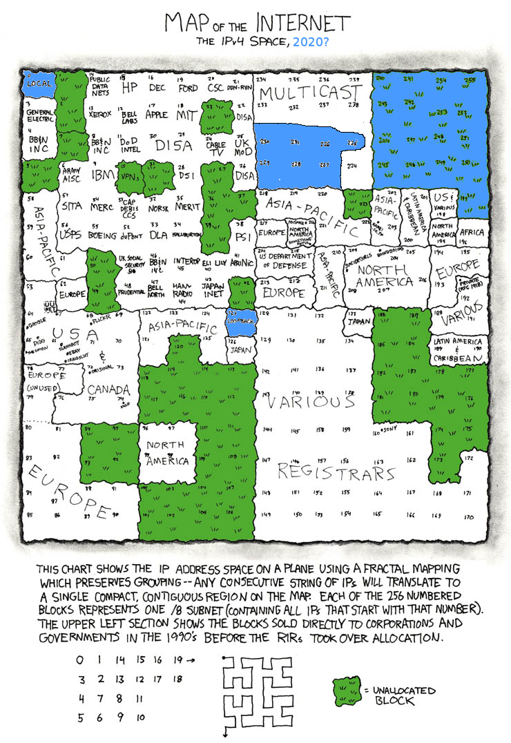
QUESTIONS?
ANY

