Slide 1
SDLC & GenAI OR ..?
Kris Schoeters
DevEx Assignment

Slide 2
Mijn persoonlijke methode om verandering te introduceren
Stap 1: Luister & Noteer
Stap 2: Implementeer
& Inspireer

Slide 3
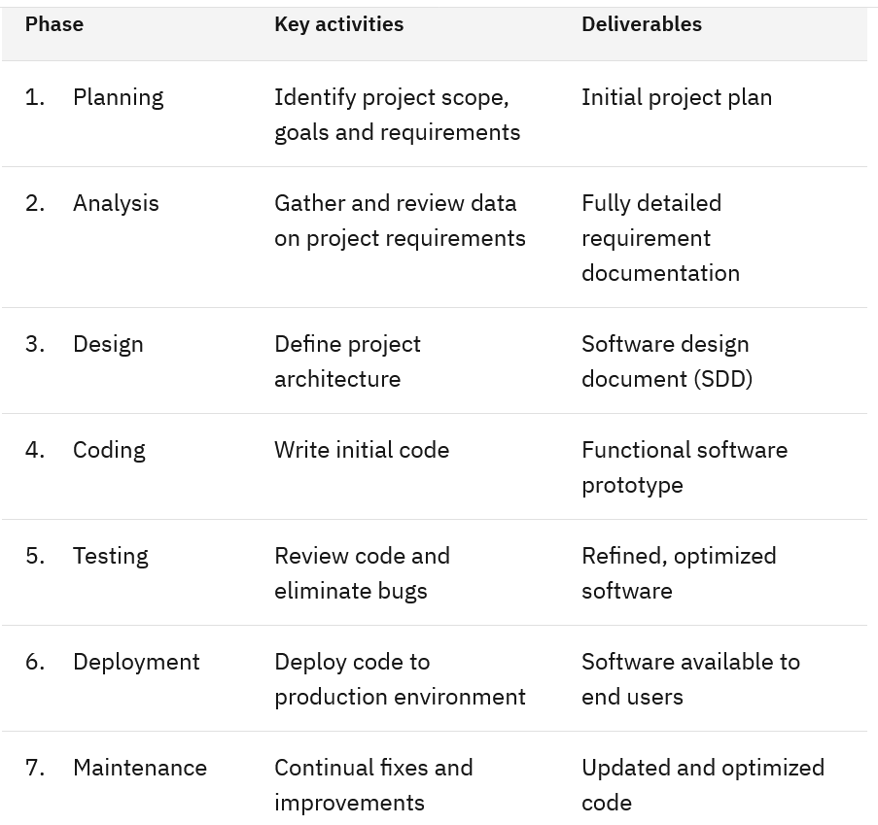
SDLC
Software
Development
Life
Cycle

Slide 4

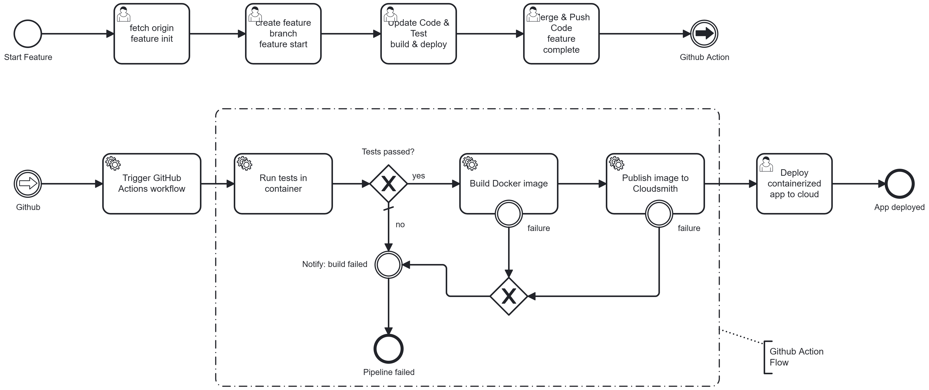

Slide 5
Context
3 jaar geleden :
Wat gaan we doen met AI ?

Slide 6
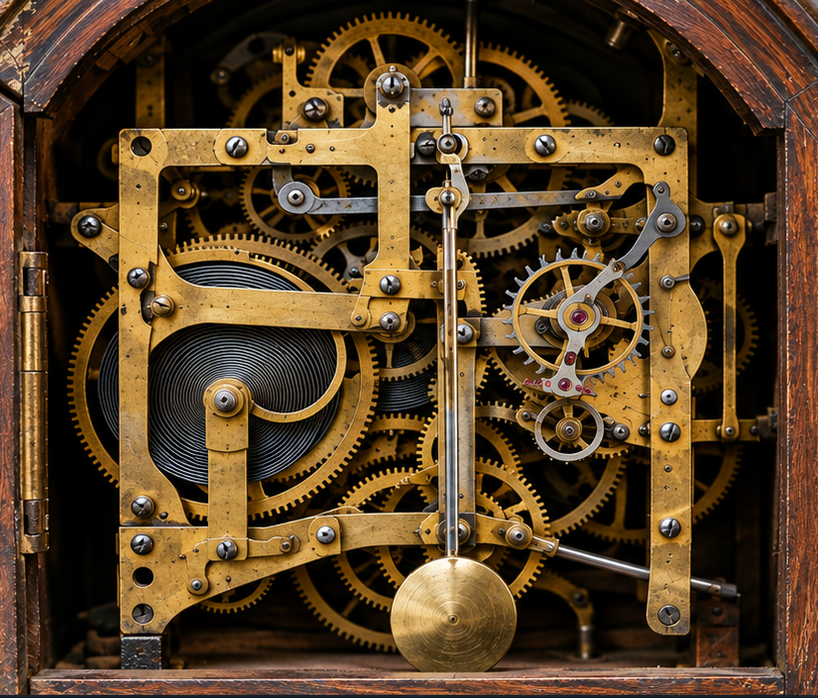
Software engineers
Hoe werkt het ?
Machine Learning
Deep Learning
RAG
...
Is dit wel de goede vraag ?

Slide 7

Sofware gebruikers ..
AI is Black box
Focus GenAI
Hoe gebruiken als TOOL !
De vraag is hoe gaan
software gebruikers van de volgende generatie om met software systemen ?
Is het huidige software system/omgeving daar klaar voor ?

Slide 8

SKILLS :
Feature-init
Copy & Check specification
Prepare Environment
Feature-start
Create branch
Implement feature
Test
Feature-complete
Complete feature
Check-In remote
Trigger Build&Publish
Github Action :
Build
Test
Publish
As Github package
SKILL (helper) :
build
build : build project
localDeploy
localStop
remoteDeploy
Deploy for production.

Slide 9
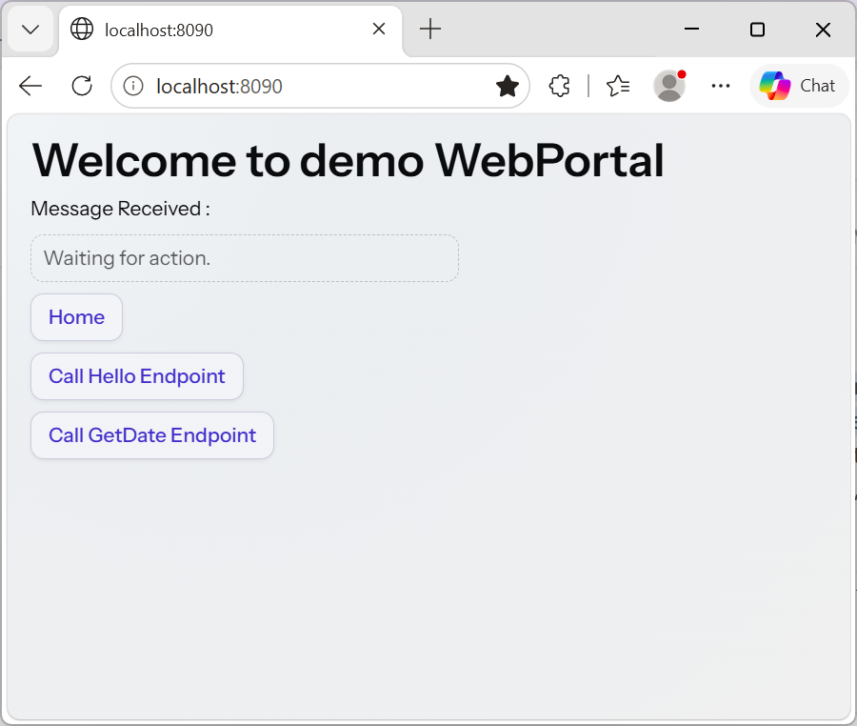
Demo
WebPortal
Demo application :
WebService : Backend server with endpoints.
Hello returns hello message JSON
GetDate returns date JSON
WebPortal : Using the backend services.
Monitor on running services.
WebService
Language: Java 21
Spring Boot : Spring Boot 4.1.1
Portal : Vaadin version v25.3.0
AI: Mistral-Code & Cline
Deployment: Docker (local)
Monitoring : TypeScript script
Build & Publish : GitHub & GitHub Package (not Cloudsmith)
GenAI used
Cline as agent
Mistral-code as LLM
Everything is generated by Cline.
Skills & Specifications written hybrid way.

Slide 10
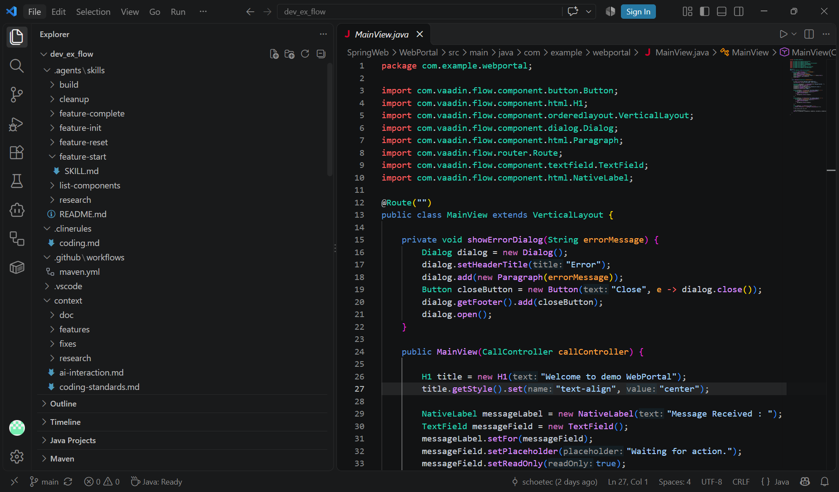
Show & Discuss in VC

Slide 11
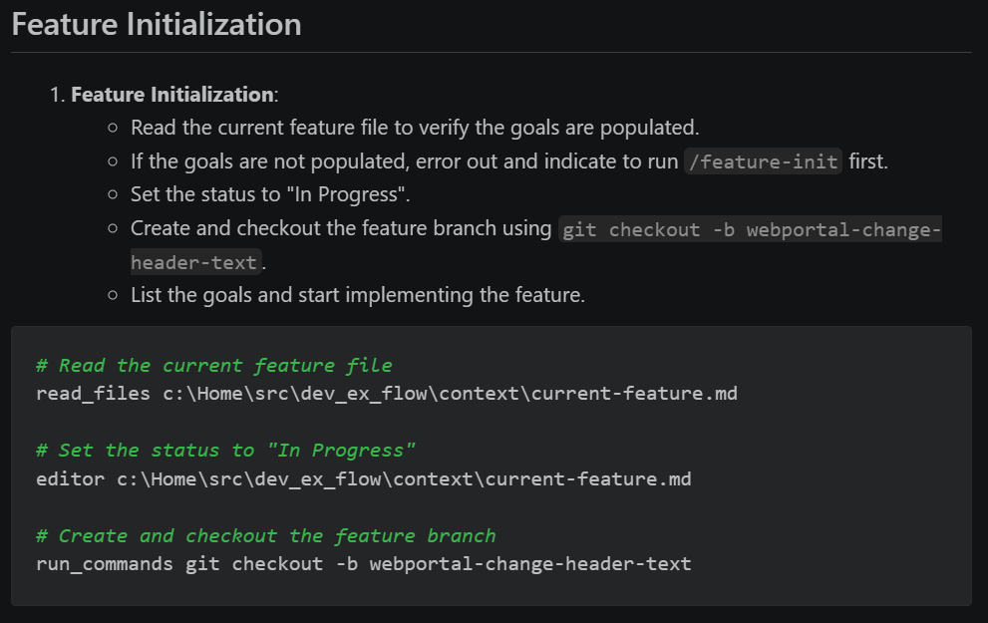
Initialization

Slide 12
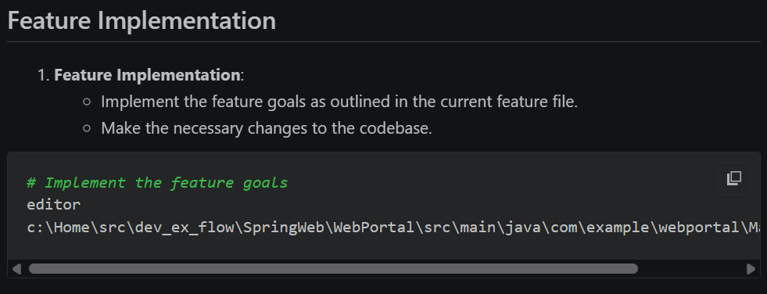
Implementation

Slide 13
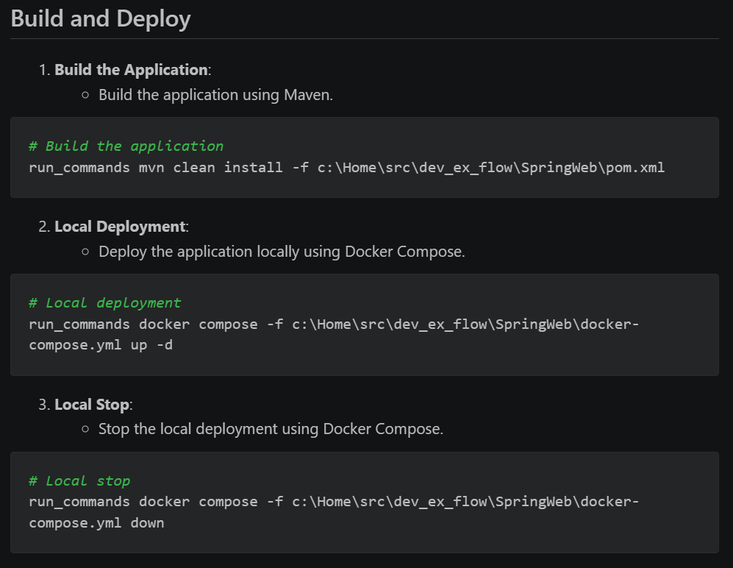
Deploy & Test local

Slide 14
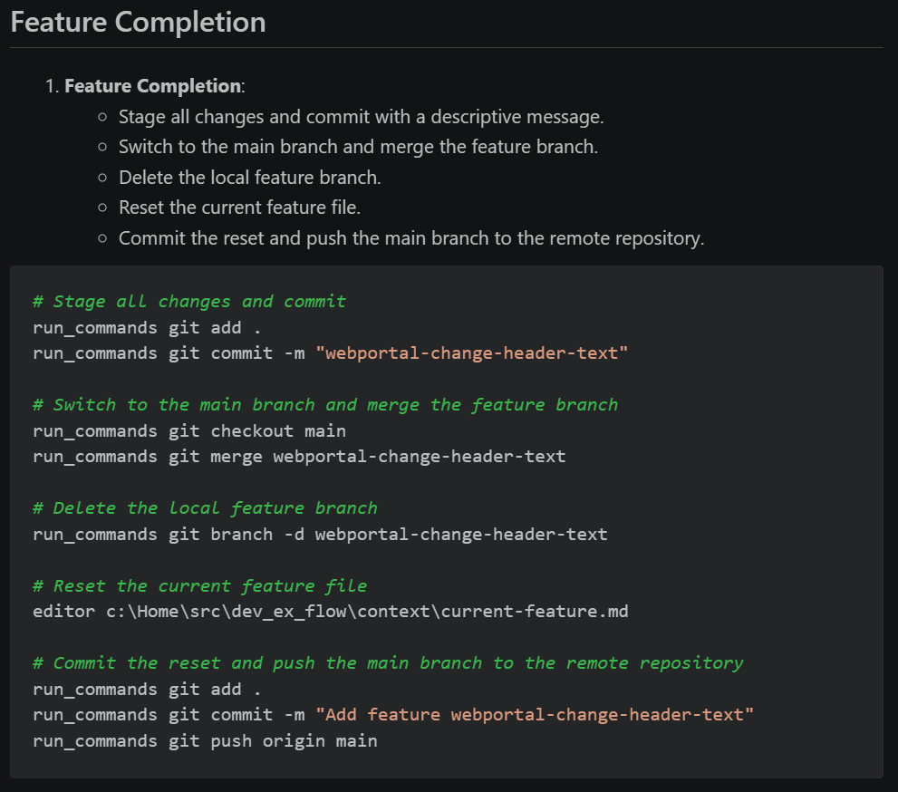
Complete & Trigger Publish

Slide 15
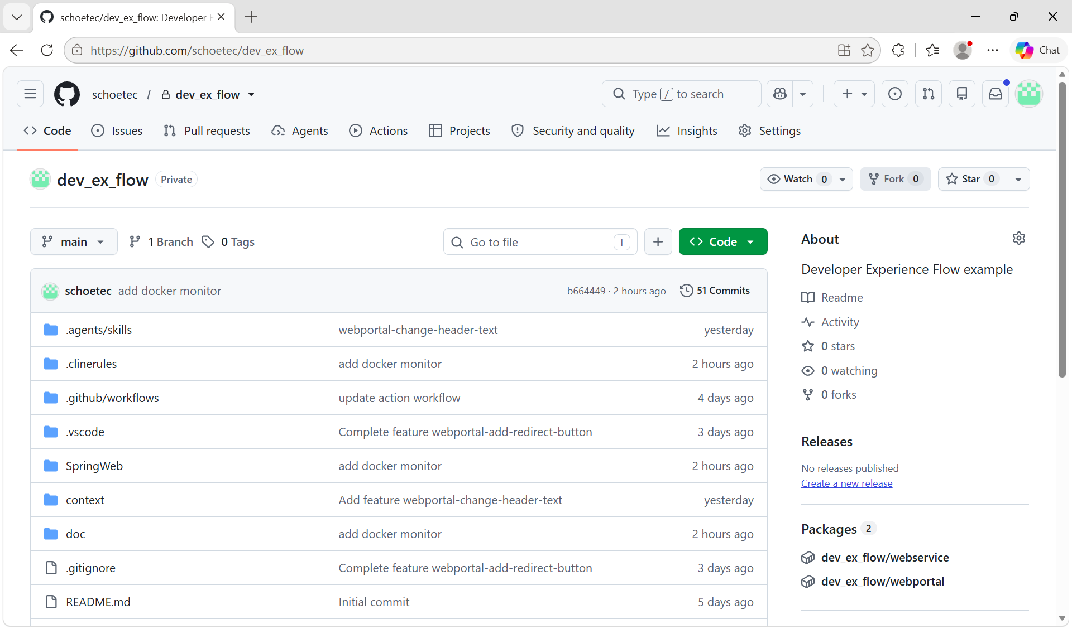

Slide 16


Slide 17

GenAI - LLM = 3P
Pathological People Pleaser

Slide 18
Deterministic
Non-deterministic
Verwacht
Krijgt

Slide 19
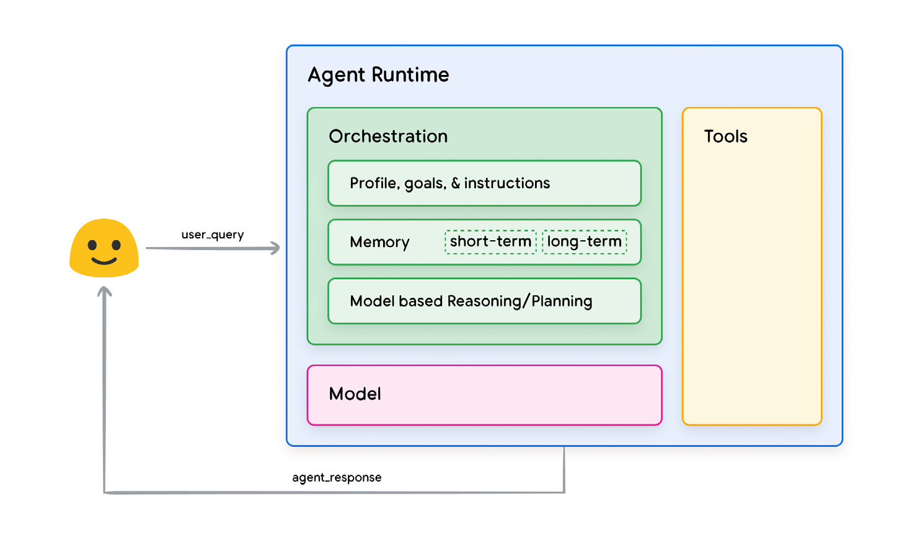
Hybrid
AI Harnessing
Model + Harness = Agent. While the model acts as the "brain" that reasons and generates text, the harness acts as the "body," workspace, and control system that lets it actually get work done.
Specialized LLM (JEV)

Slide 20
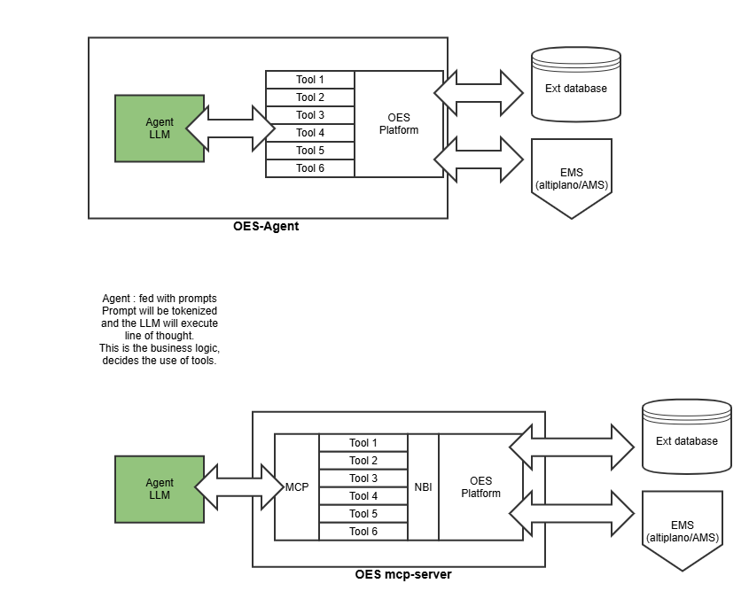
Shared Libraries
Shared functionality
Shared knowledge
Used by Agent
Control Plane
DPGDevEx-Agent
YBIYRI (You Build It, You Run It)
Control Plane

Slide 21
Production guardrails that paid off
Deterministic prompts. Store system prompts in versioned files. Diff them like code.
Strict grounding. Force the model to say “I do not know” when context is empty. Stakeholders trust the results.
Human in the loop for risky actions. Keep tools read-only by default. Require explicit flags for write operations.

Slide 22
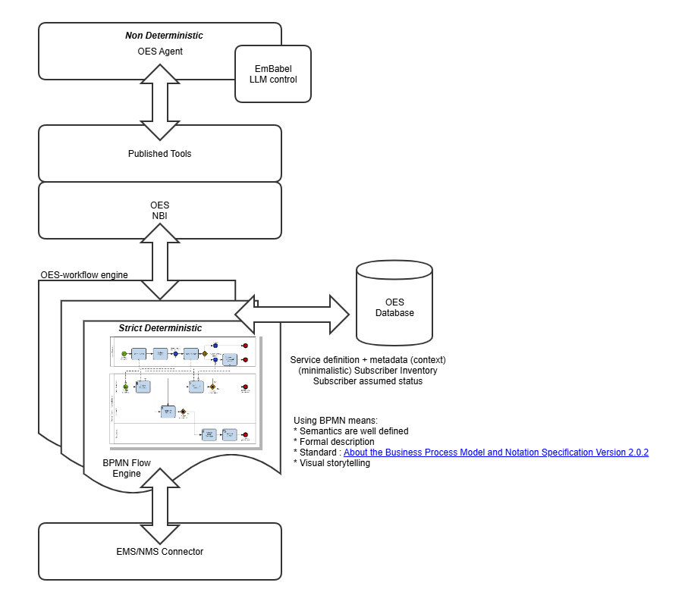
Extreme :
Forcing deterministic behaviour for certain tools/actions by using a strict defined workflow.

Slide 23
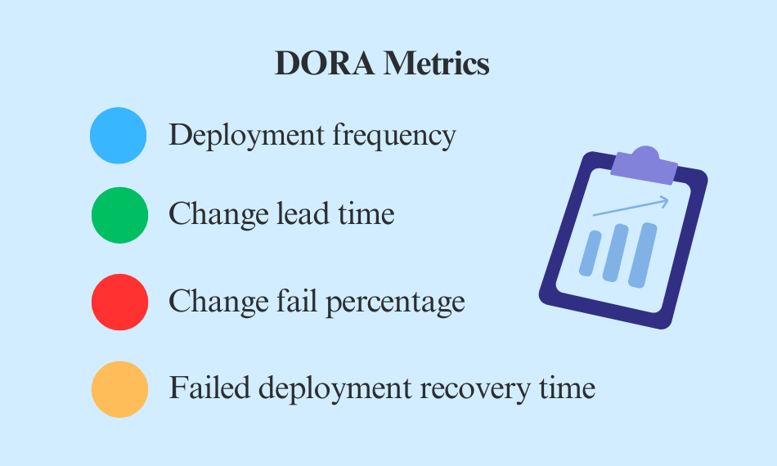
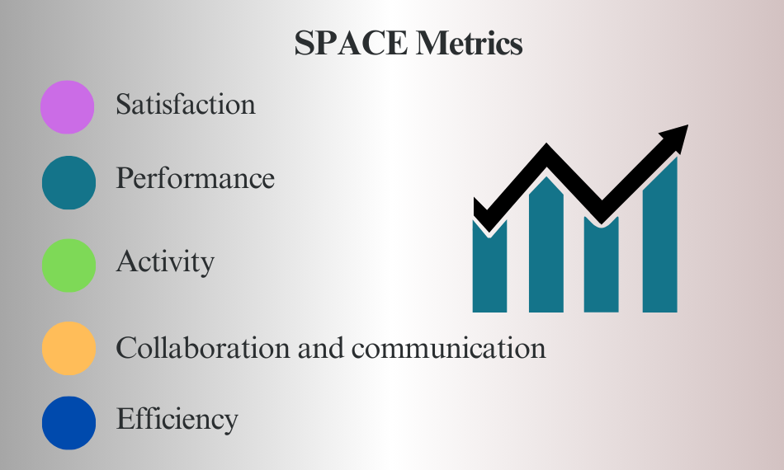
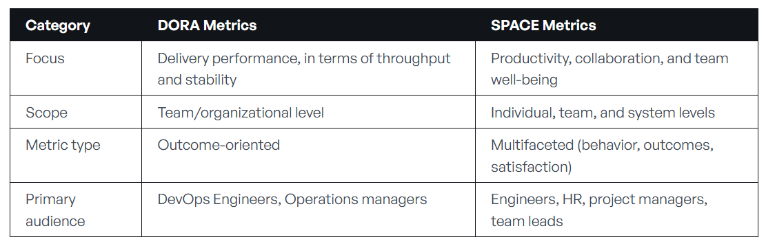
Metrics :
https://dora.dev/
https://space-framework.com/
DevOps Research and Assessment
DORA
SPACE
Google
Microsoft/Github

Slide 24
Mijn persoonlijke methode, meten is weten, maar statistiek is maar statistiek...:
Stap 1: Luister & Noteer
Stap 2: Implementeer
& Inspireer

Slide 25
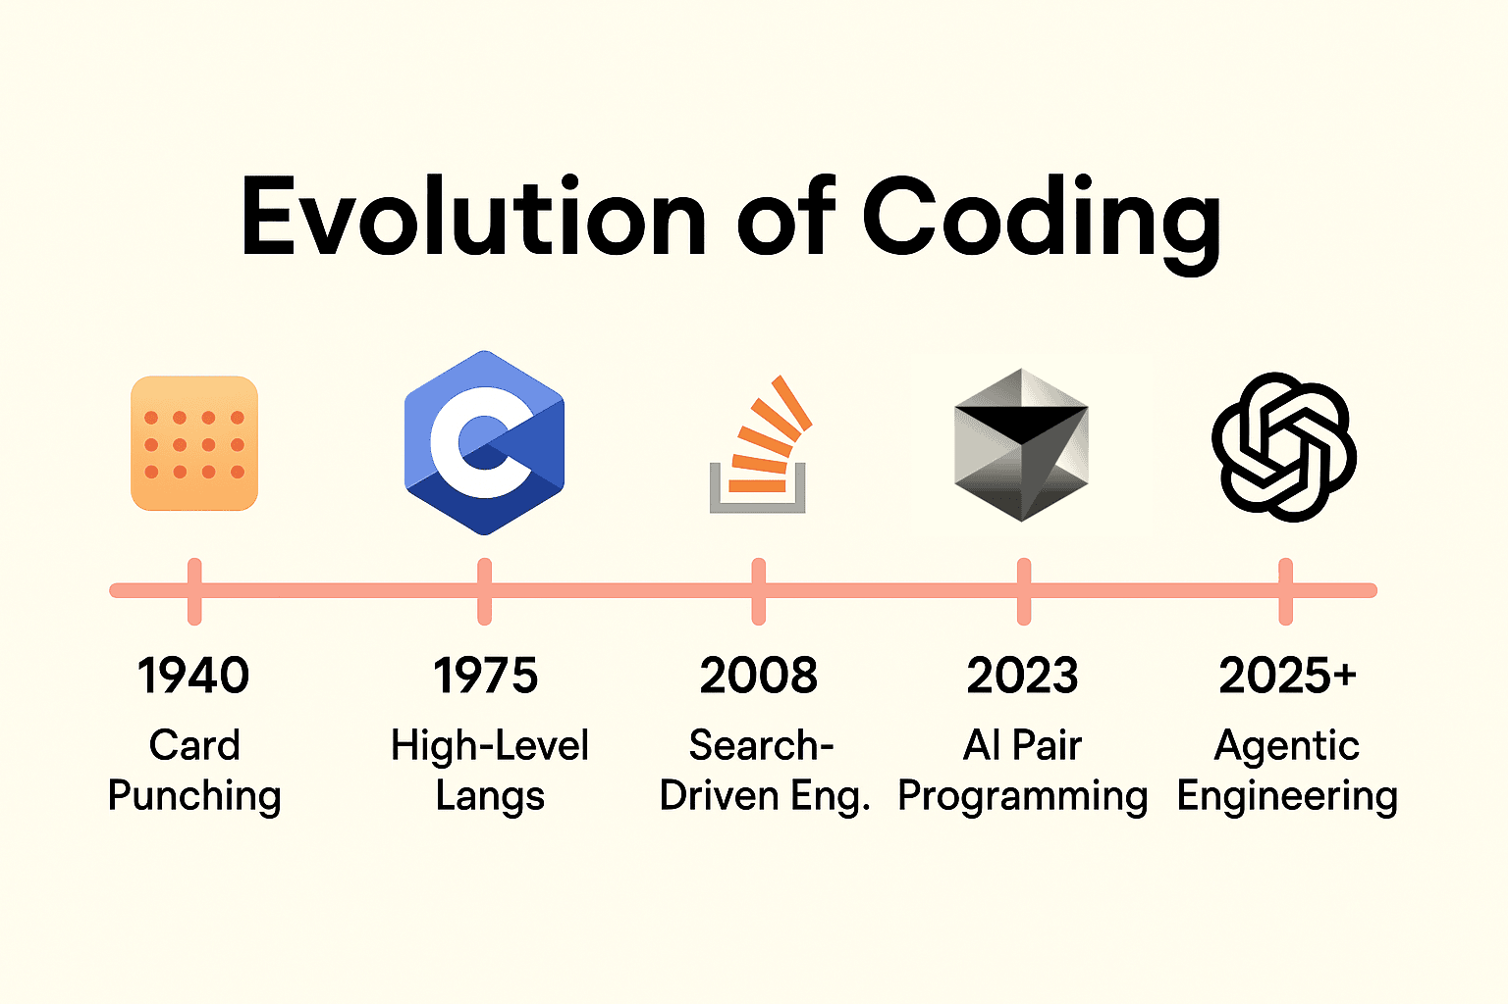
GenAI Software Engineers = Story tellers and Code reviewers
DevEx should be adapted to this change in scenery

