Slide 1
Air quality analysis
Sooyeon Choi
Summer 2021, Phase 01

Slide 2
Introduction
Saving and protecting our environment is a key topic these days. Every issue of pollution is important and
essential in our ecosystem. Out of many factors, air is essential to life and the quality of air can highly affect our health. Every year, millions of Americans suffer from adverse health impacts liked to air pollution, and tens of thousands have their lives cut short. This project focuses on air pollution with the retrieved air data.
So, what is Air data?
The United States Environmental Protection Agency (EPA) provides access to air quality data (primarily from Air quality system (AQS) database) collected at outdoor monitors across the United Sates, Puerto Rico, and the U.S Virgin Islands. The data can be used to view, create visuals and graphical displays, investigate monitor locations, and so on. It is accessible to the public and can be downloaded by hourly, daily, and annual concentration data, AQI data, and spectated particle pollution data.

Slide 3
Criteria gases
How does the four criteria gases air pollution impact us?
Ozone
Coughing and pain when taking a deep breath
Lung and throat irritation
Wheezing and trouble breathing during exercise or outdoor activities
Can affect everyone, but specifically people with asthma or other lung diseases, older adults, babies and children
Carbon monoxide
Breathing air with a high concentration of CO reduces the amount of oxygen that can be transported in the blood stream to critical organs like the heart and brain.
Can cause dizziness, confusion, unconsciousness and death.
Very high levels of CO are not likely to occur outdoors. However, when CO levels are elevated outdoors, they can be of particular concern for people with some types of heart disease.
Nitrogen dioxide
Increased inflammation of the airways
Worsened cough and wheezing
Reduced lung function
Increased asthma attacks
Greater likelihood of emergency department and hospital admissions.
Sulfur dioxide
Irritates the skin and mucous membranes of the eyes, nose, throat, and lungs.
Can cause inflammation and irritation of the respiratory system.
Pain when taking a deep breath, coughing, throat irritation, and breathing difficulties. High concentrations of SO₂ can affect lung function, worsen asthma attacks, and worsen existing heart disease in sensitive groups.

Slide 4
Project Goal/Hypothesis
Project Goal/Hypothesis:
How is air pollution different by state/county?
Clustering Analysis to see how the pollution is distributed geographically.
What are some solutions for the different clusters?
Clustering will help me find how the different states/regions differ in air pollution with different types of gas. With this information, I plan to find suggestions on how to reduce air pollution.

Slide 5
Literature review
European ozone measurements examined through a cluster analysis (CA) of 4 years of 3-hourly ozone data from 1492 European surface monitoring stations in the Airbase database
Propose the use of air quality index and the development of advanced data processing, analysis, and visualization techniques based on the AI-based k-clustering method, based in China.
Novel hybrid learning method, carried out to forecast urban air quality index (AQI). Wavelet packet decomposition (WPD) was firstly performed to decompose the original AQI data into lower-frequency subseries. (China)
Cluster analysis of European surface ozone observations for evaluation of MACC reanalysis data
Authors: Olga Lyapina, Martin G. Schultz, and Andreas Hens
2. K-Clustering Methods for Investigating Social-Environmental and Natural-Environmental Features Based on Air Quality Index
Authors: Victor Chang; Pin Ni; Yuming L
3. A clustering-based ensemble approach with improved pigeon-inspired optimization and extreme learning machine for air quality prediction
Author: Feng Jiang a,, Jiaqi He a, Tianhai Tian b

Slide 6
Dataset & eda
The Data set is retrieved from United States Environmental Protection Agency (EPA).
There are 4 datasets that will be used. Each contains same categories except the criteria gases:
Daily Summary dataset for Ozone (44201) 2020 contains 391,923 Rows, 24 Columns, and is 3,127 KB. It contains numerical and categorical data.
Daily Summary dataset for Sulfur dioxide (SO2 (42401)) 2020 contains 324,817 Rows, 24 Columns, and is 4,357 KB. It contains numerical and categorical data.
Daily Summary dataset for Carbon Monoxide (CO (42101)) 2020 contains 178,789 Rows, 24 Columns, and is 1,784 KB. It contains numerical and categorical data.
Daily Summary dataset for Nitrogen dioxide (NO2 (42602)) 2020 contains 157,726 Rows, 24 Columns, and is 2,159 KB. It contains numerical and categorical data.

Slide 7
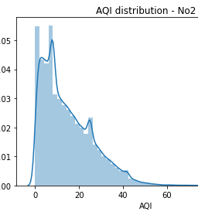
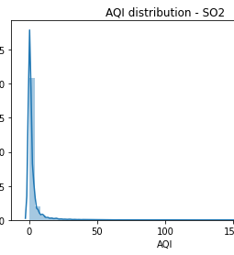
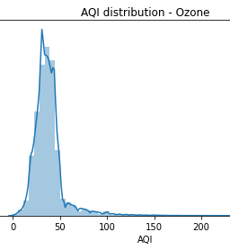
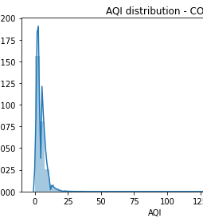
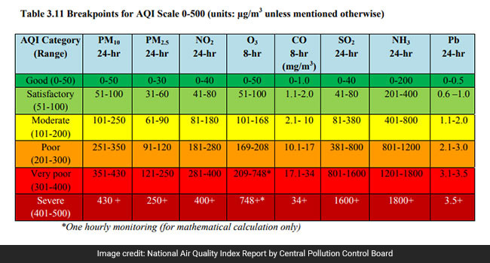
EDA (AQI)
**Unit of measure**
Ozone, carbon monoxide: Parts per million
Nitrogen dioxide (NO2), Sulfur dioxide :Parts per billion

Slide 8
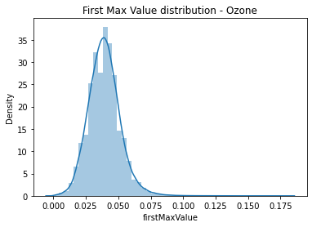
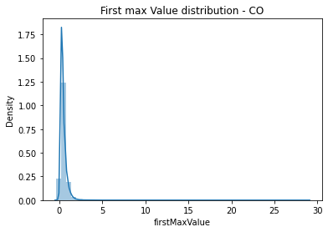
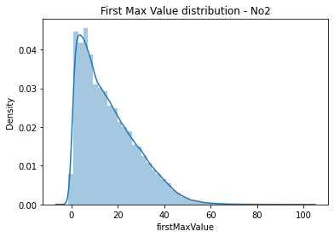
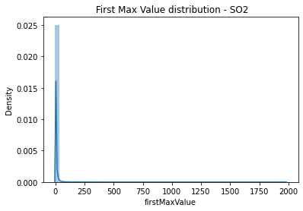
First max value

Slide 9
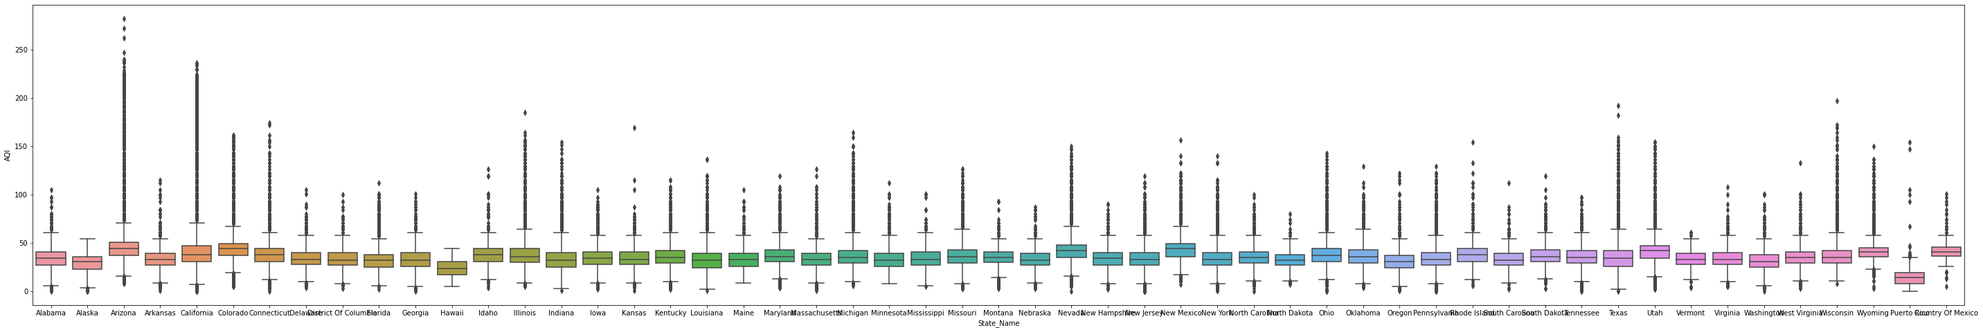
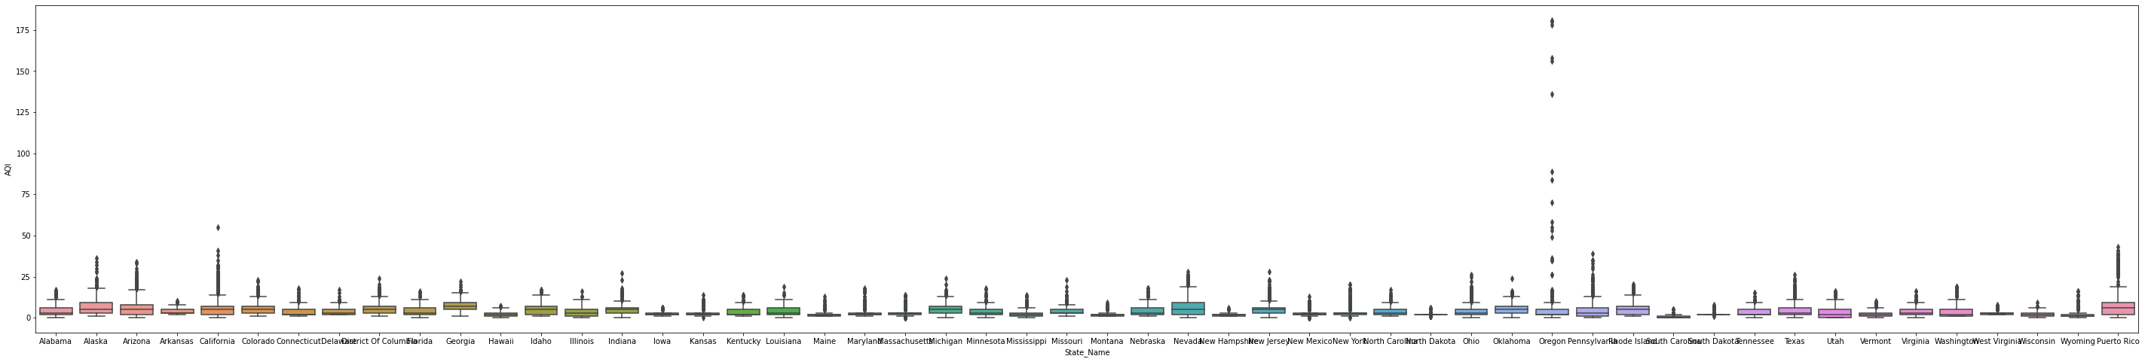
Ozone
Arizona has high AQI with highest and the most outliers. This shows that the AQI in the state seems to be very inconsistent.
On the other hand, Alaska and Hawaii has a low AQI with no outlier. The AQI for ozone seems to be consistent.
Carbon Monoxide
Oregon is the only state that has very high AQI with the outliers.

Slide 10
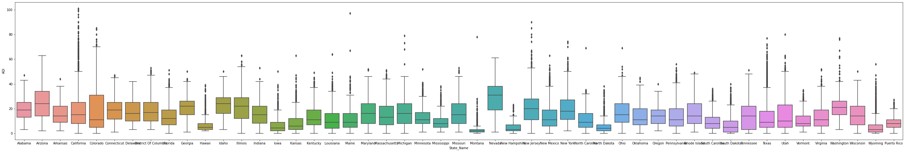
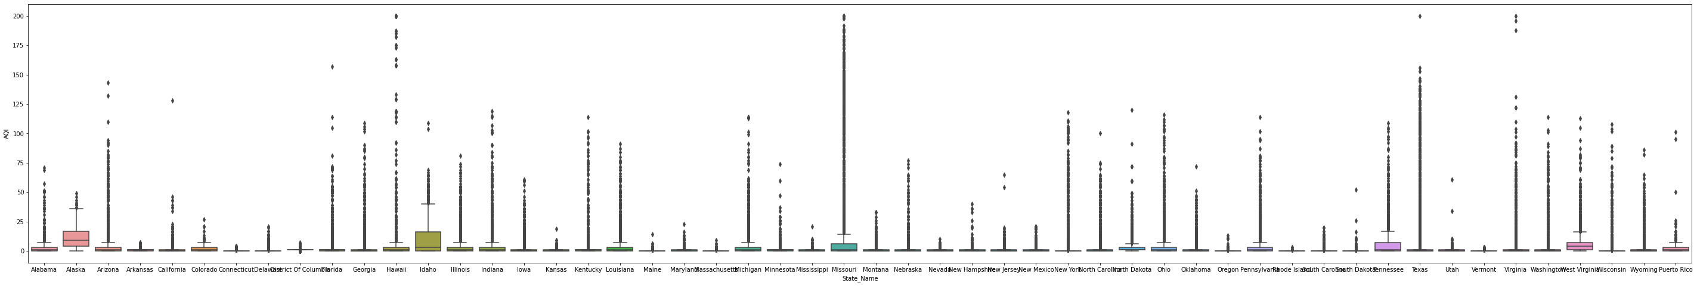
Nitrogen Dioxide
Nevada has a high AQI with no outliers. Very consistent.
Sulfur Dioxide
Overall, most of the states have many outliers which suggests that sulfur dioxide AQI is inconsistent.
Alaska has highest AQI with some low outliers.
Hawaii, Texas, and Virginia has low AQI but very high outlier.

Slide 11
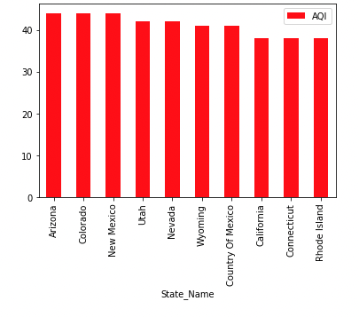
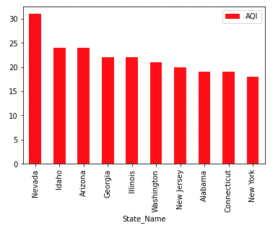
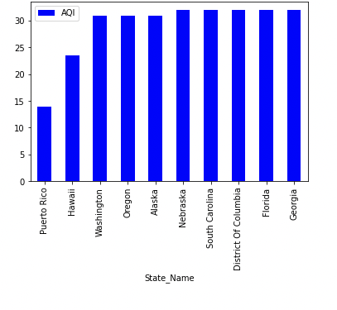
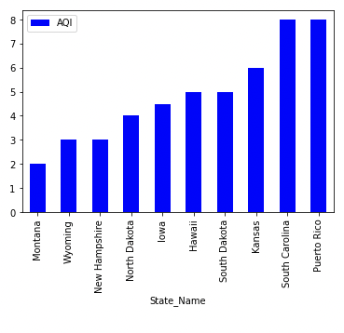
Ozone
Nitrogen
dioxide
Notes:
Ozone- Arizona Colorado newmexico/ hawai washingon Oregon
No2 = Nevada Idaho Arizona / montana Wyoming newhapshpier

Slide 12
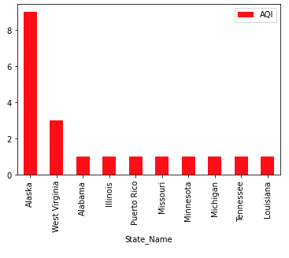
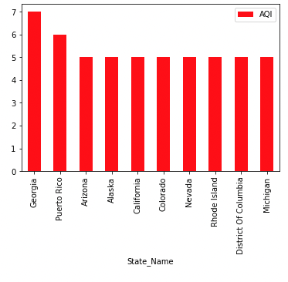
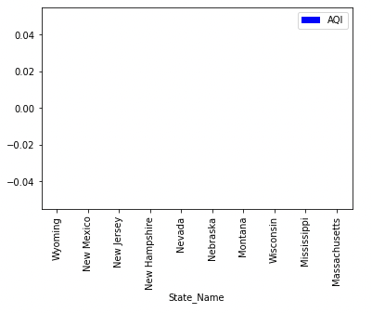
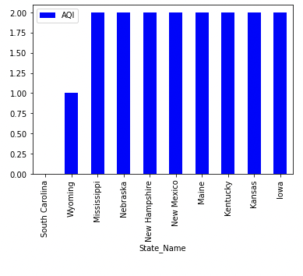
Sulfur
dioxide
Carbon
monoxide
Notes:
So2 Alaska wv alambaba/ Wyoming newmexico new jersy
Carbon – Georgia Arizona alsak a / south Carolina Wyoming missiipi

Slide 13
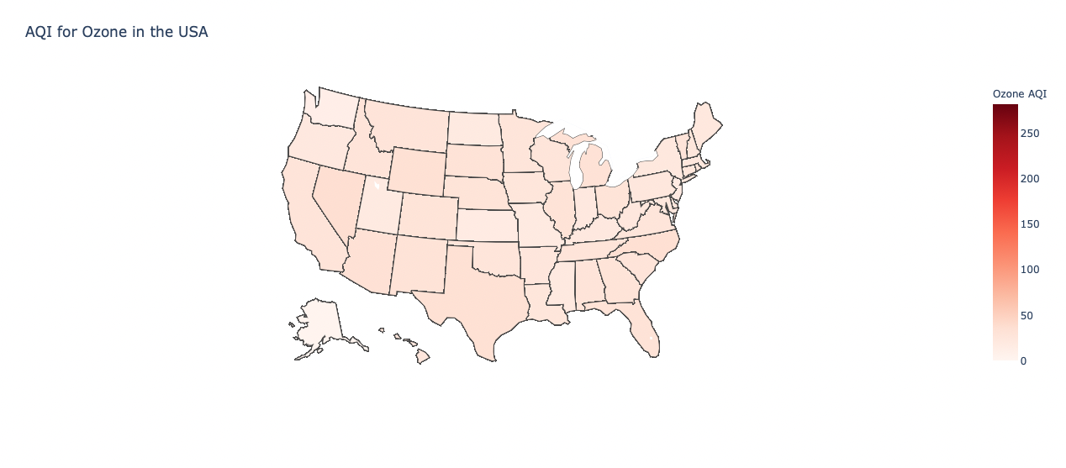
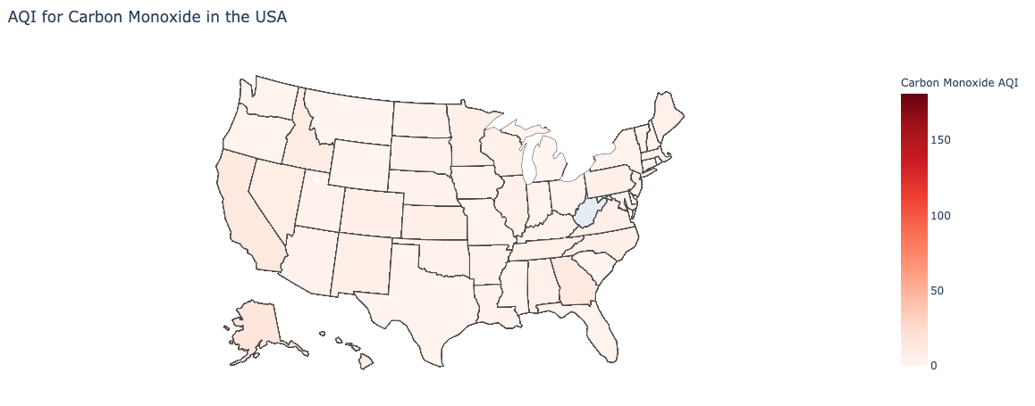

Slide 14
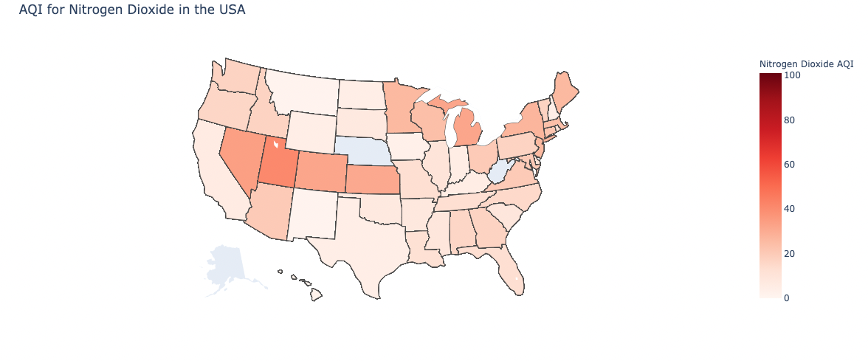
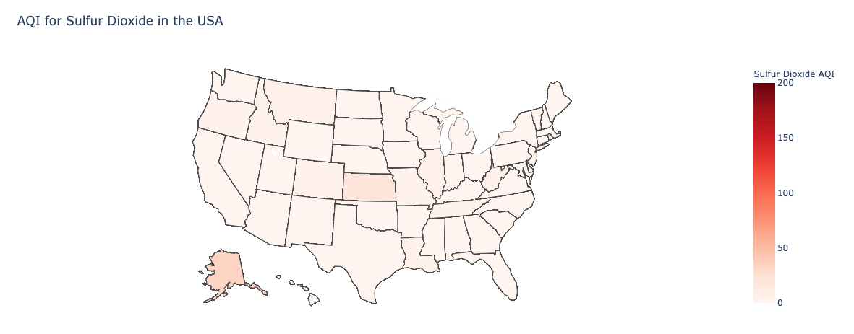

Slide 15
Clustering Analysis (K-Means)
In order to find the best analyzation for our dataset, the K-Means clustering model was ran to see how many clusters, and where the clusters were. The four data sets (four types of criteria gases) were ran separately, with the elements that had an AQI over the limit of a good-moderate pollution rate (In other words, the clusters showed the states/regions that had air pollution for each type of gas).

Slide 16
Chart retrieved from: https://swachhindia.ndtv.com/air-pollution-what-is-air-quality-index-how-is-it-measured-and-its-health-impact-40387/

Slide 17
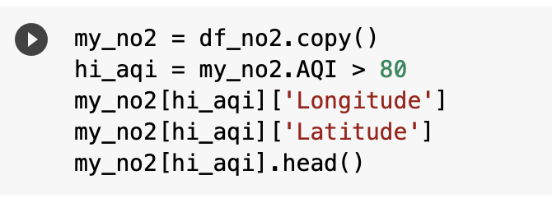
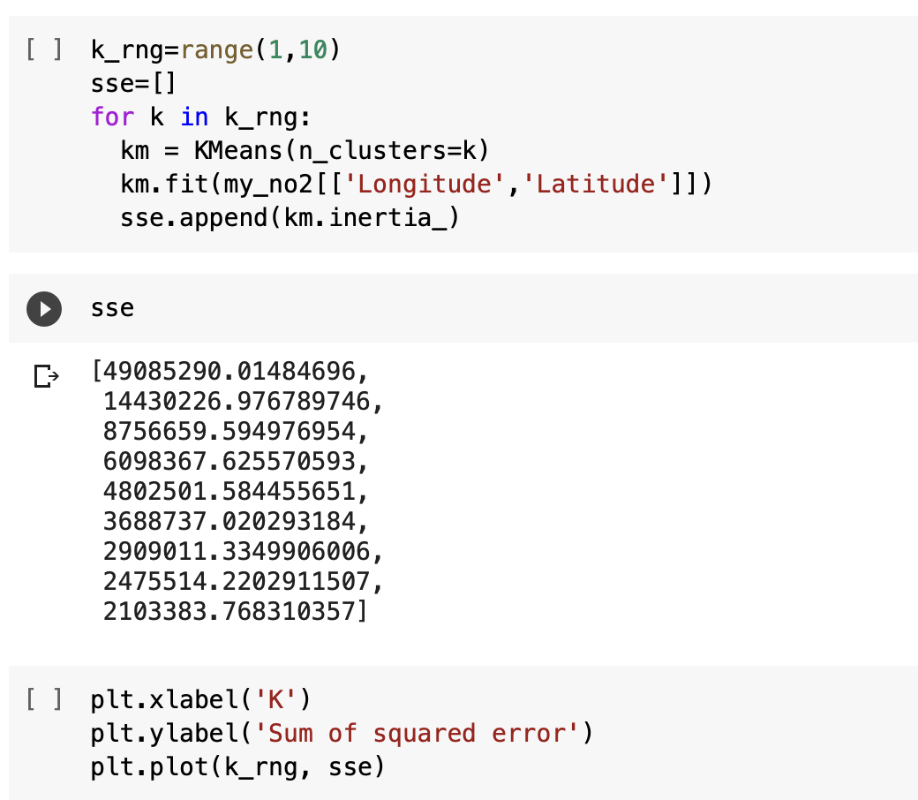
Setting boundary of the dataset to at least ’moderately polluted’
Ozone: AQI > 100
Carbon Monoxide: AQI > 10
Nitrogen Dioxide: AQI > 80
Sulfur Dioxide: AQI > 80
2. Using Longitude and Latitude for x and y
3. Compute the Sum of Squared Error (SSE) to find the number of K by the elbow method.

Slide 18
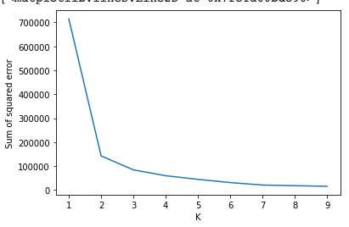
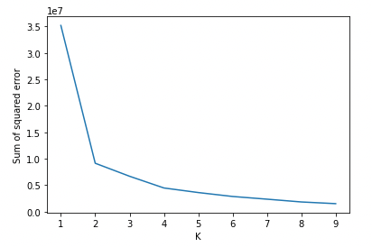
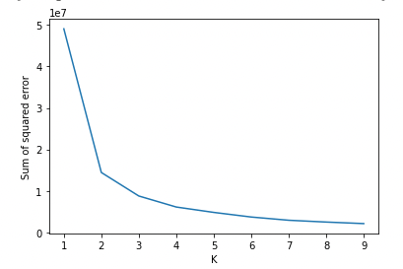
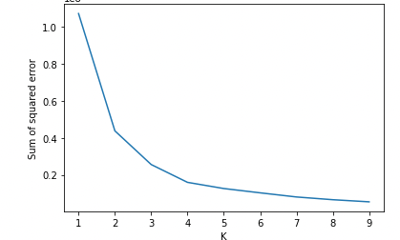
K means clustering
Elbow Method
Ozone
Carbon Monoxide
Sulfur
Dioxide
Nitrogen
Dioxide
Notes:
3,4,3,4

Slide 19
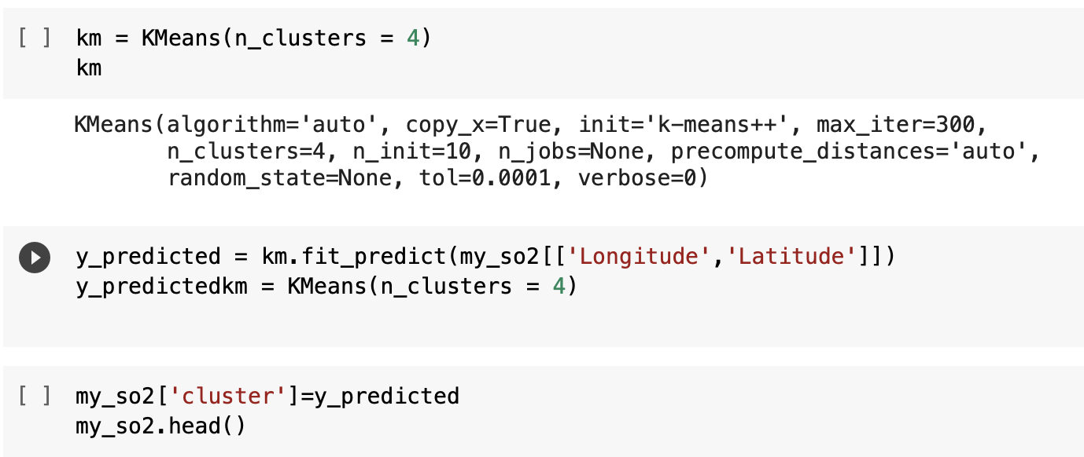
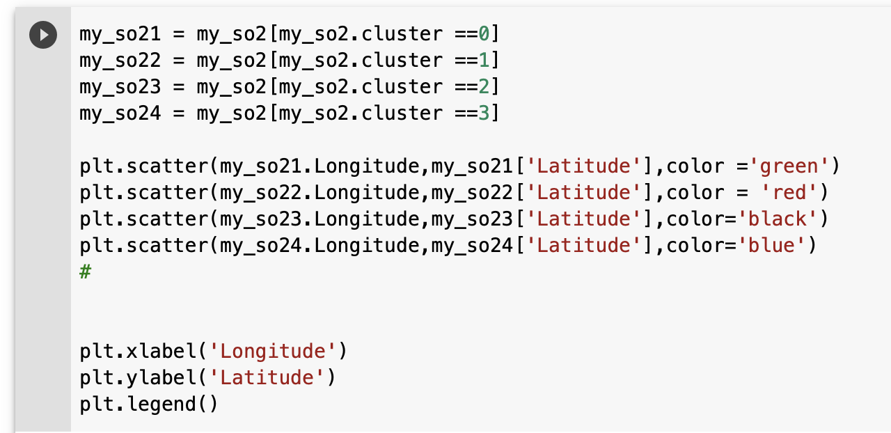
4. With the number of K clusters, generate
K-means clustering.
5. Plot the clusters

Slide 20
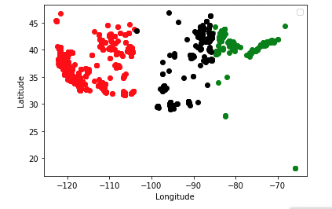
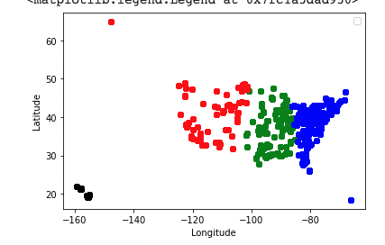
K-means Clustering
Ozone
Sulfur Dioxide
Notes:
Ozone – more than 100, sulfur dioxie- 80

Slide 21
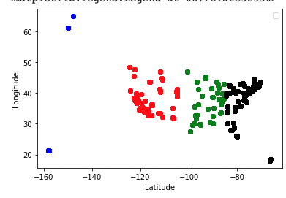
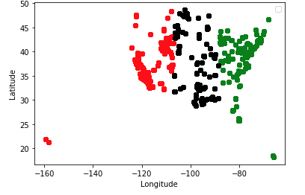
K-means Clustering
Carbon Monoxide
Nitrogen Dioxide
Notes:
Carb- 10, nit- 80

Slide 22
Findings/suggestions
Sulfur Dioxide’s air pollution is the most severe out of the 4 gases
Central States have the best AQI overall
The clusters seem to be generated by regions (West, Central, East)
Ozone
Limiting driving
Maintain vehicles/tools well
Try to use tools without motors.
2. Carbon Monoxide
Regular inspections, maintenance
Proper storage in house
3. Nitrogen Dioxide
Manage and Reduce Emissions
Conserve energy, Less driving
4. Sulfur Dioxide
- Set regulations by State
Notes:
Ozone
vehicles
Carbon monoxide-
Mostly indoor. carbon in fuels do not completely burn. Carbon monoxide is produced by any fuel burning appliance, vehicle, tool and more. Many of the potential sources of carbon monoxide come from malfunctioning indoor appliances
Nitrogen dioxide
Cars and trucks
Coal-fired power plants
Large industrial operations
Ships and airplanes
Sulfur dioxide –
burning of fossil fuels — coal, oil, and diesel — or other materials that contain sulfur. Sources include power plants, metals processing and smelting facilities, and vehicles.

Slide 23
Moving forward
Find more details for the clusters.
Find a detailed dataset that has the indicators for pollution.
Generate clusters using time (See when the pollution is more severe).
Think of other analysis/ machine learning that I can do with the dataset.

