Slide 1

Understanding RFP Requests with Client Credentials: Processes and Case Studies
Exploring secure RFP submission and practical examples
Notes:
AI-generated content may be incorrect. --- This presentation explores the intricate process of Request for Proposal (RFP) submissions involving client credentials. We'll cover the fundamentals of RFPs, analyze the role of client credentials, discuss best practices for secure management, and review real-world case studies to highlight practical insights. Image source: Microsoft 365 content library

Slide 2

Meeting Program
Introduction to RFP (Request for Proposal) Processes
Role of Client Credentials in RFP Requests
Best Practices for Managing RFPs with Client Credentials
Case Studies: Real-World Examples of RFPs Involving Client Credentials
Notes:
--- Our agenda includes an introduction to RFP processes, the role of client credentials within RFPs, best practices for managing sensitive information, and detailed case studies emphasizing real-world applications and lessons learned. Image source: Microsoft 365 content library

Slide 3
Introduction to RFP (Request for Proposal) Processes
Notes:
This section introduces the basics of RFPs, including their definition, purpose, the key stakeholders involved, and the typical phases that make up an RFP cycle.

Slide 4
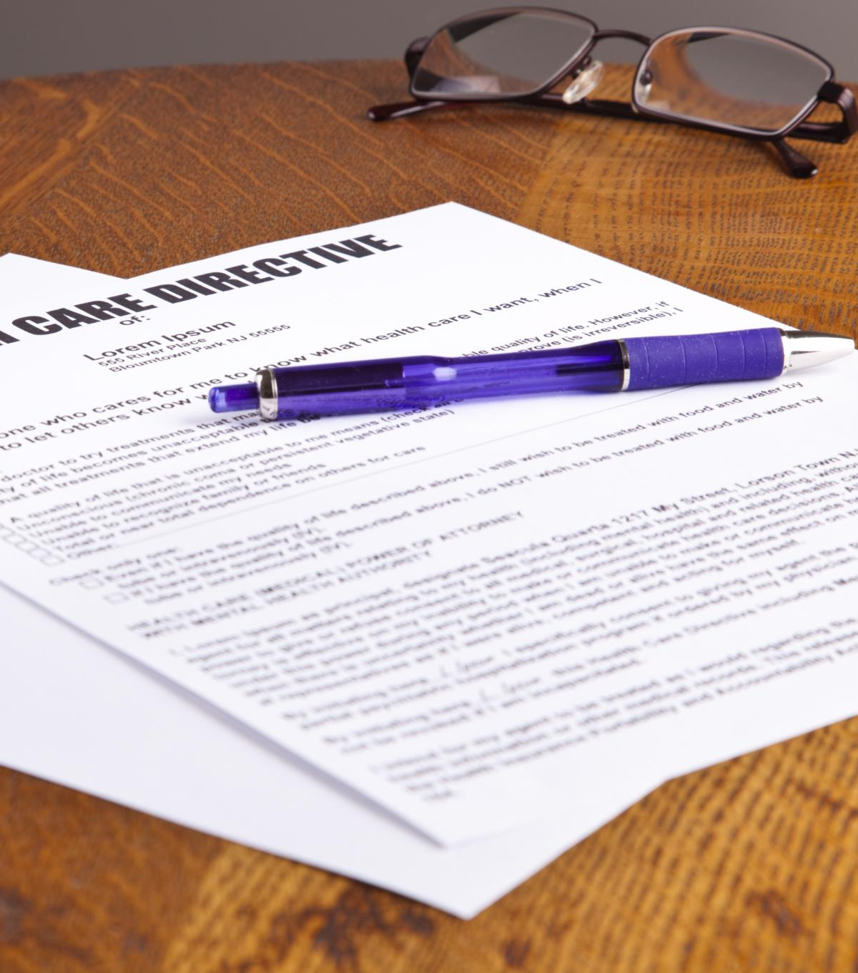
Definition and Purpose of an RFP
What is an RFP
An RFP is a formal document issued to gather proposals from vendors or service providers.
Purpose of an RFP
RFPs ensure a competitive and transparent process to select the right vendor for specific project needs.
Notes:
--- An RFP is a formal document issued by organizations to solicit proposals from potential vendors or service providers. It helps ensure a competitive and transparent selection process to meet specific project or service needs. Image source: Microsoft 365 content library

Slide 5

Key Stakeholders in the RFP Process
Issuing Organization
The issuing organization initiates the RFP to fulfill specific business needs and goals.
Procurement and Evaluation Teams
Procurement and evaluation teams assess proposals to select the best vendor meeting requirements.
Vendors and Compliance Officers
Potential vendors submit proposals while compliance officers ensure regulatory standards are met.
Notes:
--- Stakeholders typically include the issuing organization, procurement teams, evaluation committees, potential vendors, and compliance officers, all collaborating to ensure the RFP meets organizational goals and regulatory requirements. Image source: Microsoft 365 content library

Slide 6

Typical Phases of an RFP Cycle
Preparation Phase
Preparation involves defining needs and creating the RFP document to guide proposals.
Proposal Submission
Vendors submit their proposals according to the issued RFP guidelines and deadlines.
Evaluation and Negotiation
Submitted proposals are evaluated and negotiated to select the best fit for contract award.
Contract Award
The contract is awarded to the selected vendor, finalizing the RFP cycle.
Notes:
--- The RFP cycle generally involves preparation, issuance, proposal submission, evaluation, negotiation, and contract award. Understanding these phases helps streamline the process and ensures all parties are aligned. Image source: Microsoft 365 content library

Slide 7
Role of Client Credentials in RFP Requests
Notes:
This section focuses on what client credentials are, their use in RFP processes, and the critical importance of maintaining confidentiality and data security throughout.

Slide 8
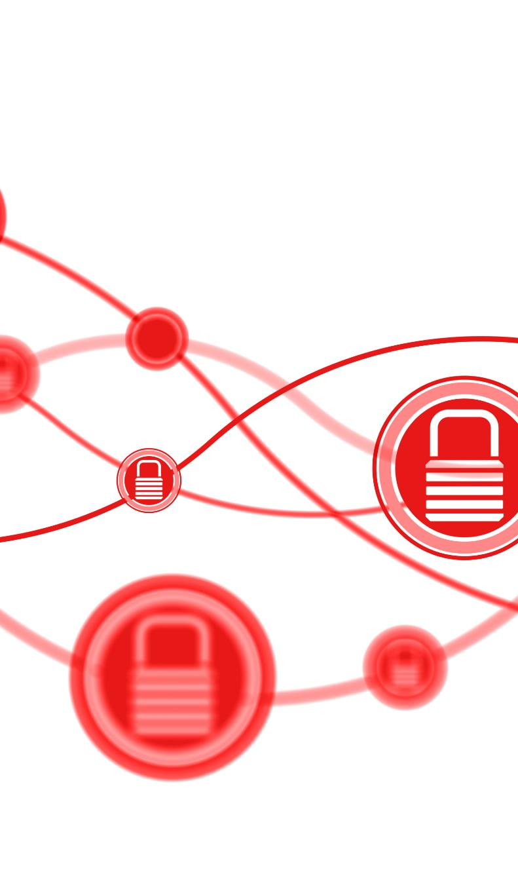
What Are Client Credentials?
Definition of Client Credentials
Client credentials are secure identifiers used to authenticate and authorize access during processes like RFP.
Types of Credentials
Common client credentials include API keys, passwords, and certificates that ensure secure system access.
Purpose in RFP Process
These credentials authorize clients to access systems and data securely during the Request For Proposal process.
Notes:
--- Client credentials are secure identifiers such as API keys, passwords, or certificates that authenticate and authorize access to client systems or data during the RFP process. Image source: Microsoft 365 content library

Slide 9

How Client Credentials Are Used in the RFP Process
Access to Client Information
Client credentials provide vendors secure access to essential client data needed for accurate proposal development.
Assessment and Evaluation
Vendors use credentials to perform thorough assessments ensuring proposals meet client requirements.
Demonstrating Integrations
Credentials enable vendors to demonstrate product integrations within client environments securely and effectively.
Maintaining Secure Communications
Using client credentials ensures all communications remain secure throughout the RFP process.
Notes:
--- These credentials enable vendors to access necessary client information or environments to prepare accurate proposals, perform assessments, or demonstrate integrations while maintaining secure communications. Image source: Microsoft 365 content library

Slide 10

Importance of Confidentiality and Data Security
Protecting Client Credentials
Safeguarding client credentials prevents unauthorized access and protects sensitive information from breaches.
Security Protocols
Implementing robust security protocols is crucial for maintaining data integrity and preventing cyber threats.
Confidentiality Agreements
Confidentiality agreements ensure trust by legally binding parties to protect sensitive information during the RFP process.
Notes:
--- Protecting client credentials is vital to prevent unauthorized access, data breaches, and maintain trust. Robust security protocols and confidentiality agreements are essential components of the RFP process. Image source: Microsoft 365 content library

Slide 11
Best Practices for Managing RFPs with Client Credentials
Notes:
Here, we discuss strategies to securely handle client credentials, including secure transmission and storage, regulatory compliance, and effective access management and monitoring.

Slide 12

Ensuring Secure Credential Transmission and Storage
Encryption for Data Protection
Encryption ensures credentials are unreadable to unauthorized users during transmission and storage.
Secure File Transfer Protocols
Using secure protocols prevents interception of credentials during exchange between systems.
Password Managers Usage
Password managers help safely store and manage credentials, reducing risk of unauthorized access.
Notes:
--- Secure methods such as encryption, secure file transfer protocols, and password managers help protect credentials from interception or unauthorized access during exchange and storage. Image source: Microsoft 365 content library

Slide 13

Compliance with Data Protection Regulations
Regulatory Frameworks
Key regulations such as GDPR, HIPAA, and CCPA define standards for handling personal and sensitive data legally and ethically.
Data Protection Practices
Organizations implement strict processes to ensure client credentials are managed securely and comply with legal requirements.
Legal Compliance Importance
Adhering to data protection laws helps prevent legal risks and builds trust with clients through responsible data management.
Notes:
--- Organizations must adhere to regulations like GDPR, HIPAA, or CCPA when handling client credentials, ensuring all processes meet legal requirements to protect personal and sensitive data. Image source: Microsoft 365 content library

Slide 14

Managing Access and Monitoring Usage
Role-Based Access Control
Assigning permissions based on roles ensures users have appropriate access levels, reducing risk of unauthorized usage.
Credential Usage Logging
Logging all credential activities enables detection and auditing of suspicious behavior effectively.
Regular Permission Reviews
Periodic audits of user permissions help identify and remove excessive access rights promptly.
Notes:
--- Implementing role-based access controls, logging credential use, and regularly reviewing permissions helps prevent misuse and detect potential security incidents promptly. Image source: Microsoft 365 content library

Slide 15
Case Studies: Real-World Examples of RFPs Involving Client Credentials
Notes:
This section presents practical case studies demonstrating how client credentials were managed in complex RFPs, highlighting challenges and solutions.

Slide 16

Case Study 1: Software Integration for a Financial Institution
Vendor Access Requirements
The RFP required vendors to securely access sensitive systems using client credentials to ensure controlled entry.
Credential Management
Strict management of client credentials was essential to protect data and prevent unauthorized access.
Regulatory Compliance
The project complied with financial regulations to maintain data privacy and operational integrity.
Notes:
--- A financial institution issued an RFP requiring vendors to access sensitive systems with client credentials. The project emphasized strict credential management and compliance with financial regulations. Image source: Microsoft 365 content library

Slide 17

Case Study 2: Cloud Migration Project with Healthcare Data
Secure Cloud Access
Vendors required secure access protocols to protect sensitive healthcare client environments during cloud migration.
Credential Security Best Practices
The migration employed best practices in managing credentials to prevent unauthorized access and data breaches.
HIPAA Regulatory Compliance
Compliance with HIPAA standards ensured the protection of patient data and adherence to healthcare regulations.
Notes:
--- In this healthcare cloud migration RFP, vendors needed secure access to client environments. The process showcased best practices in credential security and regulatory adherence to HIPAA standards. Image source: Microsoft 365 content library

Slide 18
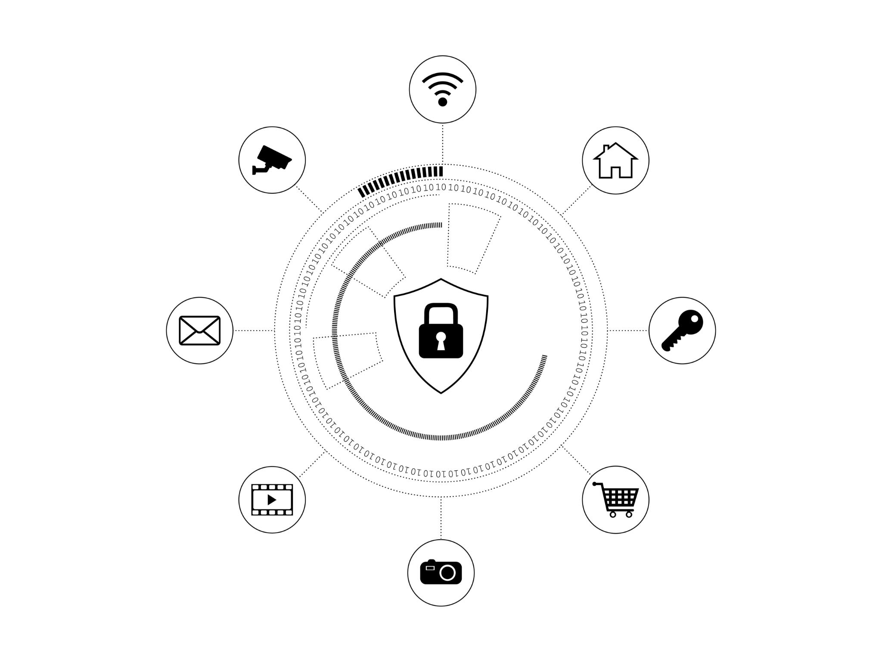
Lessons Learned and Key Takeaways From Each Scenario
Early Security Planning
Initiating security measures early helps prevent data breaches and protects sensitive information effectively.
Clear Policy Communication
Clear communication of credential use policies ensures all stakeholders understand security protocols and responsibilities.
Ongoing Monitoring
Continuous monitoring detects and mitigates risks promptly during the RFP process.
Notes:
--- Both cases underscored the importance of early security planning, clear communication of credential use policies, and ongoing monitoring to safeguard sensitive data throughout the RFP process. Image source: Microsoft 365 content library

Slide 19
Conclusion
Importance of Credential Management
Managing client credentials properly in RFPs ensures security and contributes to organizational success.
Understanding RFP Processes
Thorough knowledge of RFP procedures helps in effective and secure handling of sensitive client information.
Best Practices and Learning
Applying best practices and insights from real-world examples fosters data protection and client trust.
Notes:
Effectively managing client credentials in RFP requests is critical for security and success. By understanding RFP processes, employing best practices, and learning from real-world examples, organizations can protect data and foster trust.

