Slide 1
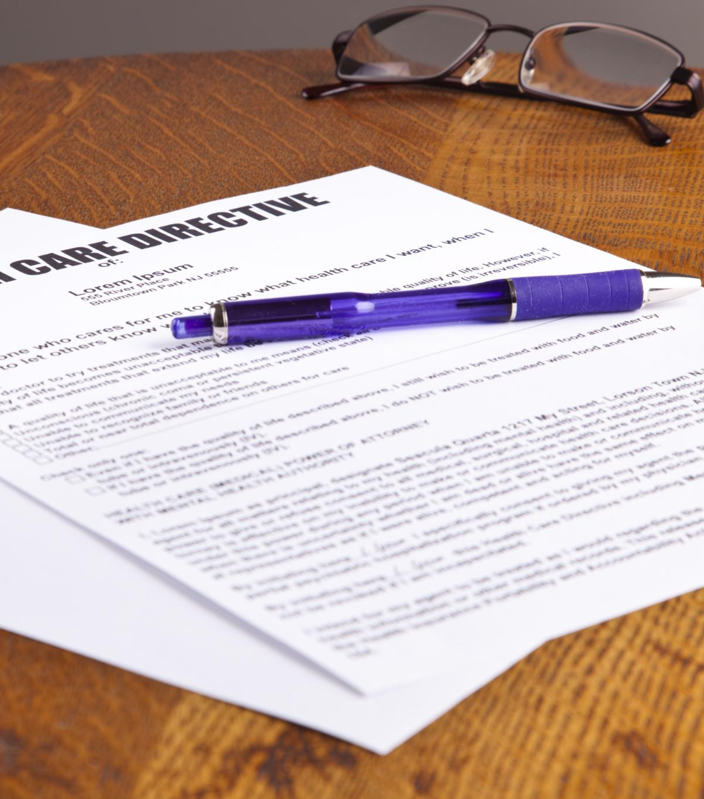
Definition and Purpose of an RFP
What is an RFP
An RFP is a formal document issued to gather proposals from vendors or service providers.
Purpose of an RFP
RFPs ensure a competitive and transparent process to select the right vendor for specific project needs.
Notes:
--- An RFP is a formal document issued by organizations to solicit proposals from potential vendors or service providers. It helps ensure a competitive and transparent selection process to meet specific project or service needs. Image source: Microsoft 365 content library

Slide 2

Key Stakeholders in the RFP Process
Issuing Organization
The issuing organization initiates the RFP to fulfill specific business needs and goals.
Procurement and Evaluation Teams
Procurement and evaluation teams assess proposals to select the best vendor meeting requirements.
Vendors and Compliance Officers
Potential vendors submit proposals while compliance officers ensure regulatory standards are met.
Notes:
--- Stakeholders typically include the issuing organization, procurement teams, evaluation committees, potential vendors, and compliance officers, all collaborating to ensure the RFP meets organizational goals and regulatory requirements. Image source: Microsoft 365 content library

Slide 3

Typical Phases of an RFP Cycle
Preparation Phase
Preparation involves defining needs and creating the RFP document to guide proposals.
Proposal Submission
Vendors submit their proposals according to the issued RFP guidelines and deadlines.
Evaluation and Negotiation
Submitted proposals are evaluated and negotiated to select the best fit for contract award.
Contract Award
The contract is awarded to the selected vendor, finalizing the RFP cycle.
Notes:
--- The RFP cycle generally involves preparation, issuance, proposal submission, evaluation, negotiation, and contract award. Understanding these phases helps streamline the process and ensures all parties are aligned. Image source: Microsoft 365 content library

Slide 4

Importance of Confidentiality and Data Security
Protecting Client Credentials
Safeguarding client credentials prevents unauthorized access and protects sensitive information from breaches.
Security Protocols
Implementing robust security protocols is crucial for maintaining data integrity and preventing cyber threats.
Confidentiality Agreements
Confidentiality agreements ensure trust by legally binding parties to protect sensitive information during the RFP process.
Notes:
--- Protecting client credentials is vital to prevent unauthorized access, data breaches, and maintain trust. Robust security protocols and confidentiality agreements are essential components of the RFP process. Image source: Microsoft 365 content library

Slide 5

Ensuring Secure Credential Transmission and Storage
Encryption for Data Protection
Encryption ensures credentials are unreadable to unauthorized users during transmission and storage.
Secure File Transfer Protocols
Using secure protocols prevents interception of credentials during exchange between systems.
Password Managers Usage
Password managers help safely store and manage credentials, reducing risk of unauthorized access.
Notes:
--- Secure methods such as encryption, secure file transfer protocols, and password managers help protect credentials from interception or unauthorized access during exchange and storage. Image source: Microsoft 365 content library

Slide 6
Conclusion
Importance of Credential Management
Managing client credentials properly in RFPs ensures security and contributes to organizational success.
Understanding RFP Processes
Thorough knowledge of RFP procedures helps in effective and secure handling of sensitive client information.
Best Practices and Learning
Applying best practices and insights from real-world examples fosters data protection and client trust.
Notes:
Effectively managing client credentials in RFP requests is critical for security and success. By understanding RFP processes, employing best practices, and learning from real-world examples, organizations can protect data and foster trust.

