Slide 1



Arithmetic
Algebra
PreCalculus
Statistics
Project-Based Learning: Applied Projects for Student Engagement
Presented on Friday: 10/11/2024 @
https://conferencepresentations.appspot.com/
“The Joy of a Teacher is the Success of his Students.” – Samuel Dominic Chukwuemeka

Slide 2
Applied Projects should be: I-S-M-A-R-T
I: Interdisciplinary
Some form of writing is required.
The writing should be part of the assessment.
S: Specific
What is the specific topic?
What are the specific concepts?
What are the specific objectives?
M: Measurable
How do we measure the success of the project?
How is the project evaluated?

Slide 3
A: Authentic
Also known as Active Learning, the project must be a real-world project that connects the knowledge acquired in the classroom to applications outside the classroom.
R: Realistic
The project should not be too simple, neither should it be too complex. At least one of the objectives of the project should be from the course learning objectives.
T: Timely
The project should have firm deadlines. It is okay to have more than one due date. However, clear expectations of deliverables for each due date should be communicated. If it is a group project or a project that needs to be completed in phases, then firm deadlines are required for each phase of the project.

Slide 4
Arithmetic: Number Theory: ISBN
One of the applications of Number Theory is in Modular Arithmetic.
One of the applications of Modular Arithmetic is in the calculation of the Check Digit of an International Standard Book Number (ISBN).
ISBN stands for International Standard Book Number. It is a unique identifier for any published book.
The Check Digit of an International Standard Book Number (ISBN) is the last digit of that number. For ISBN-10, the check digit is the 10th digit. For ISBN-13, the check digit is the 13th digit.
Objectives
Students will:
(1.) Perform basic arithmetic operations (addition, subtraction, multiplication, and division) on integers.
(2.) Solve applied problems on numbers.
(3.) Discuss the concepts of: Divisibility, Factors, and Multiples.
(4.) Meet one of the learning objectives of the VCCS (Virginia Community College System) standards for:
MTH 111: Basic Technical Mathematics (Provides a foundation in mathematics with emphasis in arithmetic, unit conversion, basic algebra, geometry and trigonometry.).

Slide 5
Objectives (Continued)
MTH 133: Mathematics for Health Professions (Presents in context the arithmetic of fractions and decimals, the metric system and dimensional analysis, percents, ratio and proportion, linear equations, topics in statistics, topics in geometry, logarithms, topics in health professions including dosages, dilutions and IV flow rates.).
MTH 154: Quantitative Reasoning [Solve real-life problems requiring interpretation and comparison of various representations of ratios (i.e., fractions, decimals, rates, and percentages including part to part and part to whole, per capita data, growth and decay via absolute and relative change)].
(5.) Meet the QM (Quality Matters) and USDOE (United States Department of Education) requirements for distance education as regards the provision of RSI (Regular and Substantive Interaction). Federal Register: Distance Education and Innovation St. John's University: New Federal Requirements for Distance Education: Regular and Substantive Interaction (RSI) Student – Content Interaction: Very high Student – Student Interaction: Flexible Student – Faculty Interaction: Flexible

Slide 6
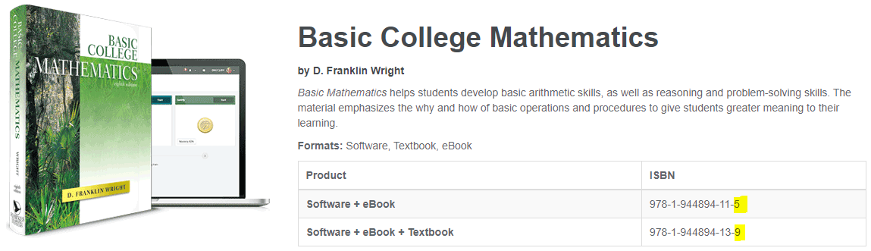
Book
Specific Objectives
(1.) Verify the check digit for ISBN-10
(2.) Verify the check digit for ISBN-13
(3.) Convert ISBN-10 to ISBN-13
(4.) Convert ISBN-13 to ISBN-10
Students Projects

Slide 7
Algebra: Percent: Show Me Your Receipts
Objectives
The Show Me Your Receipts project is designed to:
(1.) Meet one of the learning objectives of the VCCS (Virginia Community College System) standards for: MTH 132: Business Mathematics (Provides instruction, review, and drill in percentage, cash and trade discounts, mark-up, payroll, sales, property and other taxes, simple and compound interest, bank discounts, loans, investments, and annuities).
MTH 133: Mathematics for Health Professions (Presents in context the arithmetic of fractions and decimals, the metric system and dimensional analysis, percents, ratio and proportion, linear equations, topics in statistics, topics in geometry, logarithms, topics in health professions including dosages, dilutions and IV flow rates.). MTH 154: Quantitative Reasoning [Solve real-life problems requiring interpretation and comparison of various representations of ratios (i.e., fractions, decimals, rates, and percentages including part to part and part to whole, per capita data, growth and decay via absolute and relative change)].

Slide 8
Objectives (Continued)
(2.) Meet the QM (Quality Matters) and USDOE (United States Department of Education) requirements for distance education as regards the provision of RSI (Regular and Substantive Interaction). Federal Register: Distance Education and Innovation St. John's University: New Federal Requirements for Distance Education: Regular and Substantive Interaction (RSI) Student – Content Interaction: Very high Student – Student Interaction: Flexible Student – Faculty Interaction: Flexible
(3.) Solve applied problems involving percents.

Slide 9
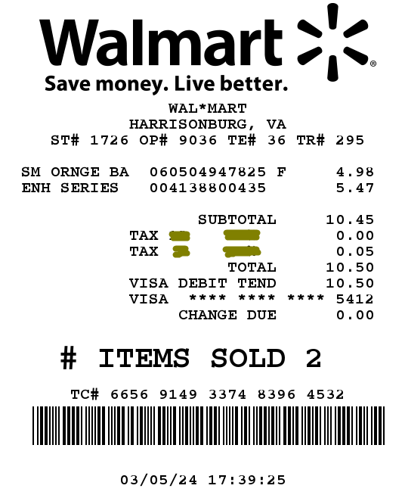
Example Guides
Case 0: What Item? SamDom4Peace did not pay a sales tax in one of the items. Identify the item.

Slide 10
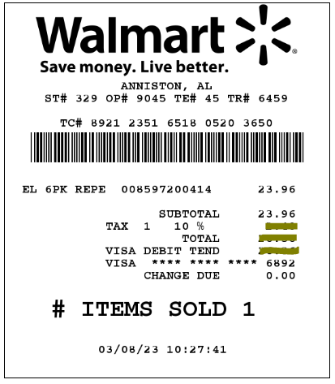
Case 1:
Given: Initial price and Tax rate Calculate: (a.) Tax (b.) Total price

Slide 11
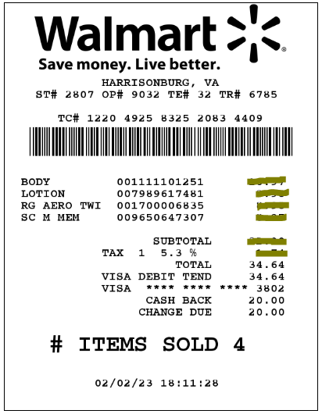
Case 2:
Given: Tax rate and Total price Calculate: (a.) Initial price (Subtotal) (b.) Tax

Slide 12
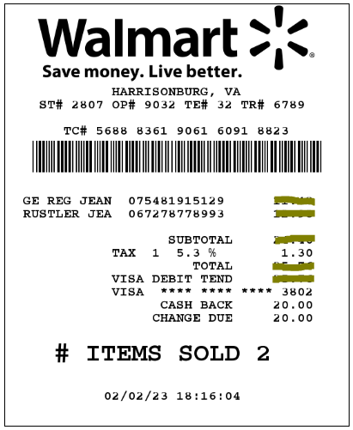
Case 3:
Given: Tax rate and Tax (Use $1.29638) Calculate: (a.) Initial price (Subtotal) (b.) Total price

Slide 13
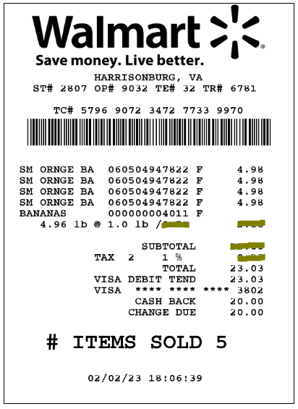
Case 4:
Given: Five items, Part of the subtotal (Initial prices of four items), Tax rate, and Total price Calculate: (a.) Subtotal (sum of the initial prices) (b.) Tax (c.) Initial price of the fifth item (d.) Unit price of the fifth item per pound

Slide 14
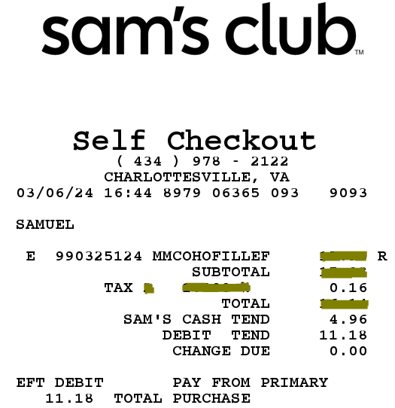
Case 5:
Given: Tax, Sam's Club credit, Remaining balance (Use $11.1798) Calculate: (a.) Total price (b.) Initial price (Subtotal) (c.) Tax rate

Slide 15
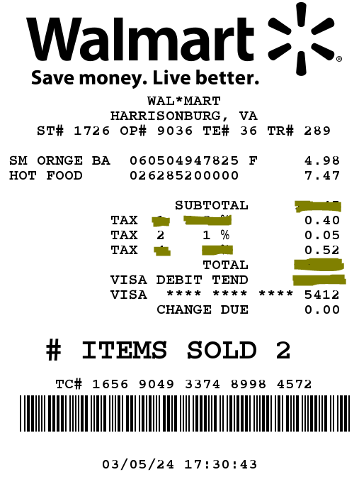
Case 6: As at March 2024, the City of Harrisonburg in the State of Virginia charges 1% sales tax on raw foods and fruits and a high tax rate on cooked food. (I guess they want Virginians to cook their meals.) Chukwuemeka was hungry and decided to buy hot food at Walmart. The hot food is high in calories and is a source of carbohydrates (carbs). He also decided to buy a bag of fresh oranges to provide essential vitamins. The receipt shows three tax rates: the tax rate on the oranges (shown) and two different tax rates on the hot food (not shown). Given: (I.) Initial price of the bag of oranges (II.) Initial price of the hot food (III.) Tax rate on the bag of oranges (IV.) Tax on the bag of oranges (V.) 1st tax on the hot food (Use $0.39591) (VI.) 2nd tax on the hot food (Use $0.5229) Calculate: (a.) Subtotal (Sum of the initial prices) (b.) 1st tax rate on the hot food (c.) 2nd tax rate on the hot food (d.) Total price

Slide 16
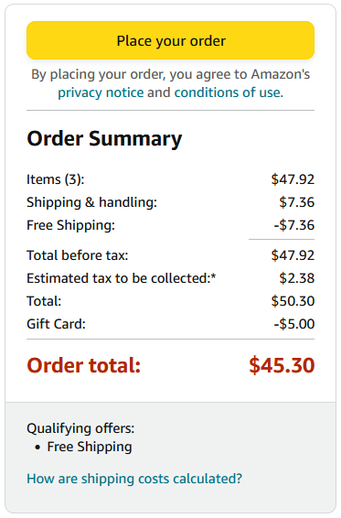
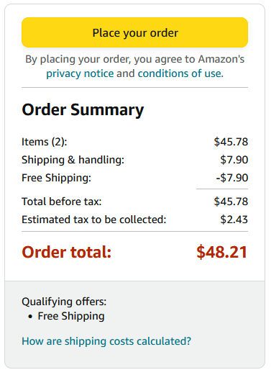
Case 7:
Samuel placed two different online orders on two different days on the Amazon website. The two different orders were sent to the same address in the State of Virginia. None of the orders has food or drinks. However, the orders were charged different tax rates.
(a.) Calculate the tax rate for the 1st order. (b.) Calculate the tax rate for the 2nd order. (c.) Samuel asked you to explain why the tax rates were different. (i.) Ask Samuel at least one question in that regard. (ii.) Provide at least one explanation to Samuel.
1st Order 2nd Order

Slide 17
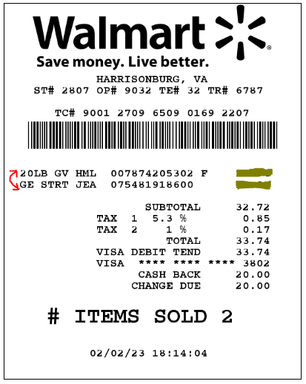
Case 8: Given: (I.) Two items: 2nd item is 20LB GV HML 1st item is GE STRT JEA Note the interchange here as opposed to the receipt (II.) Subtotal of the two items (III.) Different tax rates for the two items (Tax 1 for the 1st item and Tax 2 for the 2nd item) (IV.) Different taxes for the two items (Use $0.84694 for the 1st item and $0.1674 for the 2nd item) (V.) Total price Calculate: (a.) Initial price of the 1st item (b.) Initial price of the 2nd item

Slide 18
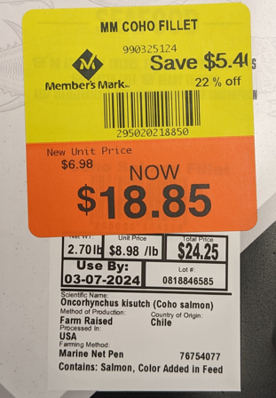
Case 9:
Given: (I.) Initial price (II.) Discount (III.) Percent Discount (IV.) Sale price But: The percent discount on the label is an approximate value. Calculate the exact percent discount.

Slide 19
Algebra: Containers: Measurements and Units
Objectives
The Measurements and Units project is designed to:
(1.) Meet one of the learning objectives of the VCCS (Virginia Community College System) standards for: MTH 111: Basic Technical Mathematics (Provides a foundation in mathematics with emphasis in arithmetic, unit conversion, basic algebra, geometry and trigonometry.). MTH 130: Fundamentals of Reasoning (Presents elementary concepts of algebra, linear graphing, financial literacy, descriptive statistics, and measurement & geometry. ). MTH 131: Technical Mathematics (Presents algebra through unit conversion, trigonometry, vectors, geometry, and complex numbers.).
MTH 133: Mathematics for Health Professions (Presents in context the arithmetic of fractions and decimals, the metric system and dimensional analysis, percents, ratio and proportion, linear equations, topics in statistics, topics in geometry, logarithms, topics in health professions including dosages, dilutions and IV flow rates.).

Slide 20
Objectives (Continued)
MTH 154: Quantitative Reasoning [Solve real-life problems requiring interpretation and comparison of various representations of ratios (i.e., fractions, decimals, rates, and percentages including part to part and part to whole, per capita data, growth and decay via absolute and relative change)].
(2.) Meet the QM (Quality Matters) and USDOE (United States Department of Education) requirements for distance education as regards the provision of RSI (Regular and Substantive Interaction). Federal Register: Distance Education and Innovation St. John's University: New Federal Requirements for Distance Education: Regular and Substantive Interaction (RSI) Student – Content Interaction: Very high Student – Student Interaction: Flexible Student – Faculty Interaction: Flexible
(3.) Convert between International Metric System of units and United States Customary System of units.

Slide 21
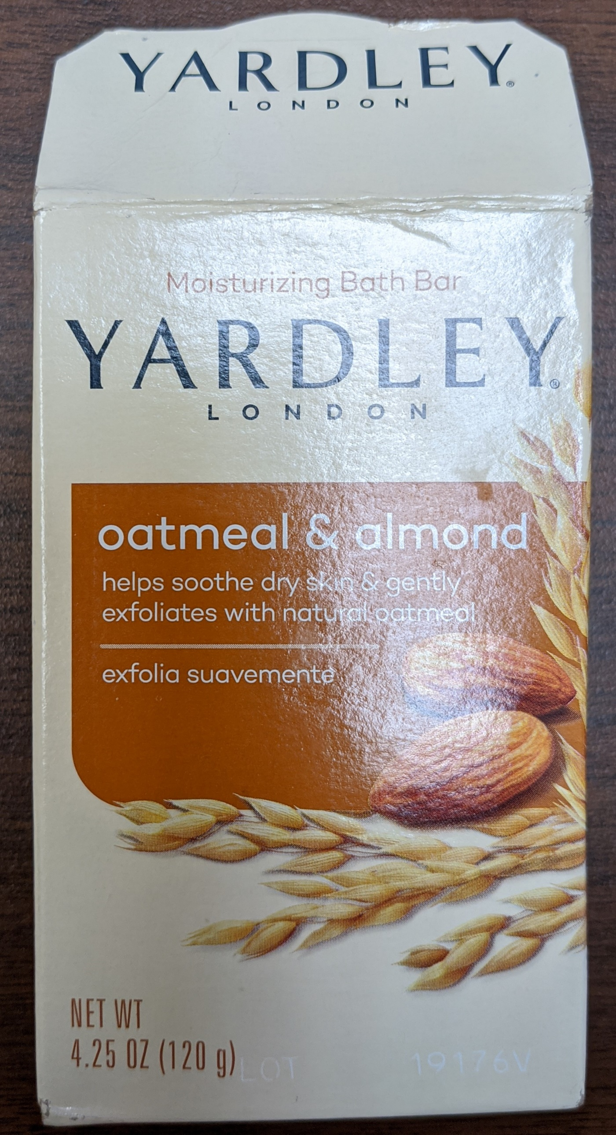
Container Used: Soap container
Calculations:
First Conversion: Convert 4.25 ounce to gram.
Second Conversion: Convert 120 grams to ounce.
Only Required Tables
Students Projects

Slide 22
PreCalculus: Piecewise Function: Power Bill
PreCalculus: Piecewise Function: Water Bill
PreCalculus: Piecewise Function: Federal Tax
Objectives
Students will: (1.) Discuss piecewise functions. (2.) Discuss real-world applications of piecewise-functions. (3.) Solve problems involving the application of piecewise functions.

Slide 23
Objectives (Continued)
(4.) Meet one of the learning objectives of the VCCS (Virginia Community College System) standards for:
MTH 161: PreCalculus I (Presents topics in power, polynomial, rational, exponential, and logarithmic functions, and systems of equations and inequalities.). MTH 167: PreCalculus with Trigonometry (Presents topics in power, polynomial, rational, exponential, and logarithmic functions, systems of equations, trigonometry, and trigonometric applications, including Law of Sines and Cosines, and an introduction to conics.).
(5.) Meet the QM (Quality Matters) and USDOE (United States Department of Education) requirements for distance education as regards the provision of RSI (Regular and Substantive Interaction). Federal Register: Distance Education and Innovation St. John's University: New Federal Requirements for Distance Education: Regular and Substantive Interaction (RSI) Student – Content Interaction: Very high Student – Student Interaction: Flexible Student – Faculty Interaction: High

Slide 24
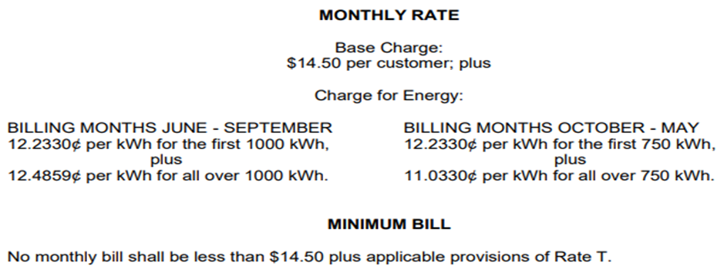
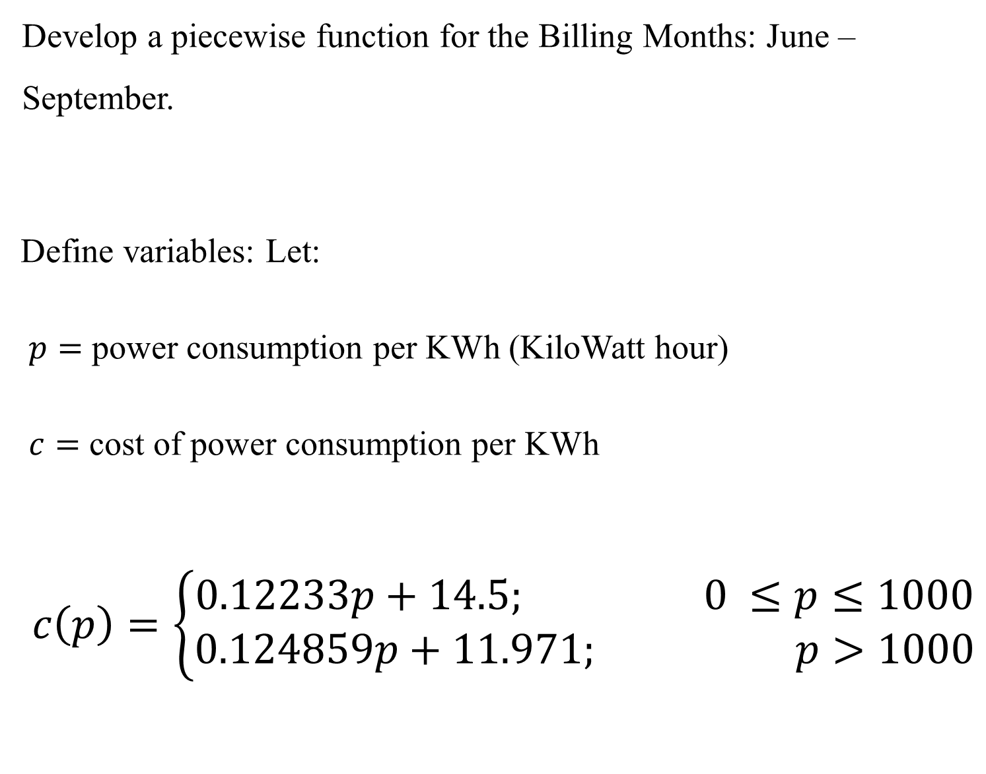
Example: Alabama Power
Screenshot of Family Dwelling: Residential Service rates of Alabama Power. Source: https://www.alabamapower.com/content/dam/alabama-power/pdfs-docs/Rates/FD.pdf
Develop a piecewise function for the Billing Months: June – September.
Define variables: Let:
$p=$ power consumption per KWh (KiloWatt hour)
$c=$ cost of power consumption per KWh
$$c\left(p\right)=\left\{\begin{aligned}0.12233p+14.5; 0 ≤p≤1000 \\ 0.124859p+11.971; p>1000\end{aligned}\right.$$
Students Projects

Slide 25
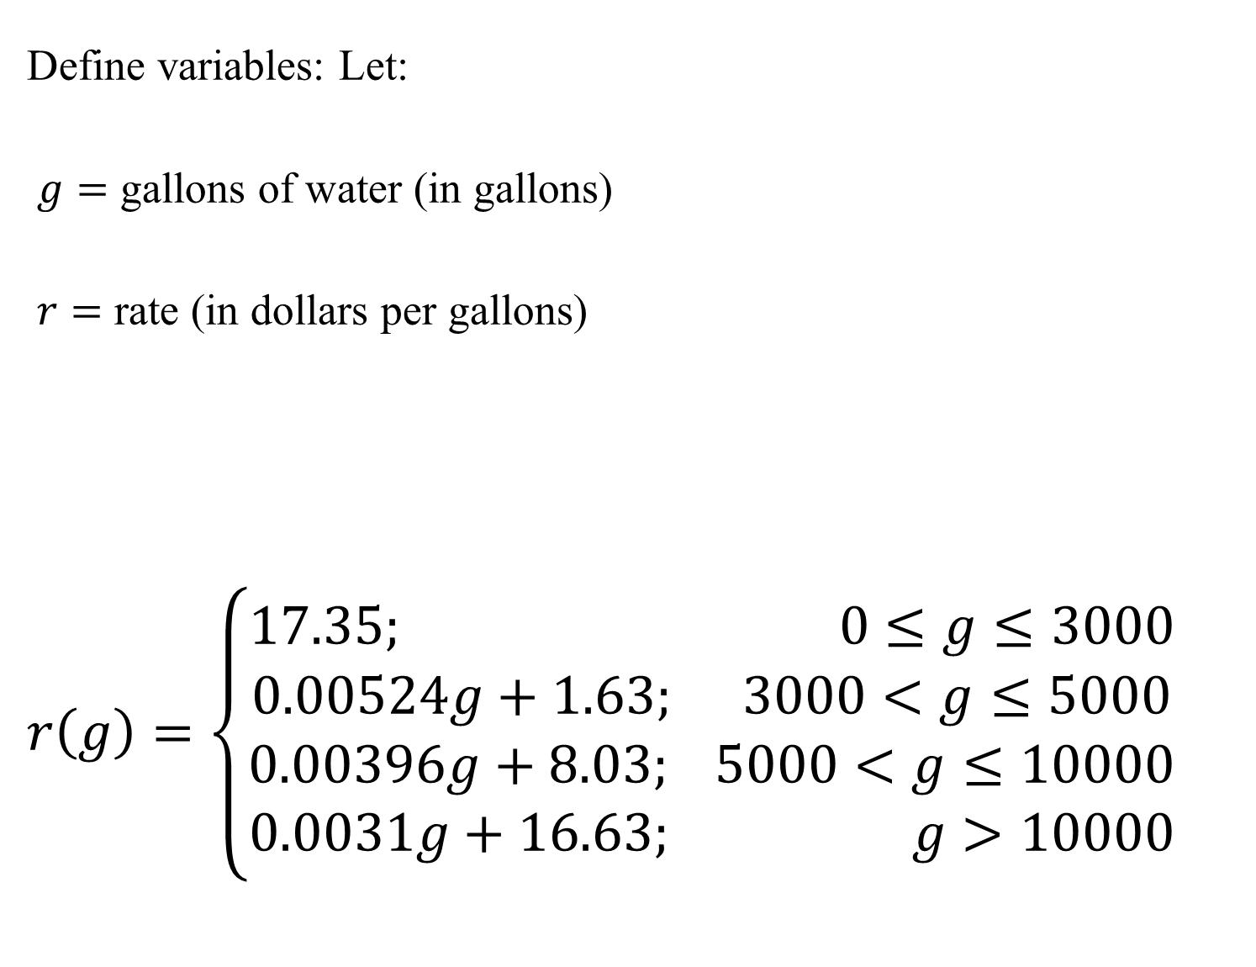
Calhoun County Water Authority
Define variables: Let:
$g=$ gallons of water (in gallons)
$r=$ rate (in dollars per gallons)
$$r\left(g\right)=\left\{\begin{aligned}17.35; 0≤g≤3000 \\ 0.00524g+1.63; 3000<g≤5000 \\ 0.00396g+8.03; 5000<g≤10000 \\ 0.0031g+16.63; g>10000\end{aligned}\right.$$
As of the 7th day of July, 2018; the residential water rates of Calhoun County Water Authority residents is:
First 3,000 Gallons: $17.35 Minimum Per Month
Next 2,000 Gallons: $5.24 per 1,000 Gallons
Next 5,000 Gallons: $3.96 per 1,000 Gallons
All over 10,000 Gallons: $3.10 per 1,000 Gallons
Develop a piecewise function for the residential water rates.
Students Projects

Slide 26
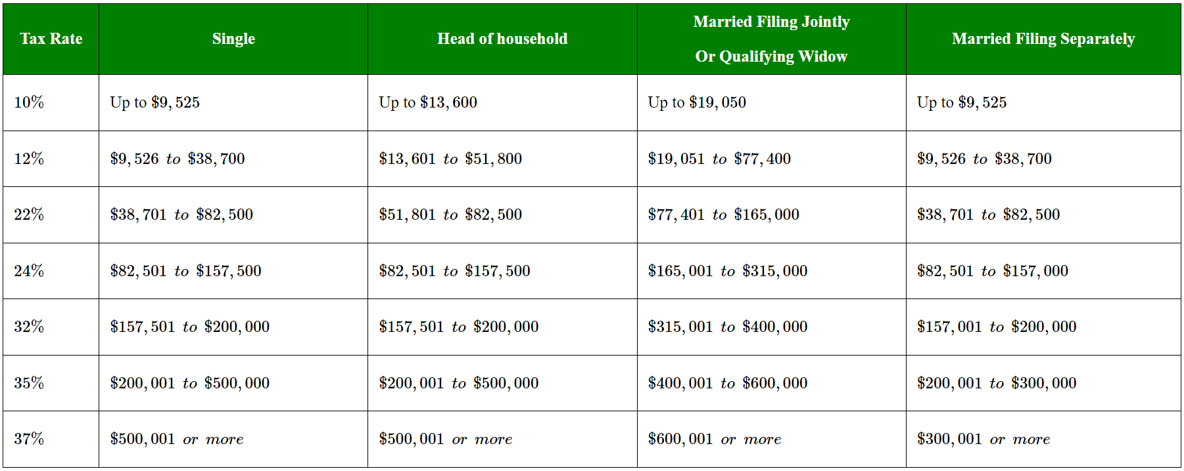
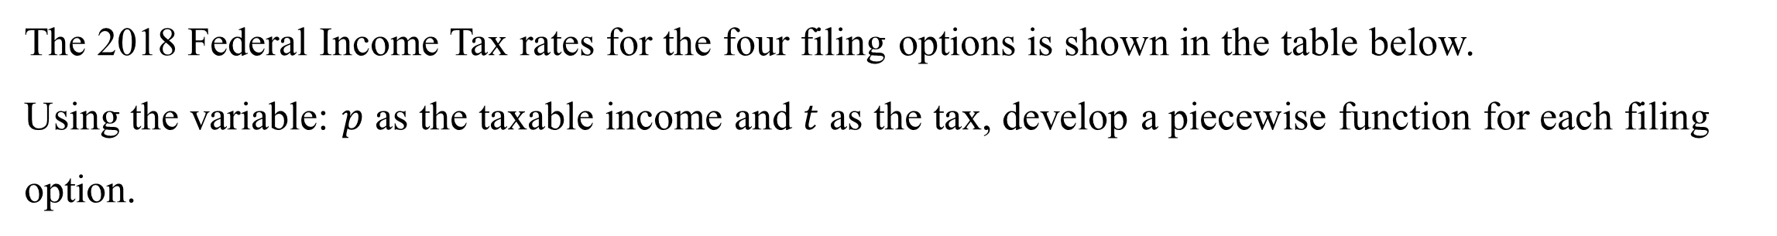
Federal Income Tax 2018
The 2018 Federal Income Tax rates for the four filing options is shown in the table below.
Using the variable: $p$ as the taxable income and $t$ as the tax, develop a piecewise function for each filing option.
Students Projects

Slide 27
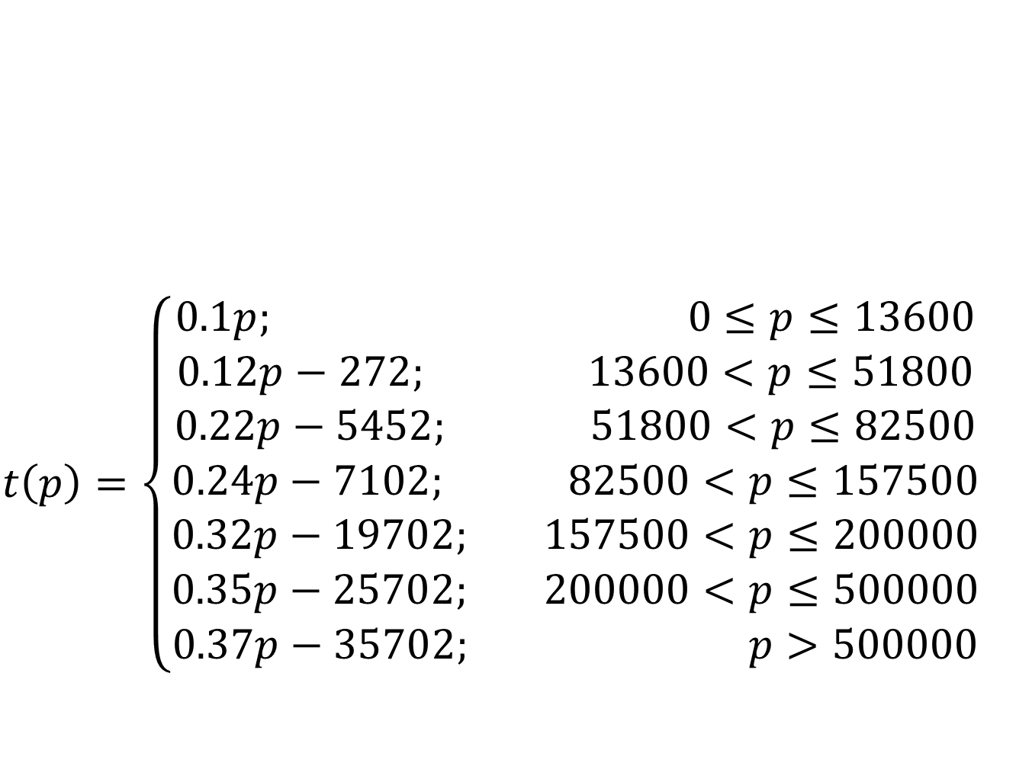
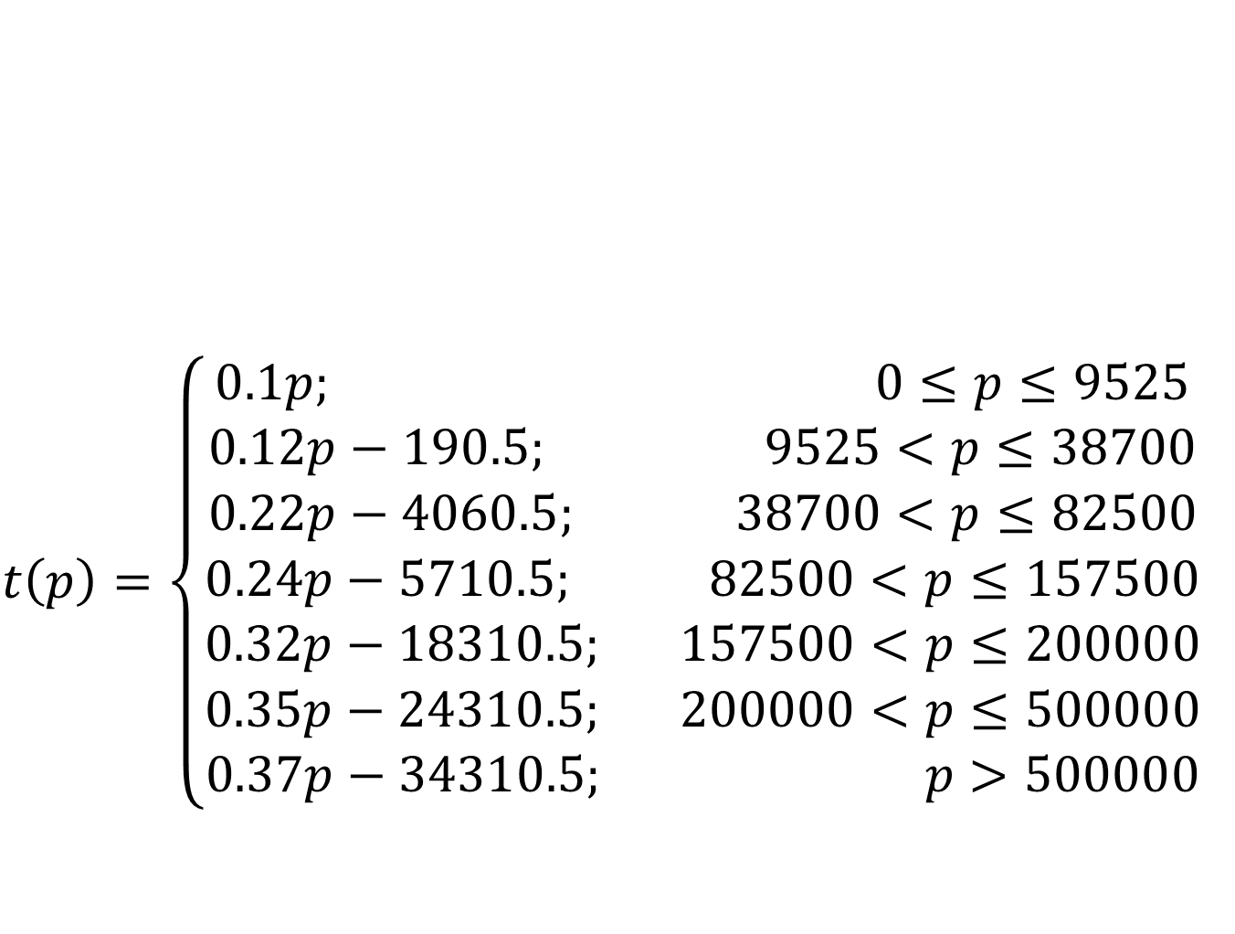
Single
Head of Household
$$t\left(p\right)=\left\{\begin{aligned}0.1p; 0≤p≤9525 \\ 0.12p−190.5; 9525<p≤38700 \\ 0.22p−4060.5; 38700<p≤82500 \\ 0.24p−5710.5; 82500<p≤157500 \\ 0.32p−18310.5; 157500<p≤200000 \\ 0.35p−24310.5; 200000<p≤500000 \\ 0.37p−34310.5; p>500000\end{aligned}\right.$$
$$t\left(p\right)=\left\{\begin{aligned}0.1p; 0≤p≤13600 \\ 0.12p−272; 13600<p≤51800 \\ 0.22p−5452; 51800<p≤82500 \\ 0.24p−7102; 82500<p≤157500 \\ 0.32p−19702; 157500<p≤200000 \\ 0.35p−25702; 200000<p≤500000 \\ 0.37p−35702; p>500000\end{aligned}\right.$$

Slide 28
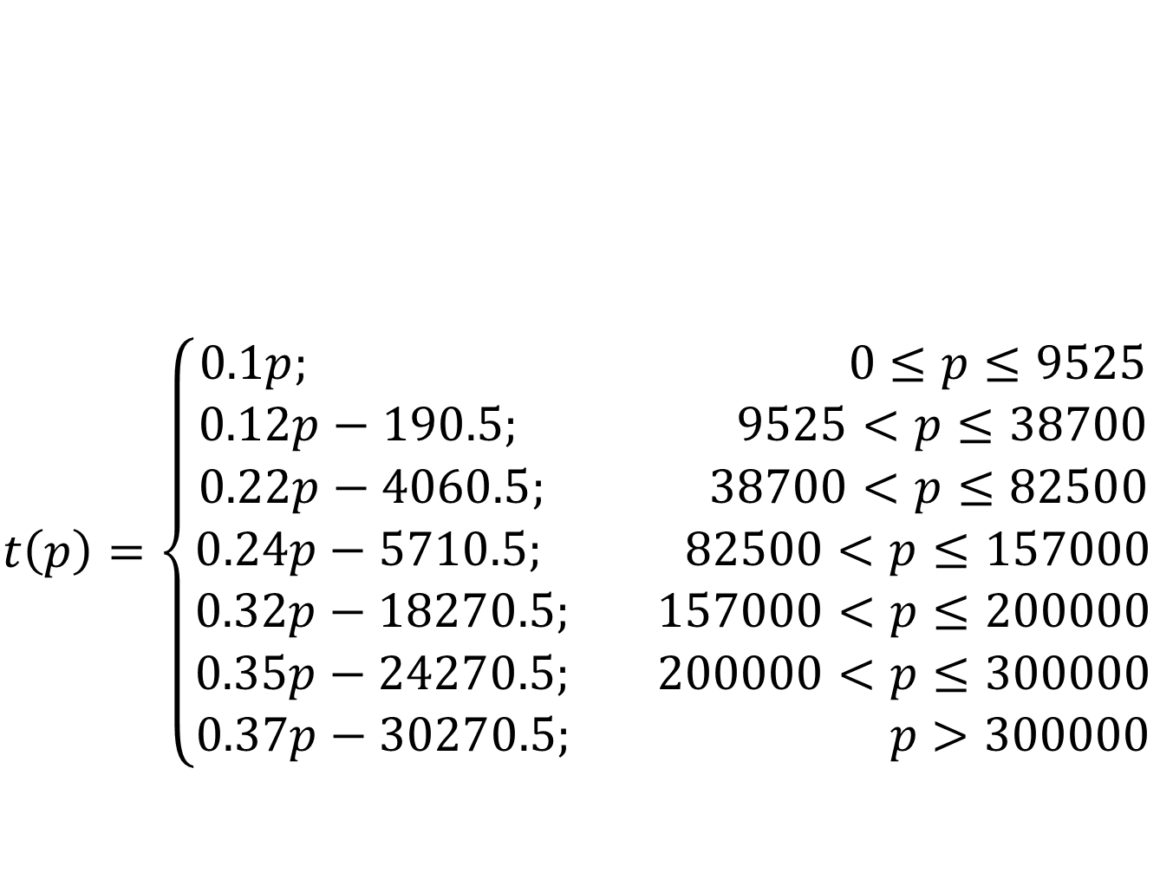
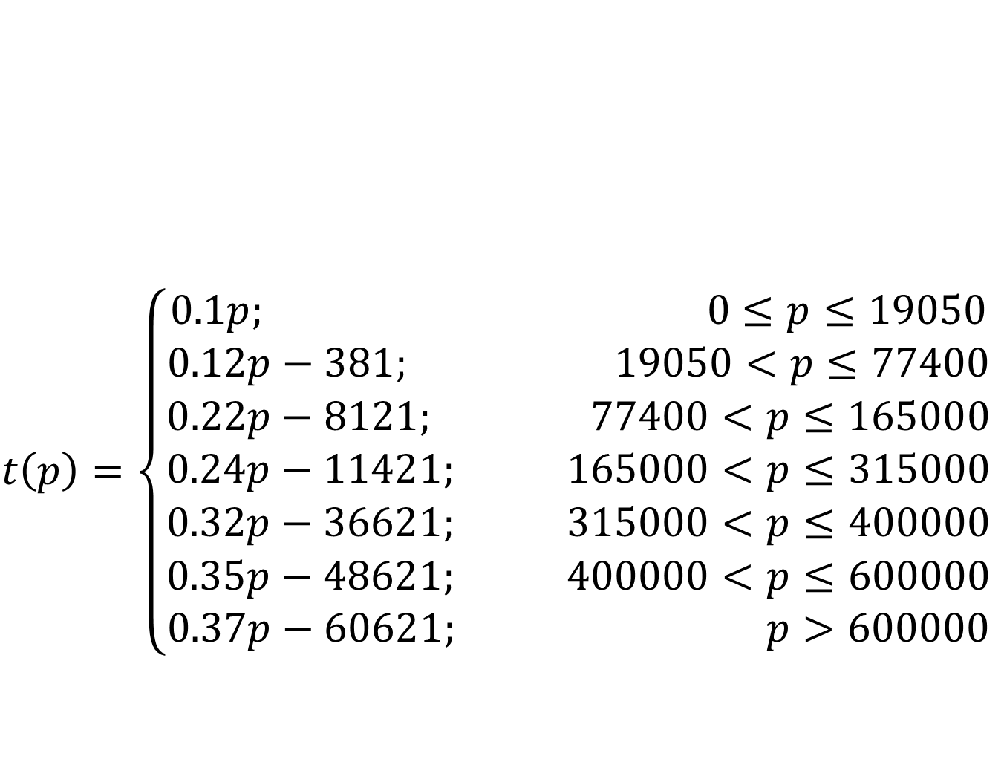
Married Filing Jointly/Qualifying Widow
Married Filing Separately
$$t\left(p\right)=\left\{\begin{aligned}0.1p; 0≤p≤19050 \\ 0.12p−381; 19050<p≤77400 \\ 0.22p−8121; 77400<p≤165000 \\ 0.24p−11421; 165000<p≤315000 \\ 0.32p−36621; 315000<p≤400000 \\ 0.35p−48621; 400000<p≤600000 \\ 0.37p−60621; p>600000\end{aligned}\right.$$
$$t\left(p\right)=\left\{\begin{aligned}0.1p; 0≤p≤9525 \\ 0.12p−190.5; 9525<p≤38700 \\ 0.22p−4060.5; 38700<p≤82500 \\ 0.24p−5710.5; 82500<p≤157000 \\ 0.32p−18270.5; 157000<p≤200000 \\ 0.35p−24270.5; 200000<p≤300000 \\ 0.37p−30270.5; p>300000\end{aligned}\right.$$

Slide 29
PreCalculus: Matrix Application: Cryptology
One of the applications of Matrices is in Cryptology.
One of the applications of Cryptology is the encoding (encrypting/enciphering) and decoding (decrypting/deciphering) of secret messages.
Objectives
Students will:
(1.) Encode a secret message. (2.) Decode the secret message. (3.) Meet one of the learning objectives of the VCCS (Virginia Community College System) standards for:
MTH 161: PreCalculus I (Presents topics in power, polynomial, rational, exponential, and logarithmic functions, and systems of equations and inequalities.) MTH 165: Finite Math (Presents topics in systems of equations, matrices, linear programming, mathematics of finance, counting theory, probability, and Markov Chains.)

Slide 30
Objectives (Continued)
MTH 167: PreCalculus with Trigonometry (Presents topics in power, polynomial, rational, exponential, and logarithmic functions, systems of equations, trigonometry, and trigonometric applications, including Law of Sines and Cosines, and an introduction to conics.) MTH 266: Linear Algebra (Covers matrices, vector spaces, determinants, solutions of systems of linear equations, basis and dimension, eigenvalues, and eigenvectors.) (4.) Meet the QM (Quality Matters) and USDOE (United States Department of Education) requirements for distance education as regards the provision of RSI (Regular and Substantive Interaction). Federal Register: Distance Education and Innovation St. John's University: New Federal Requirements for Distance Education: Regular and Substantive Interaction (RSI) Student – Content Interaction: Very high Student – Student Interaction: Very high (if the project is a group project) Student – Faculty Interaction: High

Slide 31
2 by 2 Matrix
Given: A scenario between Samuel and his Mother.
Mother: Samuel my son, what did you learn in church today?
Samuel: Mother, the priest said something very important.
He told us to always …………………………
48 47 16 55 22 80 29 20 8
His message is encoded with the encoding matrix:
2 3 1
If you were the mother, and your son wrote this to you, what would you do? ☺
3 by 3 Matrix
Please complete this sentence.
If you ……………………………, the world will be a good place to live.
The fill-in message is the encoded message:
83 91 25 50 30 33 41 91 28 51 52 17 26 40 33 48 84
The message is encoded with the encoding matrix:
1 2 2 1 1 3 1 2 1

Slide 32
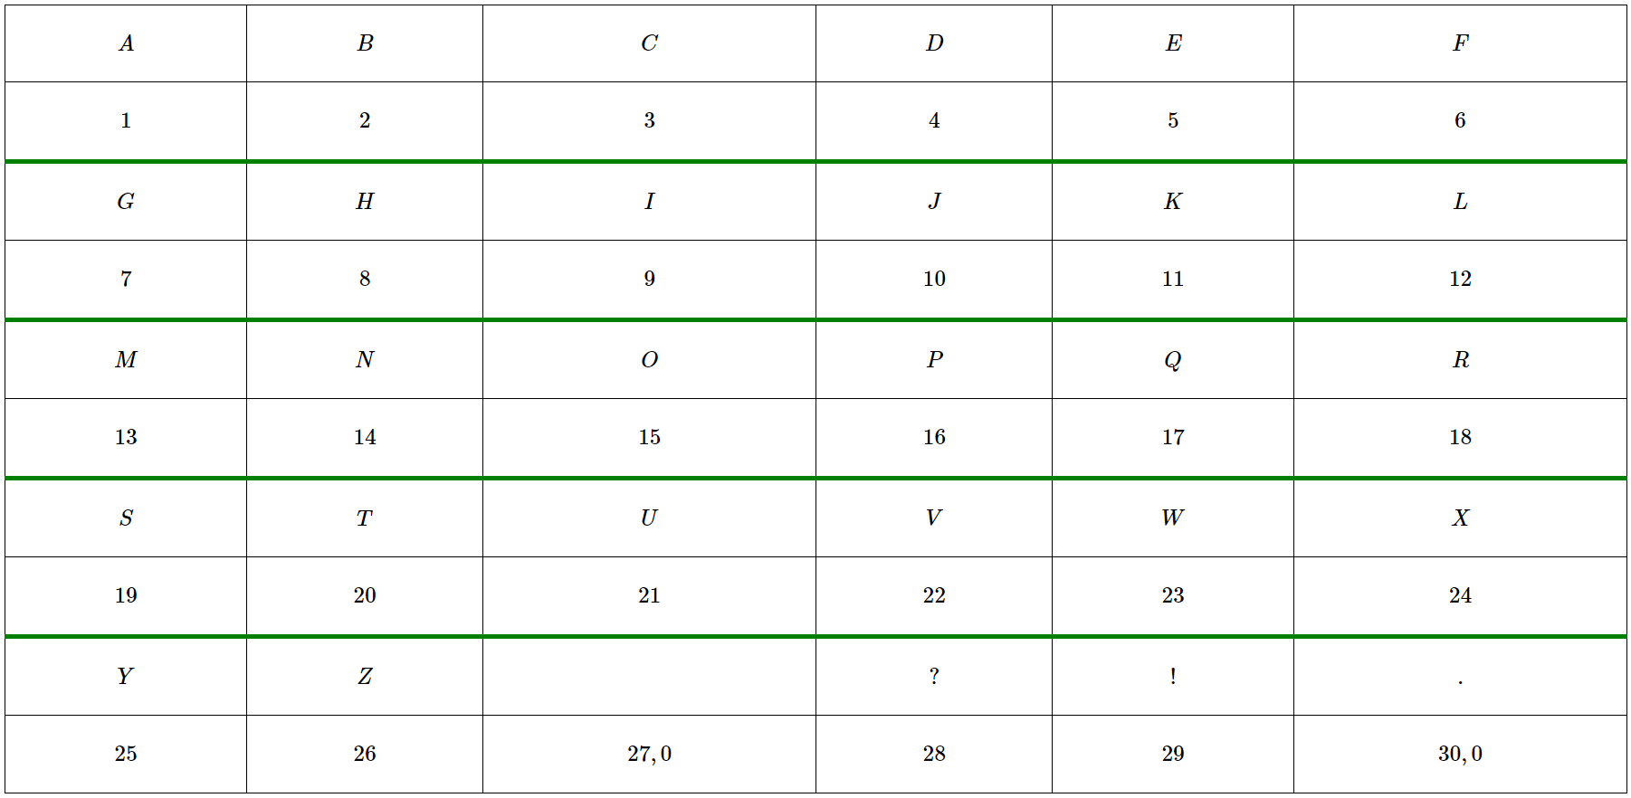
Cipher Key
Students Projects

Slide 33
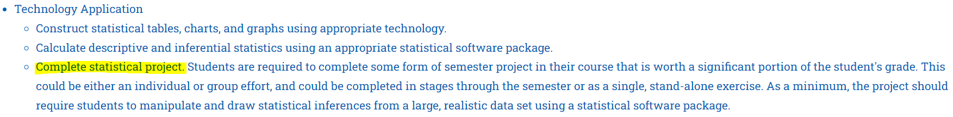
Statistics: Inferential Statistics
Objectives
The Inferential Statistics project is designed to:
(1.) Meet the requirements of the VCCS detailed course outline for MTH 245
(2.) Meet one of the learning objectives of the VCCS (Virginia Community College System) standards for: (a.) MTH 155: Statistical Reasoning (Presents elementary statistical methods and concepts including visual data presentation, descriptive statistics, probability, estimation, hypothesis testing, correlation and linear regression.). (b.) MTH 245: Statistics I (Presents an overview of statistics, including descriptive statistics, elementary probability, probability distributions, estimation, hypothesis testing, correlation, and linear regression.).

Slide 34
Objectives (Continued)
(3.) Draw statistical inferences from a sample onto a population. This is achieved by any of these tasks: (a.) Estimate a population parameter using a sample statistic. (b.) Conduct a hypothesis test of a population parameter using a sample statistic.
(4.) Meet the QM (Quality Matters) and USDOE (United States Department of Education) requirements for distance education as regards the provision of RSI (Regular and Substantive Interaction). Federal Register: Distance Education and Innovation St. John's University: New Federal Requirements for Distance Education: Regular and Substantive Interaction (RSI) Student – Content Interaction: Very high Student – Student Interaction: Flexible Student – Faculty Interaction: Very High
Students Projects

Slide 35
References
Chukwuemeka, S.D (2024, January 30). Samuel Chukwuemeka Tutorials: Math, Science, and Technology. Retrieved from https://conferencepresentations.appspot.com/
Alabama Power. (n.d.). Alabama Power. Retrieved from https://www.alabamapower.com/content/dam/alabama-power/pdfs-docs/Rates/FD.pdf
Bankrate.com. (2018, November 28). 2018-2019 Tax Brackets | Bankrate.com. Retrieved from https://www.bankrate.com/finance/taxes/tax-brackets.aspx
Calhoun County Water Association. (n.d.). Calhoun County Water Association. Retrieved from http://www.calhouncwa.com/rates.htm
Hawkes Learning | Products. (2024). Hawkeslearning.com. https://www.hawkeslearning.com/Products.htm

