Slide 1
Workshop on Workshops or Teaching Yourself a Thing to Teach Others

Slide 2
Plan
Frame next assignment
Discuss concept behind it
Share and work through Brandon's example lesson
Discuss Critical Digital Pedagogy

Slide 3
DH Workshop & Teaching Statements
Due December 4th
Use it as an opportunity to teach to learn and work on your pedagogy
Twin assignments
Develop a low-tech, pencil and paper (ish) digital humanities workshop you could give based on your individual research interests.
Draft teaching statements that incorporate digital pedagogy as relevant
Work with each other (and staff) to workshop your teaching materials and teaching statements. (workshop on Nov 6)
Outcome will be a blog post on one of the two
You’ll teach the workshop in the spring semester to a closed audience (of us)
Notes:
Other questions that should be asked?

Slide 4
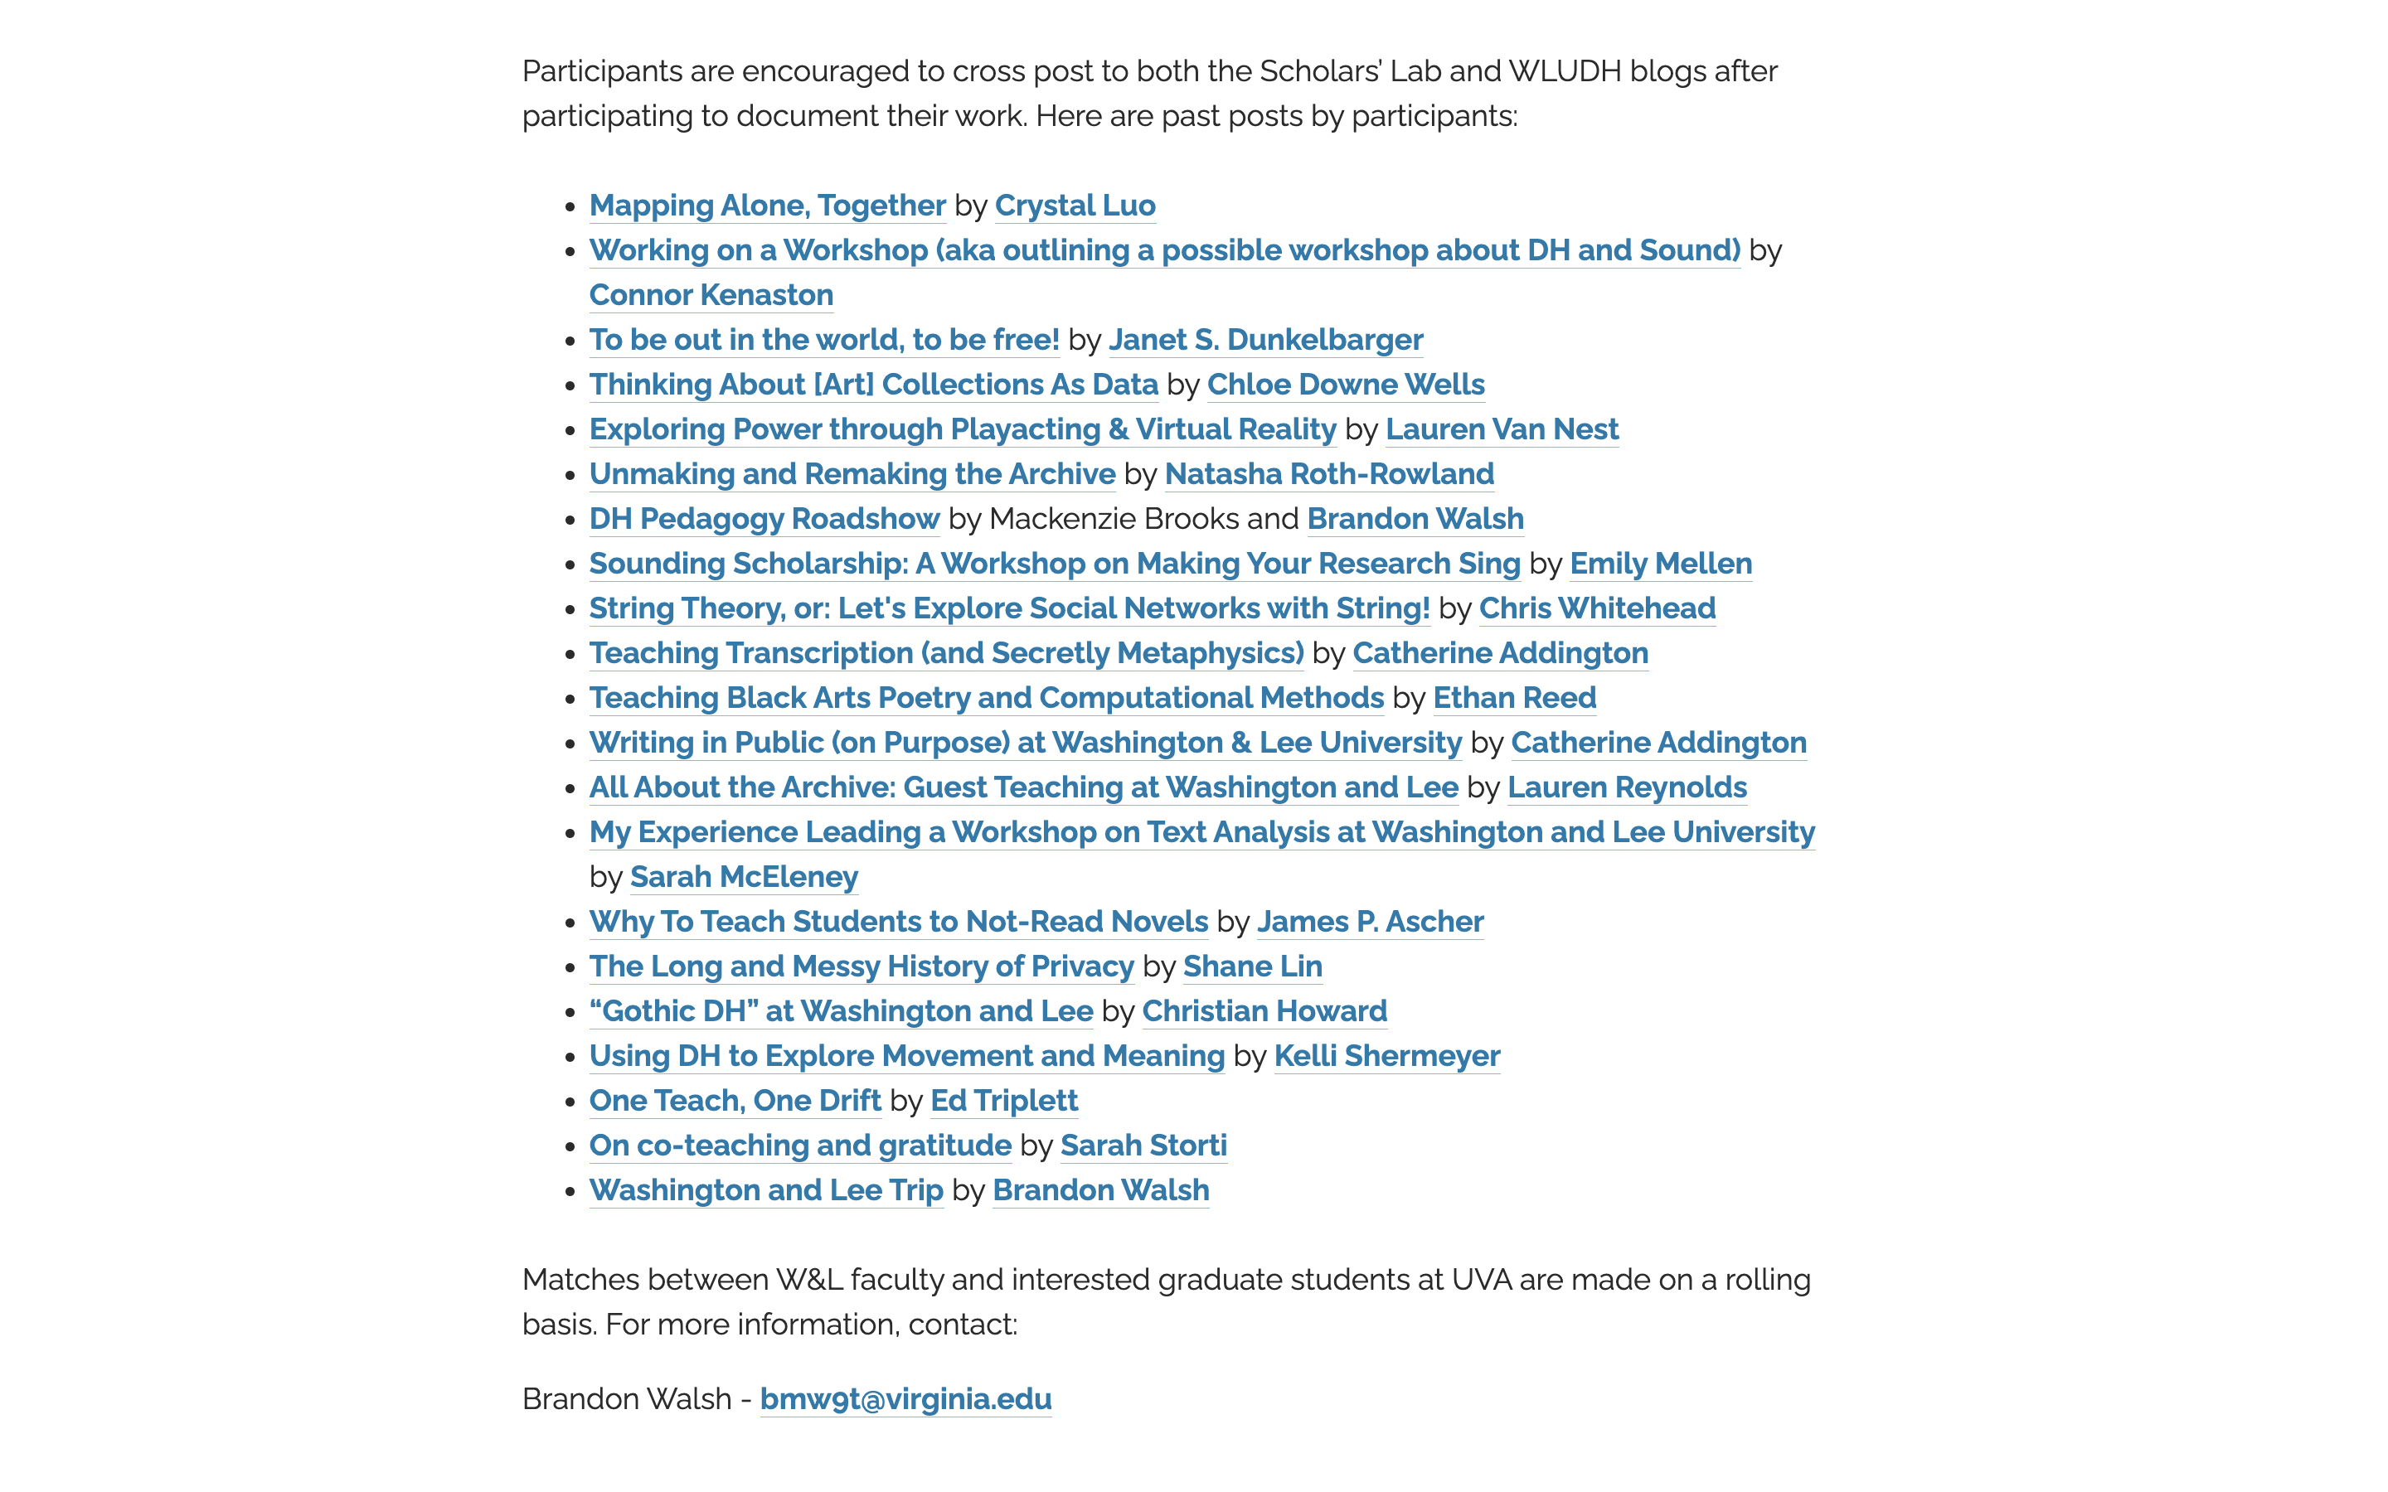
https://bit.ly/pedagogy-posts

Slide 5
Buttonology
"Knowing how to upload texts into a tool like Voyant does not help researchers think about what texts should be uploaded, how selecting data relates to a research question, or even what constitutes an effective research question."
"Beyond Buttonology: Digital Humanities, Digital Pedagogy, and the ACRL Framework" – John E. Russell and Merinda Kaye Hensley
That's the provocation for this unit.
Notes:
Reactions to the buttonology reading?
What are the worst teaching/learning experiences they've ever had?
What scares them about teaching digital humanities?
Things you want them to get to – it's ok not to know everything. The technology can get in the way; it's not always necessary; you only need to know a little bit. They're all good teachers.
Buttonology certainly has its place, but there are other ways to teach.

Slide 6
Example Workshop – Ways to Read a Text
One-shot workshop
Uses basically no technology but powerpoint
Basically it's text analysis with pen and paper
In what follows, you’ll get a micro-version of the workshop and then we’ll reflect on the pedagogy behind it together
Can find it written up here - https://walshbr.com/blog/ways-to-read/

Slide 7
Embedded Workshop Starts here
Slides start here!
At this point in the original iteration, I had already introduced:
Close reading (literary interpretation by paying attention to the text)
Bag of words approaches to texts (basically just issues in word counting as a computer would do it)
Now moving into how a computer can do more complicated forms of analysis.
But also works as a standalone

Slide 8
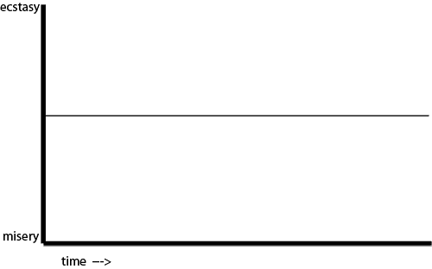
https://sive.rs/drama
Notes:
In Kurt Vonnegut’s masters’s thesis gave postulated that all stories are about moving between happiness and sadness over time, ecstasy and misery. He also returned to this idea in later lectures.

Slide 9
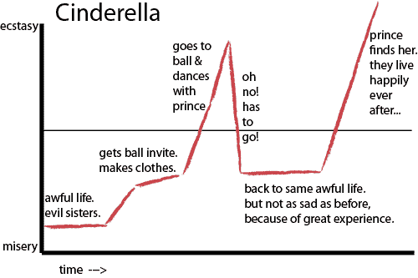
Notes:
Here he plots out cinderella. Along with certain key plot points that track to the story. He somewhat famously offered several of these plot archs as archetypes and said something like “there are six types of stories”

Slide 10
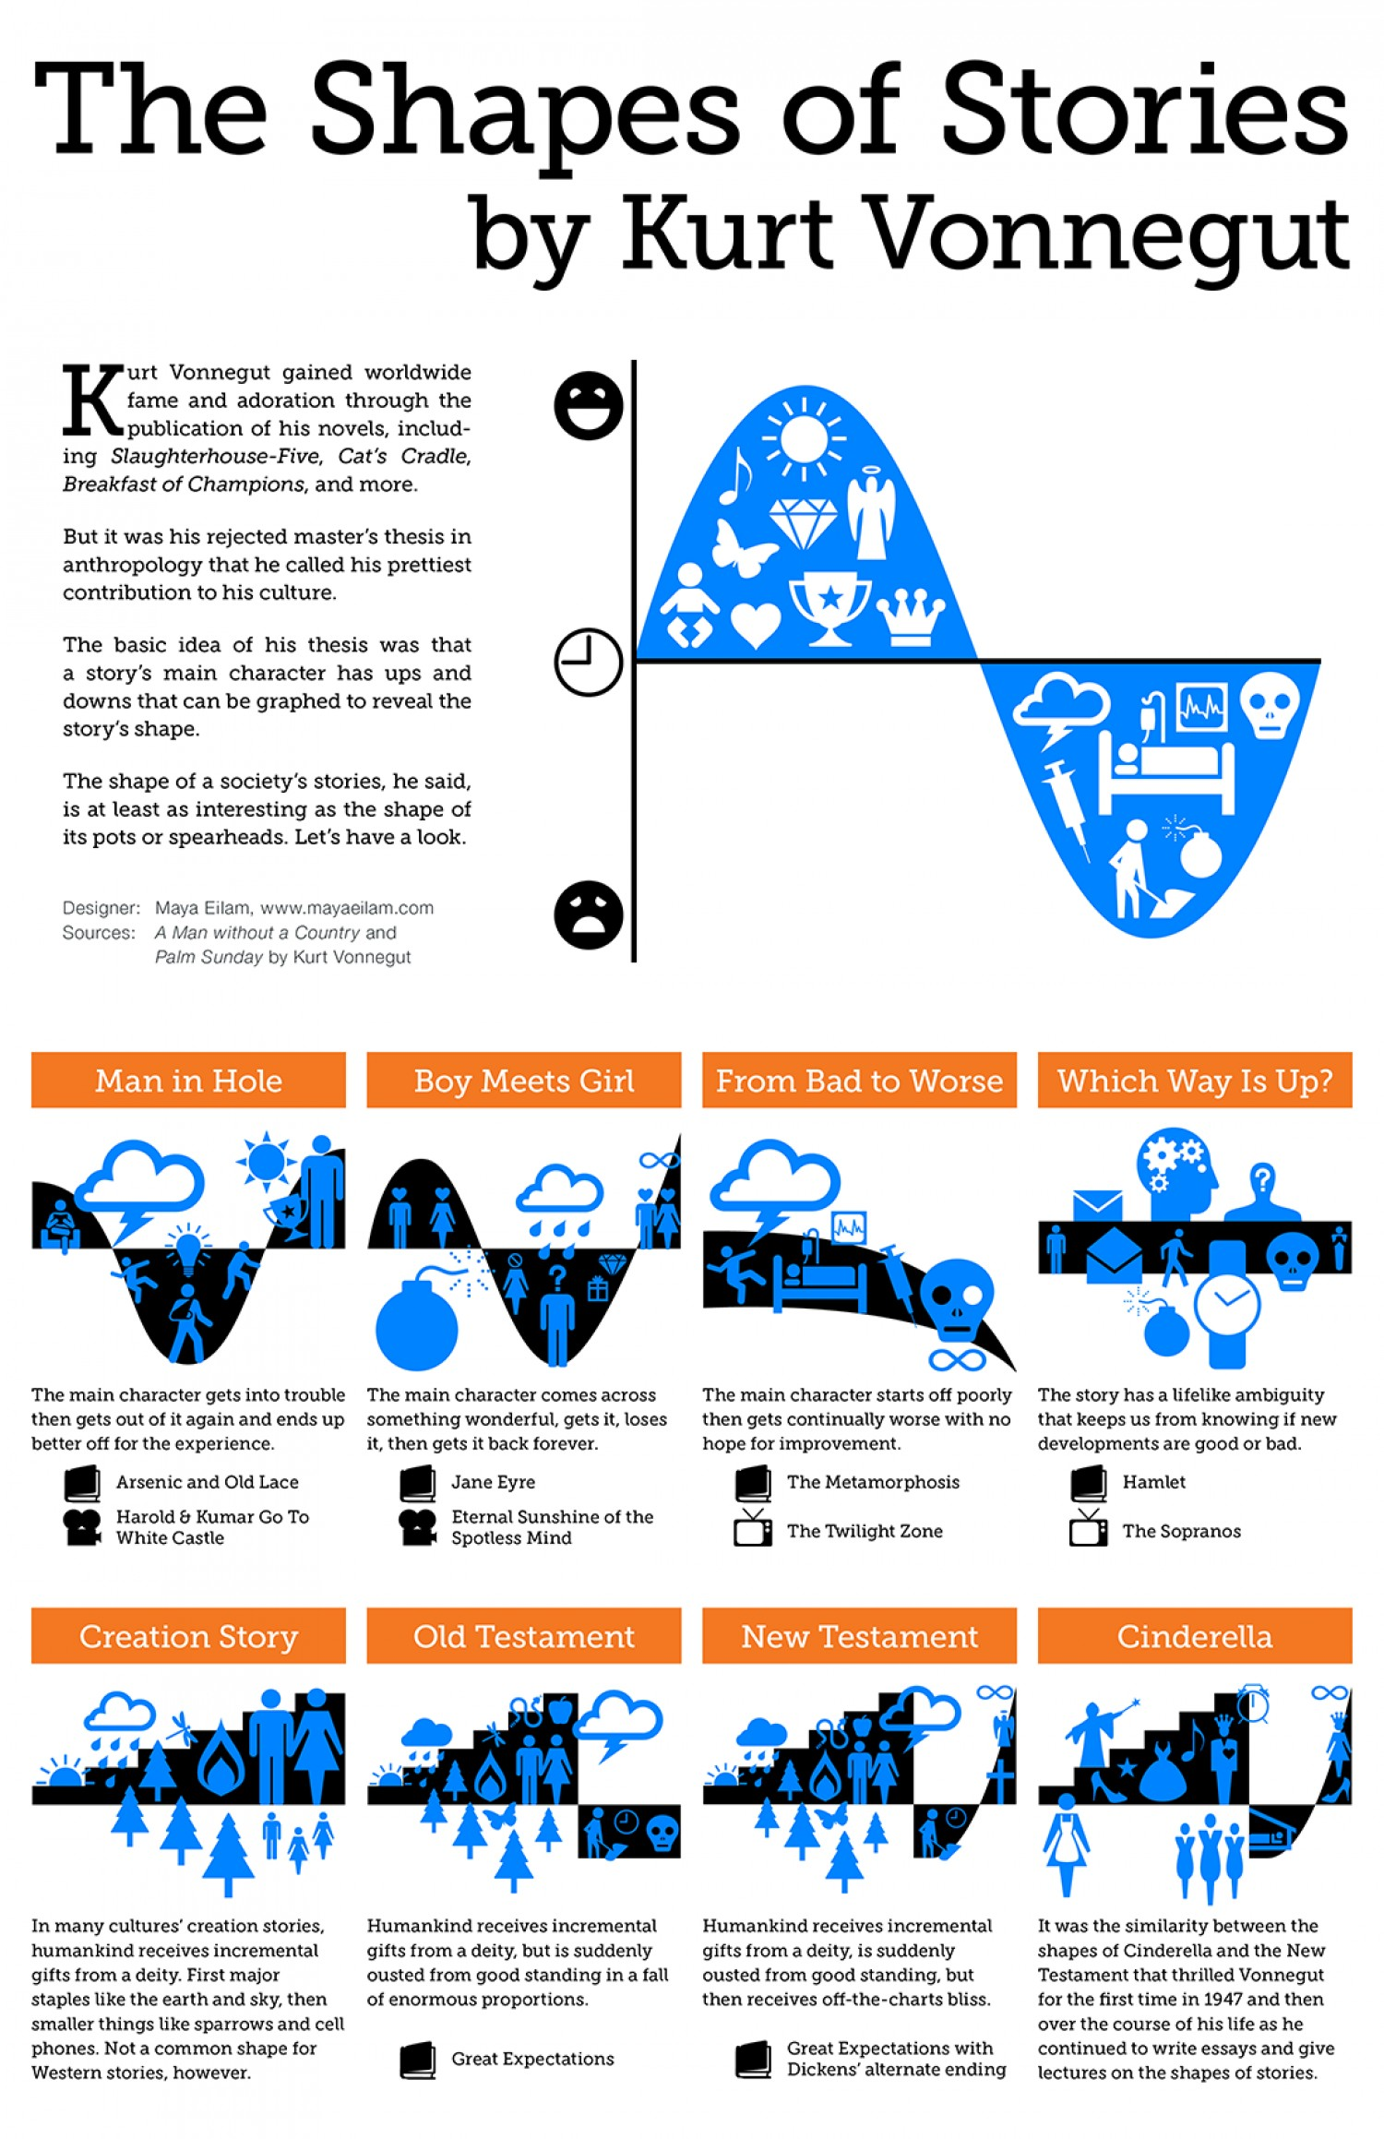
Design by Maya Eilam

Slide 11
Sentiment Analysis
Computers are very literal - they struggle with nuance.
How can they deal with complicated things like text?
Let’s look at one example - how does a text convey feeling?
Is it happy? Sad? Positive or negative?
Complicated questions!
Let’s try to tell with simple examples…
Notes:
This is a convenient thing for us because as you’ve been seeing in codelab, computers are very literally minded. You give them some information and they work with it. Given their constraints, how can we get to complex ideas like human emotions. How can a computer help us understand things.
We’ll be working with this provocation today and combining it with some of our codelab work. How does a text convey feelings? How does a computer understand things?

Slide 12
Sentiment Analysis
“I am very happy.”
“She is so sad.”
“Today was a little off but not too bad.”
Notes:
Are these sentences happy or sad? How do you tell? Positive or negative?

Slide 13
Sentiment Analysis
"It was the best of times, it was the worst of times…”
Notes:
Happy? Sad? How do you tell? Maybe there’s some other kind of measure?

Slide 14
Sentiment Analysis
"It was the best of times, it was the worst of times…”
Not a clear answer overall. If we can’t tell, how would a computer?
We need a better way to register this. Let’s go word by word.
Notes:
Happy? Sad? How do you tell? Maybe there’s some other kind of measure?

Slide 15
Sentiment Analysis
"It
was
the
best happy! / positive
of
times,
it
was
the
worst sad! / negative
of
times…"
Notes:
But remember computers like numbers. How might we register this?

Slide 16
Sentiment Analysis
"It
was
the
best happy! / positive / 1
of
times,
it
was
the
worst sad! / negative / -1
of
times…"

Slide 17
Sentiment Analysis
"It was the best of times, it was the worst of times…”
1 -1
Total = 0
Overall neutral sentiment?
So we can get at the emotional score of a sentence, by
a) assigning values to +/- words and b) counting up those values
Notes:
If we add up the numbers for the sentence, we can get a sense of the feelings in it.

Slide 18
Sentiment Analysis
Glance at the excerpts on your handout and think about them in this way.
Which do you expect to be happiest? Saddest?
Do this mathematical charting for at least one of the paragraphs.
What problems or questions does this raise?
Do in pairs
Notes:
Note in particular that Fahrenheit 451 appears to be the happiest.
Key concepts to point them towards:
How do they move from individual words to whole paragraphs' sentiment?
How do they compare or not the sentiment of each others? They need to have the same common number system
They need a dictionary of words that have sentiments
Does every word have a polarity associated with it?
What about context? How would you account for context?
Anything else?

Slide 19
Sentiment Analysis
Can imagine a range of emotions: good, better, best.
So you could use a range of numbers: good = +1, better= +3, best = +5
Say, assign any emotion-laden word a number between -5 and +5.
Keep in mind that you’re not reading for context. Simply on a word-by-word basis.
So “yes” would be positive. “no” would be negative
Notes:
Points that might come up?

Slide 20
Sentiment Analysis
How do we account for context?
How do we make sure our results are comparable?
How can we make sure everyone is getting the same results so that we could compare readings?
How do you account for longer texts?

Slide 21
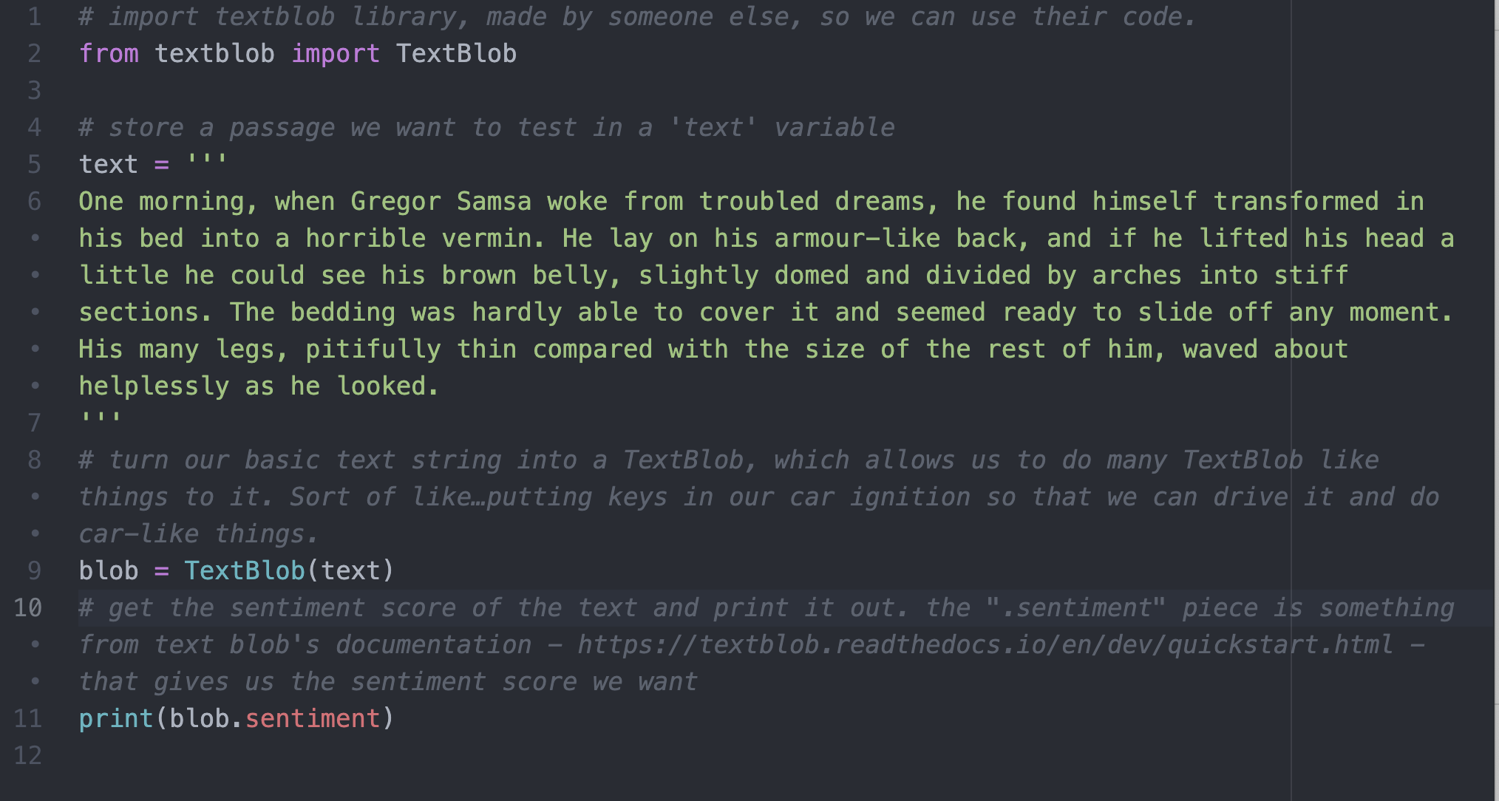

Slide 22
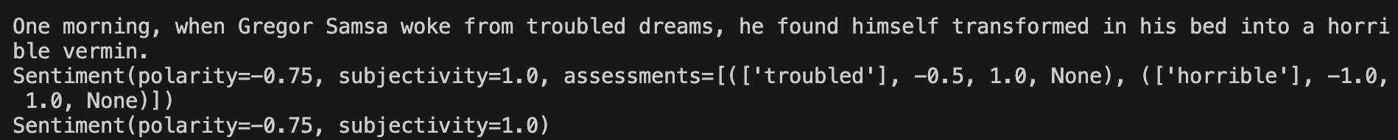

Slide 23
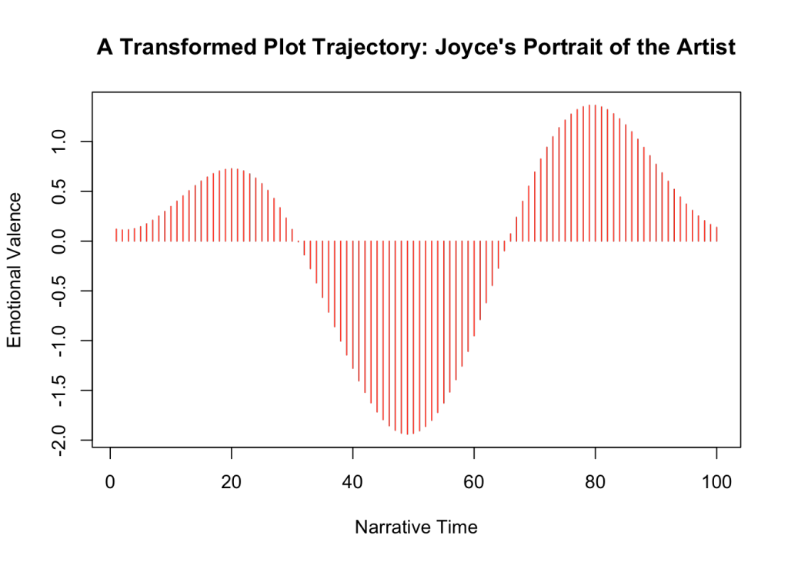
Sentiment Analysis in Use
http://www.matthewjockers.net/2015/02/02/syuzhet/
Notes:
What can you do with sentiment analysis?
From a humanities perspective, you can say that by registering moments of happiness or sadness over time, you can measure a plot’s tension. You could get a sense of the plot arc in a text. Jockers claims there are really only six shapes if you do this kind of math.

Slide 24
Reflect on the Activity
General thoughts on what we did.
Thoughts on other technical workshops you’ve been in.
Bring in the readings as relevant, though we’ll do more with those in a bit.

Slide 25
Reflect on the Activity
Low risk of technical problems going wrong
Students don't need any programming to participate
Gets concepts across but the students arrive at them on their own
Now they'll know what the tools are doing, which removes one element of confusion when learning technical tasks.
Show them where to go next

Slide 26
DH Workshop & Teaching Statements
Due December 4th
Use it as an opportunity to teach to learn and work on your pedagogy
Twin assignments
Develop a low-tech, pencil and paper (ish) digital humanities workshop you could give based on your individual research interests.
Draft teaching statements that incorporate digital pedagogy as relevant
Work with each other (and staff) to workshop your teaching materials and teaching statements. (workshop on Nov 6)
Outcome will be a blog post on one of the two
You’ll teach the workshop at the beginning of the spring semester
Notes:
Other questions that should be asked?

Slide 27
Get there by Backwards Design
Identify desired results
What are your learning goals?
Determine acceptable evidence that those have been met
What are alternative ways of demonstrating them beyond using a tool/interface?
Plan learning experiences
What will the session look like?

Slide 28
Homework for Next Week – Step 1
Think about what kind of method or concept you want as part of your profile
Think through how it might relate to your own…
Research
Workshop
Start brainstorming workshop ideas.
Talk to me – I can poke you in a direction
Some short readings on the curriculum page
Explore 2-3 categories in Digital Pedagogy in the Humanities: Concepts, Models, and Experiments that are useful for your interests and use them to begin thinking about your workshops.

Slide 29


