Slide 1

Developing a RAG-based Tutor for Course Guidance and Advice
Yannis Laaroussi
Advised by
Vinitra Swamy, Paola Mejia
13.03.25

Slide 2
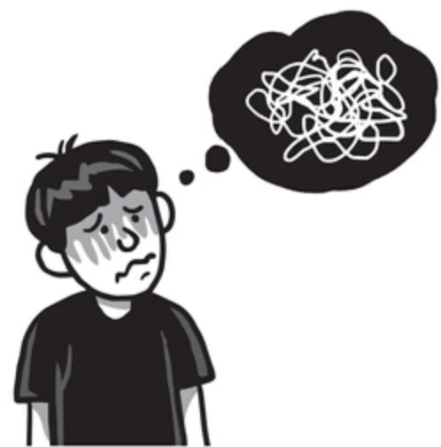

Motivation
Traditional learning methods (e.g. MOOCs): all information at once
Difficult to retain knowledge
Boring
RAG + Adaptive learning: Split a course, deliver step by step, test the learner and adapt the content
Help to learn (adaptive)
Fun (interactive)
Notes:
MOOCS

Slide 3
Overview
Scientific related work
"KRAGEN: A Knowledge Graph-Enhanced RAG Framework for Biomedical Problem Solving Using Large Language Models" (Matsumoto et al., 2024) System that enhances Retrieval-Augmented Generation (RAG) with knowledge graphs and a Graph-of-Thoughts technique.
"Designing Child-Centric AI Learning Environments: Insights from LLM-Enhanced Creative Project-Based Learning" (Zhao et al., 2024) Explores the integration of LLMs into creative project-based learning (PBL) for middle school students. The study finds that LLMs enhance problem-solving, idea generation, and project execution.
"Automated Educational Question Generation at Different Bloom’s Skill Levels Using Large Language Models" (Scaria et al., 2024) Evaluates the effectiveness of Large Language Models (LLMs) in generating educational questions aligned with Bloom’s Taxonomy.

Slide 4
Research Questions
Objective: Develop an adaptive learning system that combines Retrieval-Augmented Generation (RAG) with a knowledge graph to deliver structured, bite-sized content and dynamically generate comprehension questions based on learner progress.
Research Questions:
How can we extract bite-sized blocks of learning materials through a RAG system for structured and relevant content delivery ?
How can we generate trustworthy Bloom’s Taxonomy questions to adaptively guide learners through content ?
How does our pipeline compare to a standard MOOC static content delivery (user perception and learning) ?
Notes:
Research Questions:
How can a knowledge graph improve the retrieval process in a RAG-based learning system to ensure structured and relevant content delivery ?
How can the results of the learner to the generated question be used to adaptively guide learners through content ?

Slide 5
Methodology
Build a synthetic Knowledge Graph on Neo4j
Integrate KG with RAG : Retrieve content based on user queries.
Implement a Chunking Algorithm: Split content into bit-sized blocks
Generate a Question for the first block: Assess understanding
Adapt Learning: Adapt the difficulty of the question for the next block

Slide 6



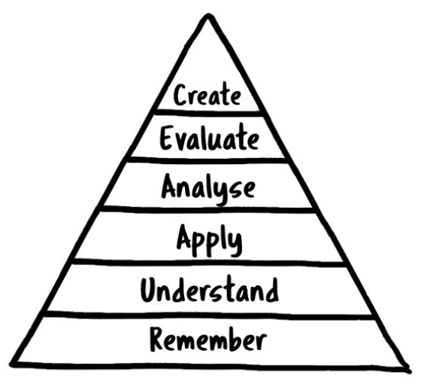
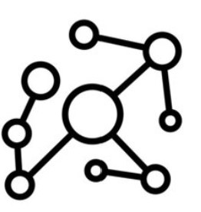
Initial Results
“I want to learn about data processing”
“What is the main purpose of data processing?”
Chunking Algorithm
Generate Question
Adaptive Learning
Synthetic KG
RAG
Done
In progress
~Week 5-6
~Week 7-8
~Week 9-10

Slide 7
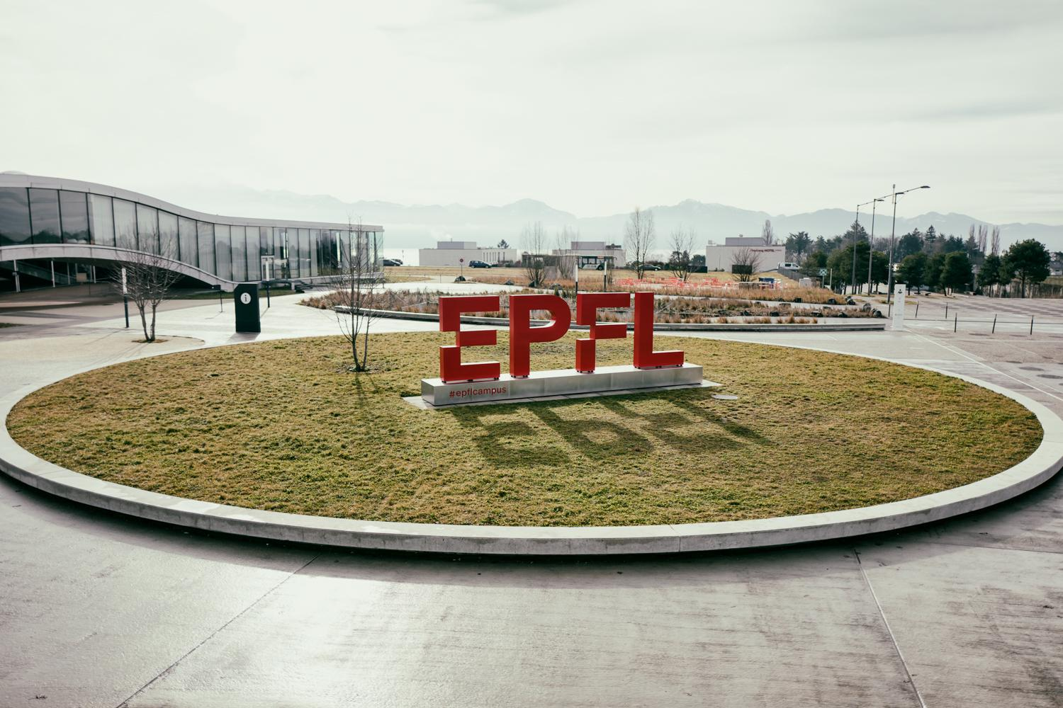
Merci
Yannis Laaroussi

