Slide 1


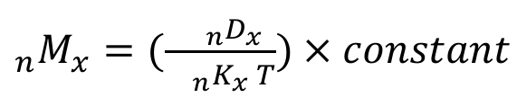
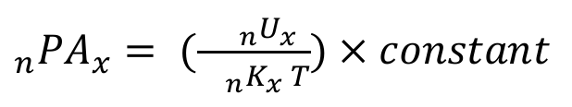
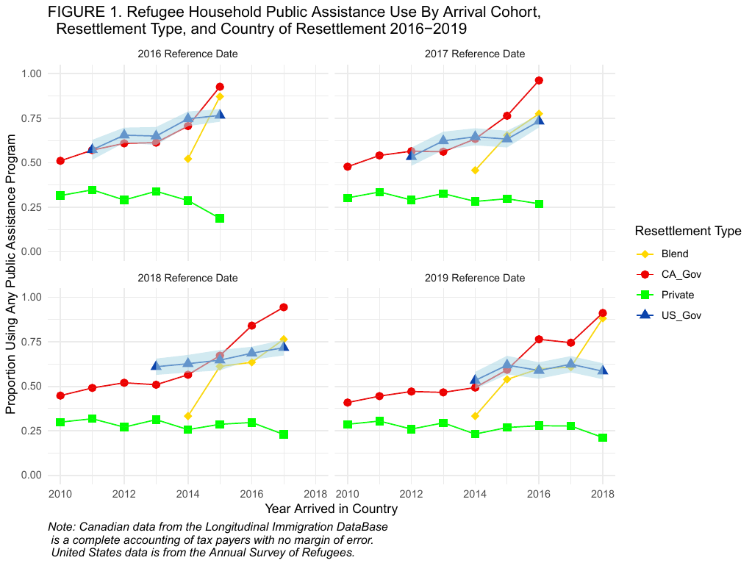
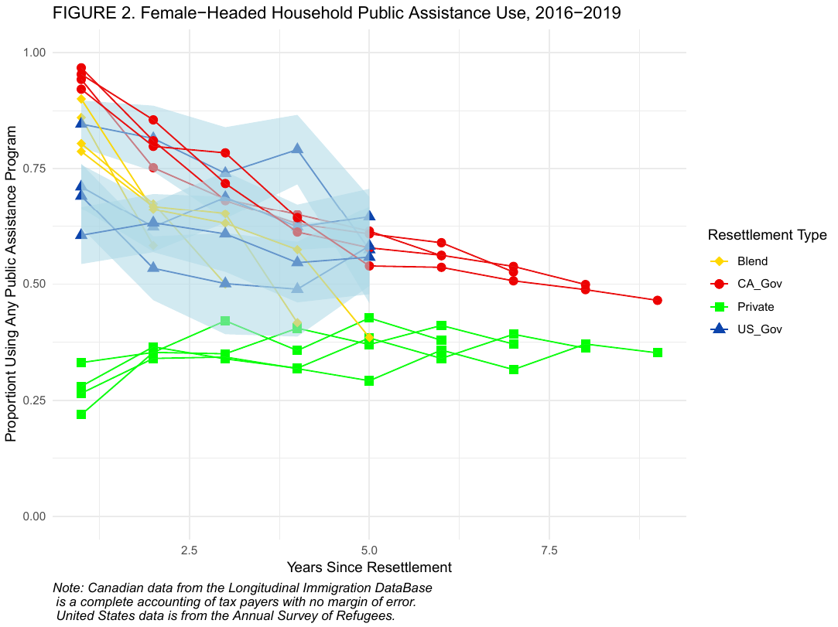
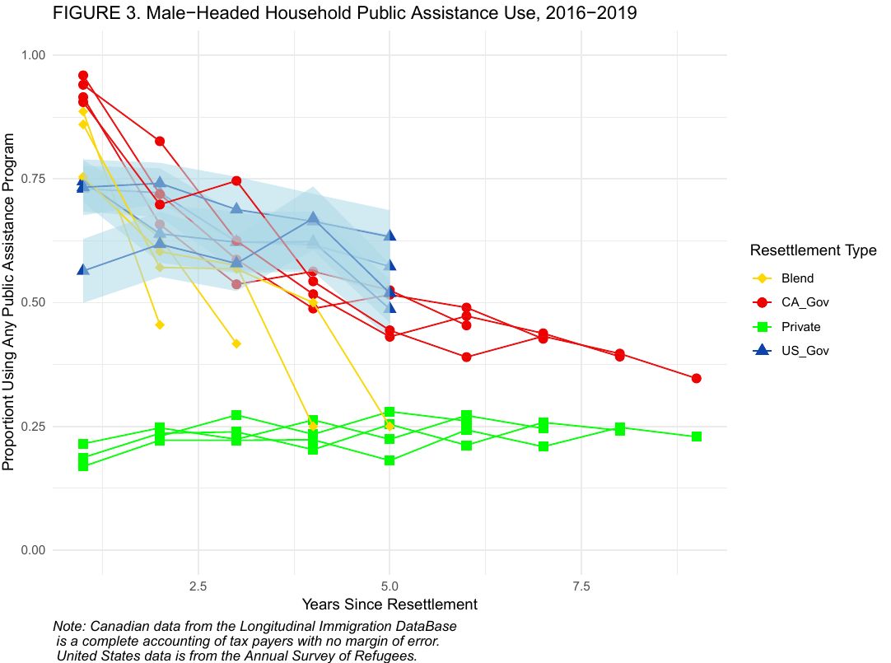
North American Refuge:
Comparing U.S. and Canadian Refugee Economic Self-Sufficiency
Paul Brayden Scholes
PURPOSE
PERIOD COHORT-SPECIFIC PUBLIC ASSISTANCE USE RATE CALCULATION
Who Invests More in Refugee Resettlement Per Capita?
Country | Reference Year | Mean Funding per Capita in 2016 U.S. Dollars
Canada | 2016 | $9,986
United States | 2016 | $1,615
Canada | 2017 | $7,584
United States | 2017 | $1,236
Canada | 2018 | $7,811
United States | 2018 | $1,622
Canada | 2019 | $8,512
United States | 2019 | $3,545
Canada | 2020 | $11,416
United States | 2020 | $6,114
Note: Dollar conversion done with the 2024 Bureau of Labor Statistics consumer price index and the 2024 U.S. Department of the Treasury’s Reporting Rates of Exchange tables.
The U.S and Canada permanently resettle more refugees than the rest of the world combined.
Canada provides more support, for longer, than the United States. Does this improve their outcomes?
Is government-led, private citizens-led, or a blended approach most effective in reducing public assistance use rate at the end of five years?
How comparable are these countries’ outcomes? What factors need to be considered for comparisons?
How can we incorporate demographic methods to analyze migration cohort outcomes?
Where:
_{n}M_{x} is the number deaths in the period
_{n}K_{x} is the population of the period
T is the length of the period
_{n} identifies the width of the age interval
_{x} represents the starting point of the age interval
Where:
_{n}U_{x} is the number of households that use public assistance programs in the period
_{n}K_{x} is the number of households in the period
T is the length of the period
_{n} identifies the width of the residency interval
_{x} represents the starting point of the residency interval
RESULTS
CONCLUSIONS
U.S. and Canadian government-led resettlement 5-year short-term outcomes are very similar, despite Canada’s increased support.
The U.S. and Canada both send about the same amount of money on refugee resettlement, the U.S. simply resettles many more.
The extant literature hypothesizes their long-term outcomes should differ.
Female headed households in both countries used more public assistance programs. Whether this indicates advantage or disadvantage is unclear, as more support should lead to better long-term outcomes.
The Canadian private resettlement program seemed to be especially effective. The U.S. had (started in 2023 but was paused by the second Trump administration) a private resettlement system of their own, but no data is available.
These results support an optimistic outlook for the U.S. counter-part. Reinstatement and data collection seem promising.
DATA
Combined 2016-2019 Annual Survey of Refugees
Surveys refugee households resettled in the past 5 years
Uses the U.S. Office of Refugee Resettlement Refugee Arrivals Data System as sampling frame
Cross-sectional design, obtains a new sample for each cohort every year.
Office of Refugee Resettlement’s Annual Report to Congress
State Department’s Bureau of Population, Refugee, and Migration Annual Report to Congress
Canada's longitudinal Migration DataBase (lMDB)
Every migrant household's tax and arrival information.
Canada's Expenditures by Standard Object for Citizenship and Migration
TABLE 2. Summaries of a Null and Full Multilevel Model of the Percentage of Cohort Using Public Assistance Programs 2016-2020. Standard Errors in Parentheses.
Variable Name | Null Model | Full Model
(Intercept) | 55.6 (9.9) | 173.0 (61.0)
Years In Country |  | -5.7 (0.6)
Female(ref=Male-headed households) |  | 6.4 (1.3)
log(Initial funds per household) |  | -6.14 (4.9)
CA Blended Resettlement |  | 2.94 (52.6)
CA Private Resettlement |  | 21.0 (52.6)
U.S. Government Resettlement |  | -22.8 (58.7)
log(Initial funds per) × CA Blended |  | -1.5 (2.3)
log(Initial funds per) × CA Private |  | -7.0 (2.3)
log(Initial funds per) × US Gov |  | 1.36 (3.6)
Number of Observations | 217 | 217
R² Marg. | 0.000 | 0.24
R² Conditional | 0.72 | 0.95
ACKNOWLEDGEMENTS
The U.S. National Science Foundation’s Graduate Research Fellowship
I'd like to thank Dr. Joseph Lariscy and Dr. Ernesto Amaral for their comments. Any shortcomings are mine.

