Slide 1
Do Refugees Who Become Economically Self-Sufficient Start With Nothing?
By Paul Scholes, University of North Carolina at Charlotte

Slide 2
Outline
Background
Research Questions
Methods
Results
Conclusion

Slide 3
Refugees are not migrants or asylum seekers
“Refugee” is UNHCR’s legal status
Petitions can only made to the UN
Extensive background checks from the UN and the US
Granted permanent resident status shortly after arrival to US

Slide 4
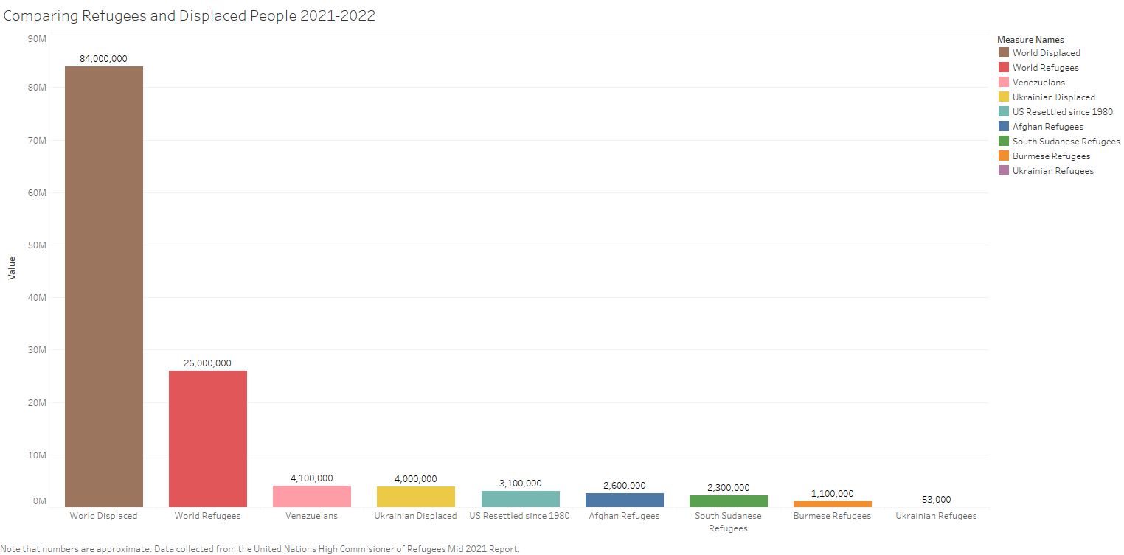
Getting a sense of Scale

Slide 5
Background
Traditional fear dependence on assistance programs (Cincinnati and Graham 2001)
Federal offices and programs prioritize finding a job ASAP, perhaps to the detriment of refugees and the U.S. economy (Fix, Hooper, and Zong 2017)
I focus on interplay of individual capital and contexts to analyze economic integration
Much more is known about immigrants than refugees.

Slide 6
Sociology and Refugee Studies offer perspectives
Alba and Nee’s (1997) New Assimilation Theory
Emphasizes human capital, reception from host-context, strength of social ties (in-group and with natives), and assimilation predicting other assimilation
Phillimore’s opportunity structures (2020)
Locality, Support, Discourse, Relations, Structure
A frequent assumption in refugee studies is the blank slate explanation (Gold 1992; Tran and Lara-Garcia 2020)

Slide 7
I am interested in the relationship between individual traits and contexts
How do pre/post-migration human capital, affect refugee economic integration?
How do pre/post-migration context factors shape economic integration?
Which set of predictors predicts economic integration better?

Slide 8
Data: Annual Survey of Refugees 2016-2018
Repeated cross-sections
Surveys ~1500 households and obtains information on ~4000 refugees per wave.
Proxy reporting for household members who are not “primary applicant”
No changes in question wording or survey method
Sampling frame is the Office of Refugee Resettlement’s Refugee Admissions Data System
Only surveys refugees who arrived in the past 5 years

Slide 9
Measures: Variables
Economic Integration DV’s:
Self-sufficiency (not using any public assistance programs and living on earned income)
Time to first job/finding a job within the first year
Weekly working hours
Pre and Post Contexts: Places of origin/resettlement , work sectors, year arrived and time periods.
Pre and Post Human Capital: Years of Education, enrollment in a US Job or English training program. English proficiency

Slide 10
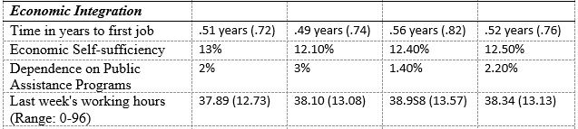
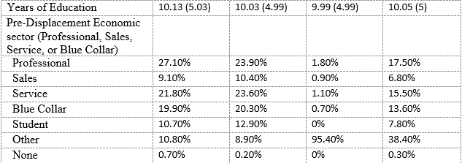
Refugees are a diverse group
2016
2017
2018
Pooled

Slide 11
Analysis
Binary Logit models for everything but the weekly working hours model.
Multiple Imputation with the MICE package
Allows for better comparisons with Tran and Laura-Garcia (2020)
Run the analysis on 21 imputation datasets and then pool the coefficient estimates.

Slide 12
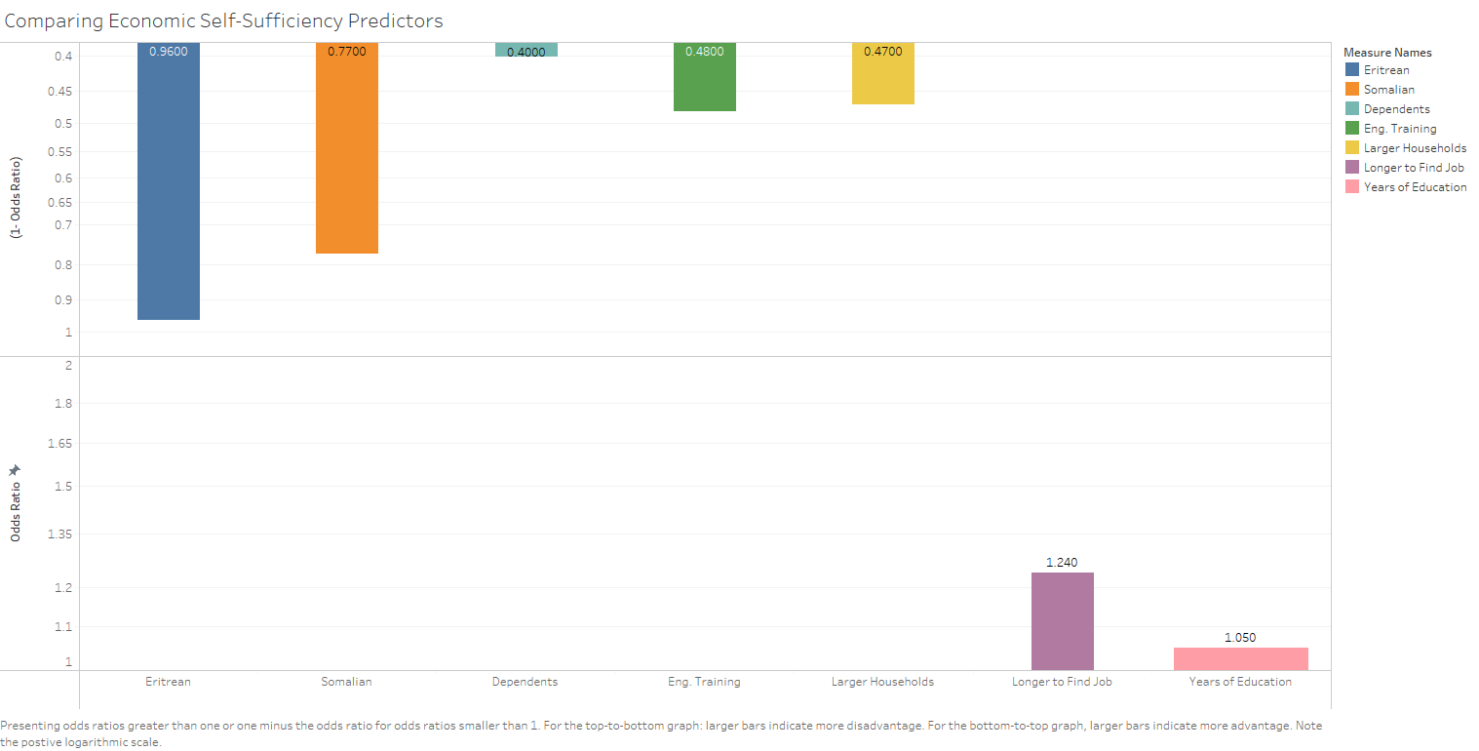
Economic Self-Sufficiency

Slide 13
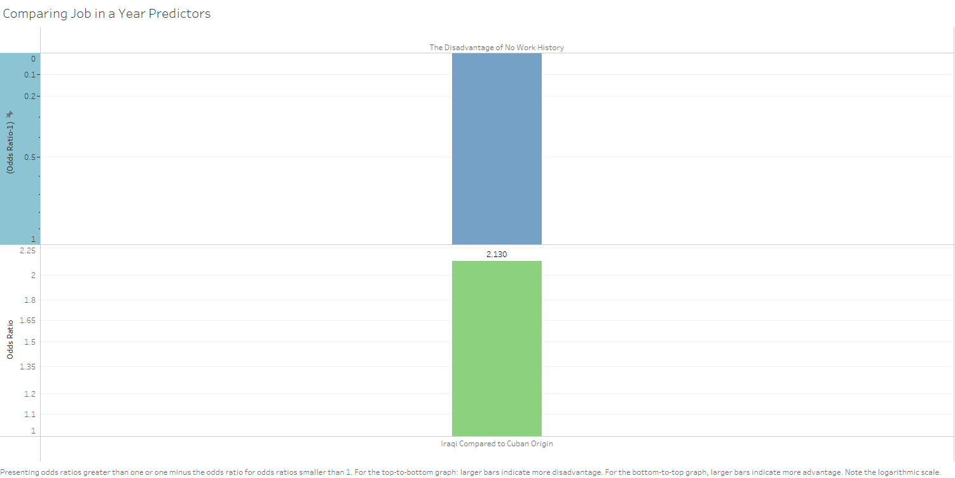
Find a Job Within a Year

Slide 14
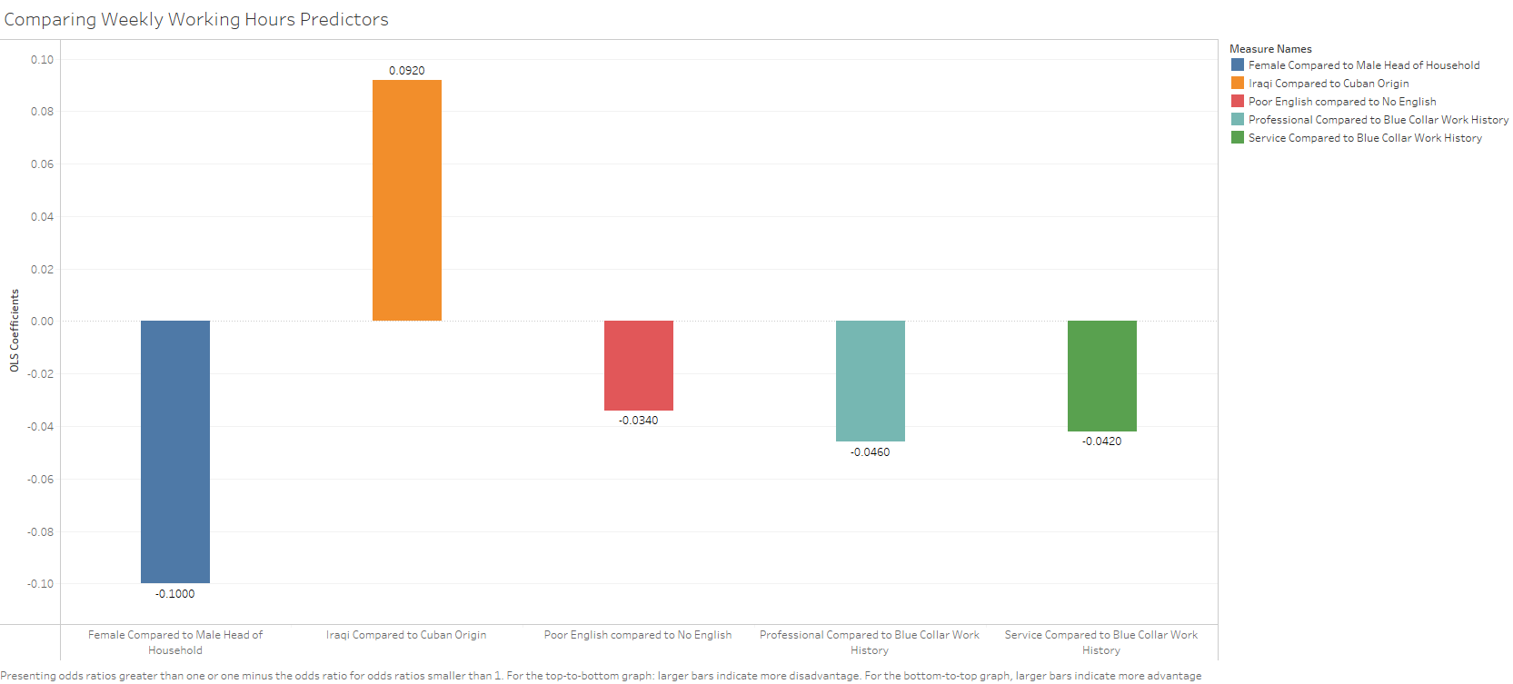
Weekly Working Hours

Slide 15
Conclusion
These findings generally do not support a blank slate argument
Time to first job analysis is the strongest blank slate evidence
Human capital and contexts both predicted most forms of economic integration
Generally, human capital was a stronger predictor than contexts.
Those who waited longer to get their first job where more likely to be economically self-sufficient.
Direct evidence against foundational goals of the Office of Refugee Resettlement and Population, Refugee, and Migration Bureau of the State Department.

Slide 16
New directions
Getting a good job quickly is important
How can we help refugees get a job they feel meets their needs quickly?
Probably need a qualitative exploration before running statistics
Getting a job quickly is an enigma
This is paradoxical because assimilating into the labor market of the host context is assimilation in the sense that New Assimilation Theory and Segmented Assimilation Theory theorize.
What about the instances where human capital and contexts didn’t predict economic integration?

Slide 17
Lessons Learned
I (and the literature) should consider these variables as either alterable or unalterable. This would’ve been a more engaging story.
Contexts and demographics are unalterable. Human capital is alterable.
Which contribute more to economic self-sufficiency?
Weighting the data is easy, imputation is doable. Both together is really hard.
I wish I took some computer science classes.

