Slide 1
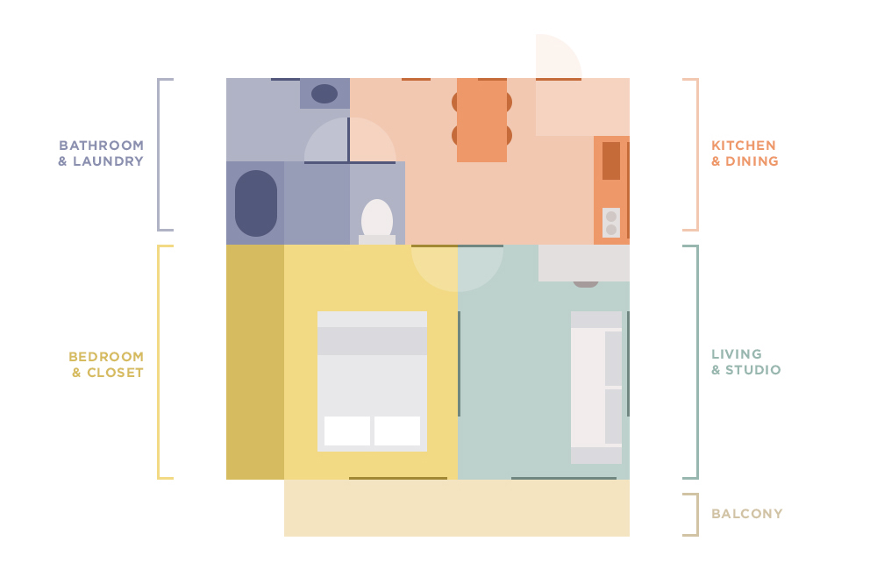
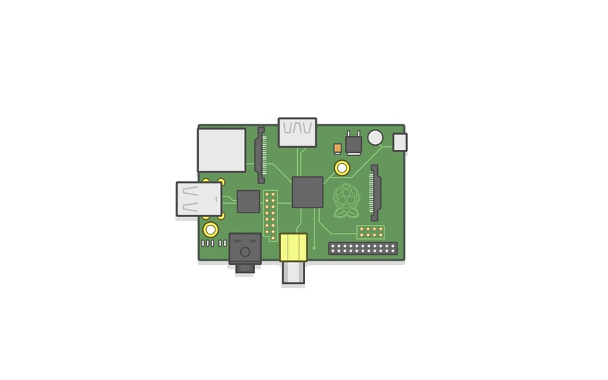


Slide 2
Pi Cluster
Pi Cluster
Any Wi-Fi device
FIND-LF server
FIND
server

Slide 3
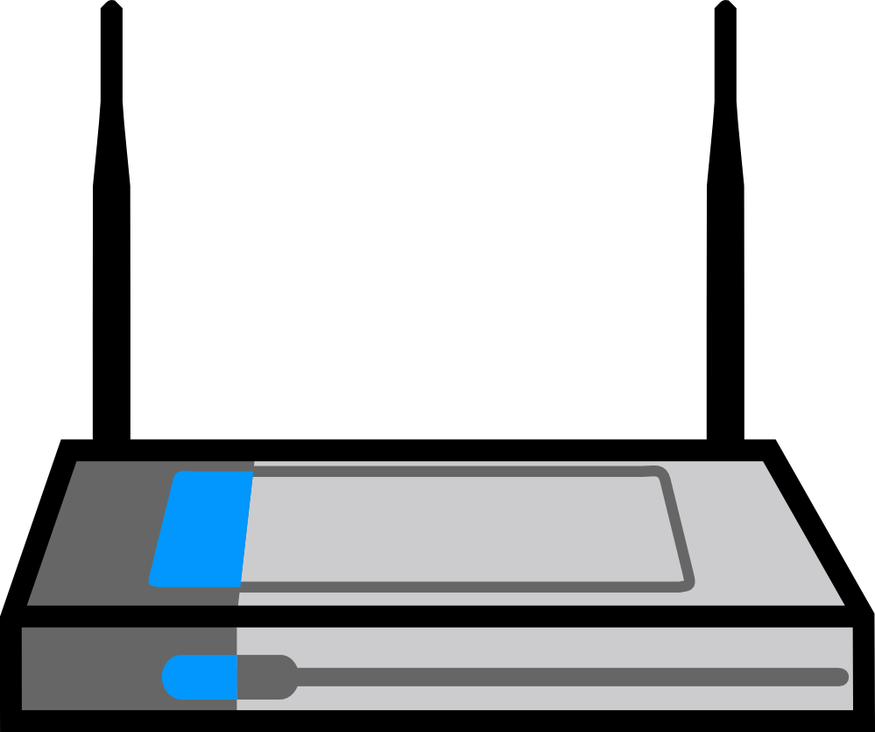

Access Points
FIND App
FIND App
FIND
server

