Slide 1
Amazon AWS Training

Slide 2
Cloud computing

Slide 3
Cloud
Provides computing resources on-demand
Resources are rapidly provisioned
Resources are created with minimal management effort
„Unlimited“ capacity
Several cloud types
Public cloud
Private cloud
Hybrid cloud

Slide 4
Cloud types
Public cloud | Private cloud | Hybrid cloud
+ Elasticity and unlimited capacity | + Better cost control | + Unlimited capacity and elasticity
+ No up-front investment needed | + In-house knowledge | + Balance between up-front investment and on-demand cost
+ Focus on core business | + Independent on third party | + Lower overall costs
+ Cloud provider‘s experience
+ Economy of scale | - Off the shelf hardware
+ Custom hardware | - Limited capacity
 | - Worse economy of scale
- Higher costs | - Up-front investment

Slide 5
Infrastructure? Platform? Service?
IaaS
Infrastructure as a service
Basic computing resources
Virtual machines
Virtual networks
Virtual disk
In short, whatever you can do with physical hardware, you can usually do with IaaS as well

Slide 6
Infrastructure? Platform? Service?
PaaS
Platform as a Service
Environment for deploying, orchestrating, managing and monitoring applications
Abstracts from used infrastructure
Developer doesn‘t care about the used virtual machines, the platform takes care
For example: Kubernetes, Cloud Foundry

Slide 7
Infrastructure? Platform? Service?
SaaS
Software as a Service
User doesn‘t care about how and where the software runs
Provider is responsible for managing the infrastructure, installing updates etc.
Example:
User requests MySQL database with 100GB capacity and performance of 1000 ops/s
User gets username / password and hostname / port
Connects to the database and uses it
User doesn‘t care where the database is running, it simply runs for him

Slide 8
Infrastructure? Platform? Service?

Slide 9
Cloud native applications
Exploit the advantages of running in cloud
Scalability
Density
Agility
Microservices
Many small services with limited functionality
Loosely coupled through APIs (HTTP, AMQP)
Independent on each other (technically but also personally)

Slide 10
Cloud native applications
DevOps
Operators developing and developers operating
Tasks being done manually in the past are more automated
Containers
Build once, run everywhere
Help to increase the compute density
Continuous Integration / Continuous Deployment
Many releases per day, each automatically tested and deployed

Slide 11
Cloud native applications
Horizontal vs. vertical scalability
Run in more instances instead of run single bigger instance
Stateless applications
State is causing problems
State is concentrated in single place (e.g. in database server)
Leads to rapid recovery

Slide 12
Cloud providers
AWS is not the only cloud provider
Microsoft Azure and Google Cloud are the main competitors
Many smaller providers
Major providers provide very similar services
There are no standards and no cross provider compatibility
Moving from one provider to another is possible, but is not effort less
Some services are proprietary and can create a lock-in!
Choosing an independent PaaS can prevent future problems, because the PaaS makes the applications independent on specific IaaS

Slide 13
Pricing
Cloud is not cheap
To leverage the cost advantages, the applications have to be written for cloud
Different price components
Per time unit (e.g. per hour of running virtual machine)
Per data transfer (e.g. per GB of transferred data)
Per operation (e.g. per million of DNS queries)
Careful: Amazon AWS bills per hour!

Slide 14
Amazon AWS

Slide 15
Amazon AWS in DBG
„Culture eats cloud for breakfast“ (Jakub Scholz ☺)
The fact that cloud allows something, doesn‘t mean that we will be able to use it
Amazon AWS is organized into accounts
(not user accounts!)
Accounts can be interconnected
Sandbox account
Development account
Test account
Production account
Some additional special purpose accounts
Billing is summed up across all accounts and routed through I&O

Slide 16
Amazon AWS in DBG
Sandbox account
Isolated from DBG networks
Access over Wi-Fi
Wide range of privileges / access rights
Development accounts
Linked with DBG network
Access from our office computers
Unclear access rights

Slide 17
Tagging
Most AWS resources can be tagged with one or more tags
Some tags are considered mandatory by DBG to keep some order within the account
Name
Creator
Owner
CostCenter
Used to split the cost bill
Resources not matching these tags should be deleted

Slide 18
How to access AWS?
Web console (login using SAML with DBG credentials and token)
Simple to use access to browser
Useful to try things for the first time or to setup a single machine
Not suitable for any serious deployments and CI/CD integration
APIs
Access using access key, secret key and session token
Many different tools for scripting the deployments
AWS CLI tool
Ansible
Terraform
The login credentials from SAML expire after 60 minutes
Access to APIs and console is possible from DBG network. SSH access is not always possible.

Slide 19
Amazon AWS
Regions and Availability Zones

Slide 20
Regions and Availability zones
AWS cloud is split into regions
Some regions are special (GovCloud, China)
Most regions are available to everyone
Prices differ per region
Each region has a name (us-east-1, eu-central-1)
Every region is split into several Availability Zones (AZ)
Different regions have different number of Azs
Frankfurt has currently only 2
Most regions have 3 AZs, some have even more
One AZ is usually one or more datacenters
Each AZ has name based on its region (eu-west-1a, eu-west-1b, eu-west-1c)

Slide 21
Regions and Availability zones
Not every service is available in every region
Only few services are truly global (e.g. S3, Route 53, IAM)
Most services are enclosed within a single region or even within one AZ
E.g. disk volumes or virtual machines are locked into their AZ
Single AZ has no SLA
To build reliable applications, you have to span them across multiple AZs
Costs more effort than just starting one machine and having it run
DBG preferred region is Frankfurt (eu-central-1)
Alternative region with 3 AZs is Ireland (eu-west-1)

Slide 22
Lab 1: AWS Web Console
Login to the AWS Web Console
Select the correct region
Get familiar with the basic controls
http://jsch.cz/awslab1

Slide 23
Amazon AWS
Identity management

Slide 24
Identity management
Identity Management (IAM)
Manages the identity of users and resources
Users = People
Resources = Roles
Different resources can have different roles and make use of them
E.g. IAM role can be assigned to EC2 host and used by the software running on this host
As a part of software deployment, roles with required permissions should be created and assigned to resources
IAM supports federated identities using SAML
Allows you to login with your DBG credentials

Slide 25
Amazon AWS
Infrastructure as a Service

Slide 26
VPC
Virtual Private Cloud
Your private virtual datacenter in AWS
Most IaaS resources which you create will be within VPC
Every VPC has a CIDR
CIDR defines the range of IP addresses which you can use in your VPC
When using multiple VPCs, be careful so that the IP addresses don‘t collide with each other as that might cause problems
a.b.c.d/N
a.b.c.0/24 gives you 256 IP addresses (~254 instances)
a.b.0.0/16 gives you 65536 IP addresses
VPC is region wide resource

Slide 27
Subnets
Subnets are virtual networks in your datacenter
Most resources you create later are in one or more subnets
Subnets are linked with a Route Table which defines the routing in such subnet
Route Tables can be used to connect subnets to the outside (Internet) as well as to connect to other subnets
Subnets always belong to single AZ

Slide 28
Internet Gateway / NAT Gateway
Internet Gateway (IGW) gives your VPC access to internet
Without IGW, your VPC can communicate internally, but not externally (well, pretty much …)
Subnet with direct route to IGW is „Public“ subnet
Subnet without route to IGW is „Private“ subnet
NAT Gateway protects your instances from direct internet access
Instances in private networks can get to internet through NAT
NAT gateway has to be placed in public subnet to route the trafic to internet
Private subnets can have a route to NAT gateway to be able to connect online (e.g. to download updates)

Slide 29
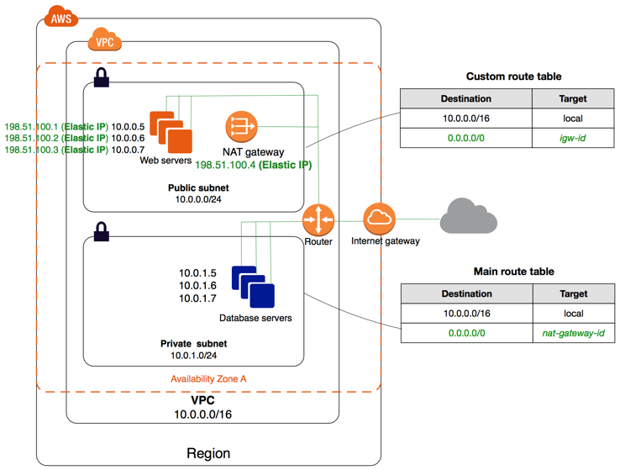
Internet Gateway / NAT Gateway

Slide 30
Other networking resources
Network ACL
Can define access control on network level
Elastic IPs
Reserved public IP addresses
For free when they are assigned to a resource
Paid when unassigned (the avoid misuse)
VPC Peering
VPN Connections and Direct connections

Slide 31
Lab 2: VPC and Networking
Create a VPC
Create Internet Gateway and NAT
Create public and private subnets in at least two AZs and connect them to internet
http://jsch.cz/awslab2

Slide 32
Storage
Elastic Block Storage (EBS)
Different types of volumes
SSD disks
IOPS disks
Disks are limited to single AZ
Disks can be encrypted
Some instances are optimized for EBS performance
Snapshots
Snapshot copies of EBS volumes
Can be used as backups
Can be created from volumes / volumes can be created from snapshots

Slide 33
Storage
Elastic File System (EFS)
Basically NFS based file system
Mirrored across AZs within one region
Performance is not as good as with SSDs

Slide 34
Compute
EC2 instances are the main compute resource
Virtual machines
Different types
Memory optimizes, CPU optimized, Disk optimized, GPU, FPGA, …
T2 instances
Have burstable CPU
Each instance has some credits per time unit which it can consume
T2.micro is usually good starting point for some playtime
EC2 instances can be stopped or restarted from the console
Pricing
Per hour
On-demand vs. Reserved vs. Spot vs. Dedicated
Price is independent on utilization!

Slide 35
Compute
Amazon Machine Images (AMI)
Volume snapshots with operating system
Are used to create new machine with specific operating system
Images available from Amazon or from Market place
Custom images can be created from existing volumes / hosts
Some images create more expensive instances (e.g. Red Hat Enterprise Linux)

Slide 36
Security Groups
Security Groups (SG) are software firewall provided by Amazon
Instances are assigned into a security group
Security group defines which ports on the machine are opened to access from outside
SSH on node 22
HTTP(S) on 80 and 443

Slide 37
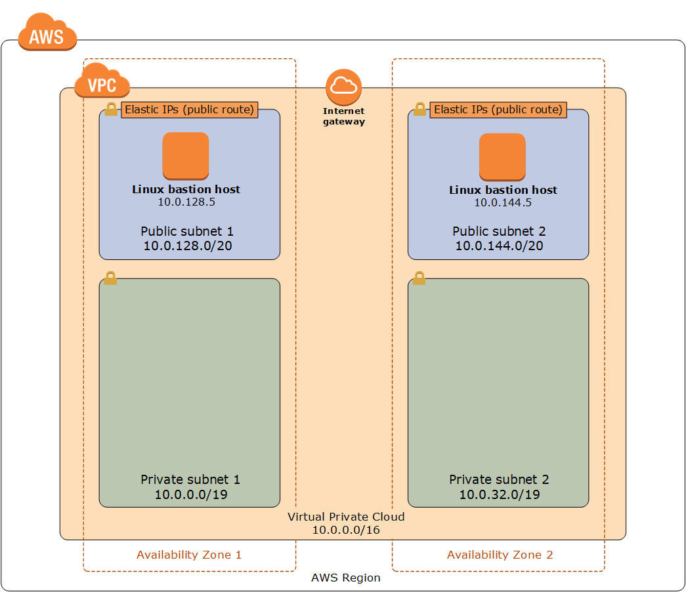
Security Groups

Slide 38
Lab 3: Create a Webserver
Create a new EC2 instance in your public subnet
Install a Nginx webserver on it
Check that you can access the webserver
http://jsch.cz/awslab3

Slide 39
Auto-Scaling
Auto scaling is controlled using Auto Scaling Groups (ASG)
Specify desired, maximum and minimum number of running instances
Can be used to automatically start new machine when the old one crashed
Desired=1, Min=1, Max=1
Can be used to scale the resources
CPU utilization is the basic factor
Other factors can be build in (Memory, custom metrics, etc.)
Can scale machines across AZs
When one AZ goes down, can be used to automatically start a new machine in other AZ
Bootstrapping
ASGs use Launch Configurations to start new instances
Custom AMI images
User data code

Slide 40
Load balancing
Elastic Load Balancing (ELB)
Allows to route and balance traffic between multiple instances
Can terminate SSL connections
Classic load balancers
Support TCP/TLS or HTTP(S) routing
For HTTP, they support sticky sessions, but cannot route according to URL
Application load balancers
Support only HTTP(S)
Support more advanced routing
E.g. myshop.com/orders/* goes to instance A, myshop.com/items/* goes to instance B
Always use the DNS name, the IP address of ELB can change

Slide 41
Lab 4: Create an ASG with webservers
Create an AMI image from your webserver from previous Lab
Use the AMI image with an ASG which starts your webservers in your private subnet
Use load balancer to balance the traffic between different webservers
Check that when you terminate one of the servers, a new one will be spawned by ASG
http://jsch.cz/awslab4

Slide 42
Amazon AWS
Managed services

Slide 43
Managed services
Amazon AWS has many different managed services
Some of them are just packaged open source tools
Other are proprietary solutions
Careful with lock in
Areas
Storage
Databases
PaaS
Messaging
Connectivity
Development

Slide 44
Storage
S3
Virtually unlimited space for object storage
Objects (files) are stored in S3 buckets
Within the buckets, folder structure can be created and files can be uploaded into it
Objects are accessible through HTTP
Policies can be associated with buckets
Is it free to access by everyone? Or only by authenticated users? Or only internally?
Can be used to host complete websites
Considered usually as the cheapest way how to store and distribute files
Supports versioning of files

Slide 45
Storage
Glacier
Cold data storage
Cheaper than S3
Slower access / bigger latency
Files from S3 which are not being accessed that often can be automatically offloaded into Glacier

Slide 46
Databases
AWS has several DB offerings
RDS
Allows to easily start different databases (MySQL, PostgreSQL, Oracle, MSSQL, MariaDB)
Aurora
Amazon‘s own SQL engine with MySQL and PostgreSQL interface compatibility
Fully managed service
Dynamo
NoSQL database
Document store, Graph database, Key-Value store
Redshift
Proprietary SQL database based on very old PostgreSQL database
ElasticCache
Caching engine based on Memcached and/or Redis

Slide 47
PaaS
Elastic Beanstalk
PaaS which allows to run applications in different languages
Java, .NET, Python, Node.js, Ruby, PHP, Go, Docker
EC2 Container Service
Allows to run Docker containers on a fleet of EC2 instances
Different containers can have different roles etc.

Slide 48
PaaS
Lambda
Serverless programming
Small functions which are triggered from outside (cron job, HTTP request, Messaging)
Paid per runtime
Can be used for automation tasks but also to construct bigger applications
Carefull about latency issues before the Lambda function starts

Slide 49
Messaging
SNS / SQS
Amazon‘s proprietary messaging service
SQS = Simple Queue Service
SNS = Simple Notification service
Compared to something like AMQP very primitive
But very well integrated with other Amazon services (e.g. to trigger Lambda function per message etc.)

Slide 50
Connectivity
Route53
DNS service
Can host public or private zones and register domains
Can be used independent on other Amazon services (a DNS hosting for services running elsewhere)
Good integration with other AWS services (e.g. ELB etc.)
CloudFront CDN
API Gateway

Slide 51
And lot more
Development
Analytics
Go to „Services“ in the web console to see all services

Slide 52
Lab 5: S3 & Lambda
Create new S3 bucket
Create new Lambda function which is triggered by changes to files in the S3 bucket
http://jsch.cz/awslab5

Slide 53
Amazon AWS
Monitoring

Slide 54
Cloudwatch
Monitoring tool for Cloud resources
Create dashboards with charts
Create alerts (can be linked with Auto Scaling Groups)
By default the metrics are received every 5 minutes (every minute as paid service)
The default offering of metrics is limited for EC2 hosts
By default, Amazon doesn‘t have any information about your VM apart from CPU consumption
Additional metrics like memory consumption have to be provided by agent running inside of the VM

Slide 55
Other tools
CloudTrail
Audit log for the activates happening in the Amazon account
CostAdvisor
Can help to optimize costs (e.g. recommend better instances to be used etc.)

Slide 56
Lab 6: Delete all resources which you created
Delete all resources which you created during the labs
http://jsch.cz/awslab6

Slide 57
https://github.com/scholzj/dbg-aws-training

