Slide 1
NASM Tutorial
COMP5201
Revision 1.1
June 02, 2004

Slide 2
The Purpose
To introduce you to the Linux workstation environment, which you will be using for all of the labs assignment for this term.
It also contains a brief introduction to do the following:
  (i) editing your assembly language program code via the VIM editor,
  (ii) building (translating) your assembly code (source program) into machine (object) code via the NASM assembler,
  (iii) linking and loading the machine codes that you wish to run, and
  (iv) run your (machine code) program under system debug facilities (gdb and its graphical interface ddd).

Slide 3
Using the Linux Workstations
The laboratory environment runs the Debian/GNU Linux platform and the NASM assembler.
To be compatible with the laboratory environment, if you do some of your laboratory assignments are home, your home machine should be compatible with the above platform.
  Most if not all Linux distros are compatible in this context.

Slide 4
VIM
Editing a file (vim editor)
VIM – VI Improved
A file can be created and/or edited using the standard vim editor available on Linux.
This section gives a brief introduction to the use of vim. If you are familiar with other editors, you can certainly use them for creating/editing a text file.
See man vim for more details. From within vim type :help in command mode.

Slide 5
VIM (2)
Working with vim:
Suppose we wish to create a new file that stores the assembly language program that we have written and call this file hello.asm. This can be accomplished as follows:
$ vim hello.asm
The system will display a new window with the name hello.asm and [new file] at the bottom.

Slide 6
VIM (3)
To start writing, you should press ESC and the “i” key (i for insert). Failing to do so may sometimes cause omission of the first characters that you entered.
The insertion allows you to type in your program’s code line by line. Corrections may be made with backspace. Insertion is terminated by pressing ESC.
To save the file properly, you can press ESC, followed by the colon key “:” and “w” (write). Saving the file and quitting vim can be accomplished by pressing ESC, followed by the colon key “:” and “wq” (write, then quit).
To quit without saving, press ESC, “:” and “q”. Vim may protest if you have written something and you don't want to save it. If you press ESC “:q!”, vim will accept it and not save your changes.
If the named file already exists, then vim will simply open the existing file for editing.

Slide 7
The NASM Assembler
The purpose of this part of the tutorial is to introduce you to the NASM assembler.
The steps next slide will take you through the complete procedure for translating an assembly program.
In your laboratory assignments, you will be repeating steps #4-6 (next slide) quite often. So it is a good idea to familiarize with the process or write a shell script (and later a Makefile for that).

Slide 8
Basic Steps
1. Get a copy of the hello.asm file from the course home page.
2. Make a directory for comp5201 course in your home directory by using mkdir command:
$ mkdir comp5201
3. Make hello directory inside comp5201 directory by typing:
$ cd comp5201
$ mkdir hello
4. Copy hello.asm file to the hello directory by using the cp command.

Slide 9
Building an Executable
Building an executable involves a two-step process of
  (i) assembling (translating the symbolic code into machine language code), and
  (ii) linking (finalizing addresses to load the machine language code into memory for execution).
Translation is accomplished by:
  $ nasm -f elf hello.asm
  this generates an (output) file with default name hello.o
Linking is accomplished by:
  $ ld -o hello hello.o
  this generates an executable image named hello
Note, this is not windows, an executable file is not obliged to have any extension, like .exe or .com or .bat to be executable.

Slide 10
NASM Cont’d
Make a directory listing, with ls
You should see your directory now contains three files:
  hello.asm, containing the original symbolic source that you have entered via vim;
  hello.o, that is generated by the NASM assembler (translator);
  hello, that is the executable memory image that is generated by the linker (ld).

Slide 11
Run the Program
Only executable images can be run (and well, scripts, but they are a different class of “executables”).
Hence to run the hello program, one can do the following:
$ ./hello
The kernel will automatically execute the hello program until it stops (and returns control to the kernel).

Slide 12
Debugging NASM Assembly Language Programs in DDD under Linux
For this course, you will use ddd to debug assembly language programs. ddd is a graphical version of gdb.
Using a debugger is more important for assembly language programming than for a high-level programming language because printing out values from an assembly language program is non-trivial.
Assembly language programs are often unstructured and unstructured changes of control flow can occur.
Adding debugging code to an assembly language program might itself introduce new errors, or make new bugs surface without actually injecting new errors in the code.
Some of the useful commands for assembly language debugging are summarized in the follow up slides.

Slide 13
Starting and Stopping Programs
We are using the pa1part1.asm program for this part of the tutorial.
After getting/creating the above file using vim, you could proceed to assemble and link it using the commands already introduced to you earlier.
After you have assembled and linked your program using nasm and ld, you can invoke the debugger using the command: ddd pa1part1
Details to follow…

Slide 14
Example
$ nasm –f elf pa1part1.asm
$ ld –o pa1part1 pa1part1.o
$ ddd pa1part1 &
  & “detaches” ddd from your terminal and sets it to background allowing you to use your terminal for other things w/o having you to quit to get to the terminal or pressing Ctrl+Z.

Slide 15
ddd
At this point ddd might complain that “no debugging symbols found”. Just ignore this particular comment.
The first few steps change some of the ddd setting to the ones that are appropriate, as follows.
  Select the view tab in the Menu Bar. This opens a sub-window. Deselect the “Source Window” (if selected) and select “Machine Code Window” in the sub-window.
  Selecting the “Machine Code Window” will open a “Command” window for use during the debug session.
  Now go to the “Status” tab in the menu bar and select “Registers” in the sub-window that pops up.
The follow up screen shots show the DDD state after performing all the above steps.

Slide 16
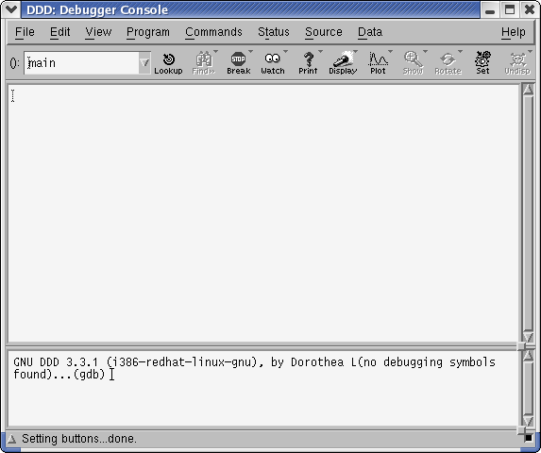

Slide 17
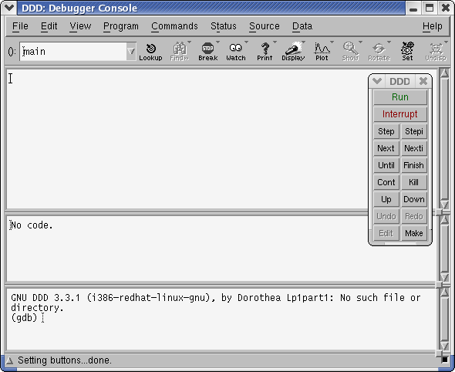

Slide 18


Slide 19
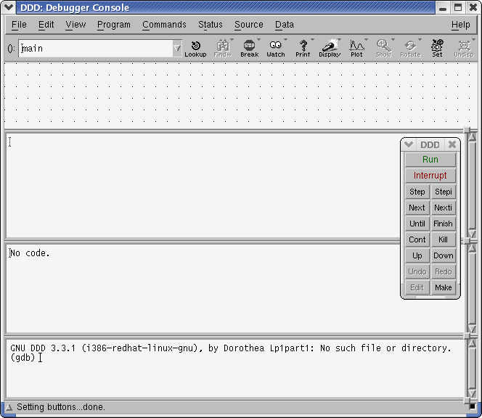

Slide 20
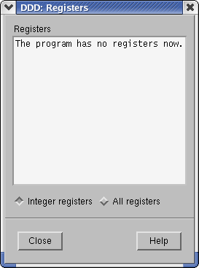

Slide 21
ddd (2)
Since the GNU assembler uses AT&T style syntax, ddd also uses AT&T style syntax instead of Intel-style syntax for disassembly.
As an example, in the AT&T style syntax the instruction for loading register EAX with the constant 1 looks like:
mov 0x1, %eax
In Intel-style syntax, the order of the source and destination are reversed. Since we are using Intel-style syntax for this course we need to change the ddd style.
To change the AT&T style syntax to Intel-style syntax you can do as follow:
  Go to the “Edit->GDB Settings” and change disassembly flavor from “att” to “intel”.
  Then select “Close”. Note: do not select apply because in some Linux version this option has a problem. You just need to close the Debugger Settings window. Then save your new options.

Slide 22
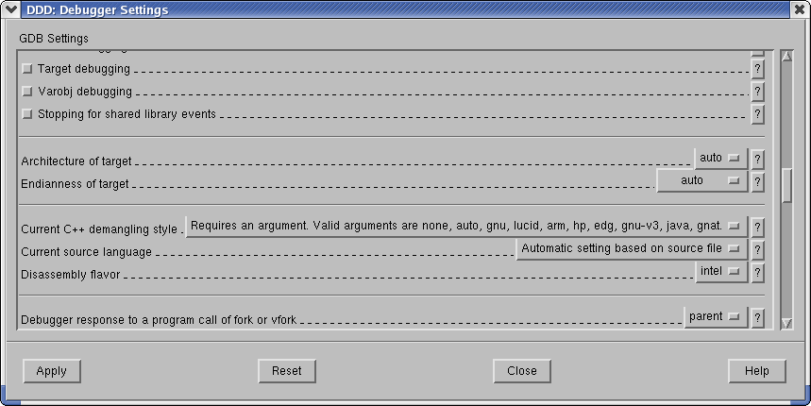

Slide 23
ddd (4)
You can now run your program inside ddd by selecting “Run” from the “Program” menu or you can click “Run” from the “Command” window.
However, the program will just behave exactly as it did when it ran under the Linux shell.
The point of using a debugger is to set “breakpoints” where the execution of the program is paused.
The pause returns you to the ddd and you can use various ddd/gdb commands to examine the contents of the registers and/or memory.
It is common to have breakpoints set at the beginning of a program, at the end of a program, at the top of a loop and anywhere you think an error exists in your program.
When using ddd with C/C++ programs, you can set breakpoints by the line number of the statement in the source file. However, NASM doesn't generate the line number information for ddd. So, you must set the breakpoints according to addresses relative to labels in the assembly language program or introduce dummy labels as a kludge.
For example:
  break *_start+5
  It will stop the execution of the program 5 bytes after the address labeled by _start.
  However, break *_start does not stop the program before the execution of the first instruction. A workaround is to add a new label after the first label in the beginning of your program and set a break point on it:
  break kludge_label

Slide 24
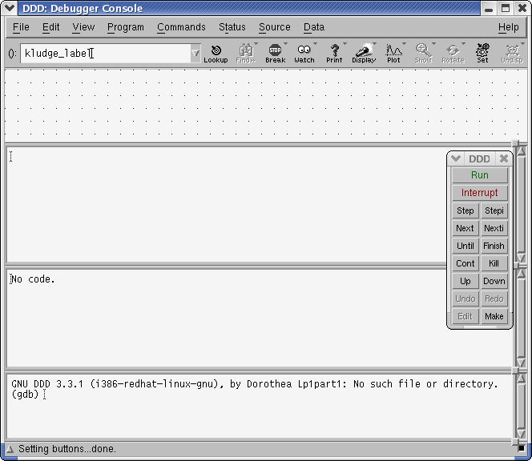

Slide 25
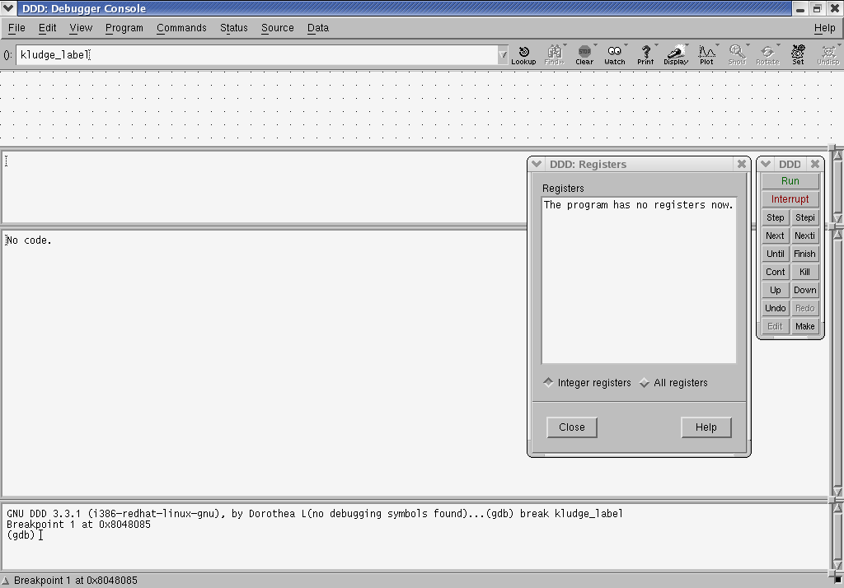

Slide 26
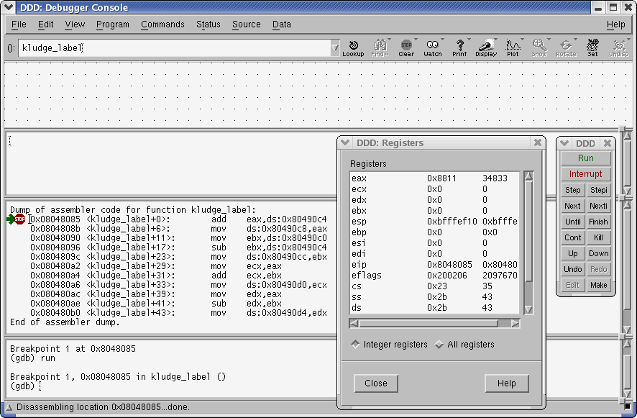

Slide 27
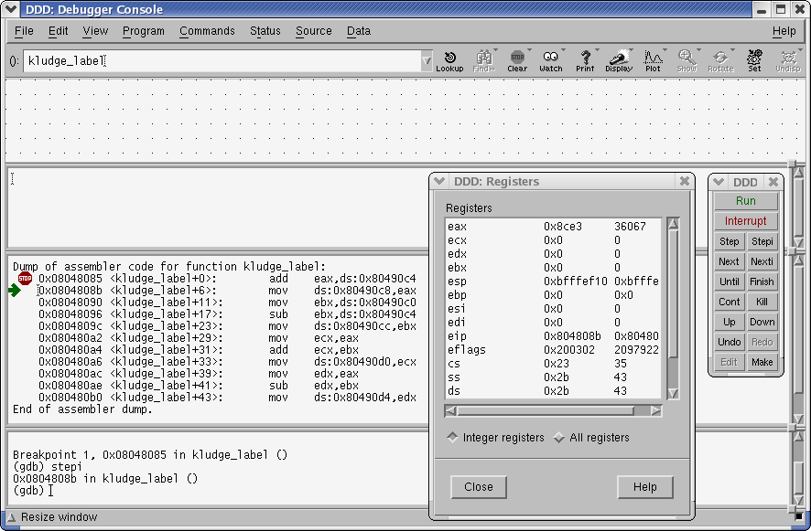

Slide 28
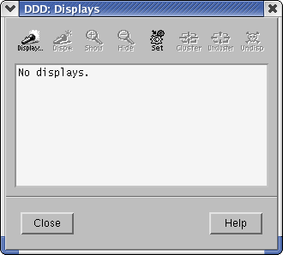
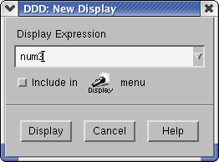
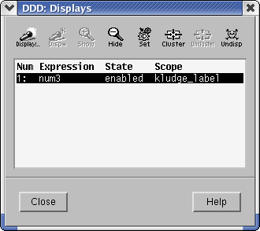

Slide 29
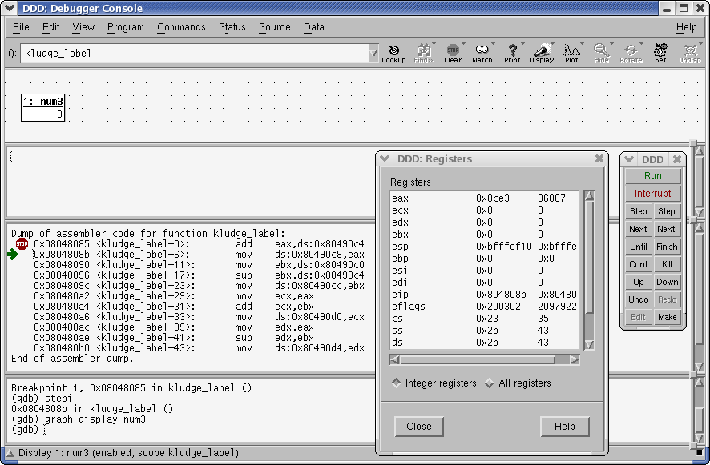

Slide 30
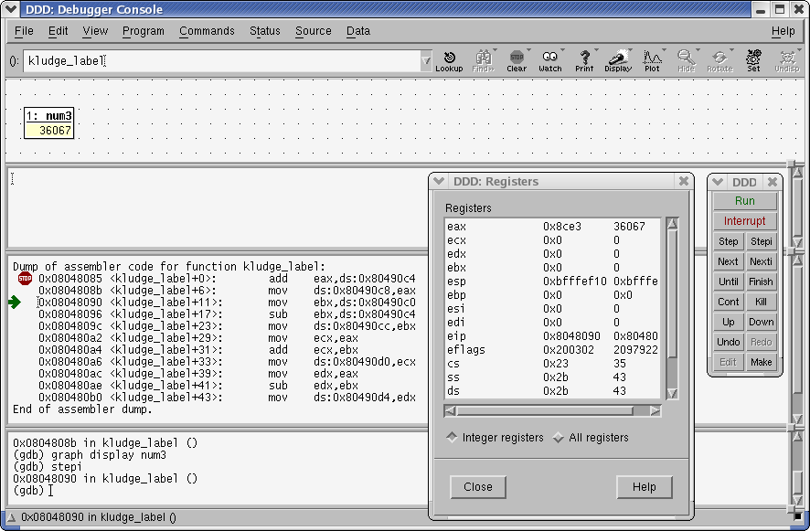

Slide 31
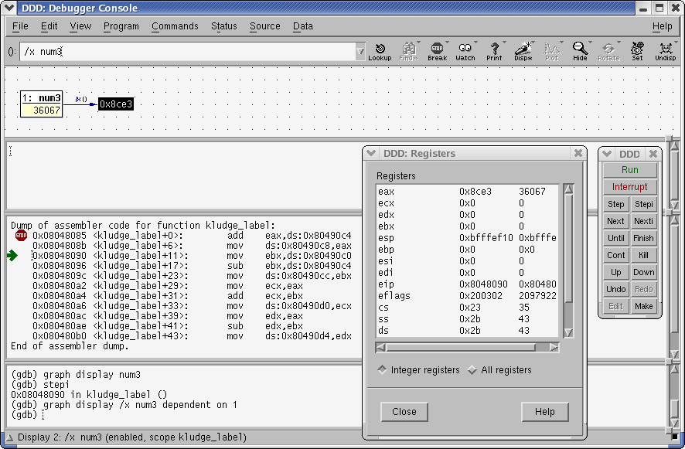

Slide 32
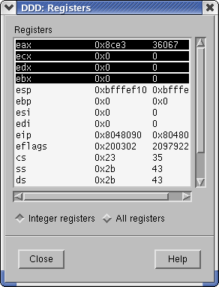

Slide 33
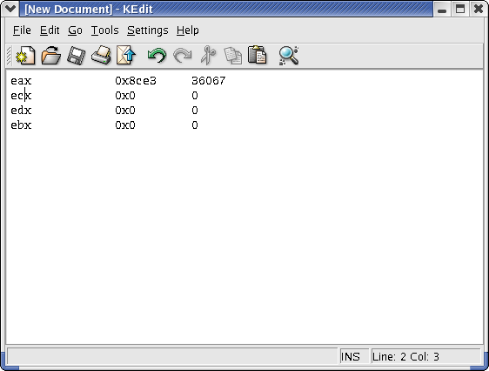

Slide 34
References
This set of tutorial slides is largely based on Ali Ansari’s COMP228/SOEN228 tutorial material.

