Slide 1





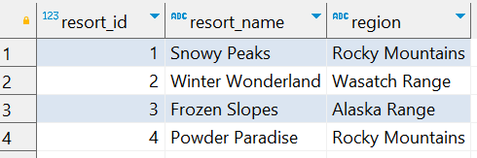
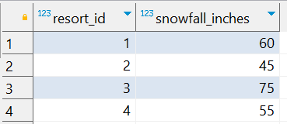
Question No: 4
School of IT
+91 98403 26240
Today's Question:
You’re planning your next ski vacation and want to find the best regions with heavy snowfall. Given the tables resorts and snowfall, find the average snowfall for each region and sort the regions in descending order of average snowfall. Return the columns region and average_snowfall.
Source table : school_of_it_2025.ski_resorts
Source table : school_of_it_2025.snowfall

