Slide 1



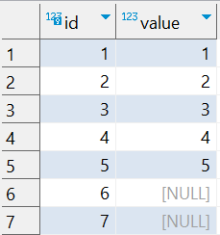

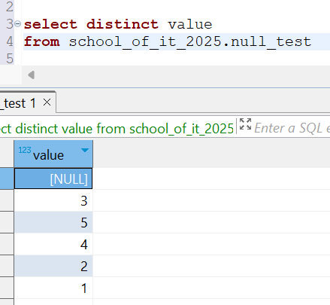
Question : 4
Understanding NULL
School of IT
+91 98403 26240
school_of_it_2025.null_test
What does query this query return?
select distinct value from school_of_it_2025.null_test
DISTINCT treats NULL as a single
unique value.
So if NULL appears multiple times,
it will only show up
once in the result set.
Answer

