Slide 1



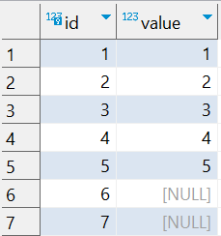

Question : 7
Understanding NULL
School of IT
+91 98403 26240
school_of_it_2025.null_test
What does query this query return?
select value, count(*) as _total from school_of_it_2025.null_test group by value

