Slide 1



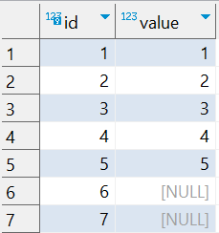

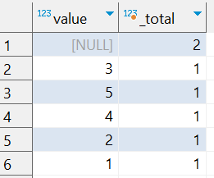
Question : 7
Understanding NULL
School of IT
+91 98403 26240
school_of_it_2025.null_test
What does query this query return?
select value, count(*) as _total from school_of_it_2025.null_test group by value
Answer
Returns rows where col is NULL, including the count of those rows.

