Slide 1




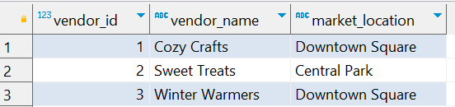

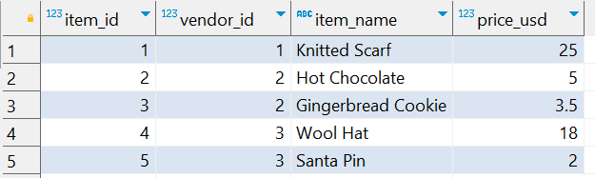
Question No: 20
School of IT
+91 98403 26240
Today's Question:
We are looking for cheap gifts at the market. Which vendors are selling items priced below $10? List the unique (i.e. remove duplicates) vendor names.
Source Table :school_of_it_2025.vendors_q_20
Source Table :school_of_it_2025.item_prices

Slide 2
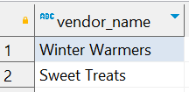
Question No: 20
School of IT
+91 98403 26240
Today's Question:
We are looking for cheap gifts at the market. Which vendors are selling items priced below $10? List the unique (i.e. remove duplicates) vendor names.
SQL Query
SELECT DISTINCT vendor_name FROM school_of_it_2025.vendors_q_20 v INNER JOIN school_of_it_2025.item_prices ip ON v.vendor_id = ip.vendor_id WHERE price_usd < 10
Answer

