Slide 1




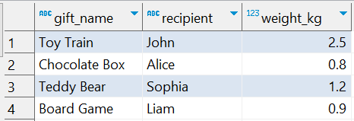

Question No: 2
School of IT
+91 98403 26240
Today's Question:
Santa wants to know which gifts weight more than 1 kg. Can you list them?
Source table : rentals

