Slide 1





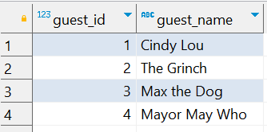
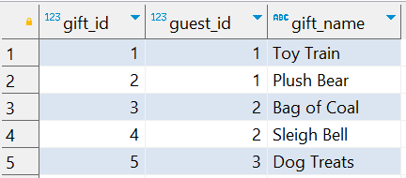
Question No: 22
School of IT
+91 98403 26240
Today's Question:
We are hosting a gift party and need to ensure every guest receives a gift. Using the guests and guest_gifts tables, write a query to identify the guest(s) who have not been assigned a gift (i.e. they are not listed in the guest_gifts table).
Source Table :school_of_it_2025.guests
Source Table :school_of_it_2025.guest_gifts

Slide 2

Question No: 22
School of IT
+91 98403 26240
Today's Question:
We are hosting a gift party and need to ensure every guest receives a gift. Using the guests and guest_gifts tables, write a query to identify the guest(s) who have not been assigned a gift (i.e. they are not listed in the guest_gifts table).
SQL Query
select
guest_name
from
school_of_it_2025.guests g
left join school_of_it_2025.guest_gifts gg
on g.guest_id= gg.guest_id
where gift_name is null;
Answer

