Slide 1



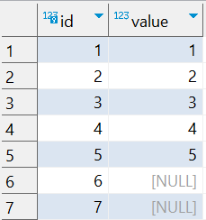

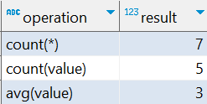
Question : 2
Understanding NULL
School of IT
+91 98403 26240
school_of_it_2025.null_test
What does query this query return?
select 'count(*)' as operation,count(*) as result from school_of_it_2025.null_test
union all
select 'count(value)' ,count(value) from school_of_it_2025.null_test
union all
select 'avg(value)',avg(value) from school_of_it_2025.null_test
Answer
Why? Aggregates like SUM, AVG, and COUNT ignore NULL values unless explicitly stated (e.g., using COUNT(*) includes NULL rows).

