Slide 1




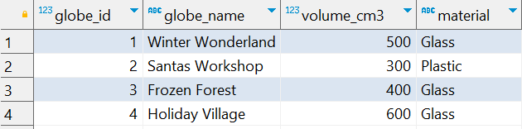

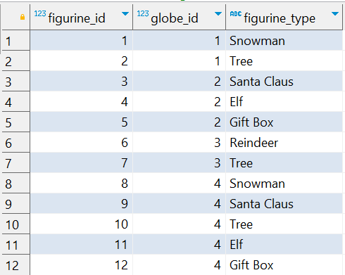
Question No: 12
School of IT
+91 98403 26240
Today's Question:
A collector wants to identify the top 10 snow globes with the highest number of figurines. Write a query to rank them and include their globe_name, number of figurines, and material.
Source Table :school_of_it_2025.snow_globes
Source Table :school_of_it_2025.figurines

