Slide 1





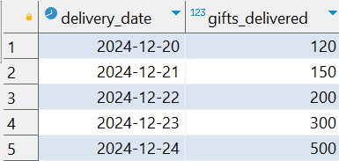
Question No: 24
School of IT
+91 98403 26240
Today's Question:
Santa is tracking how many presents he delivers each night leading up to Christmas. He wants a running total to see how many gifts have been delivered so far on any given night. Using the deliveries table, calculate the cumulative sum of gifts delivered, ordered by the delivery date.
Source Table :school_of_it_2025.deliveries

Slide 2
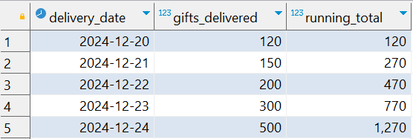
Question No: 24
School of IT
+91 98403 26240
Today's Question:
Santa is tracking how many presents he delivers each night leading up to Christmas. He wants a running total to see how many gifts have been delivered so far on any given night. Using the deliveries table, calculate the cumulative sum of gifts delivered, ordered by the delivery date.
SQL Query
select
delivery_date
,gifts_delivered
,sum(gifts_delivered) over(order by delivery_date ) running_total
from
deliveries
Answer

