Slide 1



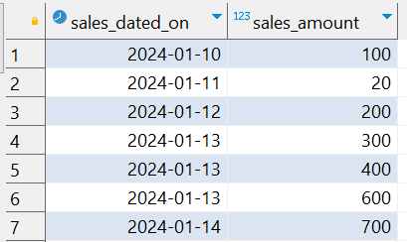


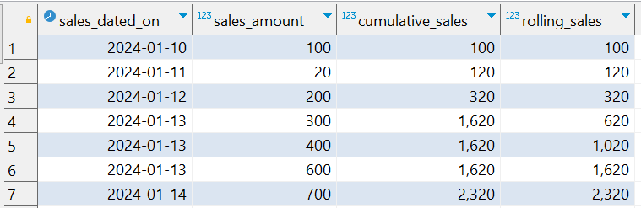
Interview Questions : 8
School of IT
+91 98403 26240
school_of_it_2025._data
Based on the table above, answer the question below.
Calculate cumulative sales
Calculate rolling sales
Answer

