Slide 1





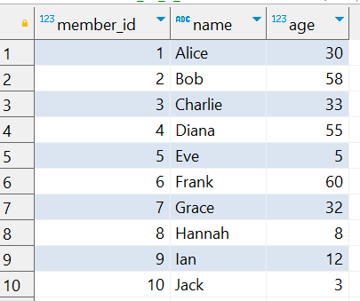
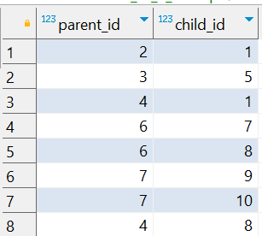
Question No: 15
School of IT
+91 98403 26240
A family reunion is being planned, and the organizer wants to identify the three family members with the most children. Write a query to calculate the total number of children for each parent and rank them. Include the parent’s name and their total number of children in the result.
Source Table :school_of_it_2025.family_members_q_15
Source Table :school_of_it_2025.parent_child_relationships

