Slide 1



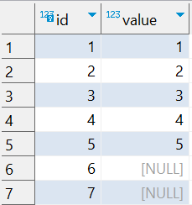

Question : 1
Understanding NULL
School of IT
+91 98403 26240
NULL in Comparisons
school_of_it_2025.null_test
What does query this query return?
SELECT *
FROM school_of_it_2025.null_test
WHERE value = NULL;
SELECT *
FROM school_of_it_2025.null_test
WHERE value != NULL;
Answer: No rows.
Why? NULL = NULL evaluates to UNKNOWN because NULL is "unknown," and you can't compare two unknowns.

