Slide 1


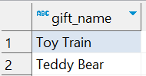
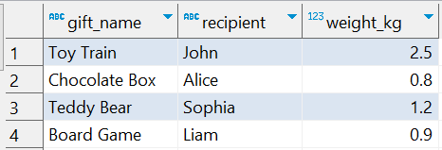
Question No: 2
Answer
School of IT
+91 98403 26240
Today's Question:
Santa wants to know which gifts weight more than 1 kg. Can you list them?
Result
Source table : school_of_it_2025.gifts
SQL Query
SELECT *
FROM school_of_it_2025.gifts
WHERE weight_kg > 1;

